Slide 1

WELCOME TO MY CLASS
Teacher: Trần Thị Trang
Quoc Tuan Primary School

Slide 2





Slide 3



Things we can do
5
LESSON 2 PERIOD 3

Slide 4
Contents
Warm-up
Look and guess.
01
04
02
03
Activity 3
Let’s talk.
Activity 1
Look, listen and repeat.
05
Games
Activity 2
Listen, point and say.

Slide 5
01
Warm-up

Slide 6
Look and guess.

Slide 7
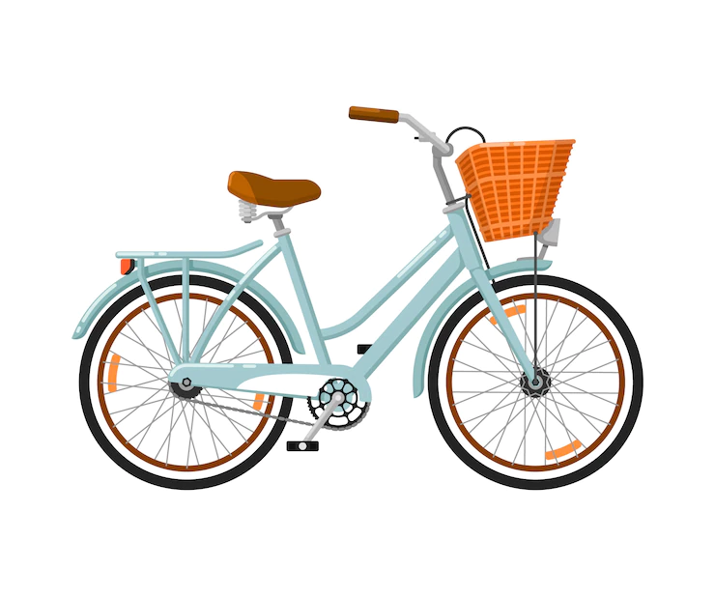

What can you do with this?
I can ride a bike.

Slide 8
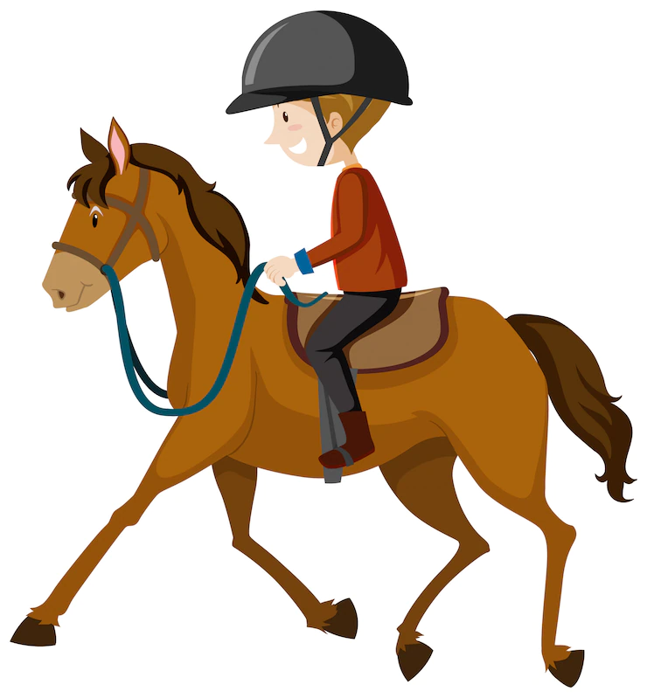

What can you do with this?
I can ride a horse.

Slide 9


What can you do with this?
I can fly a kite.

Slide 10


What can you do with this?
I can play the piano.

Slide 11
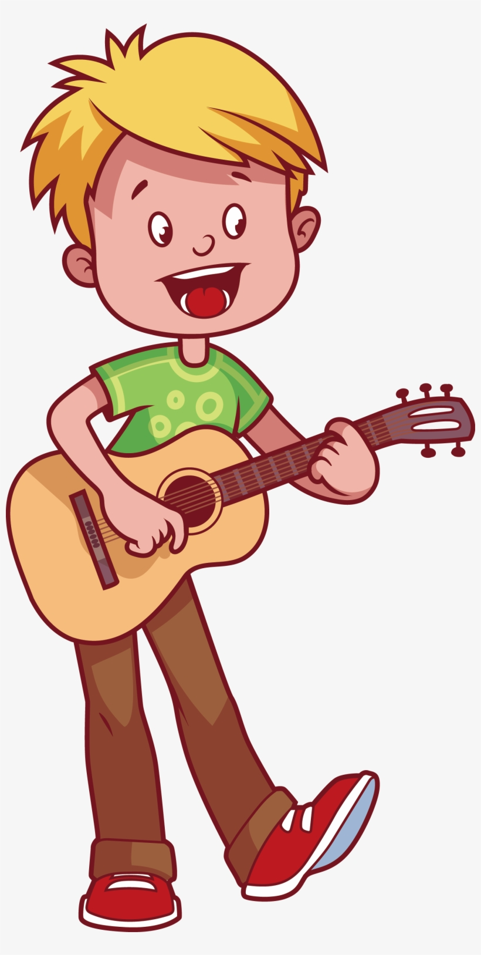

What can you do with this?
I can play the guitar.

Slide 12
02
Activity 1
Look, listen and repeat.

Slide 13
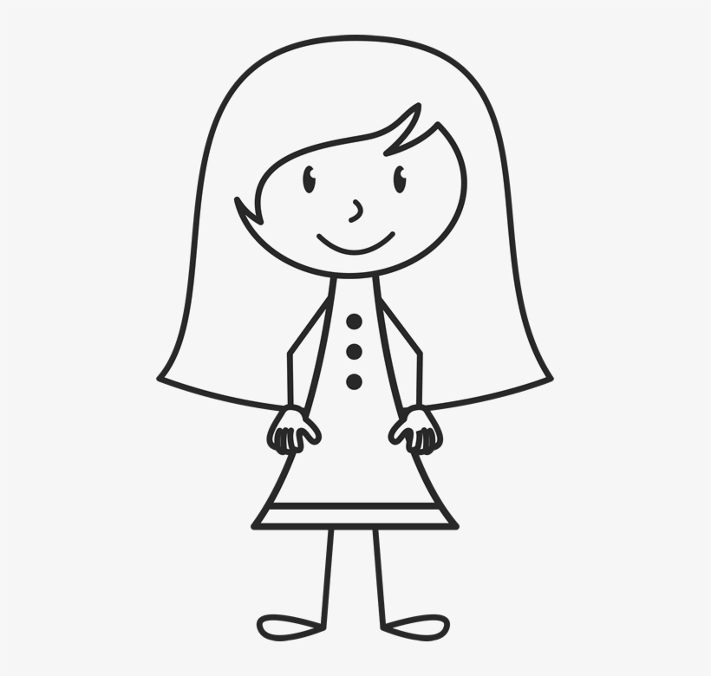
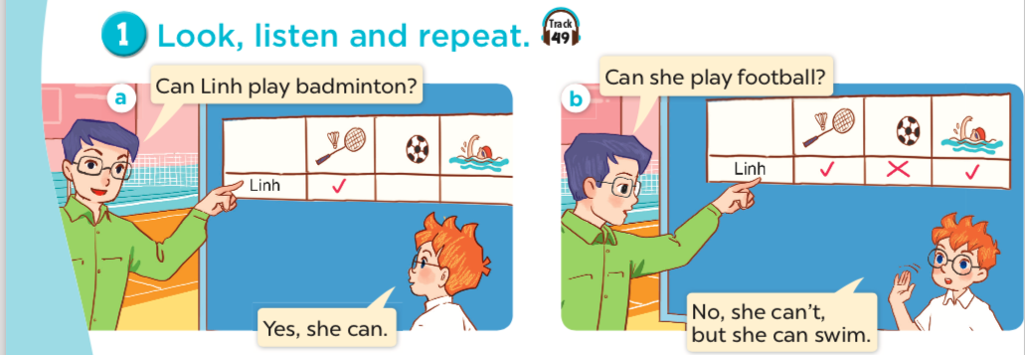
Who is Linh?
What can Linh do?
What can't Linh do?
a girl

Slide 14
Listen and repeat.

Slide 15
Listen and repeat.

Slide 16
Work in pairs. Practise.

Slide 17
03
Activity 2
Listen, point and say.

Slide 18
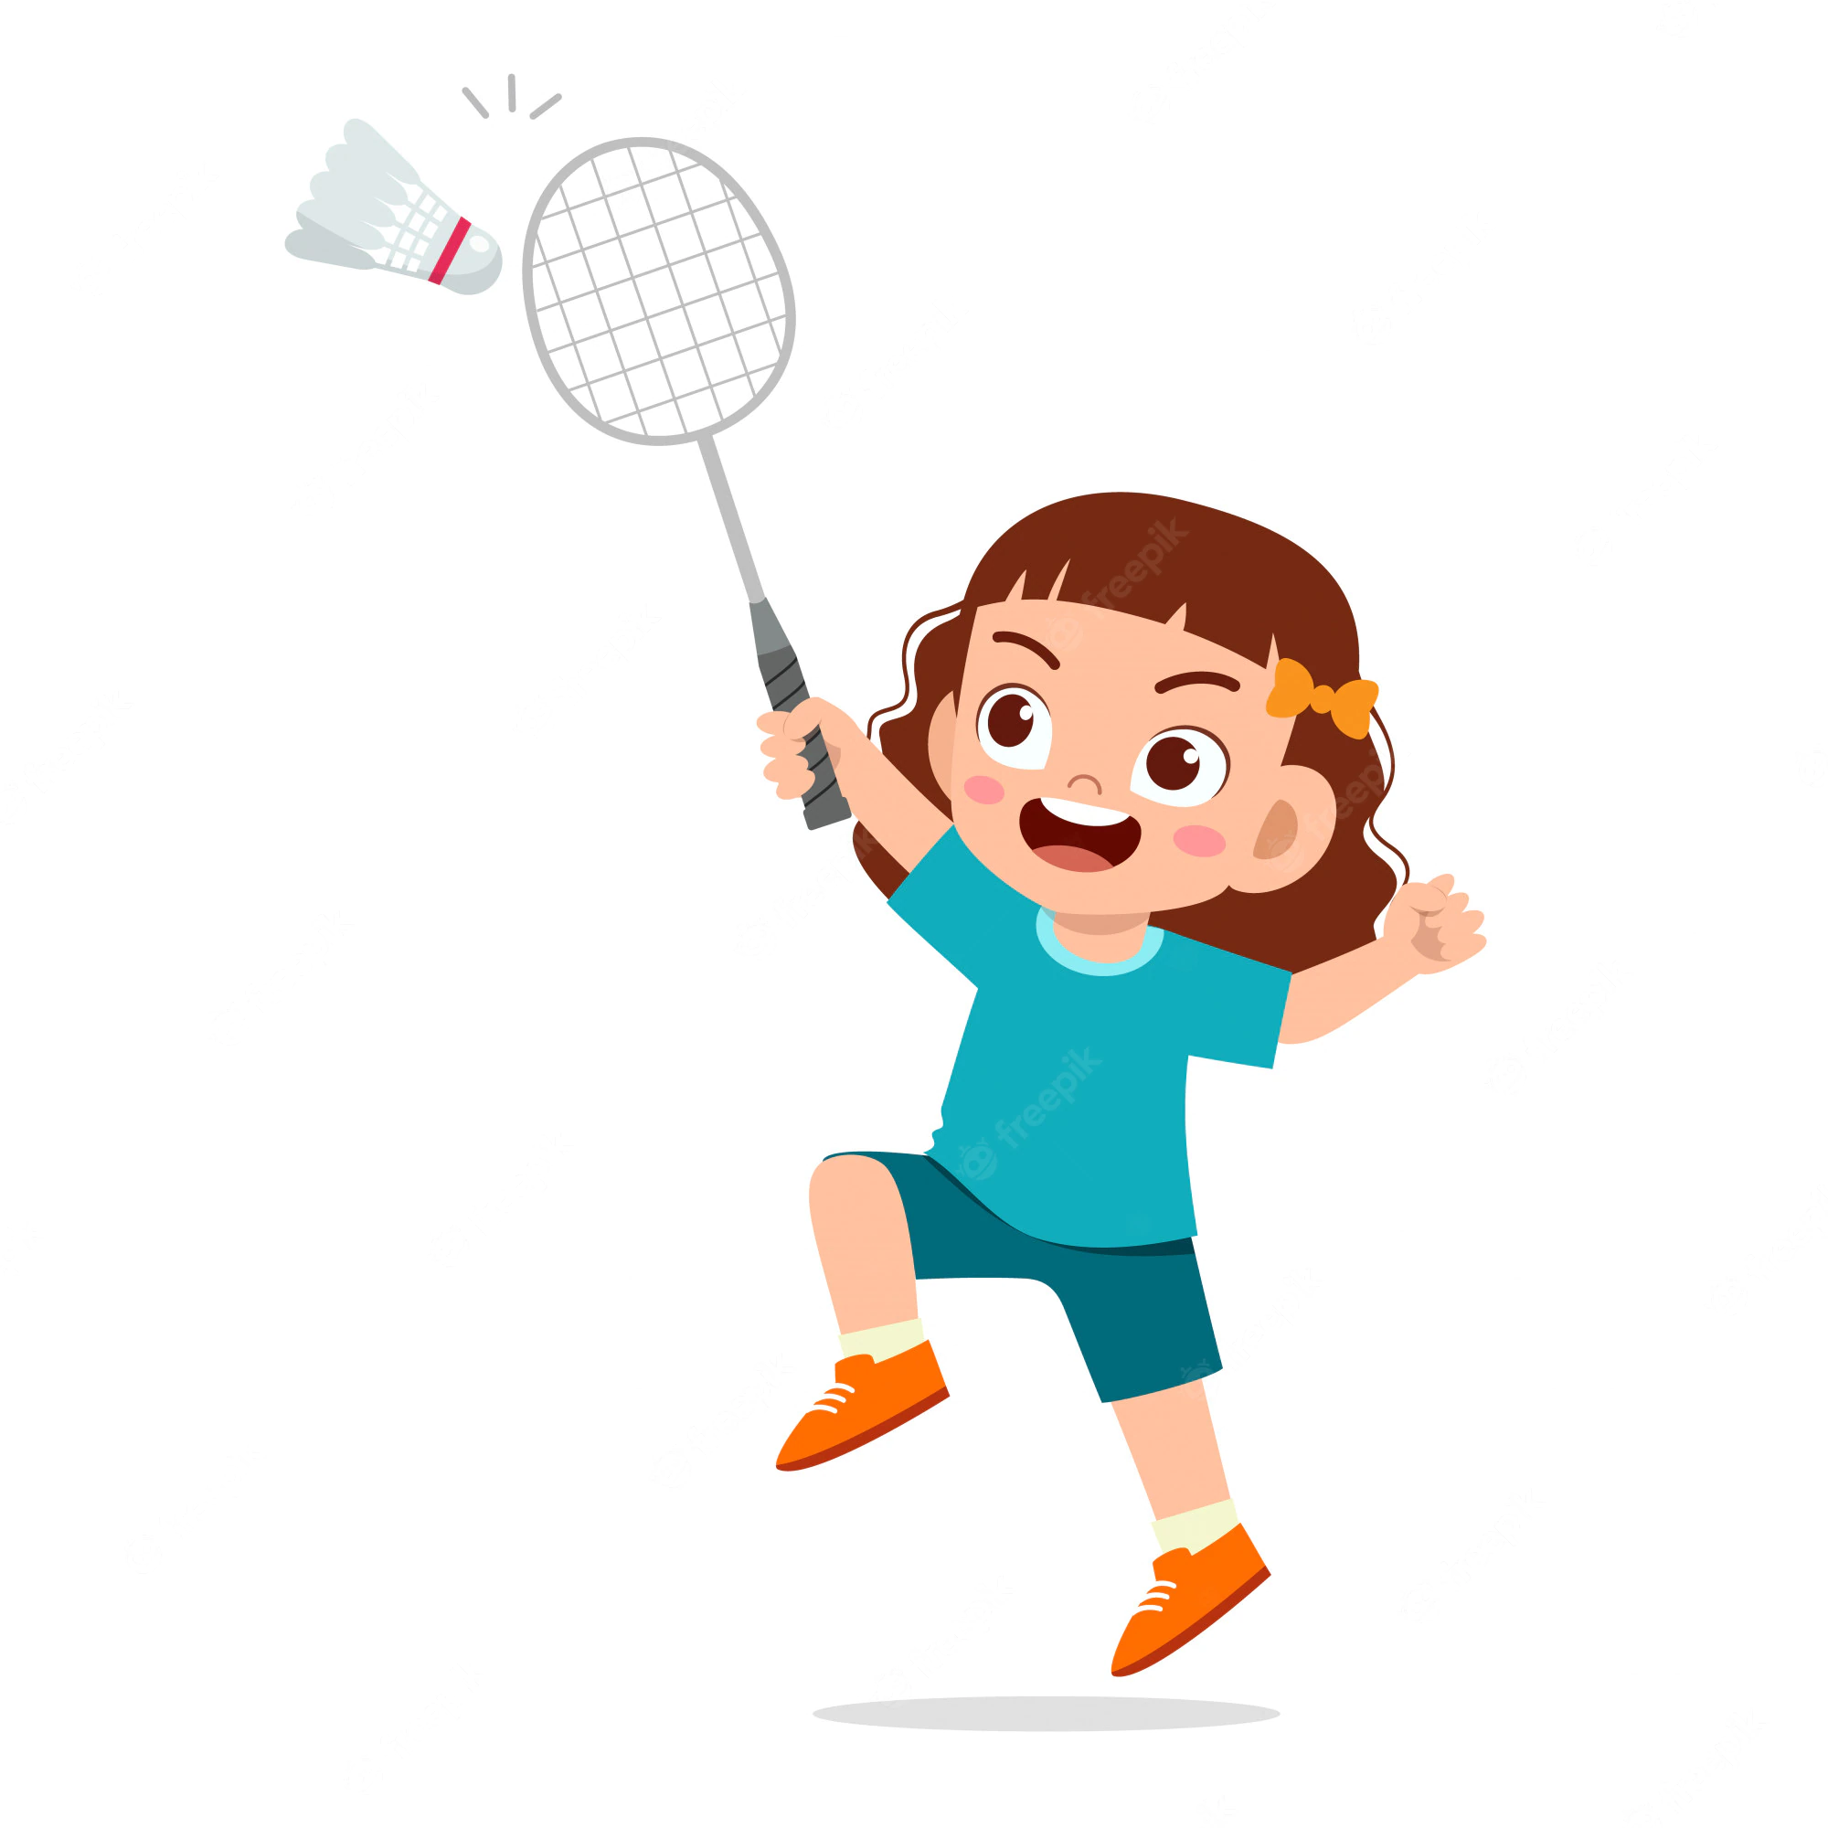
play badminton

Slide 19
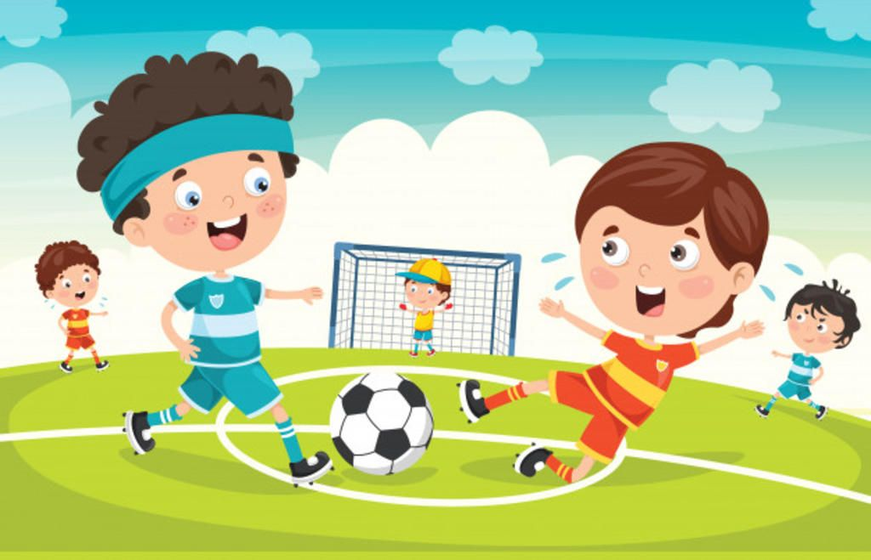
play football

Slide 20

cook

Slide 21

swim

Slide 22
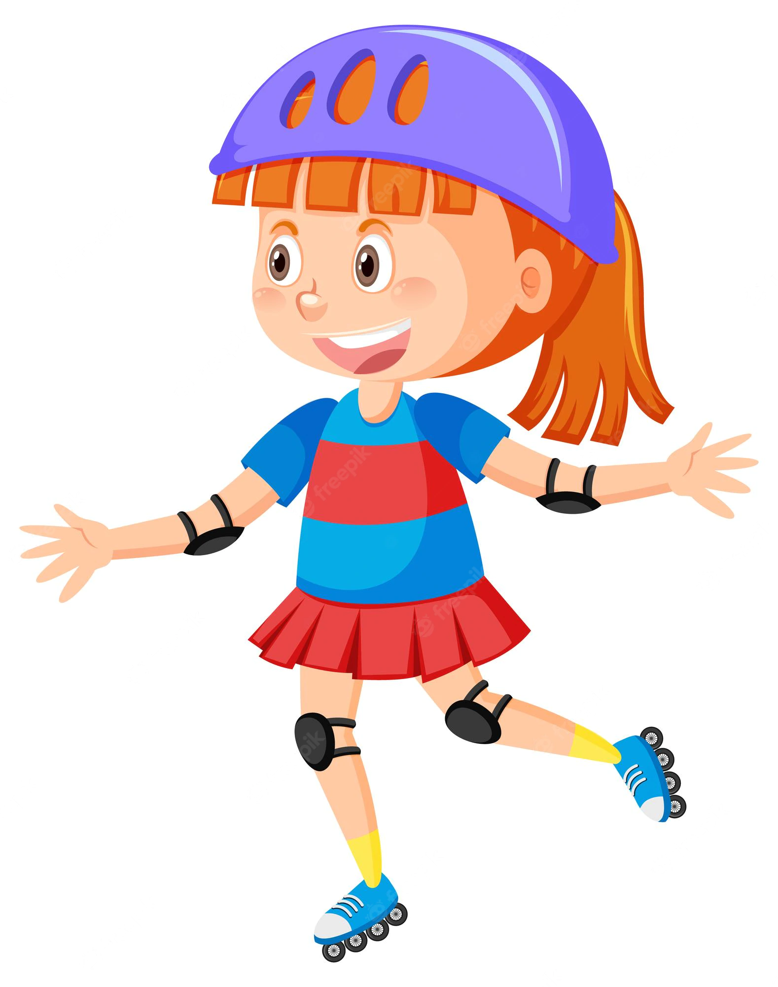
roller skate

Slide 23
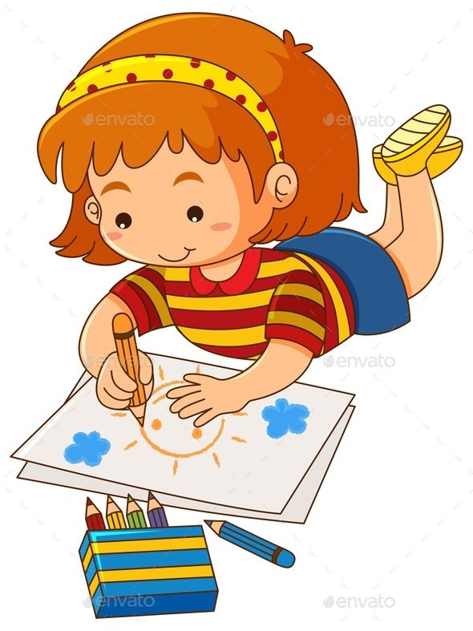
draw

Slide 24
Matching game!

Slide 25


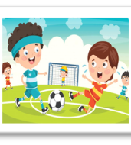

Let’s play
swim
play football
cook
Notes:
Click the card to show the words/picture. Click again to turn it face down.

Slide 26

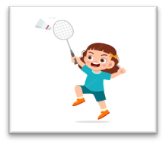
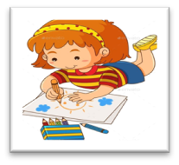
Let’s play.
draw
roller skate
play
badminton
Notes:
Click the card to show the words/ picture. Click again to turn it face down.

Slide 27

Can Mary cook?
she
Yes, she can.

Slide 28


Can she swim?
No, she can't, but she can cook.

Slide 29
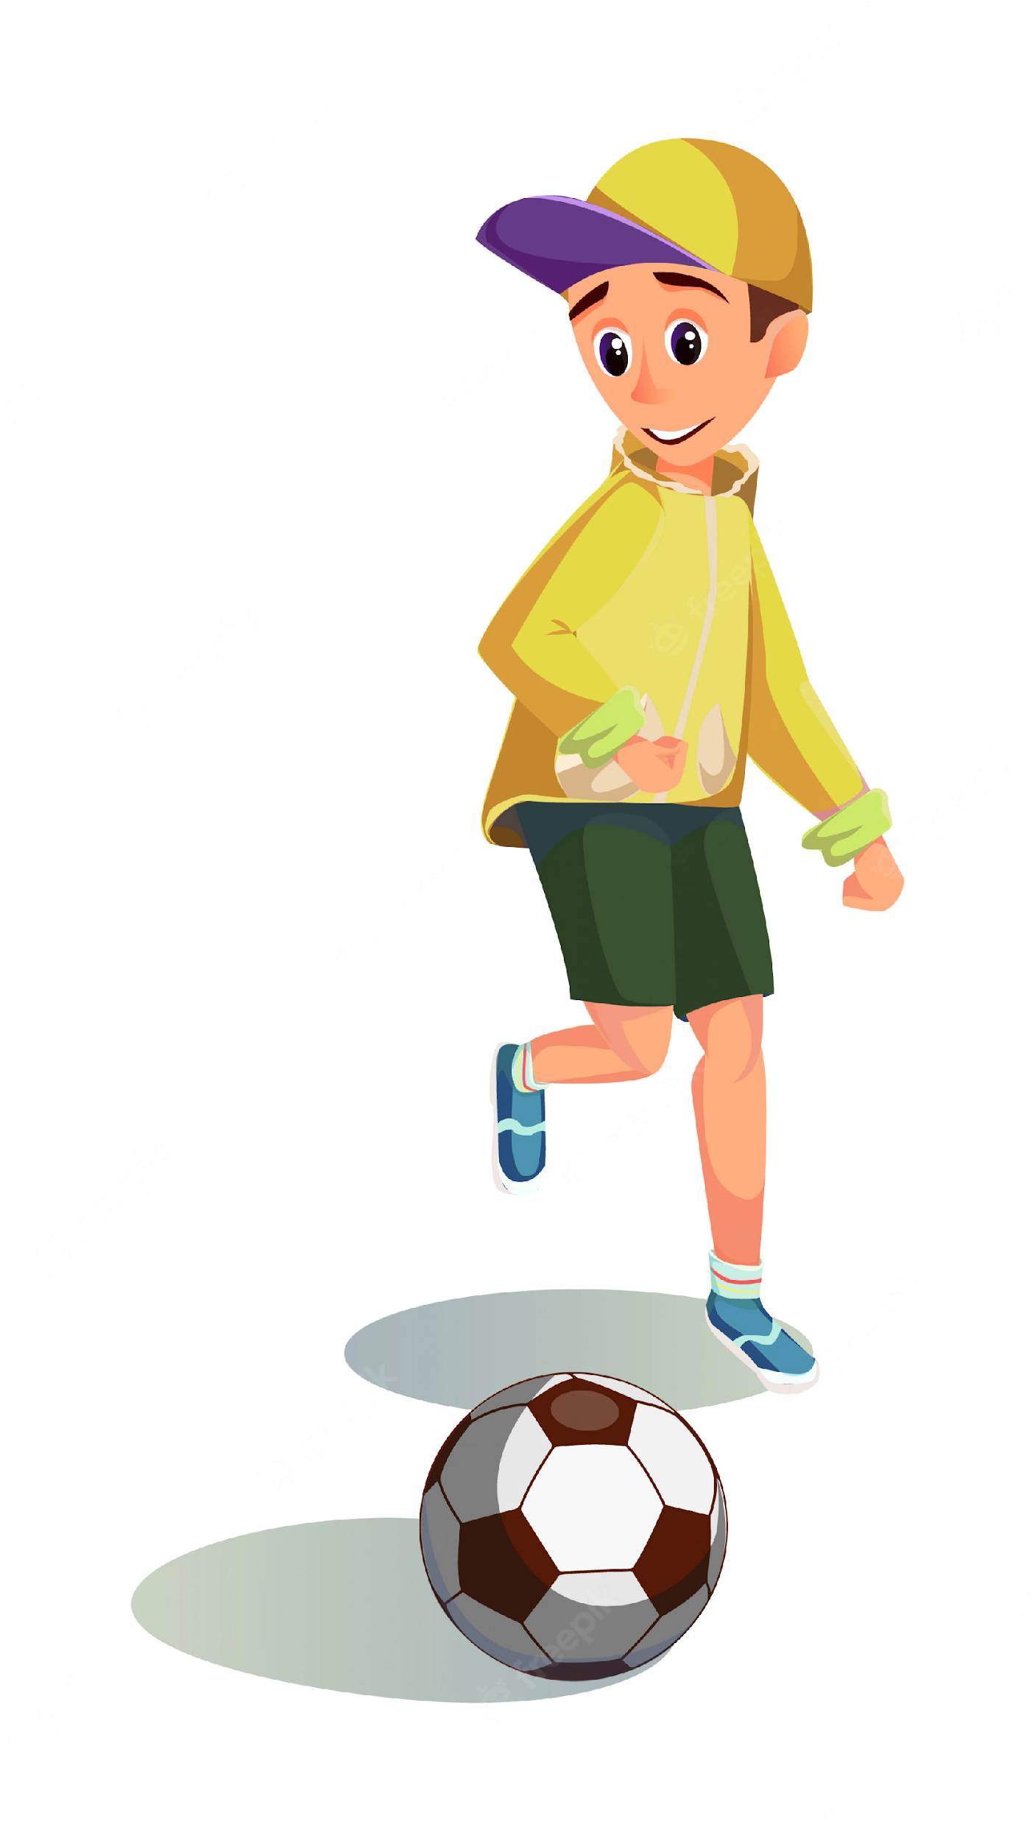
Can Ben play football?
he
Yes, he can.

Slide 30

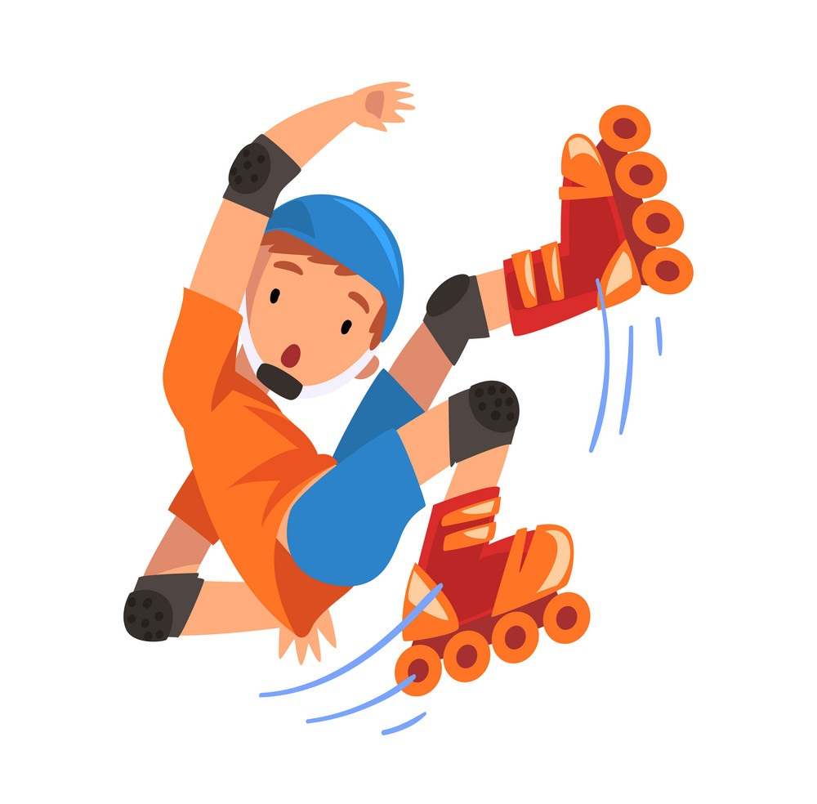
Can he roller skate?
No, he can't,
but he can play football.

Slide 31
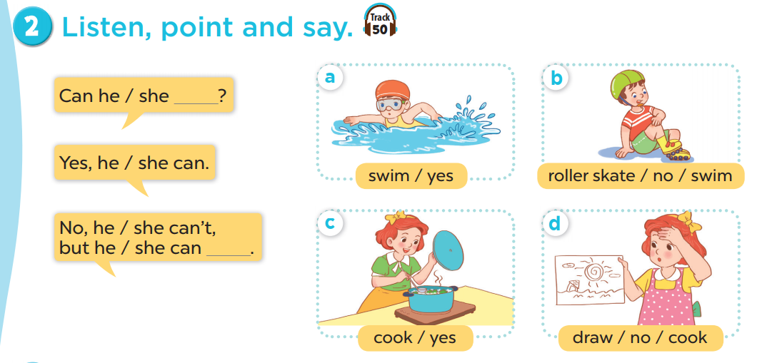
Work in pairs. Practise.
Listen, point and say.

Slide 32
04
Activity 6
Let’s talk.

Slide 33
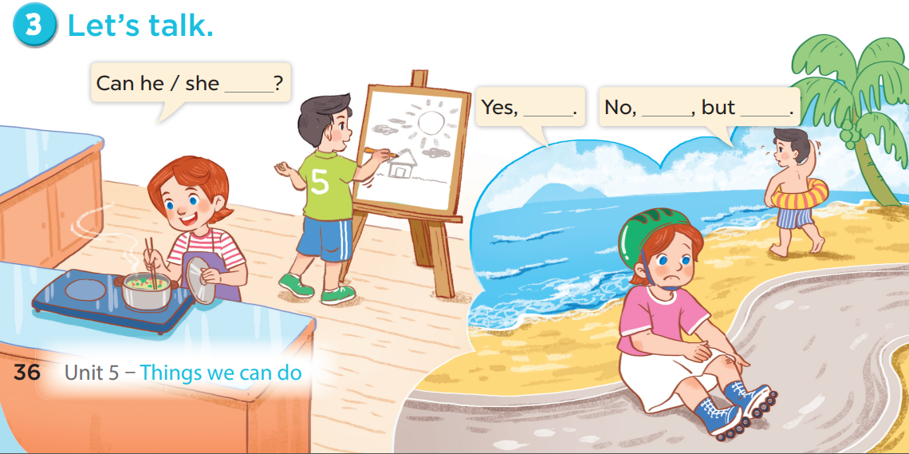

Slide 34
05
Games

Slide 35



Notes:
CLICK THE CLOUD – GO TO PART 4

Slide 36

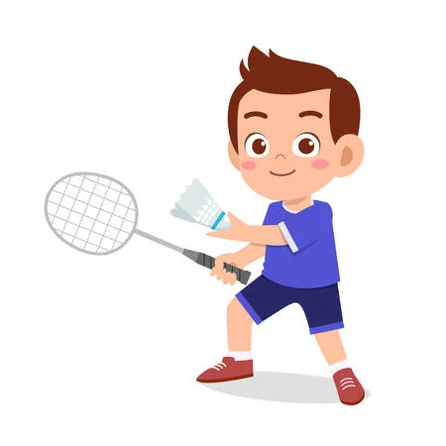

Can he _______________?
play badminton
____, he can.
Yes
Notes:
CLICK PINK AMONG US – GO TO THE POINTS

Slide 37
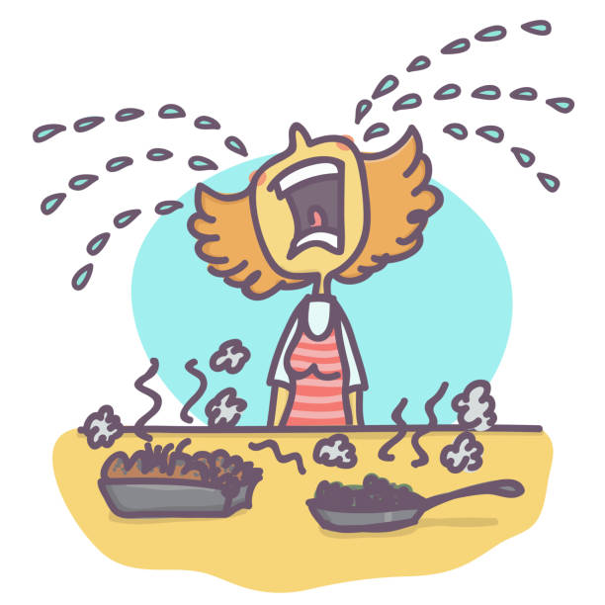
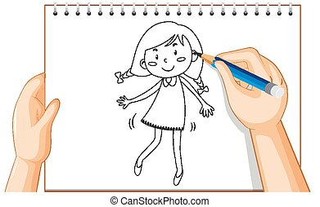
Can she cook?
No
____, she can't,
but she can _____.
draw
Notes:
CLICK PINK AMONG US – GO TO THE POINTS

Slide 38
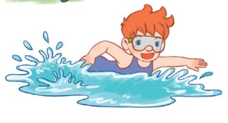
Can he ________?
swim
Yes, he _____.
can
Notes:
CLICK PINK AMONG US – GO TO THE POINTS

Slide 39
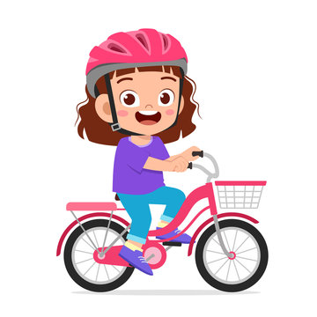
Can she ____________?
ride a bike
Yes, ________.
she can
Notes:
CLICK PINK AMONG US – GO TO THE POINTS

Slide 40
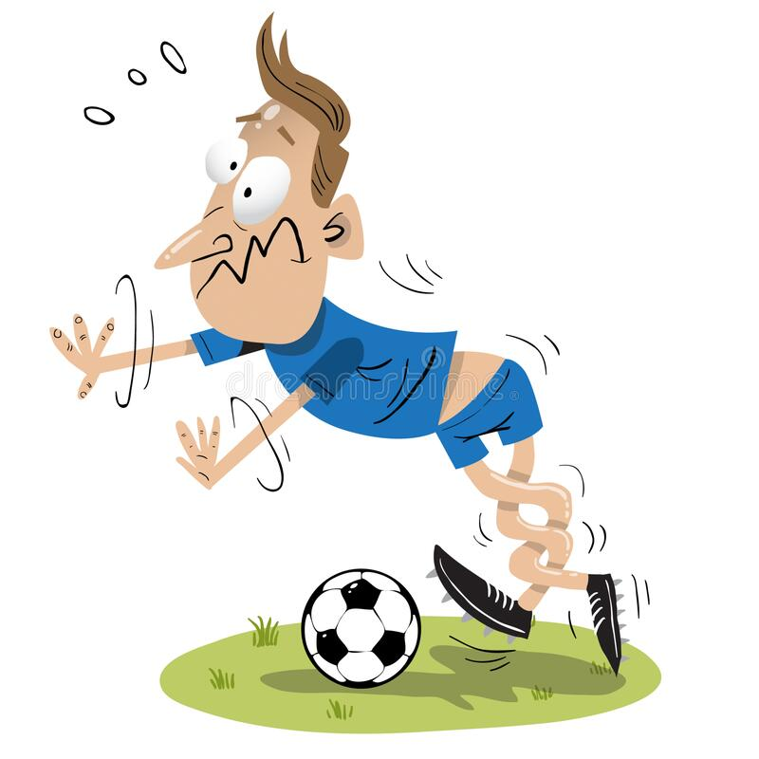
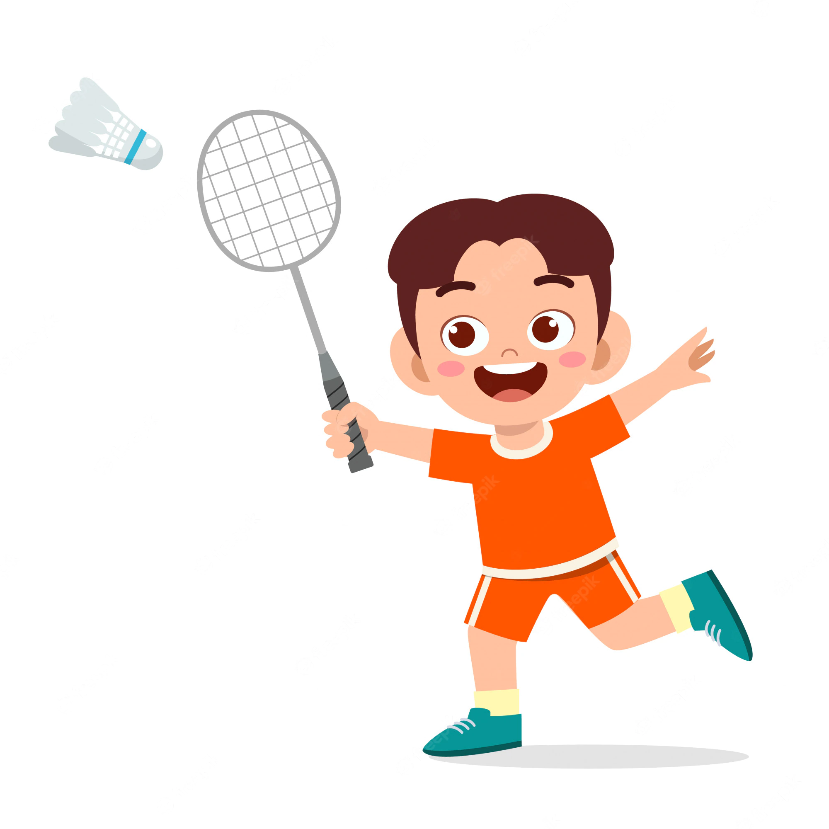
Can he play football ?
No
____, he can't,
but he can ______________.
play badminton
Notes:
CLICK PINK AMONG US – GO TO THE POINTS

Slide 41
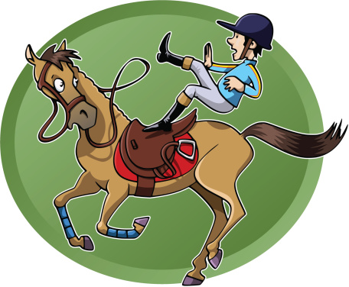
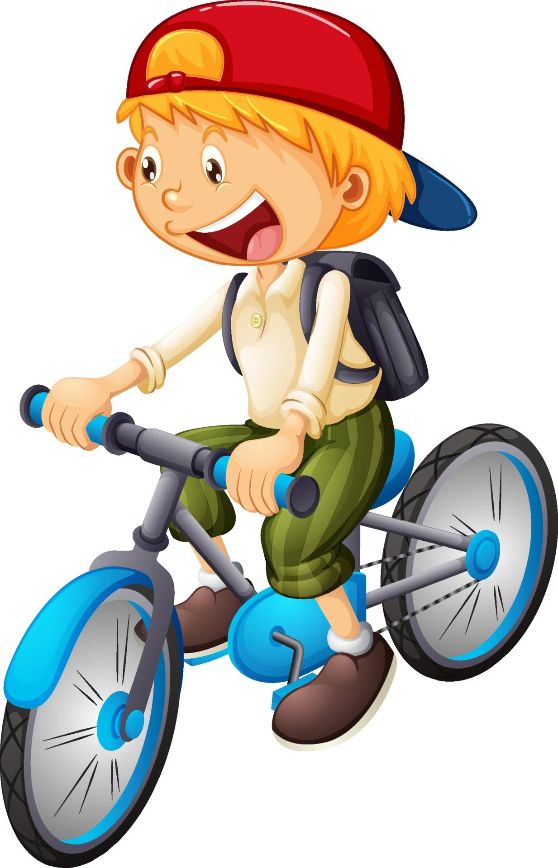
Can he ride a horse ?
can't
No, he ______,
but he _____ ride a bike.
can
Notes:
CLICK PINK AMONG US – GO TO THE POINTS

Slide 42

Can _____ play the piano?
she
Yes, _______.
she can
Notes:
CLICK PINK AMONG US – GO TO THE POINTS

Slide 43
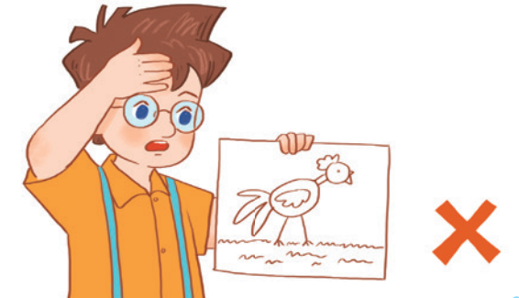
Can he ________?
draw
____, he _____.
No
can't
Notes:
CLICK PINK AMONG US – GO TO THE POINTS

Slide 44





Slide 45



Slide 46


Slide 47


Slide 48


Slide 49


Slide 50


Slide 51


Slide 52


