Slide 1

WELCOME TO MY CLASS
Teacher: Trần Thị Trang
Quoc Tuan Primary School

Slide 2





Slide 3



Things we can do
5
LESSON 2 PERIOD 4

Slide 4
Contents
Warm-up
Guessing game
01
04
02
03
Activity 5
Look, complete and read.
Review
05
Activity 6
Let’s sing.
Activity 4
Listen and tick or cross.
06
Fun corner

Slide 5
01
Warm-up
Guessing game

Slide 6
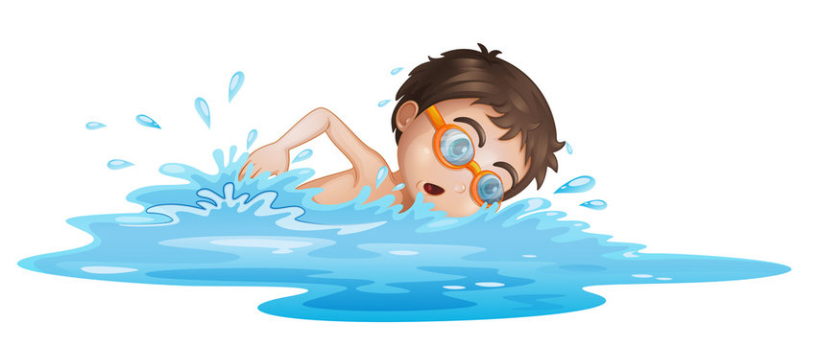

swim

Slide 7
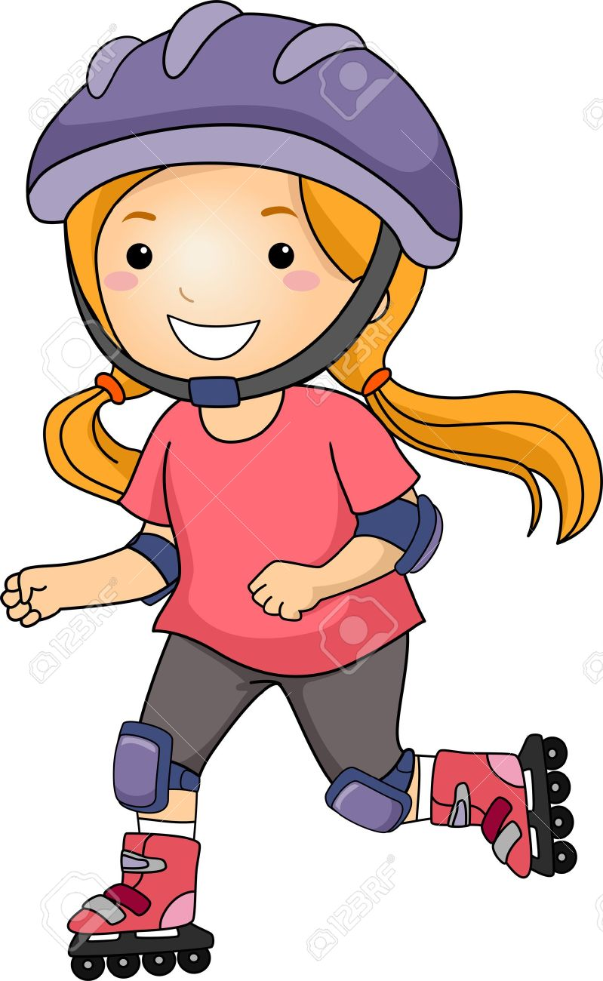
roller skate

Slide 8
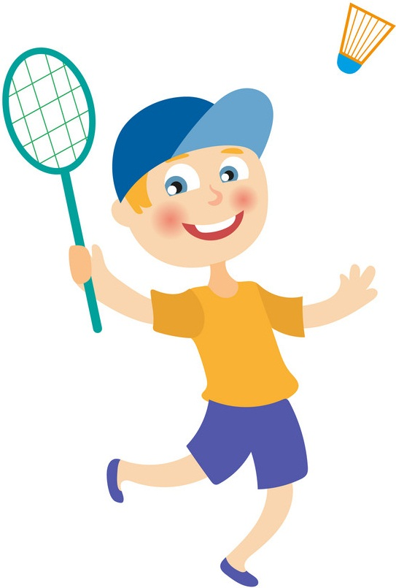
play badminton

Slide 9
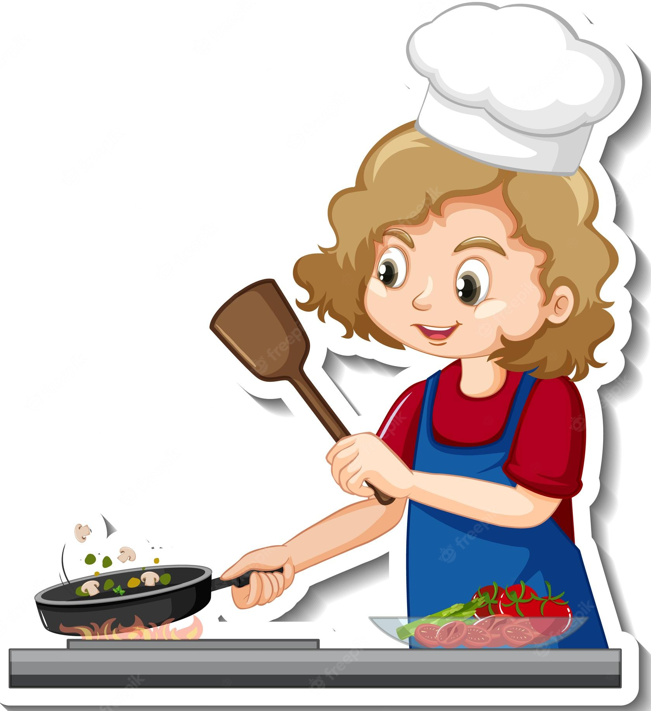
cook

Slide 10
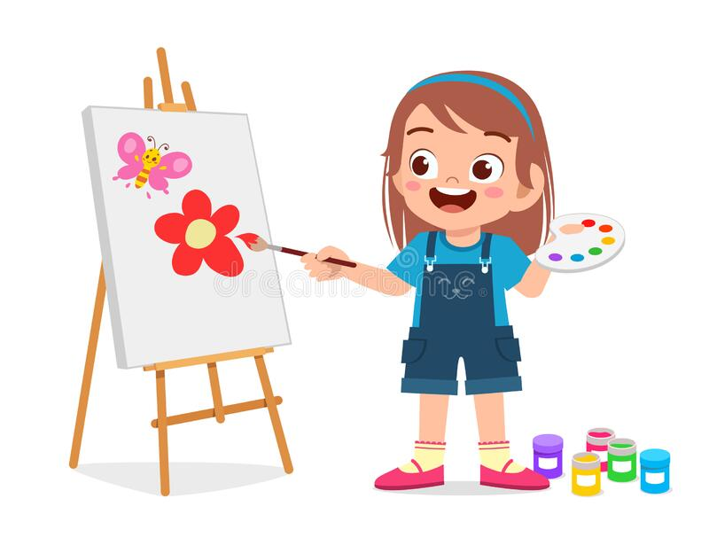
draw

Slide 11
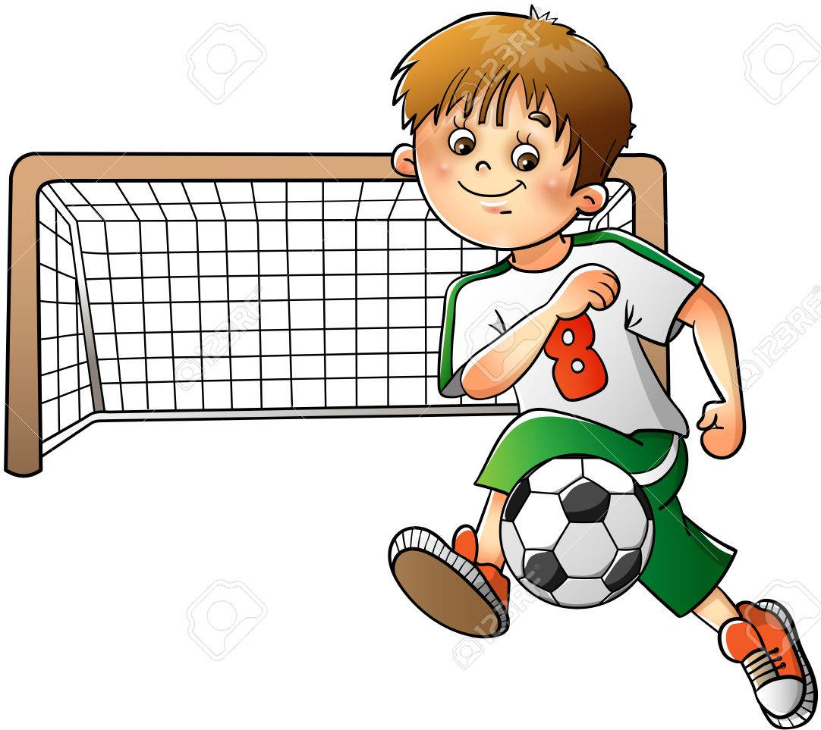
play football

Slide 12

play the piano

Slide 13
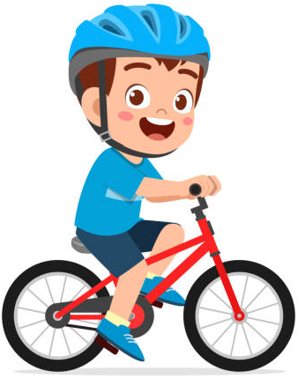
ride
a bike

Slide 15

02
Review

Slide 16
Let’s meet some
friends.
What can / can’t they do?

Slide 17
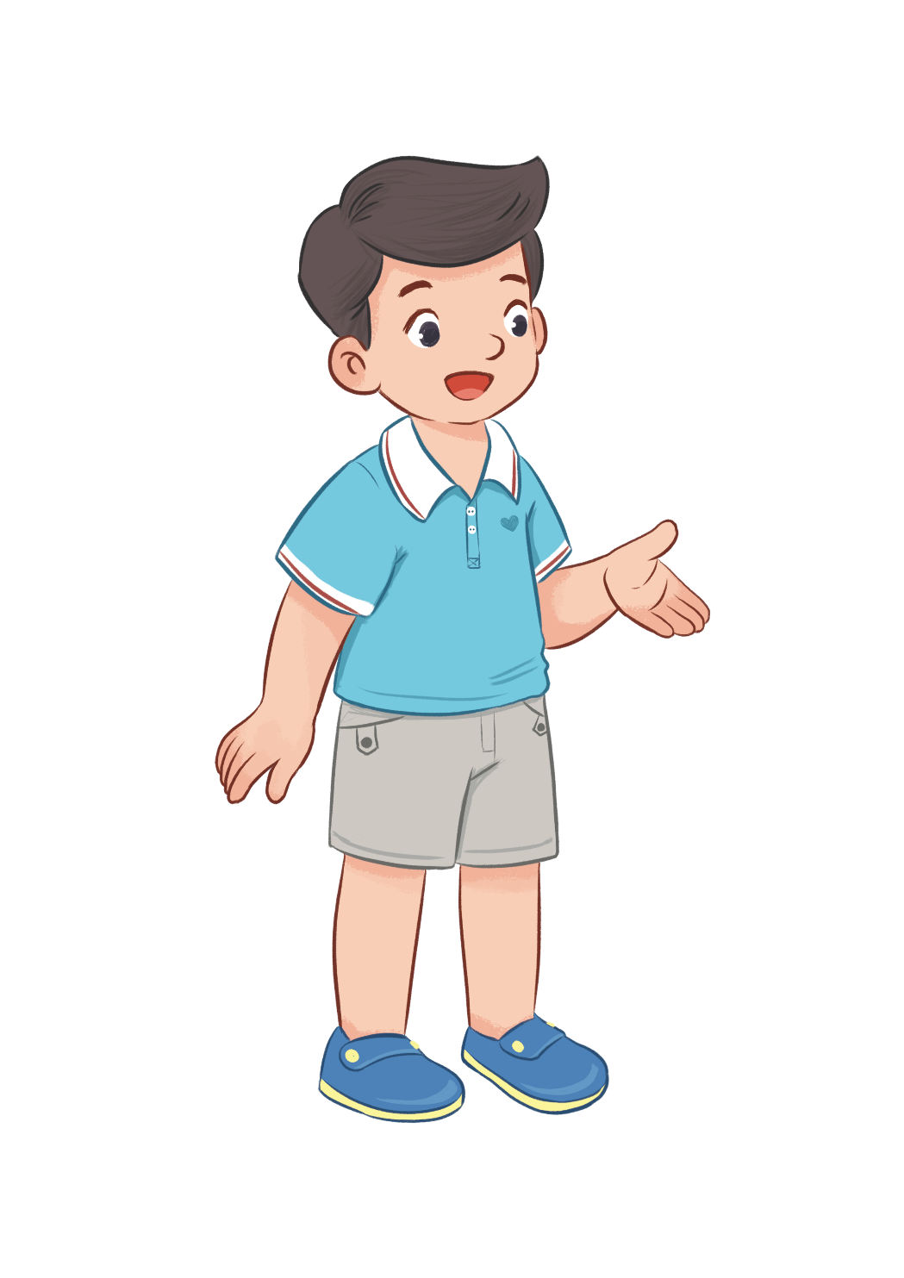
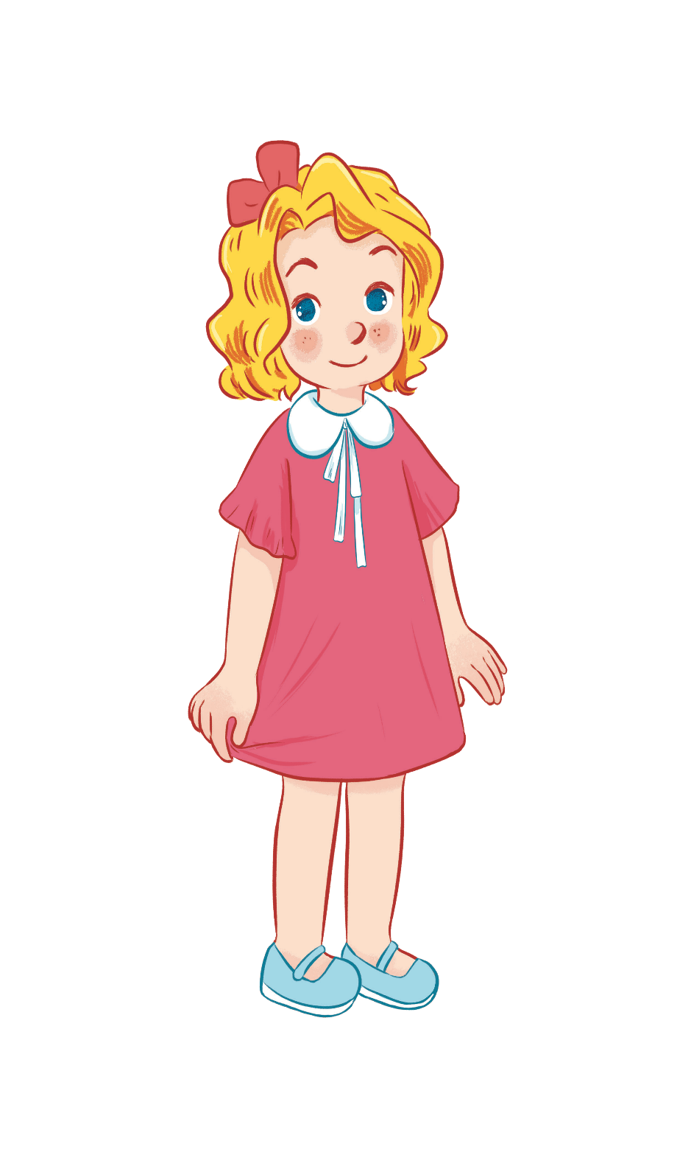



Can he play badminton?
No, he can’t.
Yes, he can.

Slide 18


Can she swim?
Yes, she can.
No, she can’t.

Slide 19
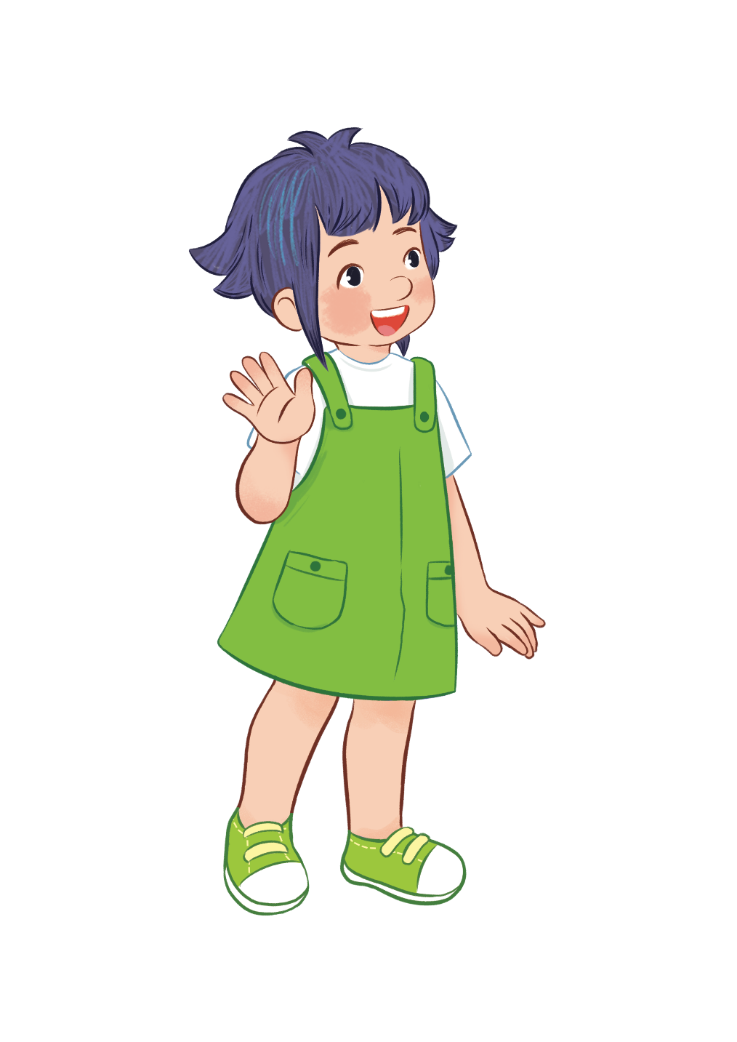
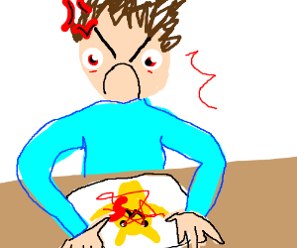
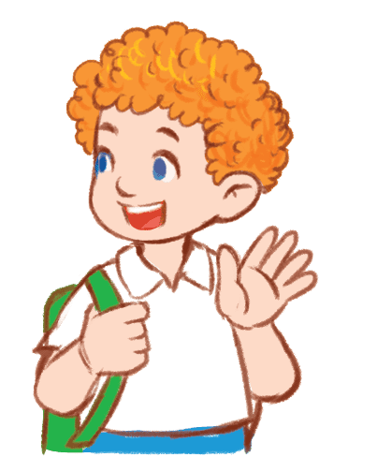
Can she draw?
Yes, she can.
No, she can’t.

Slide 20


Can he cook?
Yes, he can.
No, he can’t.

Slide 21



can ...........
can’t ...........

Slide 22
03
Activity 4
Listen and tick or cross.

Slide 23
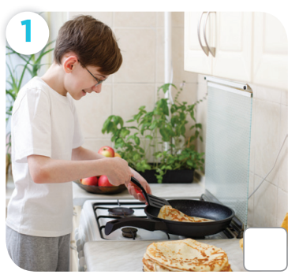
Can he cook?

Slide 24
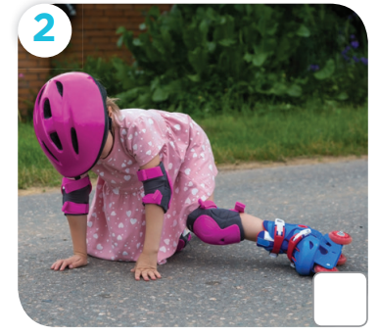
Can she roller skate?

Slide 25
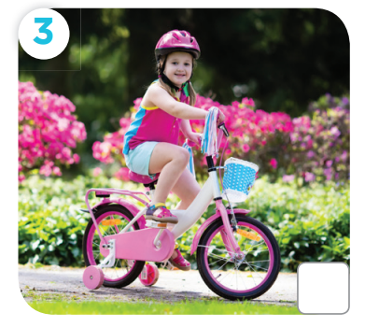
Can she ride a bike?

Slide 26
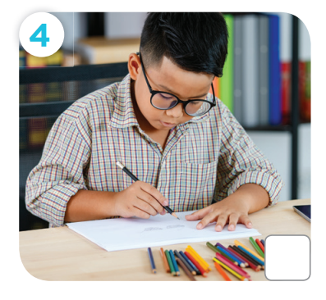
Can he draw a picture?

Slide 27

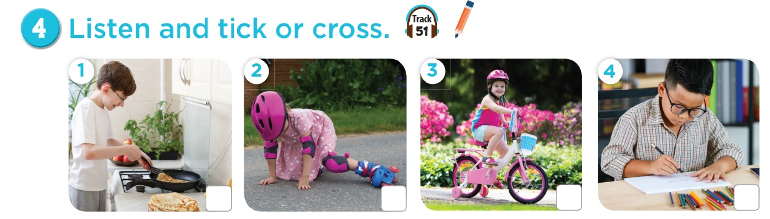



Slide 28
04
Activity 5
Look, complete and read.

Slide 29
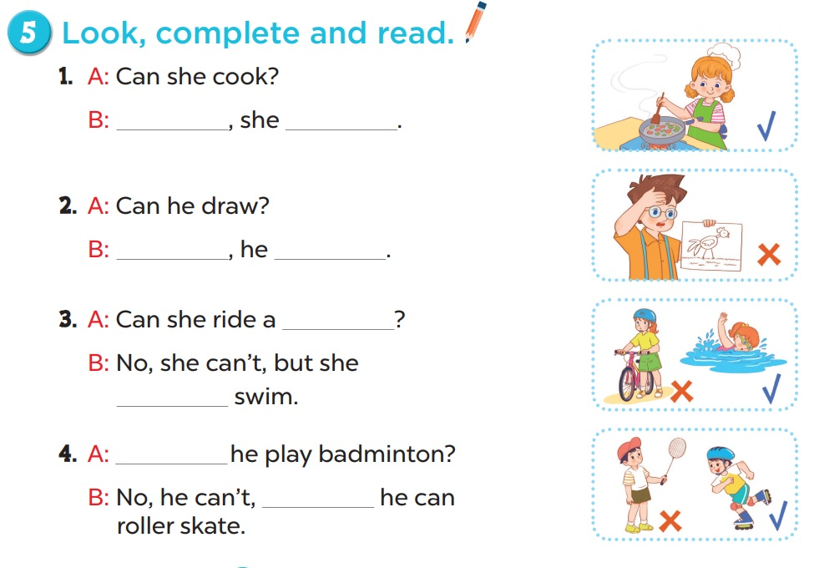
Work in pairs.
Yes
can
No
can’t
bike
can
Can
but

Slide 30
05
Activity 6
Let’s sing.

Slide 31
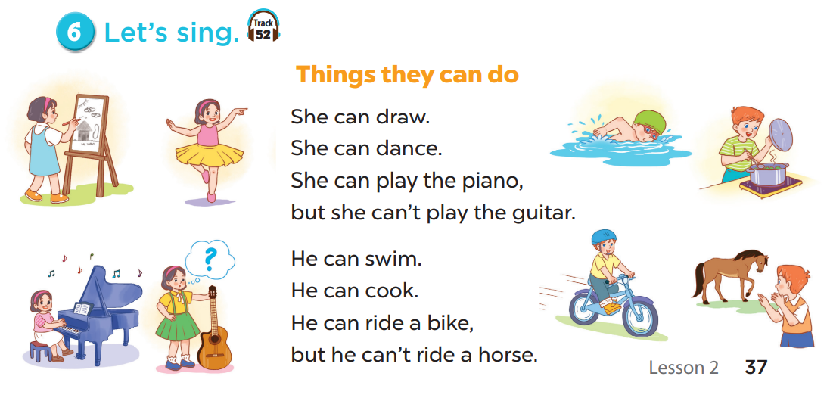

Slide 32
06
Fun corner

Slide 33


Slide 34

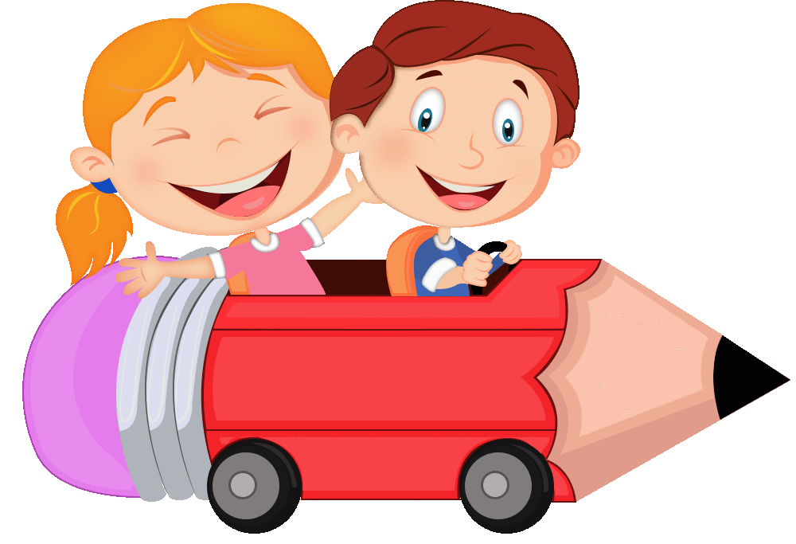

Slide 35




Slide 36




Can she play football?
No, she can’t.
Yes, she can.

Slide 37
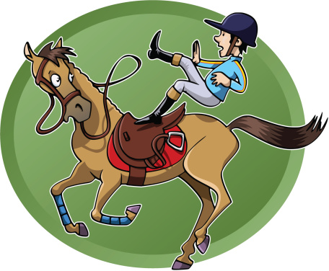



Can he ride a horse?
No, he can’t.
Yes, he can.

Slide 38



Can he ride a bike?
No, he can’t.
Yes, he can.

Slide 39
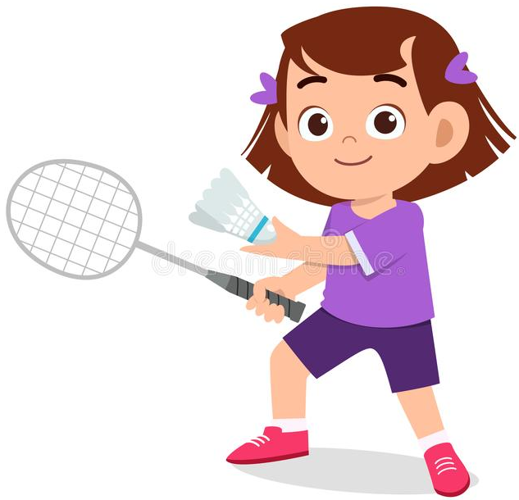
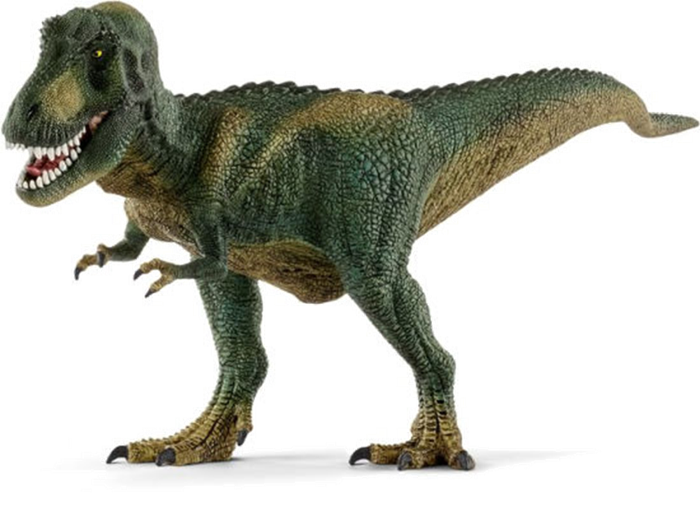

Can she play badminton?
Yes, she can.
No, she can’t.

Slide 40
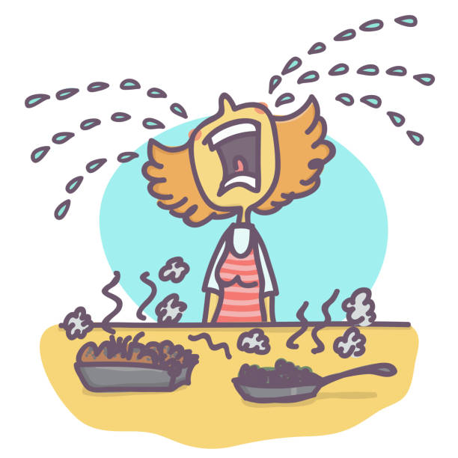
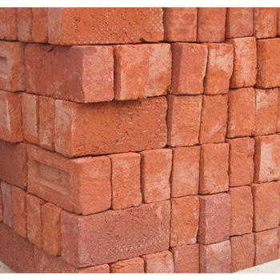


Can she cook?
Yes, she can.
No, she can’t.

Slide 41


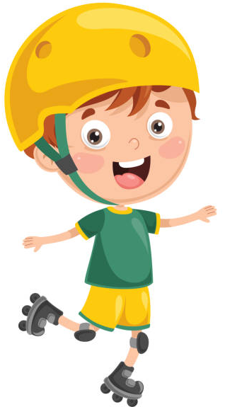
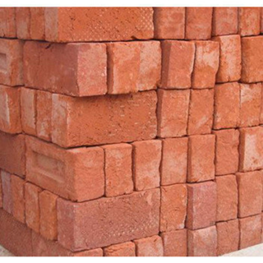

Can he roller skate?
No, he can’t.
Yes, he can.

