Slide 1

WARMLY WElcome to my class
TEACHER: ĐÀO THỊ LIỄU
QUOC TUAN PRIMARY SCHOOL

Slide 3








starter
Period 1 – Back to school

Slide 4



Table of contentS
01.
Warm-up and review
02.
Let’s sing.
03.
Let’s play.
04.
Write and share.
05.
Fun corner and wrap-up

Slide 5
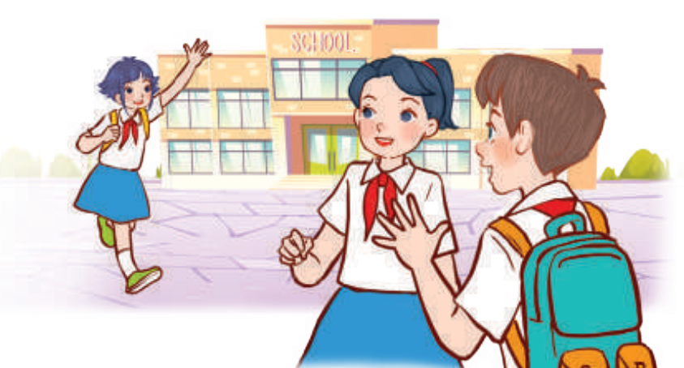
01
WARM-UP
and review

Slide 6
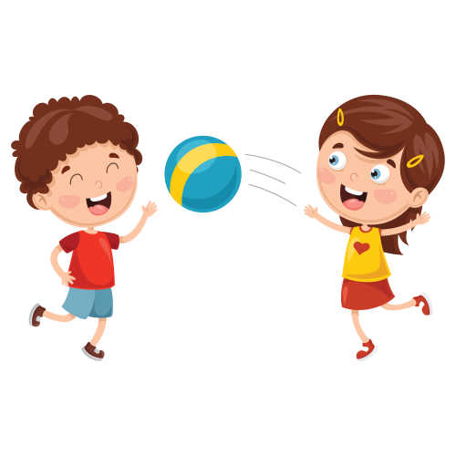


Pass the ball
Hello!/ Hi!

Slide 7
Pass the ball
My name’s ________.

Slide 8
Pass the ball
How are you?
- I’m fine, thanks. And you?
Notes:
Ask How are you? to the friend sitting in front of you.

Slide 9
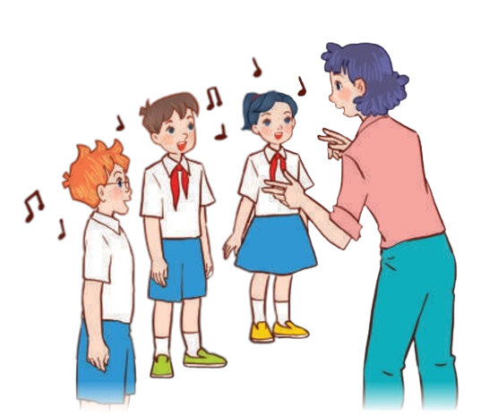
02
Let’s sing.

Slide 10


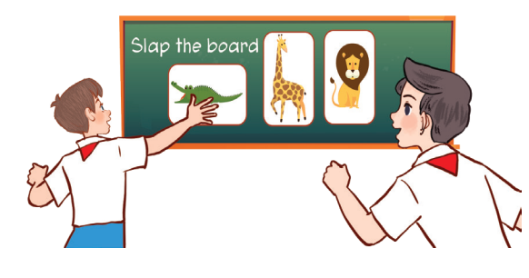
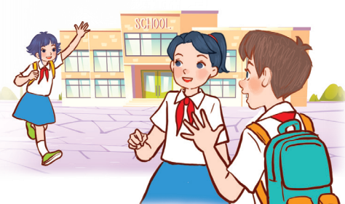
Look AND SAY.
What can you see?
Happy to learn and play!
Happy to see friends!

Slide 11






Look and read.
Back to school
Back to school.
Happy to see my friends!
Back to school.
Learning and playing are really cool!
Notes:
Step 1: Draw pupils’ attention to the title and lyrics of the song. Encourage them to point at the pictures to say what they see.

Slide 12
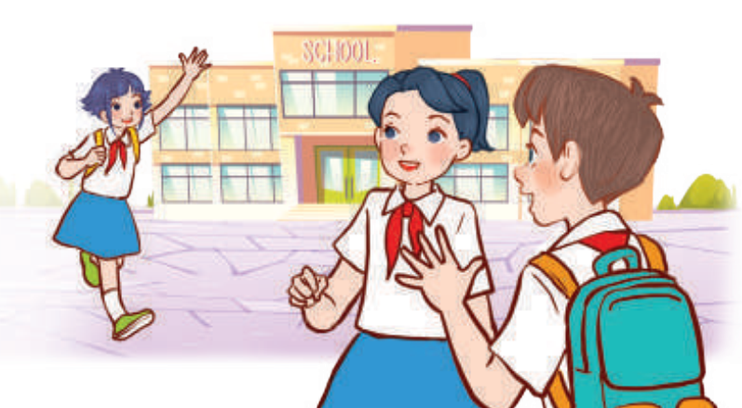
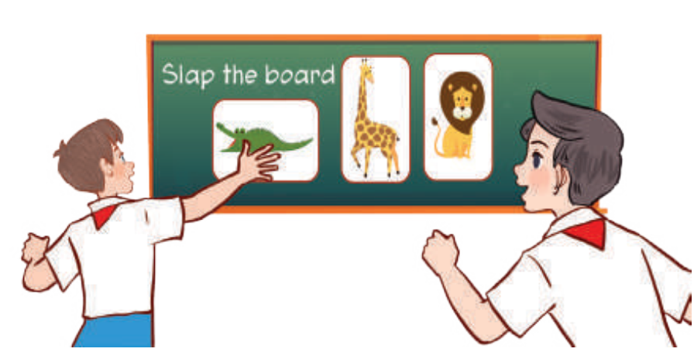
Look and read
Back to school
Back to school.
Happy to see my teachers!
Back to school.
Learning and playing are really cool!
Notes:
Step 1: Draw pupils’ attention to the title and lyrics of the song. Encourage them to point at the pictures to say what they see.

Slide 13
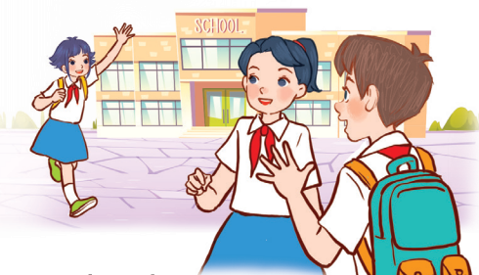
Let’s listen.
Back to school
Back to school.
Happy to see my friends!
Back to school.
Learning and playing are really cool!
Back to school.
Happy to see my teachers!
Back to school.
Learning and playing are really cool!
Notes:
Step 2: Have pupils read and listen to the song, drawing their attention to the pronunciation, rhythm and melody.

Slide 14

Let’s SING.
Back to school
Back to school.
Happy to see my friends!
Back to school.
Learning and playing are really cool!
Back to school.
Happy to see my teachers!
Back to school.
Learning and playing are really cool!
Notes:
Step 3: Play the recording again and let them listen to and practise singing the song, line by line.
(Click while playing music for pupils to follow the lines.)

Slide 15









PractiSe the actions.
Back to school
Back to school.
Happy to see my friends!
Back to school.
Learning and playing are really cool!
Back to school.
Happy to see my teachers!
Back to school.
Learning and playing are really cool!
Notes:
Step 3: Play the recording again and let them listen to and practise doing actions or clapping their hands when they hear the keywords such as school, happy, friends, learning, playing, cool in the first verse and school, happy, teachers, learning, playing, cool in the second verse.
- Practise doing actions or clapping their hands first without music first, then practise with the music later.

Slide 16
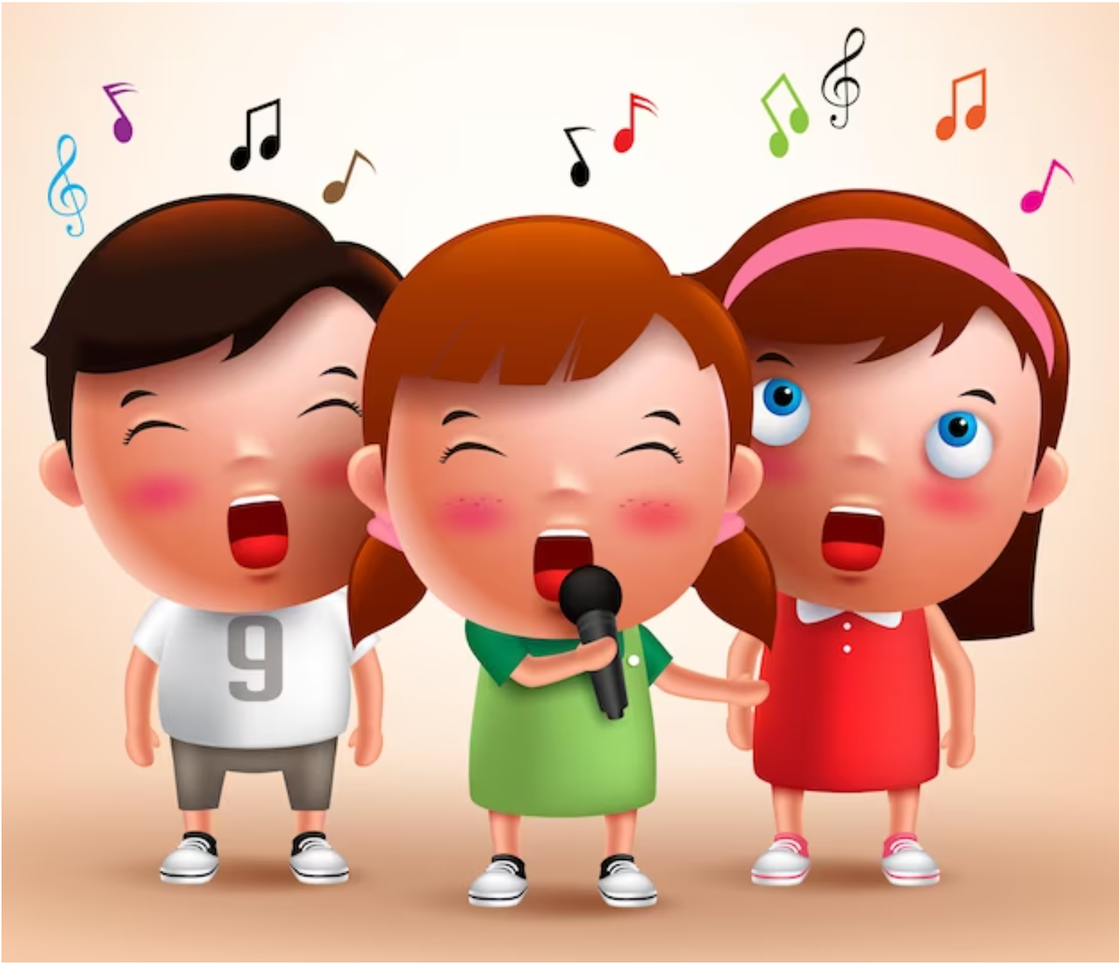
Let’s sing in groups.
Back to school
Back to school.
Happy to see my friends!
Back to school.
Learning and playing are really cool!
Back to school.
Happy to see my teachers!
Back to school.
Learning and playing are really cool!
Notes:
Step 4: Ask pupils to listen to and sing the whole song while doing actions or clapping their hands. Go around the classroom and offer help where necessary.

Slide 17
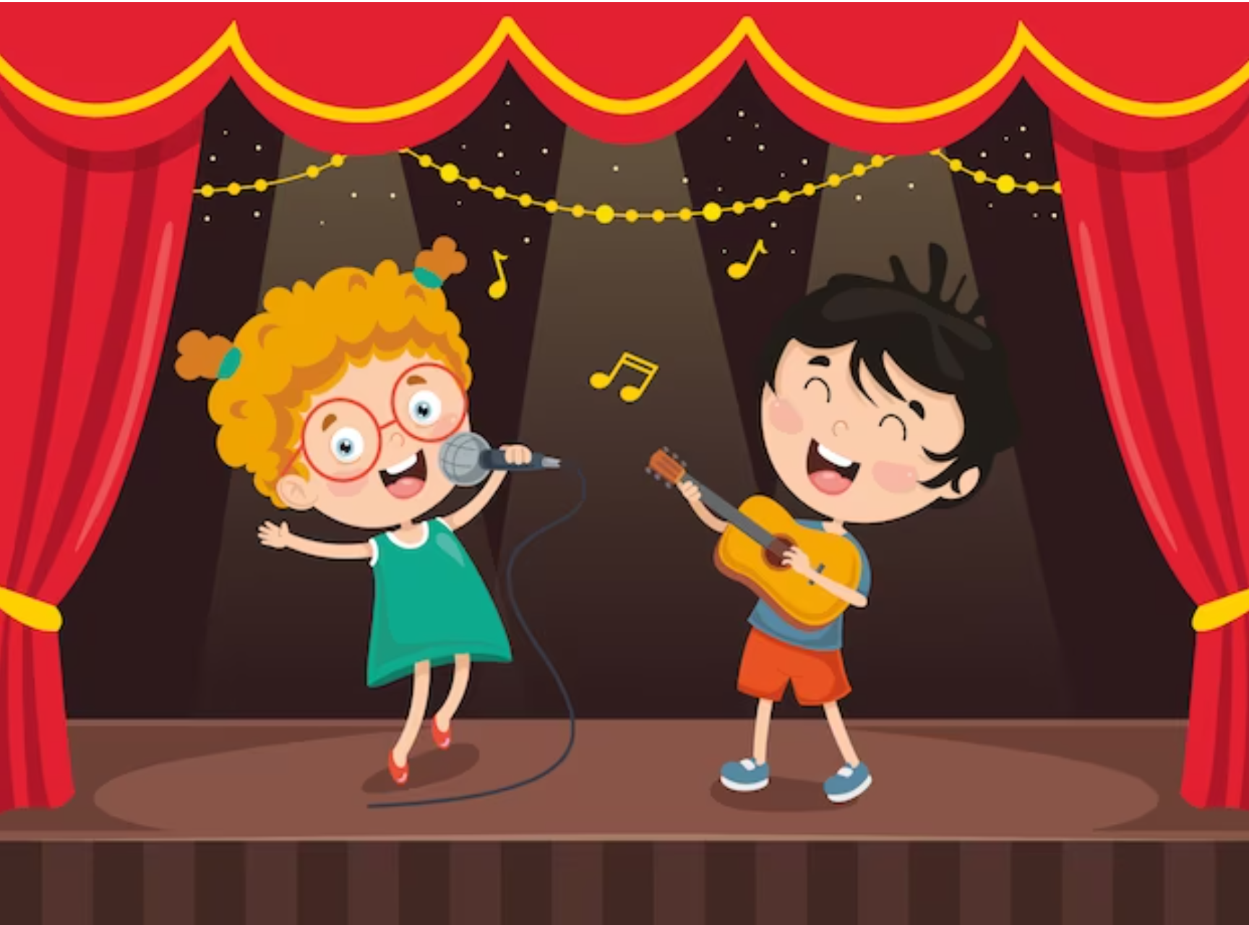
LIVE ON THE STAGE.
Notes:
Step 5: Invite a few groups to the front of the class to sing the song. The class may sing along to reinforce the activity.

Slide 18
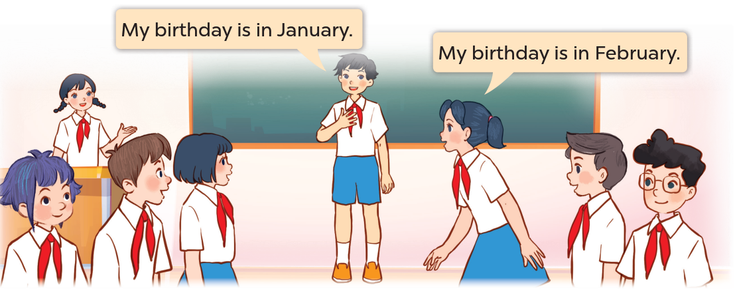
03
Let’s play.

Slide 19












Look and Say.
Notes:
Ask pupils to look and read 12 months of the year.

Slide 20






Classroom
Birthdays

Slide 21

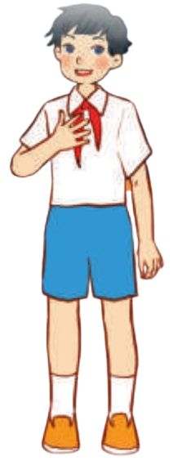












Birthday line-up
My birthday is in February.
TEAM A
1
2
3
4
5
6
My birthday is in January.
TEAM B
1
2
3
4
5
6
Notes:
Step 1: Invite two teams of six pupils. Tell pupils the instruction of the game. Pupils say their birthday months and line up from January.
Step 2: The faster team will win the game.
Step 3: Invite other teams to play the game.
- Click 3 times to play music for the three turns of playing.

Slide 22









Let's sing "Happy Birthday“!
Notes:
Let’s sing Happy birthday! to all the pupils.

Slide 23

04
Write
and share.

Slide 24







L
E
A
R
N
I
N
G
Notes:
Introduce Learning Goals to pupils.

Slide 25
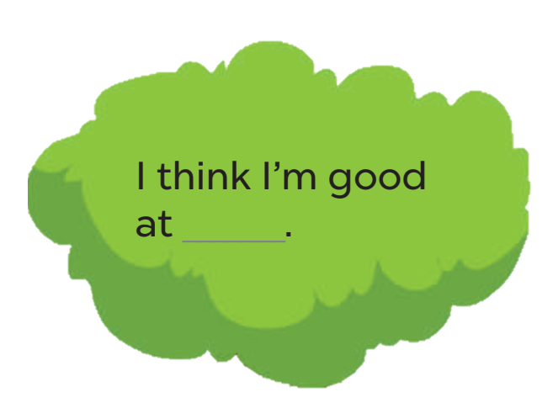

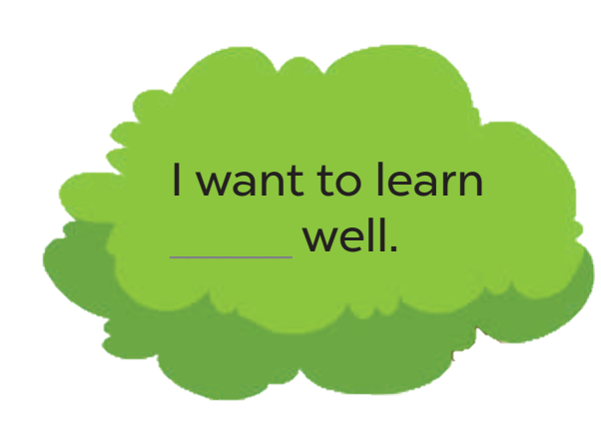
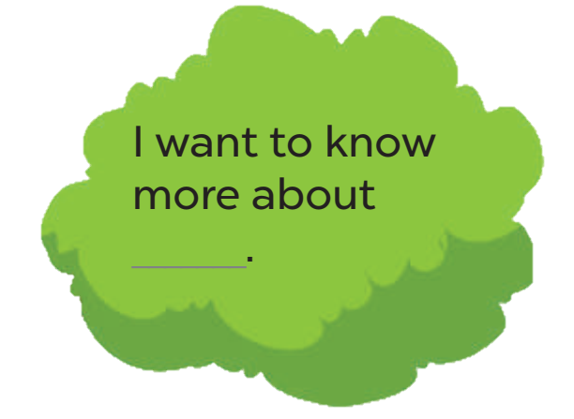
Write and share.
My Goal Tree
maths.
Notes:
Step 1: Tell the class the goal of the activity and explain that they should write three sentences about their learning goals. Check comprehension.
Step 2: Have pupils fill the first blank together as an example. Ask them to read the first line in the form and elicit possible answers. Then have them write the answer in the gap.
Step 3: Give pupils time to complete the sentences independently. Go around the classroom and offer help where necessary.
- Play music for pupils to do the task individually.

Slide 26

Write and share.
Work in pairs.
Notes:
Step 4: Get pupils work in pairs to share their learning goals.

Slide 27
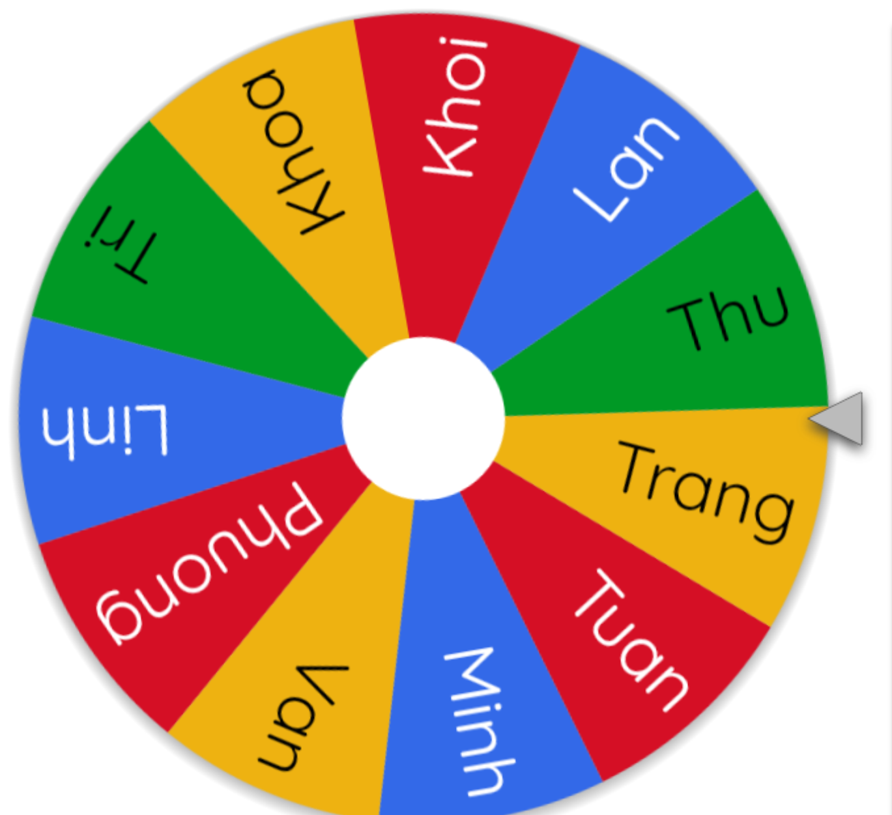

Write and share.
Let’s spin.
These are my learning goals:
- I think I’m good at _____.
- I want to learn _____ well.
- I want to know more about _____________________.
Notes:
Extension: If time allows, invite a few pupils to read the sentences they have completed / written aloud in front of the class. The class observes and praises their work.
Use this link to play game online: https://wheelofnames.com/

Slide 28
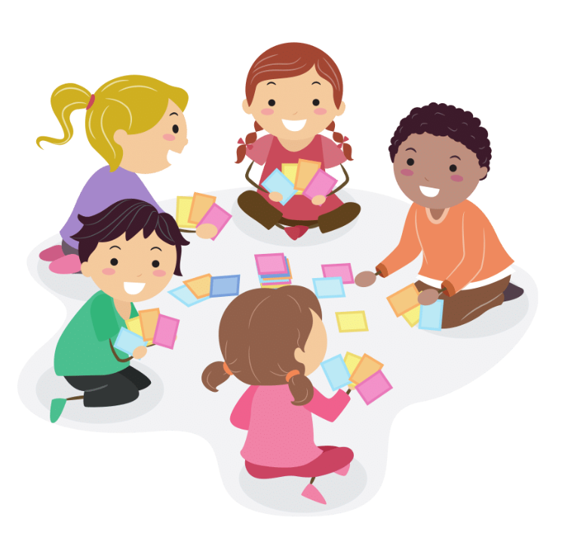
05
Fun corner and wrap-up

Slide 29






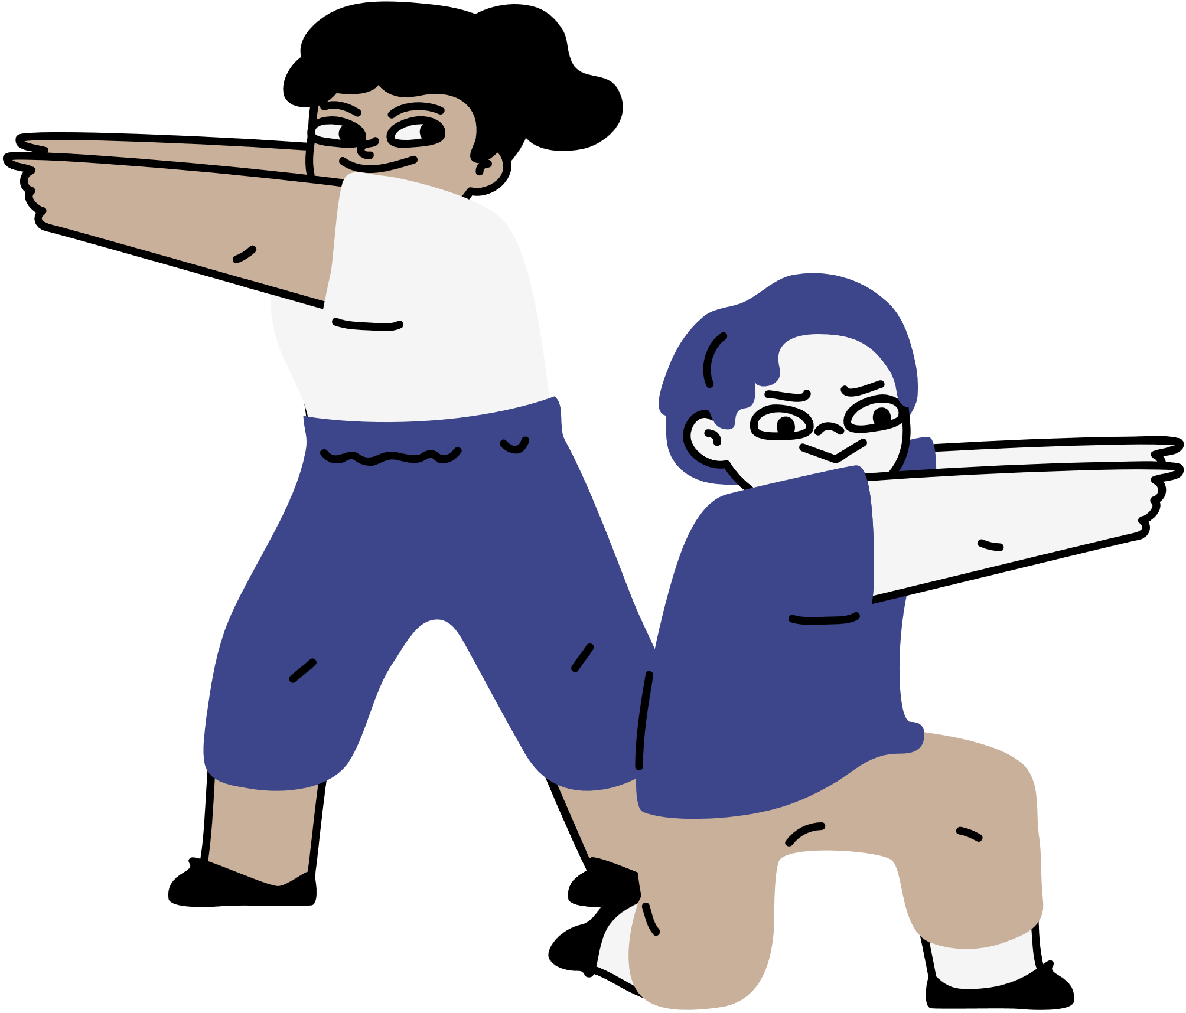
Let’s play Bingo!
Notes:
Game: Bingo
- Prepare word cards about months of a year.
- Give each pupil a bingo grid with four squares.
- Ask pupils to choose four words and write in a bingo grid.
- Explain that when you call out a word, pupils should search for that word on their bingo card. If they have the word, they should cross it out. The first pupil to cross out all of their words wins.

Slide 30



January
February
March
April
May
June
July
August
September
October
November
December
B
I
N
G
O
March
August
December
May

Slide 31



Get ALL!
Let’s start!

Slide 32


Rules
The first player to cross
ALL the words wins the game.
B
I
N
G
O
March
August
December
May

Slide 33

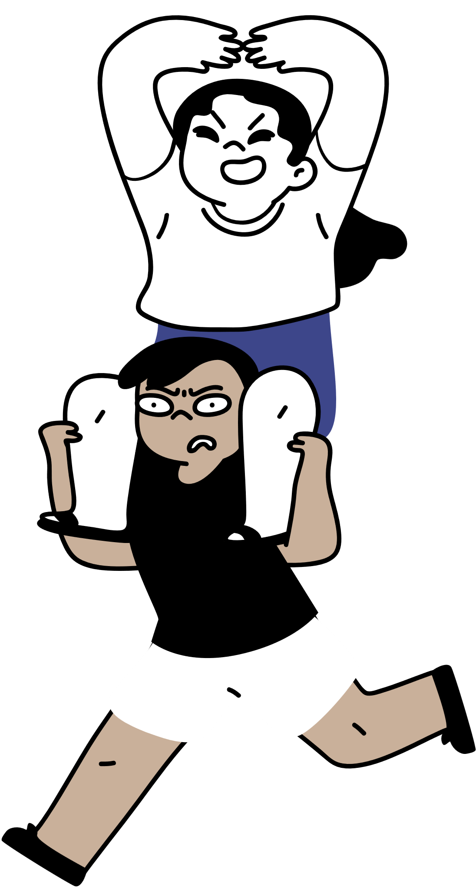
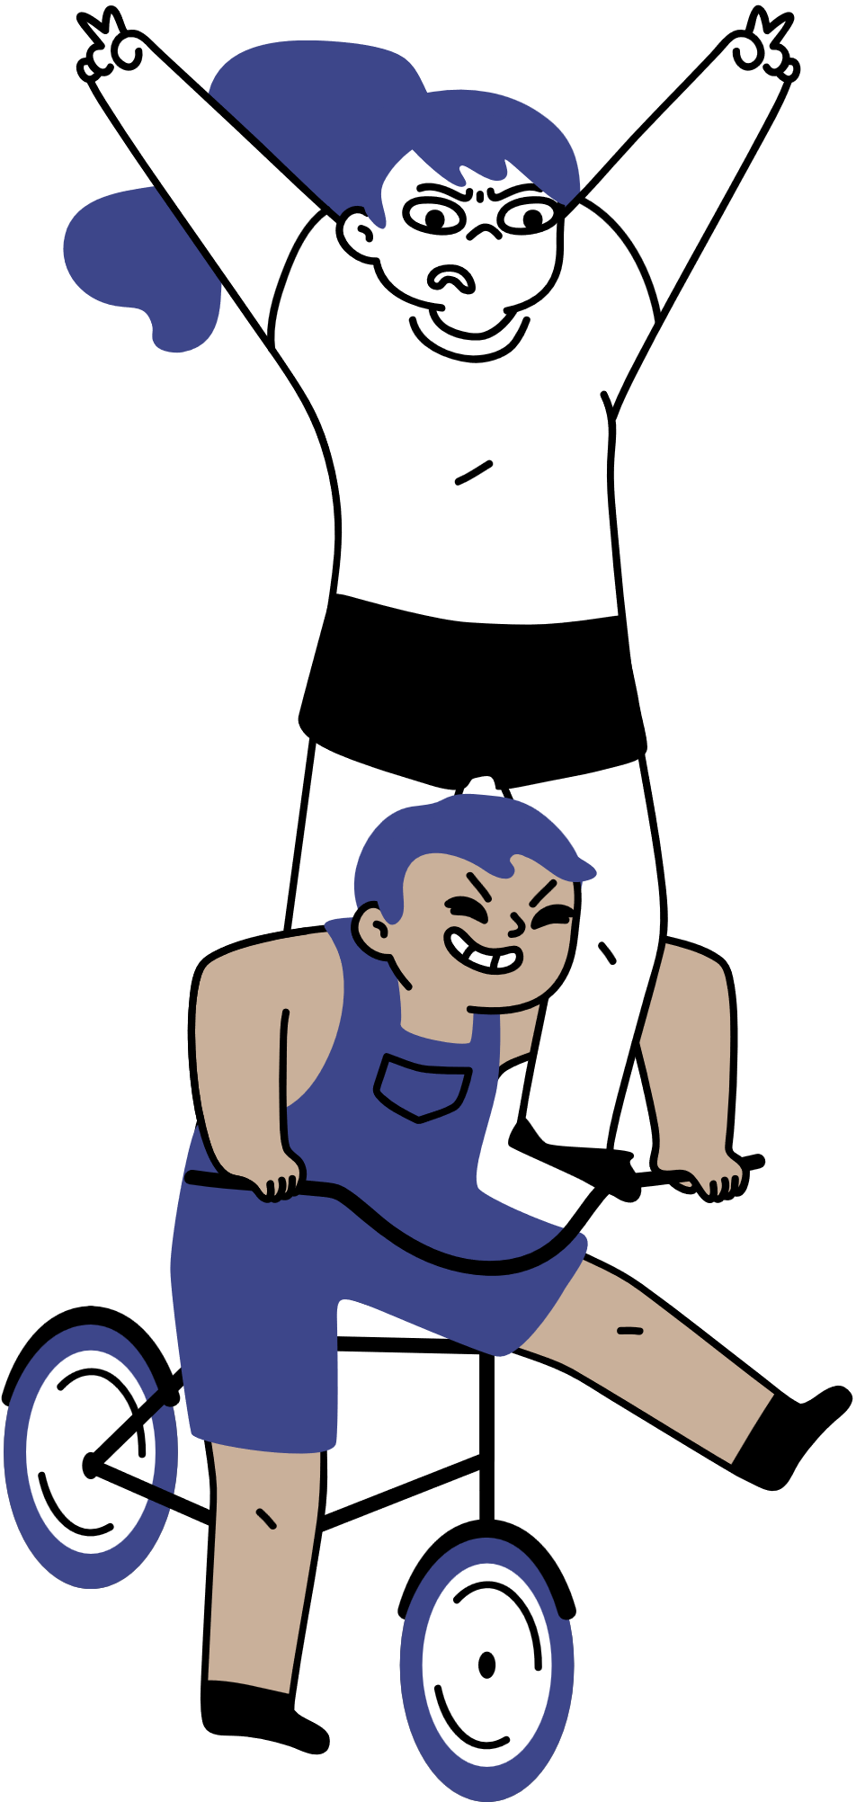
Are you ready to win?
Shout Bingo if you get all!

Slide 34
January
February
March
April
May
June
July
August
September
October
November
December
B
I
N
G
O
March
August
December
May

Slide 35
January
February
March
April
May
June
July
August
September
October
November
December
B
I
N
G
O
March
August
December
May

Slide 36
January
February
March
April
May
June
July
August
September
October
November
December
B
I
N
G
O
March
August
December
May

Slide 37
January
February
March
April
May
June
July
August
September
October
November
December
B
I
N
G
O
March
August
December
May

Slide 38

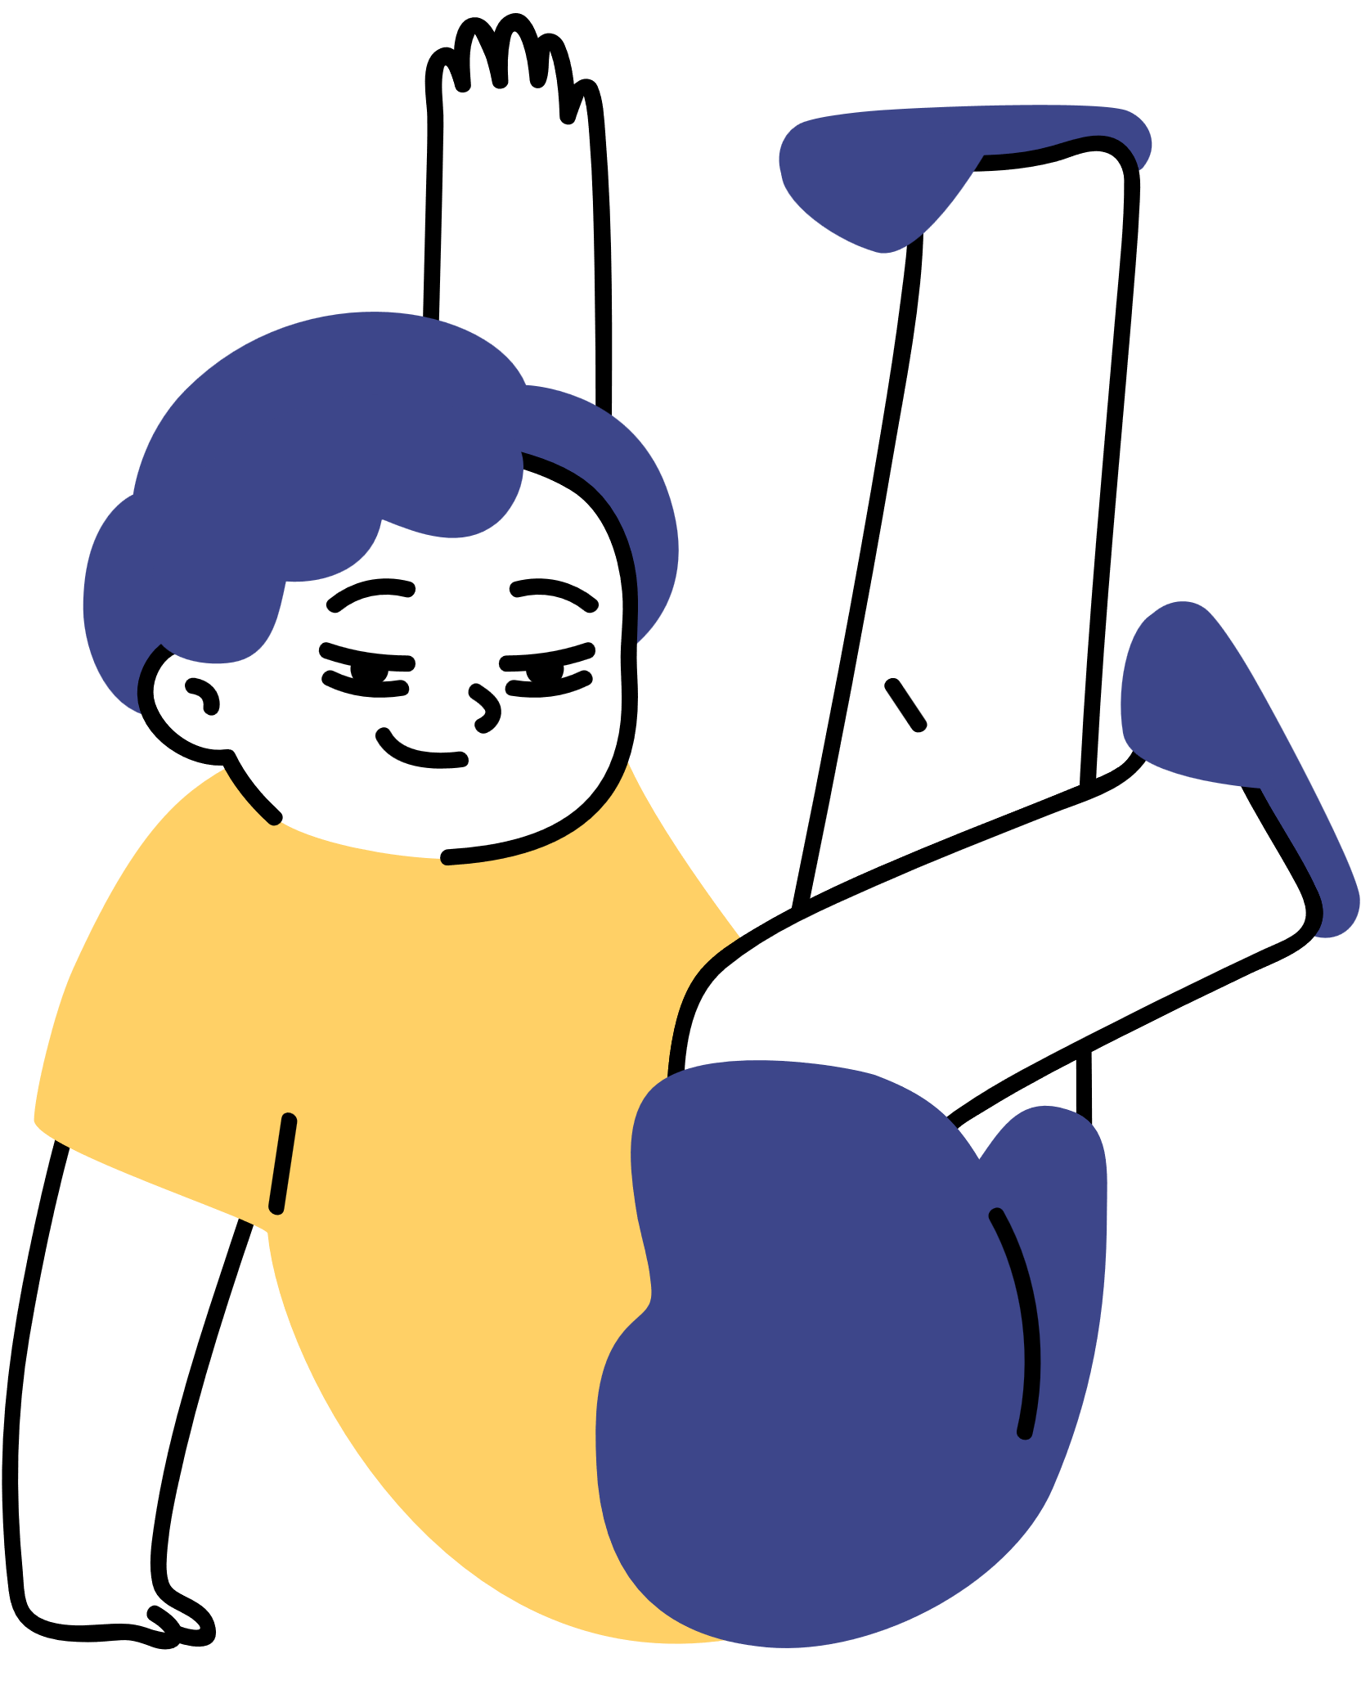

Congratulations!
Thank you!

