Slide 1

WARMLY WElcome to my class
TEACHER: ĐÀO THỊ LIỄU
QUOC TUAN PRIMARY SCHOOL

Slide 3








starter
Period 3 – Classroom Instructions

Slide 4



Table of contentS
01.
Warm-up and review
02.
Let’s chant.
03.
Listen and tick.
04.
Let’s play.
05.
Fun corner and wrap-up

Slide 5
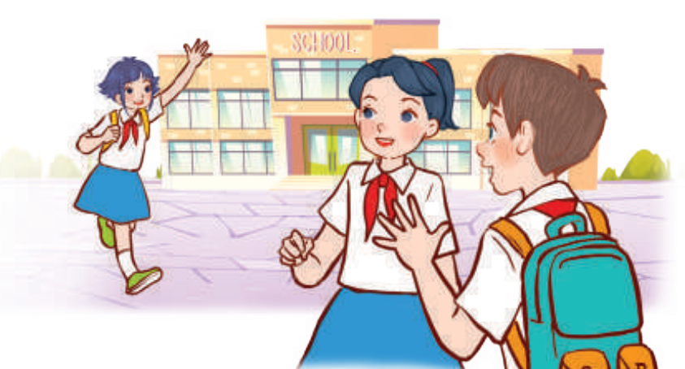
01
WARM-UP
and review

Slide 6





Yes or No
Game

Slide 7




Question
  Were you in Ha Long Bay
  last summer?
You have 30 seconds.

Slide 8



Answer
Yes, I was.

Slide 9


Question
  Was the weather hot
  yesterday?
You have 30 seconds.

Slide 10
Answer
No, it wasn’t.
It was rainy.

Slide 11


Question
  Were you at the park
  yesterday?
You have 30 seconds.

Slide 12
Answer
Yes, I was.

Slide 13


Question
  Was the weather windy
  this morning?
You have 30 seconds.

Slide 14
Answer
No, it wasn’t.
It was snowy.

Slide 15

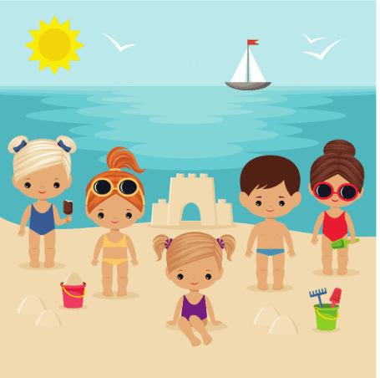
Question
  Were you in the mountains
  last summer?
You have 30 seconds
You have 30 seconds.

Slide 16
Answer
No, I wasn’t.
I was on the beach.

Slide 17
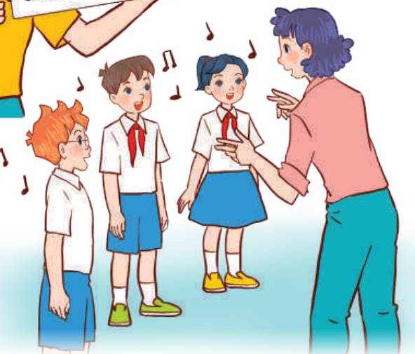
02
Let’s chant.

Slide 18
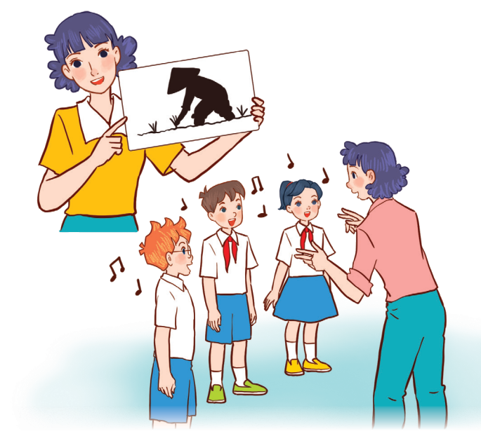

Look and say.
Notes:
Step 1: Have pupils look at the picture and state activity the characters do.

Slide 19
Look and Read.
Class, class, class!
Yes, yes, yes?
Do you want to play a game?
Yes, we do. Yes, we do.
Let’s play a guessing game.
Notes:
Step 2: Have pupils read the first verse of the chant. Check comprehension.

Slide 20
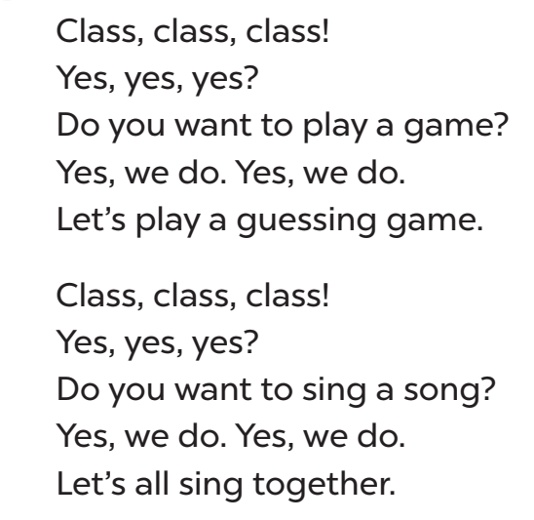


Listen and repeat.
Sa
Notes:
Step 3: Play the recording of the first verse for pupils to listen. Play it again, line by line, for pupils to listen and repeat. Draw their attention to the rhythm, word stress and pronunciation. Encourage them to clap or do actions while chanting.
(Click to drop the flowers while the chant is playing.)

Slide 21
Look and read.
Class, class, class!
Yes, yes, yes?
Do you want to sing a song?
Yes, we do. Yes, we do.
Let’s all sing together.
Notes:
Step 4: Repeat Steps 2 and 3 for the second verse of the chant.

Slide 22
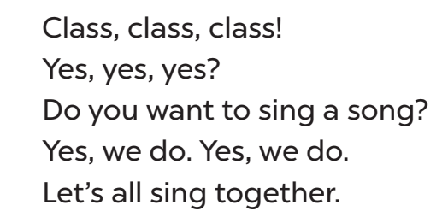
Listen and repeat.
Notes:
Step 4: Repeat Steps 2 and 3 for the second verse of the chant.
(Click to drop the flowers while the chant is playing.)

Slide 23
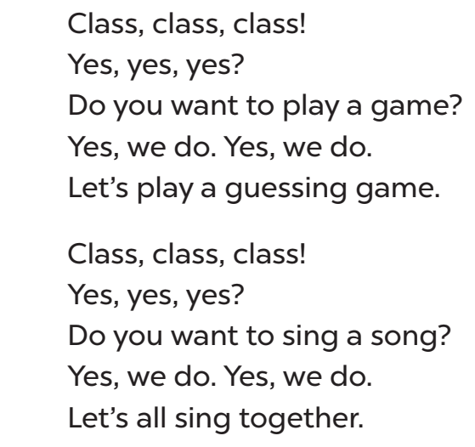
Chant and clap hands.
Notes:
Step 5: Play the recording all the way through for pupils to chant and clap their hands.

Slide 24

03
LISTEN
AND tick.

Slide 25

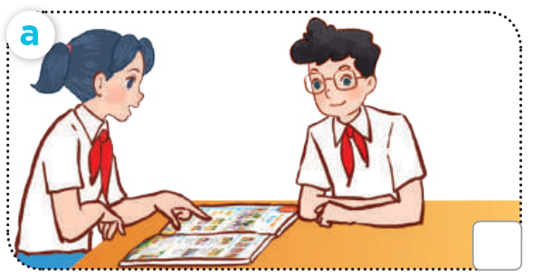
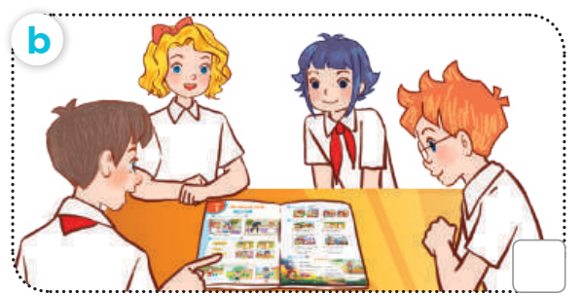

Look and Say.
work in pairs
work in groups
Notes:
Step 1: Draw pupils’ attention to the pictures and ask questions such as What are they doing? or What activity are they doing? to elicit the activities in the pictures. Remind them to look at pictures a and b to contrast.

Slide 26


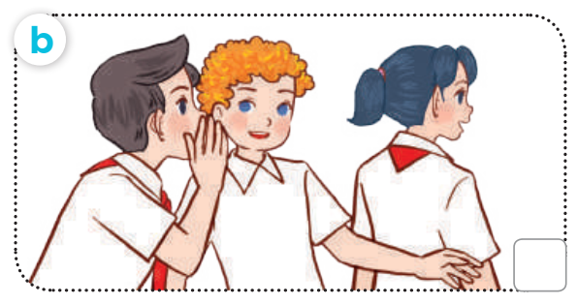
Look and Say.
do exercises
play a game
Notes:
Step 1: Draw pupils’ attention to the pictures and ask questions such as What are they doing? or What activity are they doing? to elicit the activities in the pictures. Remind them to look at pictures a and b to contrast.

Slide 27
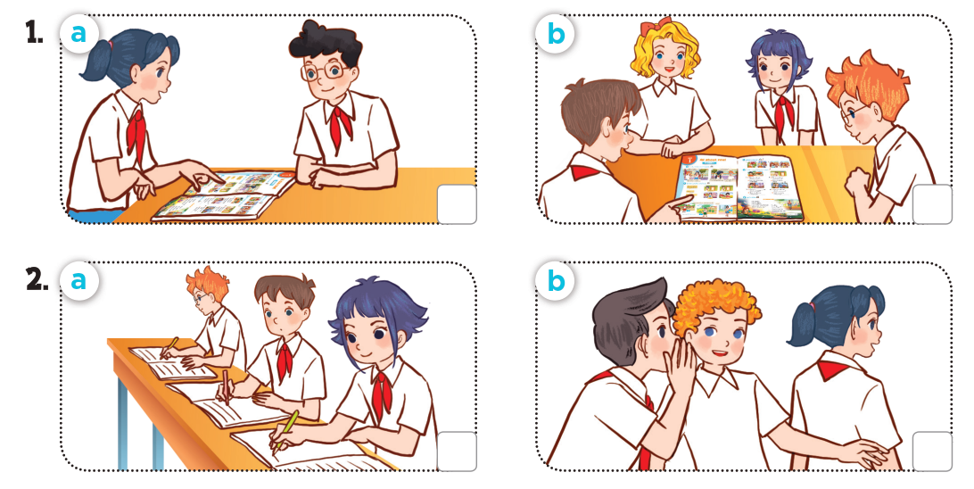
LISTEN AND POINT.
Notes:
Step 2: Play the recording all the way through. Then play the recording again for pupils to listen and choose correct pictures.

Slide 28

Work in pairs.
Notes:
Step 3: Get pupils to swap books with a partner and check their answers before checking as a class. Correct the answers, if necessary.

Slide 29
Let’s check!
✓
✓
✓
Notes:
Audio script:
1. Work in pairs. Point and say.
2. A: Do you want to play a game?
B: Yes, we do.
A: Let’s play the whispering game.
*Key: 1. a, 2. b

Slide 30
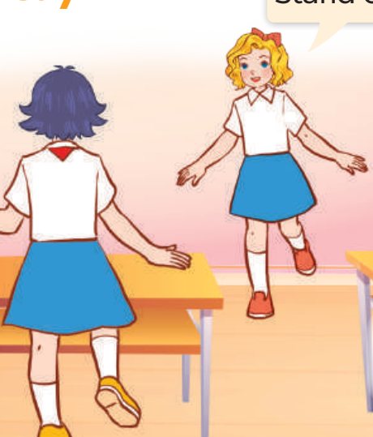
04
LET’S play.

Slide 31
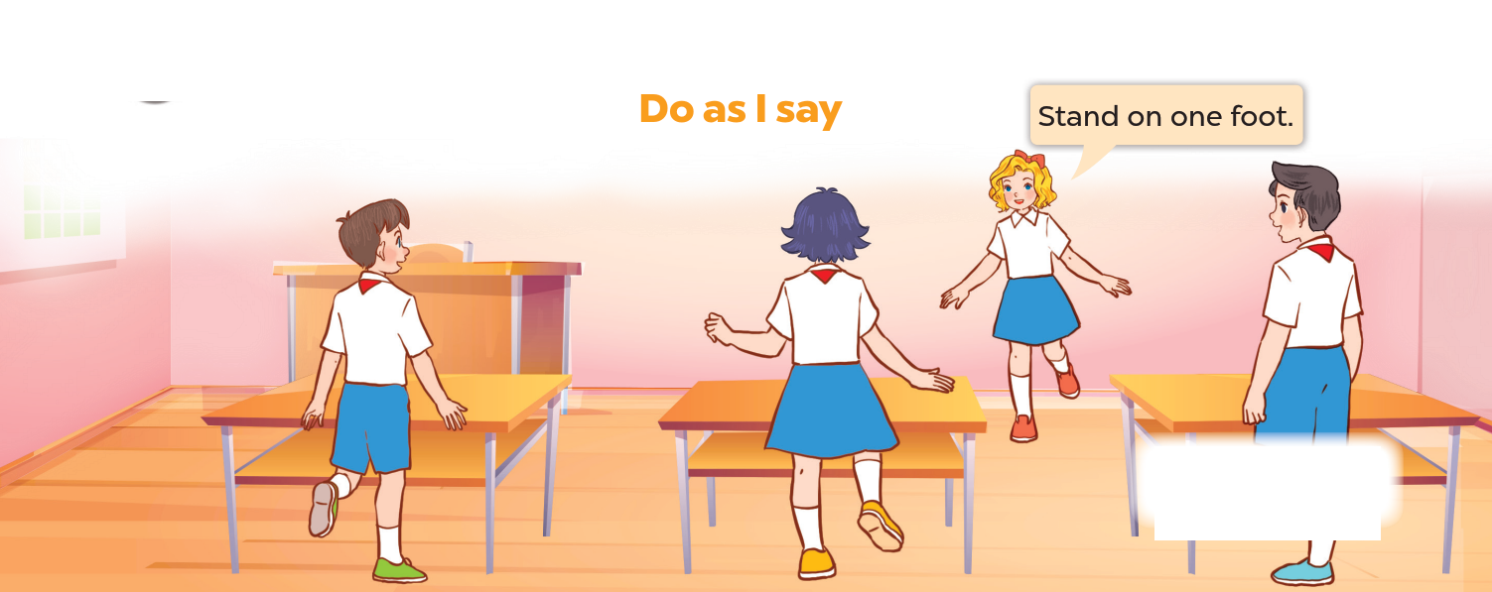
Look AND SAY.
Notes:
Introduce the game by asking pupils to talk about what the characters are doing.

Slide 32


Do as I say
2 teams
TEAM A
TEAM B
Notes:
Step 1: Ask each pupil to prepare one instruction.
Step 2: Divide the class into two teams. Invite one pupil to the front to give the instruction and do an action at the same time. The action may be similar to or different from the instruction. Other pupils need to listen and follow the instruction.

Slide 33

05
Fun corner and wrap-up

Slide 34






TIC
TAC
A FUN TWO TEAM GAME!
TOE

Slide 35


TEAM ONE
1
2
3
4
5
6
TEAM TWO
7
8
9
Notes:
Click the numbers to move to the Question slide.
Click X to move to the Scoreboard slide.

Slide 36

SAY and DO
Work in pairs.
Open your books. Point and say.
Notes:
Click the white box to back to the Number slide.

Slide 37
SAY and DO
Work in groups.
Sing back to school song.
Notes:
Click the white box to back to the Number slide.

Slide 38
SAY and DO
Open your book to page 9.
Do Exercise 2.
Notes:
Click the white box to back to the Number slide.

Slide 39
SAY and DO
Go to the board.
Slap the correct picture.
Notes:
Click the white box to back to the Number slide.

Slide 40
SAY and DO
Please be quiet!
Listen carefully.
Notes:
Click the white box to back to the Number slide.

Slide 41
SAY and DO
Make a groups of five.
Notes:
Click the white box to back to the Number slide.

Slide 42
SAY and DO
Clap your hands
three times.
Notes:
Click the white box to back to the Number slide.

Slide 43
SAY and DO
Pass the ball to
your friends sitting next to you.
Notes:
Click the white box to back to the Number slide.

Slide 44
SAY and DO
Read this sentence aloud
I am happy today.
Notes:
Click the white box to back to the Number slide.

Slide 45

SCOREBOARD
TEAM ONE
TEAM TWO
Notes:
Reward teams.

Slide 46
THANKS
FOR
PLAYING!

