Slide 1

WARMLY WElcome to my class
TEACHER: ĐÀO THỊ LIỄU
QUOC TUAN PRIMARY SCHOOL

Slide 3

Unit 1. All about me!
Lesson 3 - Period 5

Slide 4

Table of contents
01
Warm-up and review
02
Listen and repeat.
03
Circle, listen and check.
04
Let’s chant.
05
Fun corner and wrap-up

Slide 5


01
Warm-up and review

Slide 6
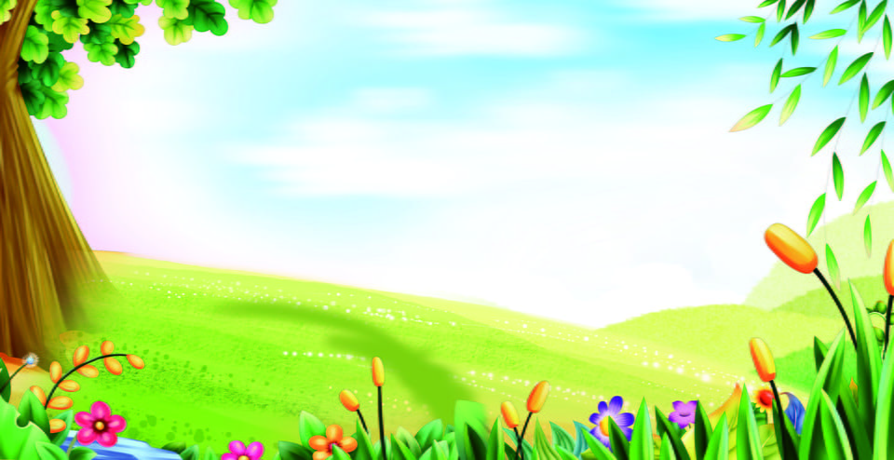
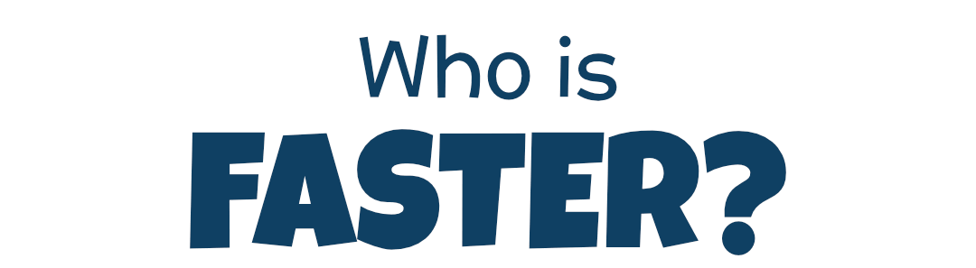
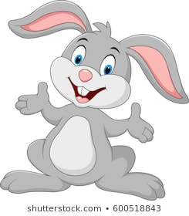
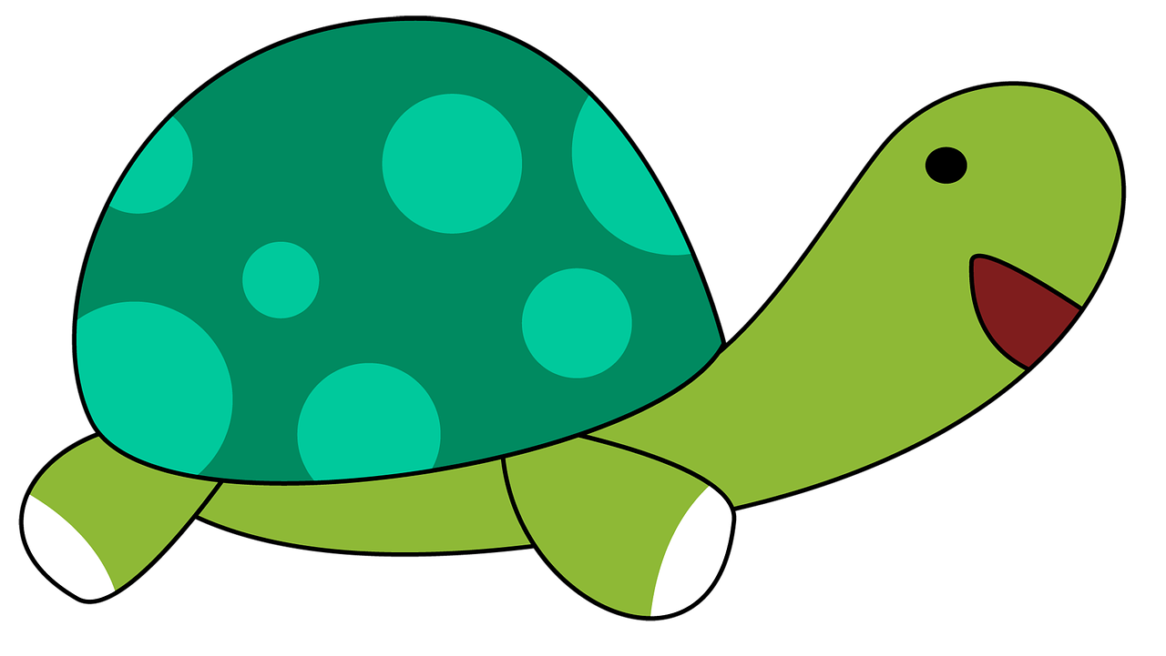
Team Turtle
Team Rabbit

Slide 7
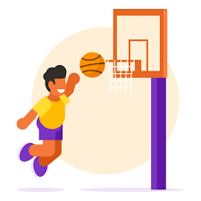
Choose the correct answer a,b or c.
A: What’s your favourite _______?
B: It’s basketball.
a
b
c
food
animal
sport

Slide 8
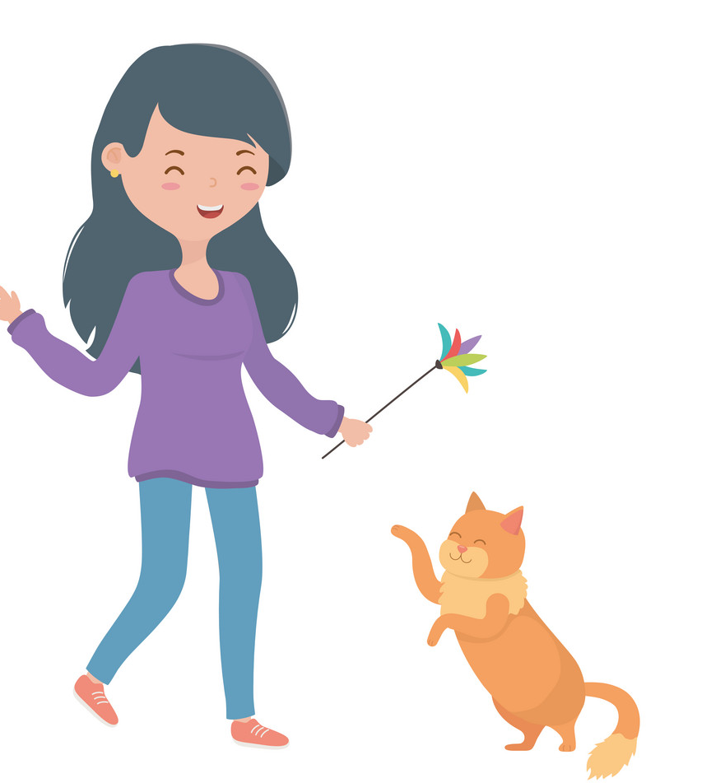
Choose the correct answer a,b or c.
A: What’s your favourite animal?
B: It’s _____.
a
b
c
cat
a cat
a dog

Slide 9

Choose the correct answer a,b or c.
A: What’s your favourite colour?
B: ___ red.
a
b
c
It
A
It’s

Slide 10
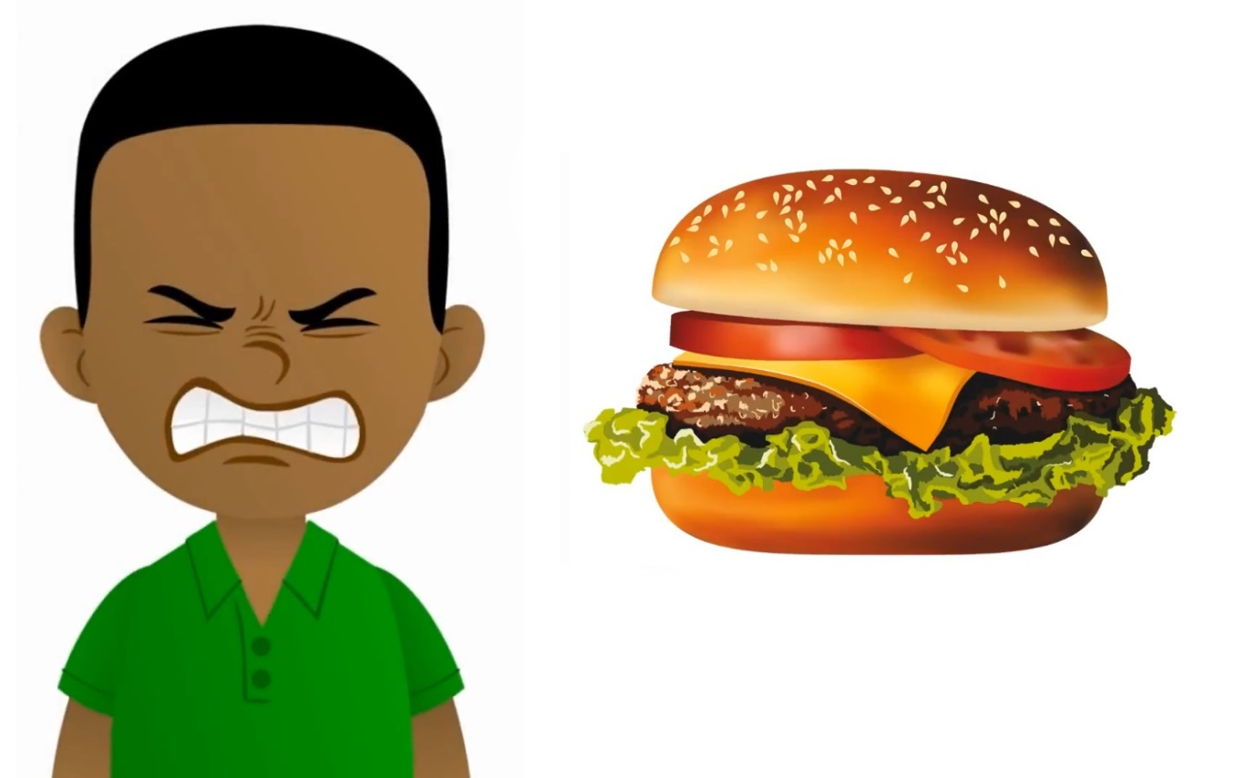
Choose the correct answer a,b or c.
A: My favourite food is hamburger.
Do you like hamburger, too?
B: No, I ____.
a
b
c
don’t
do
am

Slide 11

Summary
Notes:
GV nháy vào biểu tượng của đội chơi để tính điểm cho các đội. Mỗi lần nháy 1 ngôi sao xuất hiện.

Slide 12
02
Listen and repeat.

Slide 13

Listen and repeat.
'
I like dolphins.
dolphin
'

Slide 14
Listen and repeat.
'
'
tennis
He plays tennis on Sundays.

Slide 15
Listen and repeat.
'
'
dolphin
I like dolphins.
'
'
tennis
He plays tennis on Sundays.

Slide 16
03
Circle, listen and check.

Slide 17
Circle, listen and check.
1.
a. dolphin
b. giraffe
c. behind
2.
a. Japan
b. July
c. England
3.
a. tennis
b. hello
c. goodbye

Slide 18
Circle, listen and check.
1.
a. dolphin
b. giraffe
c. behind

Slide 19
Circle, listen and check.
2.
a. Japan
b. July
c. England

Slide 20
Circle, listen and check.
3.
a. tennis
b. hello
c. goodbye

Slide 21
Circle, listen and check.
1.
a. dolphin
b. giraffe
c. behind
2.
a. Japan
b. July
c. England
3.
a. tennis
b. hello
c. goodbye

Slide 22
04
Let’s chant.

Slide 23
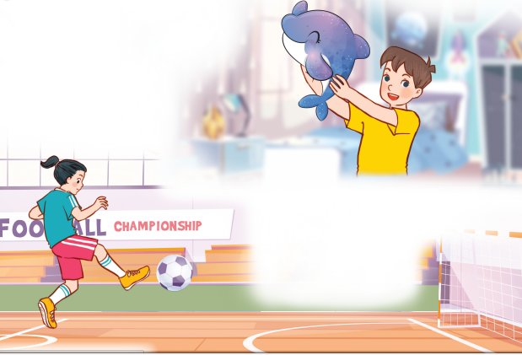
Let’s chant.
What’s your favourite animal?
Do you like pandas?
No, I don’t.
I don’t like pandas.
I like dolphins.
What’s your favourite sport?
Do you like tennis?
No, I don’t.
I don’t like tennis.
I like football.

Slide 24

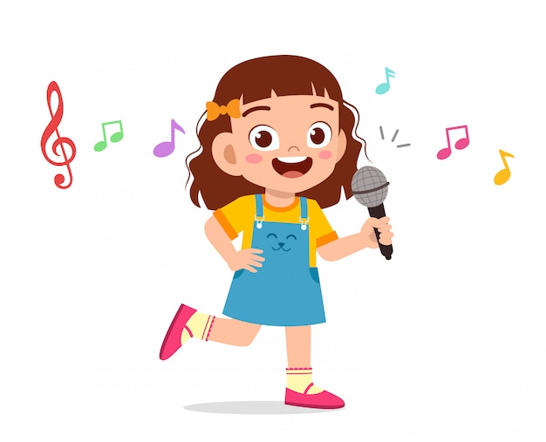
Let’s chant.
What’s your favourite animal?
Do you like pandas?
No, I don’t.
I don’t like pandas.
I like dolphins.
What’s your favourite sport?
Do you like tennis?
No, I don’t.
I don’t like tennis.
I like football.

Slide 25
05
Fun corner and wrap-up

Slide 26
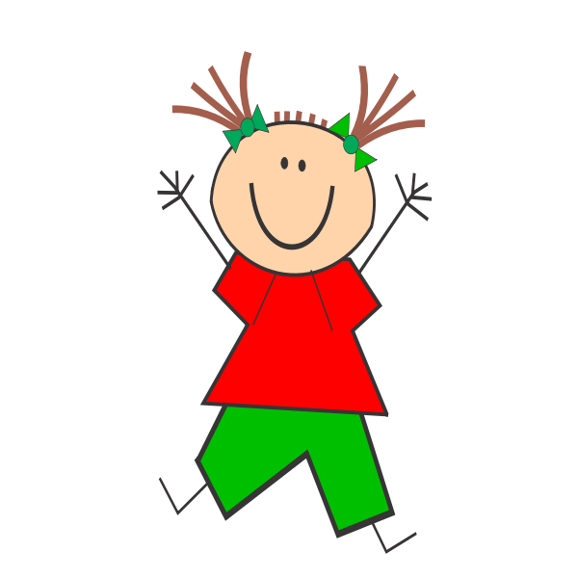
Jumping Games

Slide 27

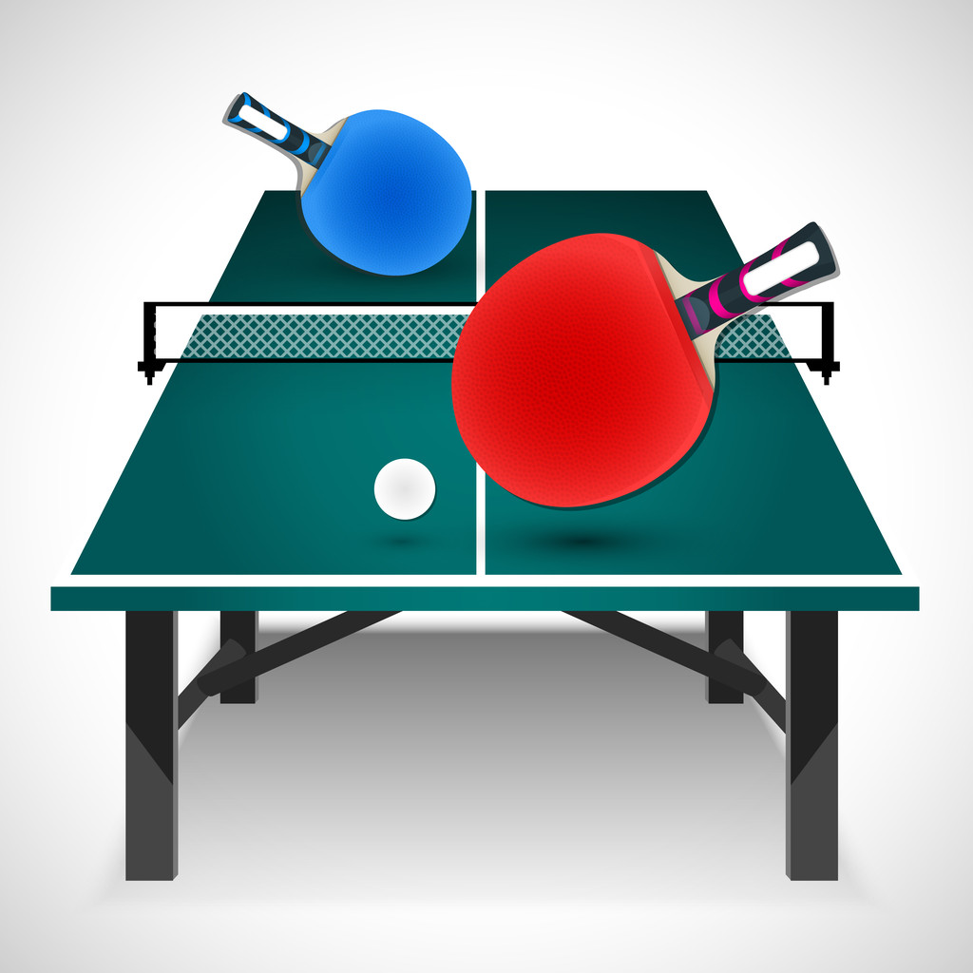
table tennis

Slide 28
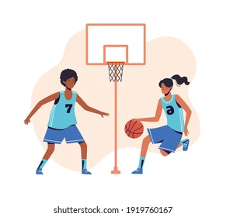
football

Slide 29

Japan

Slide 30
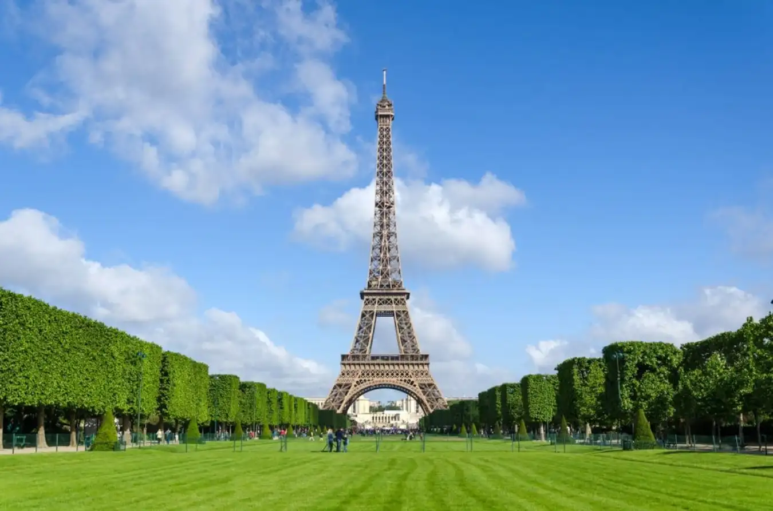
England

Slide 31
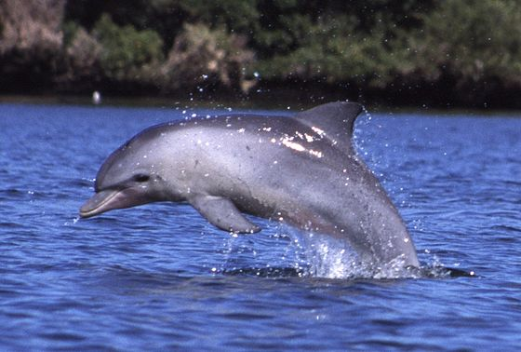
dolphin

Slide 32
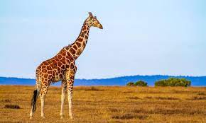
giraffe

