Slide 1

WARMLY WElcome to my class
TEACHER: ĐÀO THỊ LIỄU
QUOC TUAN PRIMARY SCHOOL

Slide 2



Slide 3



1
Hello
LESSON 2
Period 4

Slide 4
Contents
1
2
Listen and number.
Warm-up
Read and match.
3
4
Let’s play.
5
Fun corner and wrap-up

Slide 5
1
Warm-up
Game

Slide 6






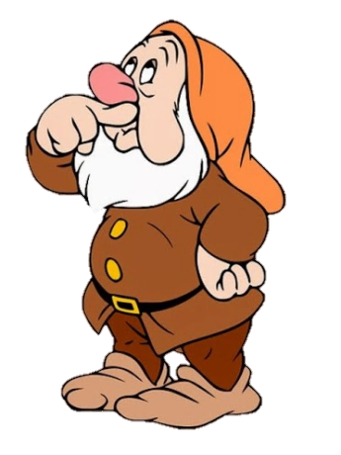

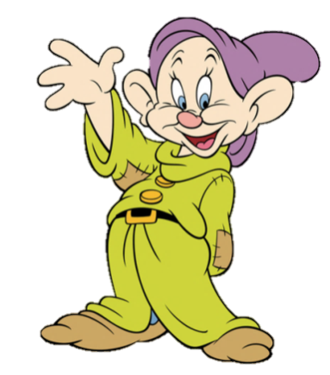



Numbers
Notes:
Divide the class into 4 groups. Invite pupils to go to the monitor and touch to choose the numbers. Pupils will get points for their teams if the answers are correct.
Give points to the groups and encourage them.

Slide 7
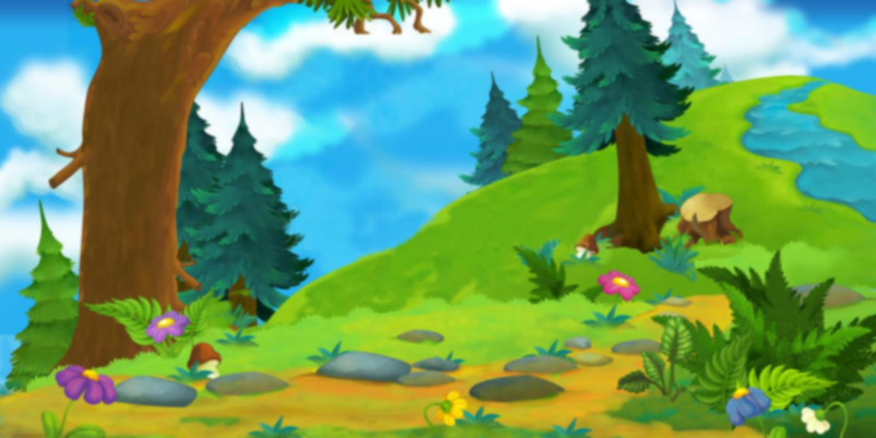







seven
A. 17
B. 10
C. 9
D. 7
That’s correct.

Slide 8

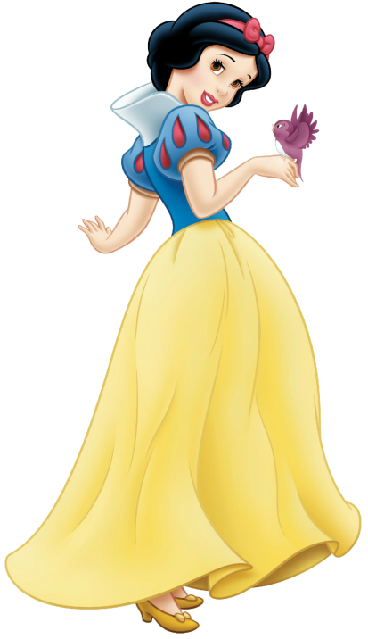

ten
A. 8
B. 10
C. 5
D. 1
That’s correct.

Slide 9

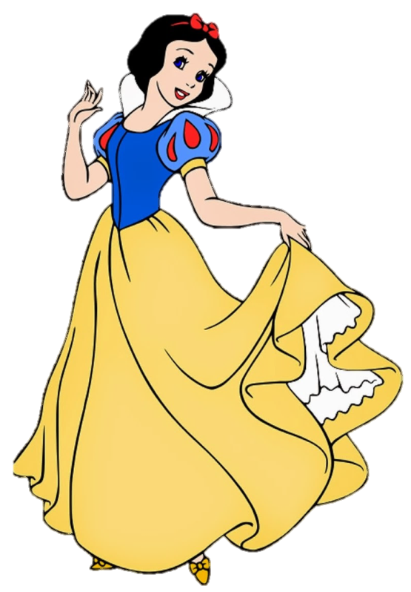
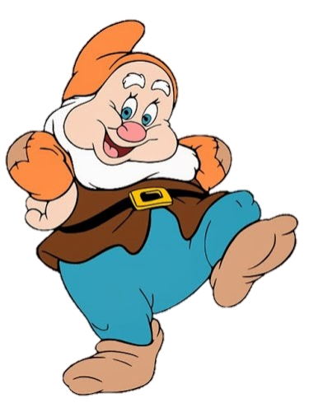
eight
A. 8
B. 2
C. 3
D. 10
That’s correct.

Slide 10
2
Listen and number.

Slide 11


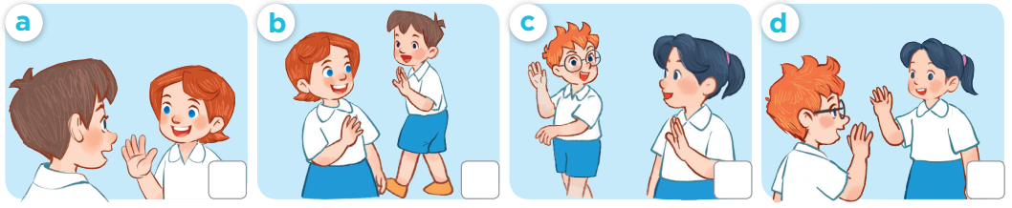
3
4
2
1

Slide 12
3
Read and match.

Slide 13
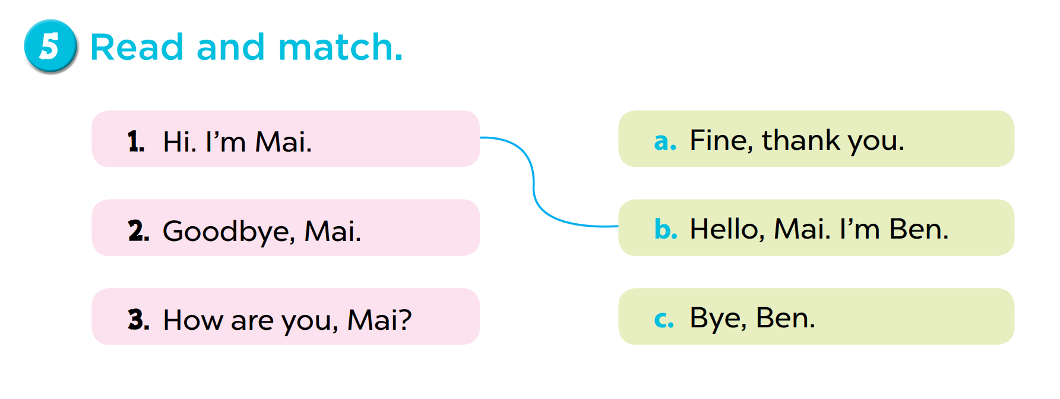

Slide 14

Game: Pass the ball!
Notes:
Step 1: Give 2 balls for pupils.
Step 2: Turn on the music and have students pass the ball. Then stop the music. Have students stop to pass the ball. The pupils who have the ball must stand up and practise speaking with their friends.
Step 3: Give point to pupils.
Step 4: Encourage pupils to practise speaking English.

Slide 15
4
Let’s play!

Slide 16
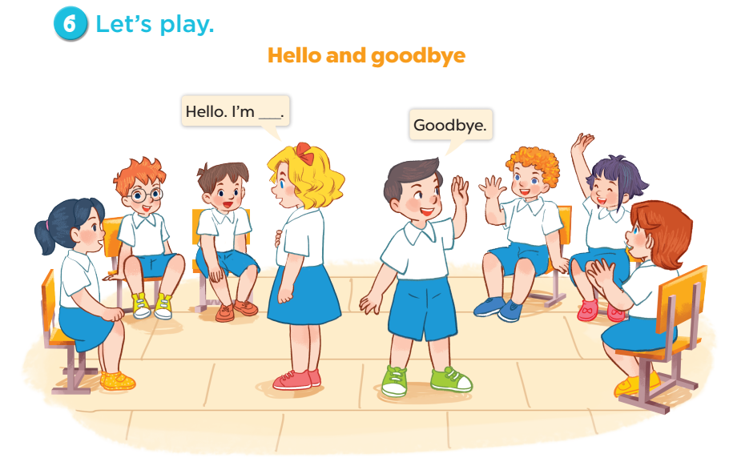

Slide 17
Fun corner and wrap-up
5

Slide 18


Find a partner
Boys
Girls
Notes:
Step 1: Divide the class into 2 teams: boys and girls. Prepare the name tags.
Step 2: Set the rules: Make a circle, then ask 1 pupil to come stand in the circle and choose a name tag.
The one whose name is called will come to the circle and practise speaking by saying Hi, I’m ___.
Step 3: Encourage students to join the game.

Slide 19
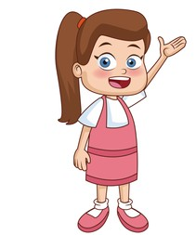


Slide 20


