Slide 1

WARMLY WElcome to my class
TEACHER: ĐÀO THỊ LIỄU
QUOC TUAN PRIMARY SCHOOL

Slide 3
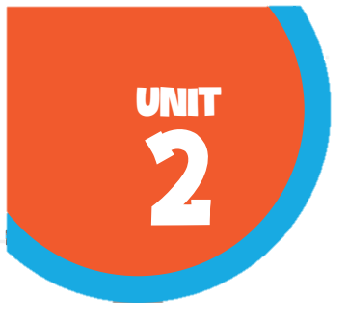








Our home
Lesson 1 - Period 1

Slide 4

Table of contents
01
02
03
Look, listen and repeat.
Listen, point and say.
Warm-up and review
04
05
Let's talk.
Fun corner and wrap-up

Slide 5

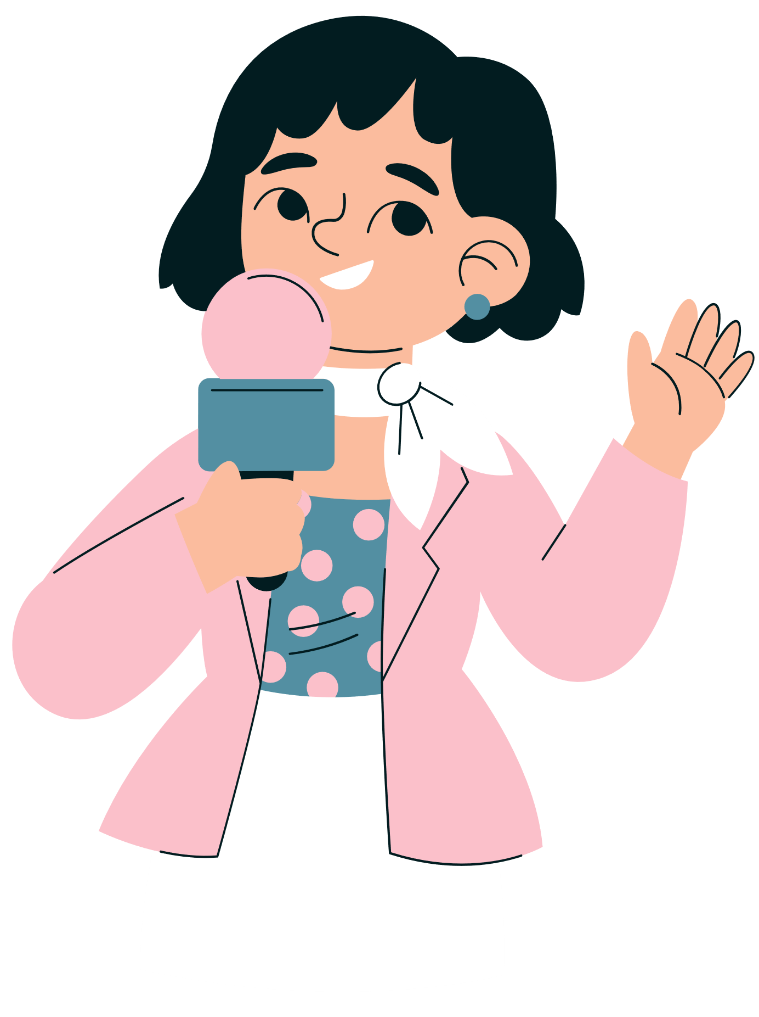

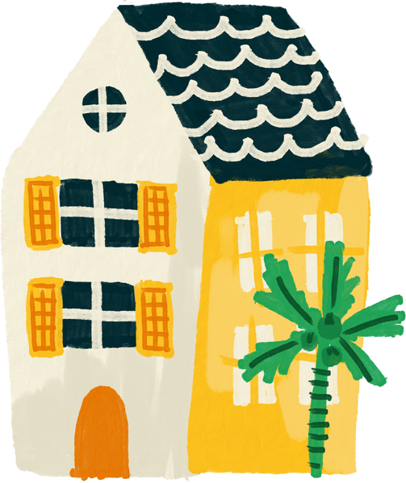
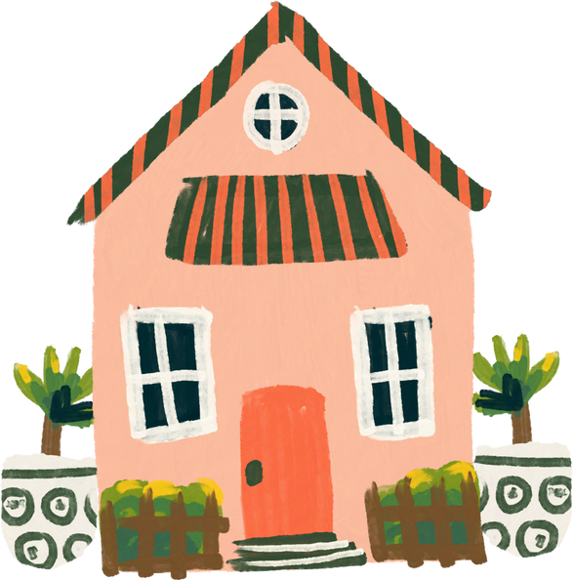
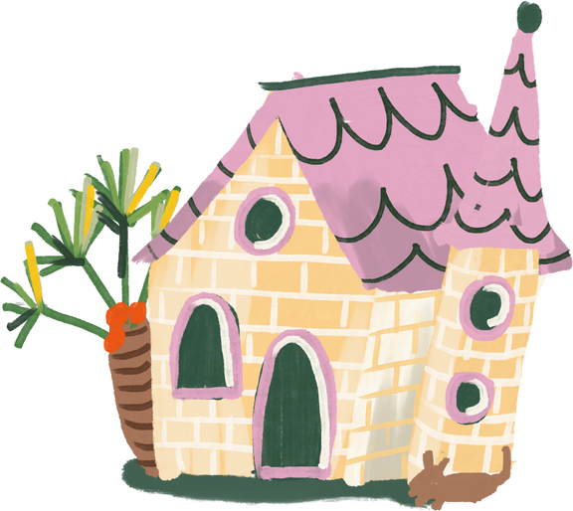
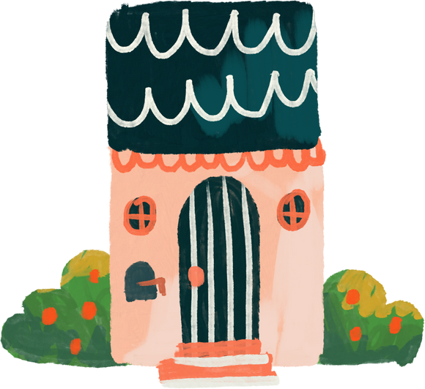
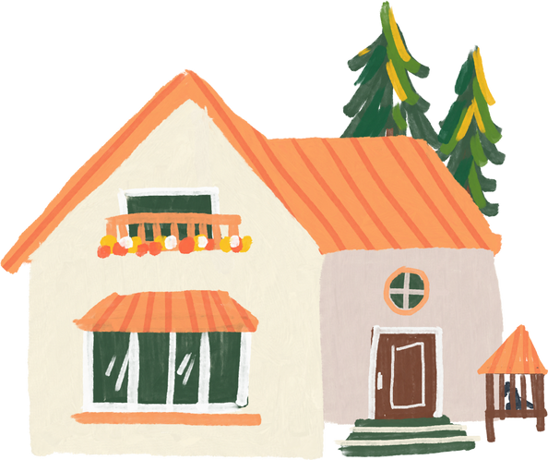
01
Warm-up and review

Slide 6



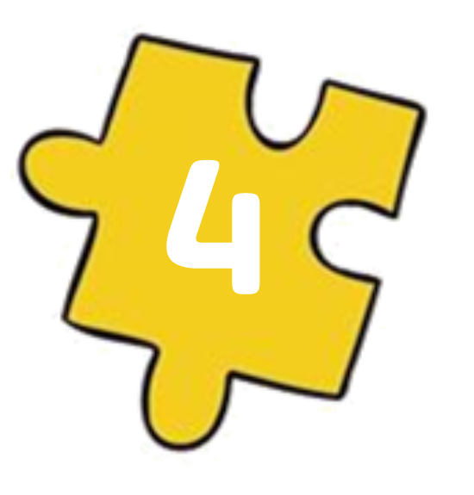
Guess the key word
Collect the letters.
E
O
HOME
M
H
Next Activity

Slide 7
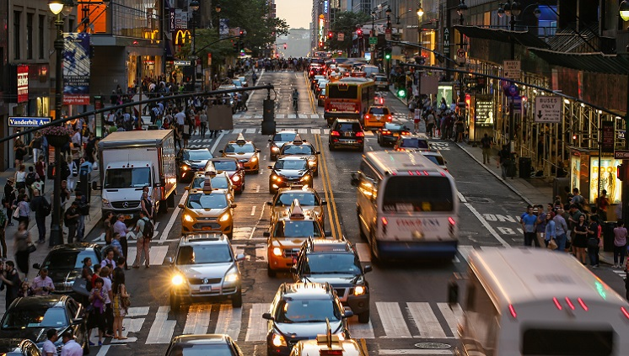
It's a busy .
st_ _e_
street

Slide 8
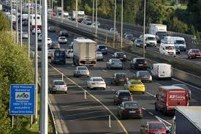
It's a noisy .
r_ _ _
road

Slide 9
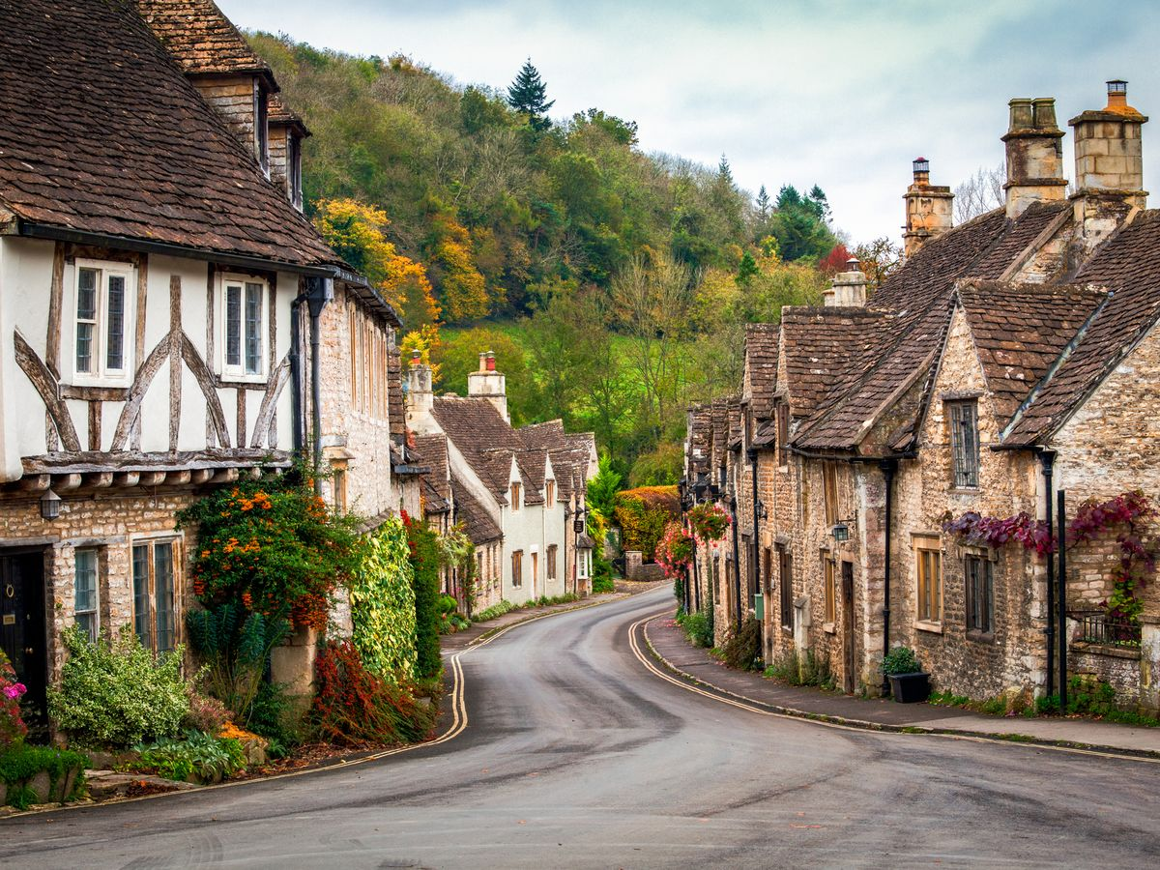
It's a quiet .
village
v_l_ag_

Slide 10

It's a big ..
c_ _y
city

Slide 11
02
Look, listen and repeat.

Slide 12
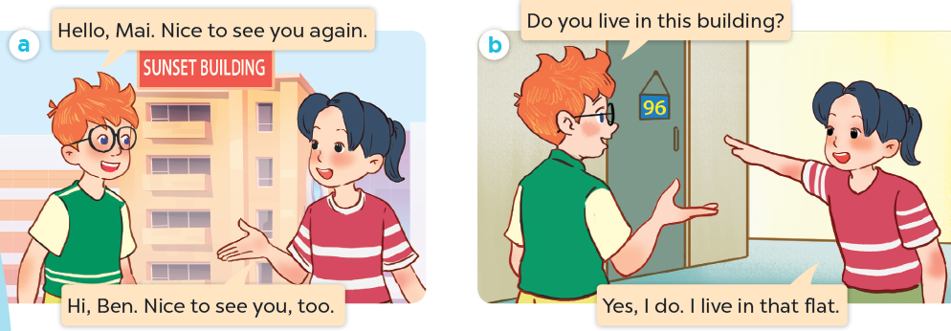
What are they talking about?
Where are they?
Who are they?

Slide 13

Look, listen and repeat.

Slide 14
Look, listen and repeat.

Slide 15
Look, listen and repeat.

Slide 16
03
Listen, point and say.

Slide 17
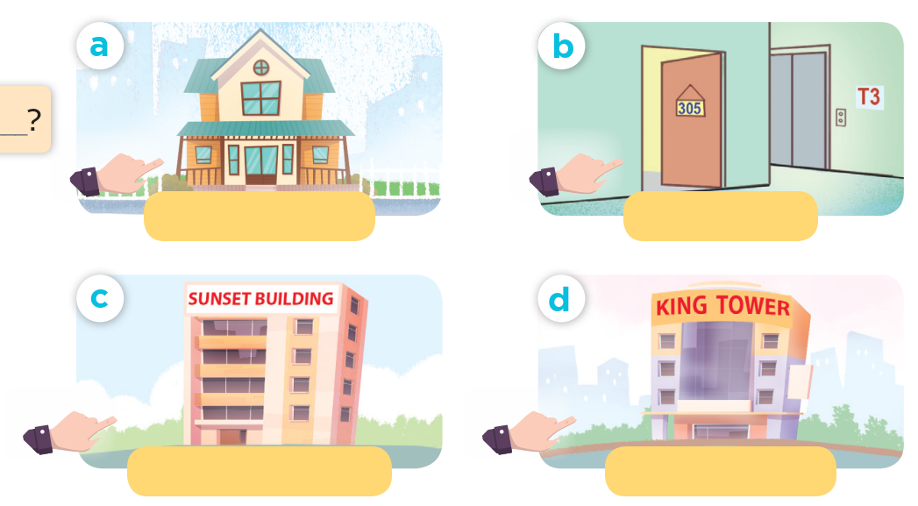
Look and say.

Slide 18
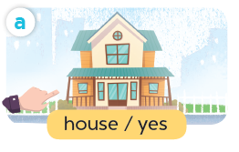
Listen, point and say.
house / yes

Slide 19
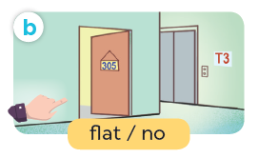
Listen, point and say.
flat / no

Slide 20
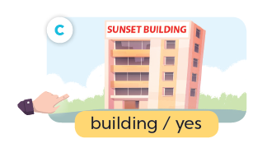
Listen, point and say.
building / yes

Slide 21
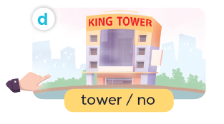
Listen, point and say.
tower / no

Slide 22
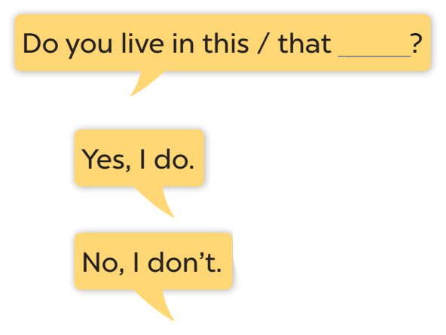




Slide 23
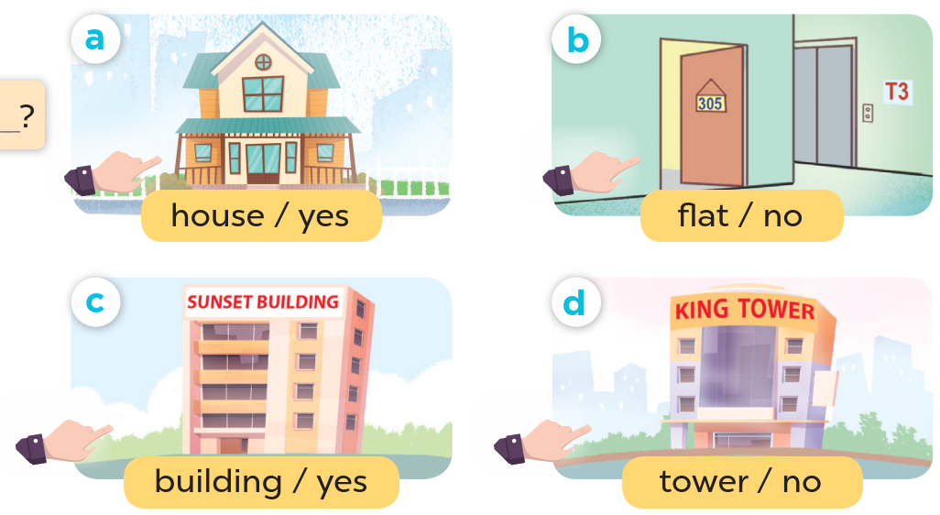
Look at the hands.

Slide 24
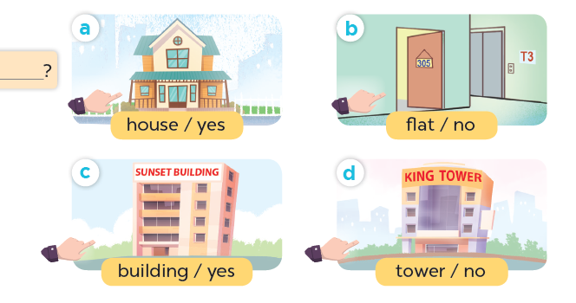
Listen, point and say.
Do you live in this house?
Yes, I do.
house / yes

Slide 25
Listen, point and say.
Do you live in this flat?
No, I don't.
flat / no

Slide 26
Listen, point and say.
Do you live in that building?
Yes, I do.
building / yes

Slide 27
Listen, point and say.
Do you live in that tower?
No, I don't.
tower / no

Slide 28
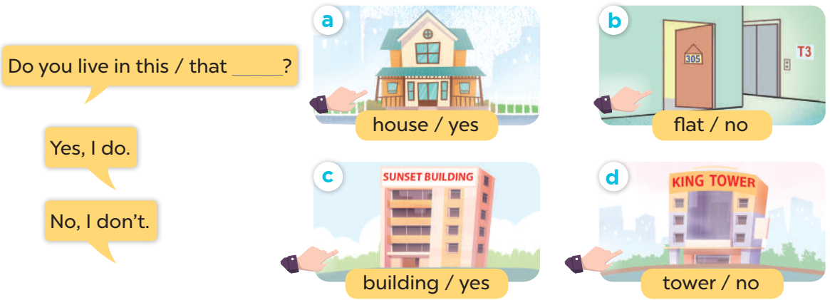
Work in pairs. Ask and answer.

Slide 29
04
Let's talk.

Slide 30
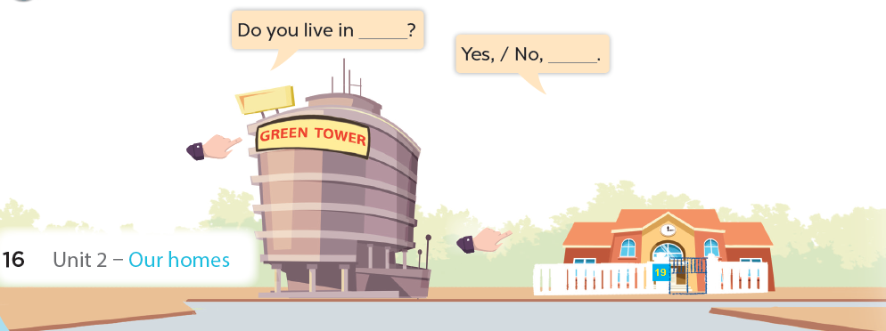

Slide 31
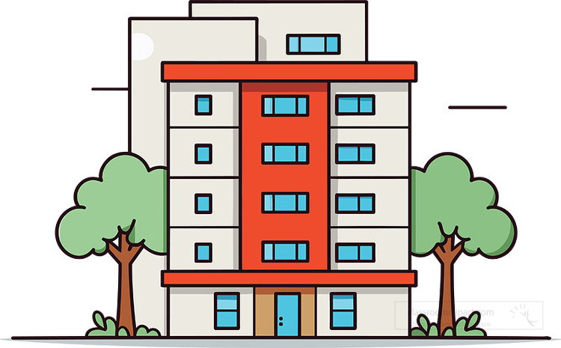


Do you live in that building?
No, I don't.

Slide 32

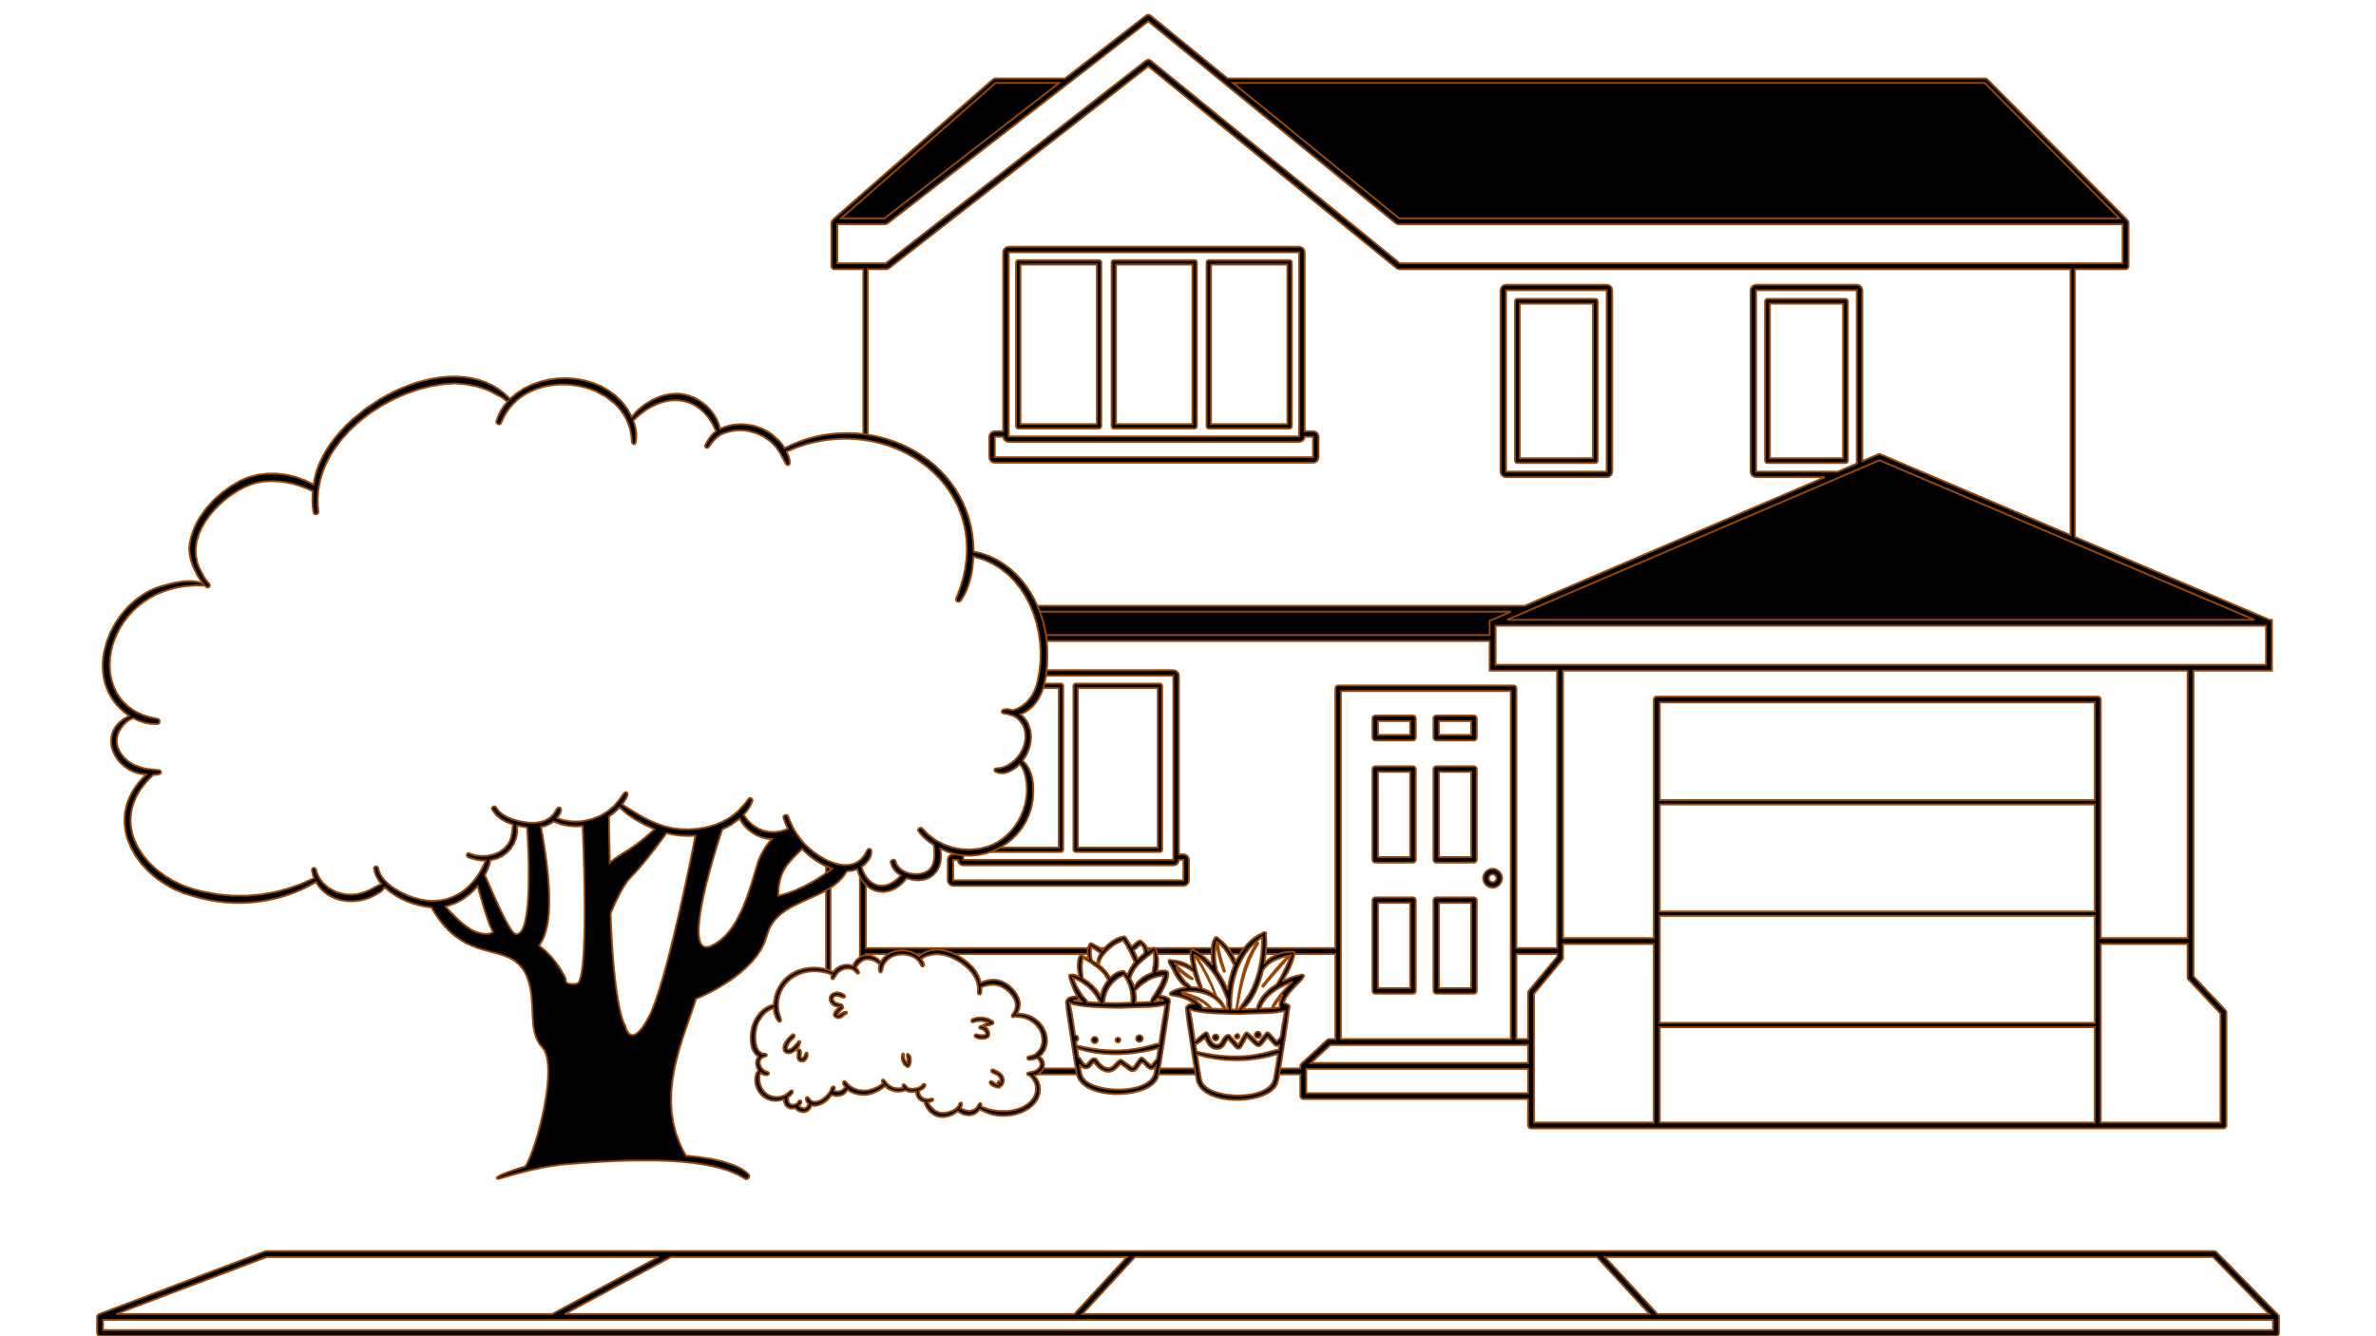
Do you live in this house?
Yes, I do.

Slide 33
05
Fun corner and wrap-up
Lucky letter

Slide 34

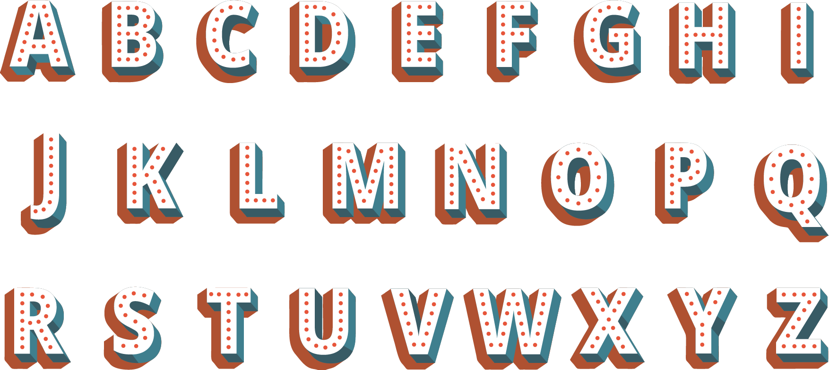
1
2
1
1
3
1
1
2

Slide 35
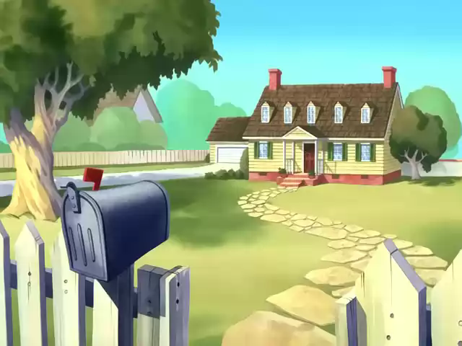

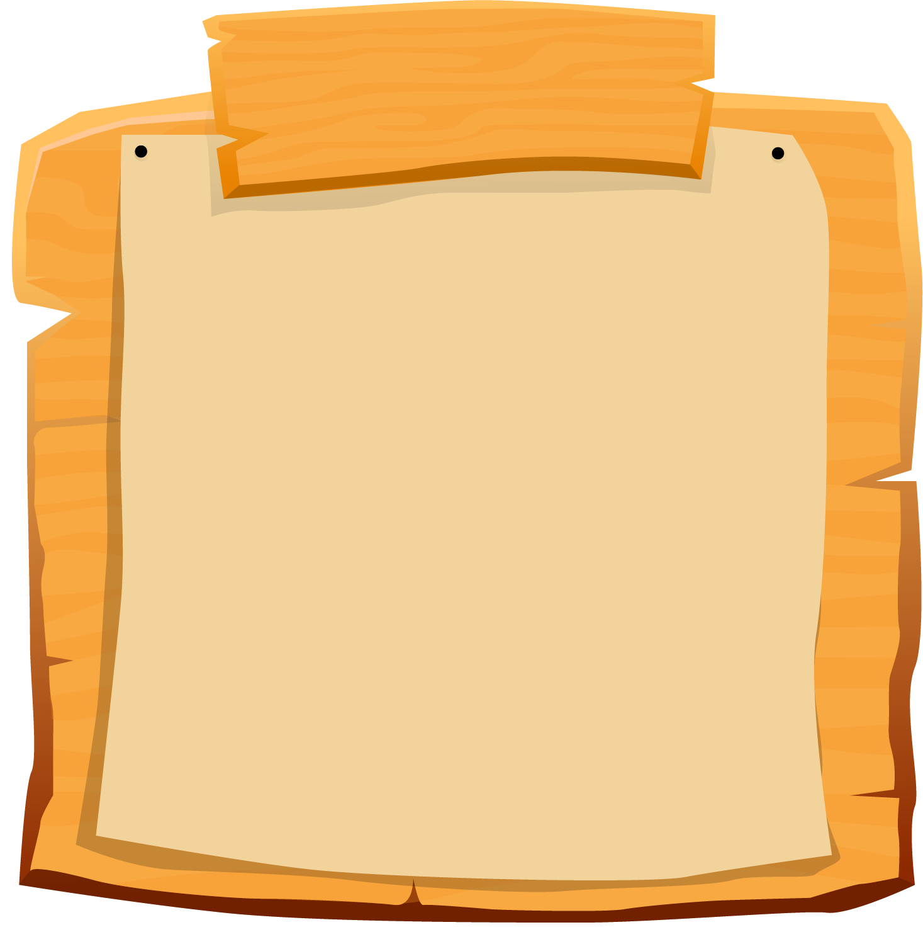

SCOREBOARD
Boys
Girls
0
1
2
3
4
5
6
7
8
9
0
1
2
3
4
5
6
7
8
9
Questions
Notes:
- Teacher clicks on each team's score board to add up on the score.
- Teacher click on the Questions sign to get back to the questions slide

Slide 36
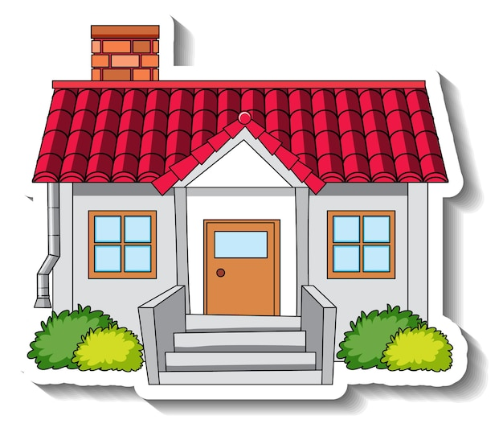
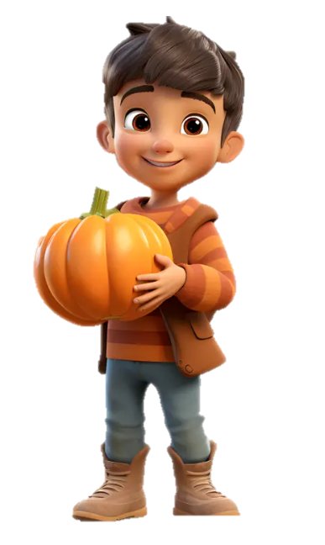

Do you live in this house?
Yes, I do.

Slide 37



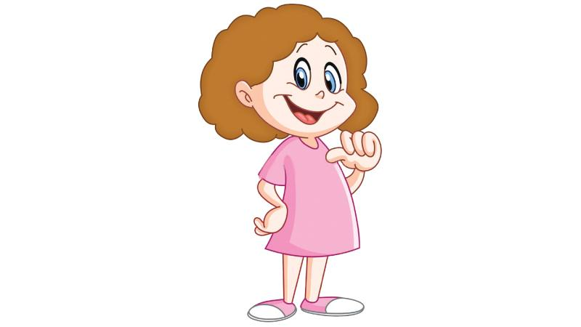
Do you live in that house?
Yes, I do.

Slide 38
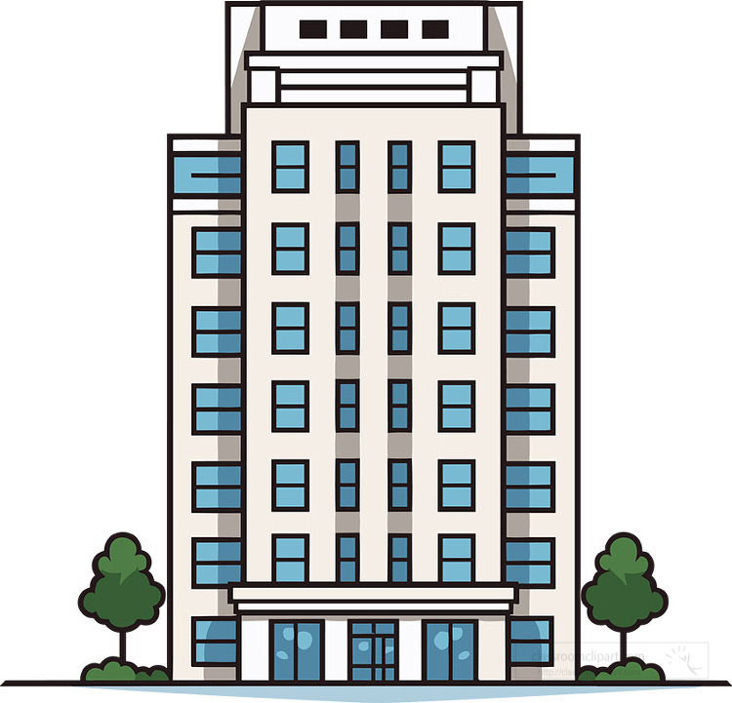
Moon Building
Do you live in this building?
No, I don't.

Slide 39
Moon Building
Do you live in that building?
No, I don't.

Slide 40

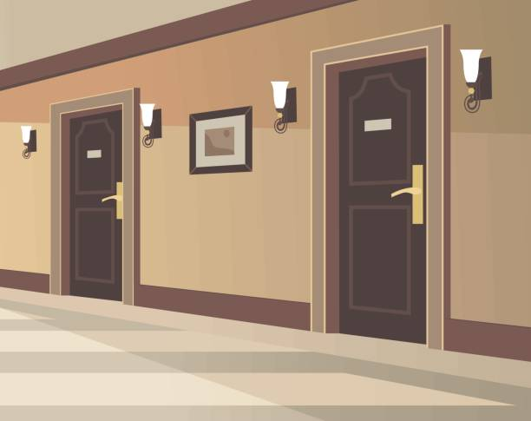

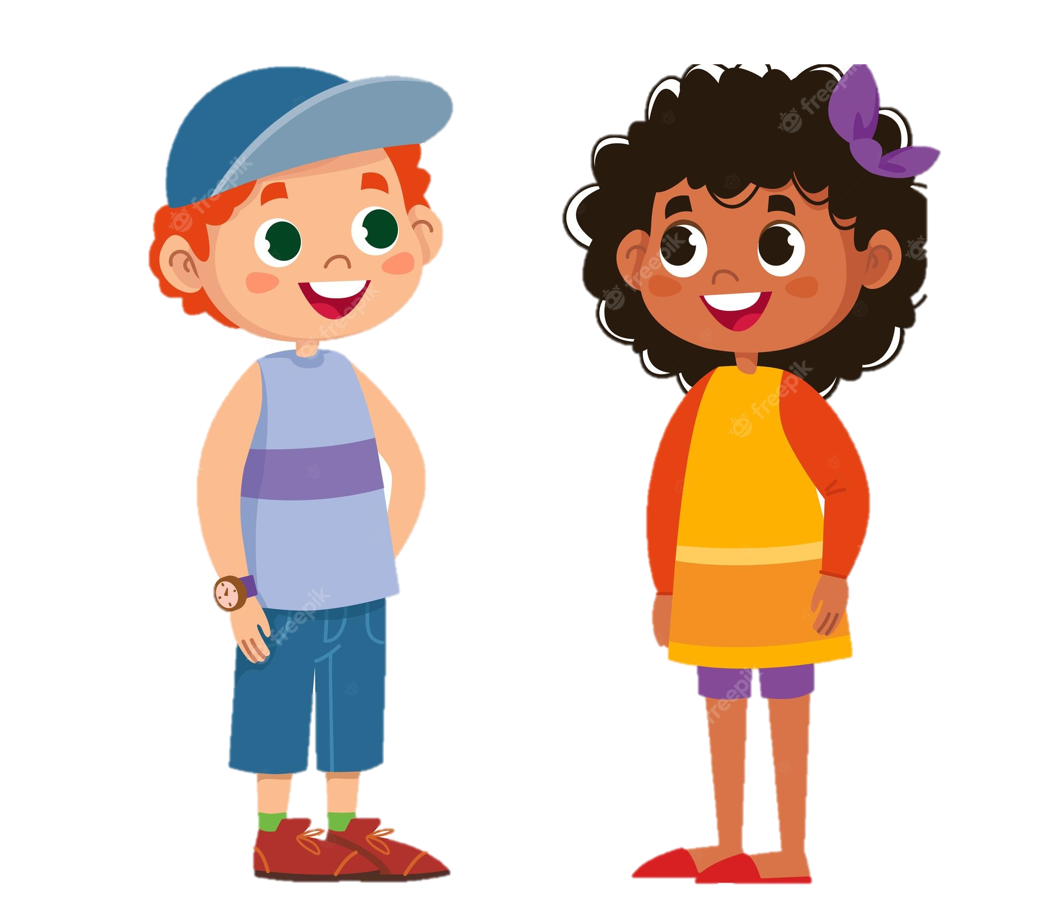
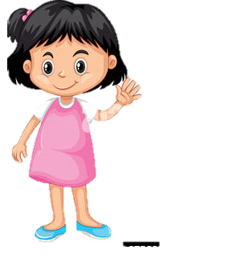
Do you live in this flat?
No, I don't.

Slide 41

Do you live in that flat?
Yes, I do.

Slide 42

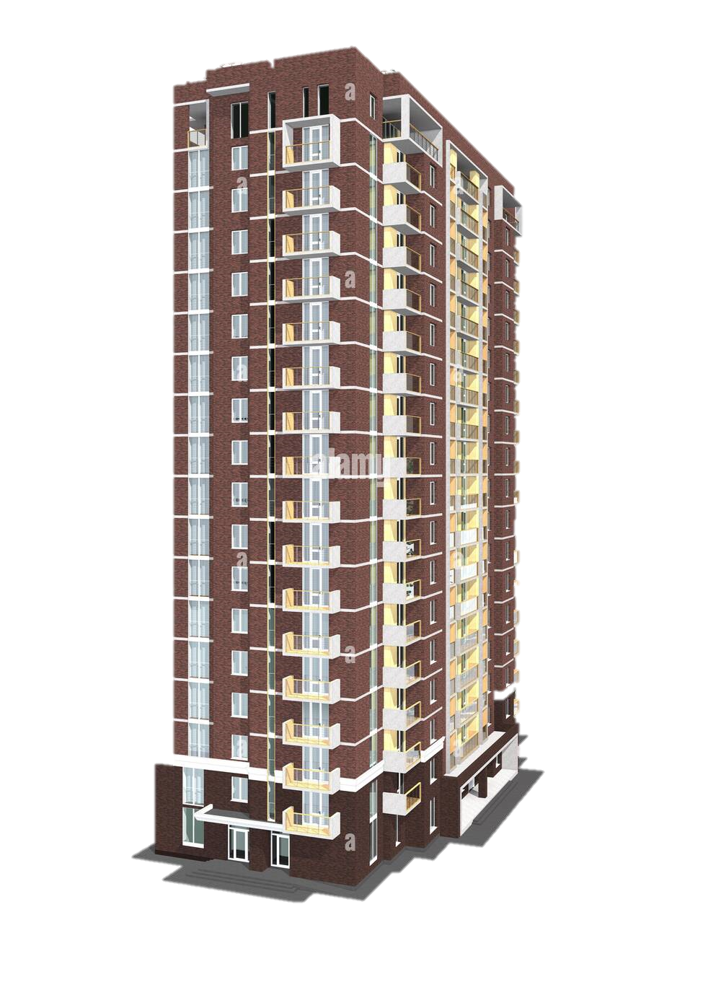
Do you live in this tower?
Yes, I do.
Queen Tower

Slide 43


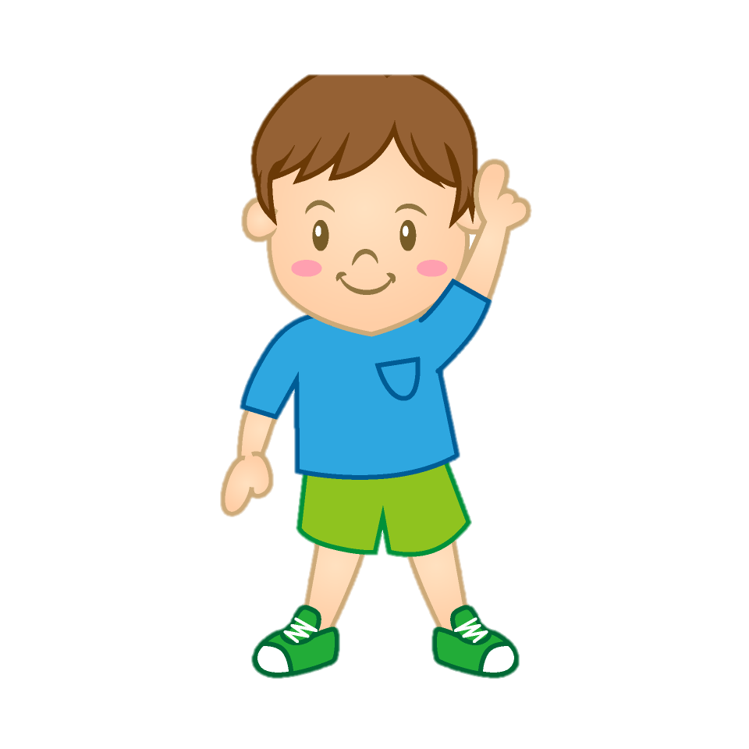
Prince Tower
Do you live in that tower?
No, I don't.

