Slide 1

WARMLY WElcome to my class
TEACHER: ĐÀO THỊ LIỄU
QUOC TUAN PRIMARY SCHOOL

Slide 3









Our home
Lesson 1 - Period 2

Slide 4

Table of contents
01
02
03
Listen and number.
Read and complete.
Warm-up and review
04
05
Let's play.
Fun corner and wrap-up

Slide 5






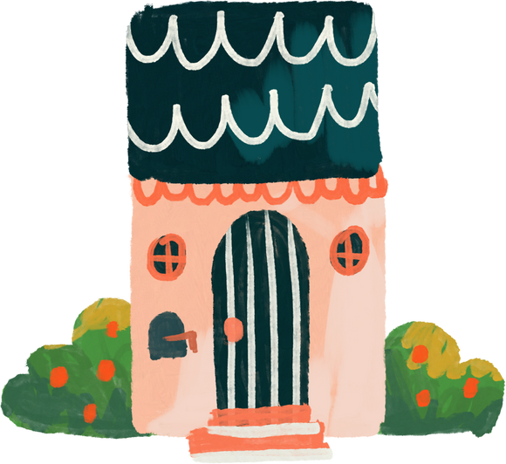
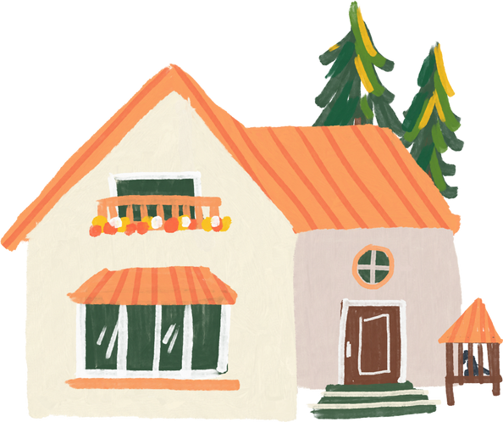
01
Warm-up and review

Slide 6
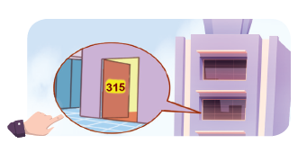
What's the missing letter?
FL__T
A
A
O
I
A
B
C

Slide 7
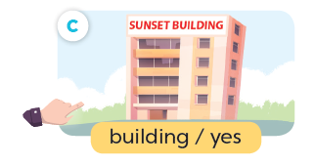
What's the missing letter?
BU__LDING
I
Y
E
I
A
B
C

Slide 8

What's the missing letter?
TO__ER
W
R
W
U
A
B
C

Slide 9

What's the missing letter?
HO__SE
U
U
O
W
A
B
C

Slide 10
Do you live in _____ tower?
that
that
this
A
B

Slide 11
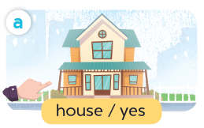
Do you live in _____ house?
this
that
this
A
B

Slide 12



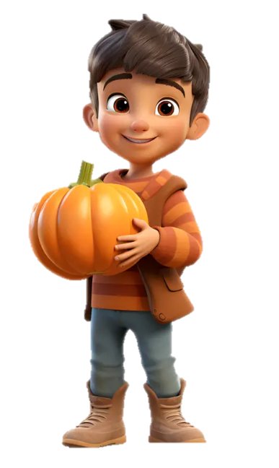
Do you live in this house?
___, I do.
Yes
Yes
No
A
B

Slide 13
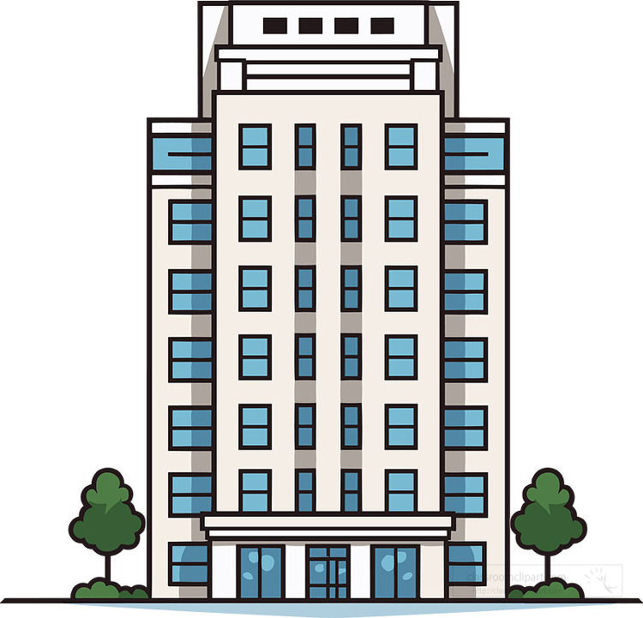



Do you live in that building?
Yes
No
___, I don’t.
No
A
B

Slide 14
02
Listen and number.

Slide 15
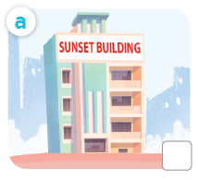
What is it?
building

Slide 16
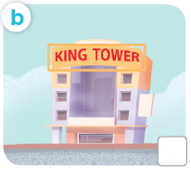
What is it?
tower

Slide 17
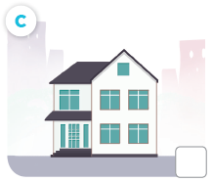
What is it?
house

Slide 18
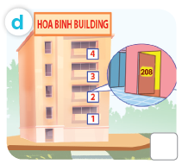
What is it?
flat

Slide 19

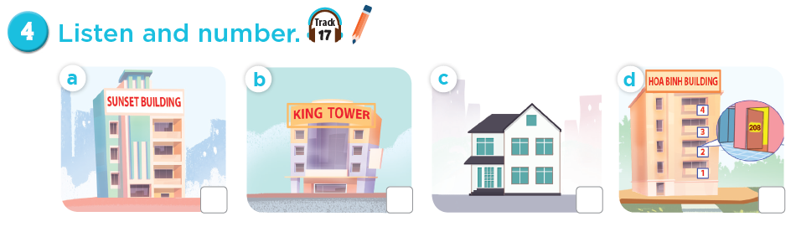
Listen and number.
4
3
1
2

Slide 20
03
Read and complete.

Slide 21


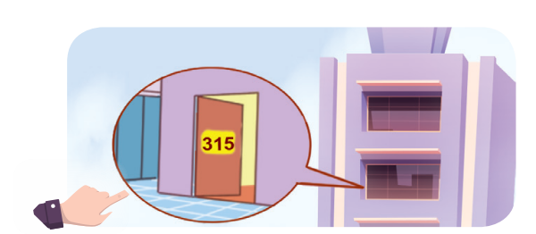


Slide 22

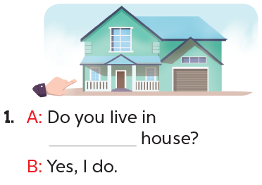
this

Slide 23
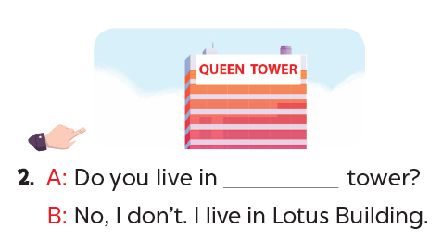
that

Slide 24
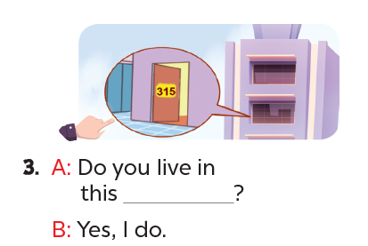
flat

Slide 25
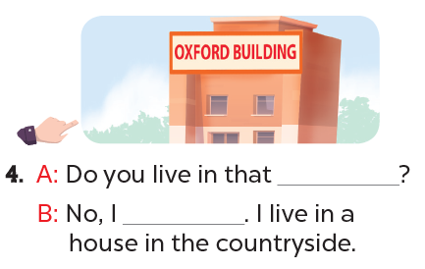
building
don’t

Slide 26
04
Let's play.

Slide 27
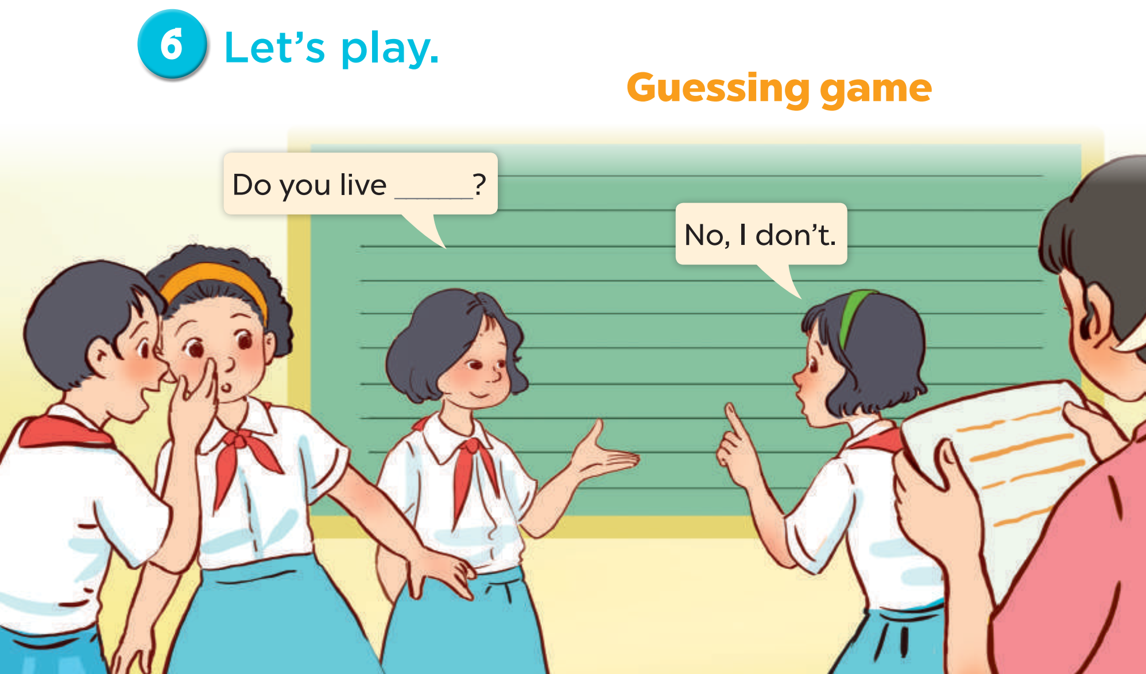
Notes:
Follow instructions in the lesson plan.

Slide 28
05
Fun corner and wrap-up

Slide 29

Zootopia

Slide 30




Explore Zootopia and catch the criminals!

Slide 31


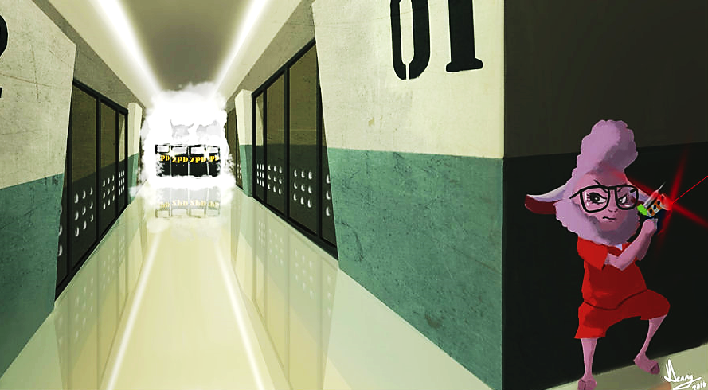

WANTED
B
e
l
l
w
e
t
h
e
r
s
n
E
p
r
i
s
c
a
e
d
p
o
By the ZPD

Slide 32

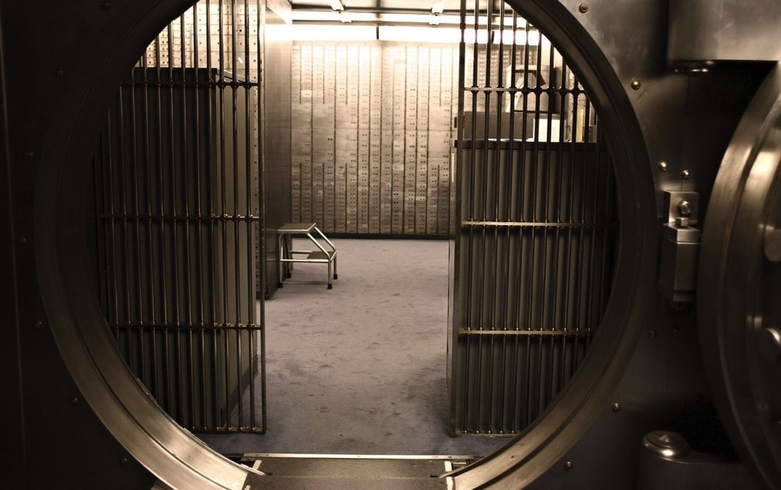



WANTED
F
i
n
n
i
c
k
o
b
a
a
R
b
e
d
b
n
k
By the ZPD

Slide 33

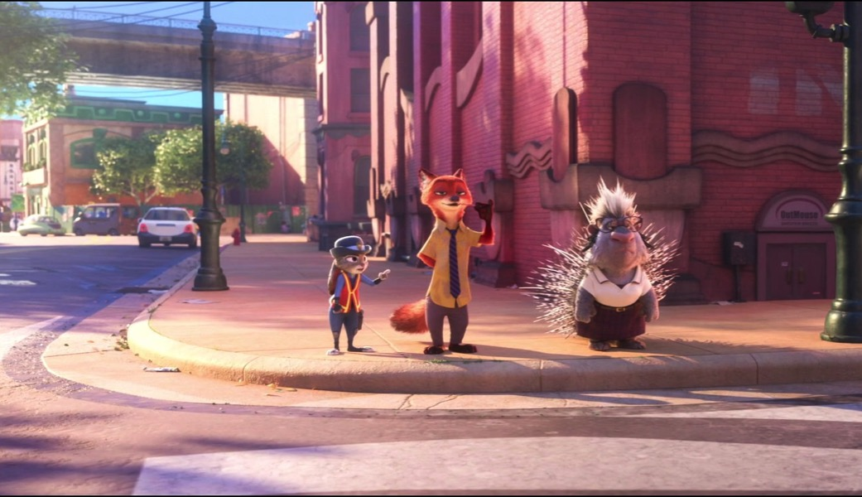
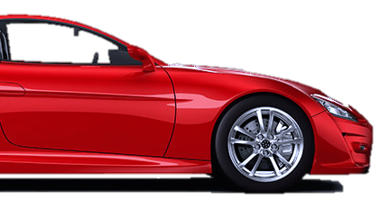

WANTED
F
l
a
s
h
l
t
o
e
r
S
a
c
a
By the ZPD

Slide 34




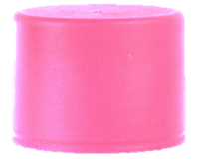


Minus points
+1
+5
Swap points
Steal

Slide 35





Let’s go!

Slide 36
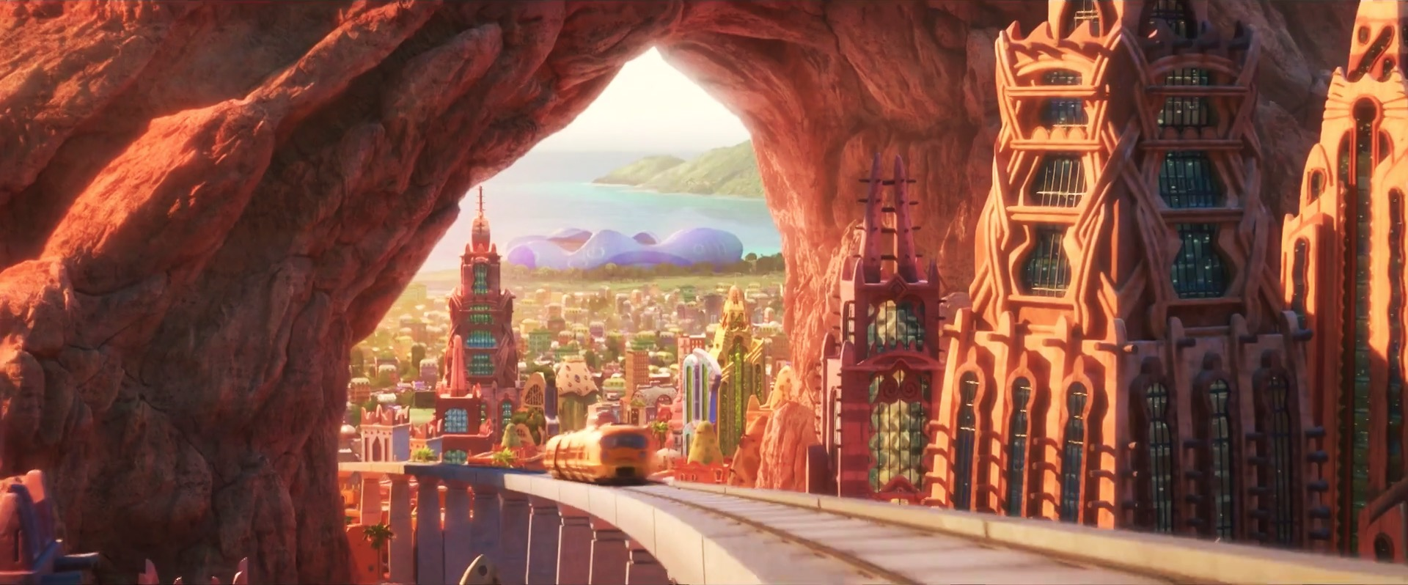


2
4
1
3
5
7
6
8
Notes:
CLICK THE ARROW IN THE BOTTOM RIGHT CORNER TO GO TO THE ENDING SLIDE

Slide 37




Do you live in this tower?
Queen Tower
No, I don’t.

Slide 38



+3
+3
Notes:
Click Judy to go to the home page

Slide 39
live / Do / this / you / builing / in / ?
Do you live in this building?

Slide 40

Choose!
Choose!
Left
Right

Slide 41

Rock paper scissors ...
Rock paper scissors...
Winner steal
Winner steal
2
2
Notes:
Click Judy to go to the home page

Slide 42
Trade
Swap points
Notes:
Click Judy to go to the home page

Slide 43


Queen Building
Yes, I do.
Do you live in this building?

Slide 44

+2
+2
Notes:
Click Judy to go to the home page

Slide 45
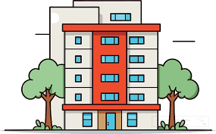
I live in that ____.
house
flat
building

Slide 46

+4
+1
Notes:
Click Judy to go to the home page

Slide 47
Do you live in that ________?
house

Slide 48
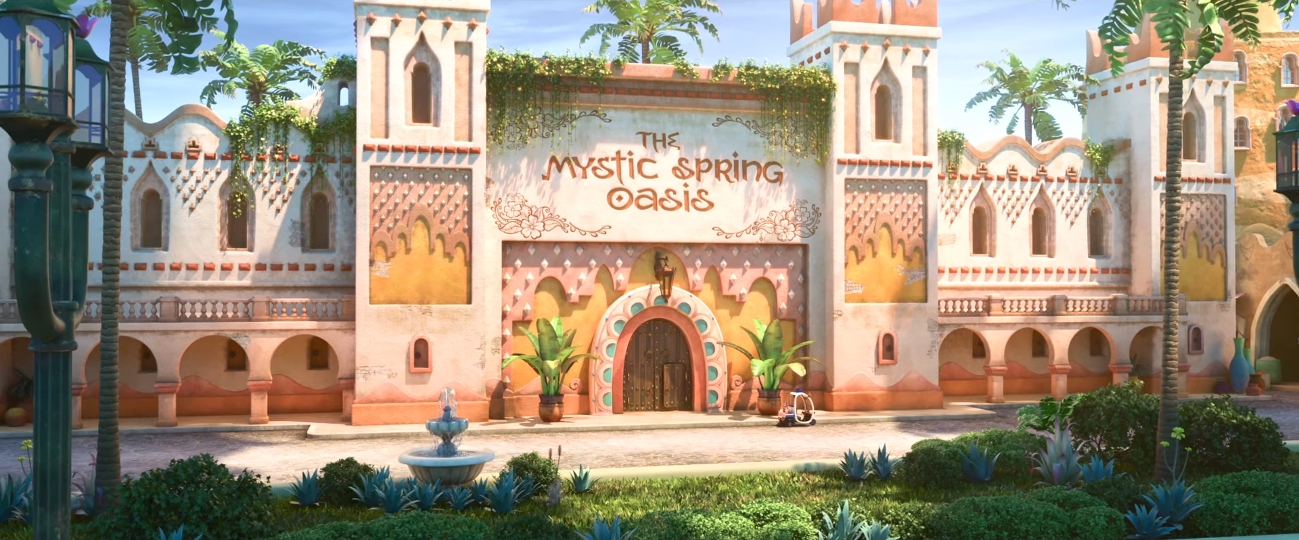
Go inside?
Go inside?
Yes
No

Slide 49
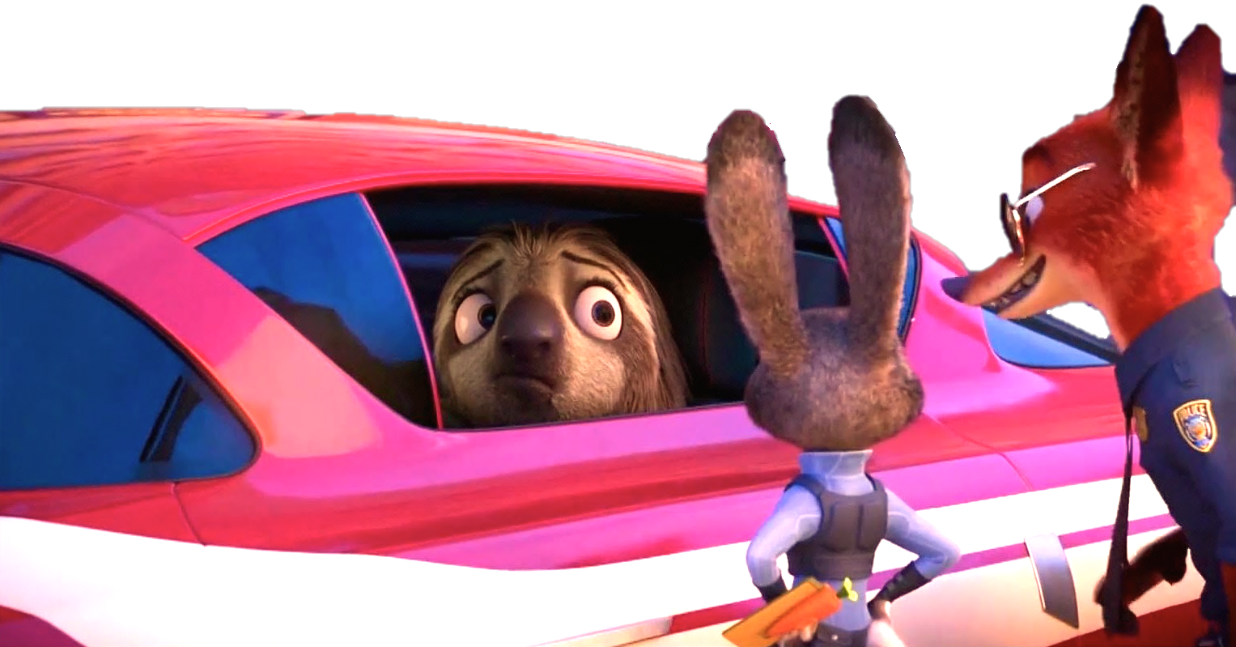
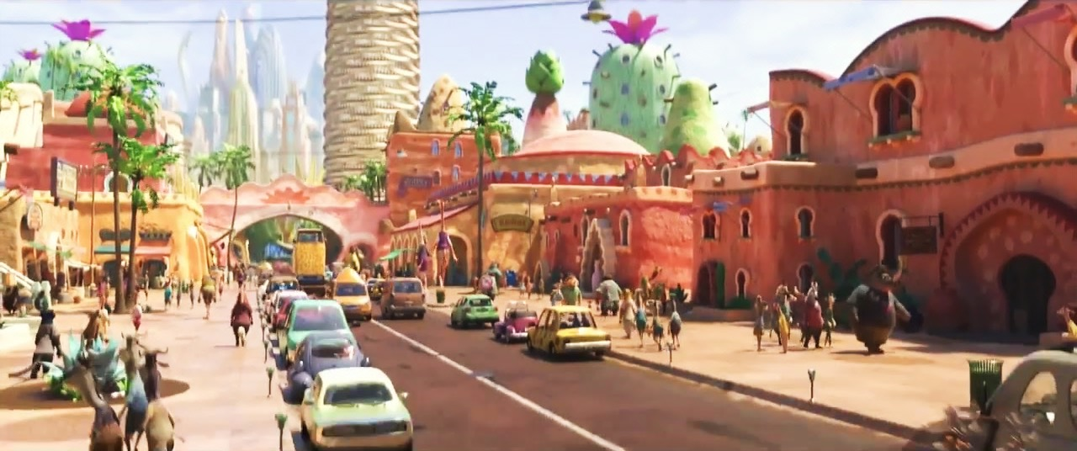
It’s Flash!
It’s
Flash!

Slide 50




WANTED
+10
+15
By the ZPD
Flash
Notes:
Click Nick & Judy to go to the home page

Slide 51



Do you live in this flat?
No, I don’t.

Slide 52

+5
+5
Notes:
Click Judy to go to the home page

Slide 53
Yes, I do.
Do you live in that flat?

Slide 54
+6
Steal 4
Notes:
Click Judy to go to the home page

Slide 55

Complete:
you / live / this / tower?
Do you live in this tower?

Slide 56



Choose!
Choose!

Slide 57





-5
-3
Notes:
Click Judy to go to the home page

Slide 58
+10
+10
Notes:
Click Judy to go to the home page

Slide 59

-5
-5
Notes:
Click Nick to go to the home page

Slide 60
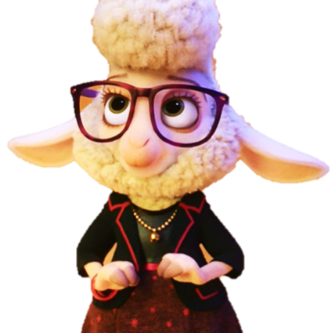





WANTED
WANTED
WANTED
WANTED
WANTED
By the ZPD
WANTED
By the ZPD
By the ZPD
By the ZPD
By the ZPD
By the ZPD
Bellwether
Bellwether
Flash
Flash
Finnick
Finnick

Slide 61

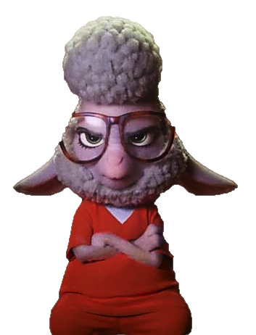







Good job!
Bellwether
Flash
Finnick

