Slide 1

WARMLY WElcome to my class
TEACHER: ĐÀO THỊ LIỄU
QUOC TUAN PRIMARY SCHOOL

Slide 3









Our Home
Lesson 2 - Period 4

Slide 4

Table of contents
01
02
03
Listen and circle.
Read and complete.
Warm-up and review
04
05
Listen, complete and sing.
Fun corner and wrap-up

Slide 5



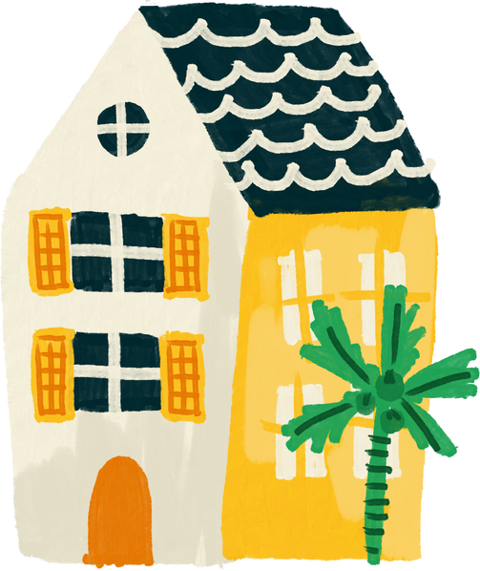


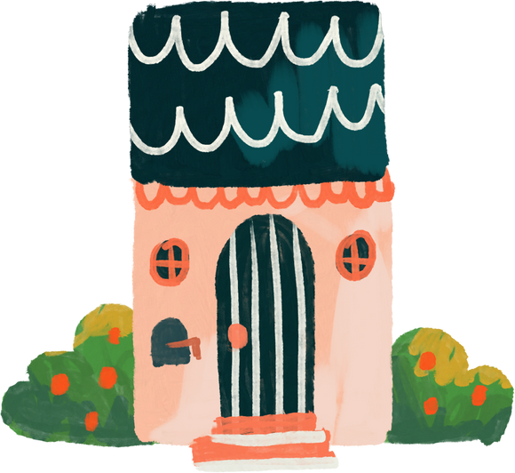
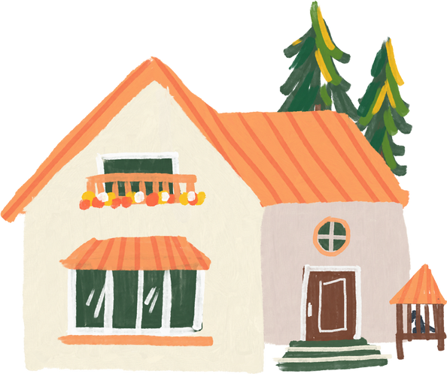
01
Warm-up and review

Slide 6


55
49
45

Slide 7
17
79
97

Slide 8
135
153
159

Slide 9
19
98
89

Slide 10
376
267
276

Slide 11
77
17
70

Slide 12
55
59
45

Slide 13
02
Listen and circle.

Slide 14
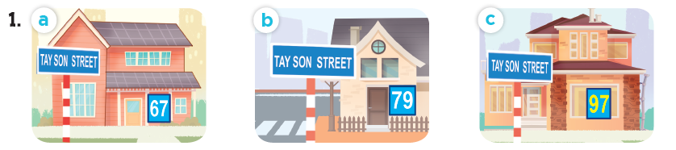
Look and say the number.
sixty-seven
seventy-nine
ninety-seven

Slide 15
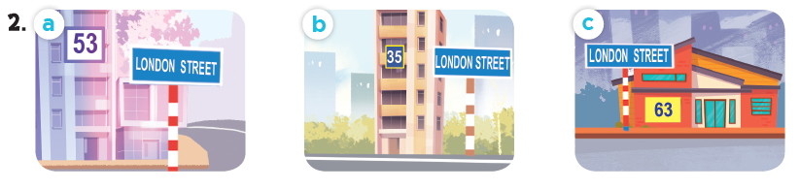
Look and say the number.
fifty-three
thirty-five
sixty-three

Slide 16
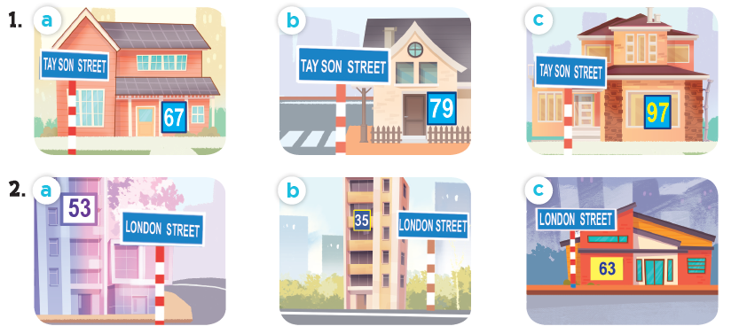
Listen and circle.

Slide 17
03
Read and complete.

Slide 18
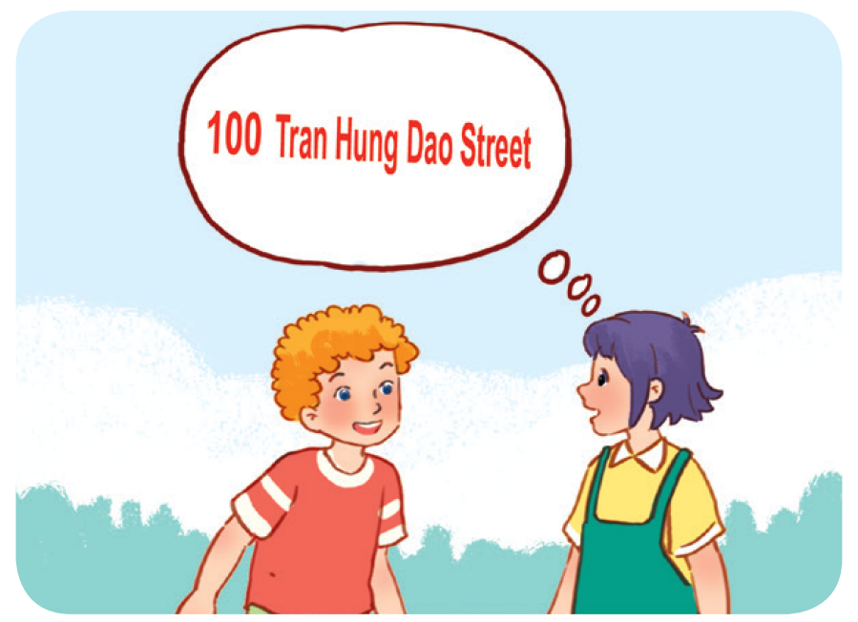
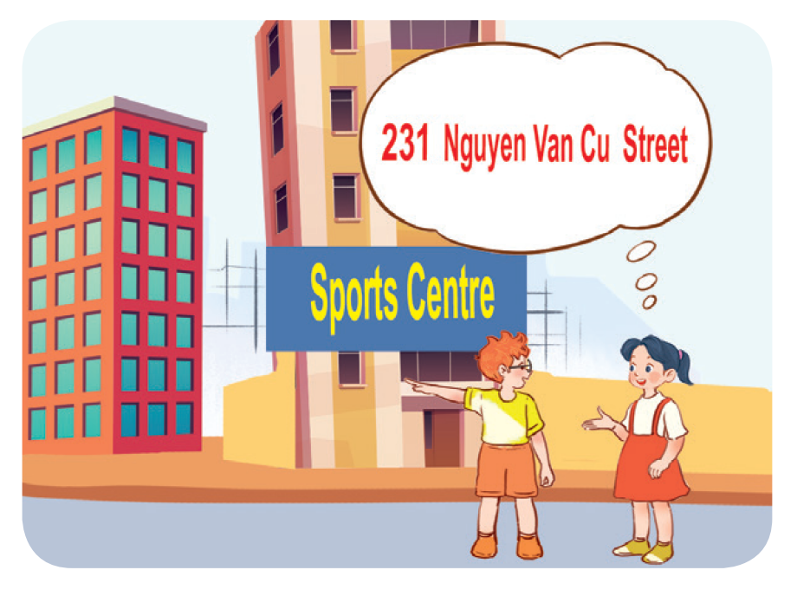
Work in pairs. Read and complete.
1. A: What’s your address?
B: It’s ________________.
A: Is it far ________________ here?
B: Yes, it is. It’s about ten kilometres from here.
2. A: I live in ________________ building over there.
B: Oh, it’s near the sports centre.
A: ________________ do you live?
B: I live far from here, in District 5.
A: ________________ your address?
B: It’s ________________.

Slide 19
Work in pairs. Read and complete.
1. A: What’s your address?
B: It’s ________________________.
A: Is it far ______ here?
B: Yes, it is. It’s about ten kilometres from here.
100 Tran Hung Dao Street
from

Slide 20
Work in pairs. Read and complete.
2. A: I live in ______________ building over there.
B: Oh, it’s near the sports centre.
A: _________ do you live?
B: I live far from here, in District 5.
A: ________ your address?
B: It’s _________________________.
that
Where
What’s
231 Nguyen Van Cu Street

Slide 21
04
Listen, complete and sing.

Slide 22

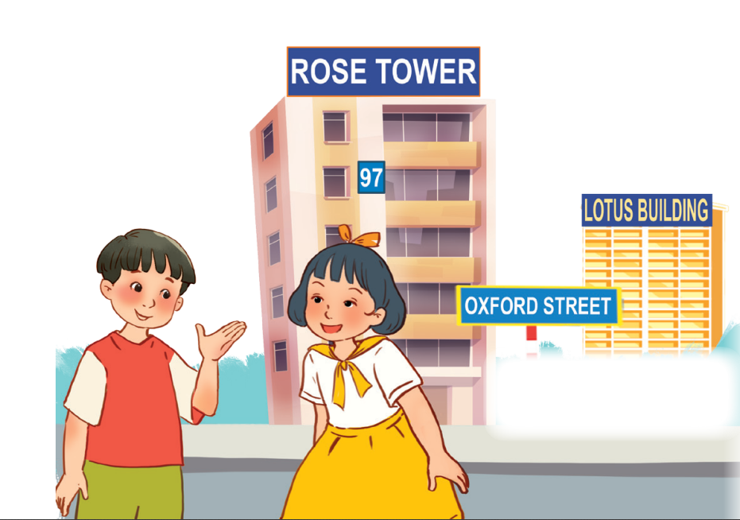
Let’s sing.
Look and read.
Listen and complete.
building
Do you live in that (1) _______?
No, I don’t.
Do you live in this (2) ______?
Yes, I do.
What’s your address?
It’s (3) _____ Oxford Street.
tower
19

Slide 23
05
Fun corner and wrap-up

Slide 24

Where do I live?

Slide 25





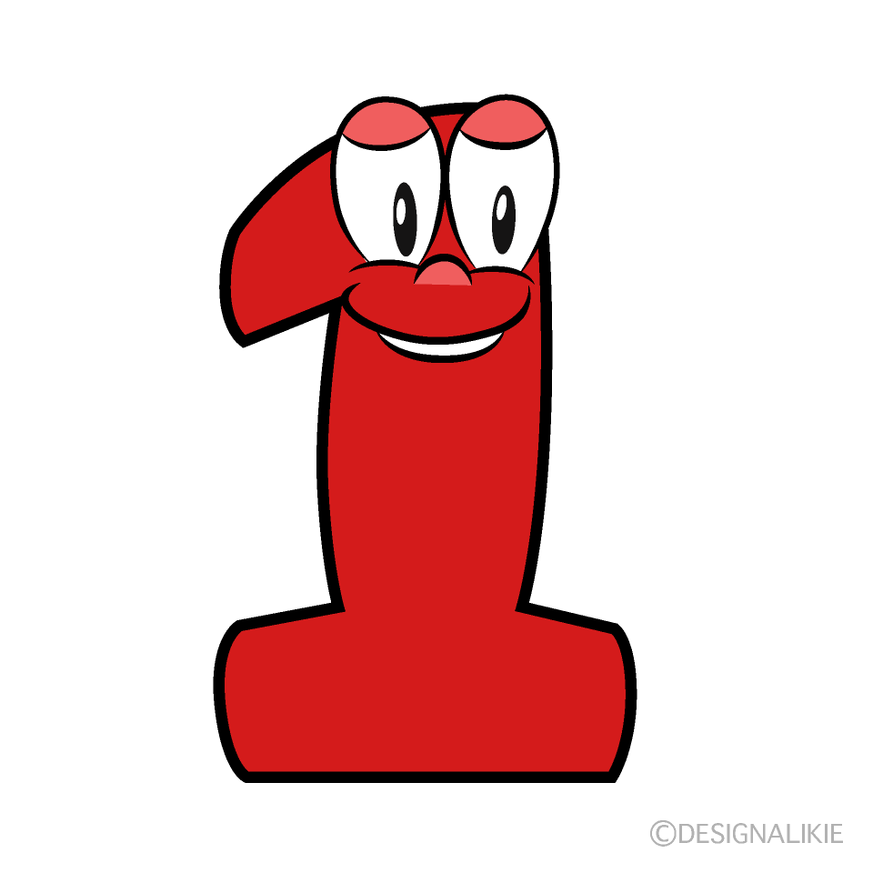







boys
girls
Notes:
Teacher can insert a picture of her/ his address behind the puzzles. After the game, students know teacher’s address.

Slide 26


______ is your address?
What
It’s 23 London Street.

Slide 27




Slide 28
I live in Sports Centre Building.
Where
______ do you live?

Slide 30

It’s 126 Tran Phu Street.
What is your _______?
address

Slide 32
No, it isn’t.
Is it far _____ here?
from

Slide 34
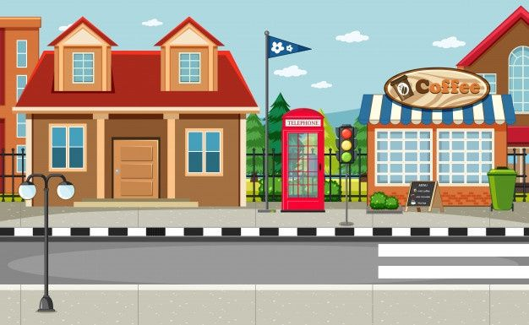

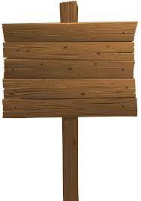
What’s your address?
32
Oxford
It’s _________________.
32 Oxford Street

Slide 36
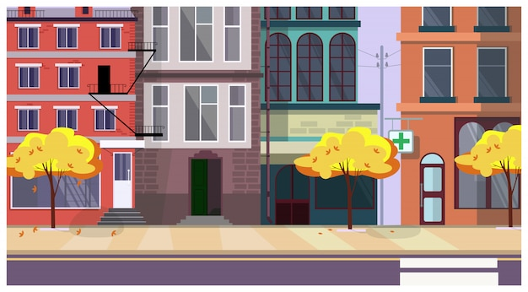
London
I live on London _______.
Street

