Slide 1

WARMLY WElcome to my class
TEACHER: ĐÀO THỊ LIỄU
QUOC TUAN PRIMARY SCHOOL

Slide 3









Our Home
Lesson 3 - Period 5

Slide 4

Table of contents
01
02
03
Listen and repeat.
Circle, listen and check.
Warm-up and review
05
04
Let’s chant.
Fun corner and wrap-up

Slide 5

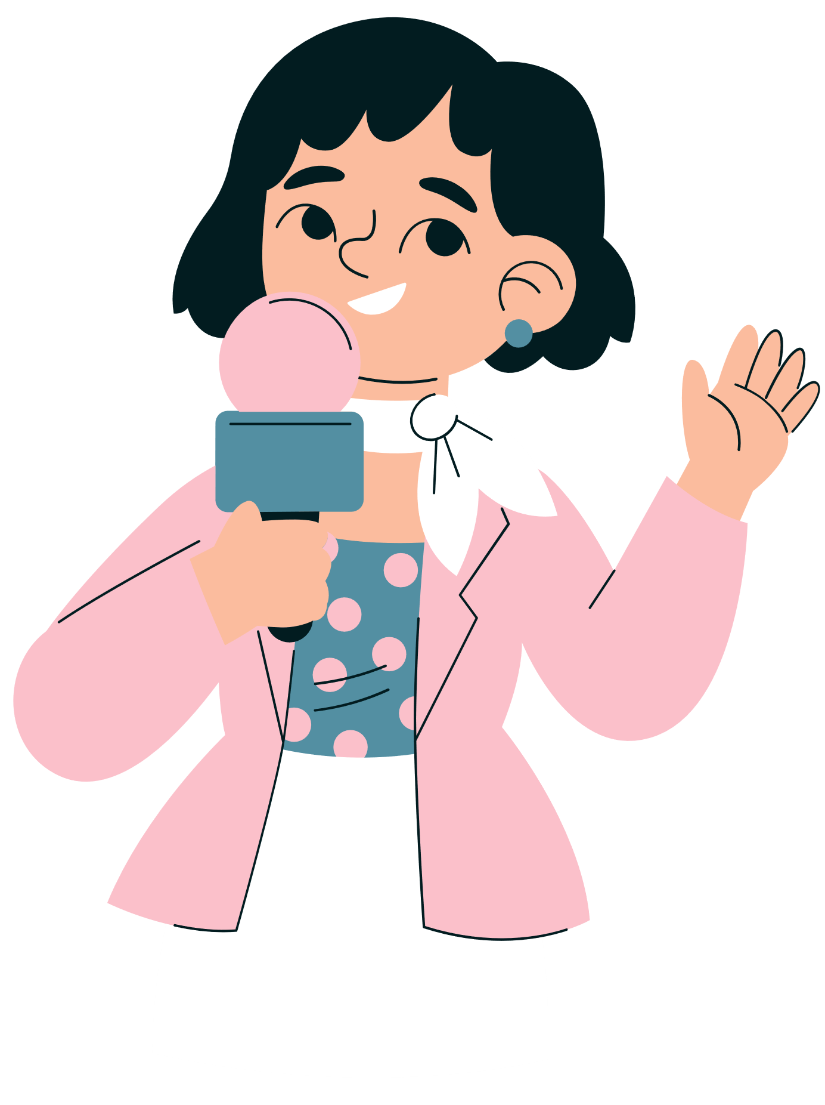




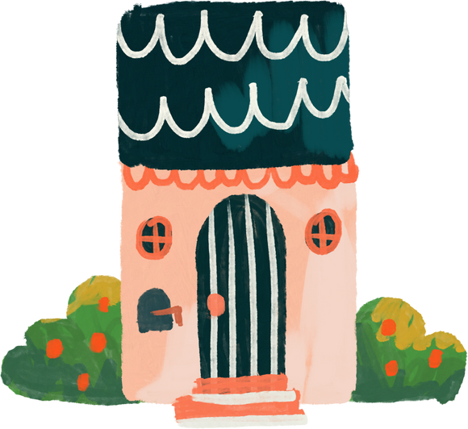
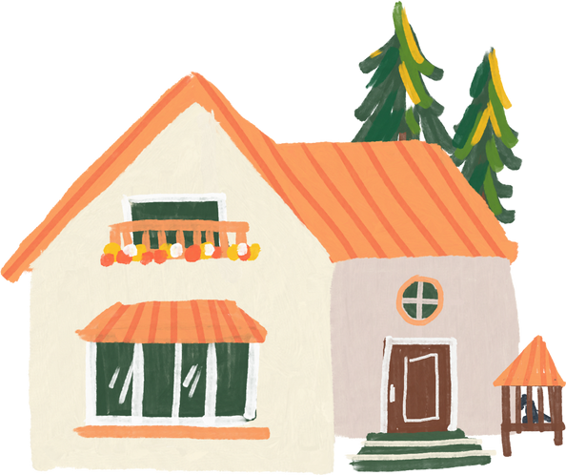
01
Warm-up and review
Notes:
- Sing "Big Number" Song
- Play Matching Game

Slide 6

Notes:
Link: https://youtu.be/bGetqbqDVaA?si=1tjRIzMLx0WwKR6e

Slide 7
1
2
3
eighteen
eighty
fourteen
4
5
6
14
13
fifty
7
8
9
60
18
sixty
10
11
12
80
thirteen
50

Slide 8
02
Listen and repeat.

Slide 9



Listen and repeat.
fifteen
sixteen

Slide 10
Which part is stressed?
fif'teen
six'teen
fifteen
sixteen

Slide 11
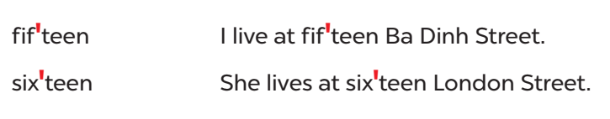
Listen and repeat.
Practice in pairs.

Slide 12
03
Circle, listen and check.

Slide 13
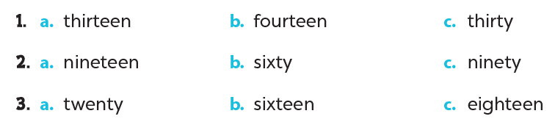
Odd one out. Circle.

Slide 14
Listen and check.

Slide 15
Word stress
13 thir'teen
14 four'teen
15 fif'teen
16 six'teen
17 seven'teen
18 eigh'teen
19 nine'teen
30 'thirty
40 'forty
50 'fifty
60 'sixty
70 'seventy
80 'eighty
90 'ninety

Slide 16
04
Let's chant.

Slide 17
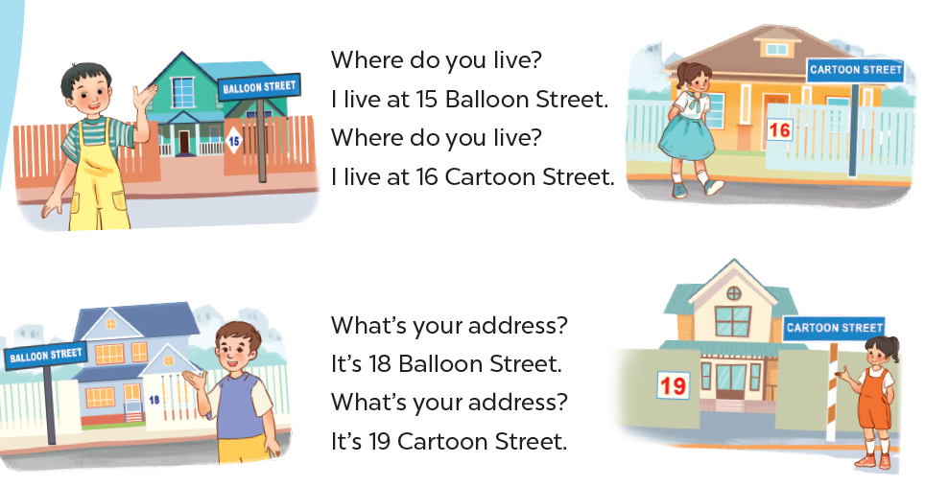

Slide 18
05
Fun corner and wrap-up
Notes:
Variations:
(1) Board race: T numbers the students in each team. T plays the recording then calls out the number, the students of that number from each team comes to the board, write the number they hear and read it aloud.
(2) Writing race: Each student/ pair gets a small erasable board. When T plays the audio, students write their answer on their board and shows it to the teacher.

Slide 19



Find the pearl and you win points!

Slide 20


= 1 point
= 3 points
= 5 points

Slide 21



Listen and choose the number you hear.
14
40
13

Slide 22
Listen and choose the number you hear.
80
90
30

Slide 23
Listen and choose the number you hear.
19
16
90

Slide 24
Listen and choose the number you hear.
12
18
80

Slide 25
Listen and choose the number you hear.
50
18
15

Slide 26
Listen and choose the number you hear.
50
18
15

Slide 27
Listen and choose the number you hear.
15
60
16

Slide 28
Listen and choose the number you hear.
40
14
90

