Slide 1

WARMLY WElcome to my class
TEACHER: ĐÀO THỊ LIỄU
QUOC TUAN PRIMARY SCHOOL

Slide 2



Slide 3


Our names
2
9
LESSON 1 – PERIOD 2

Slide 4
TABLE OF CONTENTS
01
02
03
04
05
SING WITH ME
REVIEW
PRACTICE
LET’S PLAY
FUN TIME

Slide 5

SING with ME
01

Slide 6
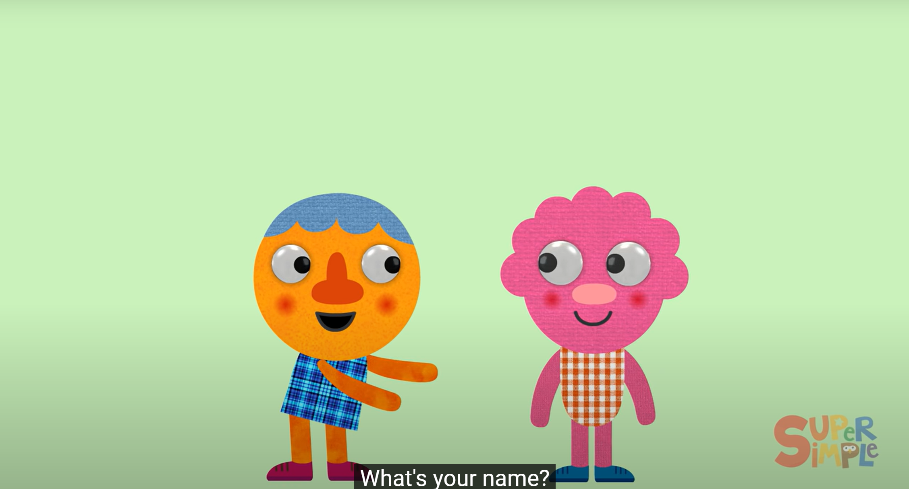
Notes:
https://www.youtube.com/watch?v=zMdq9jSaNLg

Slide 7
REVIEW
02

Slide 8

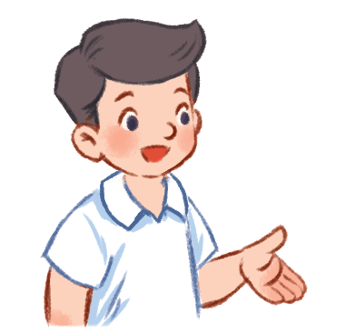
I’m Nam.
What’s your name?
Hello!
My name’s Lucy.
Hi!

Slide 9
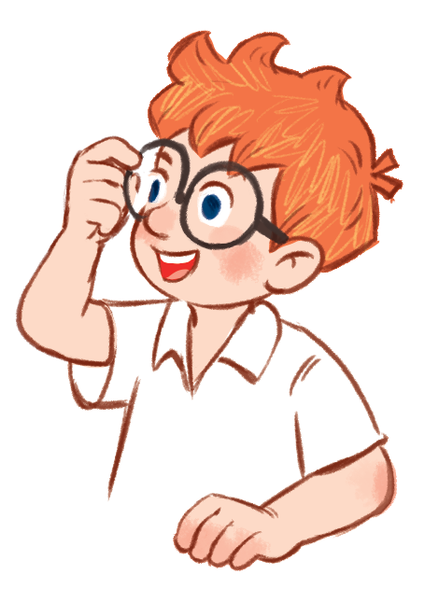
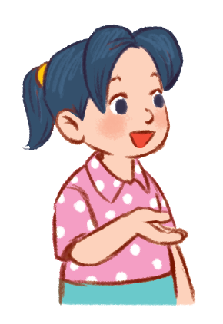
I’m Nam.
What’s your name?
My name’s …….
Mai
Ben

Slide 10

Pair work
What’s your name?
My name’s …….
Work in pairs, ask and answer about names, using the model sentences.

Slide 11
PRACTICE
03

Slide 12
ACTIVITY 4

Slide 13
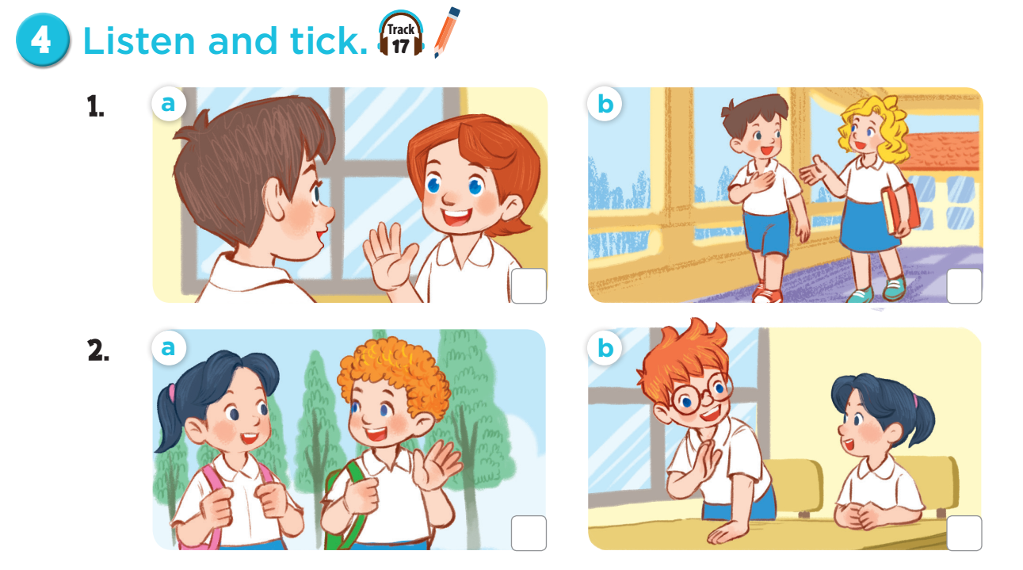

Slide 14
Ask and answer questions.
Notes:
Ask pupils some questions about Activity: How many pictures are there? Who can you see? What are they doing?

Slide 15



Slide 16
ACTIVITY 5

Slide 17
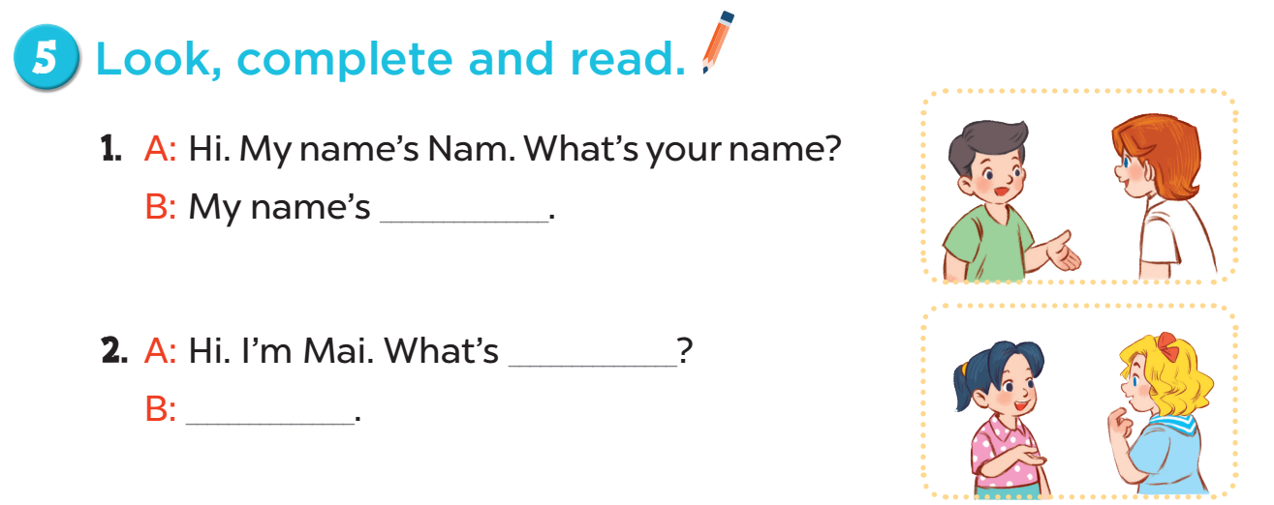
Lucy
your name
My name’s Mary

Slide 18
LET’S PLAY
04

Slide 19
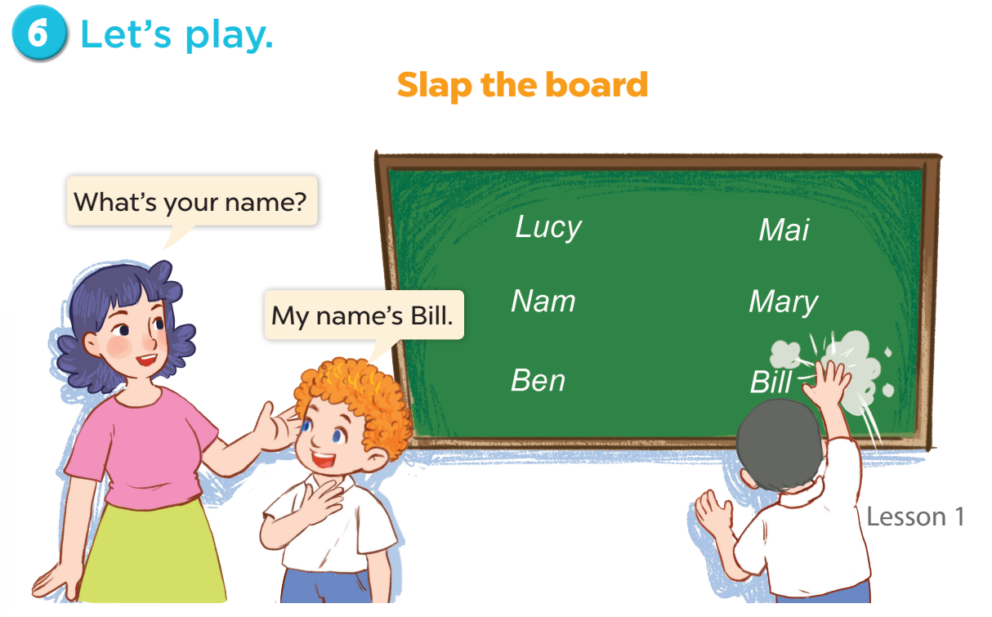

Slide 20
FUN TIME
05

Slide 21

Hello.
My name’s …….
5
2
1
8
-3
SPIN
10
10
9
3
1
7
-5
Notes:
12 Segments

Slide 22


