Slide 1

WARMLY WElcome to my class
TEACHER: ĐÀO THỊ LIỄU
QUOC TUAN PRIMARY SCHOOL

Slide 3








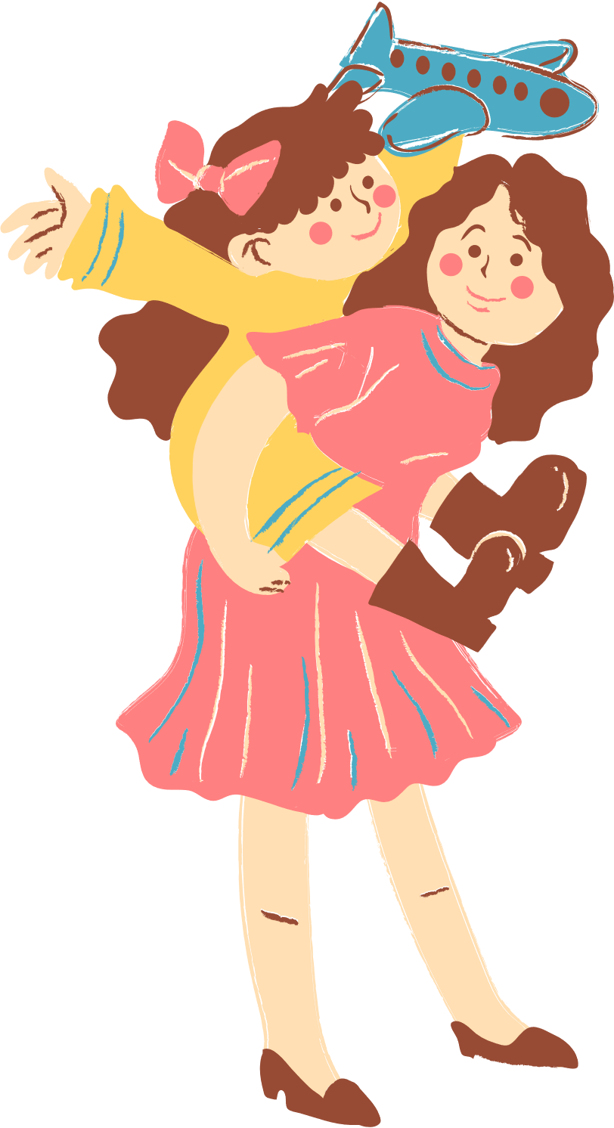
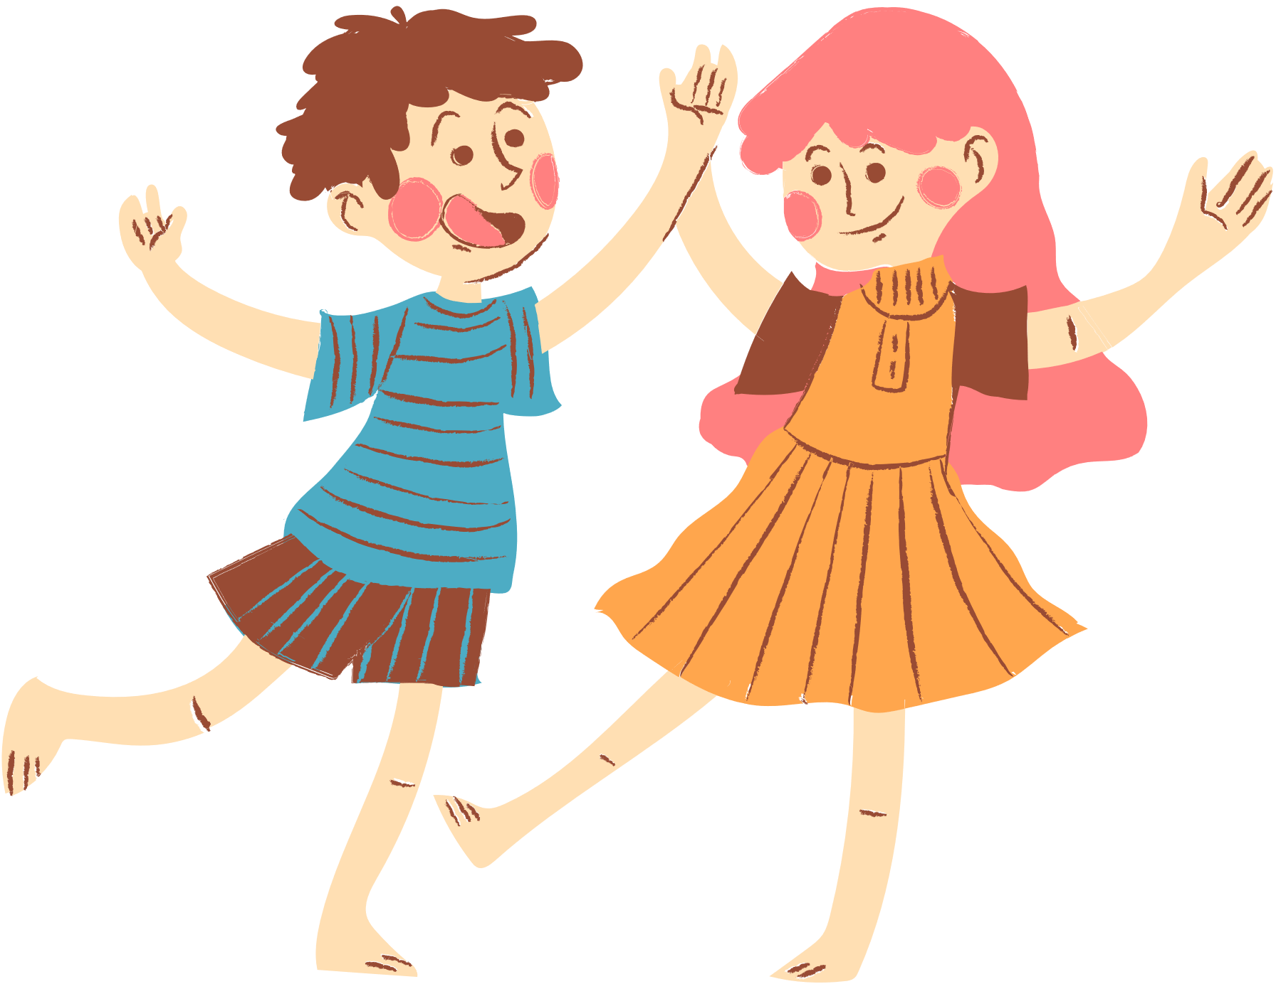
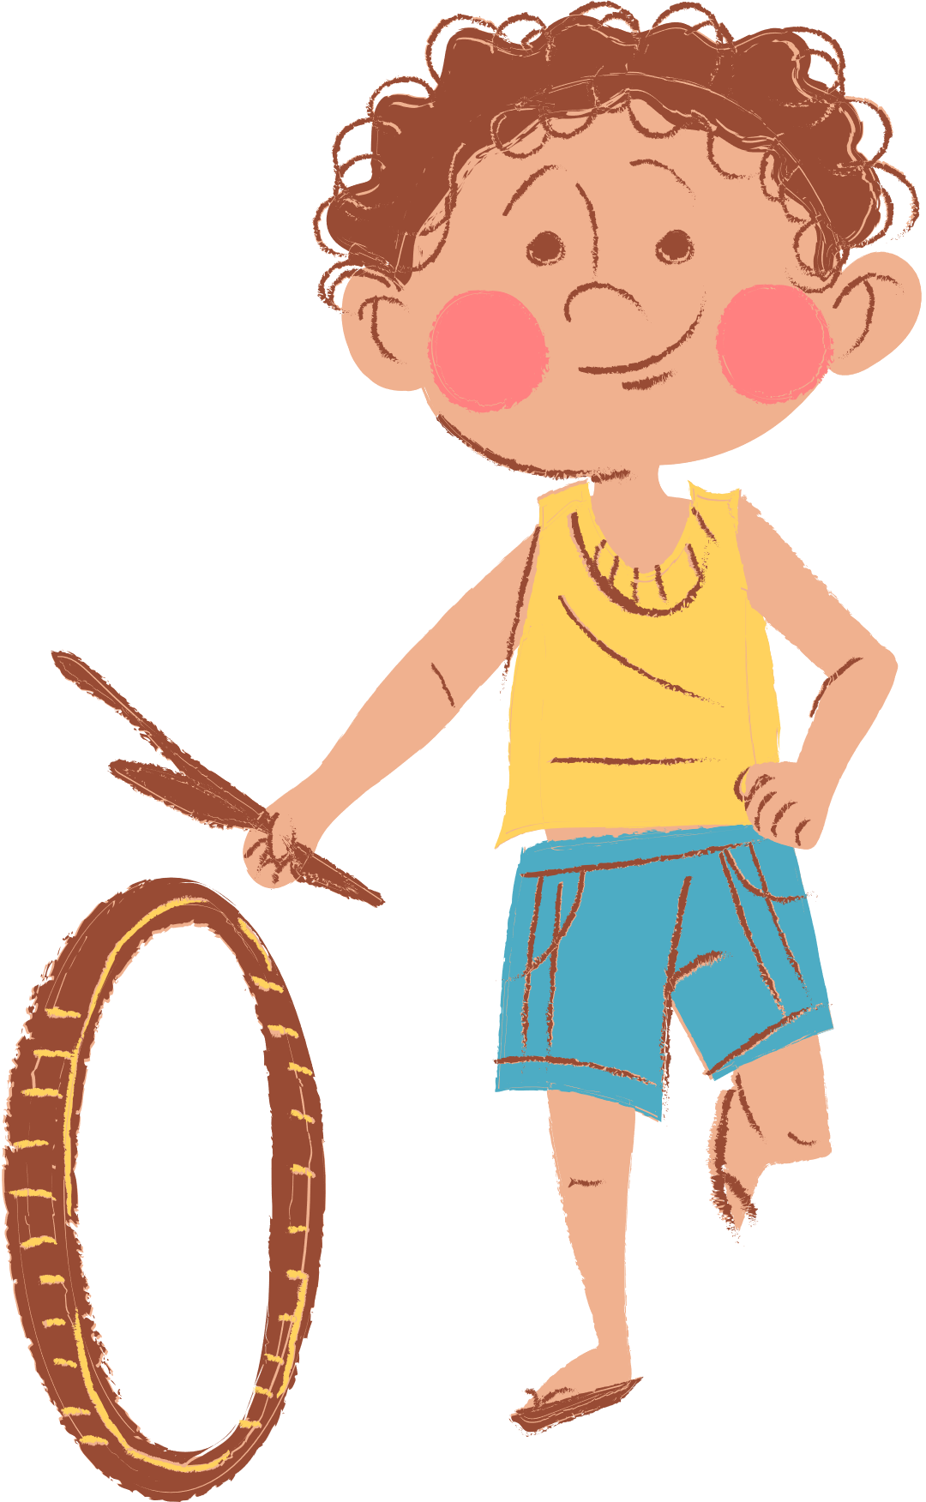
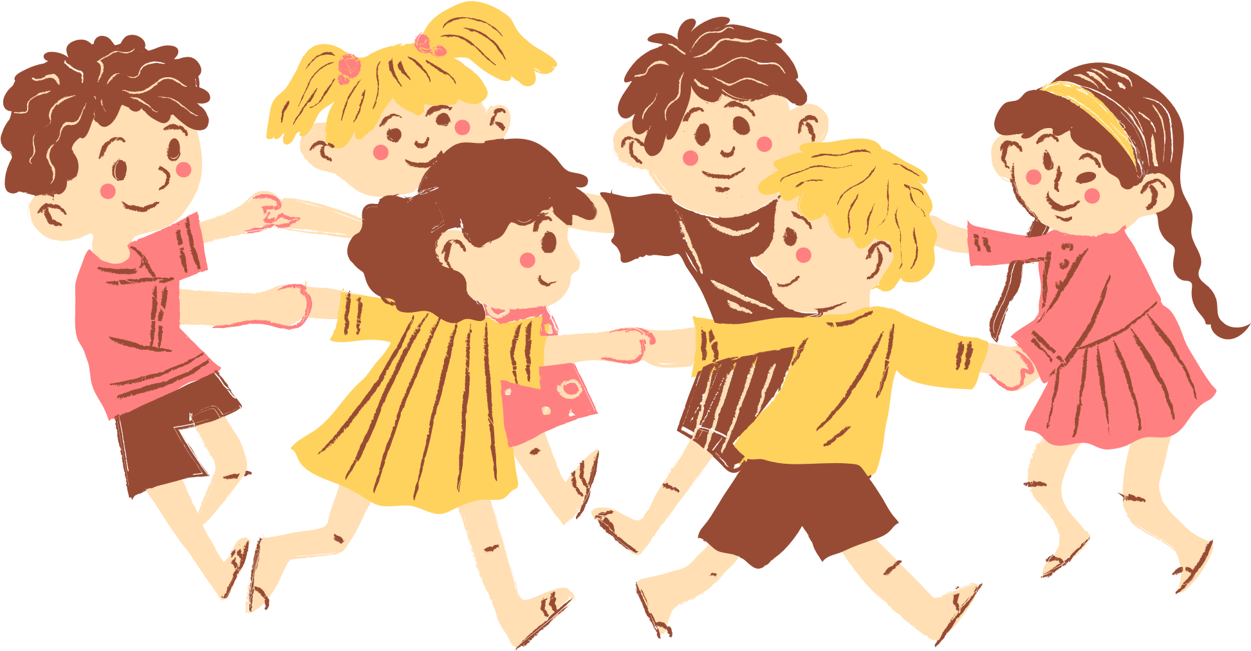
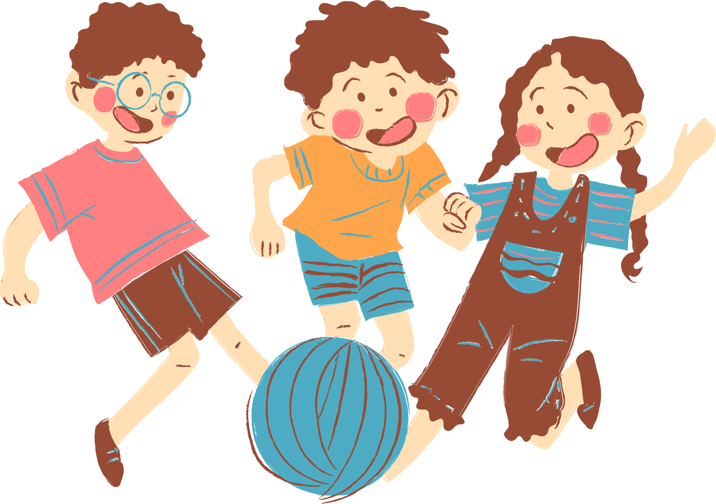
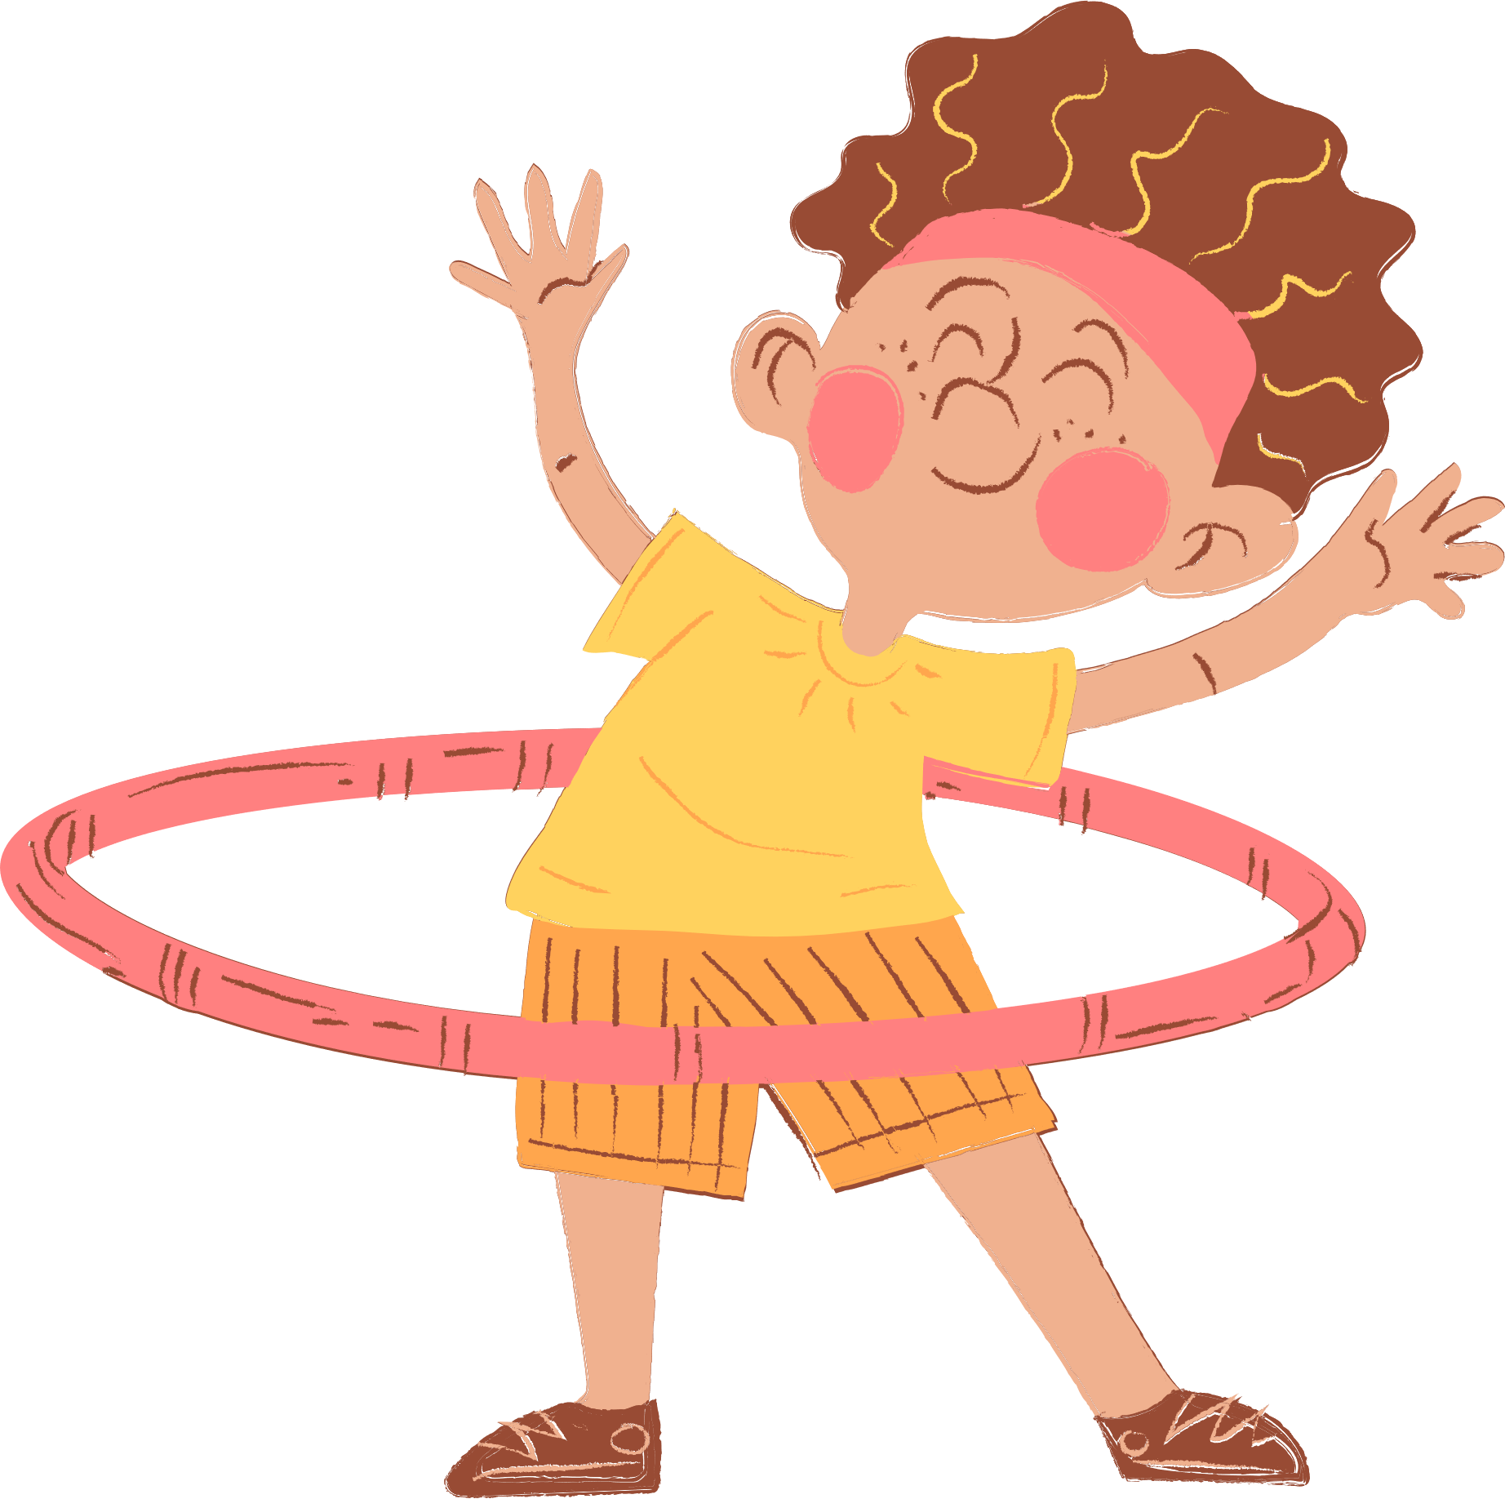
4
Our Free-time Activities

Slide 4






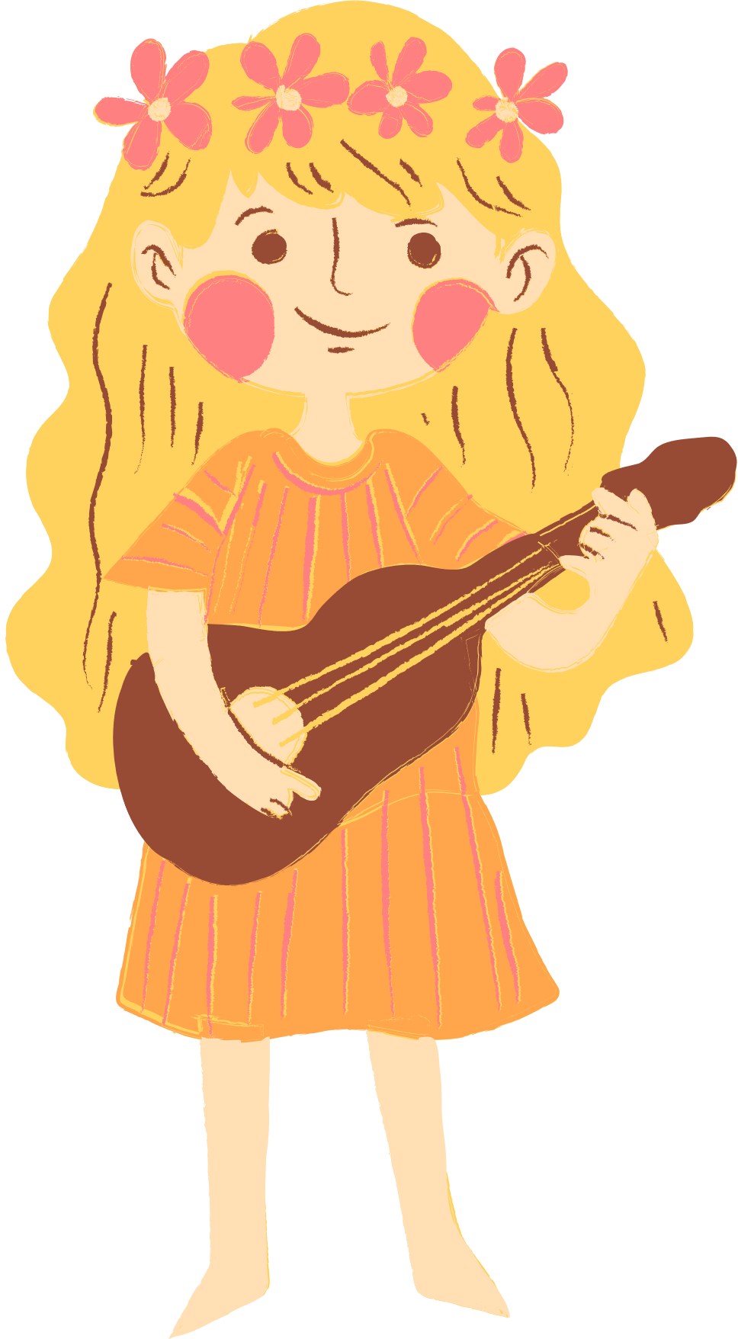
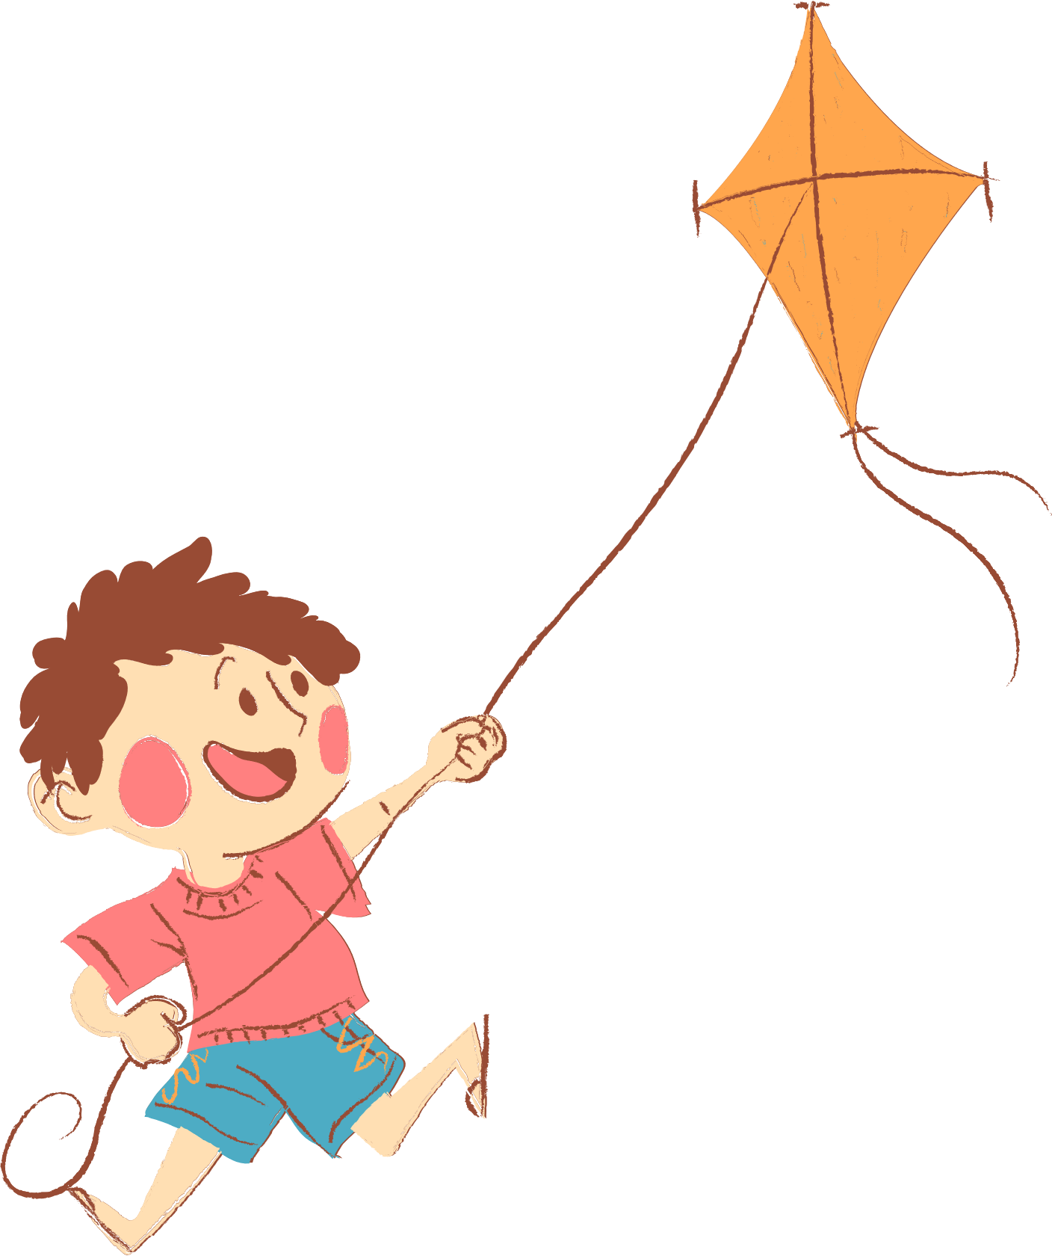
01. Review
02. Listen and repeat.
03. Circle, listen and check.
04. Let’s chant.
05. Fun corner

Slide 5
01. Review
Look and choose.

Slide 6
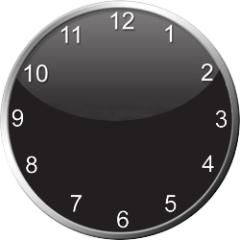


1
0
Start!
4
3
0
2
8
7
10
5
1
9
6
A. ride a bike
B. surf the Internet
C. play the violin
Notes:
- Student must answer in 10 seconds to get points.

Slide 7
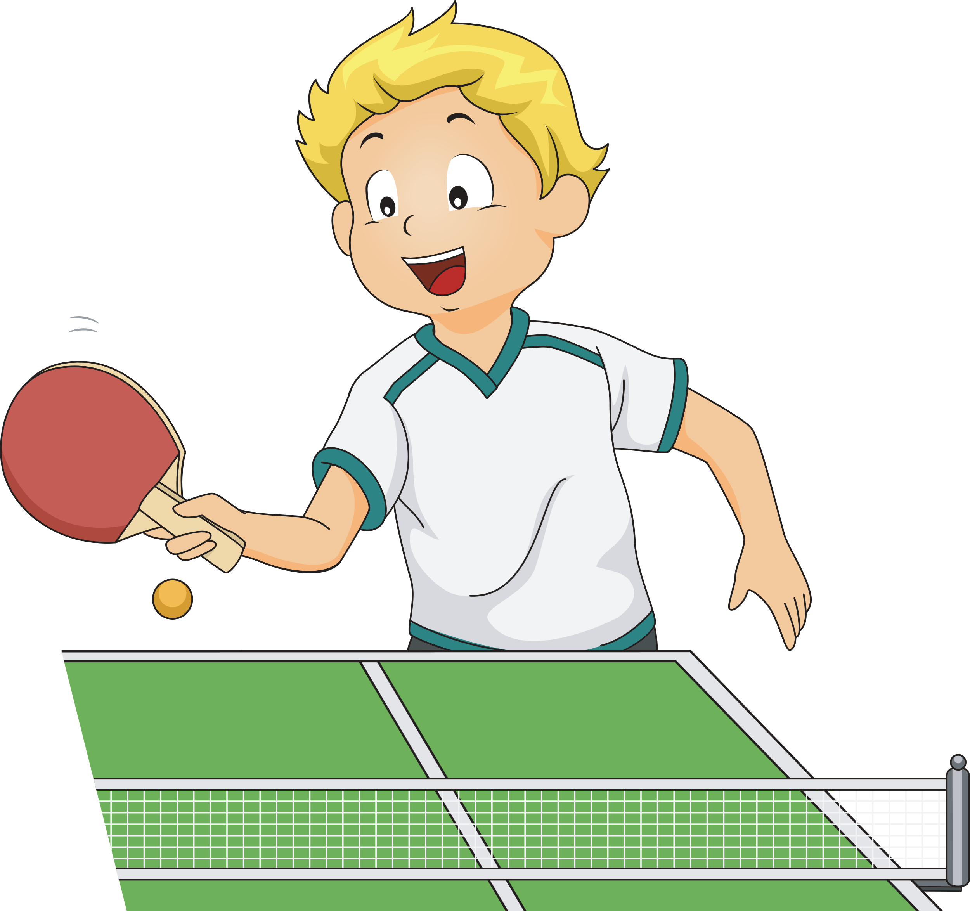
2
0
Start!
4
3
0
2
8
7
10
5
1
9
6
A. play table tennis
B. play tennis
C. play volleball
Notes:
- Student must answer in 10 seconds to get points.

Slide 8
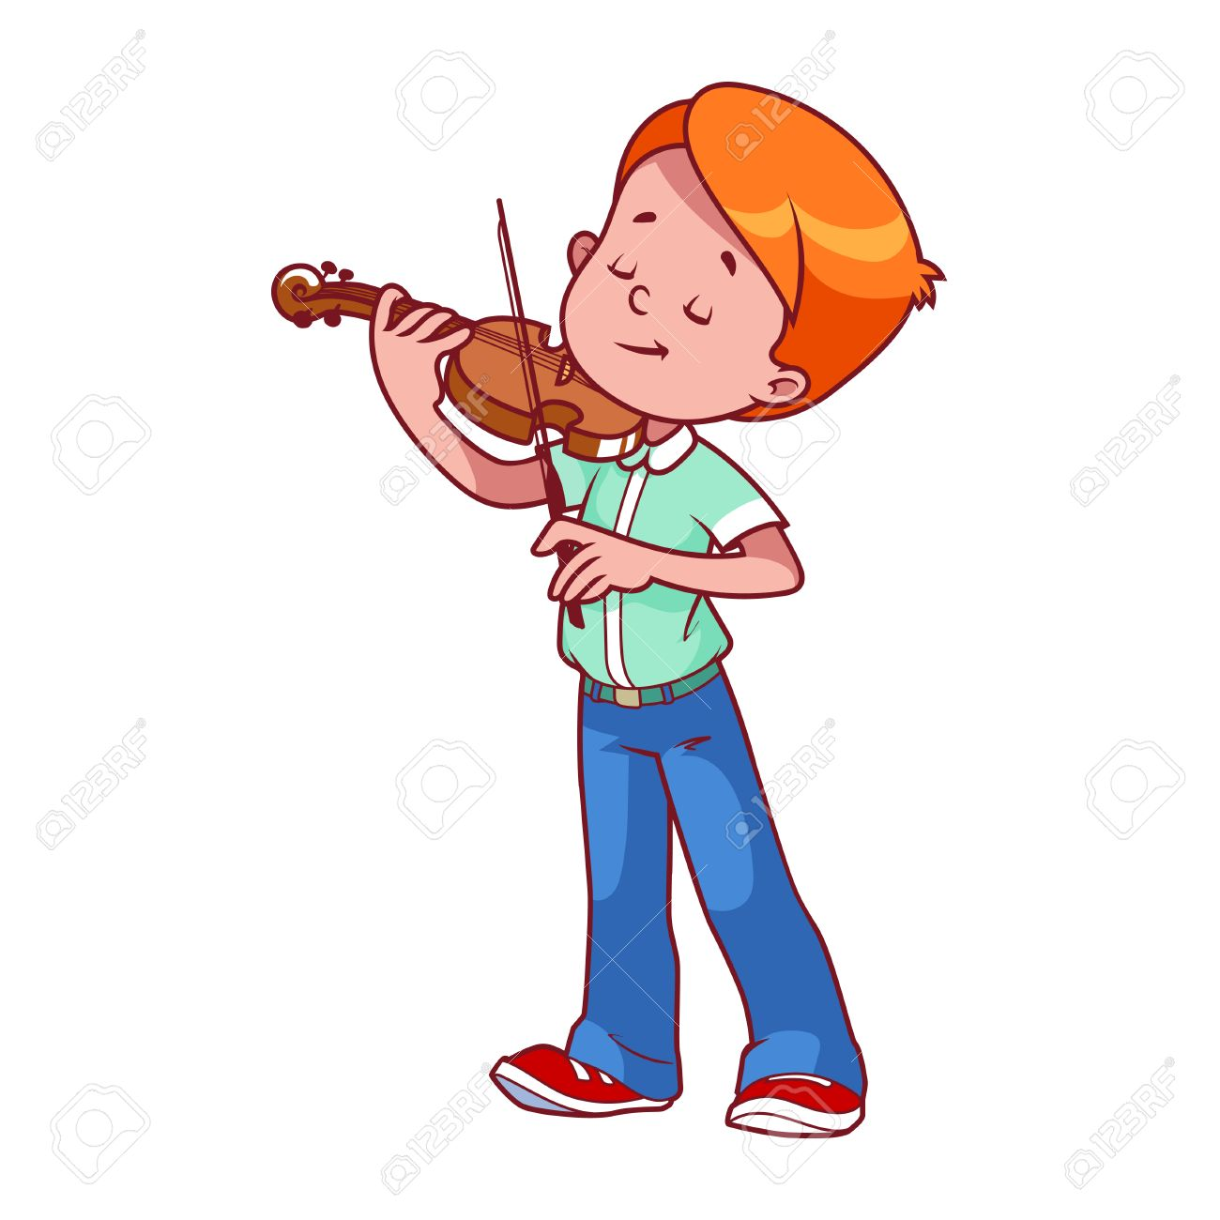
3
0
Start!
4
3
0
2
8
7
10
5
1
9
6
A. play the guitar
B. play the piano
C. play the violin
Notes:
- Student must answer in 10 seconds to get points.

Slide 9

4
0
Start!
4
3
0
2
8
7
10
5
1
9
6
A. go for a walk
B. read stories
C. listen to music
Notes:
- Student must answer in 10 seconds to get points.

Slide 10
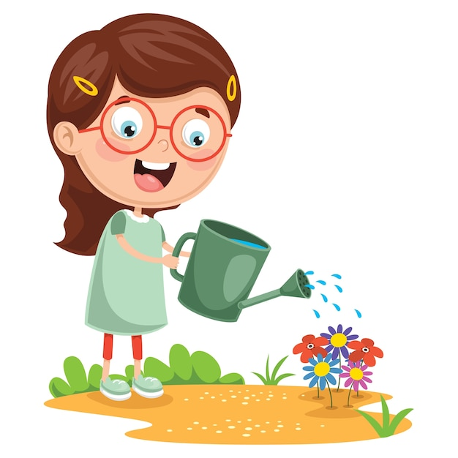
5
0
Start!
4
3
0
2
8
7
10
5
1
9
6
A. water the flowers
B. surf the Internet
C. go for a walk
Notes:
- Student must answer in 10 seconds to get points.

Slide 11
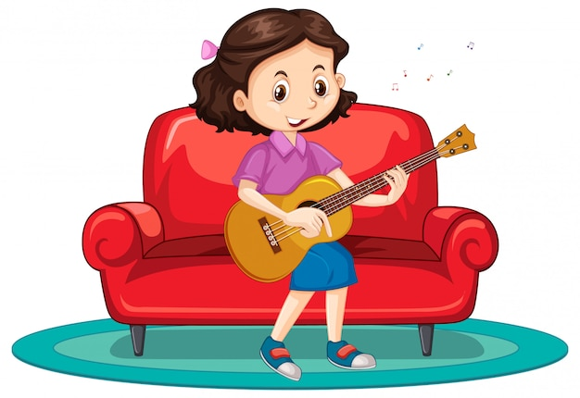
6
0
Start!
4
3
0
2
8
7
10
5
1
9
6
A. play the guitar
B. play the violin
C. play the piano
Notes:
- Student must answer in 10 seconds to get points.

Slide 12
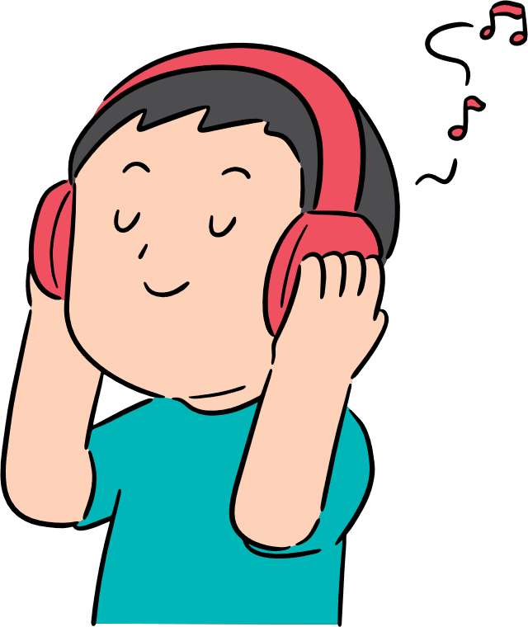
7
0
Start!
4
3
0
2
8
7
10
5
1
9
6
A. surf the Internet
B. read stories
C. listen to music
Notes:
- Student must answer in 10 seconds to get points.

Slide 13
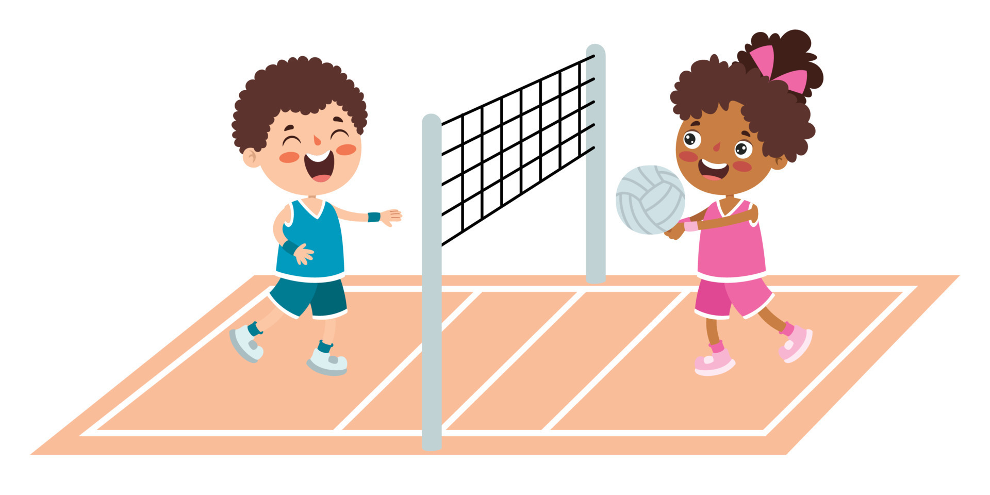
8
0
Start!
4
3
0
2
8
7
10
5
1
9
6
A. play basketball
B. play volleyball
C. play badminton
Notes:
- Student must answer in 10 seconds to get points.

Slide 14
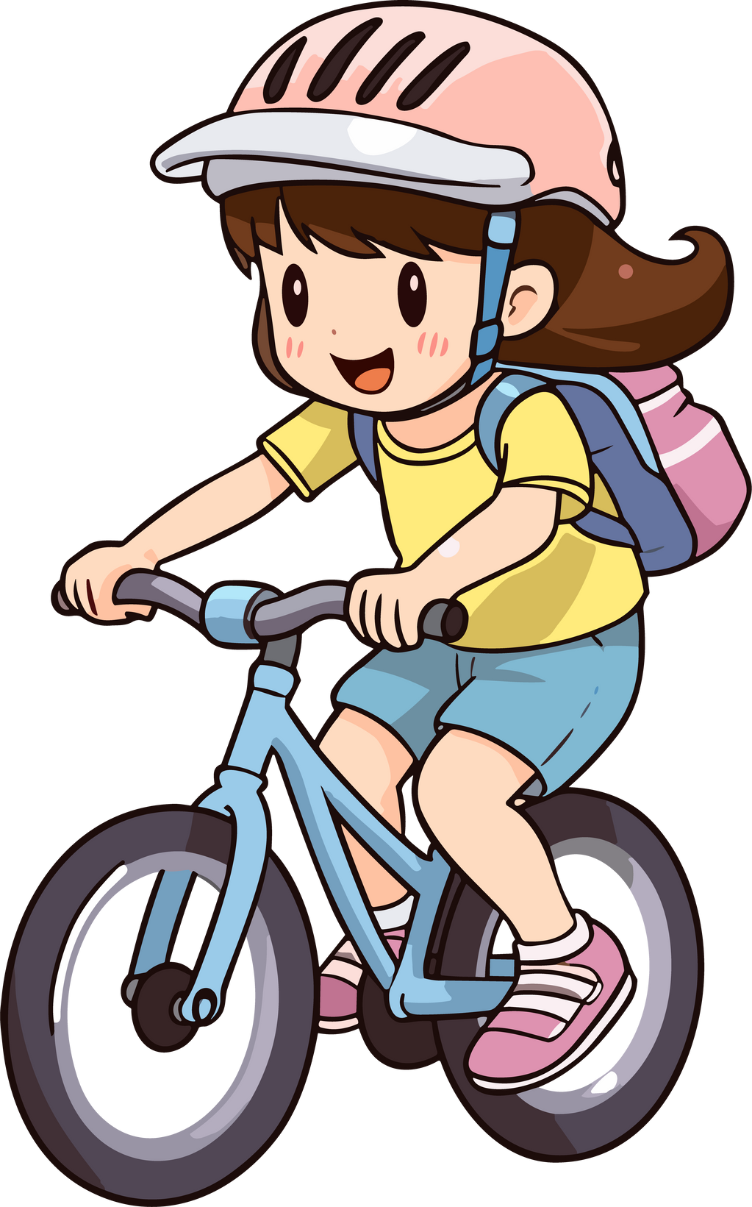
9
0
Start!
4
3
0
2
8
7
10
5
1
9
6
A. ride my bike
B. drive my car
C. ride my horse
Notes:
- Student must answer in 10 seconds to get points.

Slide 15
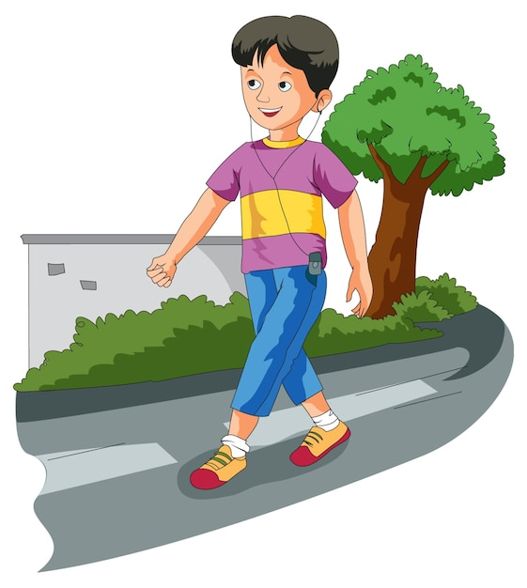
10
0
Start!
4
3
0
2
8
7
10
5
1
9
6
A. run
B. go for a walk
C. jump
Notes:
- Student must answer in 10 seconds to get points.

Slide 16
02. Listen and repeat.

Slide 17
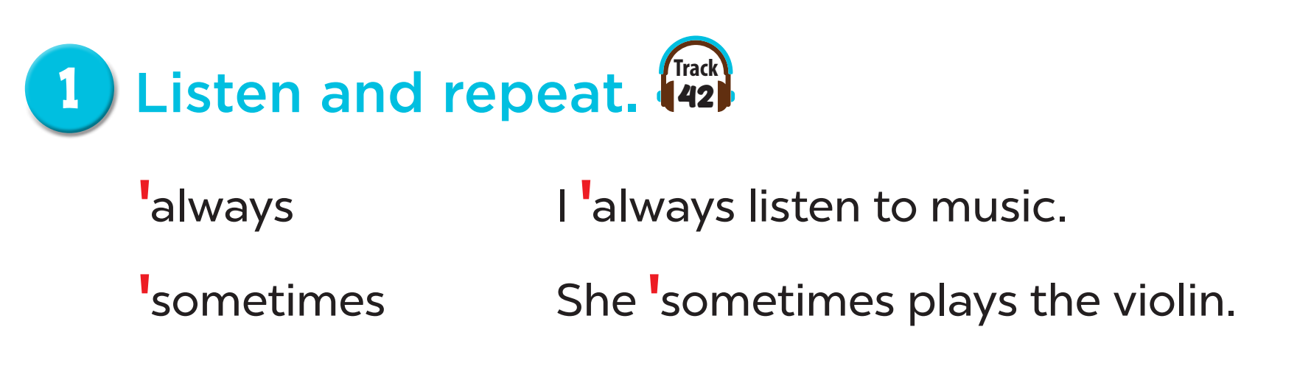


Slide 18
03. Circle, listen and check.

Slide 19
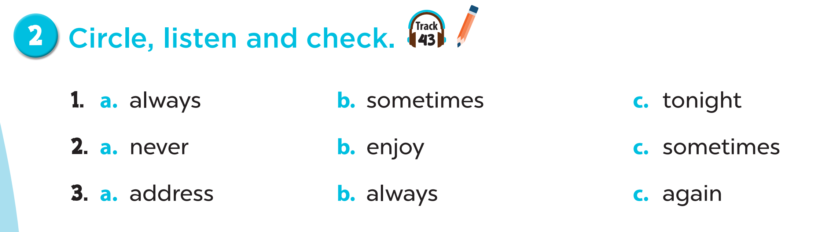
‘
‘
‘
‘
‘
‘
‘
‘
‘

Slide 20
04. Let’s chant.

Slide 21
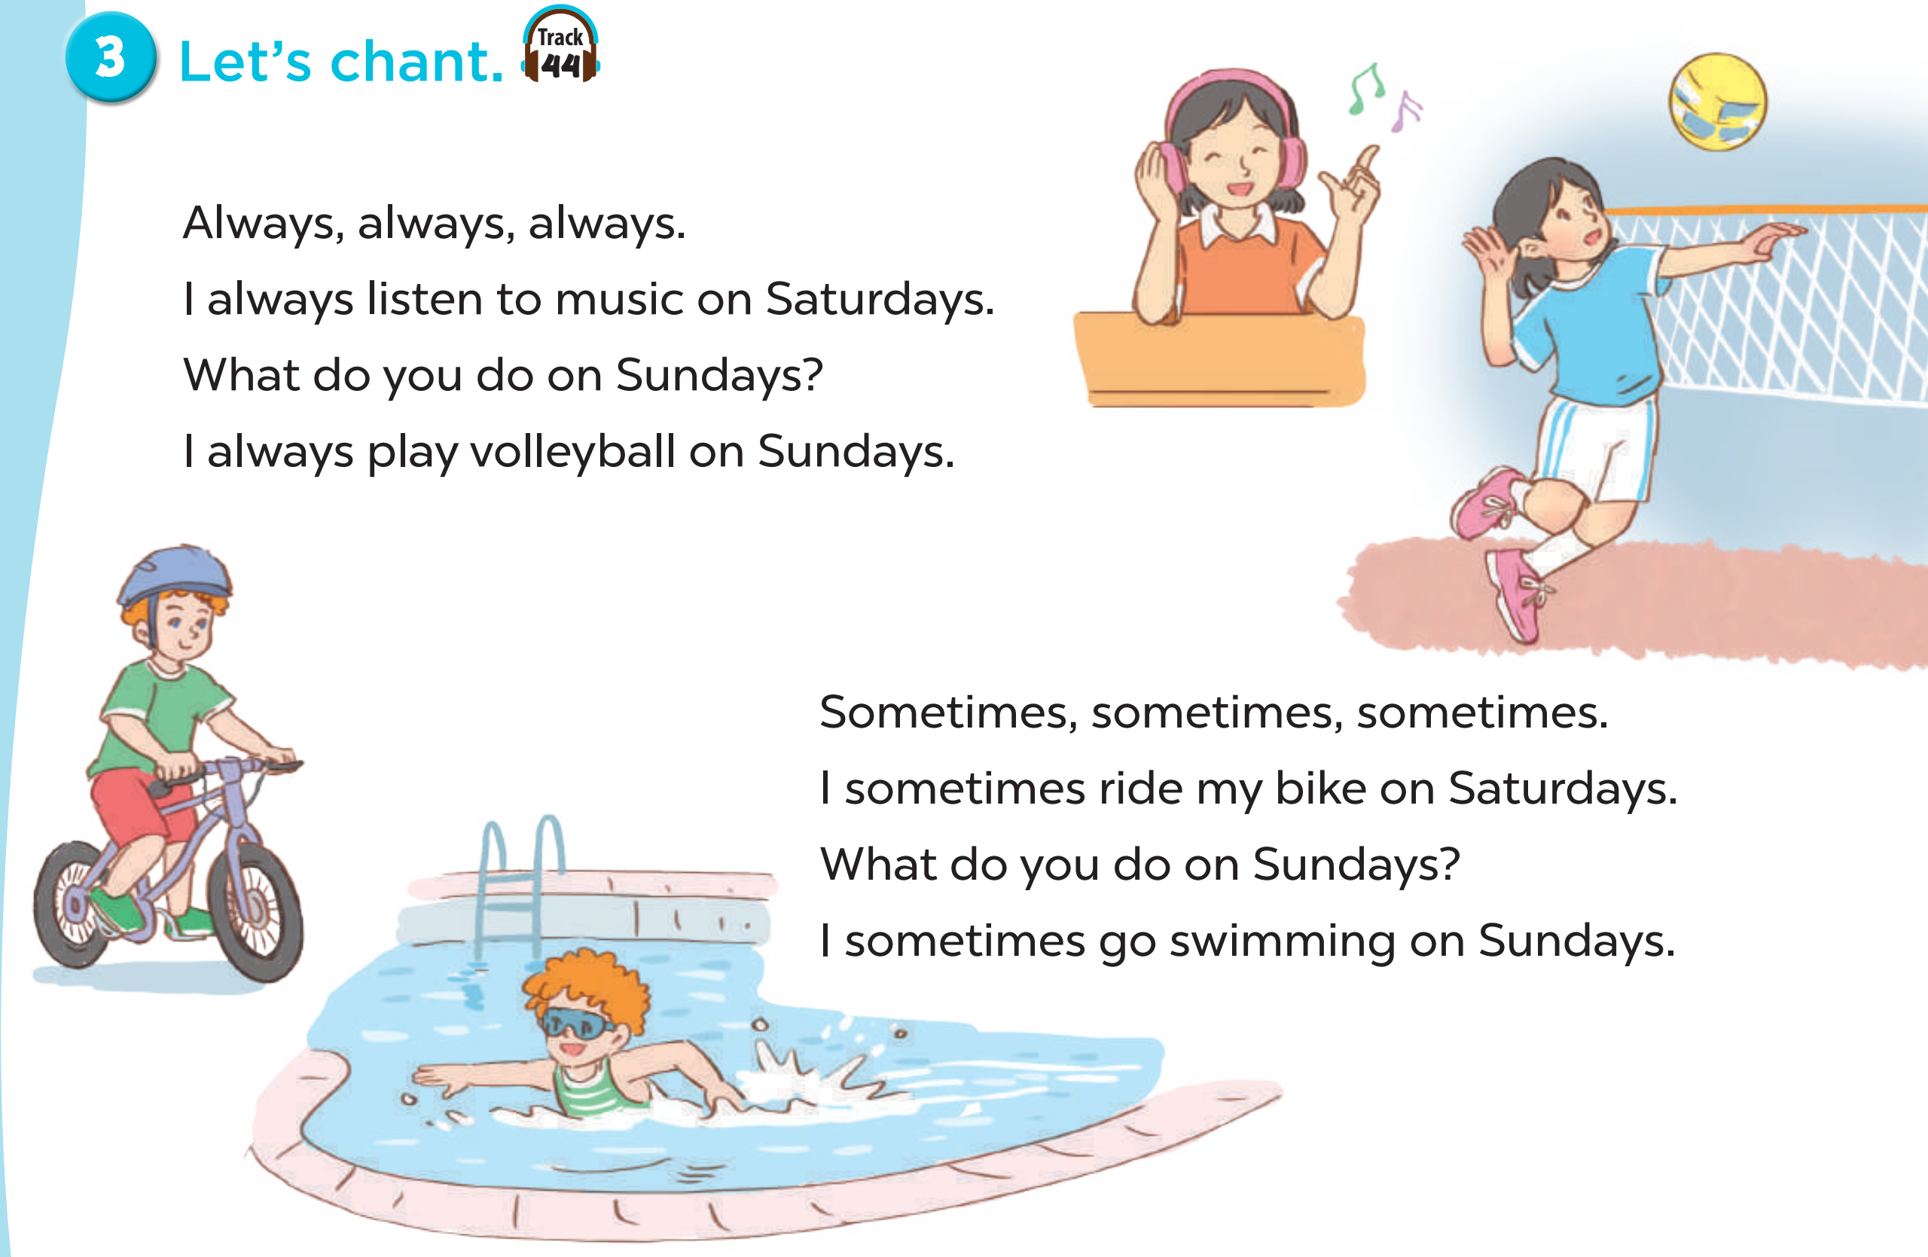

Slide 22
05. Game time!

Slide 23
SPIN THE WHEEL
How to play
Choose a number
Answer the question
Spin the wheel to get points

Slide 24




END
SPIN THE WHEEL
1
3
1
2
3
-3
10
4
5
6
5
4
2
-5
7
8
9
TURN
Notes:
Click numbers to open questions
Click TURN to spin the wheel
Click END to move to Thank you slide.

Slide 25
What do you like doing in your free time?
I like playing table tennis.
BACK
Notes:
- Click BACK to move back to slide 22

Slide 26
What do you do after school?
usually
I usually read stories.
BACK
Notes:
- Click BACK to move back to slide 22

Slide 27
What do you do at the weekend?
often
I often play the guitar.
BACK
Notes:
- Click BACK to move back to slide 22

Slide 28
What do you do on Sundays?
sometimes
I sometimes play volleyball.
BACK
Notes:
- Click BACK to move back to slide 22

Slide 29
What do you like doing in your free time?
I like riding my bike.
BACK
Notes:
- Click BACK to move back to slide 22

Slide 30
What do you do on Saturdays?
always
I always listen to music.
BACK
Notes:
- Click BACK to move back to slide 22

Slide 31
What do you like doing in your free time?
I like watering the flowers.
BACK
Notes:
- Click BACK to move back to slide 22

Slide 32
What do you do in the evening?
often
I often surf the Internet.
BACK
Notes:
- Click BACK to move back to slide 22

Slide 33
What do you like doing in your free time?
I like playing the violin.
BACK
Notes:
- Click BACK to move back to slide 22

