Slide 1

WELCOME TO MY CLASS
Teacher: Trần Thị Trang
Quoc Tuan Primary School

Slide 2





Slide 3
Unit 7
Our timetables
Lesson 3 - period 6

Slide 4
Table of Contents
01
02
03
04
Read and circle.
Warm-up
Let’s write.
Project
fun corner & wrap-up
05

Slide 5
01
Warm-up

Slide 6
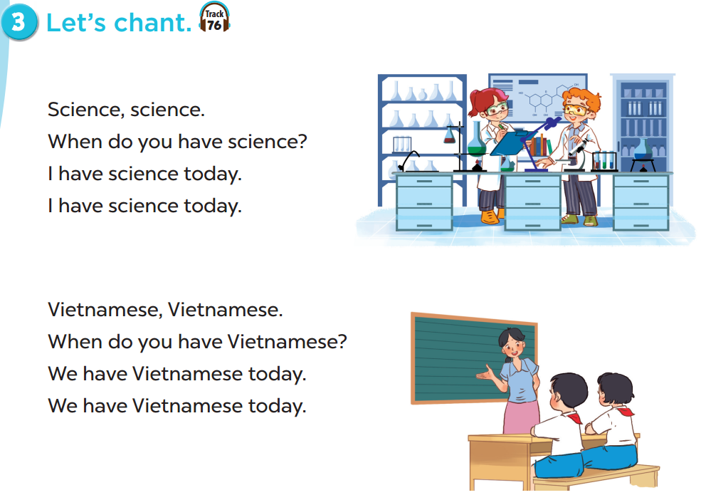


Slide 7
02
Read and circle.

Slide 8
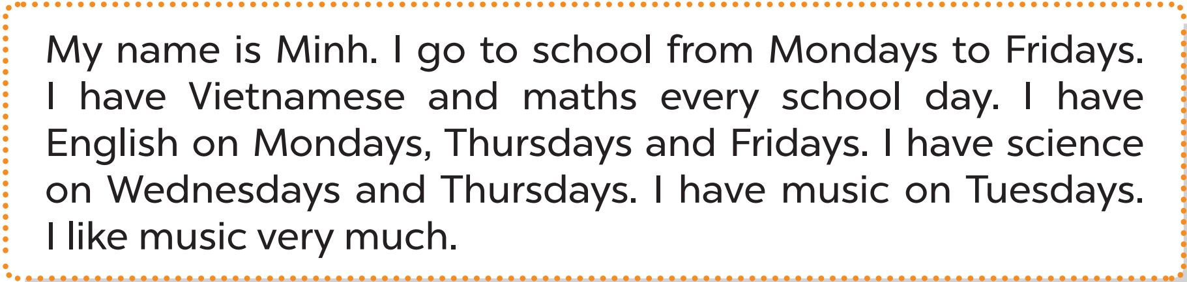

Slide 9
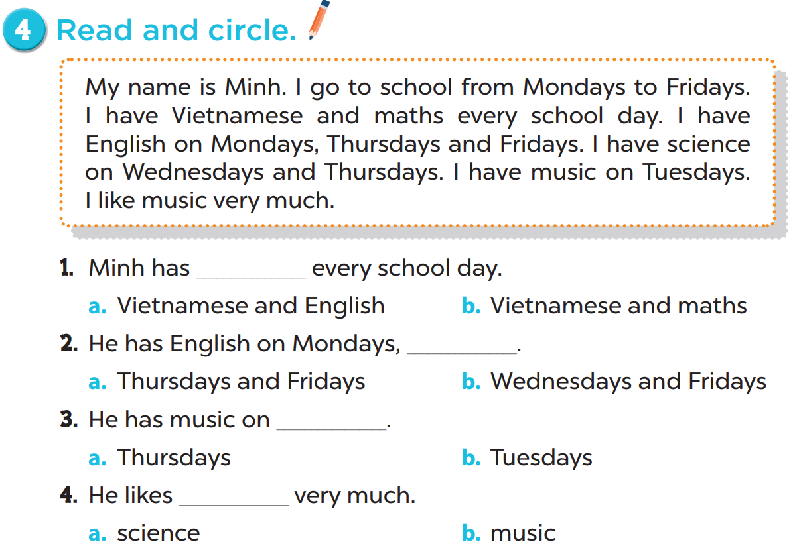

Slide 10


Slide 11
03
Let’s write.

Slide 12
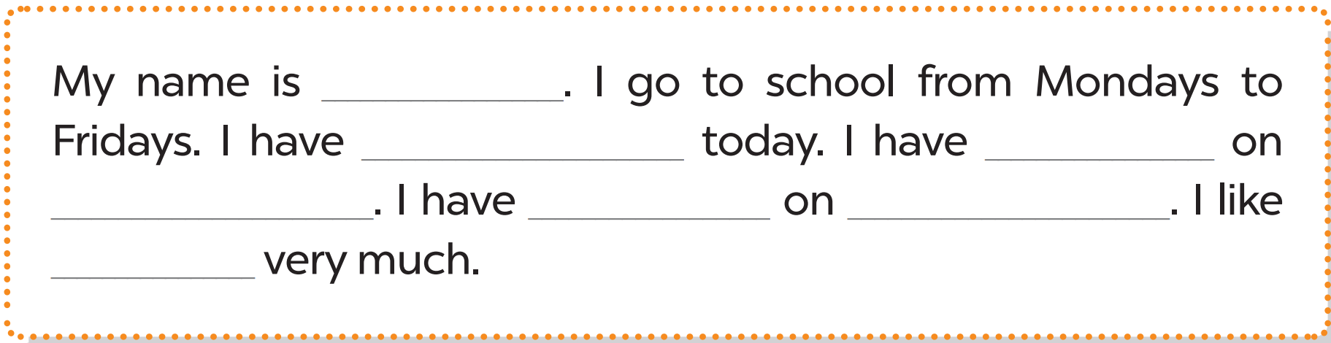
Lucy
English
science
Tuesdays
music
Fridays
music

Slide 14
04
Project

Slide 15
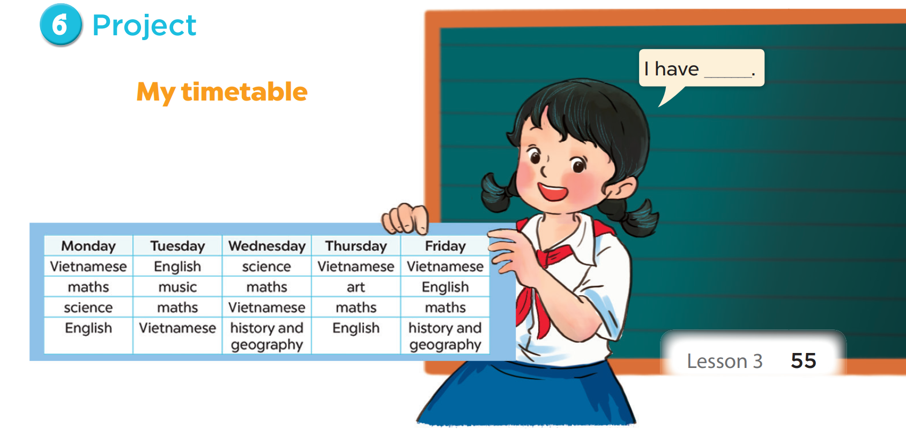

Slide 16
05
Fun corner
& wrap-up

Slide 17

Reorder the words.
Fridays./ Mondays/ I/ to/
school/ go/ from
I go to school from Mondays to Fridays.

Slide 18
Reorder the words.
every/ day./ I/ maths/ have
I have maths every day.

Slide 19
Reorder the words.
Fridays./ and/ have/ science
Mondays/ I/ on
I have science on Mondays and Fridays.

Slide 20
Reorder the words.
much./ like/ I/
science/ very
I like science very much.

Slide 21


