Slide 1

WELCOME TO MY CLASS
Teacher: Trần Thị Trang
Quoc Tuan Primary School

Slide 2





Slide 3


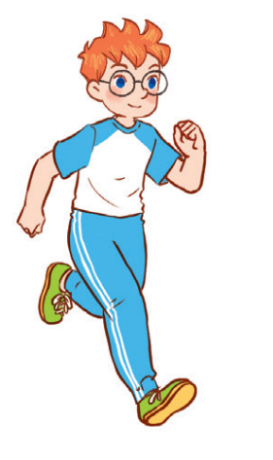
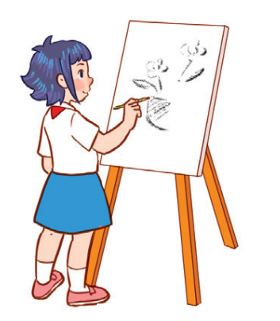

Unit 8
Period 1

Slide 4
Contents
Look, listen and repeat.
Listen, point and say.
Warm-up and review
Let’s talk.
Fun corner and wrap-up
2
1
2
1
3
3
5
4
5
4

Slide 5
Warm-up and review
1
1
Watch a video.

Slide 6

Notes:
Link: https://www.youtube.com/watch?v=2G85e-xBPX4&t=14s

Slide 7
2
Look, listen and repeat.
2
7

Slide 8

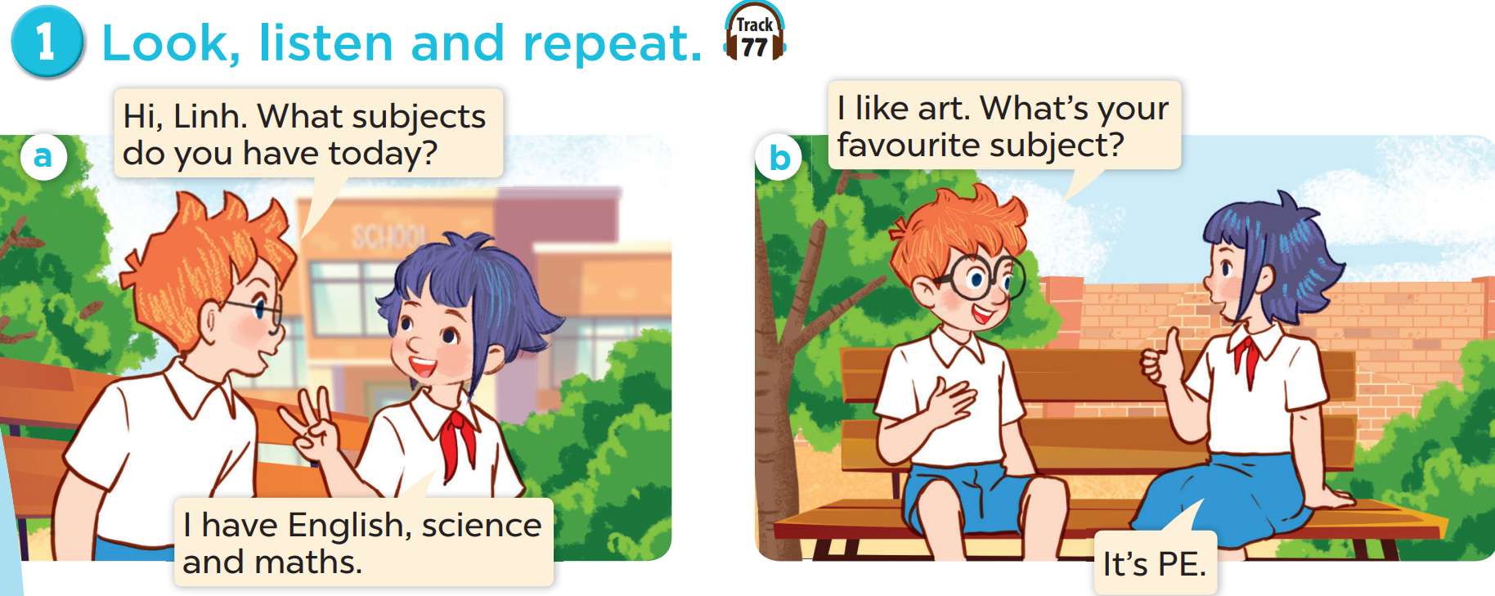

Slide 10
3
Listen, point and say.
3
10

Slide 11
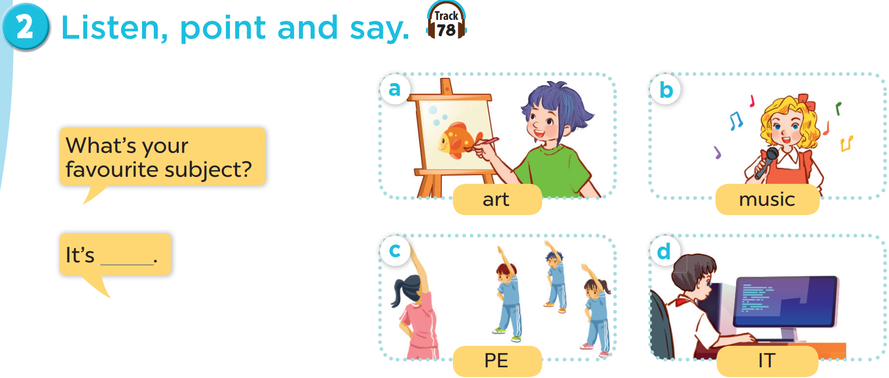

Slide 12
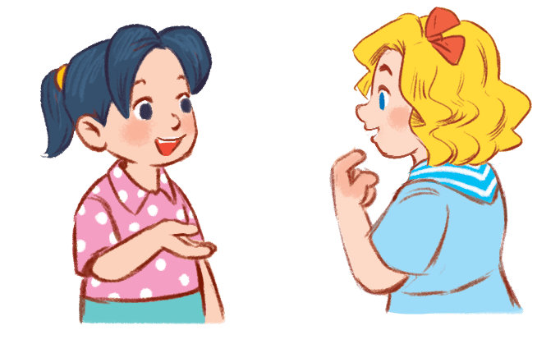
4
Let’s talk.
4
12

Slide 13
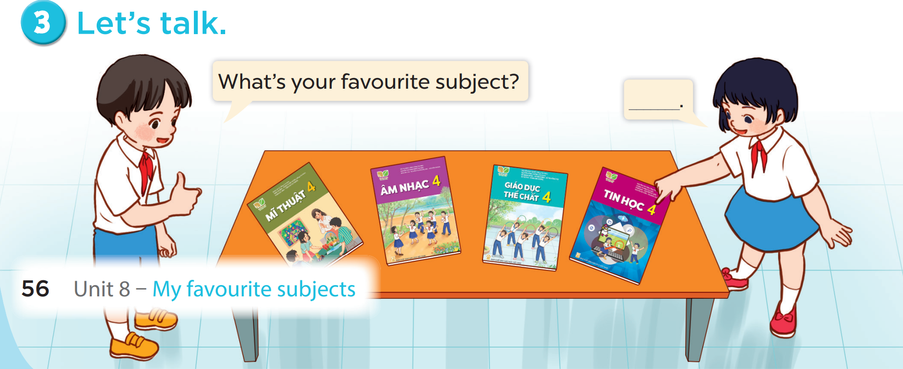

Slide 14
5
Fun corner and wrap-up
5
Game: Matching game

Slide 15





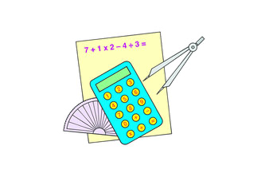
1
2
3
MATHS
4
5
6
PE
SCIENCE
7
8
9
ART
IT
MUSIC
10
11
12
Notes:
Click on the blue part to show pictures/words, if pupils get the correct pairs, leave the square open.
If pupils answer incorrectly, click on the red circle to cover the square again.
Repeat until pupils match all the words with the corresponding pictures.

Slide 16


