Slide 1

WELCOME TO MY CLASS
Teacher: Trần Thị Trang
Quoc Tuan Primary School

Slide 2




Slide 3



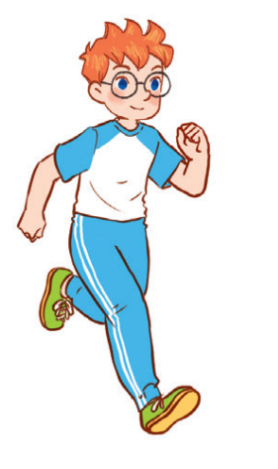
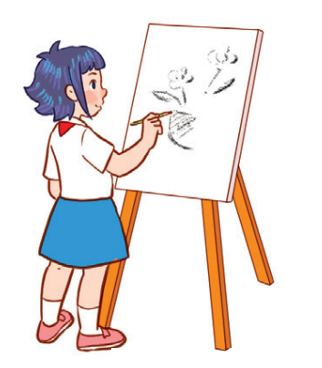

Unit 8
Period 3

Slide 4
Contents
2
1
3
Look, listen and repeat.
Listen, point and say.
Warm-up and review
5
4
Let’s talk.
Fun corner and wrap-up

Slide 5
Warm-up and review
1
1
Game: Who’s faster?

Slide 6

I LIKE…

Slide 7
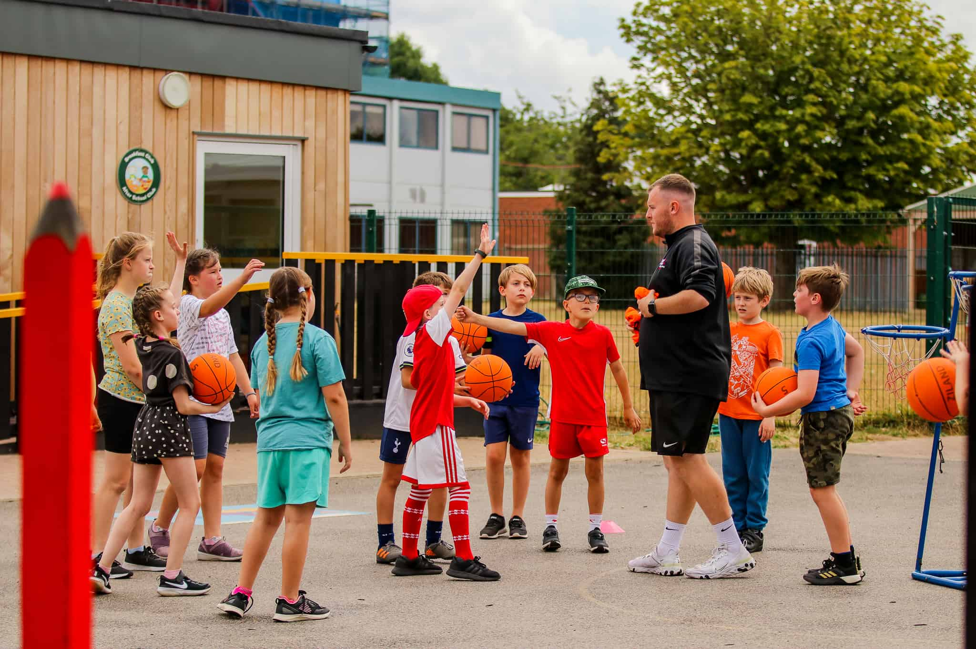
MY FAVOURITE SUBJECT IS...

Slide 8
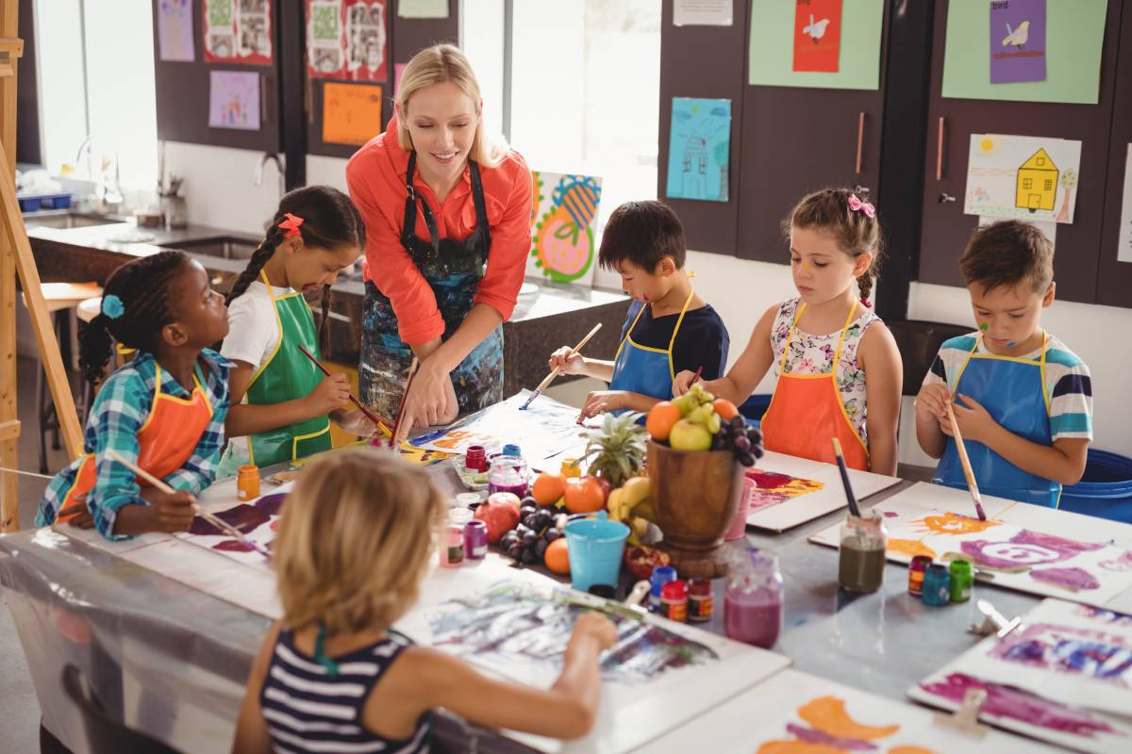

Slide 9


Slide 10
Look, listen and repeat.
2
2

Slide 11

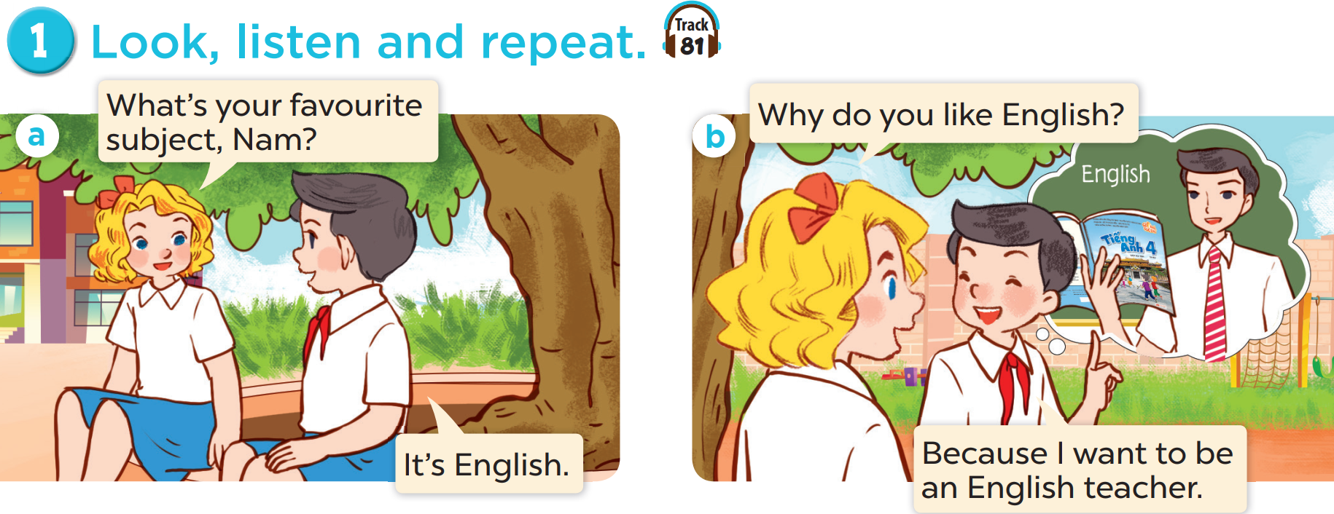

Slide 13
Listen, point and say.
3
3

Slide 14
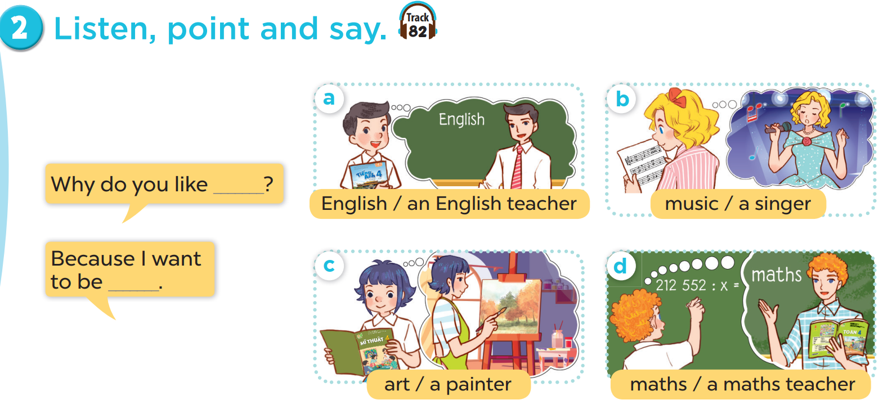

Slide 15


Slide 16
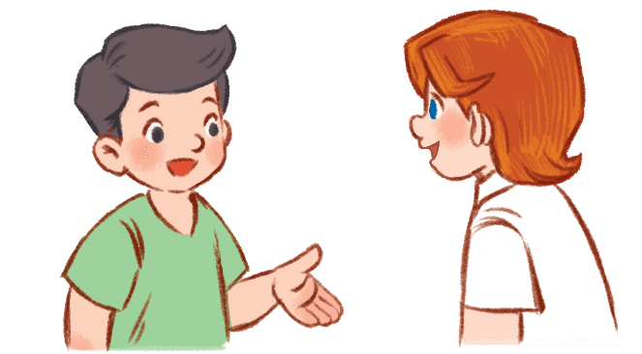
Let’s talk.
4
4

Slide 17
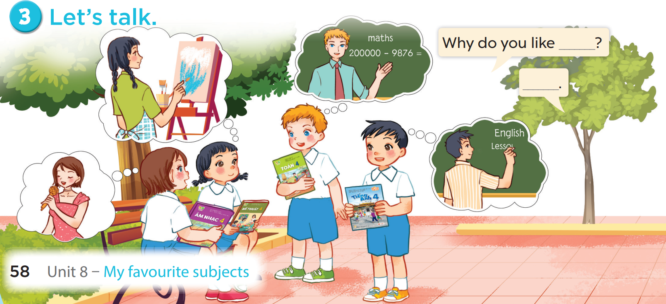

Slide 18
Fun corner and wrap-up
5
5
Game: Guessing game

Slide 19

SHOW

Slide 20

SHOW

Slide 21
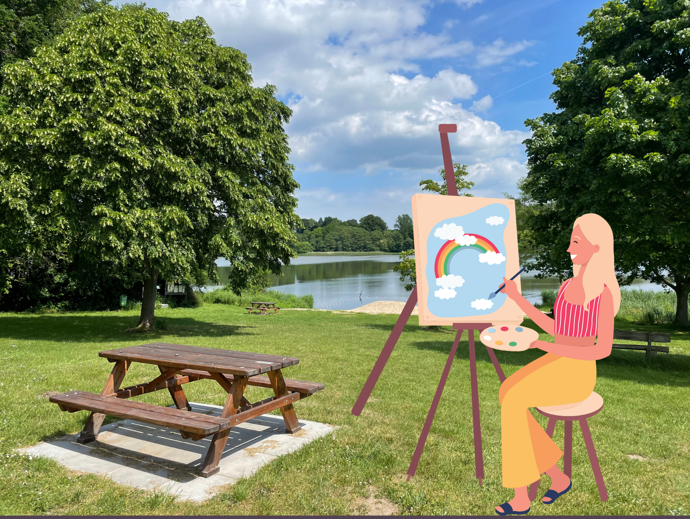
SHOW

Slide 22


