Slide 1

WELCOME TO MY CLASS
Teacher: Trần Thị Trang
Quoc Tuan Primary School

Slide 2




Slide 3



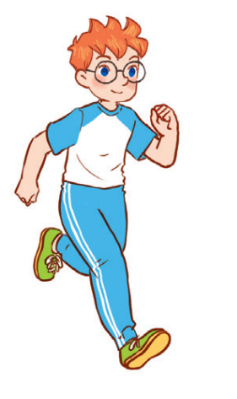
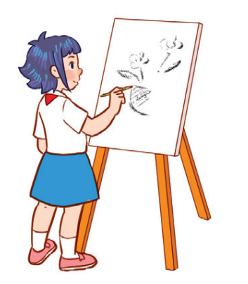
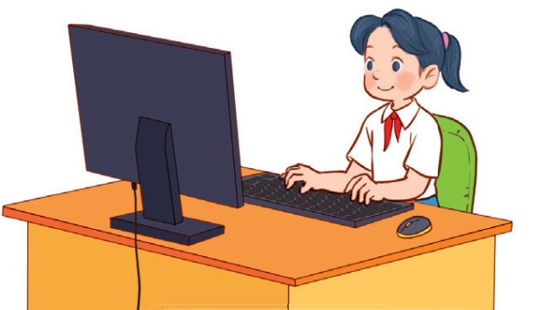
Unit 8
Period 4

Slide 4
Contents
2
1
3
Listen and number.
Look, complete and read.
Warm-up and review
5
4
Let’s play.
Fun corner and wrap-up

Slide 5
Warm-up and review
1
1
Game: Ask and answer.

Slide 6
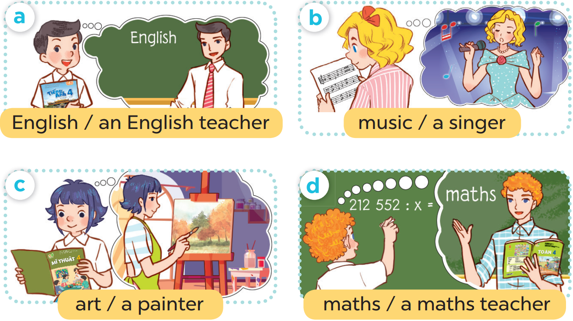

Slide 7
Listen and number.
2
2

Slide 8
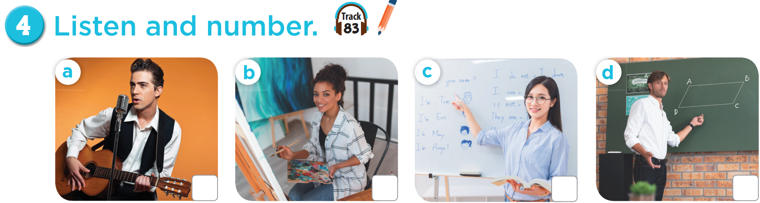


Slide 9
3
1
4
2

Slide 10
Look, complete and read.
3
3

Slide 11
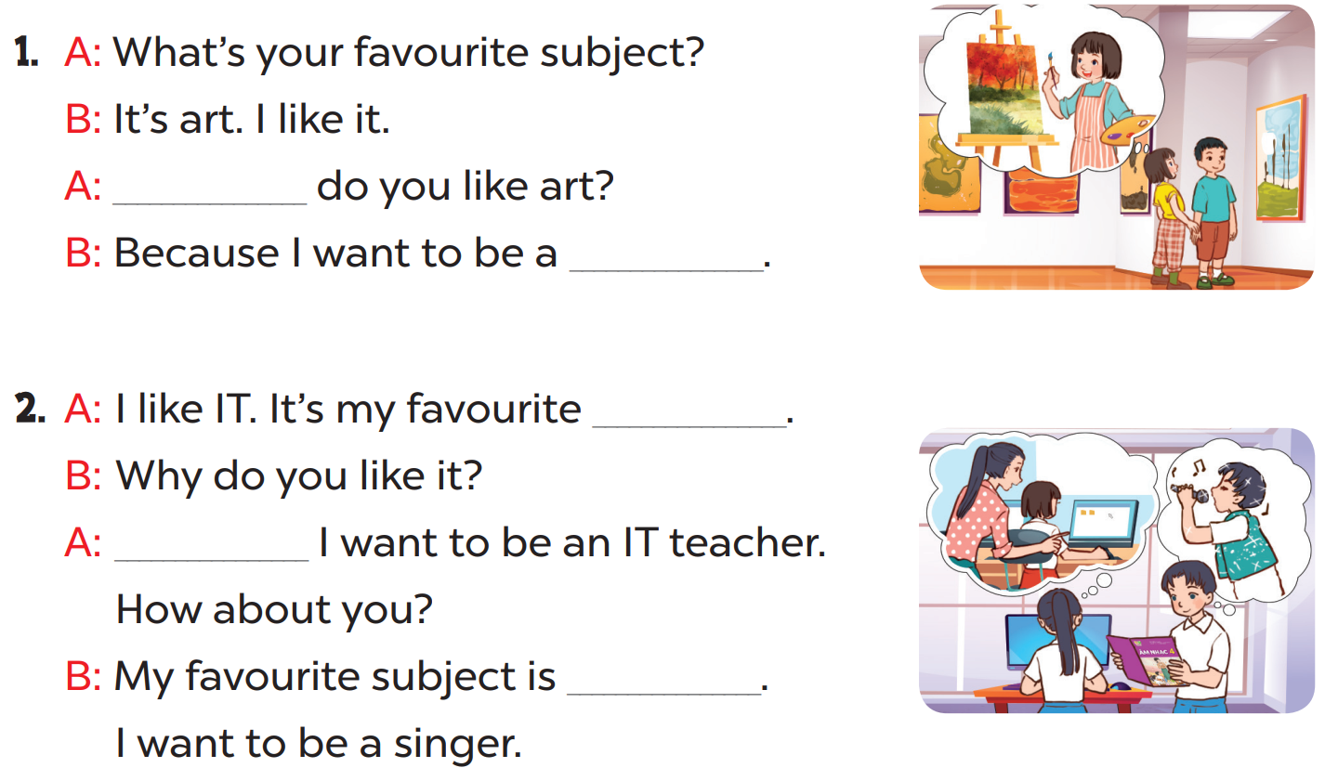

Slide 12
Why
painter
subject
Because
music

Slide 13
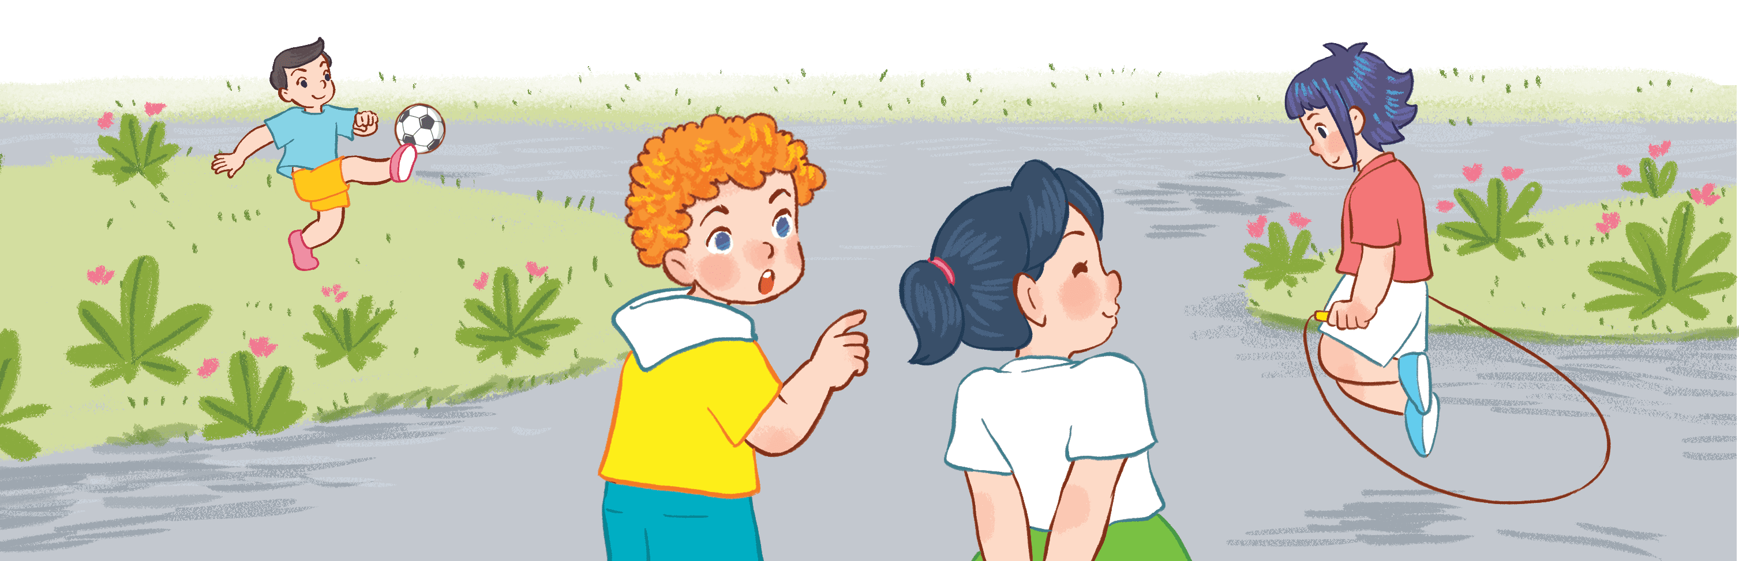
4
4
Let’s play.

Slide 14
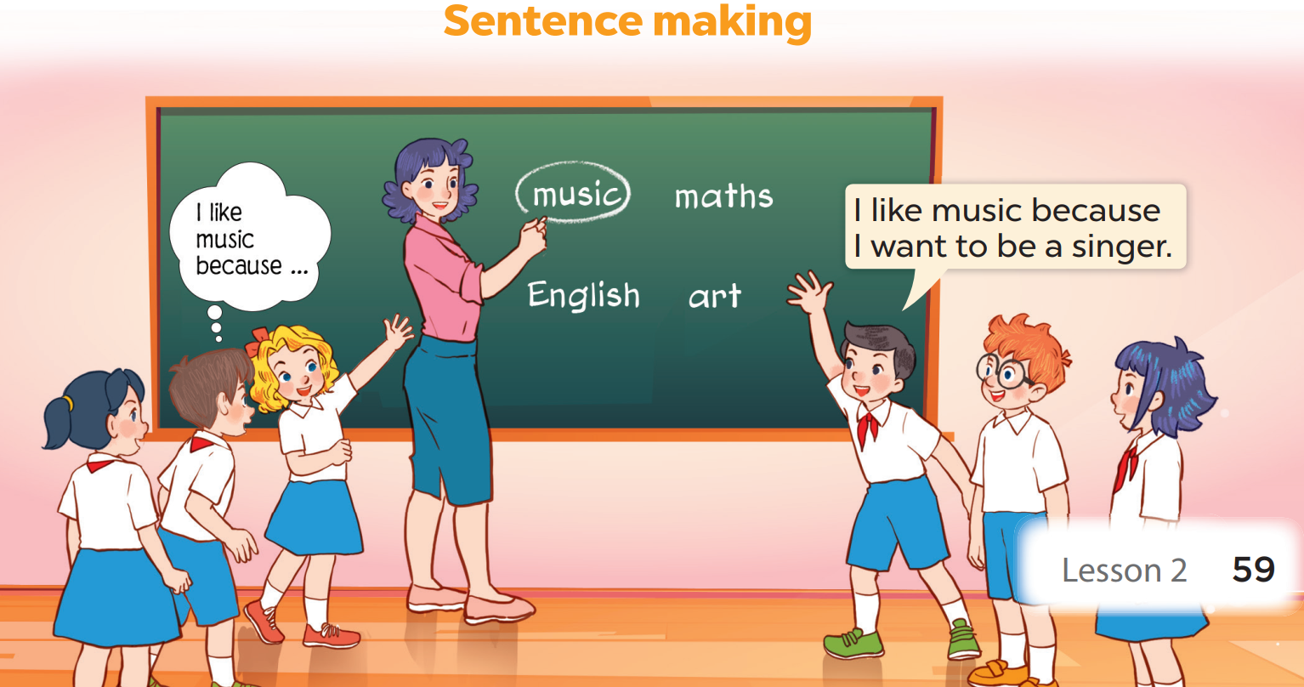

Slide 15
5
5
Fun corner and wrap-up

Slide 16

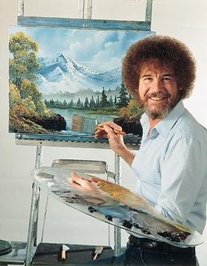
I
be
to
want
???
I want to be a painter.

Slide 17
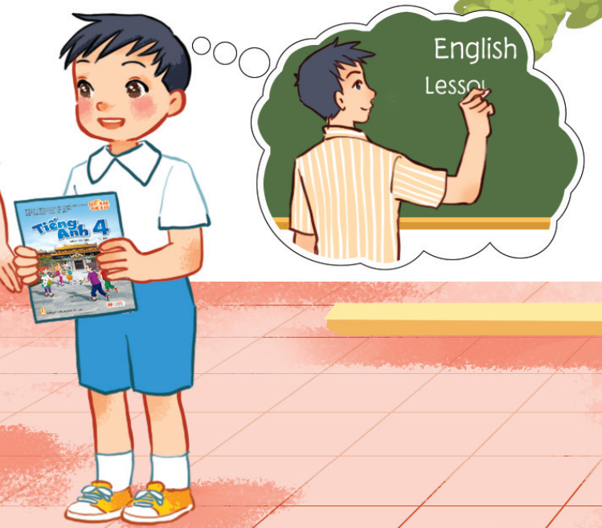
He
be
wants
to
???
He wants to be an English teacher.

Slide 18


What’s your favourite subject?
It’s ________.
Why do you like _________?
Because I want to be a _______.
music
music
singer

Slide 19
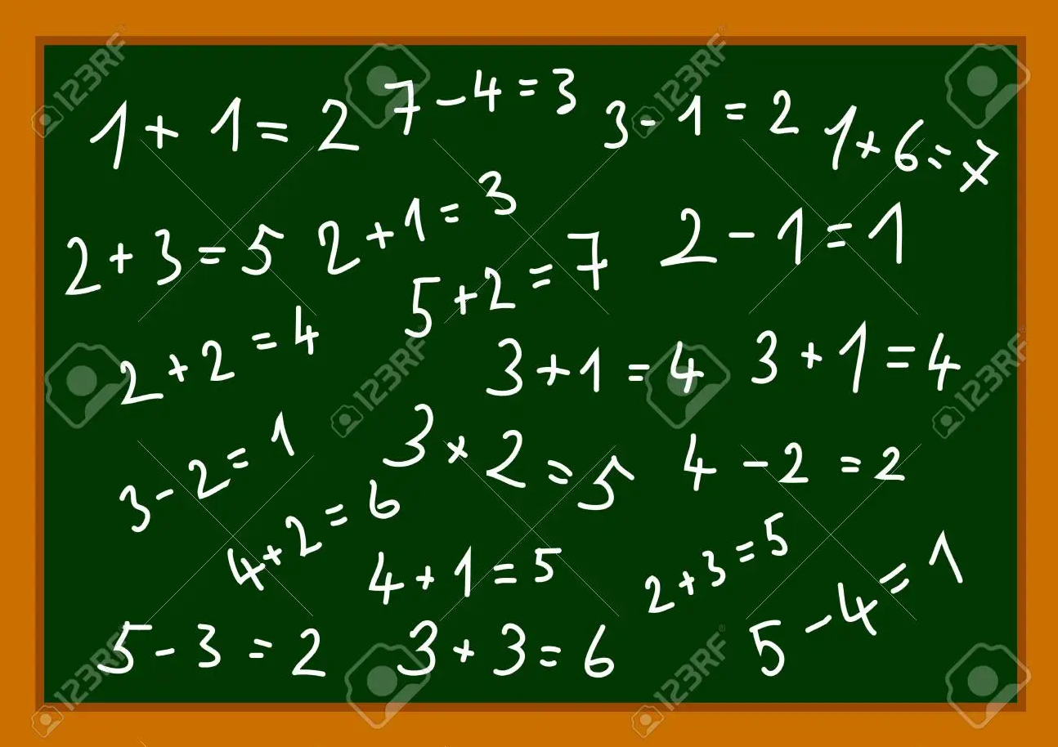
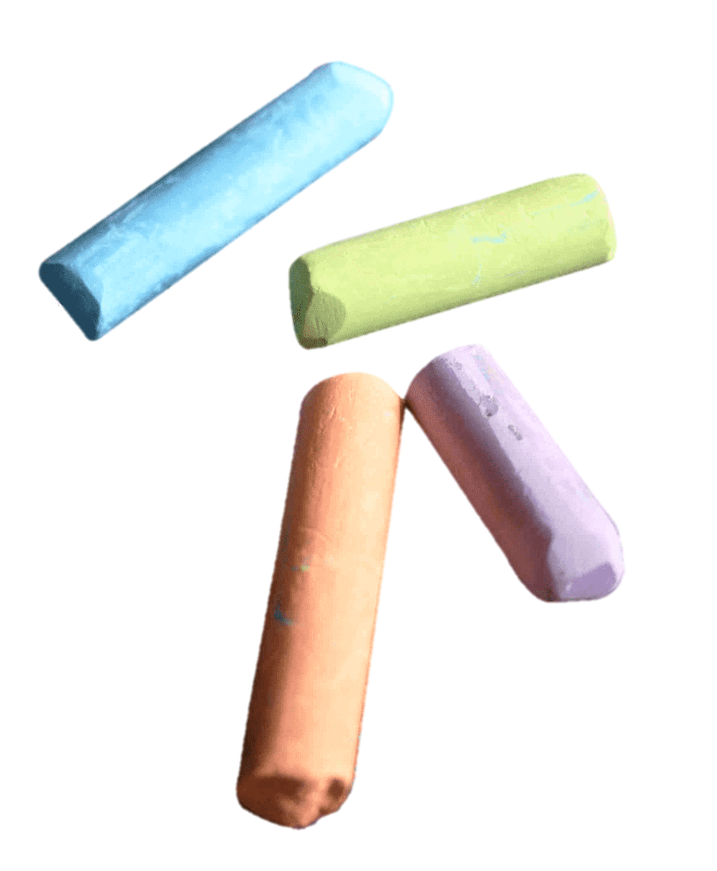
Make a dialogue with these clues!

Slide 20


