Slide 1
Unit 19
Which place would you like to visit?
Lesson 2

Slide 2
Vocabulary

Slide 3
Vocabulary
expect
exciting
beautiful
interesting
attractive
delicious
friendly
/ɪkˈspekt/
/ɪkˈsaɪtɪŋ/
/ˈbjuːtɪfl/
/ˈɪntrestɪŋ/
/əˈtræktɪv/
/dɪˈlɪʃəs/
/ˈfrendli/
: Chờ đợi, tưởng
: Thú vị
: Đẹp
: hấp dẫn
: hấp dẫn
: thơm ngon
: thân thiện

Slide 4





Look and match
1.
2.
3.
4.
5.
exciting
expect
interesting
friendly
delicious
a.
b.
c.
d.
e.
Hấp dẫn
Thân thiện
Thơm ngon
Thú vị
Chờ đợi

Slide 5
Grammar

Slide 6
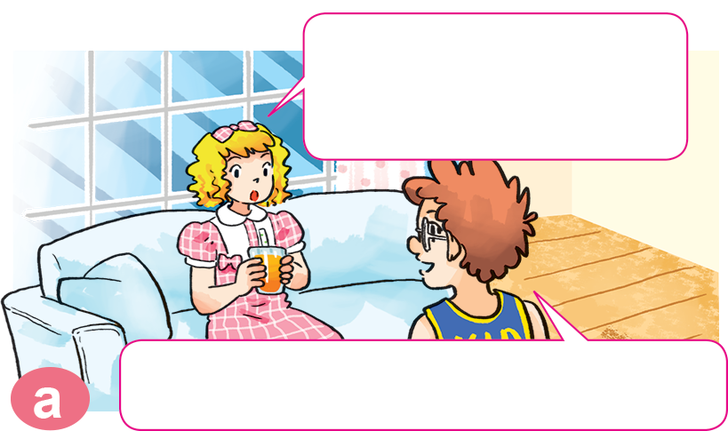
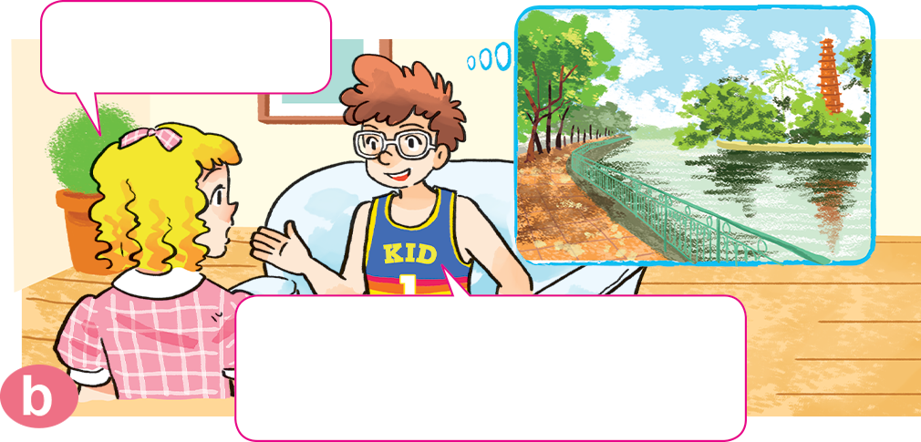

1. Look, listen and repeat.
What did you do yesterday?
Where is it?
It's on an island in the middle of West Lake.
I visited Tran Quoc Pagoda.

Slide 7
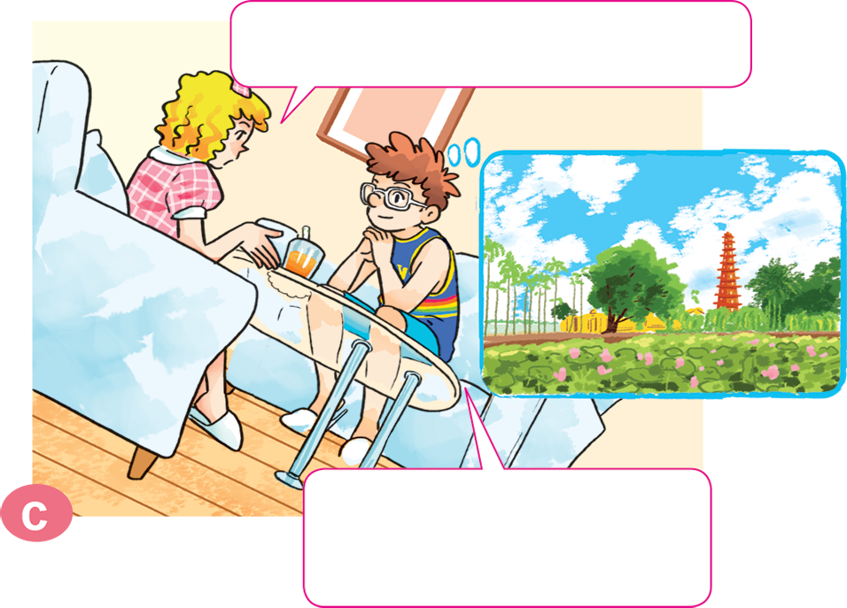
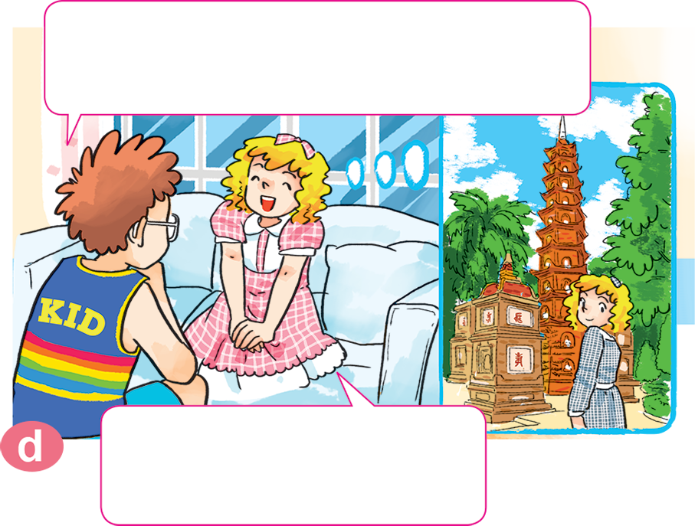
1. Look, listen and repeat.
What do you think of it?
The pagoda is really beautiful. I enjoyed the visit very much.
It's more beautiful than I expected.
That's great. I think I'll visit it one day.

Slide 8


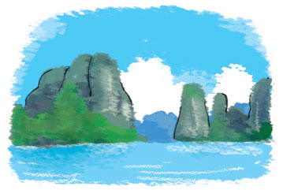
2. Point and say
What do you think of ________________ ?
Ha Long Bay
It's more ____________
than I expected.
attractive

Slide 9
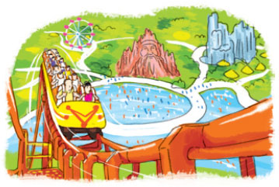
2. Point and say
What do you think of ________________ ?
Dam Sen Park
It's more ____________
than I expected.
exciting

Slide 10
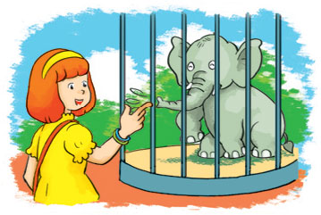
2. Point and say
What do you think of ________________ ?
Thu Le zoo
It's more ____________
than I expected.
interesting

Slide 11
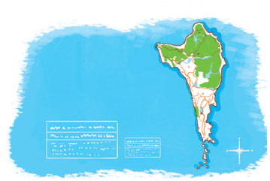
2. Point and say
What do you think of ________________ ?
Phu Quoc Island
It's more ____________
than I expected.
beautiful

Slide 12
3. Let’s talk.
Where did you go ______________?
I went to ______________.
What do you think of ______________?
It's more ______________ than I expected.

Slide 13


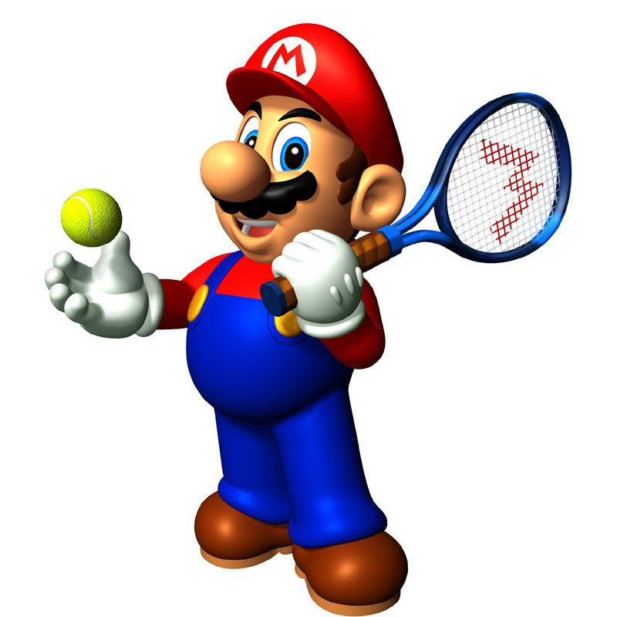





Slide 14
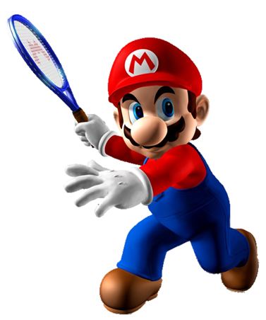
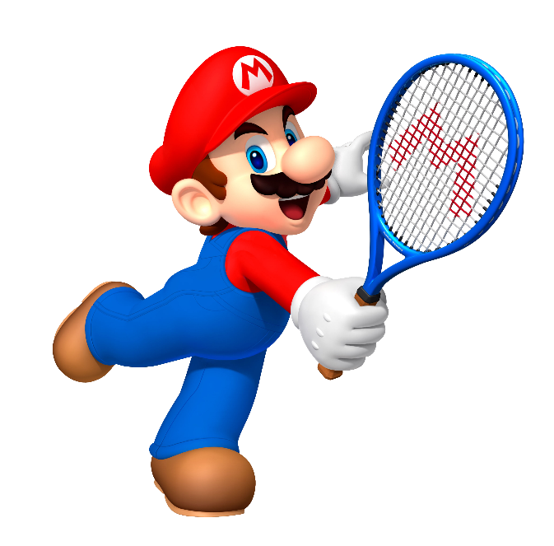


attractive
What do you think of
Ha Long Bay?
It’s more _________ than
I expected.
big
I wants

Slide 15
small
What do you think of
Dam Sen Park?
It’s more _________ than
I expected.
exciting
Intelligent

Slide 16
beautiful
What do you think of
Phu Quoc Island?
It’s more _________ than
I expected.
far
I wants

Slide 17
bored
What do you think of
Thu Le Zoo?
It’s more _________ than
I expected.
interesting
Intelligent

Slide 18
I expecting
I expect
What do you think of Nha Trang?
It’s more beautiful than
____________.
I expected

Slide 19
usually
more
What do you think of Ha Noi?
It’s ____ interesting than
I expected.
very

Slide 20
think of
think
What do you _____ Vietnamese?
They’re more friendly than
I expected.
thinking of

Slide 21
What are you think of
What do you think of
____________ Vietnamese food?
They’re more delicious than
I expected.
What do you think

Slide 22
more interesting than
interesting than
What do you think of Cat Ba Island?
It’s _________
I expected.
more interesting

Slide 23
atractive
more than
More than atractive
What do you think of Hue Imperia City?
It’s _________
I expected.
more atractive
than

Slide 24
Time’s up!

Slide 25




The bye bye song
Bye, bye.
See you tomorrow.
Bye, bye.
See you tomorrow.
Bye, bye.
See you tomorrow.
Bye, bye. Bye, bye.
The bye bye song

