Slide 1


Slide 2



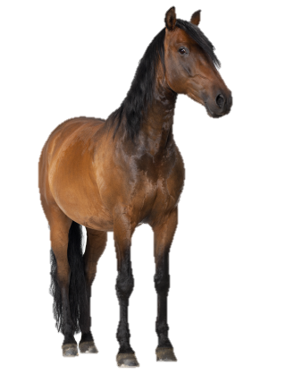
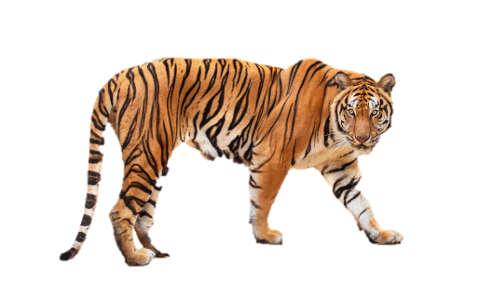


At the zoo
20
LESSON 1
Period 1

Slide 3












1
Warm-up and review

Slide 4
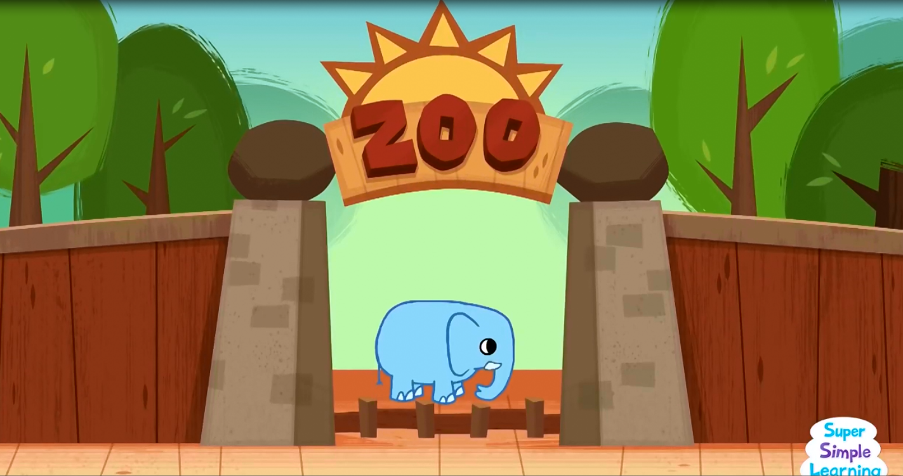
Notes:
Option 1: Sing a “At the zoo” song
https://www.youtube.com/watch?v=OwRmivbNgQk

Slide 5

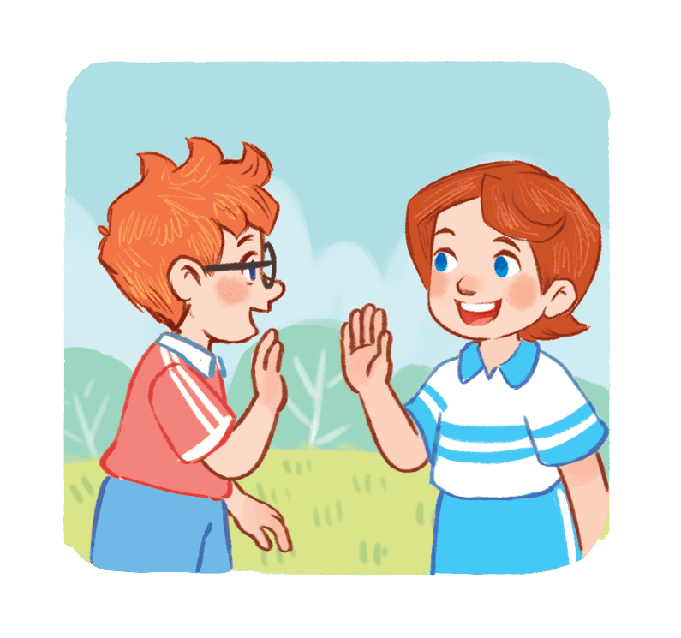
What’s your favourite animal?
I like....
Notes:
Option 2: Ask pupils if they have ever been to the zoo and what animals they saw. (Pupils can show their pictures at the zoo if they want). Then introduce the animal names and key expressions for the lesson.

Slide 6
2
Look, listen and repeat.

Slide 7
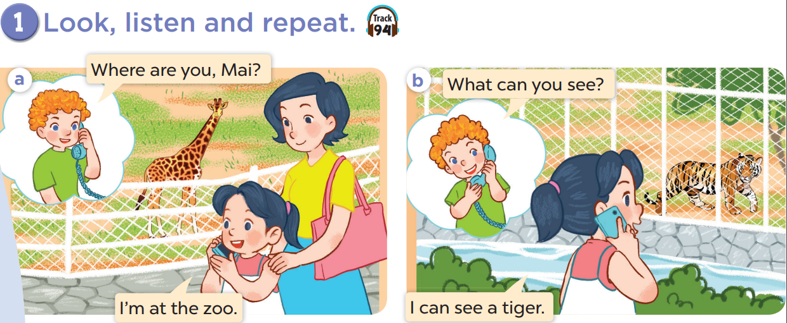


Slide 9
3
Listen, point and say.

Slide 10
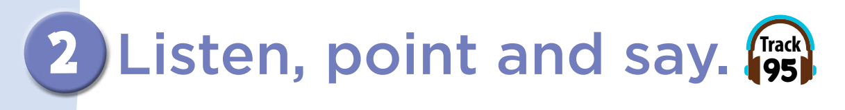
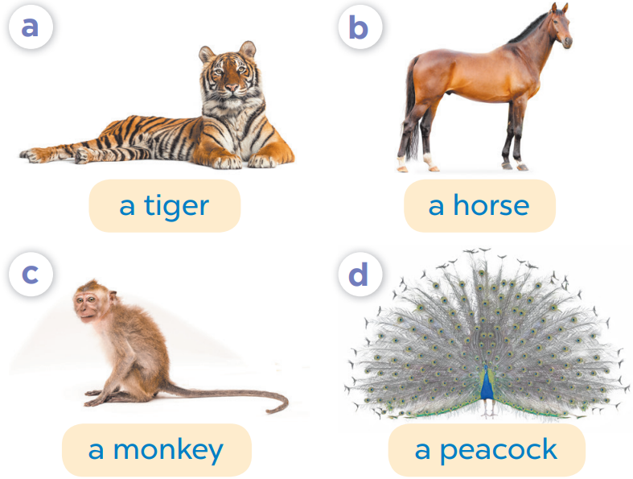
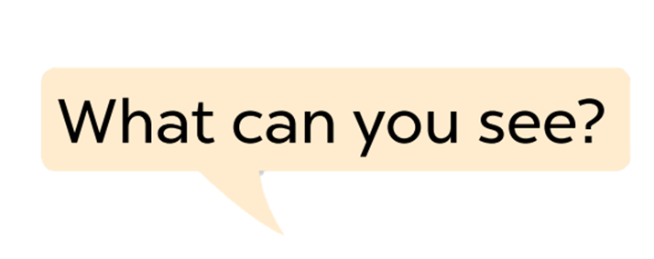

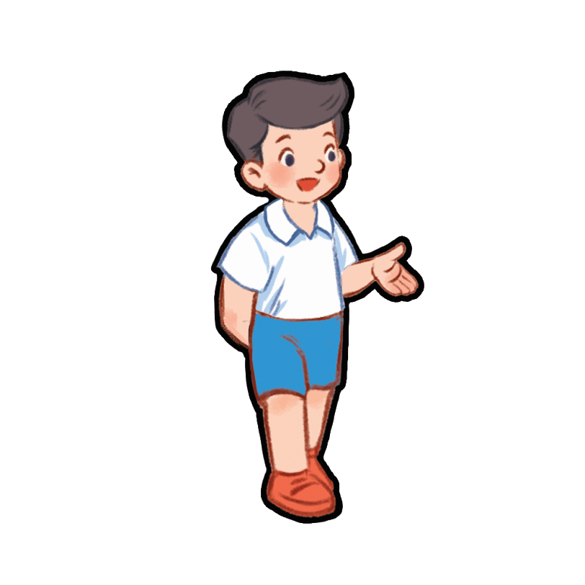
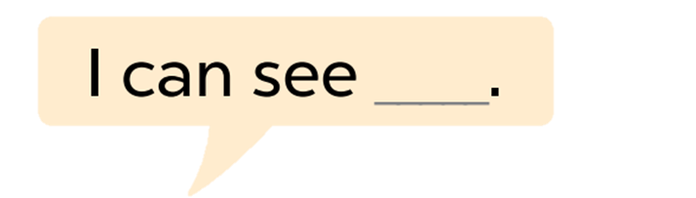

Slide 11
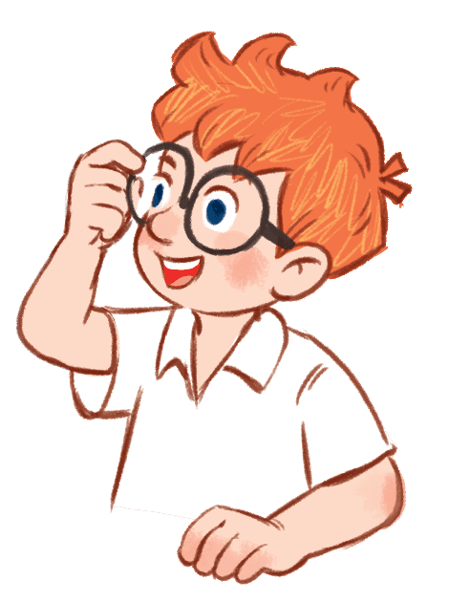

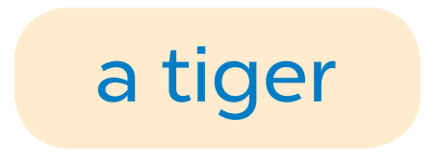

Slide 12
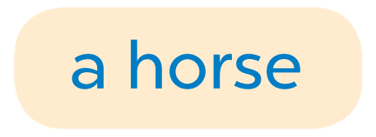

Slide 13
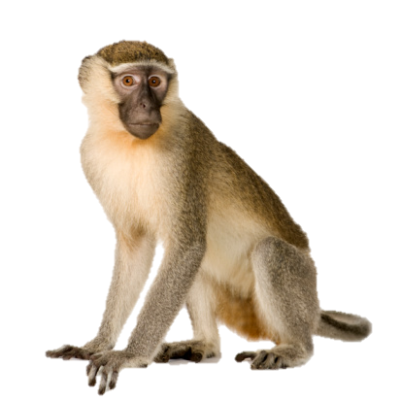
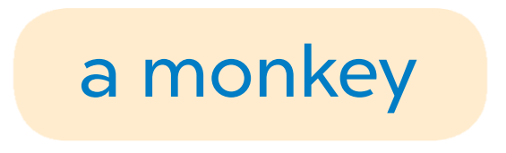

Slide 14
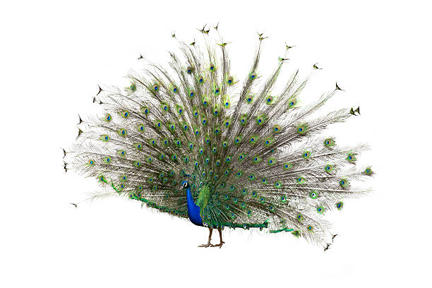


Slide 15
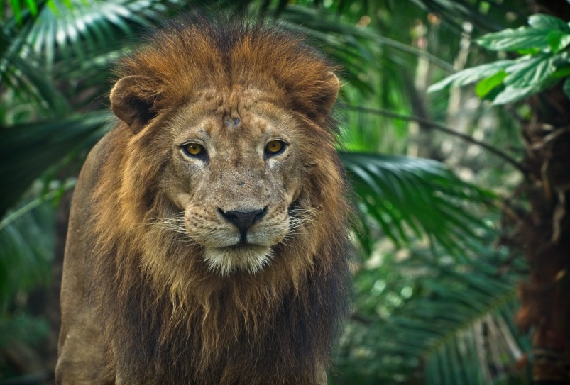
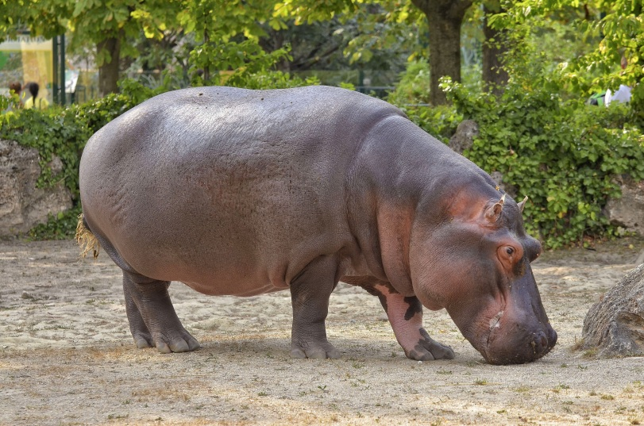
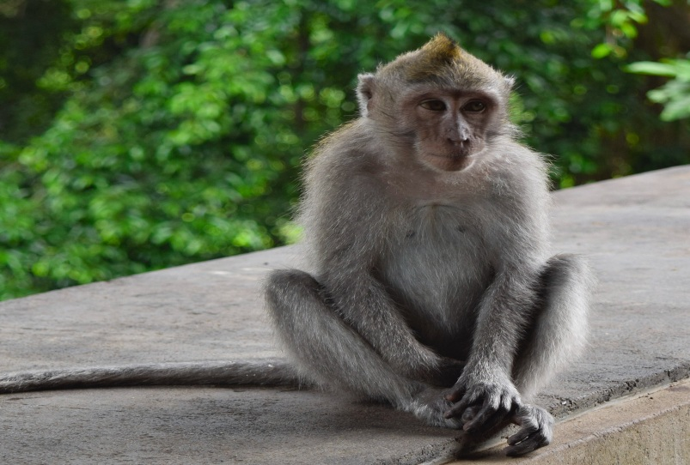
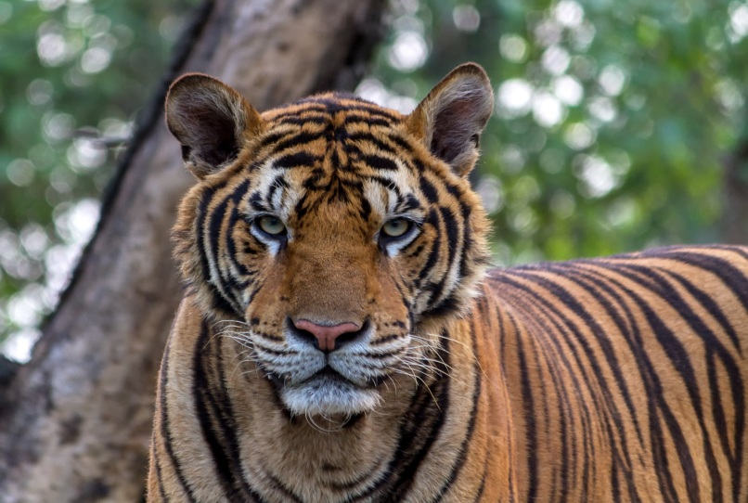
Listen and choose.
A
B
C
D
Notes:
Mini game: Listen and choose
Teacher asks pupils to listen carefully, then choose the correct answer. Write it on the board.
Key: D

Slide 16
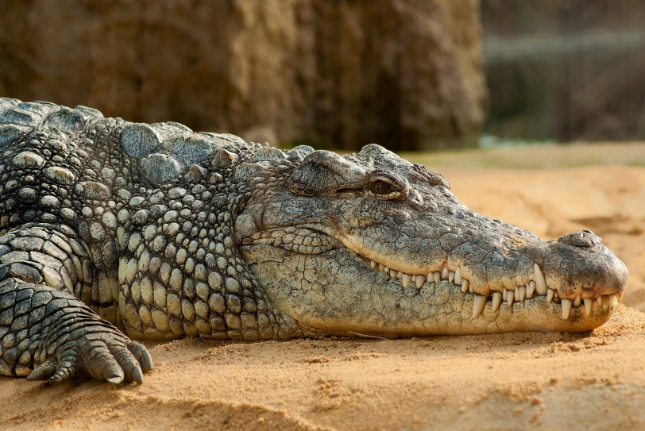
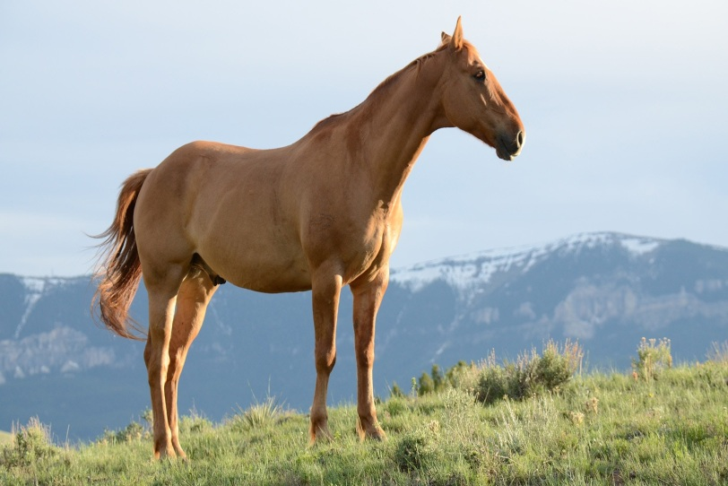
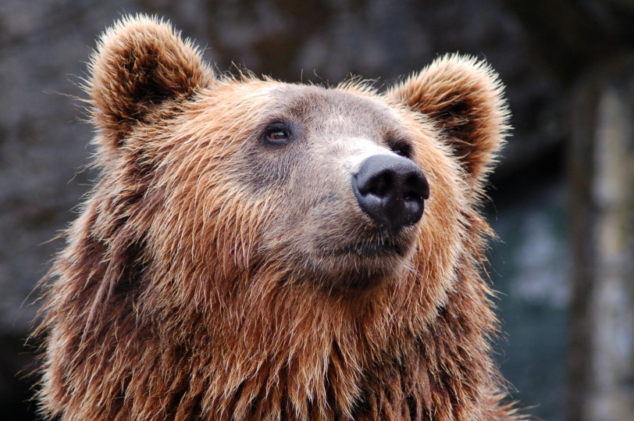
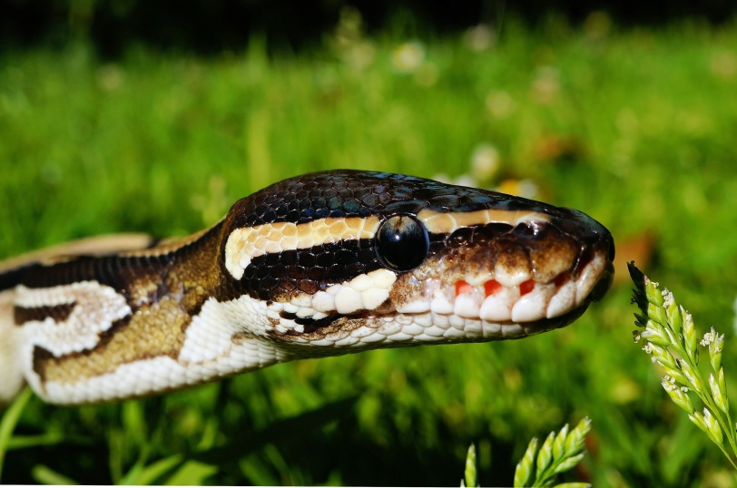
Listen and choose.
A
B
C
D
Notes:
Key: B

Slide 17
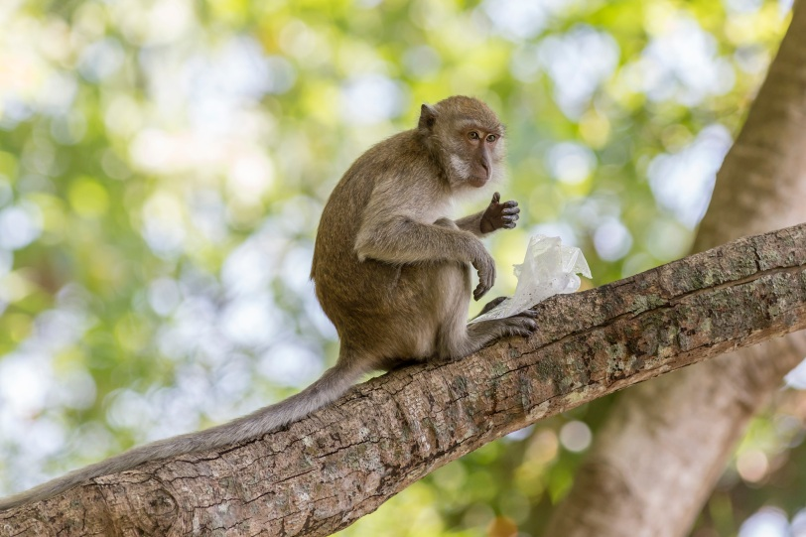
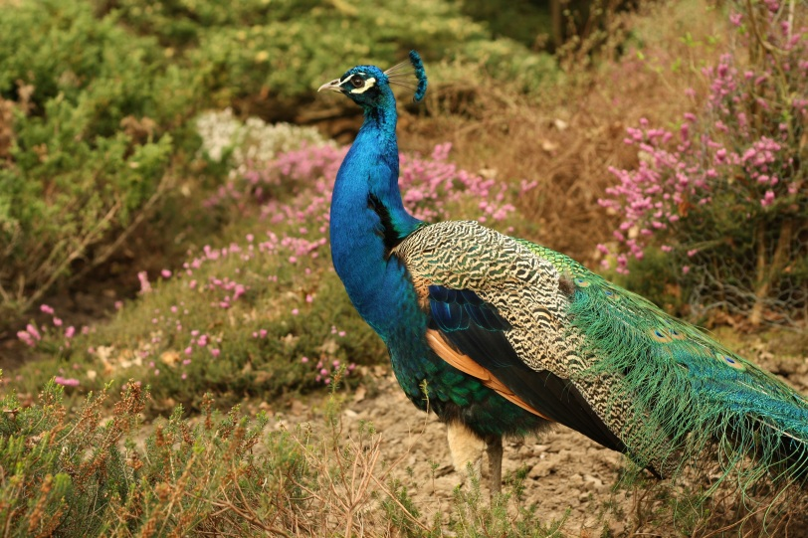
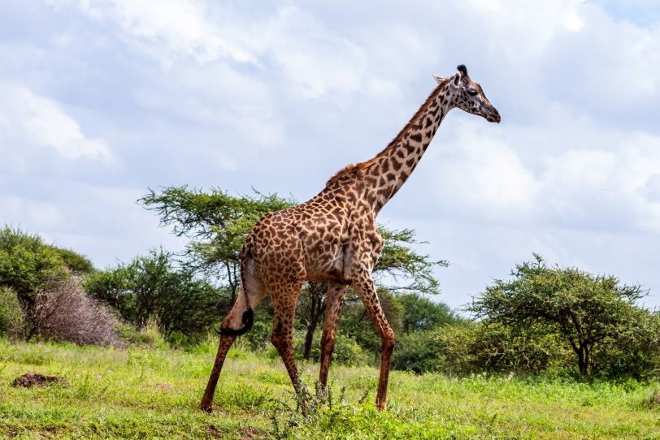
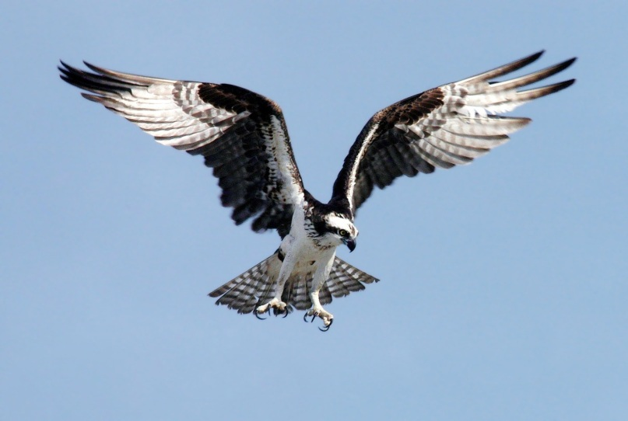
Listen and choose.
A
B
C
D
Notes:
Key: A

Slide 18
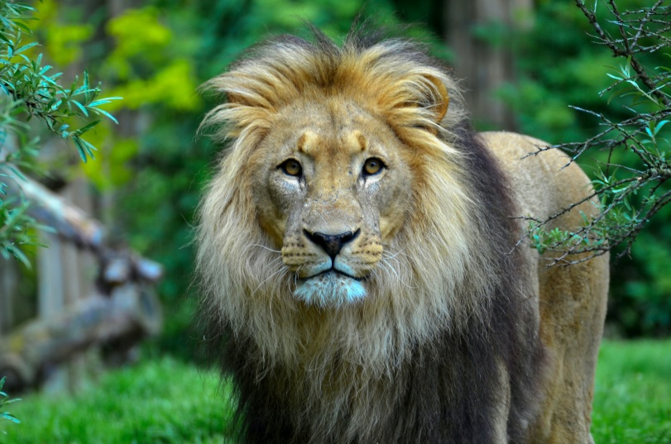
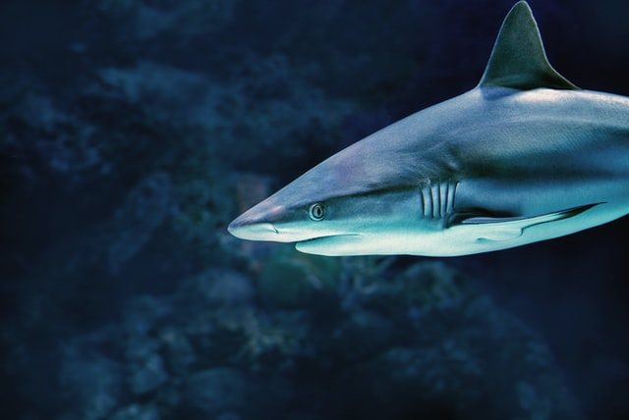
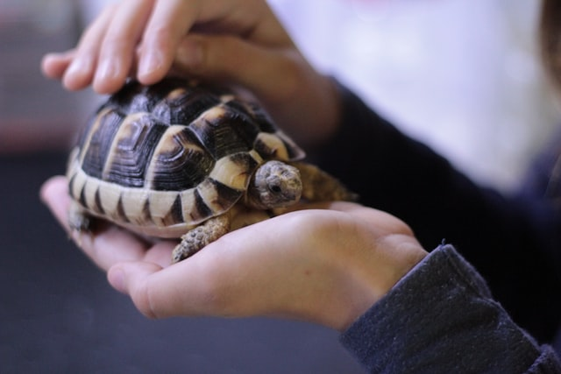
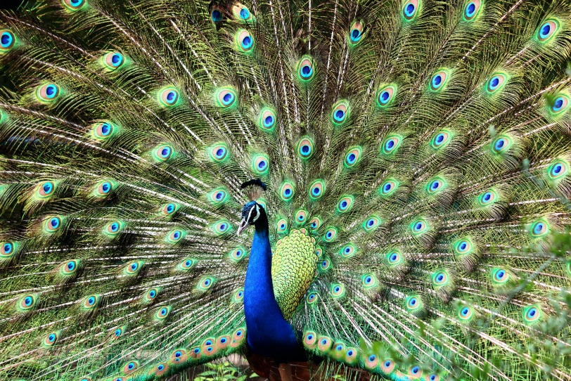
Listen and choose.
A
B
C
D
Notes:
Key: D

Slide 19
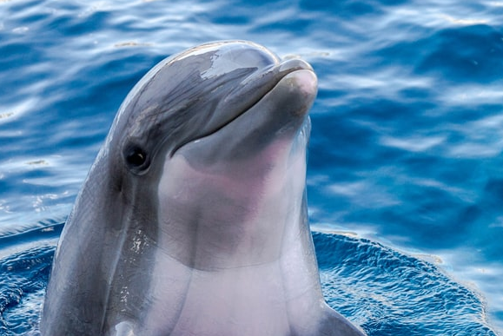
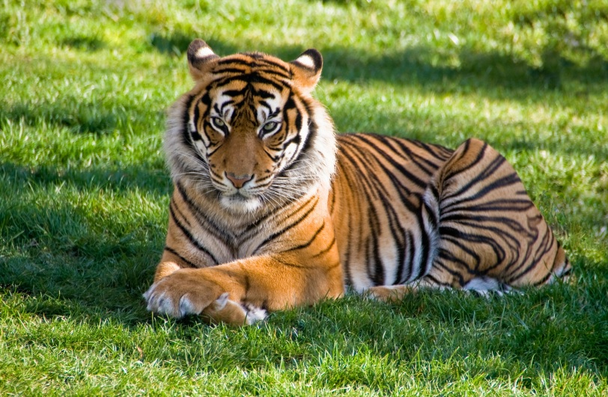
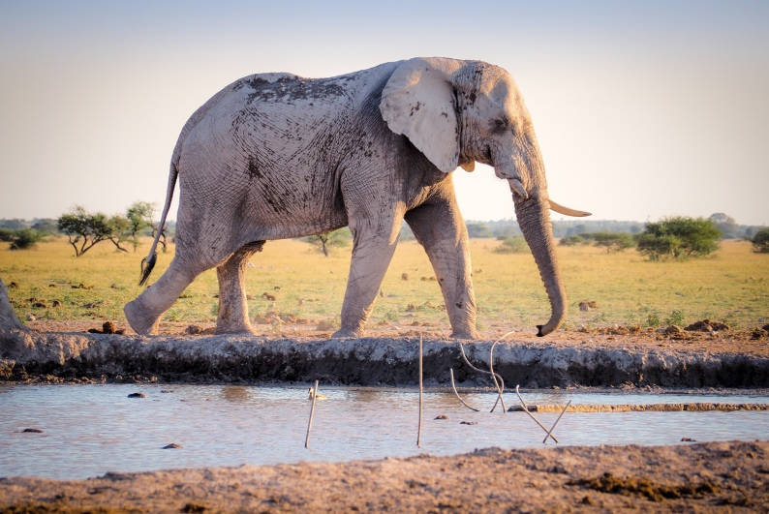
Listen and choose.
A
B
C
D
Notes:
Key: C

Slide 20
4
Let’s talk!

Slide 21

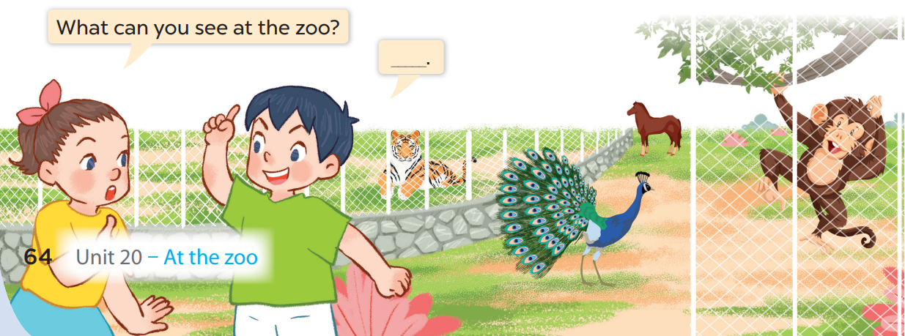




Slide 22
I can see a monkey and a tiger.

Slide 23
I can see a horse and a peacock.

Slide 24
5
Fun corner and wrap-up

Slide 25



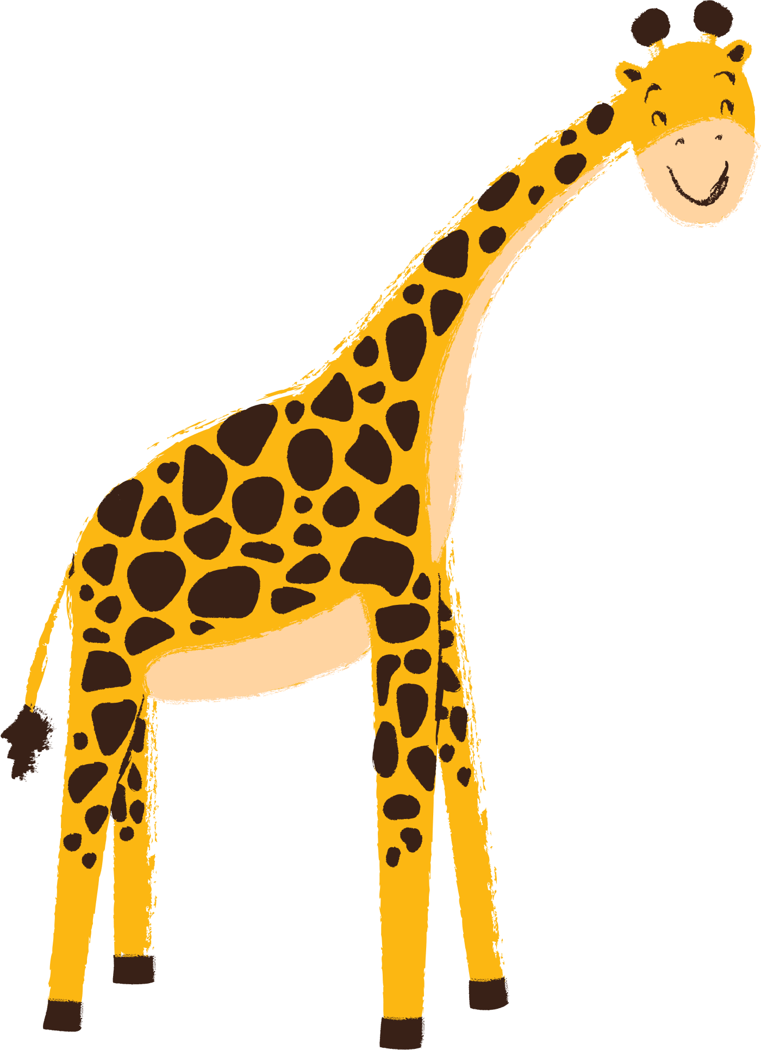


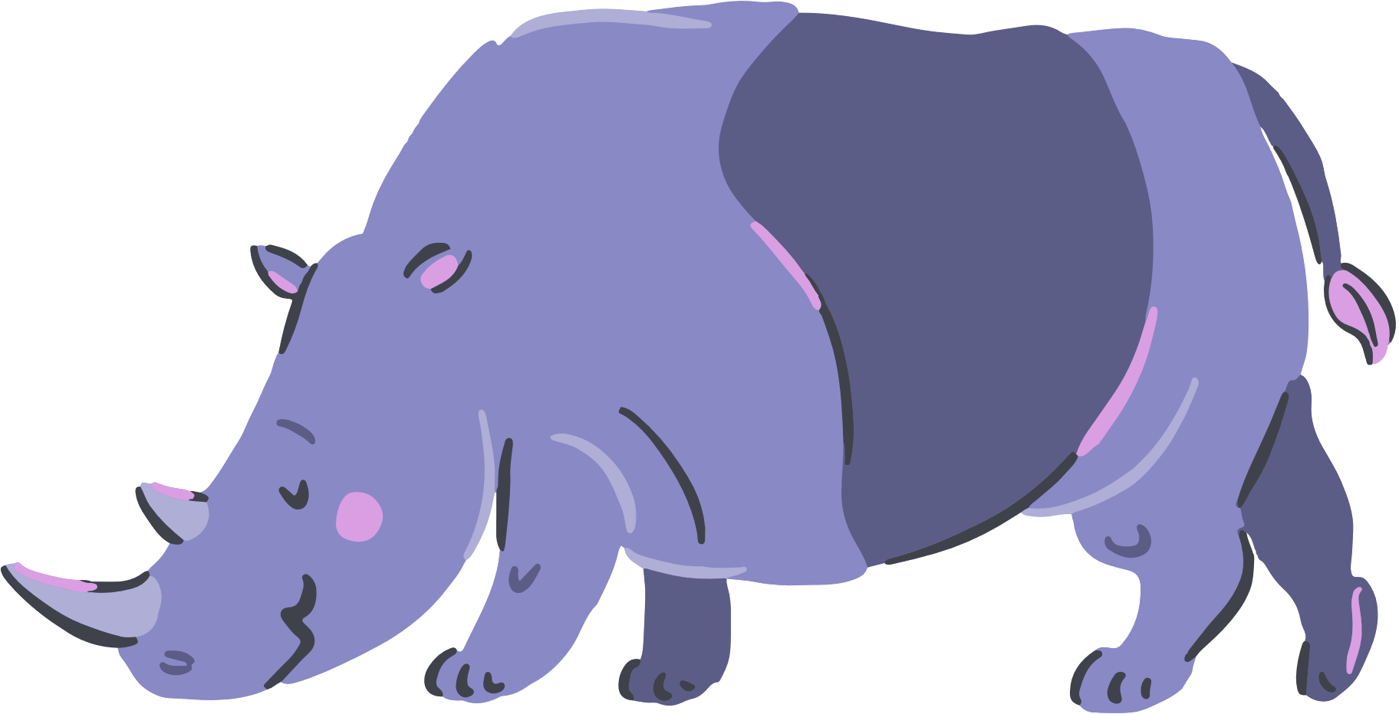



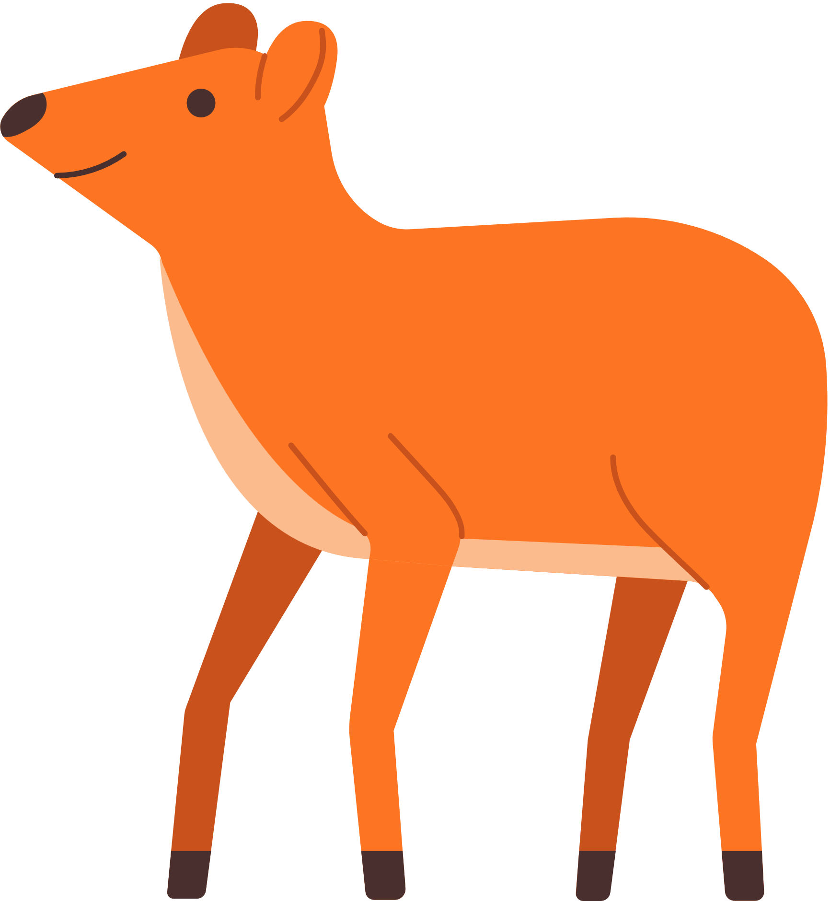
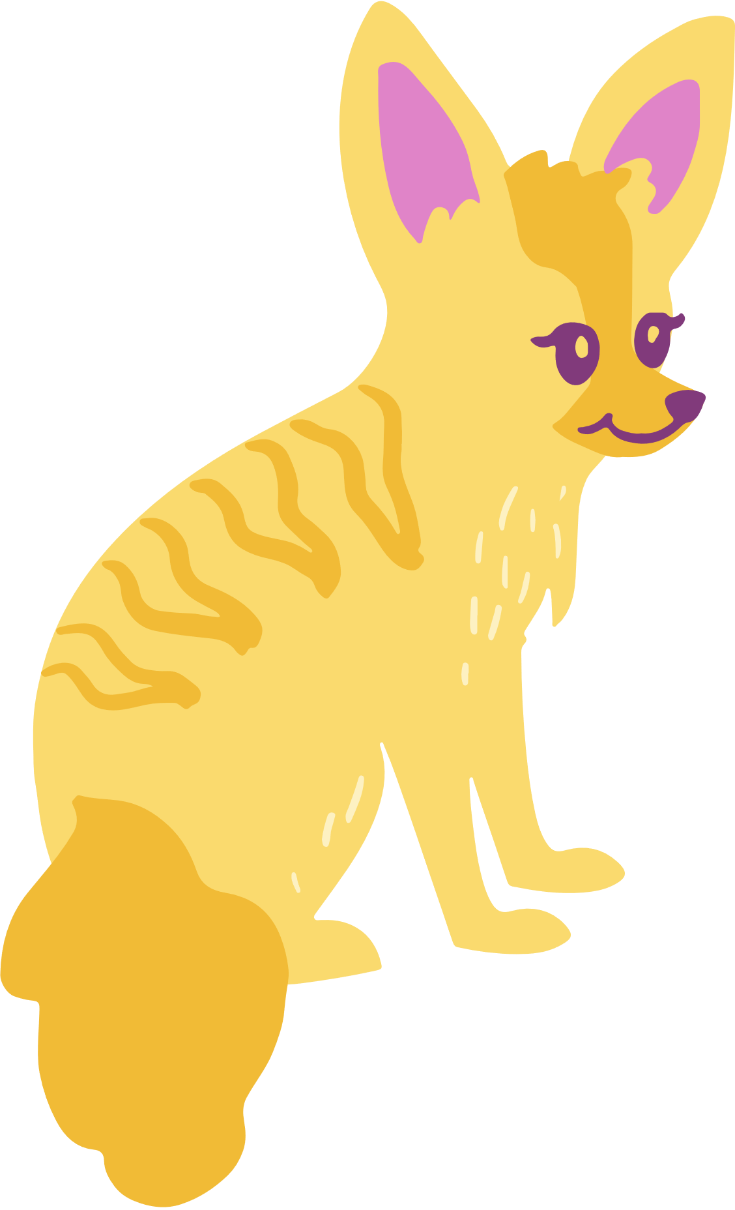


Notes:
Game: Animal sounds
Ask pupils to listen to the sound carefully, then guess the animal’s name.
Teacher: What do you hear?
Pupils: It’s a ______

Slide 26
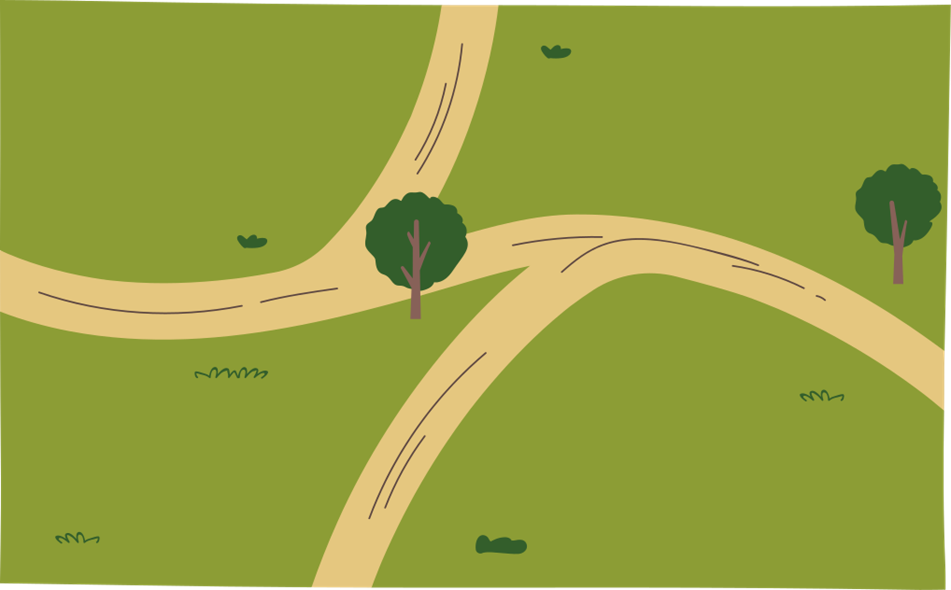
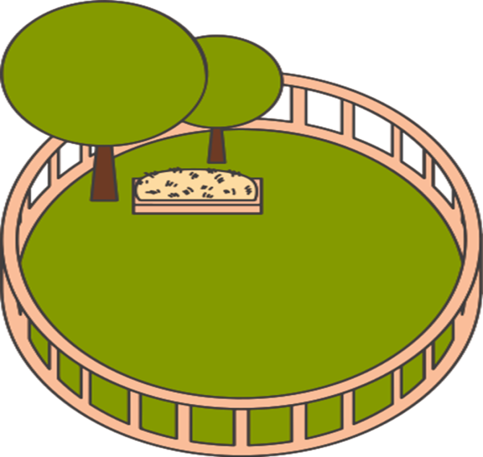
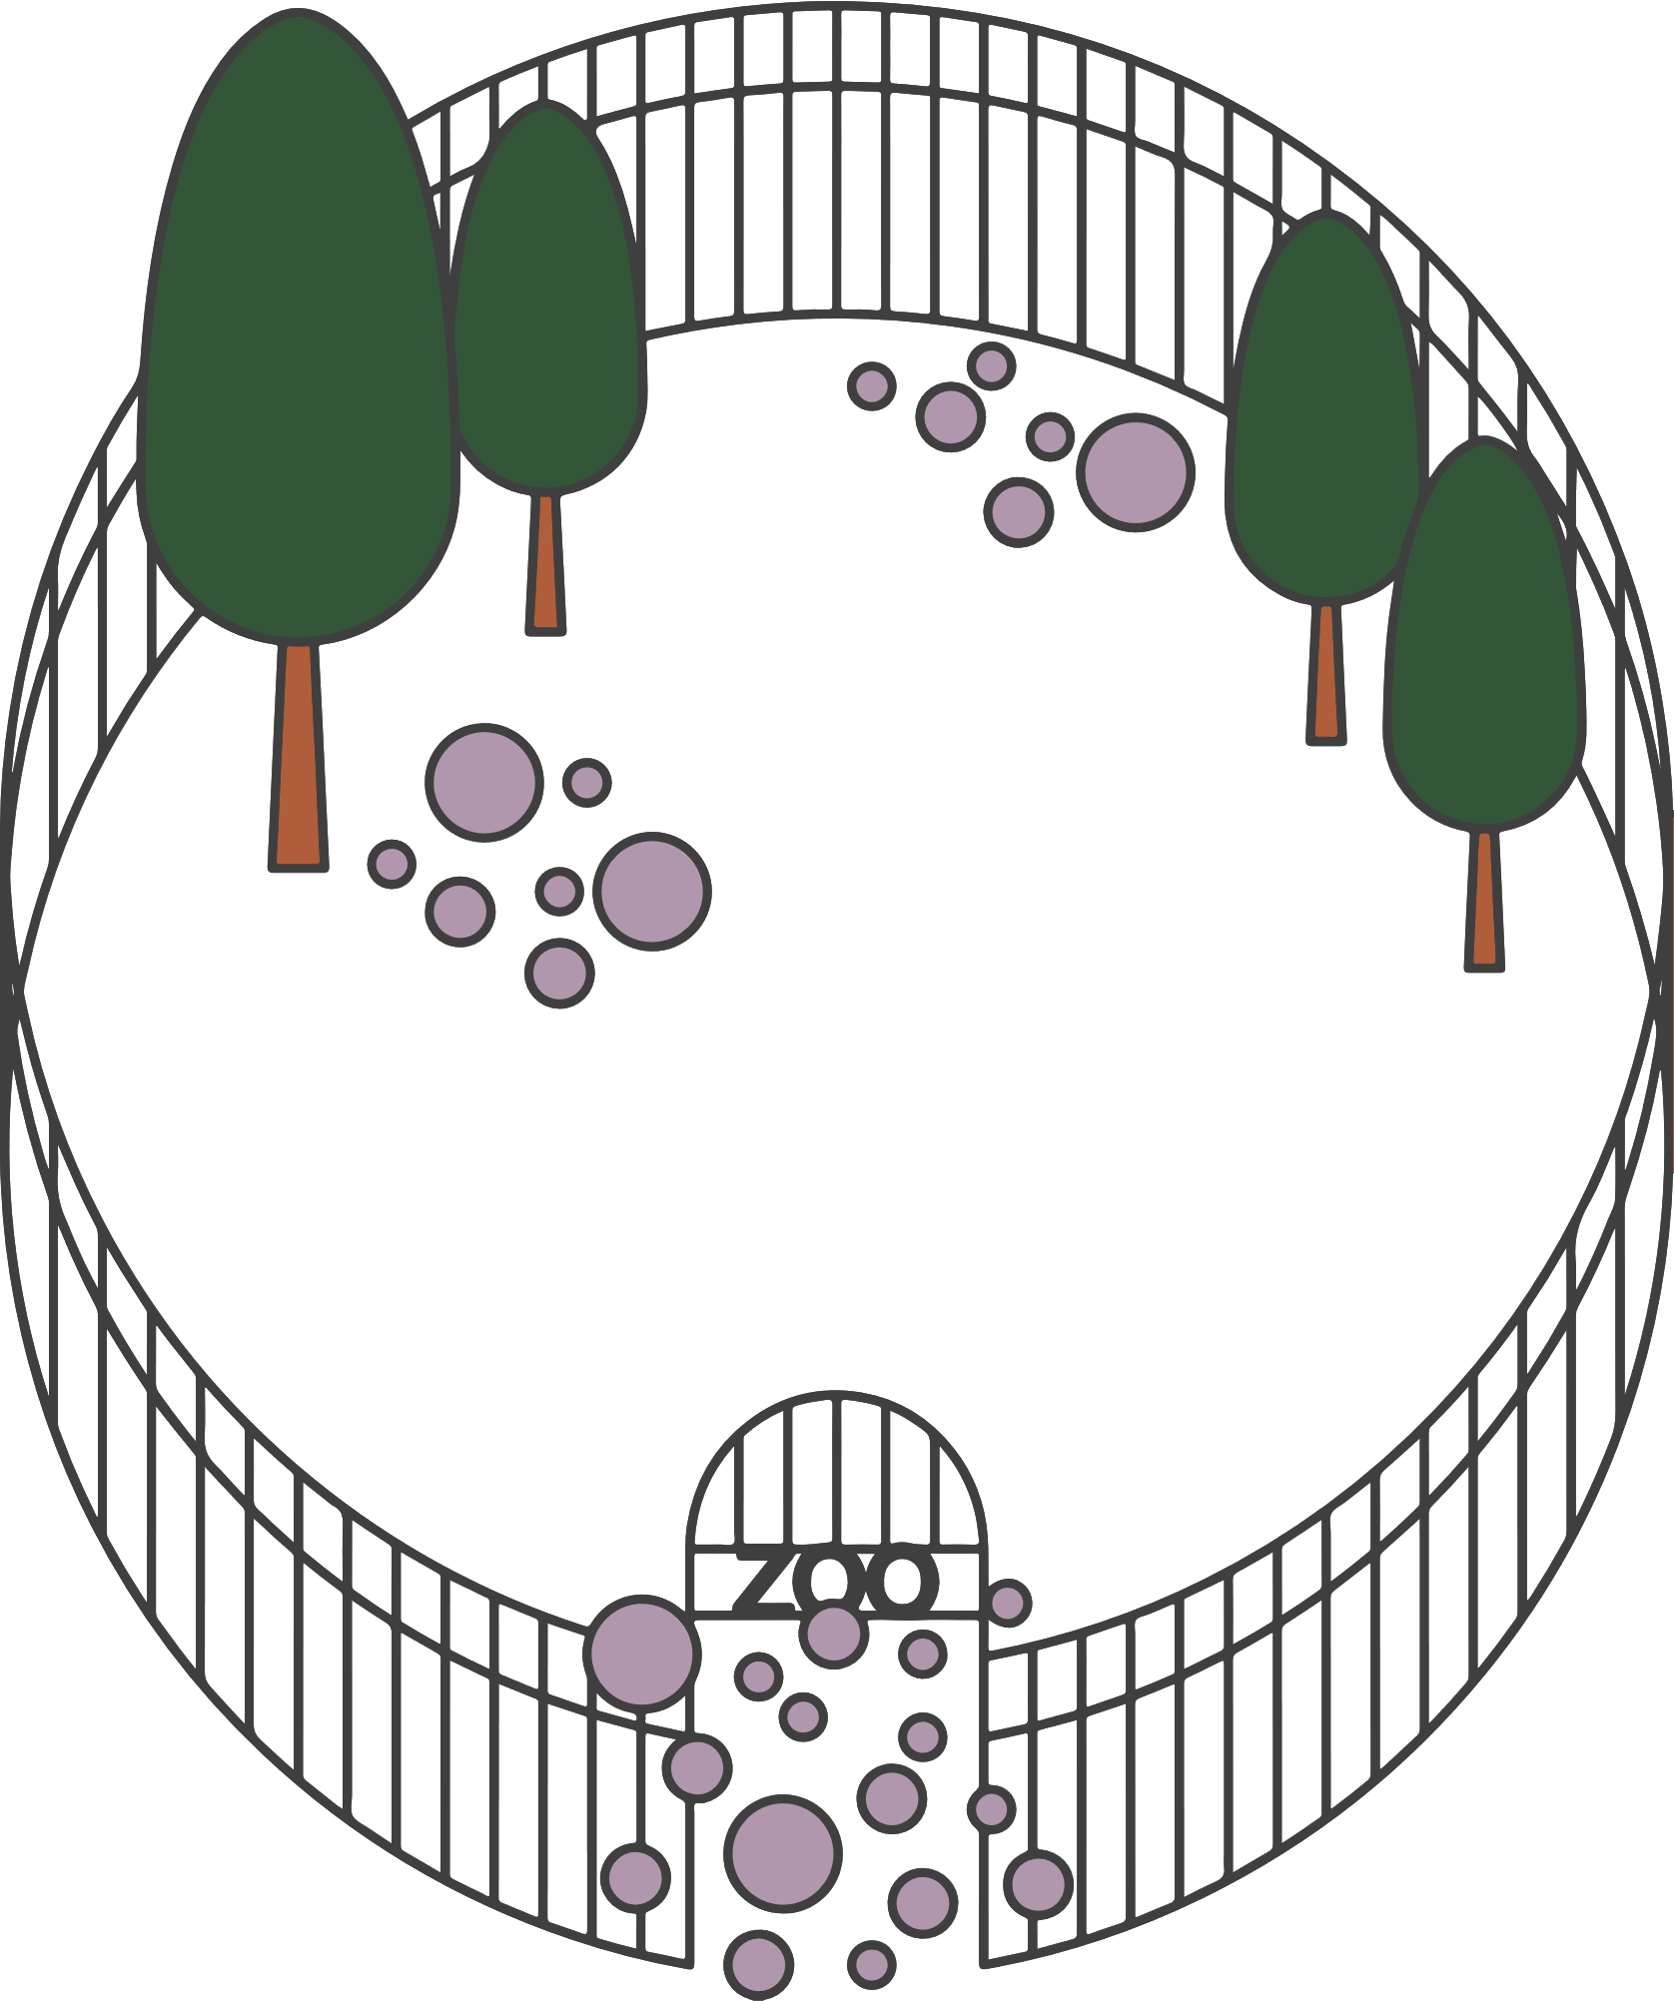



1
2
3
4

Slide 27

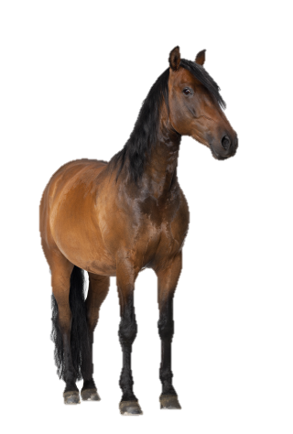
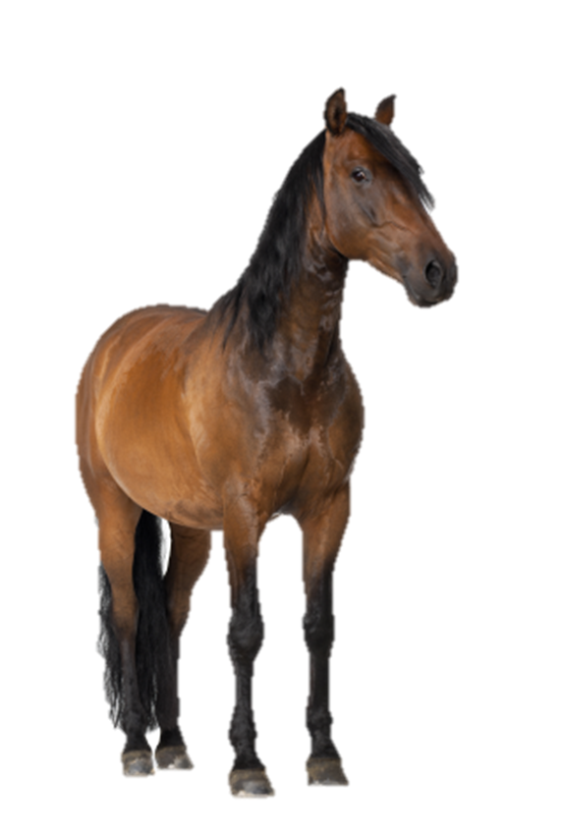

1
horse

Slide 28

2
tiger

Slide 29
3
monkey

Slide 30
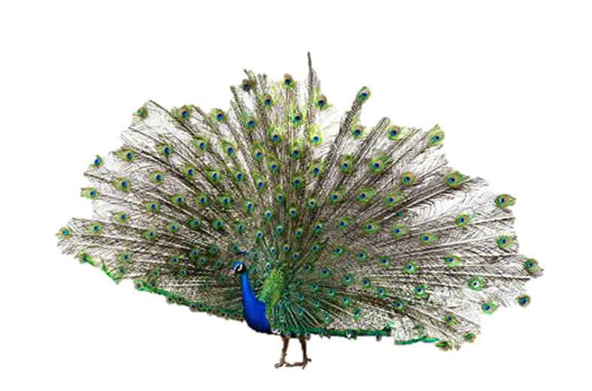
4
peacock

Slide 31

Website: hoclieu.vn
Fanpage: facebook.com/www.tienganhglobalsuccess.vn

