Slide 1
Table of contents
01
Warm-up
04
02
03
Let’s talk.
Look, listen and repeat.
05
Fun corner & wrap-up
Listen, point and say.

Slide 2
01
Warm-up

Slide 3




Notes:
FLASH THE CARDS TO CONSOLIDATE PUPILS’ PRONUNCIATION AND SPEELING

Slide 4



WHAT DAY IS IT?

Slide 5

WHAT DAY IS IT?

Slide 6
02
Activity 1
Look, listen and repeat.

Slide 7

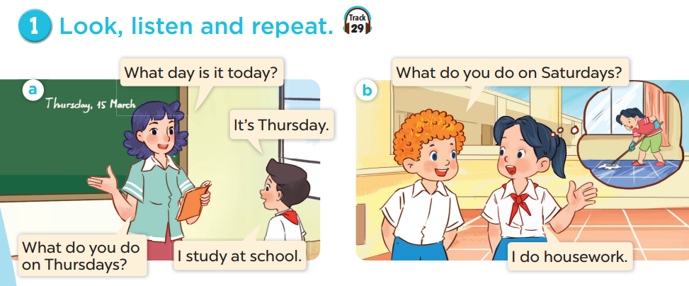

Slide 8
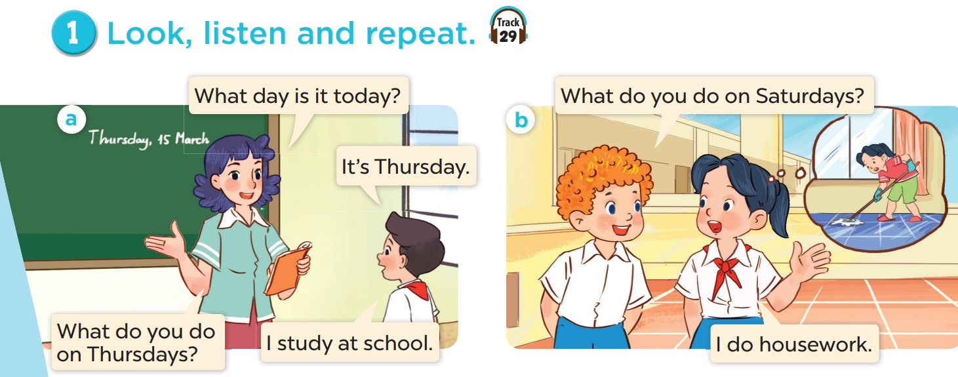
Explore the dialogues.
Notes:
EXPLORE THE QUESTIONS

Slide 9
03
Activity 2
Listen, point and say.

Slide 10
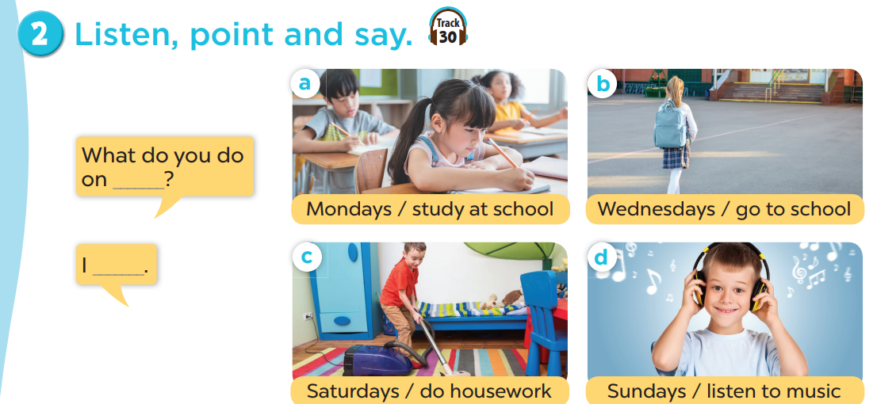

Slide 11
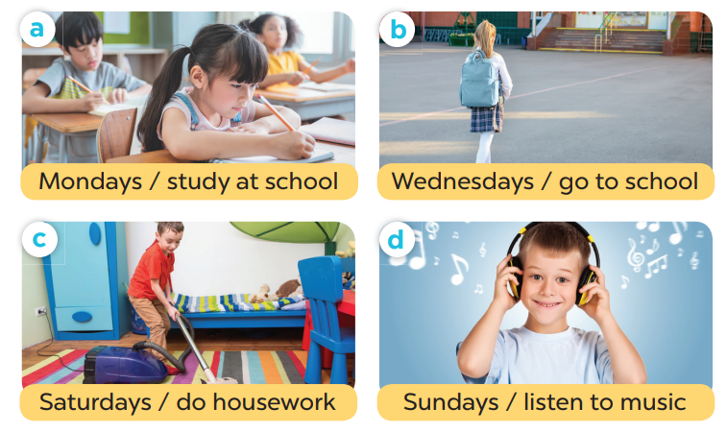
Point and say.
What do you do on _______?
- I _______.
Notes:
EXPLORE PICTURES

Slide 12
04
Activity 3
Let’s talk.

Slide 13
