Slide 1
My foreign friends
Unit 3
Lesson 2 – Period 3

Slide 2


Table of contents
01
Warm up and Review
02
Look, listen and repeat.
03
Listen, point and say.
05
Fun corner and Wrap-up
04
Let’s talk.

Slide 3

01
Warm-up and Review

Slide 4















CHOOSE AND ANSWER.
Notes:
Click the numbers to link to the Question slide.
Click the watermelon to disappear it and show the scores.
Click CHOOSE and ANSWER to end the game.

Slide 5

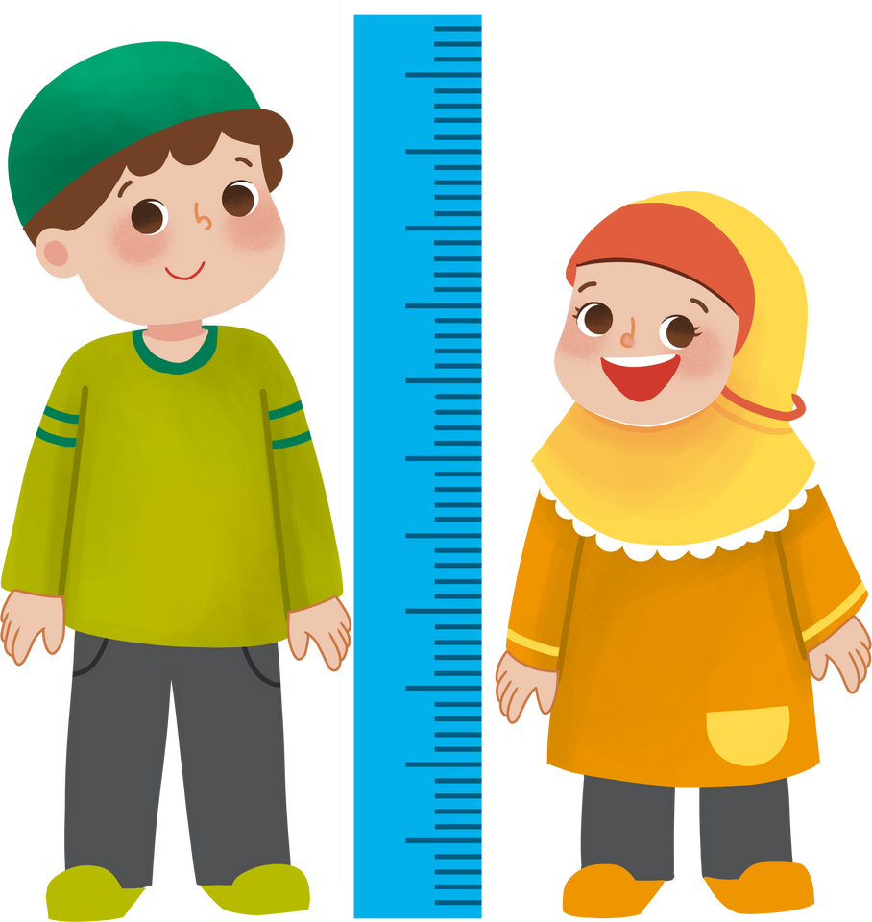


What does he look like?
He’s tall.

Slide 6

What does she look like?
She’s short.

Slide 7
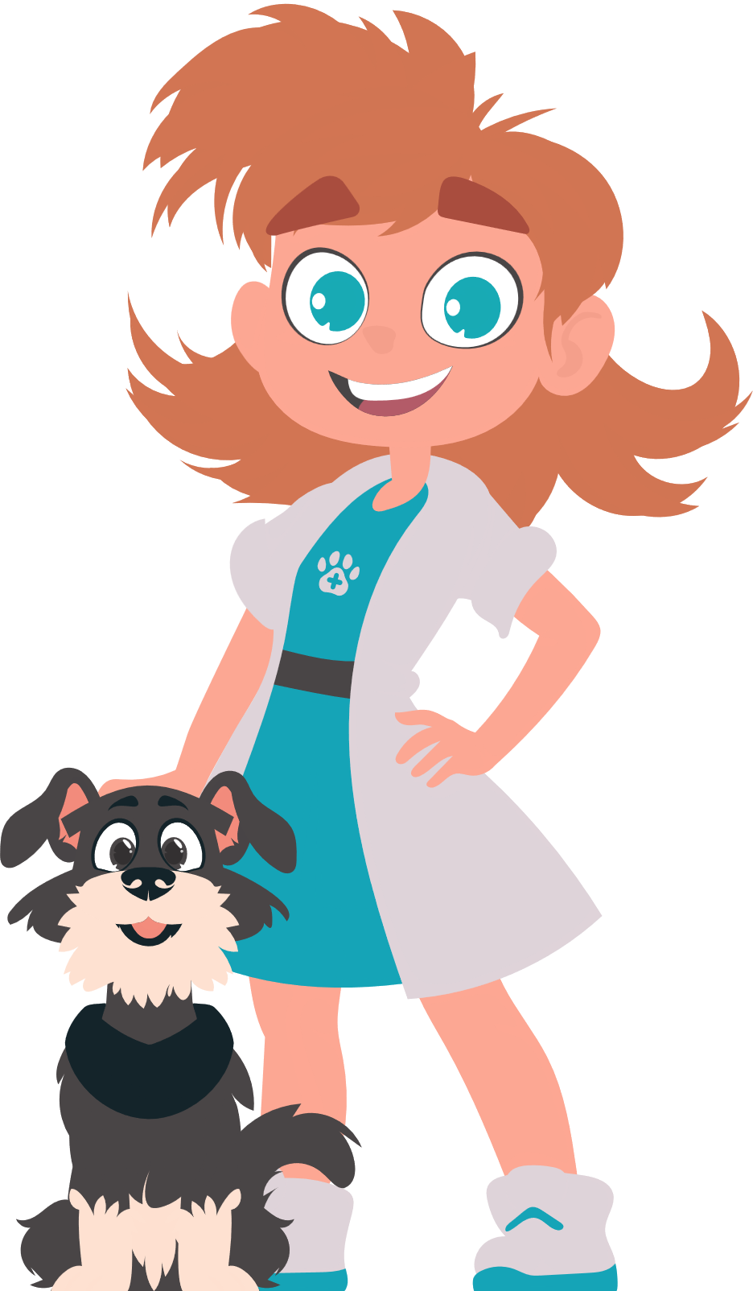




What does she look like?
She has big eyes.

Slide 8



What does he look like?
He’s big and fat.

Slide 9

What does she look like?
She has long hair.

Slide 10
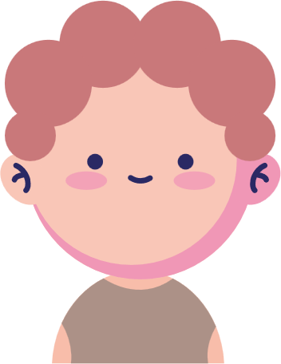
What does he look like?
He has a round face.

Slide 11


What does she look like?
She’s slim.

Slide 12

What does she look like?
She has short hair.

Slide 13

02
Look, listen and repeat.

Slide 14



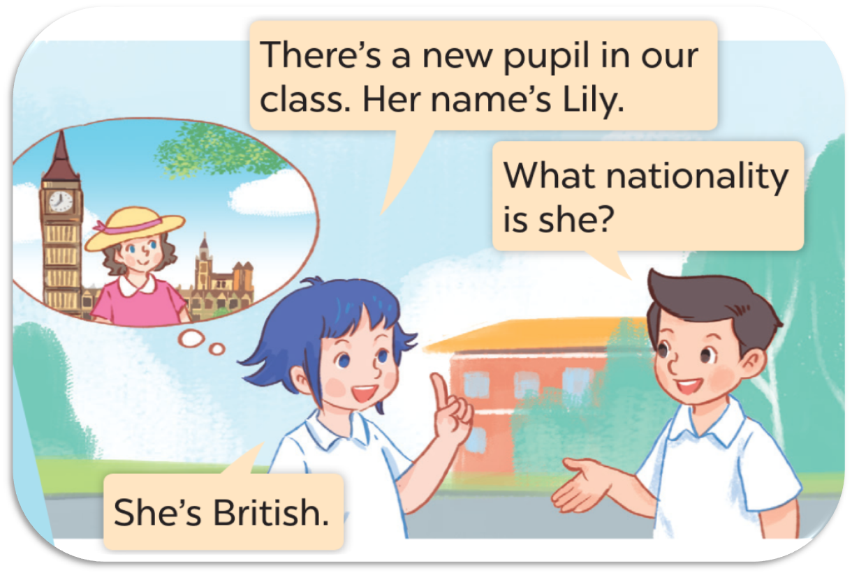
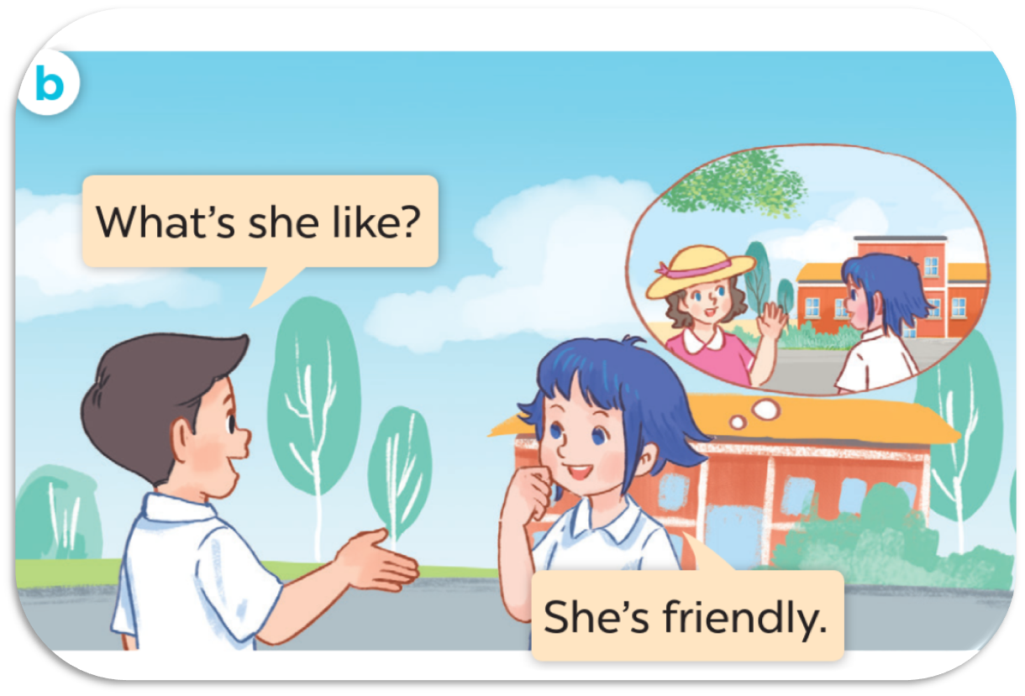


LISTEN AND POINT.

Slide 15


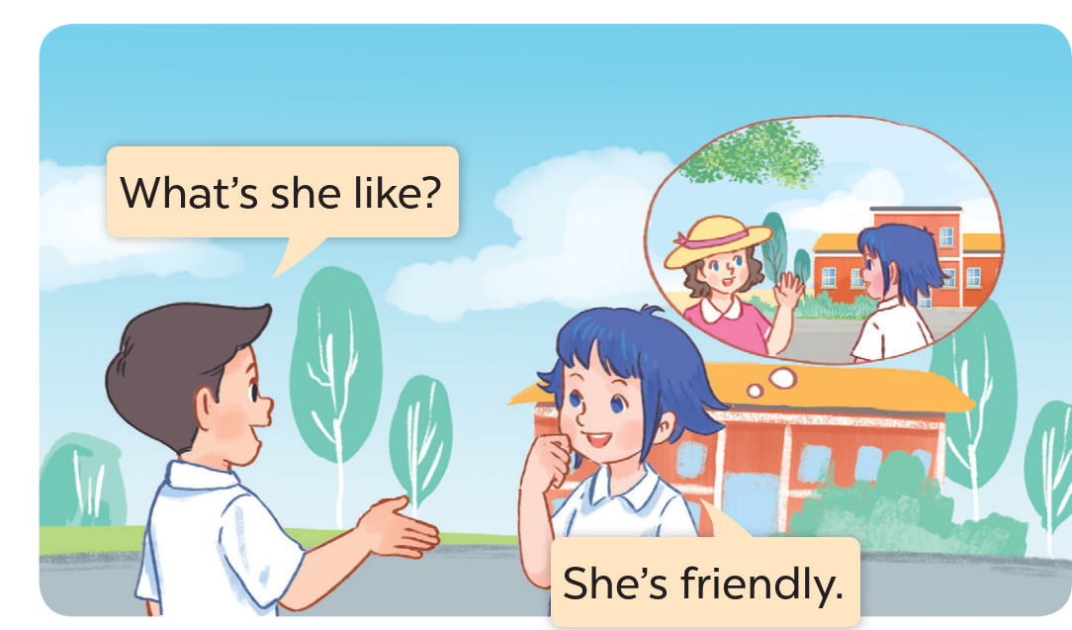
LISTEN, POINT AND REPEAT.
Notes:
.

Slide 16
03
Listen, point and say.

Slide 17




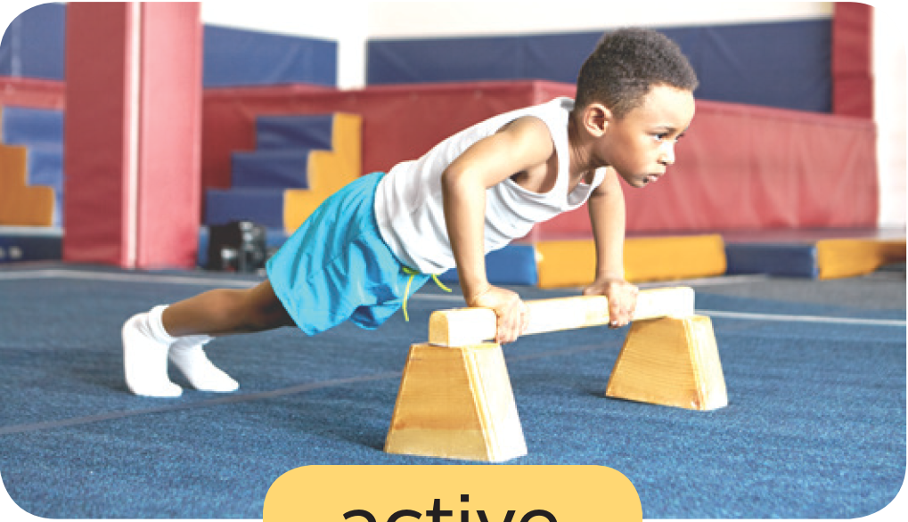
LOOK AND SAY.
friendly
helpful
clever
active

Slide 18

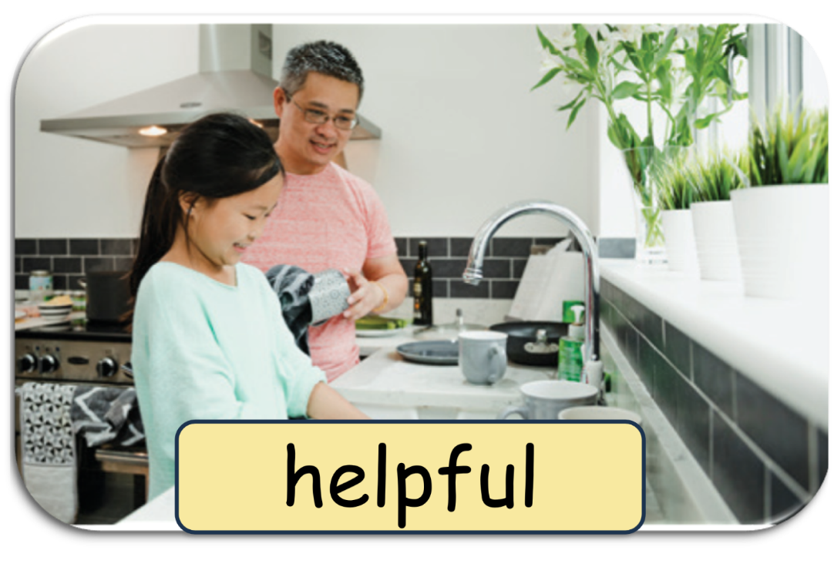


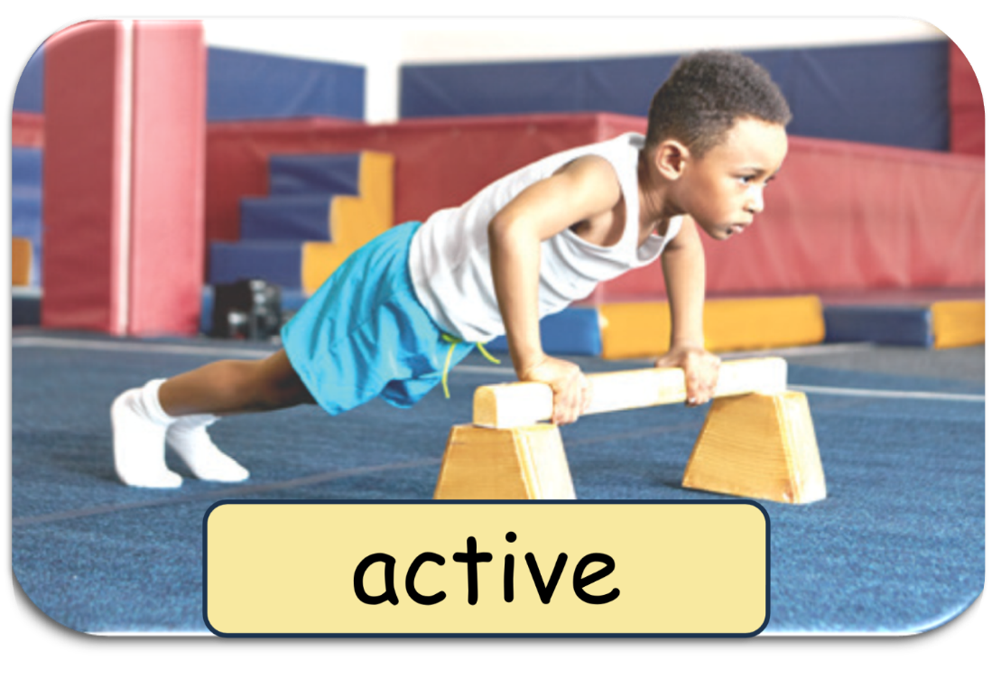
ASK AND ANSWER.

Slide 19




THINK AND WRITE.
Appearance
Personality
long
short
tall
friendly
big
small
helpful
fat
thin
clever
round
slim
active

Slide 20
04
Let’s talk.

Slide 21



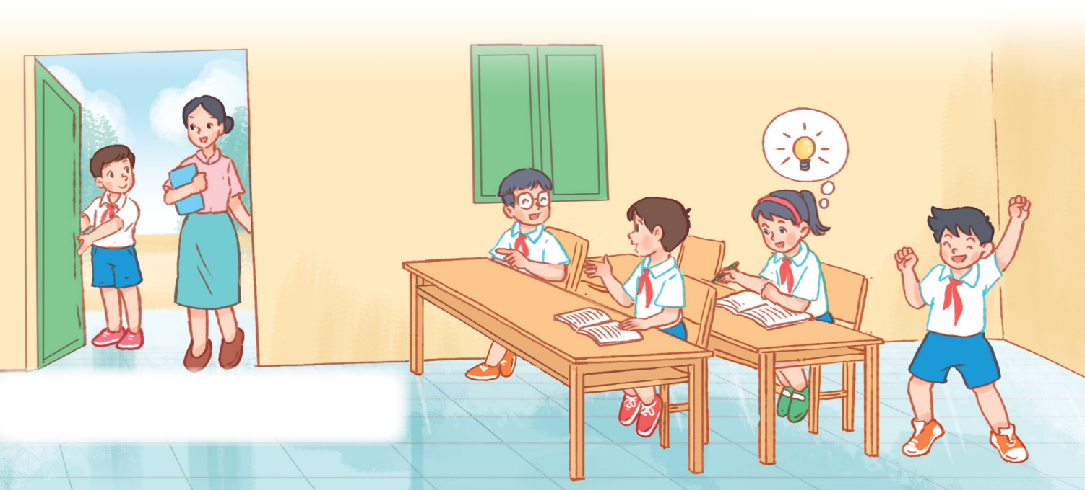


LOOK AND SAY.
clever
helpful
friendly
active

Slide 22
05
Fun corner
and Wrap-up

Slide 23





WHISPER GAME
Let's play.

