Slide 1



Slide 2




3
Our friends
LESSON 3 – PERIOD 6

Slide 3


CONTENTS
1
Warm up & Review
2
Read and match.
3
Let’s write.
4
Project
Fun corner & Wrap-up
5
Next
Notes:
G

Slide 4










A
B
Warm-up & Review
1
60
10
70
45
90
30
20
100
35
80
40
50
CLICK THE WHEEL
Notes:
HS chọn con cá mình thích để đi đến câu hỏi, nhấn vào loa để nghe rồi chọn câu trả lời. Nhấn vào nút Home để quay lại vòng quay và nhận điểm.

Slide 5






LISTEN AND CHOOSE THE RIGHT SOUND.
Th
θ
Th
θ
Th
θ
__ - __ank - __ank you, Bill.
th
ð
th
θ

Slide 6

LISTEN AND CHOOSE THE RIGHT SOUND.
th
ð
th
ð
th
ð
__ - __is - Is __is Linh?
th
ð
th
θ

Slide 7

LISTEN AND CHOOSE THE RIGHT SOUND.
th
ð
th
ð
th
ð
__ - __at - Is __at Ben?
th
ð
th
θ

Slide 8
LISTEN AND CHOOSE THE RIGHT SOUND.
Th
θ
Th
θ
Th
θ
___ - __ank - ___ank you, Mai.
th
ð
th
θ

Slide 9
LISTEN AND CHOOSE THE RIGHT SOUND.
Th
ð
__ - __is - __is is Mary.
Th
ð
Th
ð
th
ð
th
θ

Slide 10

LISTEN AND CHOOSE THE RIGHT SOUND.
Th
ð
Th
ð
Th
ð
__ - __at - __at's Lucy.
th
ð
th
θ

Slide 11
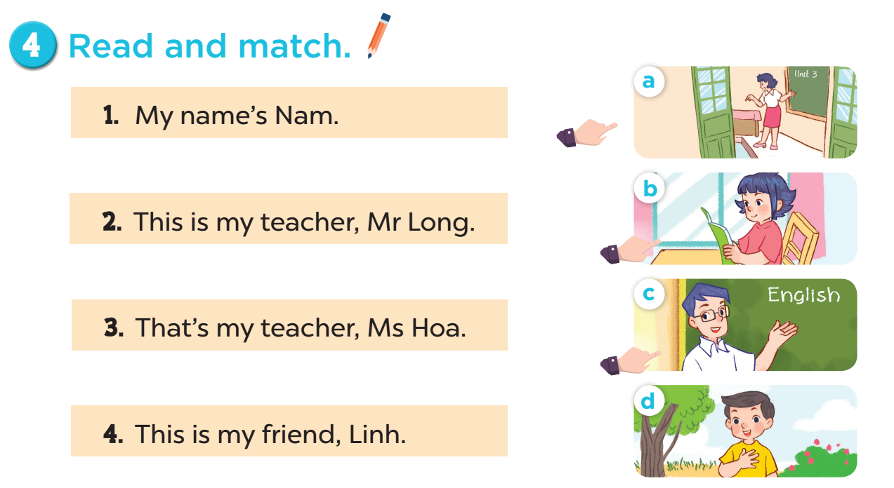

Slide 12
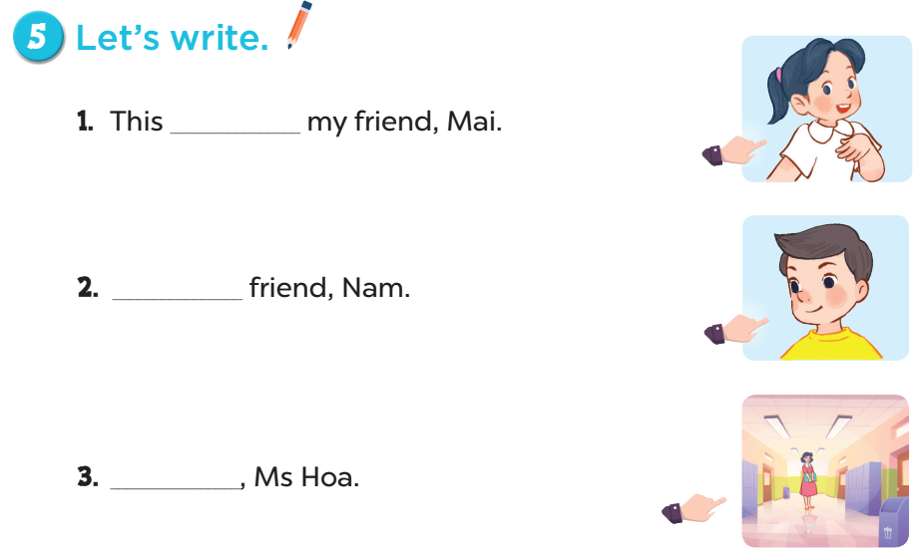
is
This is my
That’s my
teacher

Slide 13


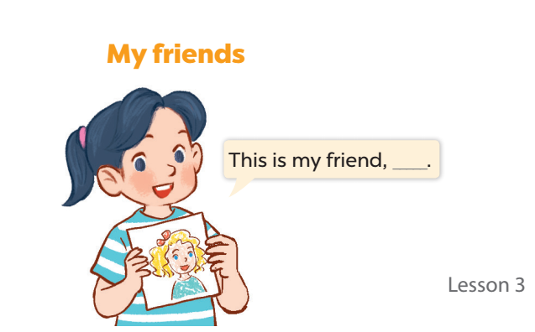


Slide 14



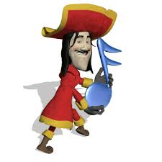




5
Fun corner & Wrap-up
TEAM A
9
9
9
0
1
2
3
4
5
6
7
8
0
1
2
3
4
5
6
7
8
0
1
2
3
4
5
6
7
8
50 points
- 10 points
1
2
TEAM B
10 points
3
4
40 points
9
9
9
0
1
2
3
4
5
6
7
8
0
1
2
3
4
5
6
7
8
0
1
2
3
4
5
6
7
8
30 points
20 points
5
6
Notes:
GV chia lớp thành 2 đội và lần lượt trả lời câu hỏi. Với mỗi đáp án đúng, học sinh được chọn một ô cửa trên tàu và nhận số điểm tương tứng với hình đã chọn.

Slide 15

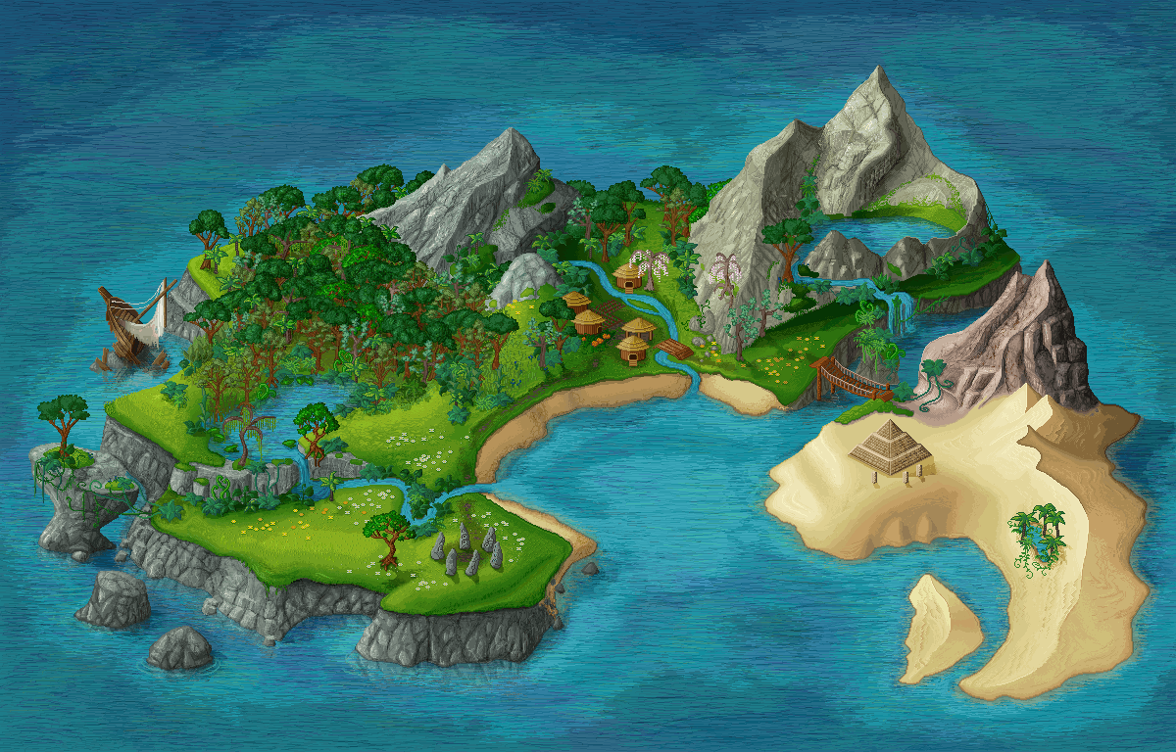




_____my friend, Mary.
This is
This
That’s
This is
NEXT

Slide 16


A
B
C
What are on the ship?
Let’s choose one window!

Slide 17


________ friend, Ben.
That is my
This is my
That is my
Is that my
NEXT

Slide 18
A
B
C
What are on the ship?
Let’s choose one window!

Slide 19

_________friend, Lucy.
This is my
This is my
Is this my
That’s my
NEXT

Slide 20
A
B
C
What are on the ship?
Let’s choose one window!

Slide 21

______ Bill?
Yes, it is.
Is that
This is
Is this
Is that
NEXT

Slide 22
A
B
C
What are on the ship?
Let’s choose one window!

Slide 23

________ friend, Linh.
This is my
This is my
Is this my
That’s
NEXT

Slide 24
A
Bb
Cc
What are on the ship?
Let’s choose one window!

Slide 25

______ friend, Nam.
That is my
This is my
That is my
Is that my
NEXT

Slide 26
A
B
C
What are on the ship?
Let’s choose one window!

Slide 27

Website: sachmem.vn
Fanpage: www.facebook.com/sachmem.vn

