Slide 1
My foreign friends
Unit 3
Lesson 2 – Period 4

Slide 2


Table of contents
01
Warm up and Review
02
Listen and number.
03
Read and complete.
05
Fun corner and Wrap-up
04
Let’s play.

Slide 3

01
Warm-up and review

Slide 4



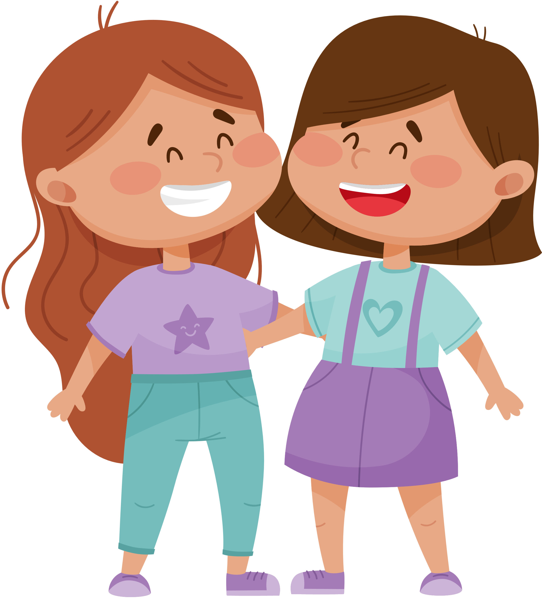
WHAT IS THE WORD?
E
F
I
N
D
L
R
Y

Slide 5



friendly

Slide 6

WHAT IS THE WORD?
R
V
E
E
L
C

Slide 7
clever

Slide 8

WHAT IS THE WORD?
I
C
V
T
E
A

Slide 9
active

Slide 10
02
Listen and number.

Slide 11
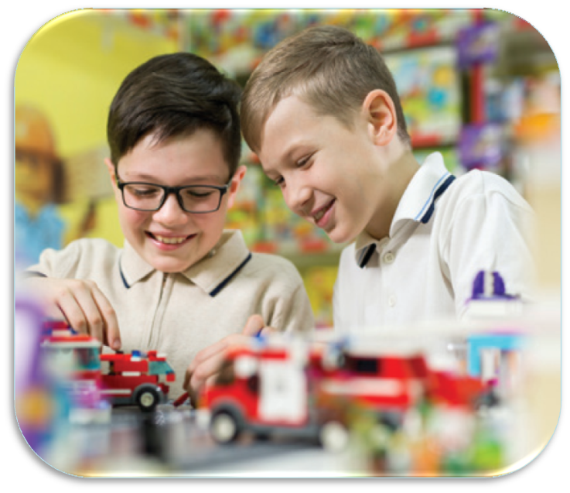
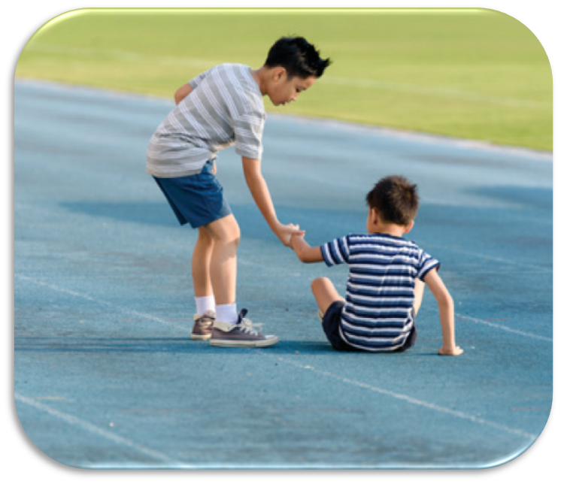

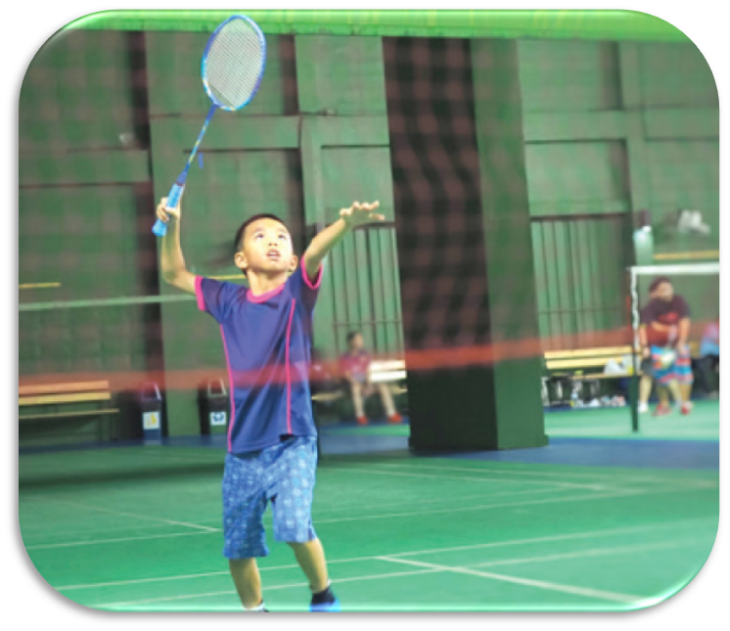
LISTEN AND NUMBER.
1

Slide 12
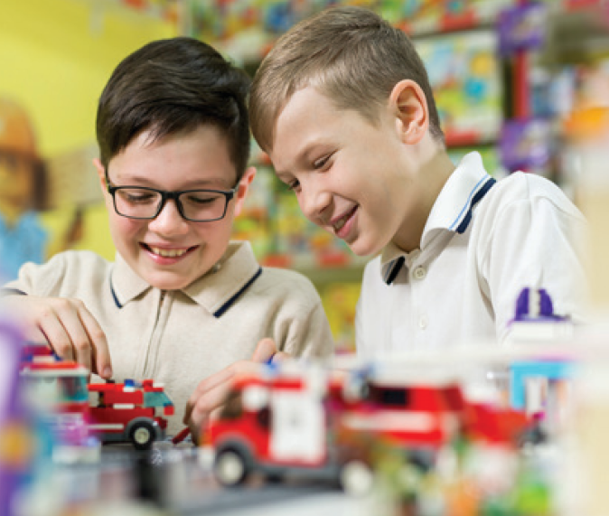
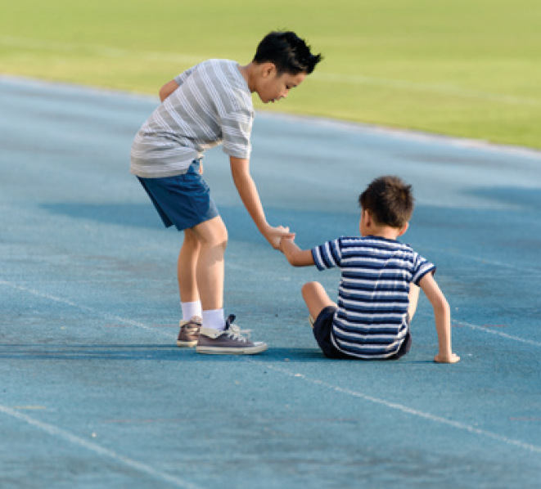
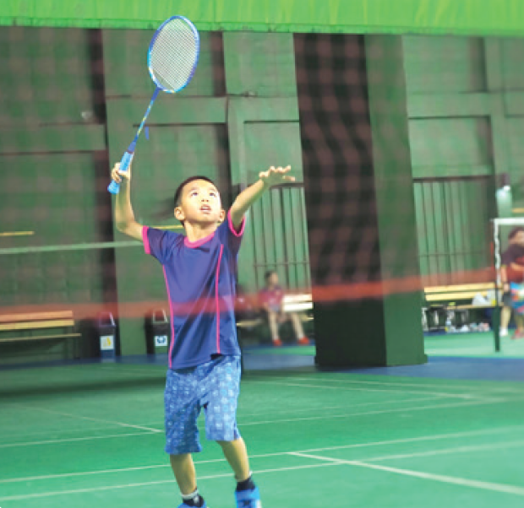
LISTEN AND CHECK.
2
1
4
3

Slide 13
03
Read and complete.

Slide 14
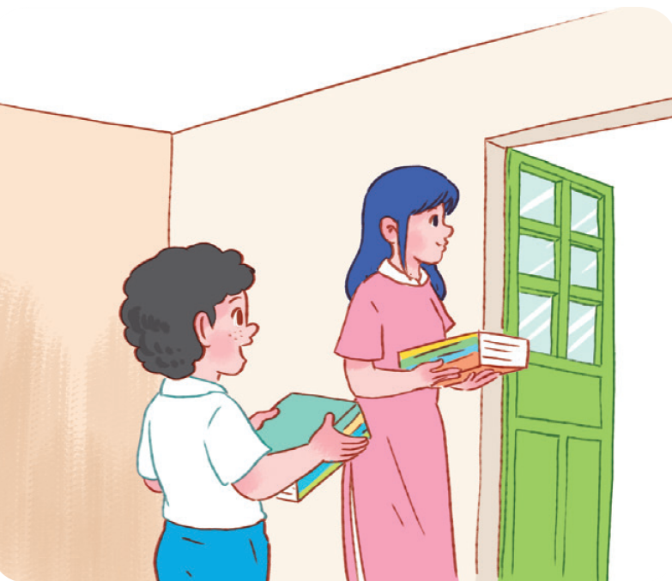


READ AND GUESS.
1. A: I have a new friend at school.
He’s Malaysian.
B: Really? I also have a friend from _____________. Is he from Kuala Lumpur?
A: Yes, he is.
B: What’s he like?
A: He’s _________. He likes helping others.
Malaysia
helpful

Slide 15
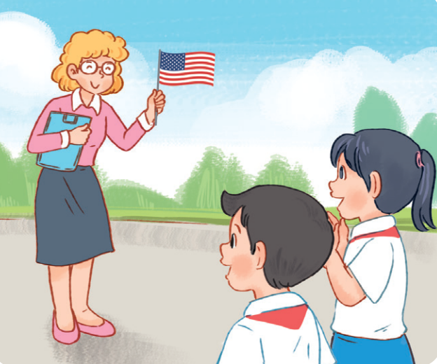
READ AND GUESS.
2. A: Do you have a new English teacher?
B: Yes, I do.
A: What nationality is she?
B: She’s ____________.
A: What’s she _____?
B: She’s friendly.

Slide 16

SWAP YOUR BOOKS

Slide 17




LET’S CHECK.
2. A: Do you have a new English teacher?
B: Yes, I do.
A: What nationality is she?
B: She’s ____________ .
A: What’s she _____?
B: She’s friendly.
American
like

Slide 18


The new friend is helpful. He likes helping others.
False
True

Slide 19
True
The new friend is helpful.
He likes helping others.

Slide 20


The new English teacher is from America.
False
True

Slide 21
True
The new English teacher is from America. She’s American.

Slide 22

The new English teacher is not friendly.
False
True

Slide 23
False
The new English teacher is friendly.

Slide 24

04
Let’s play.

Slide 25









WORK IN GROUPS
Group 1
Group 6
Group 2
Group 7
Group 3
Group 8
Group 4
Group 9
Group 5
Group 10

Slide 26

LOOK AND WRITE.
friendly

Slide 27
LOOK and WRITE.
active

Slide 28
LOOK and WRITE.
helpful

Slide 29
LOOK and WRITE.
clever

Slide 30
05
Fun corner
and Wrap-up

Slide 31

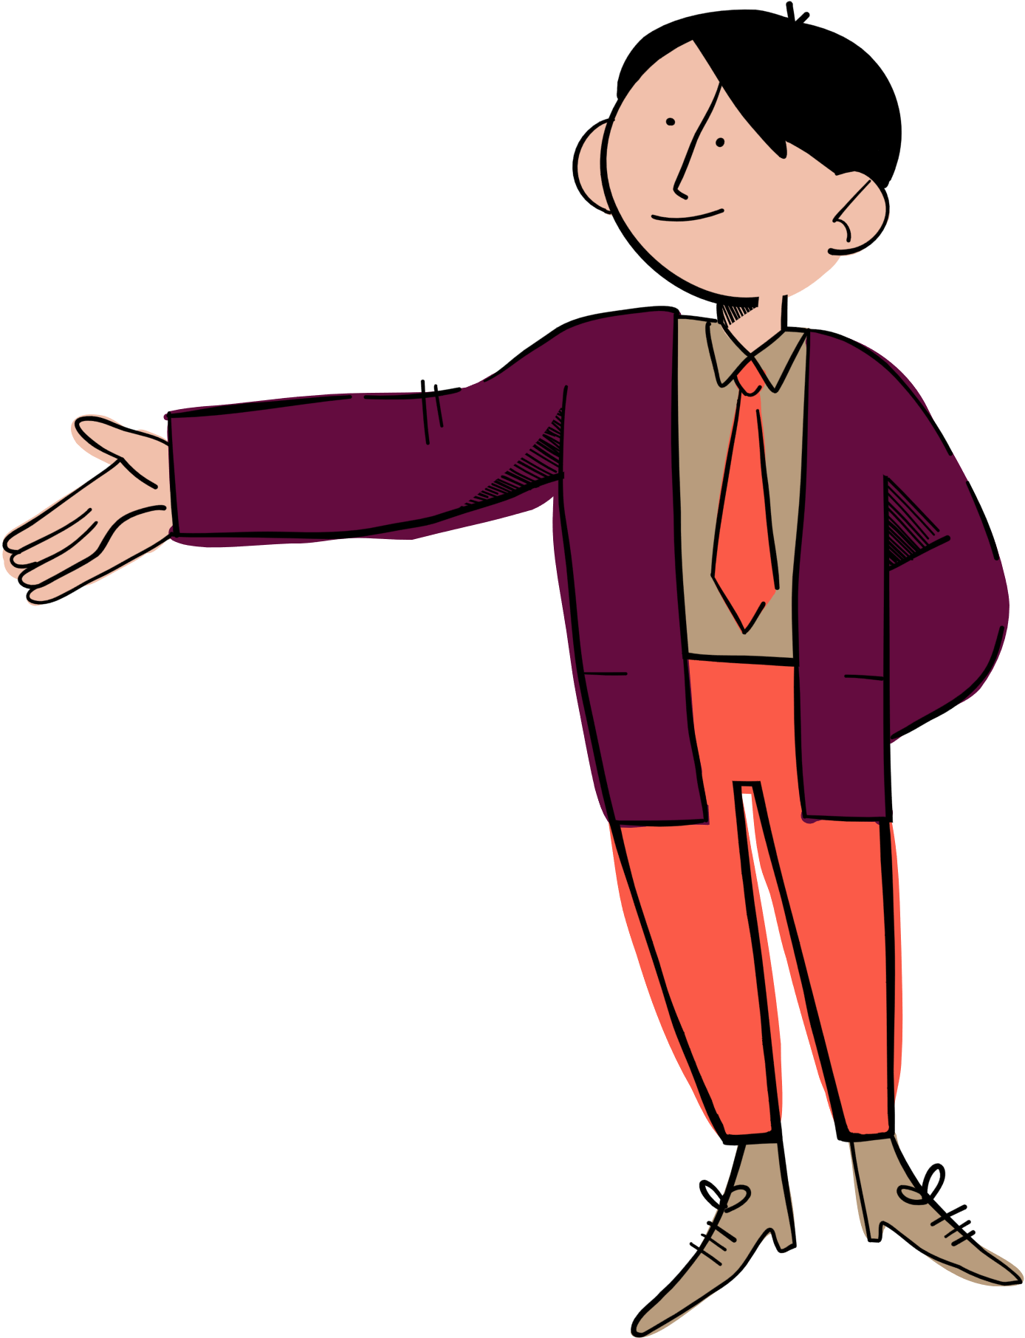


Let’s
spin the wheel!
big
friendly
clever
slim
tall
active
helpful
short

