Slide 1





My foreign friends
Unit 3
Lesson 3 – Period 6

Slide 2
Table of contents
01
Warm up and Review
02
Read and complete.
03
Let’s write.
05
Fun corner and Wrap-up
04
Project

Slide 3


01
Warm-up and Review

Slide 4






LISTEN, SING AND CLAP.
My friends
Notes:
Link video hoạt hình: https://hoclieu.vn/hop-phan-bo-tro/video-hoat-hinh/203?gidzl=zOIHFJEOs53ncvauCu7VN_2QdJKkXTuBw9gNP7hKXGZloSLdBjo43hl9nJLorOnSiydFDZFmBN1VDvdPKm

Slide 5







LET’S SING IN THE FRONT.

Slide 6
02
Read and complete.

Slide 7


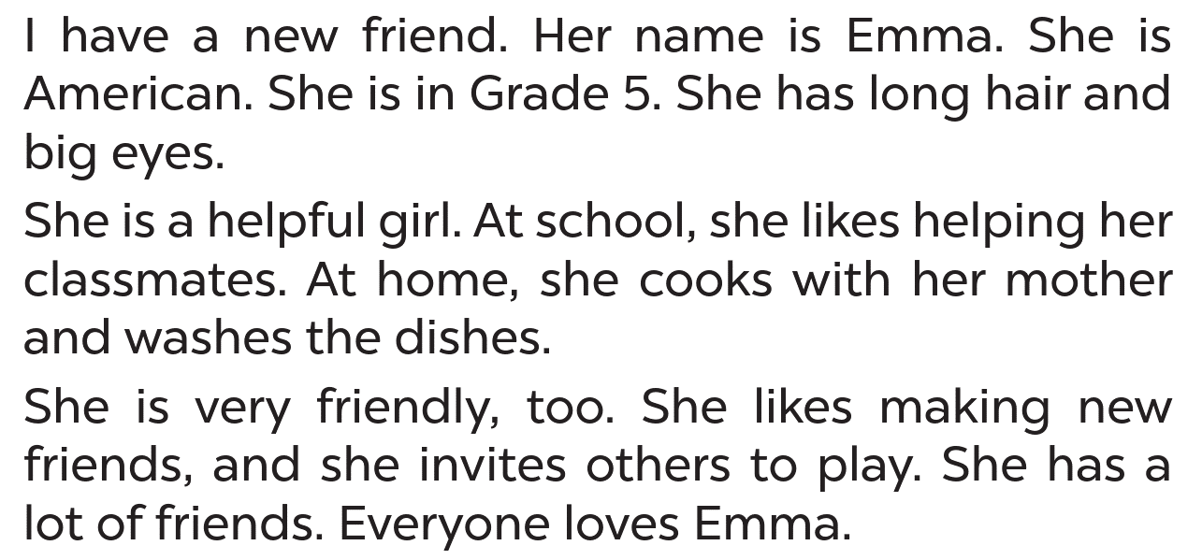



LISTEN AND READ
Emma

Slide 8



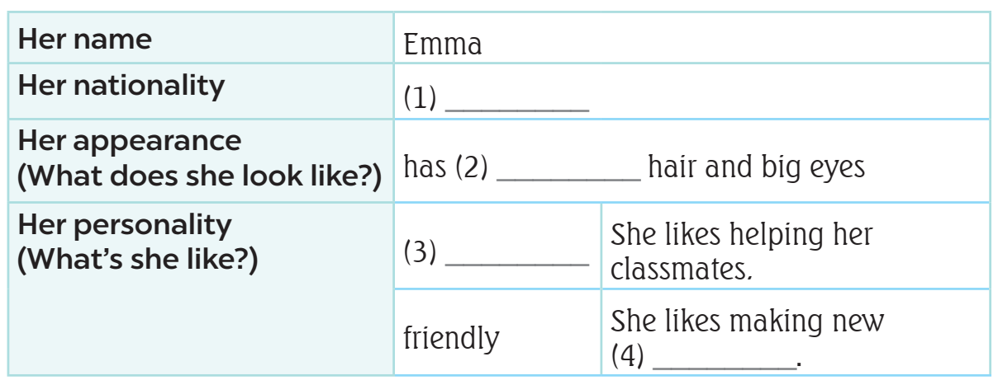


LISTEN AND READ
What’s
the information?
main
information

Slide 9

READ AND ANSWER.

Slide 10
READ AND ANSWER.
nationality
Emma

Slide 11

READ AND ANSWER.
American

Slide 12

SWAP YOUR BOOKS.

Slide 13
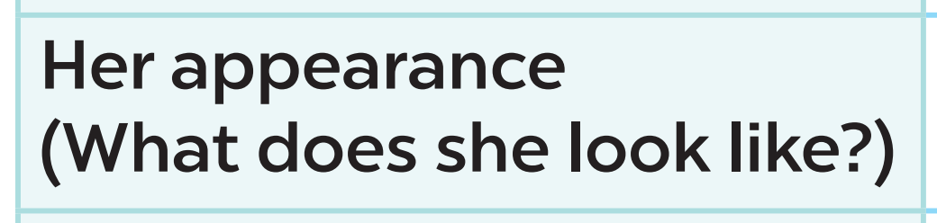

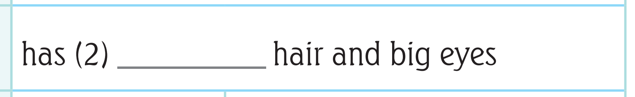


LET’S CHECK!
long

Slide 14
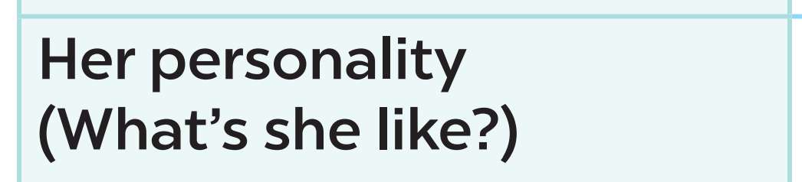
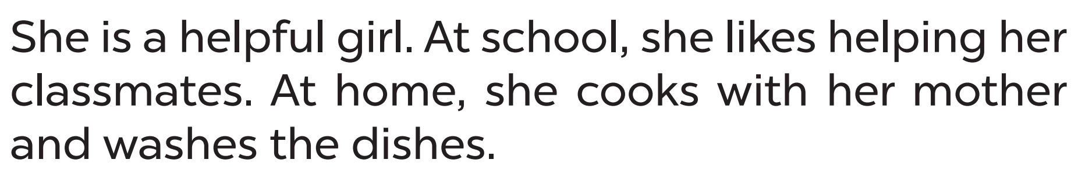
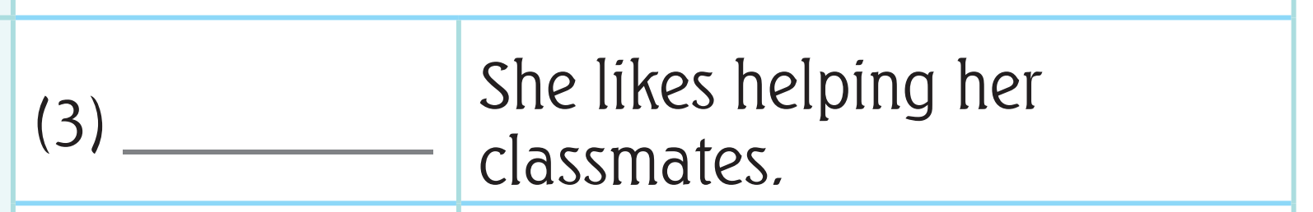



LET’S CHECK!
helpful

Slide 15
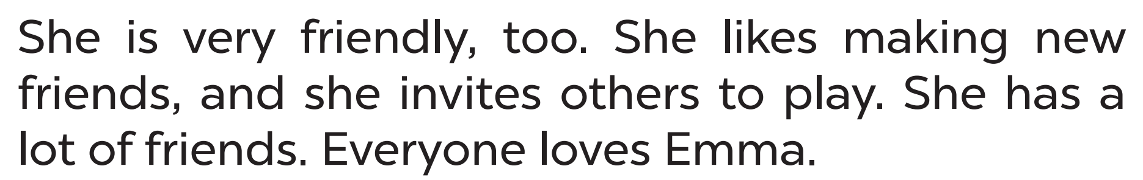



LET’S CHECK!
friends

Slide 16
ASK AND ANSWER ABOUT EMMA.
American
dishes
hair
friendly
classmate

Slide 17
03
Let’s write.

Slide 18

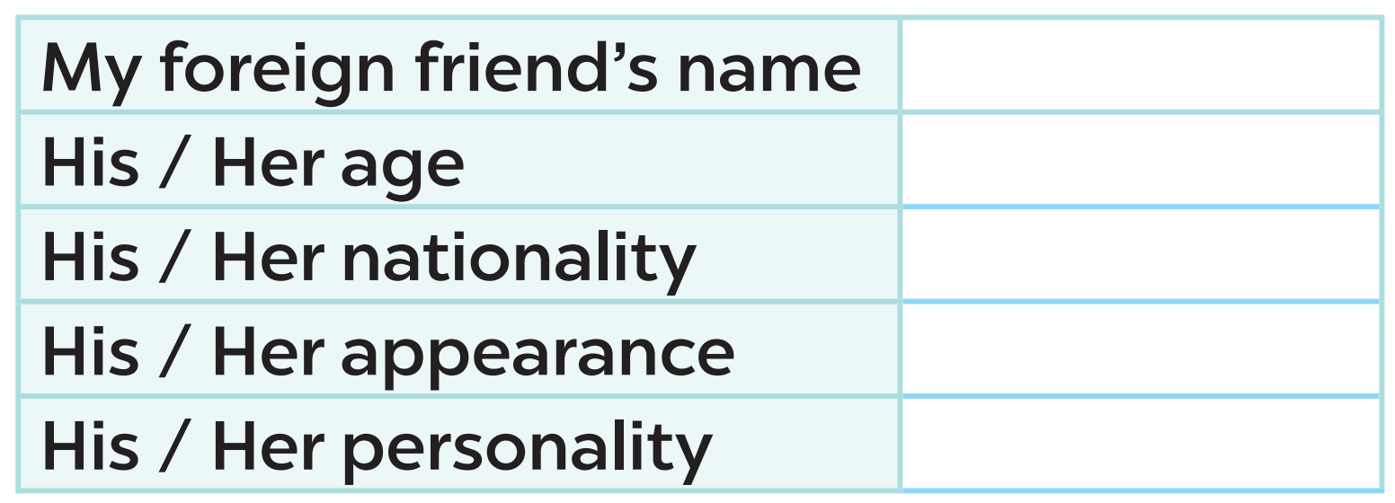

READ AND ANSWER

Slide 19
READ AND ANSWER
Lisa

Slide 20
04
Project

Slide 21
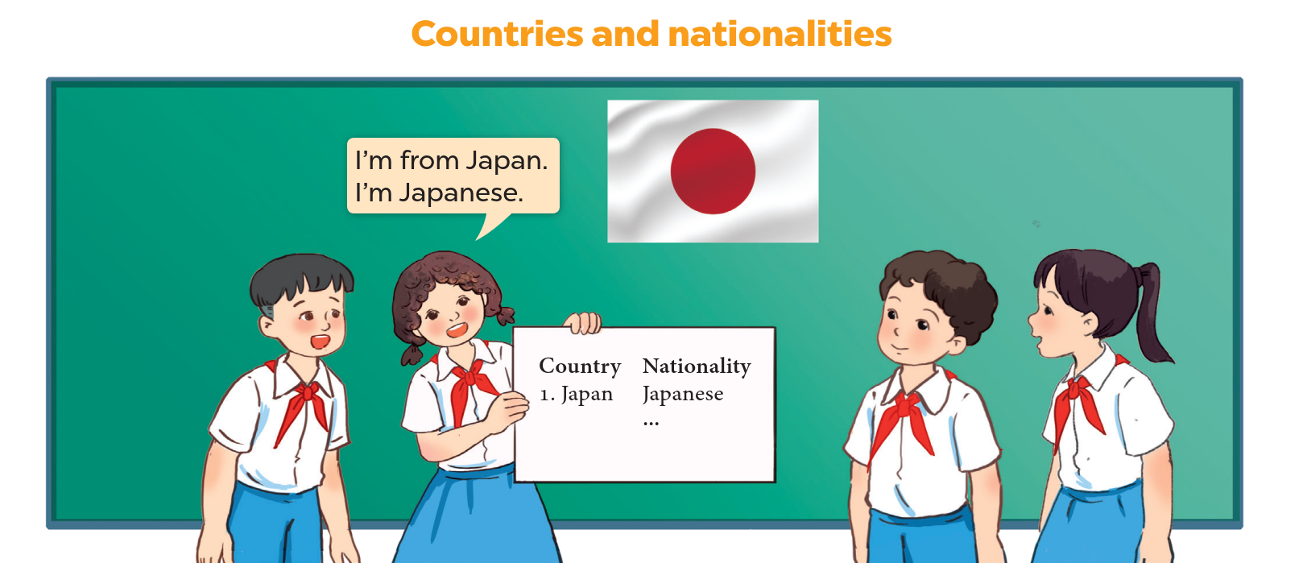
LET’S CHECK YOUR POSTERS!
5 countries
nationalities

Slide 22


WORK IN GROUPS.
Talk about your poster!!!!

Slide 23


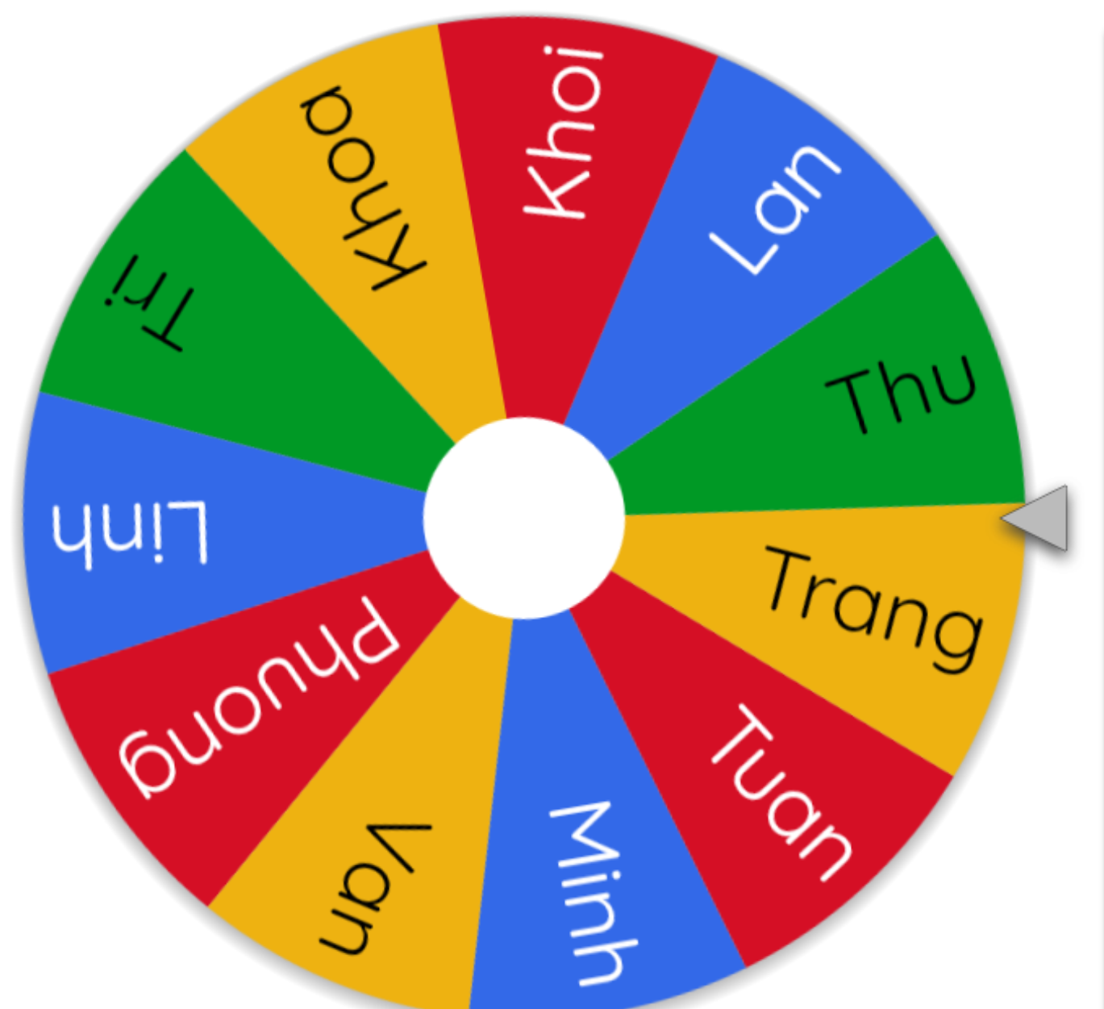


LET’S SPIN!
Notes:
Use this link https://wheelofnames.com/ to choose pupils in random.

Slide 24
05
Fun corner
and Wrap-up

Slide 25




Game
WHO’S FASTER?
friendly
helpful
active
clever

