Slide 1





Slide 2


My birthday party
4
Lesson 1 – Period 1

Slide 3


Table of contents
01
Warm-up
02
Activity 1
Activity 2
03
Guessing game
Look, listen and repeat.
Listen, point and say.
04
Activity 3
05
Let’s talk.
Game

Slide 4
01
Warm-up
Guessing game

Slide 5
Guess the words.
Days of the week

Slide 6

a y M n o d
Monday

Slide 7
a i r y d F
Friday

Slide 8
W y d a n e s e d
Wednesday

Slide 9
S t r u a a d y
Saturday

Slide 10
u T s e d y a
Tuesday

Slide 11
s a y u T h r d
Thursday

Slide 12
S n a y d u
Sunday

Slide 13
02
Activity 1
Look, listen and repeat.

Slide 14
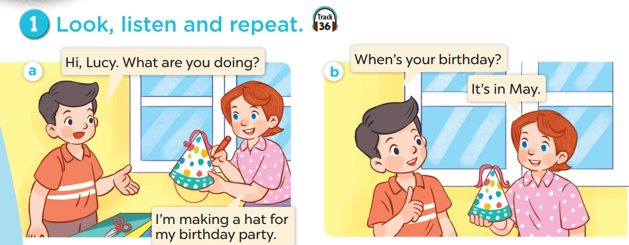

Look and listen.

Slide 15
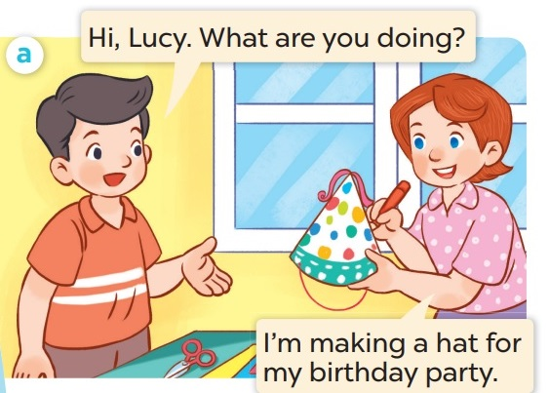
Listen and repeat.

Slide 16
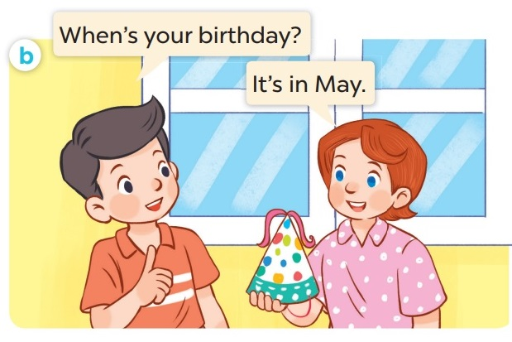
Listen and repeat.

Slide 17
03
Activity 2
Listen, point and say.

Slide 18
New words

Slide 19
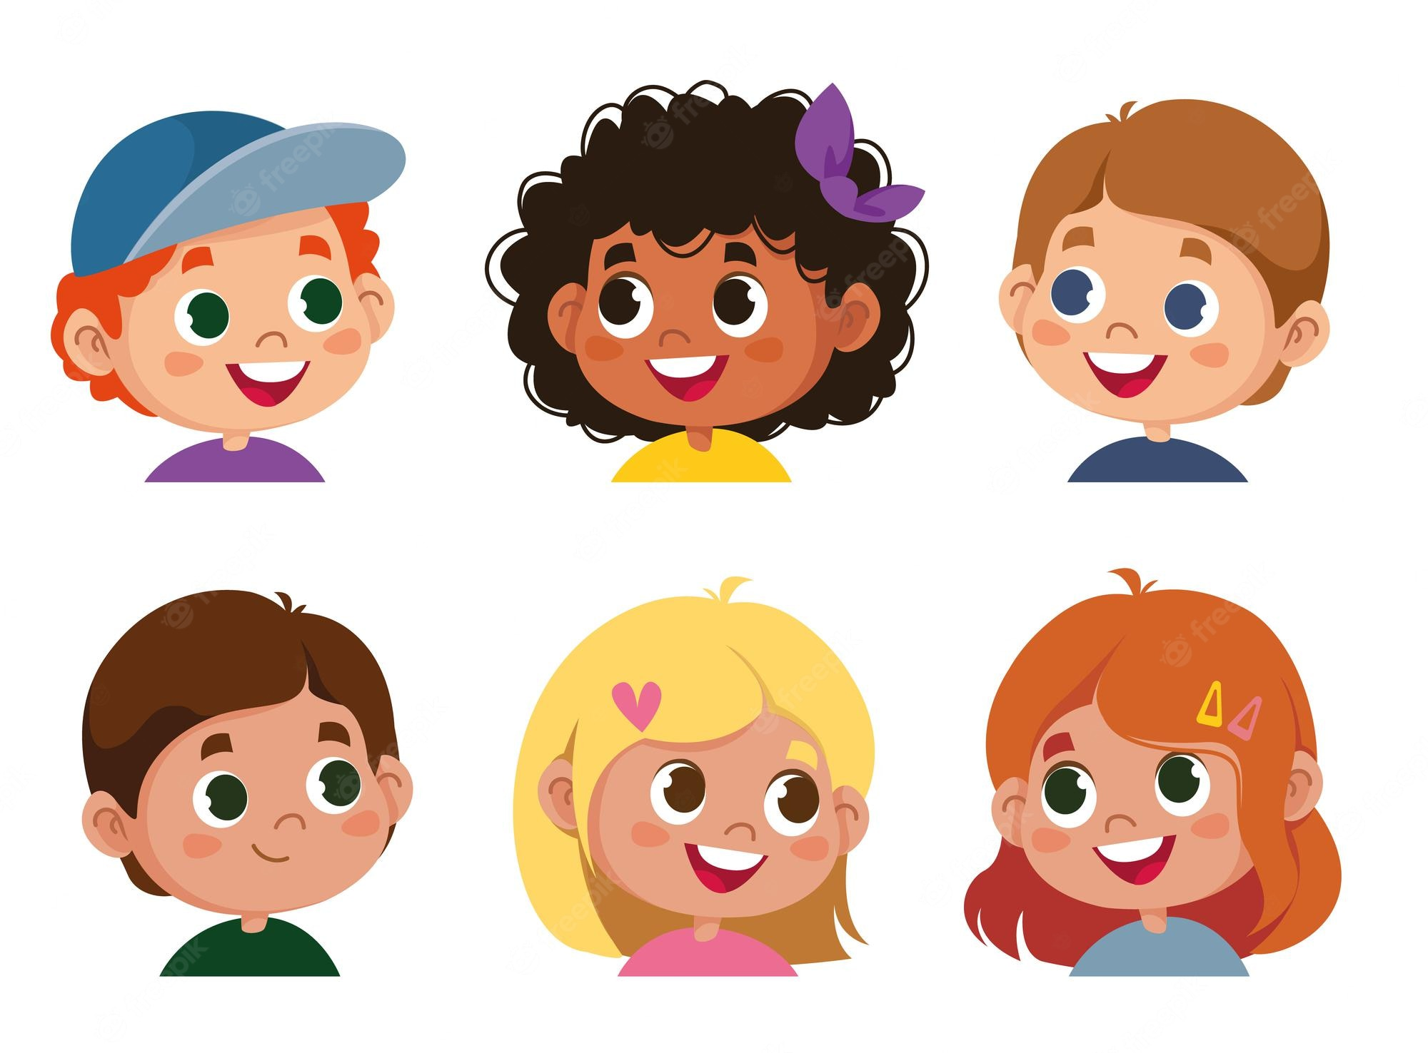
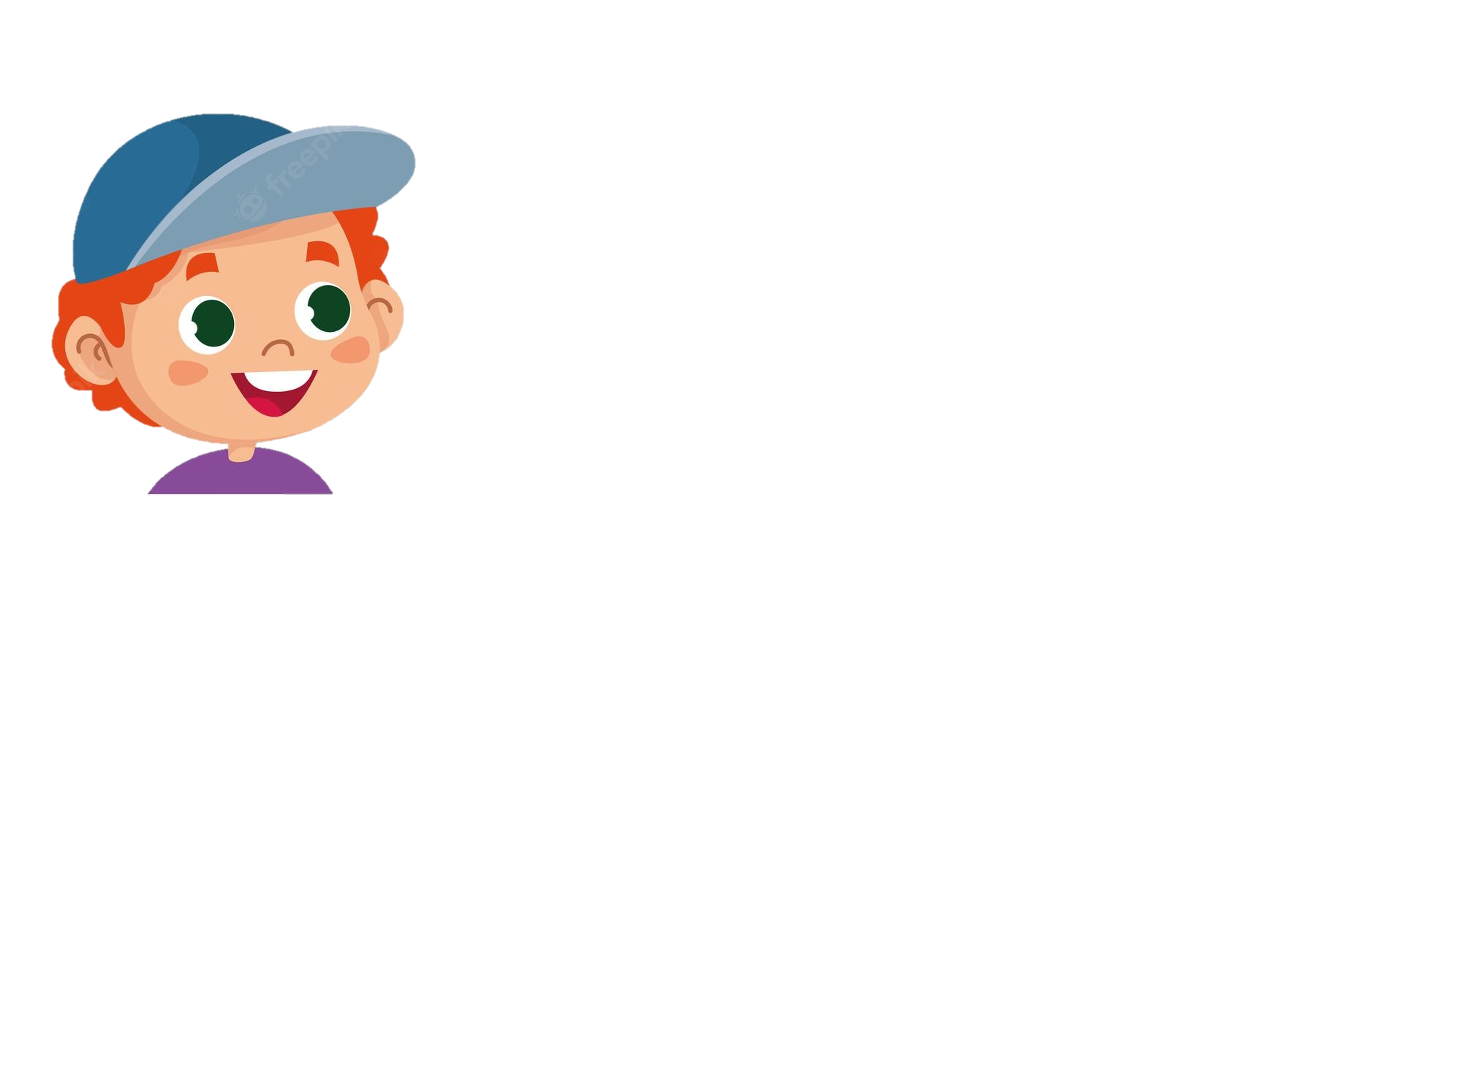
There are 12.
Let’s watch a video about 12 months in a year!
How about months in a year? How many?
Do you know how many days there are in a week?
I don’t know. How many?
Seven.

Slide 20
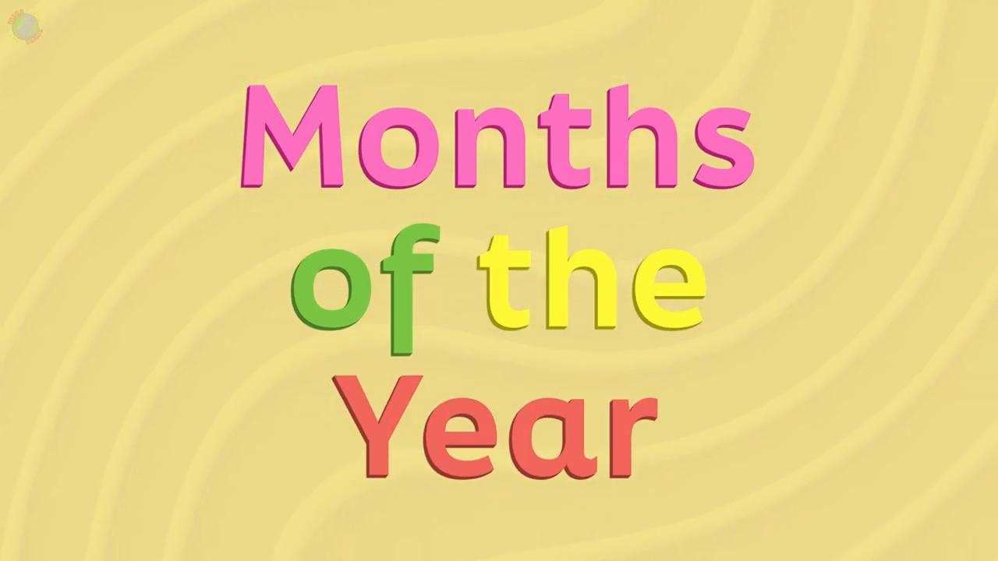

Slide 21
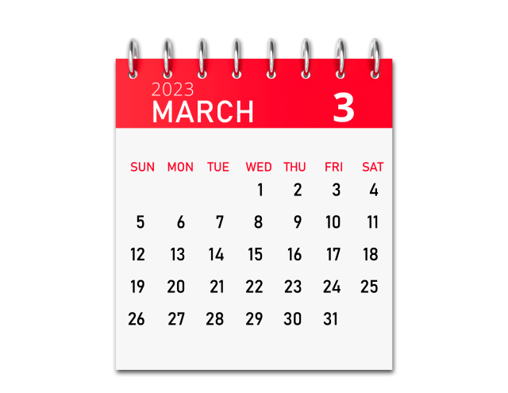
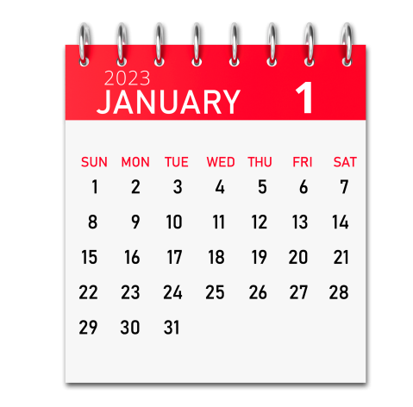
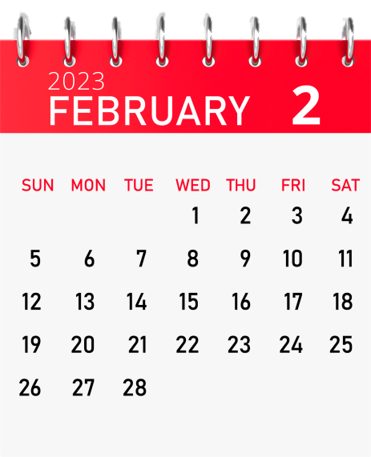
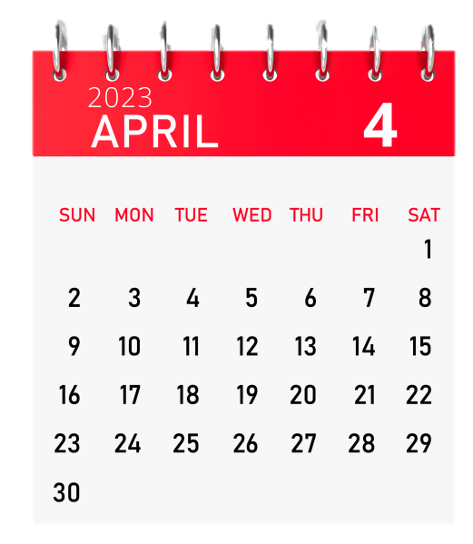
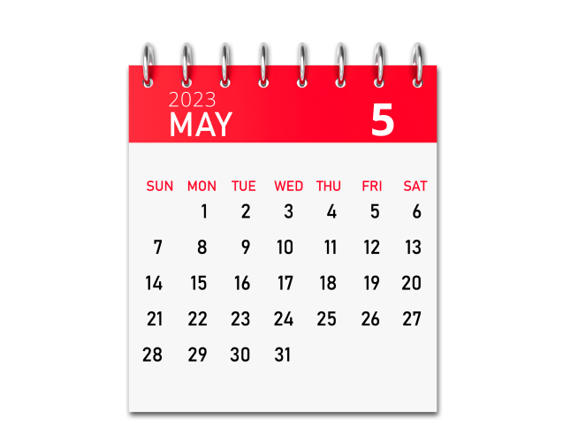
January
February
March
April
May

Slide 22

BOARD RACING
Notes:
Teacher says the months, students write the number.

Slide 23
May
5

Slide 24
March
3

Slide 25
January
1

Slide 26
April
4

Slide 27
February
2

Slide 28
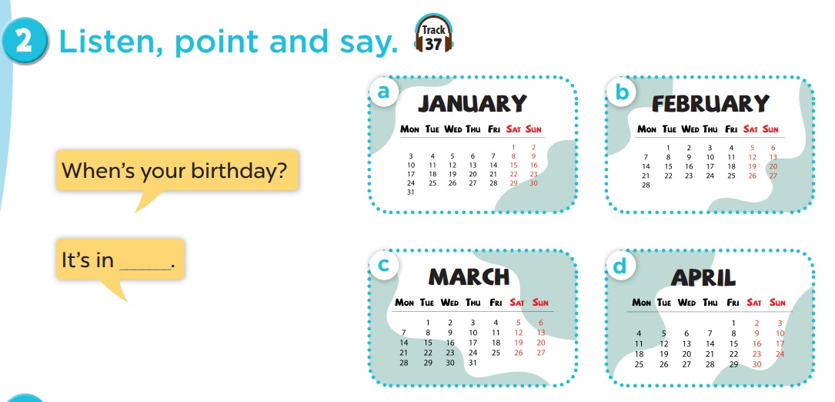
Work in pairs. Play roles.
Listen and repeat.

Slide 29
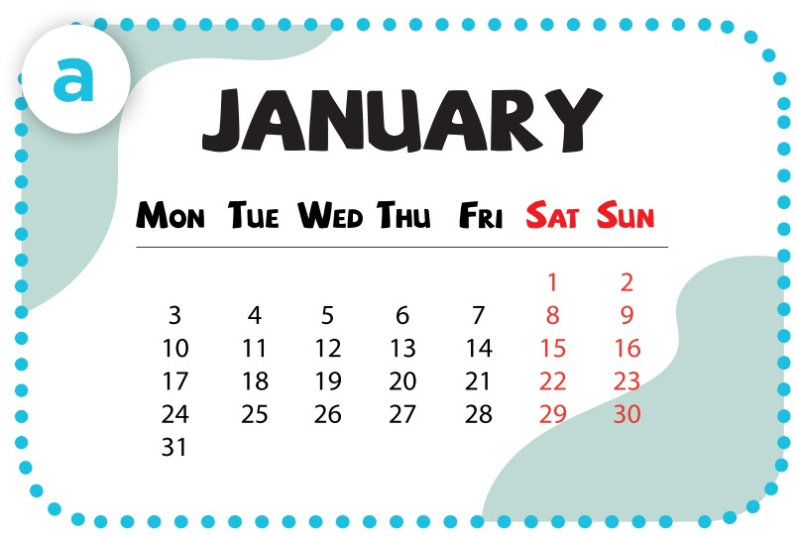
- When’s your birthday?
- It’s in January.

Slide 30
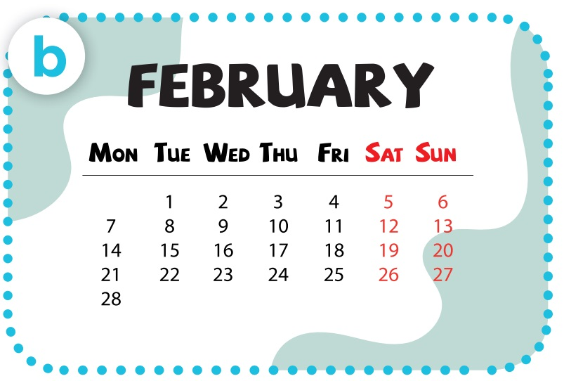
- When’s your birthday?
- It’s in February.

Slide 31
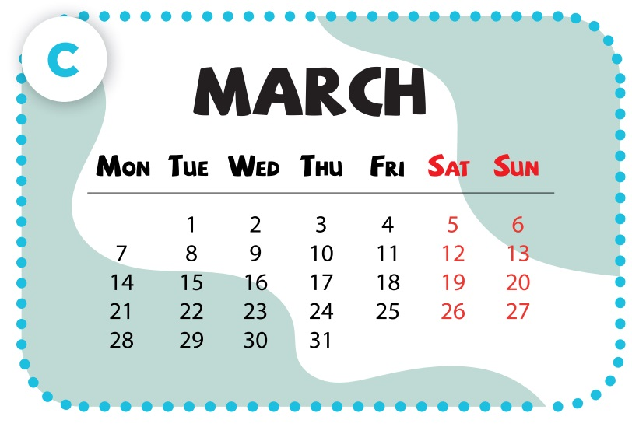
- When’s your birthday?
- It’s in March.

Slide 32
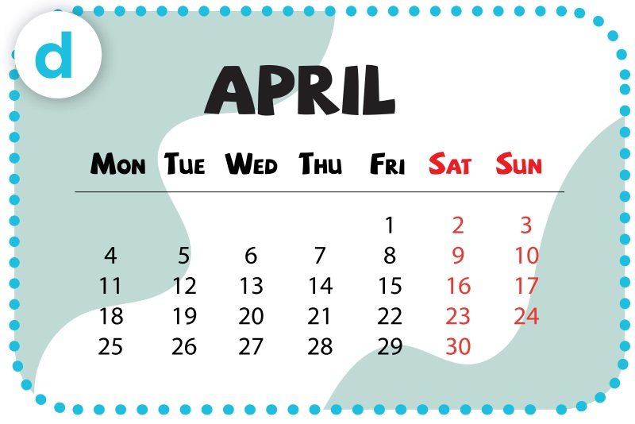
- When’s your birthday?
- It’s in April.

Slide 33
04
Activity 3
Let’s talk.

Slide 34
