Slide 1





Slide 2


My birthday party
4
Lesson 2 – Period 3

Slide 3


Table of contents
Warm-up
Activity 1
Activity 2
01
02
03
Look, listen and repeat.
Listen, point and say.
Let’s sing.
04
Activity 3
05
Game
Let’s talk.

Slide 4
01
Warm-up
Let’s sing.

Slide 5
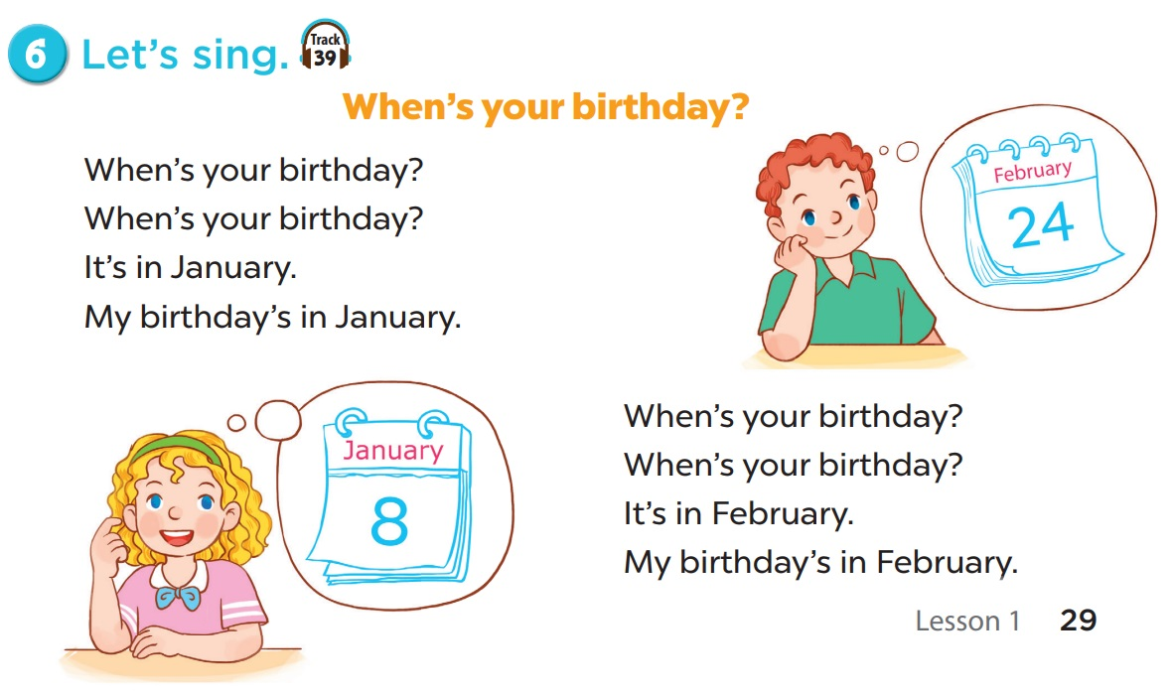


Slide 6
02
Activity 1
Look, listen and repeat.

Slide 7
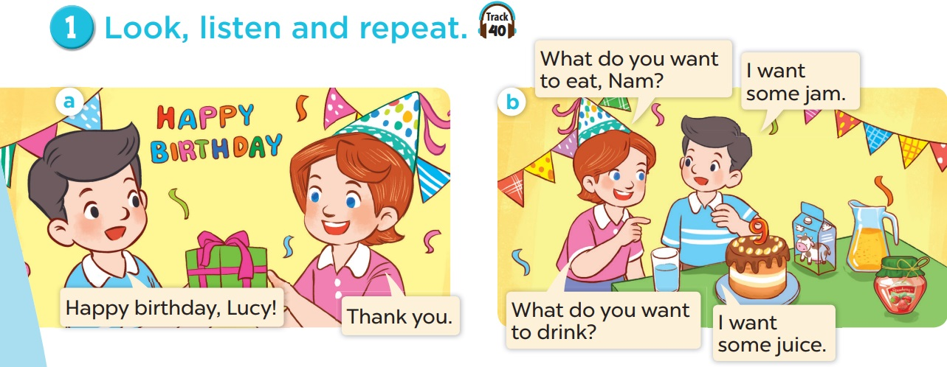
Look and listen.

Slide 8
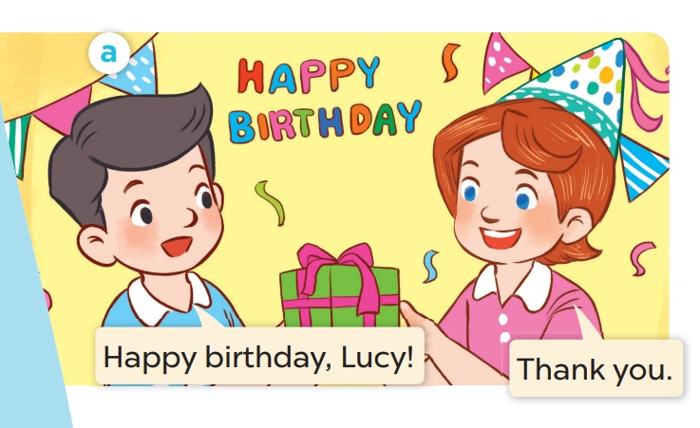
Listen and repeat.

Slide 9
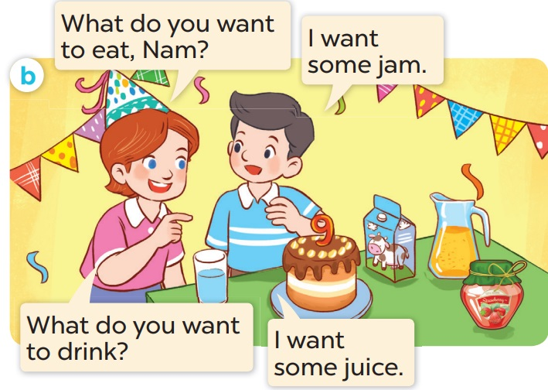
Listen and repeat.

Slide 10
03
Activity 2
Listen, point and say.

Slide 11

chips

Slide 12

grapes

Slide 13

jam

Slide 14

lemonade

Slide 15
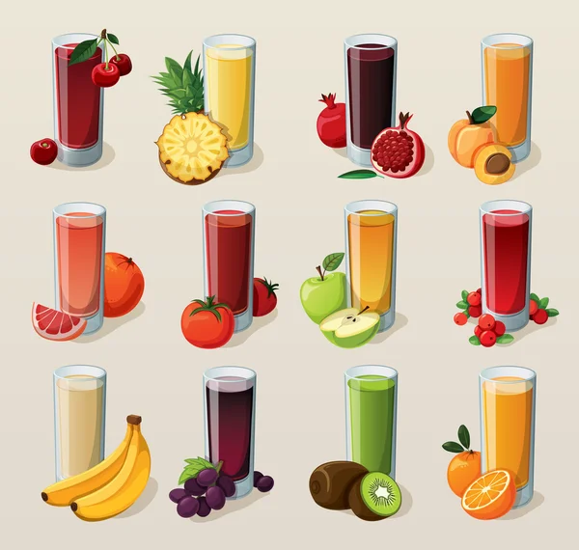
juice

Slide 16
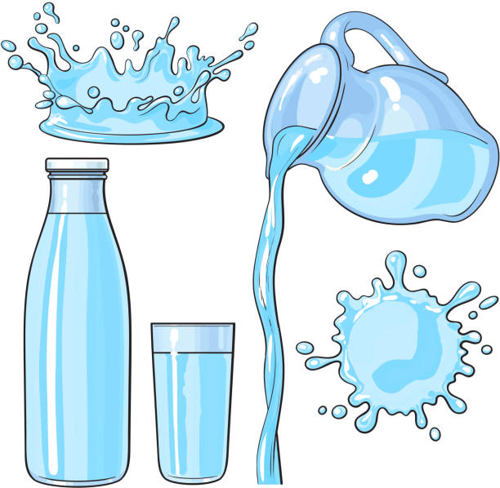
water

Slide 17
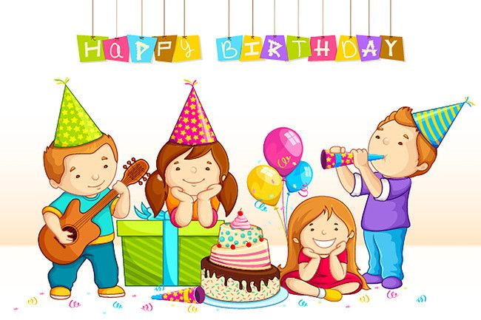
party

Slide 18
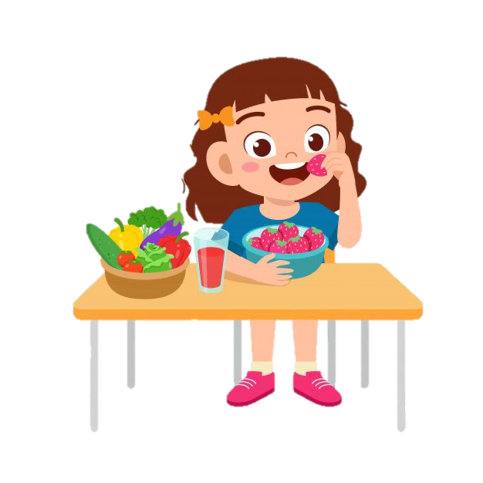
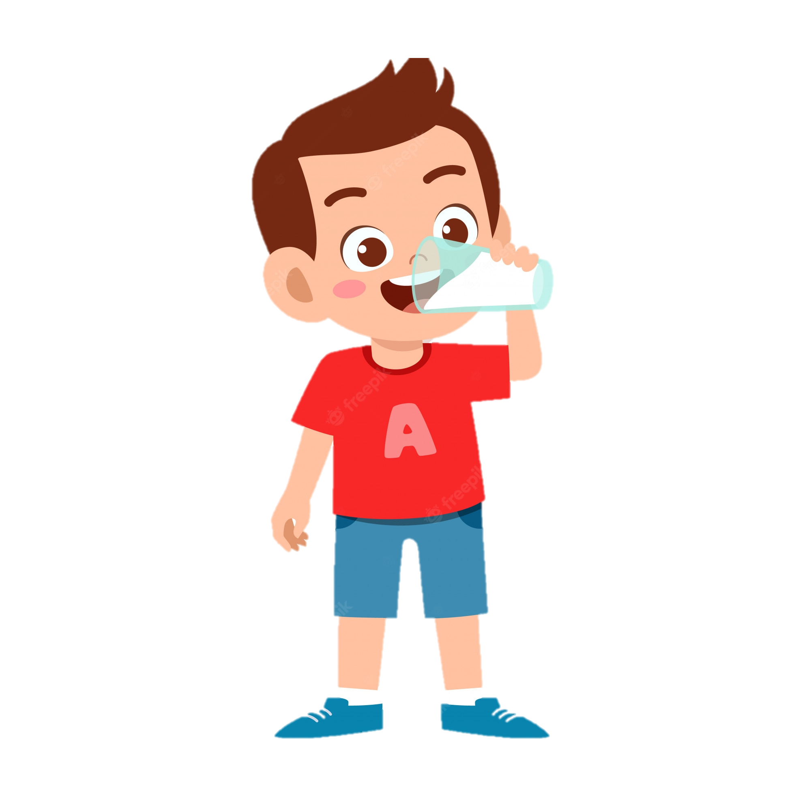
eat
drink

Slide 19
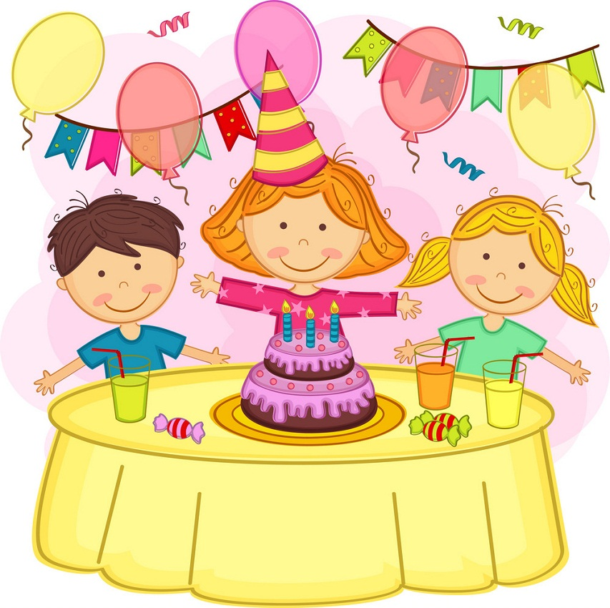
juice
birthday
grapes
chips
jam
party
water
lemonade

Slide 20
What is missing?

Slide 21

chips

Slide 22
party

Slide 23
jam

Slide 24
juice

Slide 25
lemonade

Slide 26
grapes

Slide 27
birthday

Slide 28
water

Slide 29
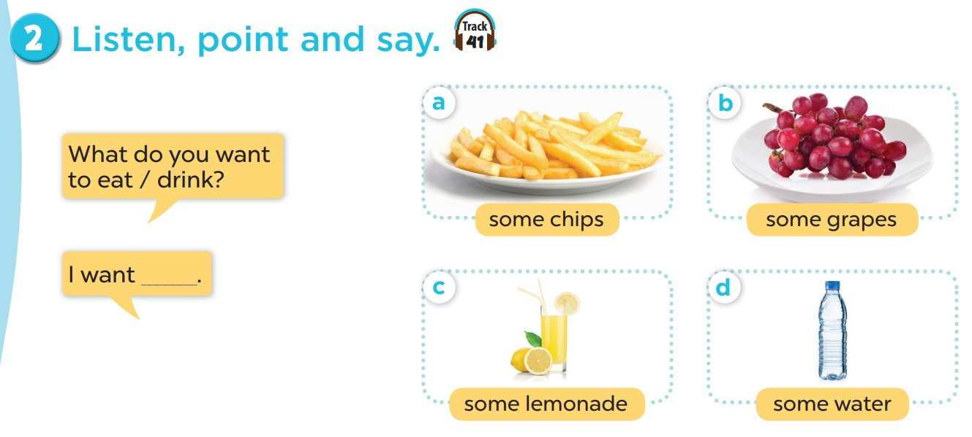
Listen and repeat.
Work in pairs. Role play.

Slide 30
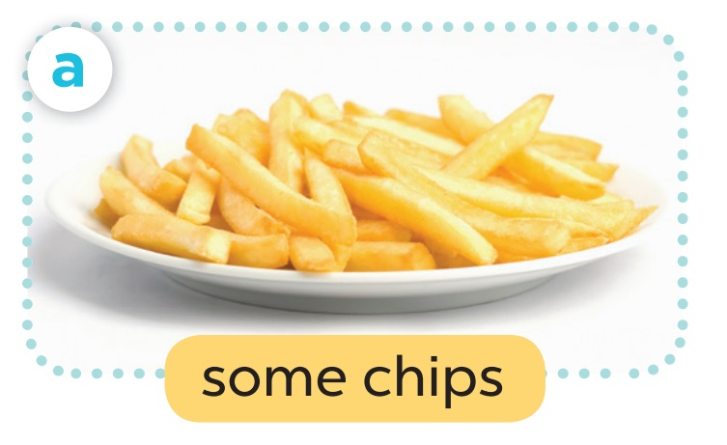
- What do you want to eat?
- I want some chips.

Slide 31
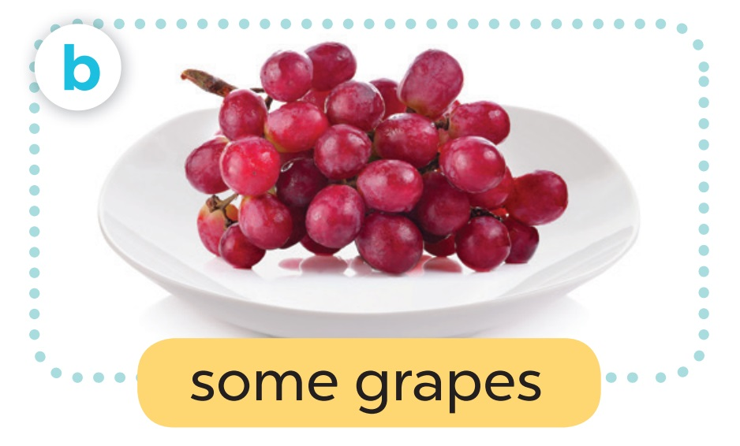
- What do you want to eat?
- I want some grapes.

Slide 32
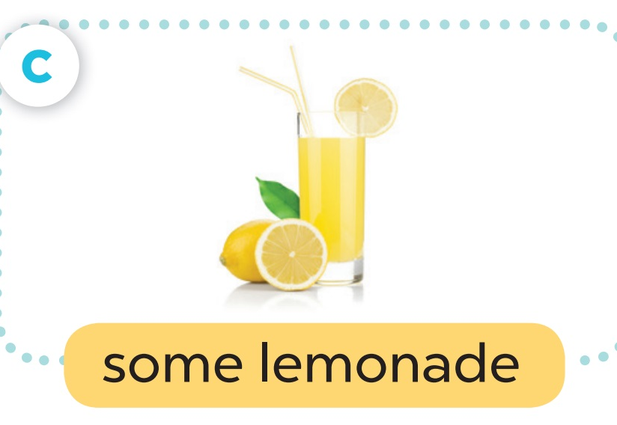
- What do you want to drink?
- I want some lemonade.

Slide 33
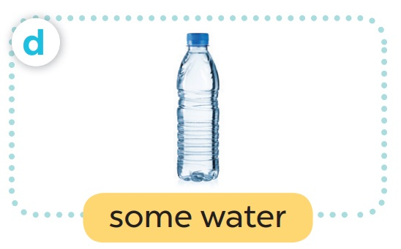
- What do you want to drink?
- I want some water.

Slide 34
04
Activity 3
Let’s talk.

Slide 35
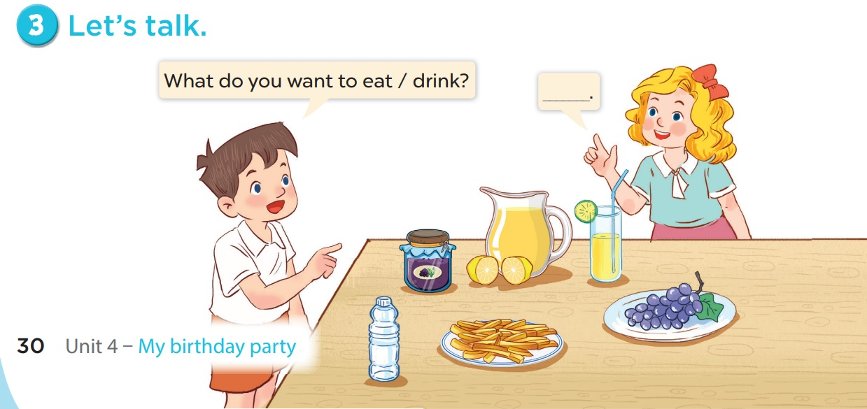

Slide 36
06
Game

Slide 37






BOMB STAR GAME
Choose one number to open the question.
Answer the question.
Lose the turn.
Write (A – B – C) on your white board to answer the questions.
Correct – get points behind the star.
Incorrect – no points.

Slide 38














BOMB STAR
+2
+2
+5
+3
+5
+2
+4
+1
+3
+1

Slide 39
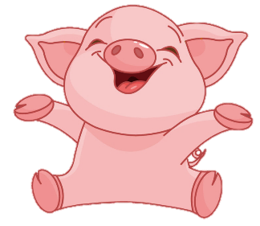


I want to eat some ____.
Back
A
B
C
juice
jam
grapes

Slide 40
I want to eat some ____.
Back
A
B
C
chips
grapes
jam

Slide 41

I want to drink some ____.
Back
A
B
C
lemonade
juice
water

Slide 42
I want to drink some ____.
Back
A
B
C
lemonade
juice
water

Slide 43
I want to ___ some juice.
Back
A
B
C
eat
drink
want

Slide 44
I want to ___ some chips.
Back
A
B
C
eat
drink
want

Slide 45
It’s a birthday ___.
Back
A
B
C
happy
party
music

Slide 46
Happy _____!
Back
A
B
C
school
party
birthday

