Slide 1





Slide 2


My birthday party
4
Lesson 2 – Period 4

Slide 3


Table of contents
01
Warm-up
02
Activity 4
03
Activity 5
Guessing game
Listen and tick.
Look, complete and read.
04
Activity 6
05
Fun time
Let’s play.

Slide 4
01
Warm-up
Guessing game

Slide 5

shpic
chips

Slide 6

apergs
grapes

Slide 7
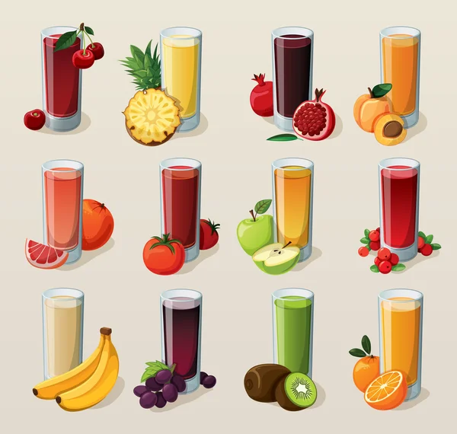
uicje
juice

Slide 8
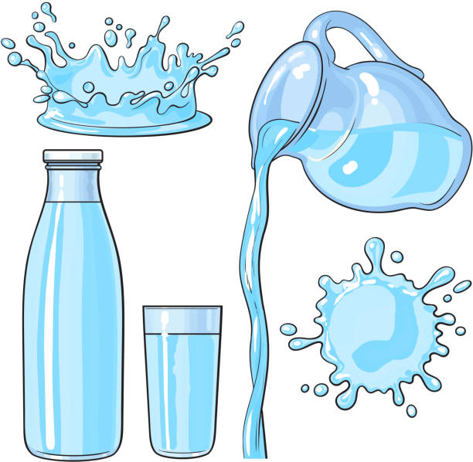
wtera
water

Slide 9

amj
jam

Slide 10
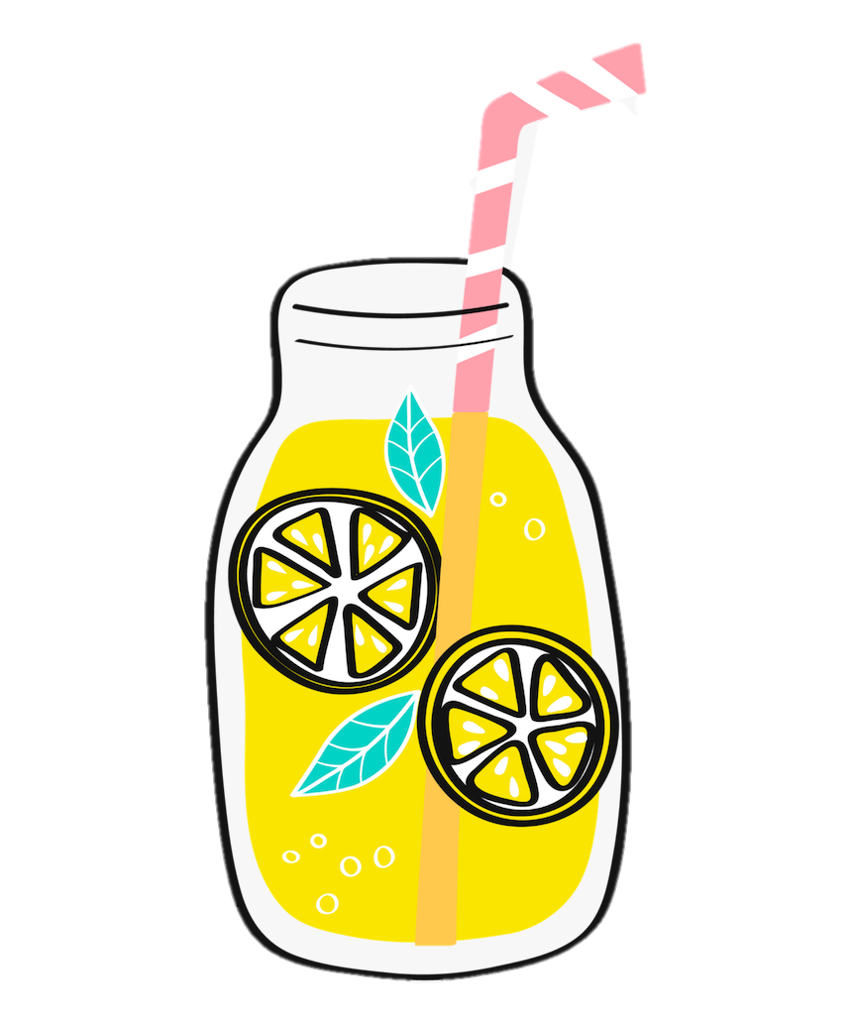
emonlaed
lemonade

Slide 11
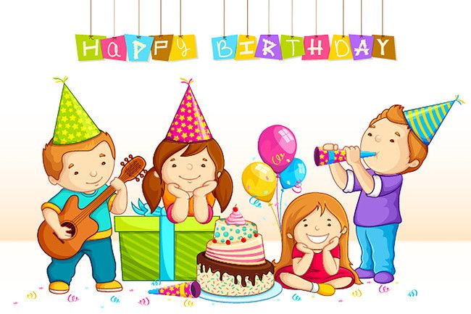
prayt
party

Slide 12
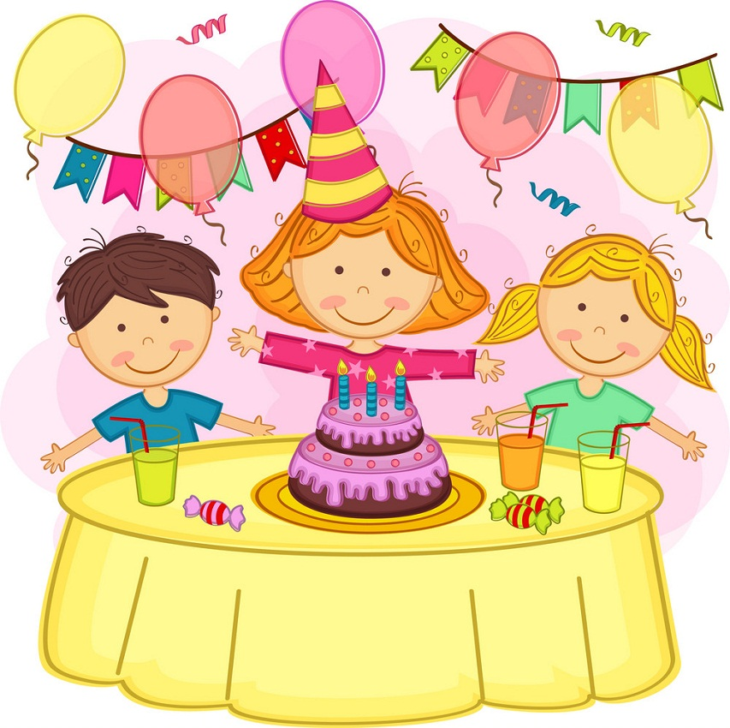
irdbayth
birthday

Slide 13
02
Activity 4
Listen and tick.

Slide 14
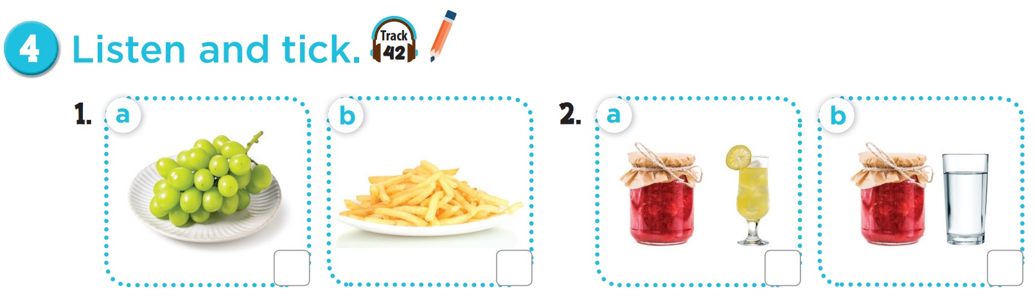


Slide 15
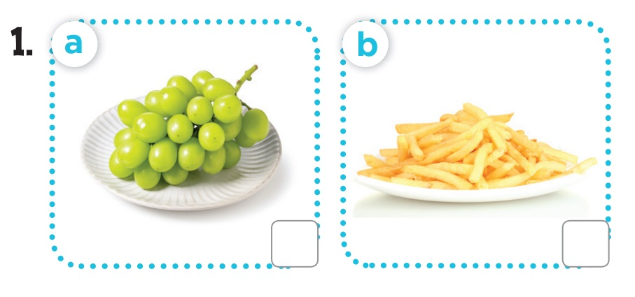

Listen and tick.
grapes
chips

Slide 16
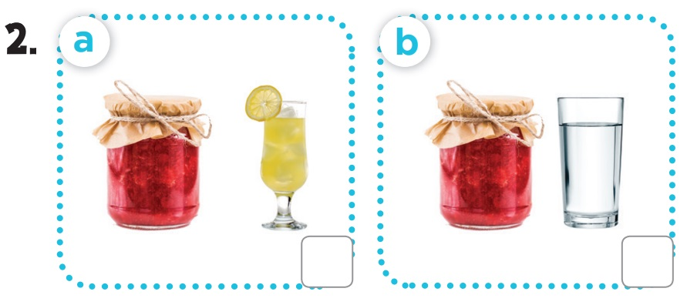
Listen and tick.
jam - lemonade
jam - water

Slide 17
03
Activity 5
Look, complete and read.

Slide 18
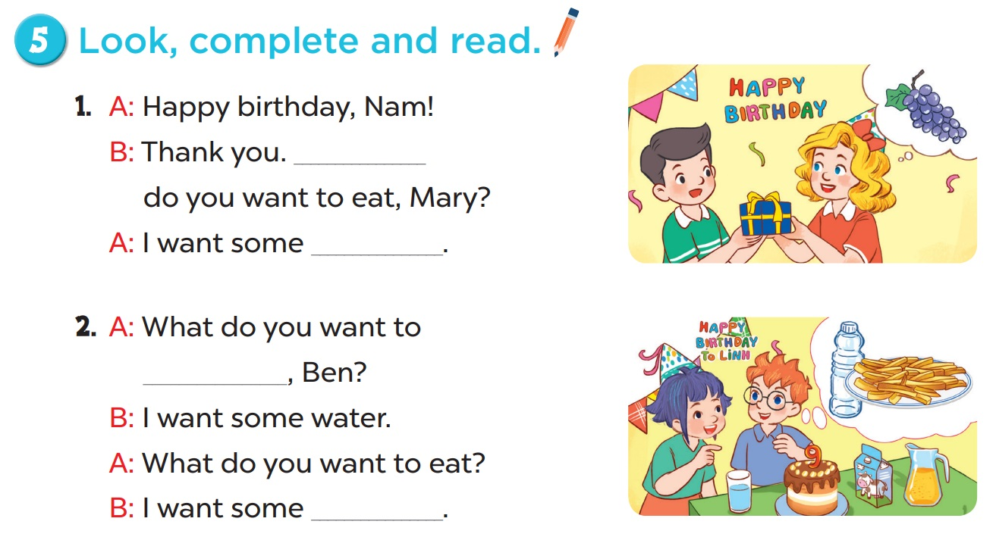

Slide 19
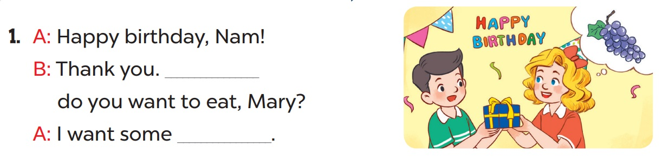
What
grapes

Slide 20
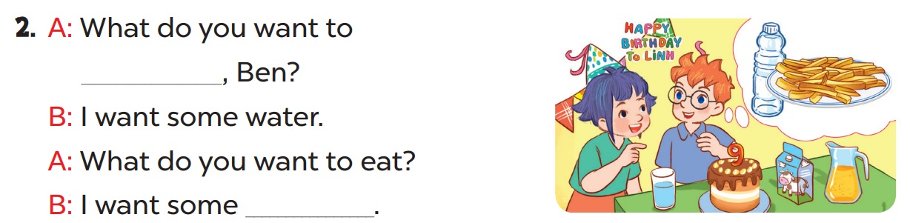
drink
chips

Slide 21
04
Activity 6
Let’s play.

Slide 22
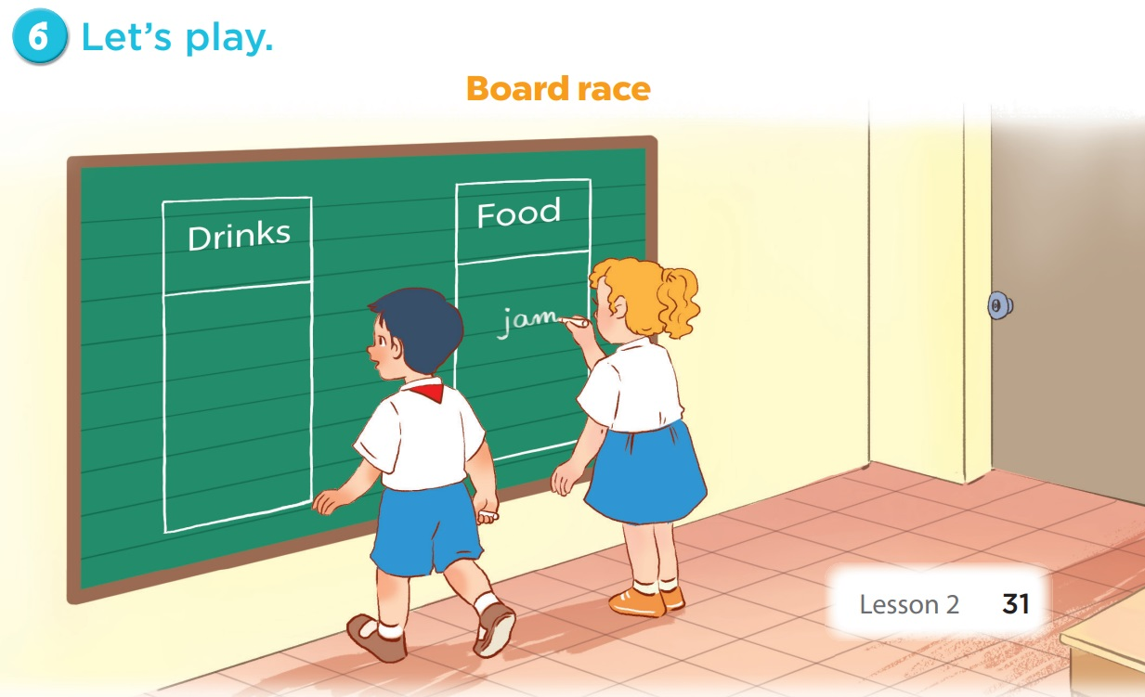

Slide 23
05
Fun time

Slide 24
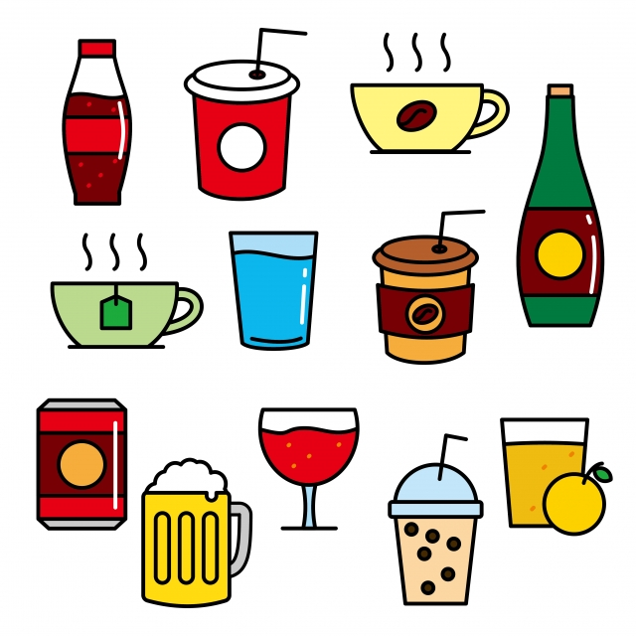
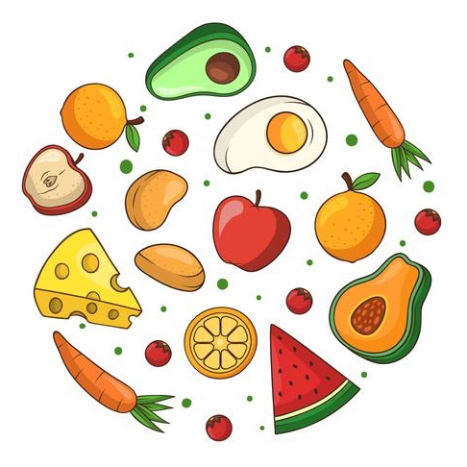
Food
Drinks

Slide 25
(Option 1)
Food or Drinks

Slide 26


juice
A
B

Slide 27
jam
A
B

Slide 28
water
A
B

Slide 29
lemonade
A
B

Slide 30
grapes
A
B

Slide 31
chips
A
B

Slide 32
(Option 2)
PINE TREE

Slide 33








9
8
7
6
5
4
3
2
1
0
9
8
7
6
5
4
3
2
1
9
0
8
7
6
5
4
3
2
1
0
9
8
7
6
5
4
3
2
1
9
0
8
7
6
5
4
3
2
1
0
9
8
7
6
5
4
3
2
1
0
TEAM 1
TEAM 2
TEAM 3
End

Slide 34

1
2
3
4
5
6
7
8
Score

Slide 35

I want to eat some ____.
A. juice
B. jam

Slide 36

+7
Score

Slide 37
What do you want to ___?
A. eat
B. drink

Slide 38
+2
Score

Slide 39
Happy birthday!
A. Thank you.
B. Sorry.

Slide 40
+12
Score

Slide 41
- What do you want to drink?
- I want some ____.
A. lemonade
B. chips

Slide 42
+8
Score

Slide 43
I want to drink ___ water.
A. a
B. some

Slide 44
+5
Score

Slide 45

I want to eat some ____.
A. grapes
B. grape

Slide 46
steal 7 points
Score

Slide 47
I want _____ some juice.
A. to drink
B. drinking

Slide 48
+20
Score

Slide 49
_ar_y
A. p - t
B. b - d

Slide 50
+10
Score

