Slide 1
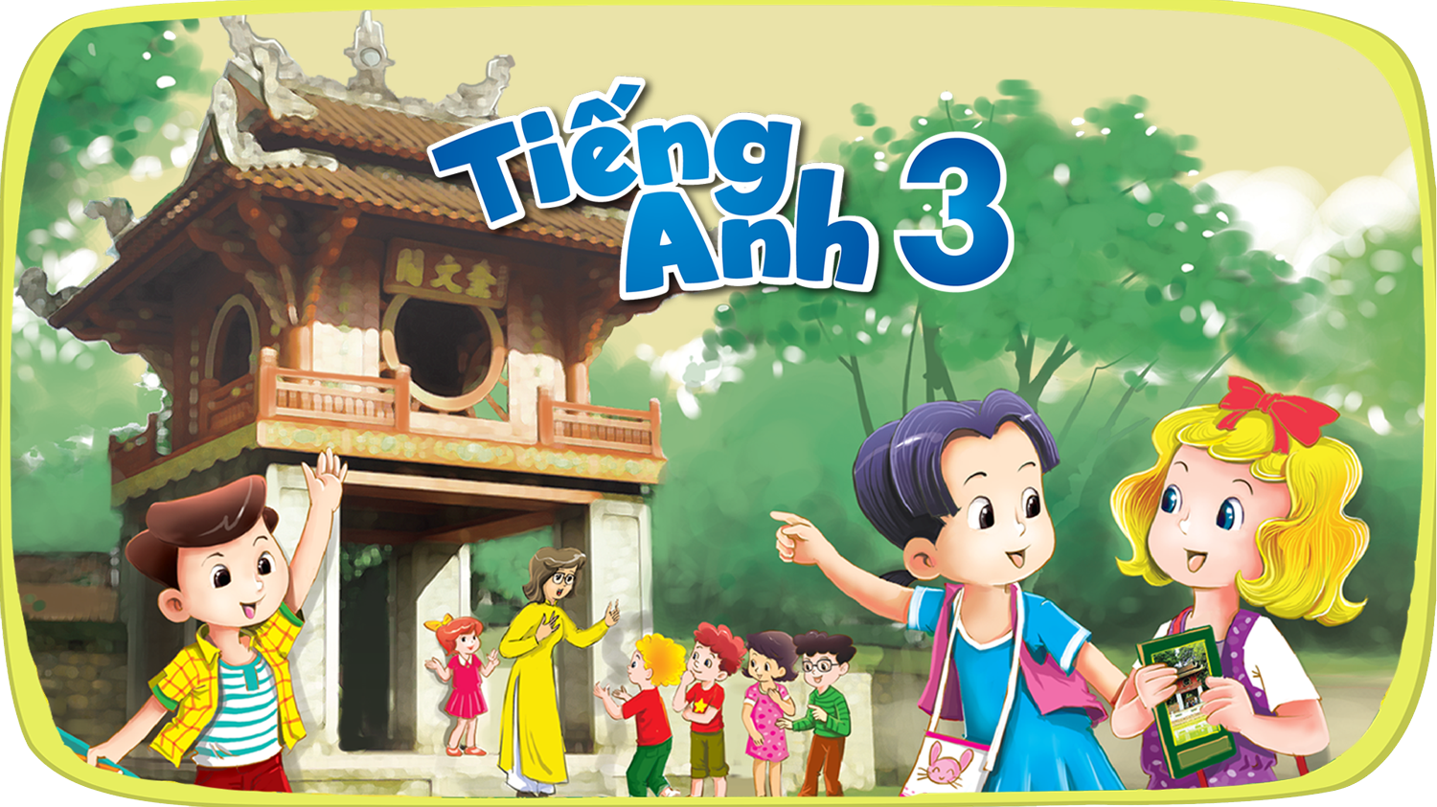




Slide 2


My birthday party
4
Lesson 3 – Period 6

Slide 3
01
Warm-up
Let’s chant!

Slide 4

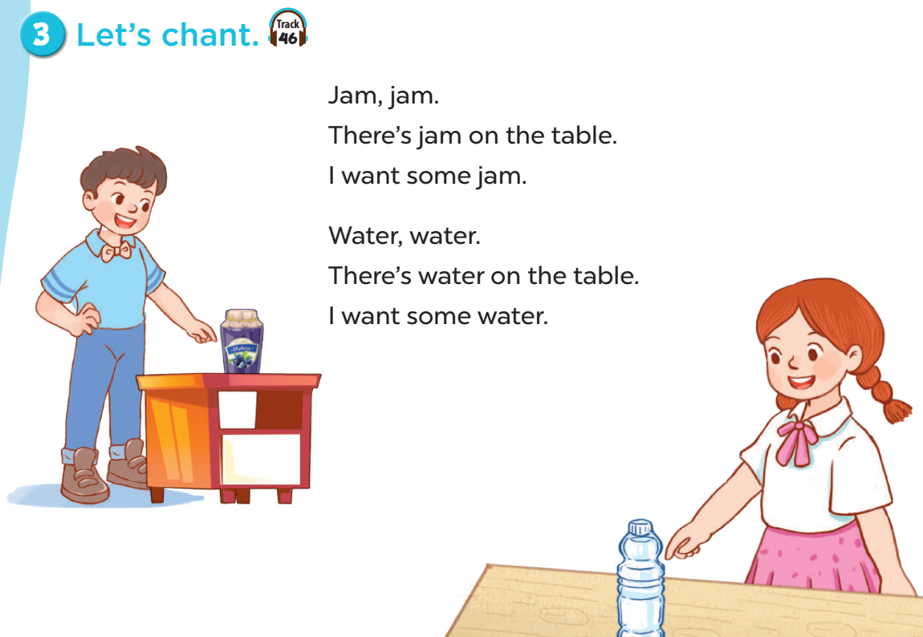

Slide 5
02
Activity 4
Read and circle.

Slide 6
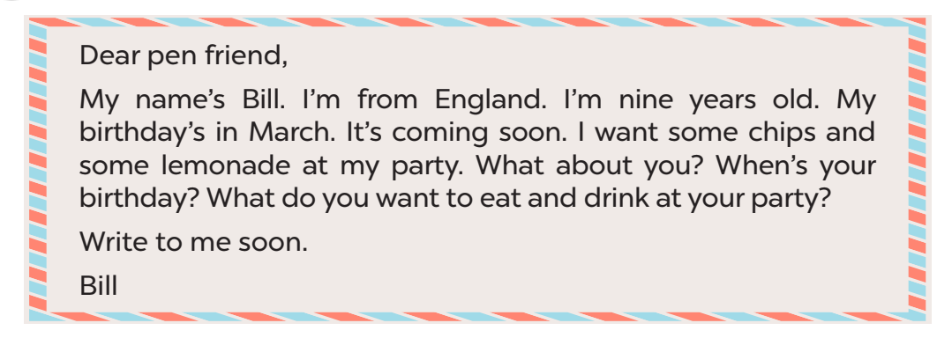
Read.

Slide 7
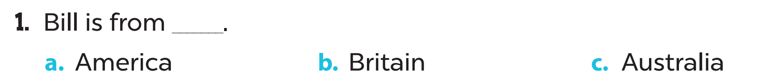
Circle.

Slide 8
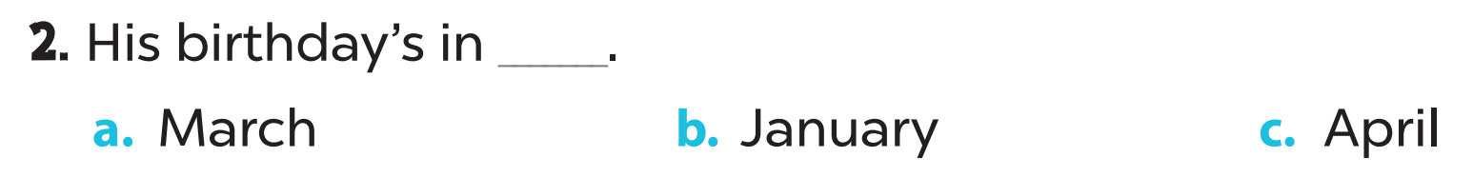
Circle.

Slide 9
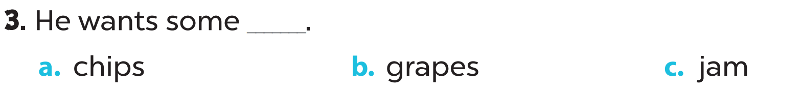
Circle.

Slide 10
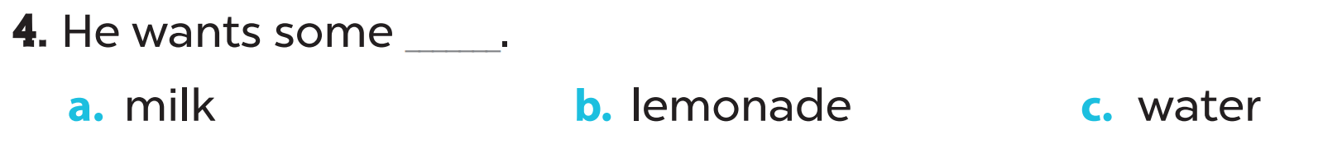
Circle.

Slide 11
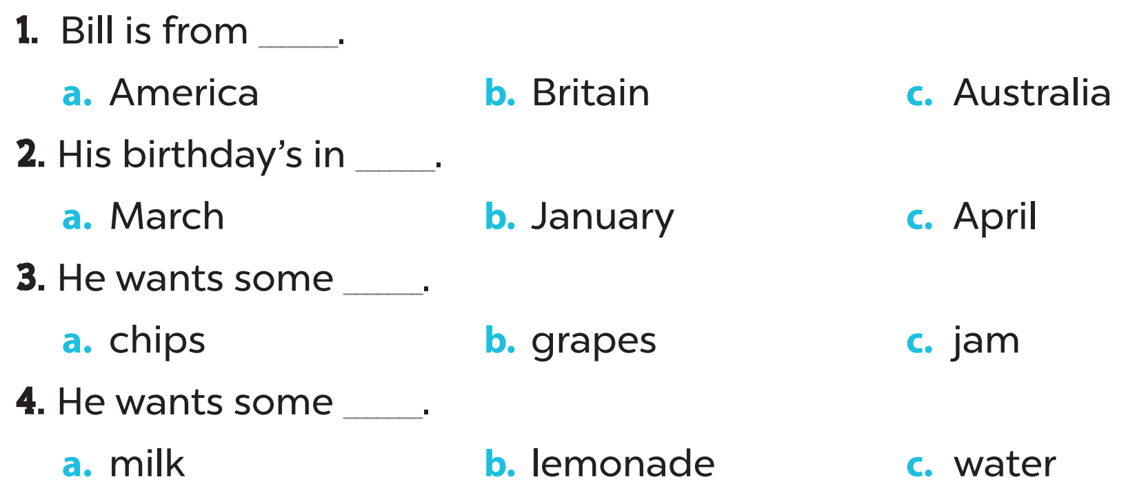
Look and check.

Slide 12
03
Activity 5
Let’s write.

Slide 13
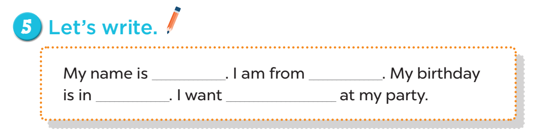

Slide 14
My name is ______.
Trang

Slide 15
I am from ________.
Ha Noi
Viet Nam

Slide 16
My birthday is in ___.
January February March
April May June July
August September October November December

Slide 17
I want ___ at my party.
some chips/ grapes/ jam
and
some water/ juice/ lemonade

Slide 18
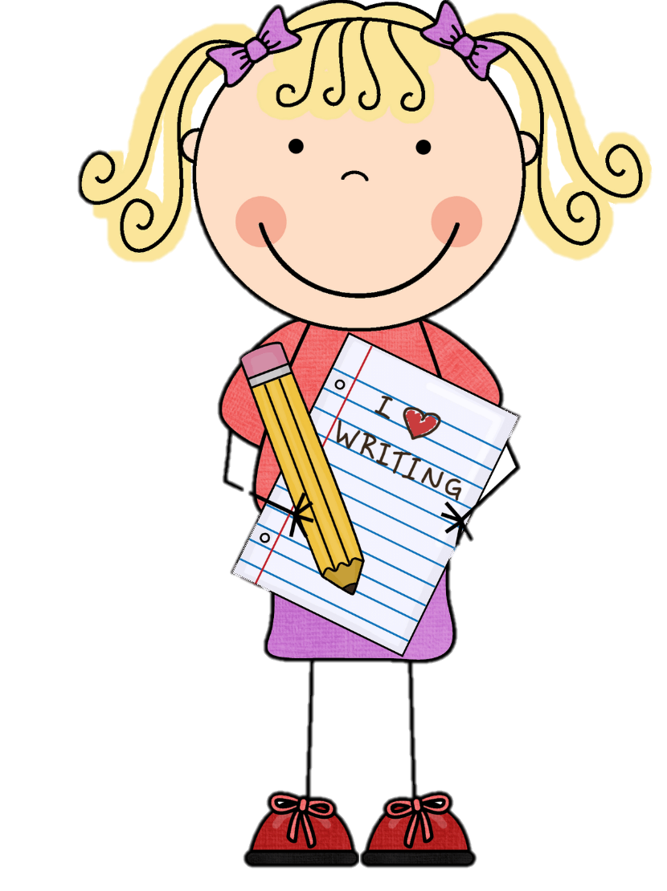
Time to share

Slide 19
04
Fun time

Slide 20

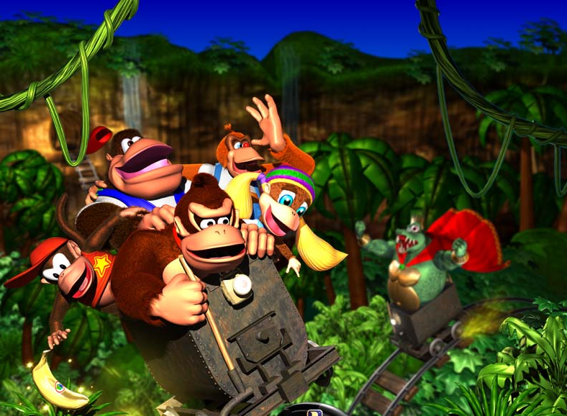




Slide 21
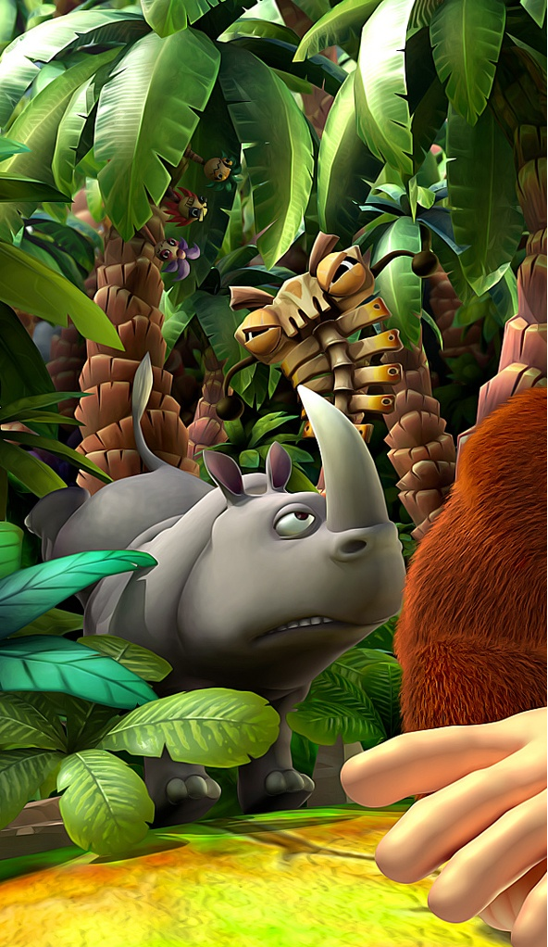
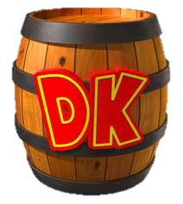
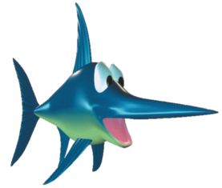

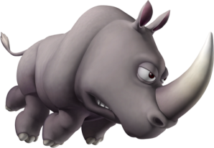
Rules:
Each team will have one turn to answer a question.
If your answer is correct: +2 Points!
Then choose a mystery barrel:
Sword Fish:
Switch
points with another team
Angry Rhino
BOMB!
Lose all points.
Golden Banana:
+ points
Poison
Banana:
- points
Notes:
Click on each barrel to reveal the bonus

Slide 22
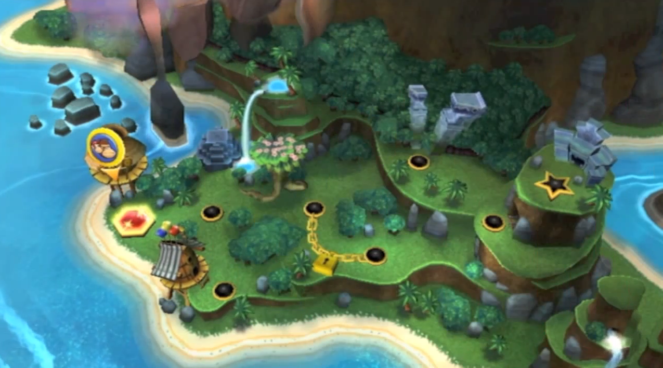




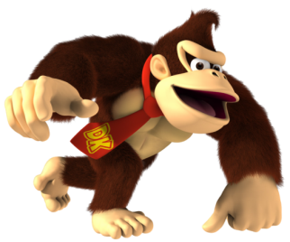
End
Notes:
Tell your students to choose a color for question.
Make sure you choose is the star last!! (far right)
It will progress to the next “world” (Next question board)

Slide 23
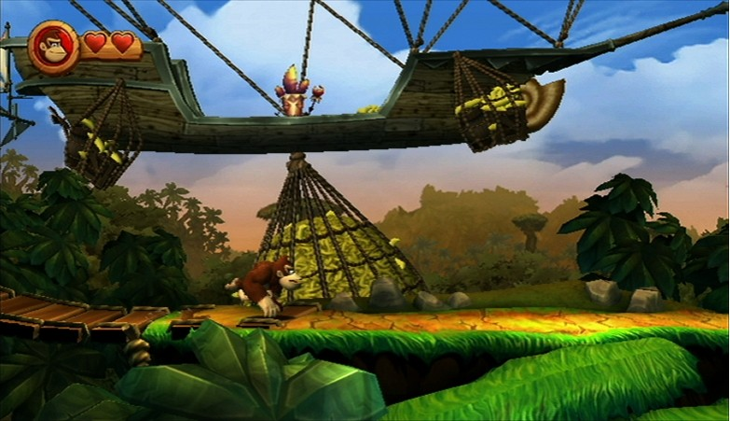

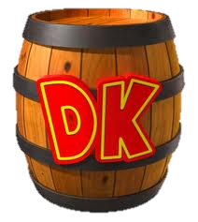
When’s your birthday?
It’s in _______.
Notes:
Click on the DK barrel to hyperlink to the bonus points slide. You must click on the barrel to continue the game.

Slide 24
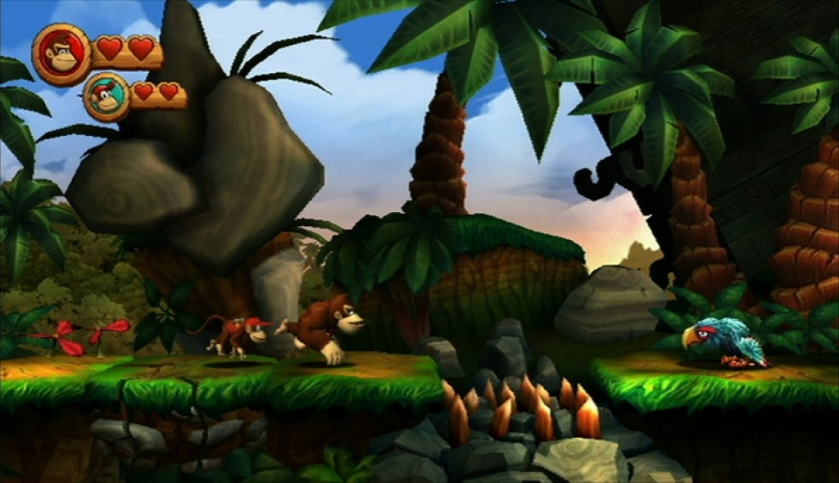
What food do you want at your birthday party?
I want some _____.
Notes:
Click on the DK barrel to hyperlink to the bonus points slide. You must click on the barrel to continue the game.

Slide 25
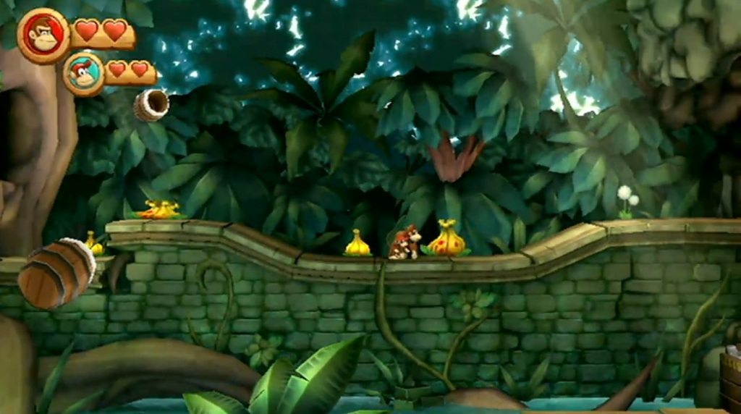
What drinks do you want at your birthday party?
I want some _____.
Notes:
Click on the DK barrel to hyperlink to the bonus points slide. You must click on the barrel to continue the game.

Slide 26
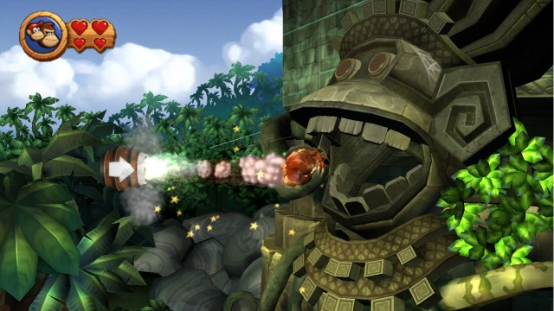
Where are you from?
I am from ____.
Notes:
Click on the DK barrel to hyperlink to the bonus points slide. You must click on the barrel to continue the game.

Slide 27
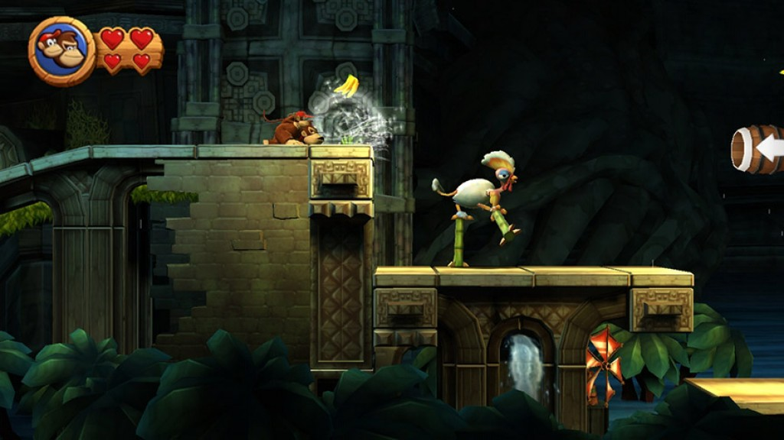
How old are you?
I am _____ years old.
Notes:
Click on the DK barrel to hyperlink to the bonus points slide. You must click on the barrel to continue the game.

Slide 28
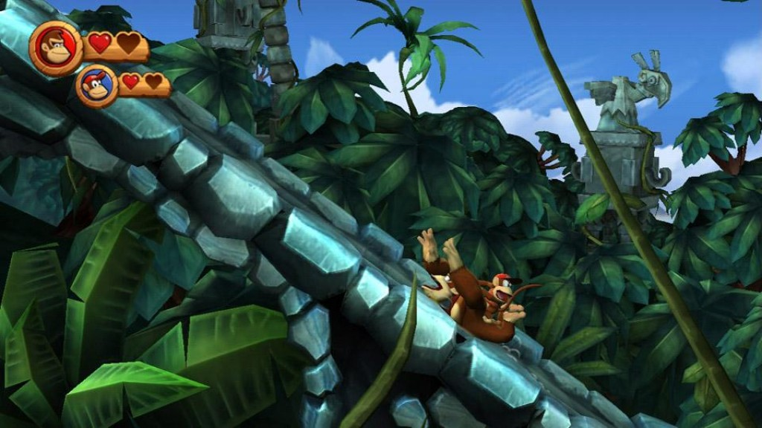
Say 3 words starting with “W”
water, window, white, ..
Notes:
Click on the DK barrel to hyperlink to the bonus points slide. You must click on the barrel to continue the game.

Slide 29
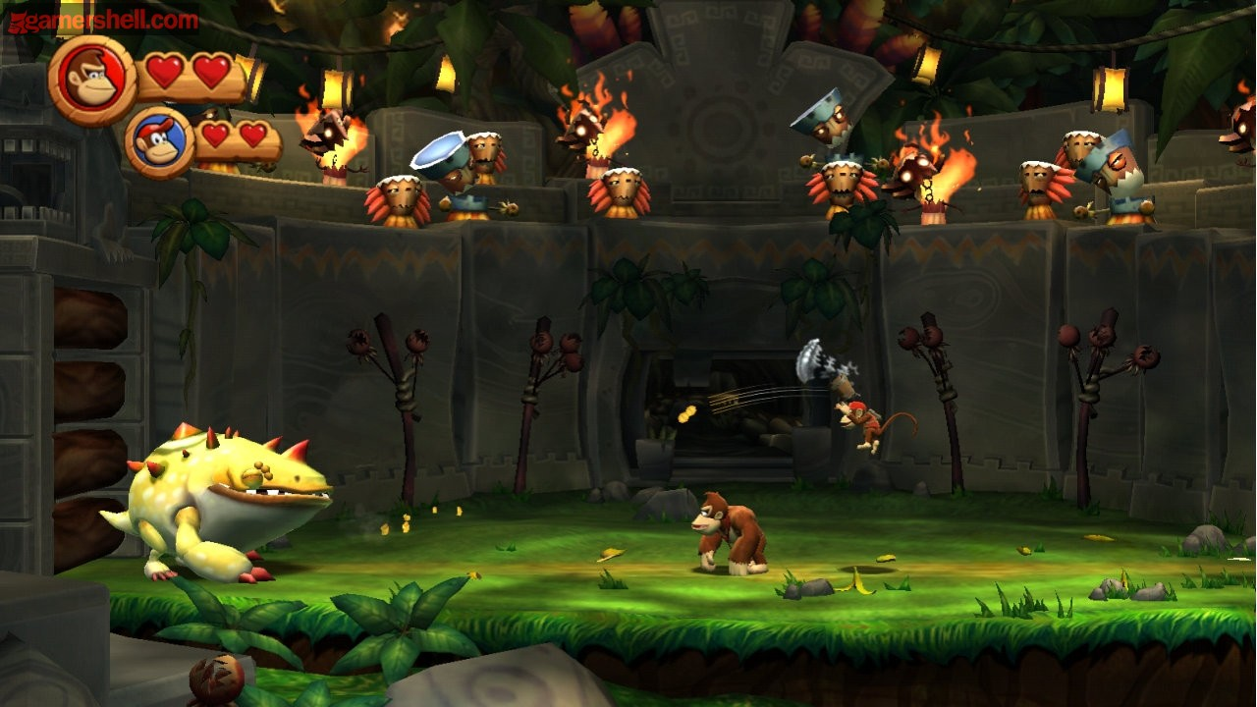
Say 3 words starting with “J”
jam, juice, jump, ..
Notes:
Click on the DK barrel to hyperlink to the bonus points slide. You must click on the barrel to continue the game.

Slide 30
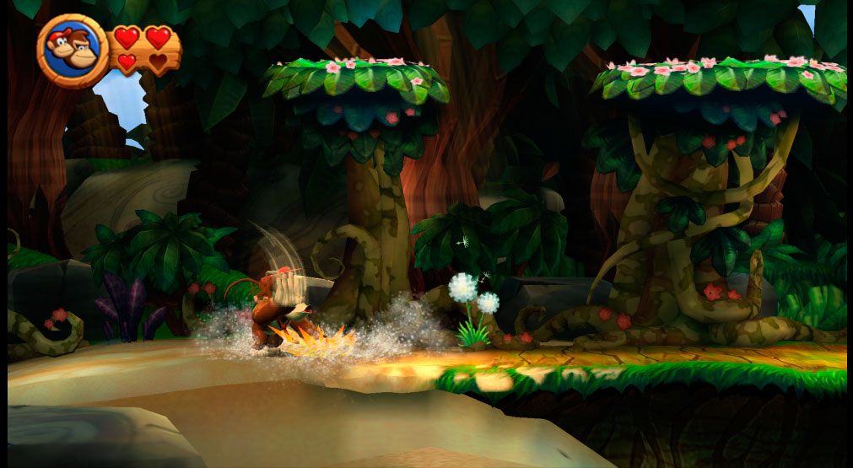
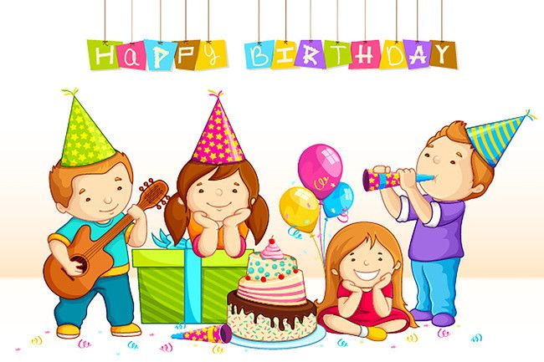
I am having a birthday ____ with my friends.
party
Notes:
Click on the DK barrel to hyperlink to the bonus points slide. You must click on the barrel to continue the game.

Slide 31
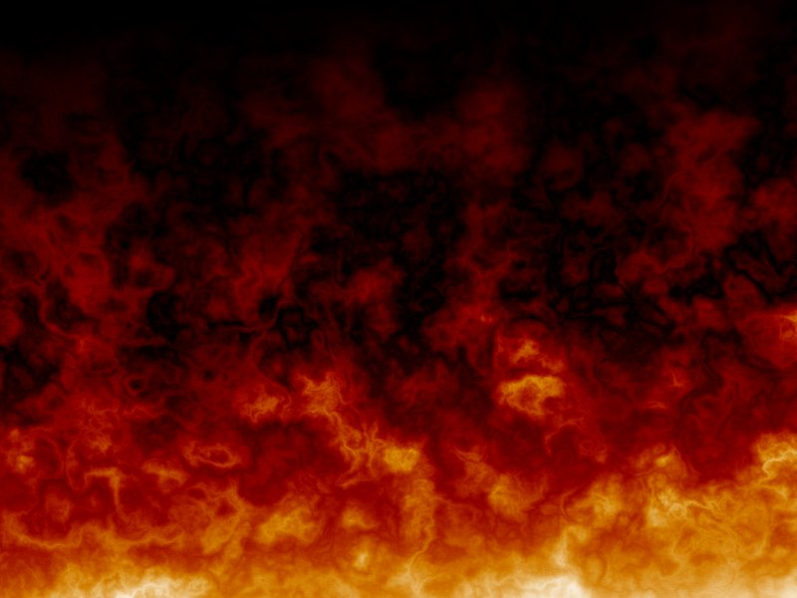

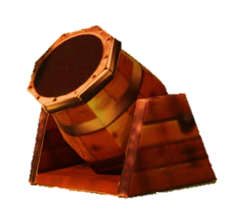
Notes:
Click a barrel for a bonus prize.
Click the cannon to return to the main page.

Slide 32
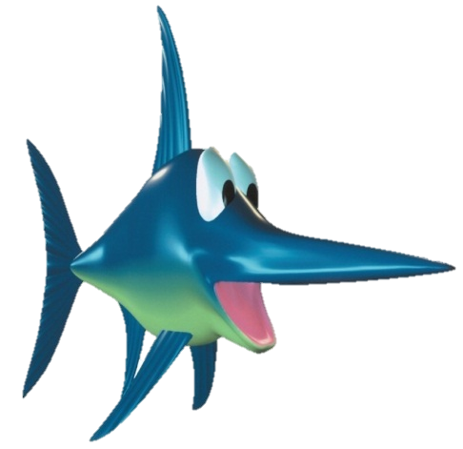
Notes:
Click a barrel for a bonus prize.
Click the cannon to return to the main page.

Slide 33
Notes:
Click a barrel for a bonus prize.
Click the cannon to return to the main page.

Slide 34
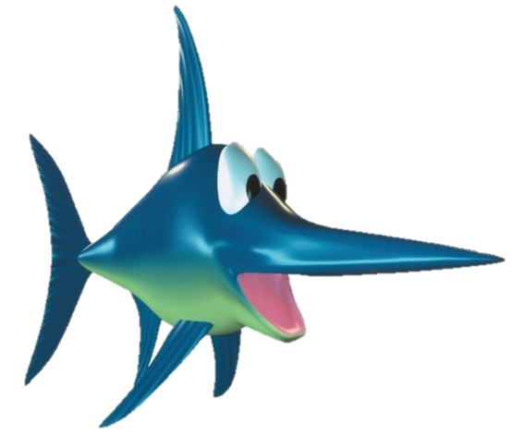
Notes:
Click a barrel for a bonus prize.
Click the cannon to return to the main page.

Slide 35
Notes:
Click a barrel for a bonus prize.
Click the cannon to return to the main page.

Slide 36
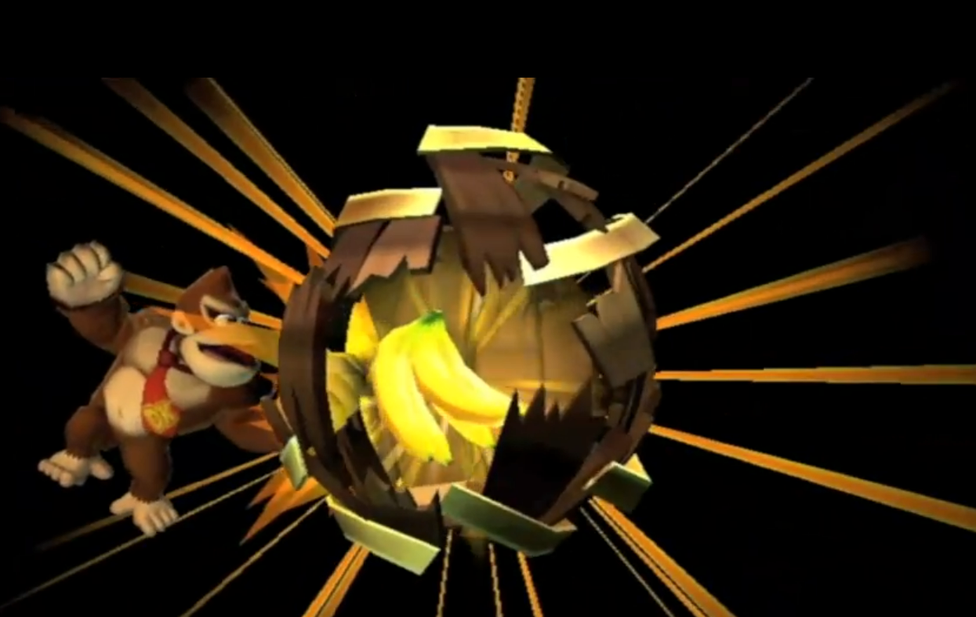
You found a giant golden banana! 5 points!
Notes:
Click the cannon to return to the main screen,

Slide 37

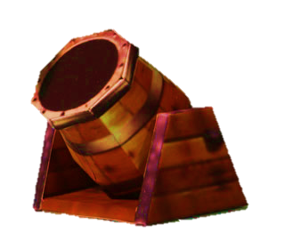
+7
Notes:
Click a barrel for a bonus prize.
Click the cannon to return to the main page.

Slide 38
You found a giant golden banana! 5 points!
Notes:
Click the cannon to return to the main screen,

Slide 39
+7
Notes:
Click a barrel for a bonus prize.
Click the cannon to return to the main page.

Slide 40
+7
Notes:
Click a barrel for a bonus prize.
Click the cannon to return to the main page.

Slide 41
05
Activity 3
Project

Slide 42
