Slide 1


Our names
2
9
LESSON 1 – PERIOD 1

Slide 2
TABLE OF CONTENTS
01
02
03
04
05
WARM-UP
EXPLORATION
MODEL SENTENCES
PRACTICE
FUN TIME

Slide 3
WARM-UP
01

Slide 4

Sing with me!

Slide 5

Notes:
Youtube link: https://www.youtube.com/watch?v=tVlcKp3bWH8

Slide 6
EXPLORATION
02

Slide 7


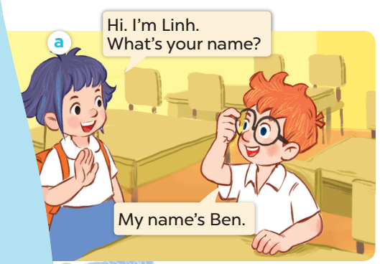
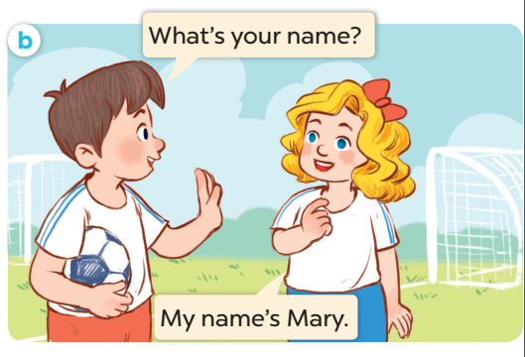

Slide 8
MODEL SENTENCES
03

Slide 9
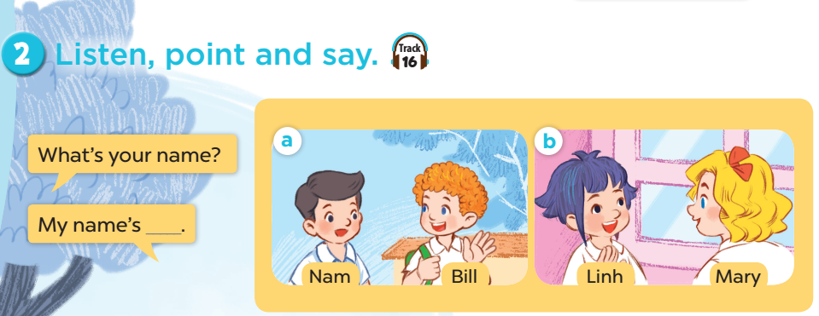

Slide 10


I’m Minh.
What’s your name?
Hello!
My name’s Lucy.
Hi!

Slide 11


I’m Minh.
What’s your name?
My name’s _____.
Mai
Ben

Slide 12

Blow up balloons
Notes:
Divide the class into 2 teams. Let each pupil choose a balloon by its colour. Pupil(s) answer the question(s). If their answer(s) are correct, they get points (behind each balloon) for their teams. The winning team is the team with more points.

Slide 13







5
15
15
20
5
10
25

Slide 14
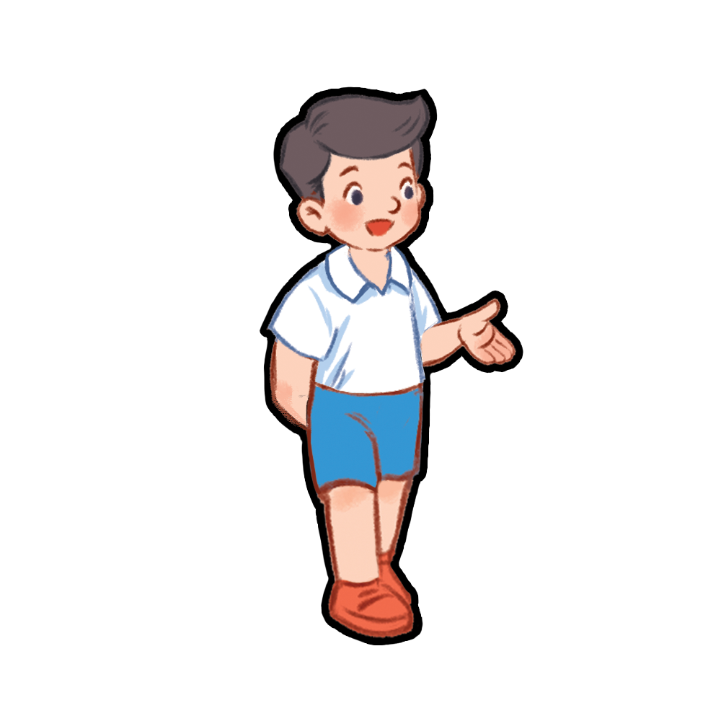
What’s your name?
Nam

Slide 15

What’s your name?
Mary

Slide 16

What’s your name?
Bill

Slide 17
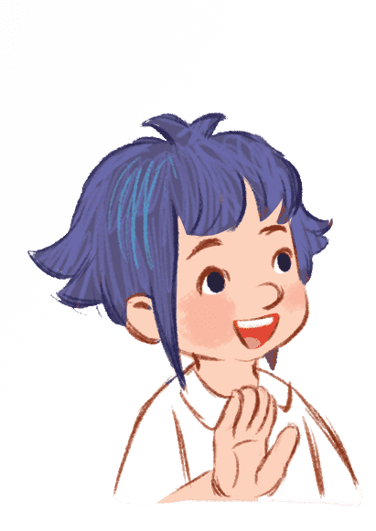
What’s your name?
Linh

Slide 18
What’s your name?
Ben

Slide 19
What’s your name?
Mai

Slide 20
What’s your name?
Lucy

Slide 21
PRACTICE
04

Slide 22
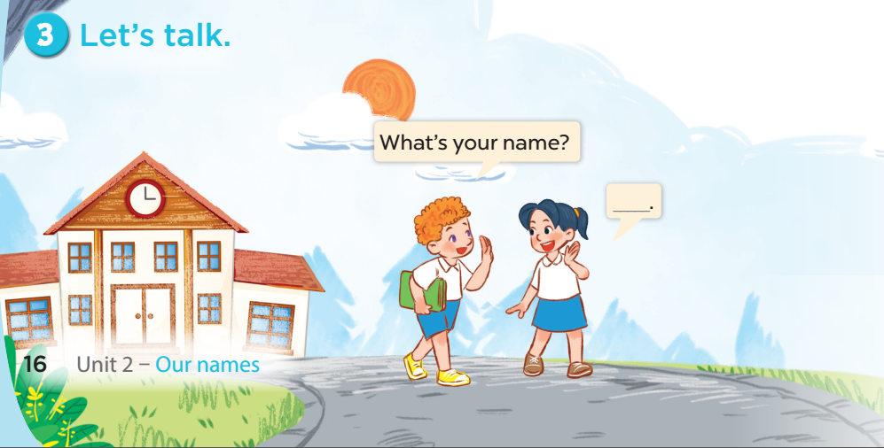

Slide 23
FUN TIME
05

Slide 24
Let’s ask people around you!
 | What’s your name?
You | NGUYÊN
Your friend | …………………………………………………
Your grandma / grandpa | …………………………………………………
Your mom / dad | …………………………………………………
Your sister/brother | …………………………………………………

Slide 25

Website: sachmem.vn
Fanpage: www.facebook.com/sachmem.vn
Youtube: Sách Mềm

