Slide 1


Our names
2
9
LESSON 2 – PERIOD 3

Slide 2
TABLE OF CONTENTS
01
02
03
04
05
WARM-UP
MODEL
SENTENCES
PRACTICE
LET’S TALK!
FUN TIME

Slide 3
WARM-UP
01

Slide 4
WHO’S FASTER?

Slide 5


Slide 6


Slide 7


Slide 8


Slide 9


Slide 10


Slide 11


Slide 12


Slide 13










Let’s count together!

Slide 14
MODEL SENTENCES
02

Slide 15
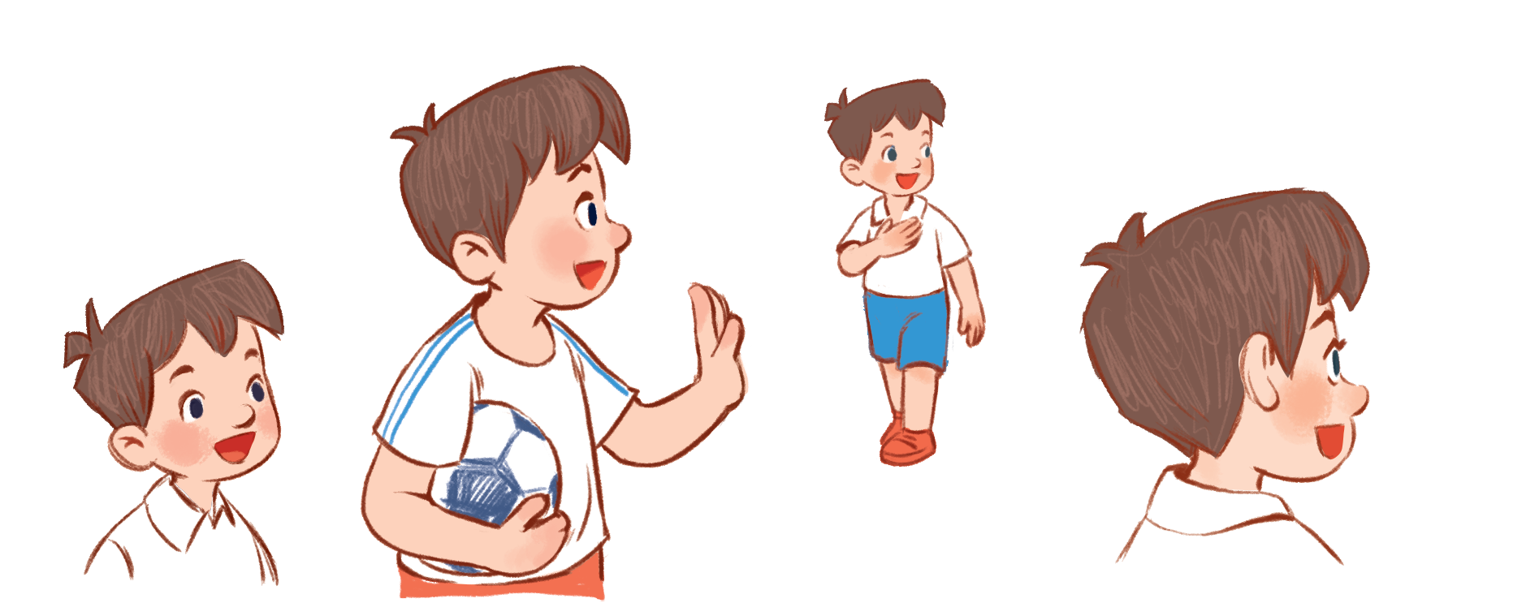

I’m Minh.
What’s your name?
Hello!
My name’s Mary.
Hi!

Slide 16
How old are you?
I’m …… years old.
eight
8

Slide 17

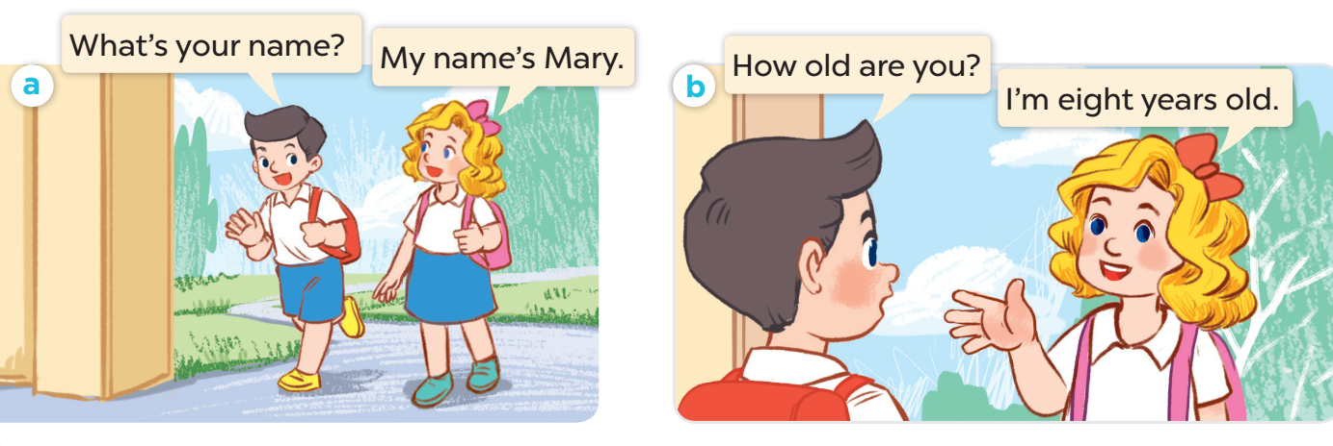

Slide 18
PRACTICE
03

Slide 19
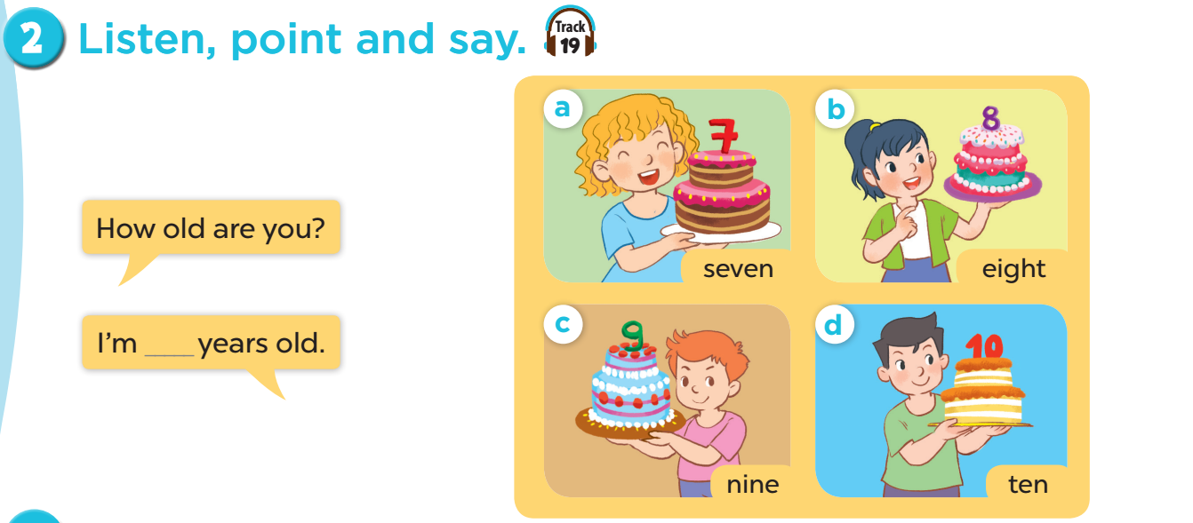

Slide 20


Slide 21


1. Work in teams (girls & boys)
2. Choose and answer.

Slide 22

Notes:
CLICK THE CLOUD – GO TO PART 4

Slide 23



How old are you?
I’m __ years old.
7
Notes:
CLICK PINK AMONG US – GO TO THE POINTS

Slide 24

How old are you?
I’m __ years old.
5
Notes:
CLICK PINK AMONG US – GO TO THE POINTS

Slide 25

How old are you?
I’m __ years old.
9
Notes:
CLICK PINK AMONG US – GO TO THE POINTS

Slide 26

How old are you?
I’m __ years old.
8
Notes:
CLICK PINK AMONG US – GO TO THE POINTS

Slide 27

How old are you?
I’m ___ years old.
10
Notes:
CLICK PINK AMONG US – GO TO THE POINTS

Slide 28

What’s your name?
My name’s ____.
Bill
Notes:
CLICK PINK AMONG US – GO TO THE POINTS

Slide 29
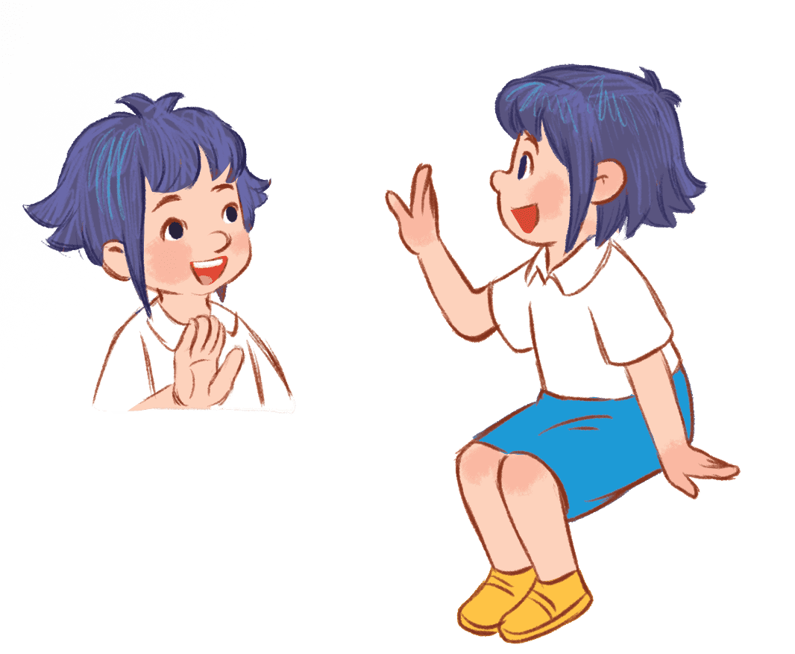
What’s your name?
My name’s ____.
Linh
Notes:
CLICK PINK AMONG US – GO TO THE POINTS

Slide 30

What’s your name?
My name’s ____.
Lucy
Notes:
CLICK PINK AMONG US – GO TO THE POINTS

Slide 31





Slide 32



Slide 33


Slide 34


Slide 35


Slide 36


Slide 37


Slide 38


Slide 39
LET’S TALK!
04

Slide 40
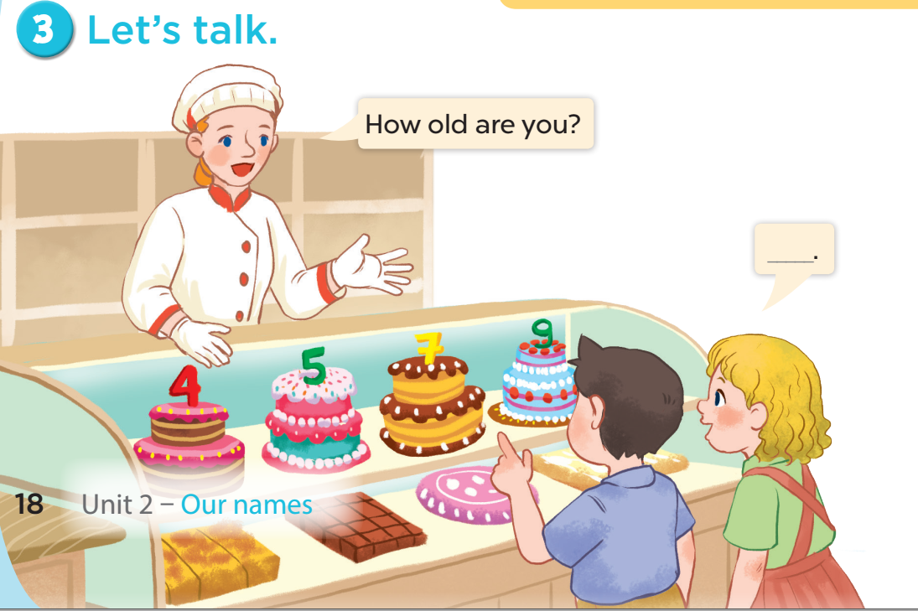

Slide 41
FUN TIME
05

Slide 42


5
10
1
7
8
SPIN
-5
3
9
-3
4
6
2
tekhnologic

Slide 43

Website: sachmem.vn
Fanpage: www.facebook.com/sachmem.vn
Youtube: Sách Mềm

