Slide 1





My foreign friends
Unit 3
Lesson 1 – Period 1

Slide 2


01
Warm-up

Slide 3






I’m from ___.
Australia

Slide 4


I’m from ____.
Viet Nam

Slide 5


I’m from ___.
Malaysia

Slide 6

I’m from ...
Britain

Slide 7

I’m from ...
Thailand

Slide 8

I’m from ____.
Singapore

Slide 9

I’m from _____.
America

Slide 10


Let's have a great class!

Slide 11
02
Look, listen and repeat.

Slide 12



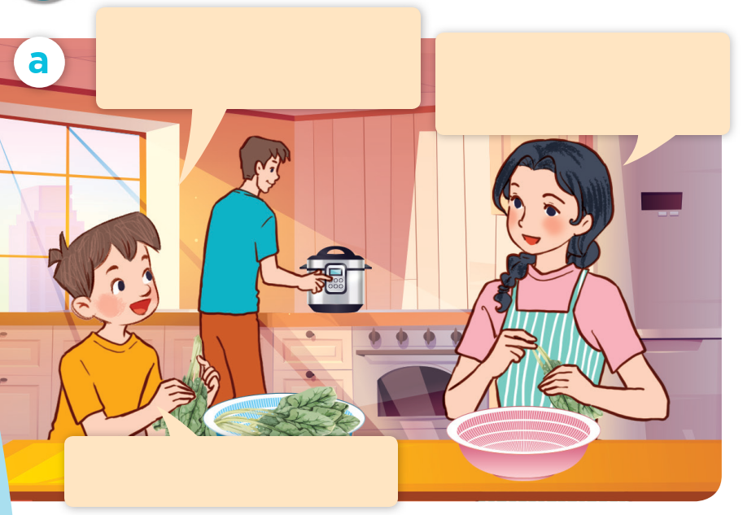


LOOK and SAY.
Mum, I have a new
foreign friend.
Do you? Where’s he from?
He’s from Australia.

Slide 13



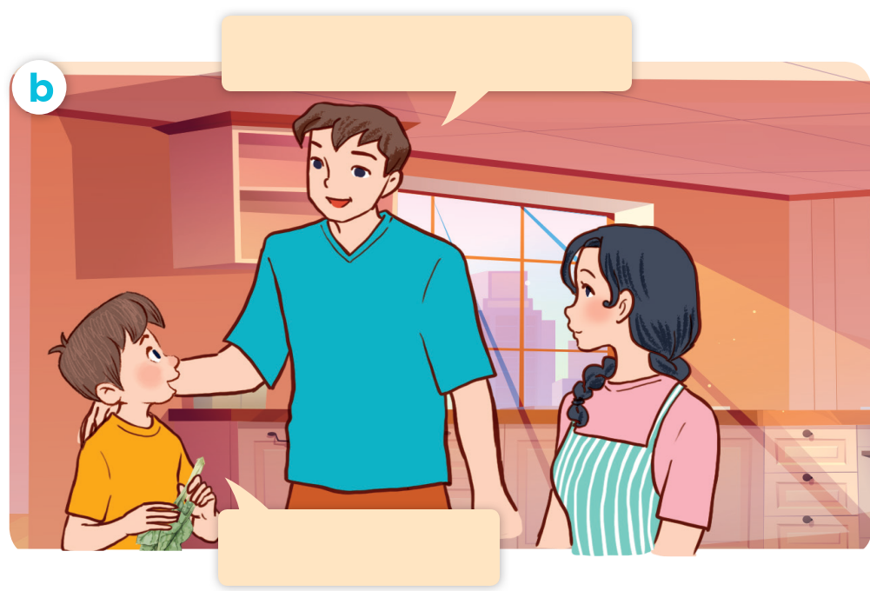


LOOK and SAY.
What nationality is he?
He’s Australian.

Slide 14






LISTEN and POINT.
Mum, I have a new
foreign friend.
Do you? Where’s he from?
What nationality is he?
He’s from Australia.
He’s Australian.

Slide 15

LISTEN, POINT and REPEAT.
Mum, I have a new
foreign friend
Do you? Where’s he from?
He’s from Australia.

Slide 16
LISTEN, POINT and REPEAT.
What nationality is he?
He’s Australian.

Slide 17


LISTEN and POINT.
What nationality is he?
He’s Australian.

Slide 18



Slide 19
03
Listen, point and say.

Slide 20








LOOK and SAY.
Australian
Malaysian
American
Japanese

Slide 21
LISTEN and REPEAT.
Australian

Slide 22
LISTEN and REPEAT.
Malaysian

Slide 23
LISTEN and REPEAT.
American

Slide 24
LISTEN and REPEAT.
Japanese

Slide 25

Listen, point and say.
What nationality is he?
He’s Australian.

Slide 26

Listen, point and say.
What nationality is she?
She’s Malaysian.

Slide 27
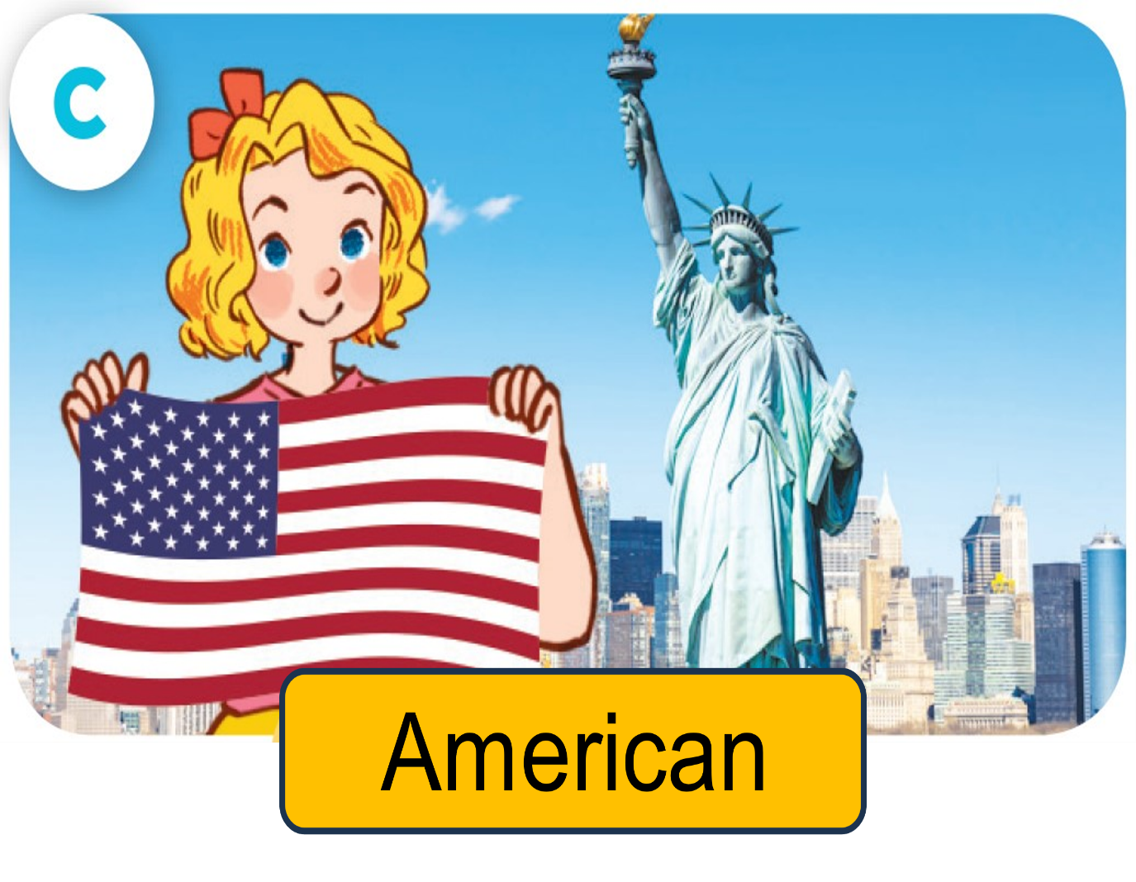
Listen, point and say.
What nationality is she?
She’s American.

Slide 28

Listen, point and say.
What nationality is she?
She’s Japanese.

Slide 29
ASK and ANSWER.
Australian
Malaysian
American
Japanese

Slide 31
04
Let’s talk.

Slide 32

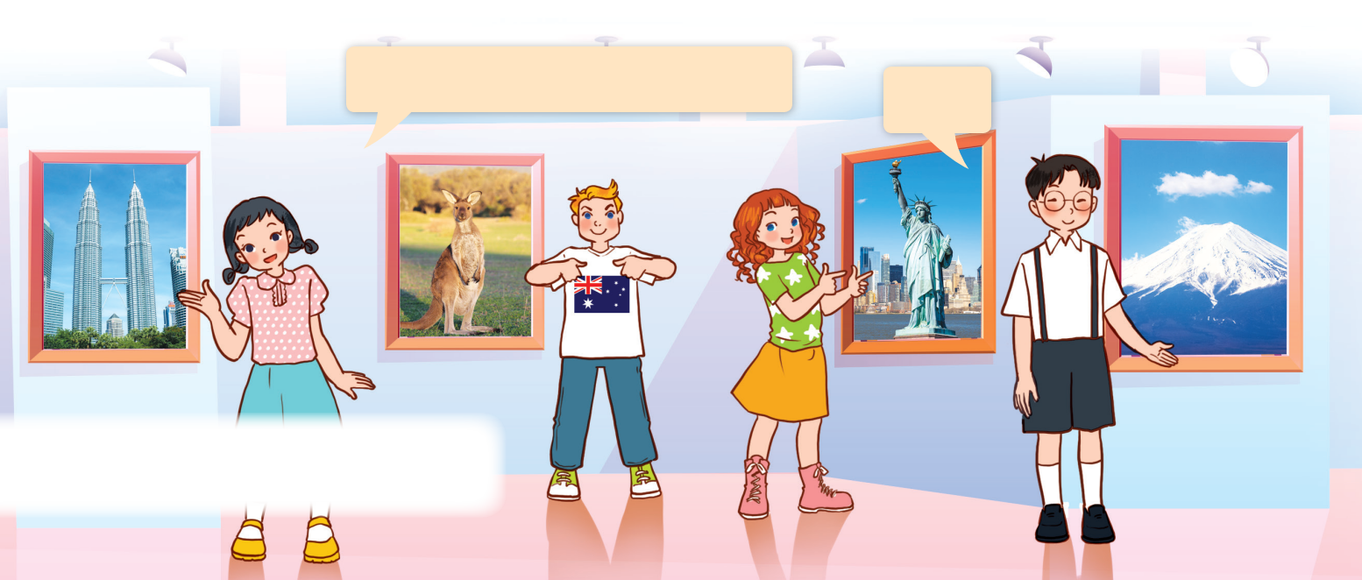
LOOK and SAY.

Slide 33

LOOK and SAY.
What nationality is she?
She’s Malaysian.

Slide 34
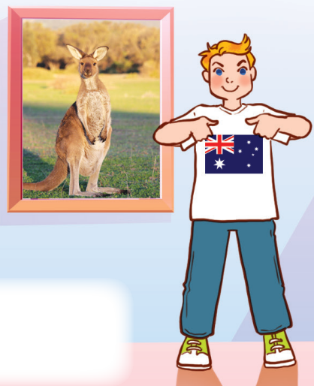
LOOK and SAY.
What nationality is he?
He’s Australian.

Slide 35
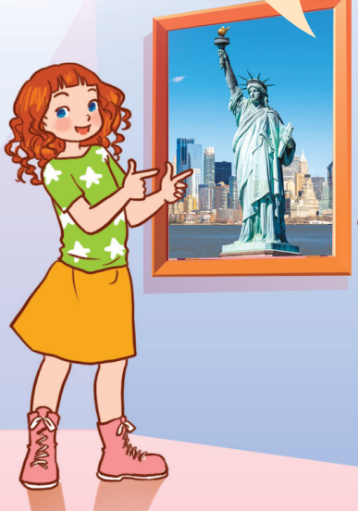
LOOK and SAY.
What nationality is she?
She’s American.

Slide 36
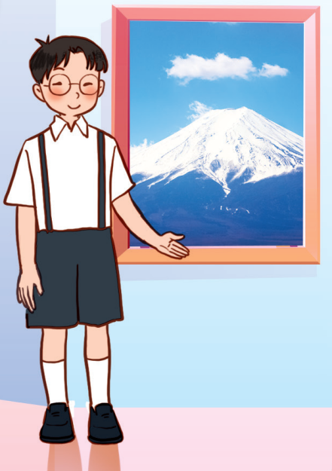
LOOK and SAY.
What nationality is he?
He’s Janpanese.

Slide 37

ASK and ANSWER.
What nationality is she / he?
________.

Slide 38
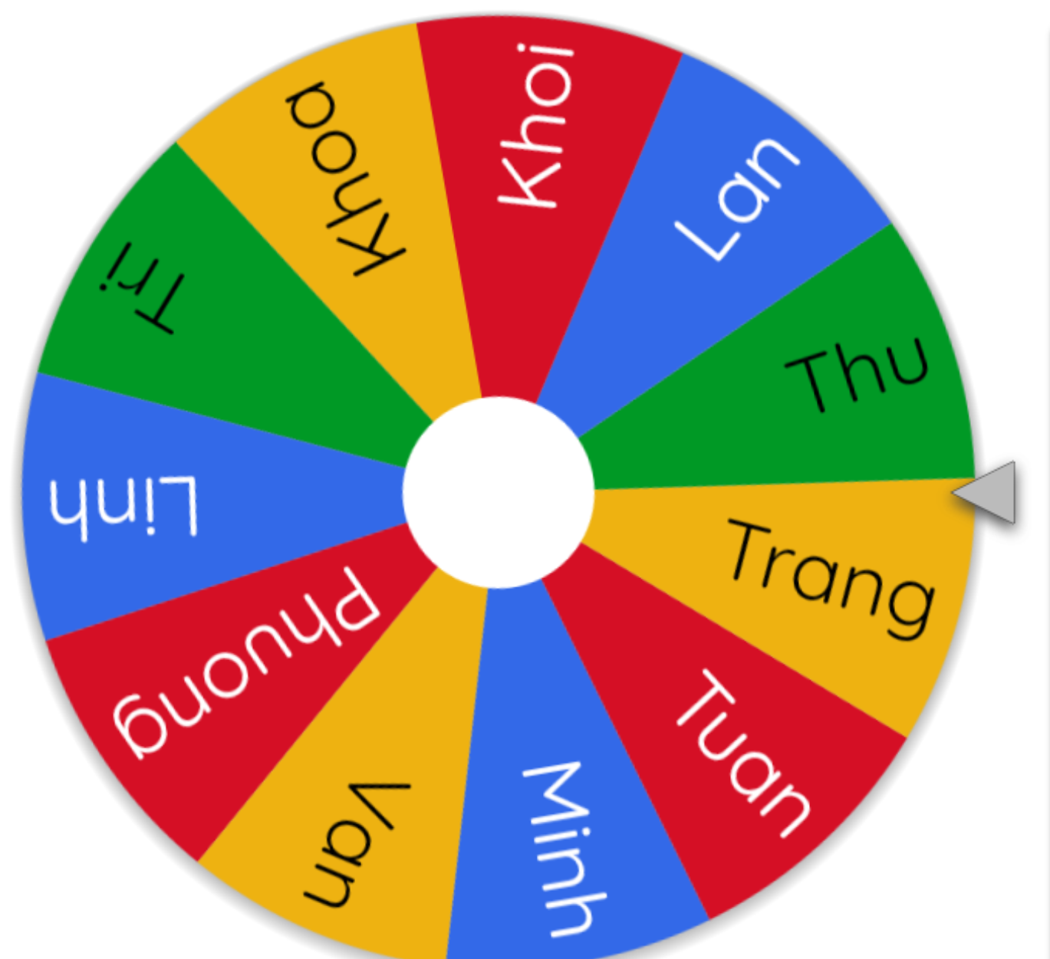
LET’S SPIN!
Notes:
Use this link https://wheelofnames.com/ to choose pupils in random.

Slide 40
05
Fun corner
and wrap-up

Slide 41

What nationality is she?
She’s American.

Slide 42

What nationality is she?
She’s Japanese.

Slide 43

What nationality is he?
He’s Australian.

Slide 44

What nationality is she?
She’s Malaysian.

