Slide 1




Slide 2





REVIEW 1
PERIOD 1

Slide 3



CONTENTS
1. Warm-up and review
3. Listen and number.
2. Listen and tick.
4. Let’s talk.
5.Fun corner and wrap-up

Slide 4
1. Warm-up and review

Slide 5






Notes:
- Divide the class into 2 groups.
- Ask pupils in each group to stand closely in a straight line.
- Teacher says a word or phrase to the first pupil in line.
- Then, the first pupil whispers what she/ he hears to the second person in line and so on until the last pupil in the line.
- The last pupil will say the word or phrase out loud.

Slide 6



2. Listen and
tick.

Slide 7

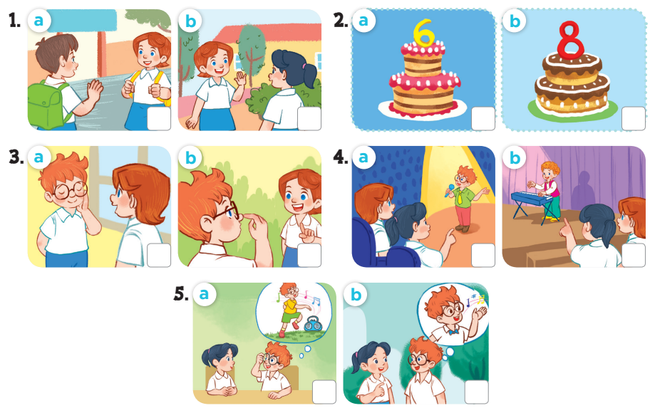
Notes:
Key: 1. b 2. b 3. a 4. b 5. b

Slide 8



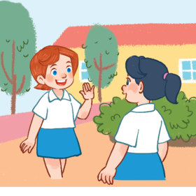



1
a
b

Slide 9



2
a
b

Slide 10
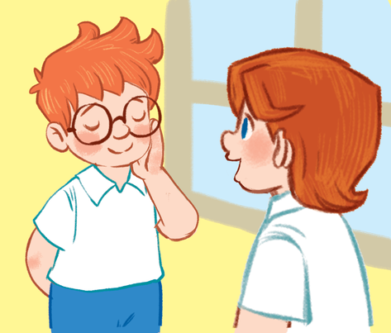
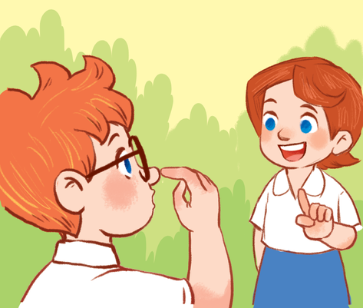

3
a
b

Slide 11
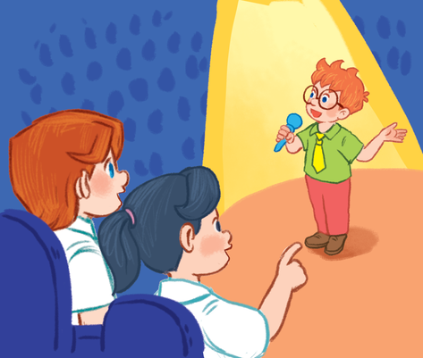
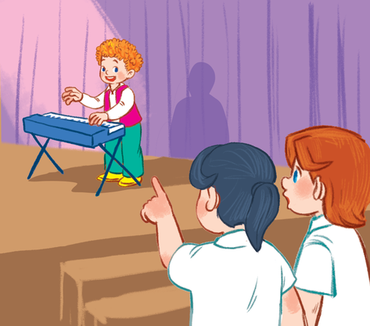

4
a
b

Slide 12
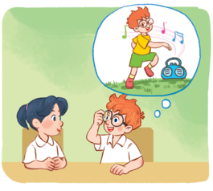
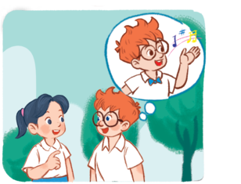
5
a
b

Slide 13
3.Listen and
number.

Slide 14

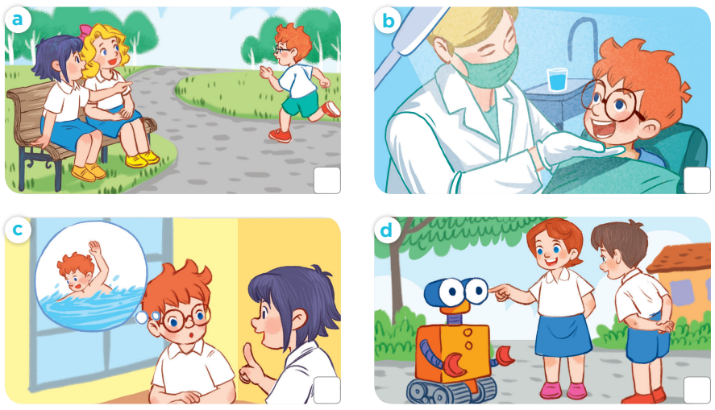
4
1
2
3
Notes:
Key:
1. b
2. c
3. d
4. a

Slide 15


4. Let’s talk.

Slide 17


Let’s talk
What...?
How old...?

Slide 18


5. Fun corner and wrap-up
Notes:
A survey
- Pupils use the questions to interview their friends.
+ What's your name? − My name's ...
+ How old are you? – I’m _____ years old.
+ What's your hobby? − It's ...
- Afterwards, pupils can tell the class what they found out about their friends.

Slide 19
Name | Age | Hobby
1.
2.
3.
4.
5.
6.
7.
Notes:
A survey
− Pupils use the questions to interview their friends.
+ What's your name? − My name's...
+ How old are you? – I’m _____ years old.
+ What's your hobby? − It's ____.
- Afterwards, pupils can tell the class what they found out about their friends.

Slide 20
Name | Age | Hobby
1. Minh | 8 | drawing
2.
3.
4.
5.
6.
7.
Notes:
Example

Slide 21

Website: sachmem.vn
Fanpage: www.facebook.com/sachmem.vn

