Slide 2

Our school rooms
Lesson 3 - Period 5

Slide 3




Table of contents
01
02
03
04
Let's chant.
Warm-up & Review
05
Listen and repeat.
Fun corner
& Wrap-up
Circle, listen and check.

Slide 4


01
Warm-up & Review

Slide 5
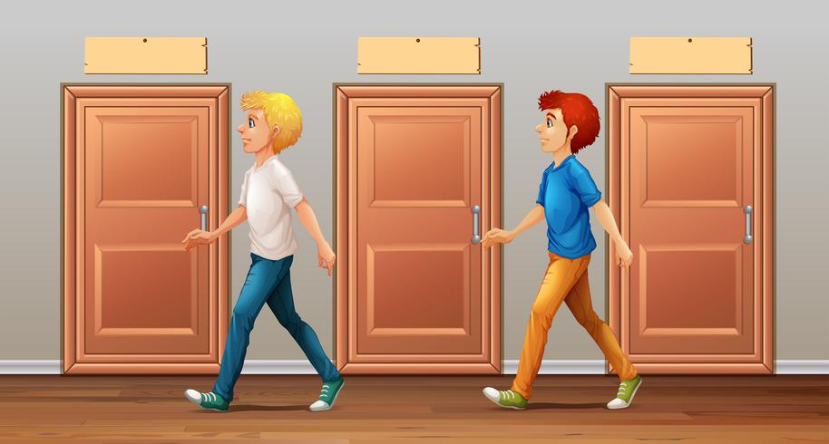
go along the corridor

Slide 6

go upstairs

Slide 7
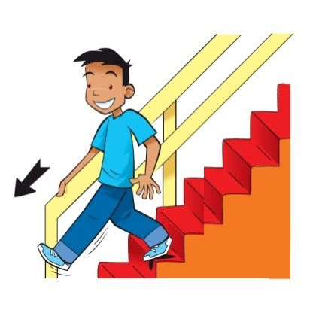
go downstairs

Slide 8

turn left

Slide 9

turn right

Slide 10

go past the library

Slide 11
Syllable
and stress
Notes:
Click the options A/B/C to check the answer.

Slide 12
Listen, and clap. How many syllables?
upstairs
along
library
corridor
downstairs
second
sunny
computer
ahead
2 syllables | More than 2 syllables

Slide 13
We say the red part more loudly.
The stress is on the second syllable.
down’stairs
up’stairs
downstairs
upstairs
a’long
a’head
along
ahead
inside
in’side
in’door
indoor

Slide 14
02
Listen and repeat.

Slide 15

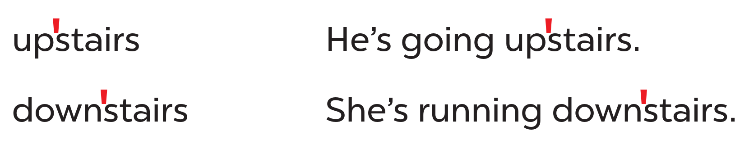
Look at the words and the sentences.
Work in pairs and say.
Listen and repeat.
stress mark

Slide 16
03
Circle, listen and check.

Slide 17
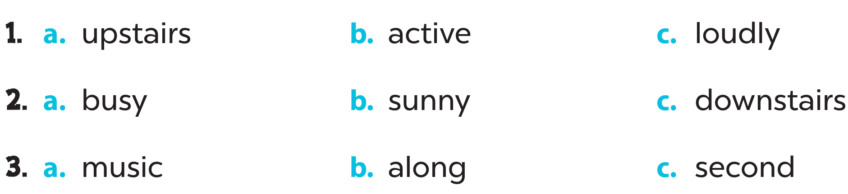
Look and circle.
Listen and check.

Slide 18
04
Let’s chant.

Slide 19
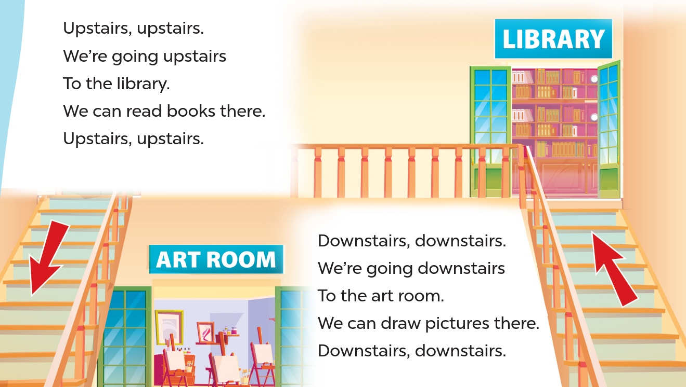
Listen and repeat.
Clap and chant.
Look and read.

Slide 20
05
Fun corner & Wrap-up

Slide 21

Odd one out
Notes:
Click the options A/B/C to check the answer.

Slide 22


A. along
B. second
C. downstairs

Slide 23
A. music
B. second
C. along

Slide 24
A. active
B. downstairs
C. upstairs

Slide 25
A. writer
B. sunny
C. along

Slide 26
A. along
B. busy
C. ahead

Slide 27
A. artist
B. second
C. downstairs

Slide 28
Website: hoclieu.vn
Fanpage: https://www.facebook.com/tienganhglobalsuccess.vn/

