Slide 2

Our school rooms
Lesson 3 - Period 6

Slide 3




Table of contents
01
02
03
04
Project
Warm-up & Review
05
Read and tick True or False.
Fun corner & Wrap-up
Let's write.

Slide 4



01
Warm-up & Review
Collect the pencils
= + 1 point
= - 3 point

Slide 5
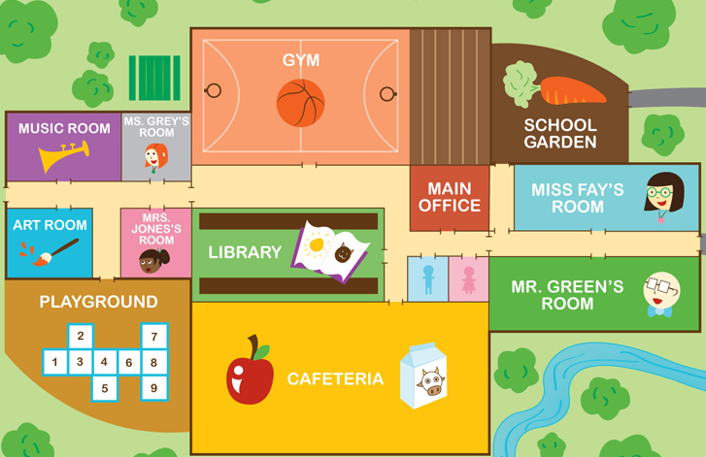

GYM
MUSIC ROOM
CLASS
5C
ART ROOM
CLASS
5A
CLASS
5B
LIBRARY
NURSE'S ROOM
PLAYGROUND
COMPUTER ROOM

Slide 6
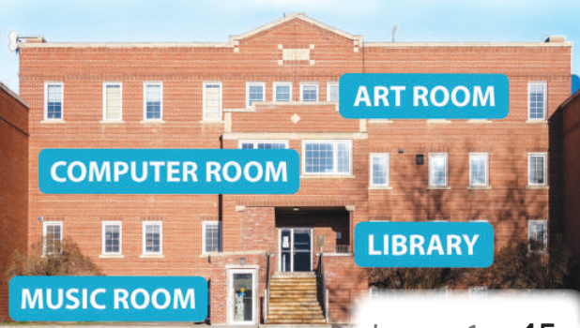


Where's the music room?
It's on the ground floor.

Slide 7

Where's the art room?
It's on the third floor.

Slide 8
Where's the computer room?
It's on the second floor.

Slide 9
Where's the library?
It's on the first floor.

Slide 10

Could you tell me the way to the library, please?
Go past the music room and turn left.

Slide 11
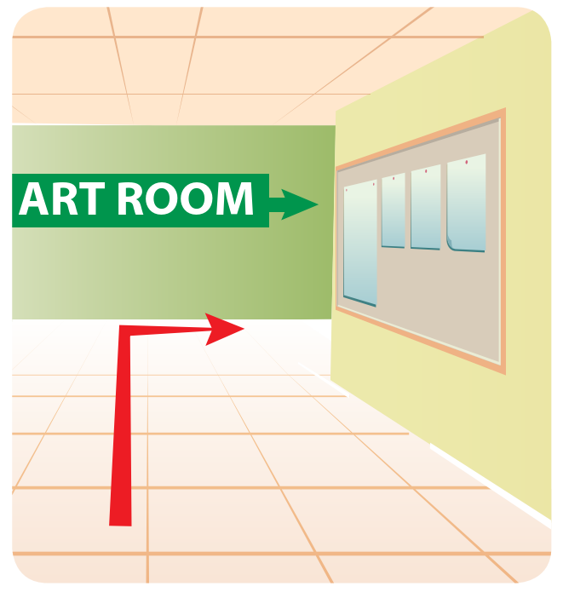
Could you tell me the way to the art room, please?
Go along the corridor and turn right.

Slide 12
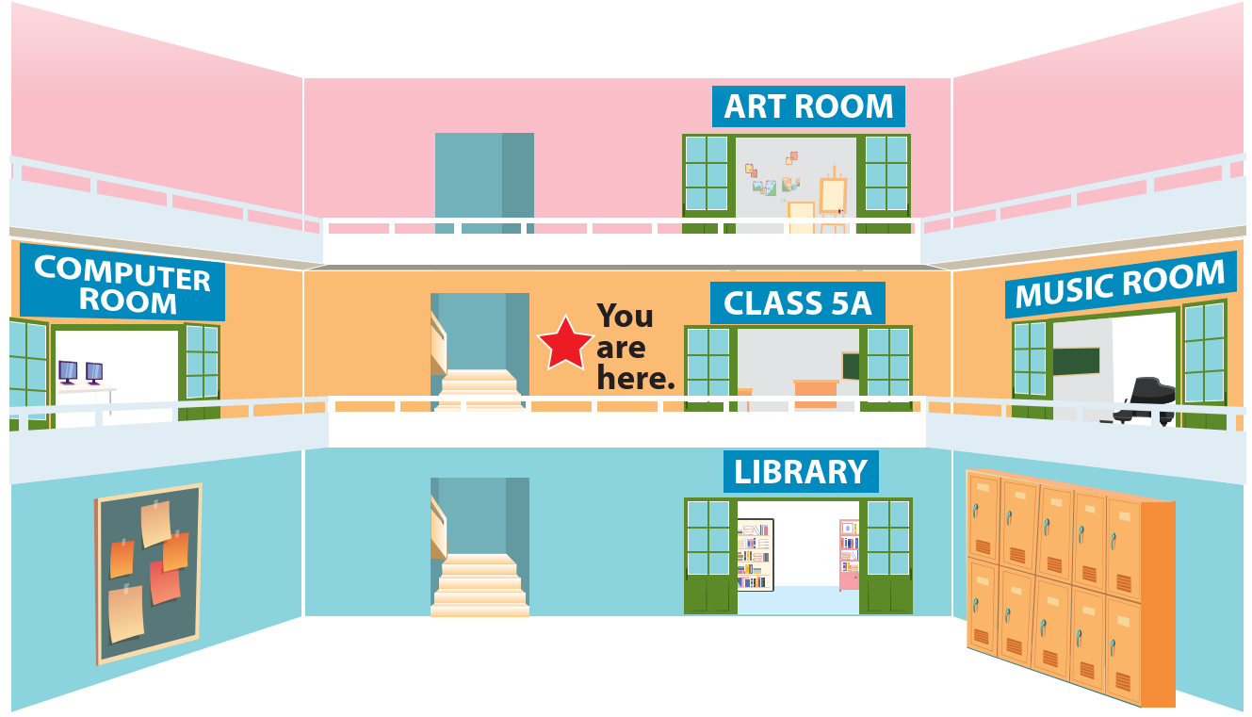
I'm going downstairs to the _______
library

Slide 13
I'm going ________ to the art room.
upstairs

Slide 14


Listen. Odd one out.
A.
upstairs
A. up'stairs
B.
active
B.
'active
C.
loudly
C.
'loudly

Slide 15
Listen. Odd one out.
A.
busy
A.
'busy
B.
sunny
B.
'sunny
C.
down'stairs
C.
downstairs

Slide 16

02
Read and tick True or False.

Slide 17
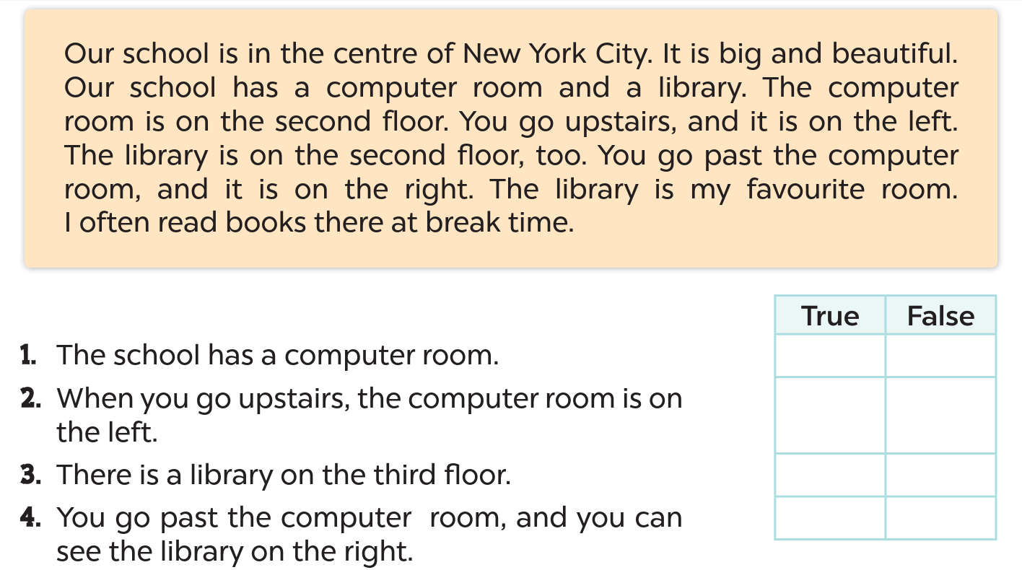





Slide 18
03
Let's write.

Slide 19
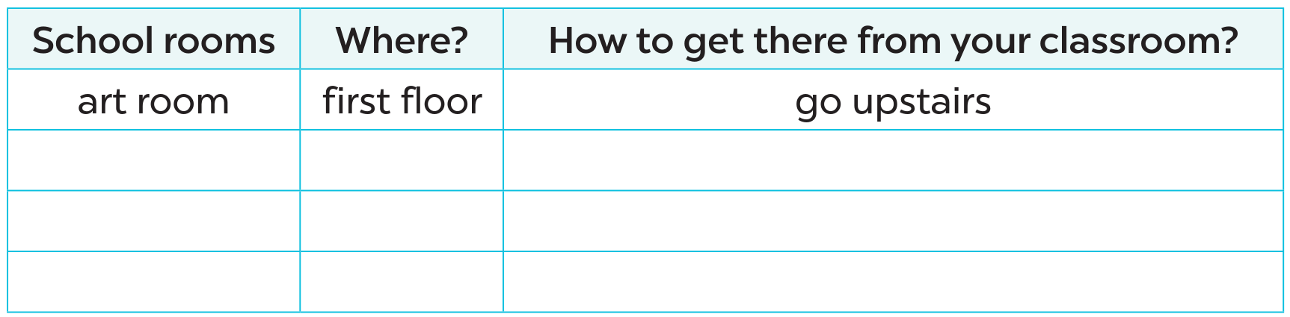
Let's write.

Slide 20
04
Project

Slide 21
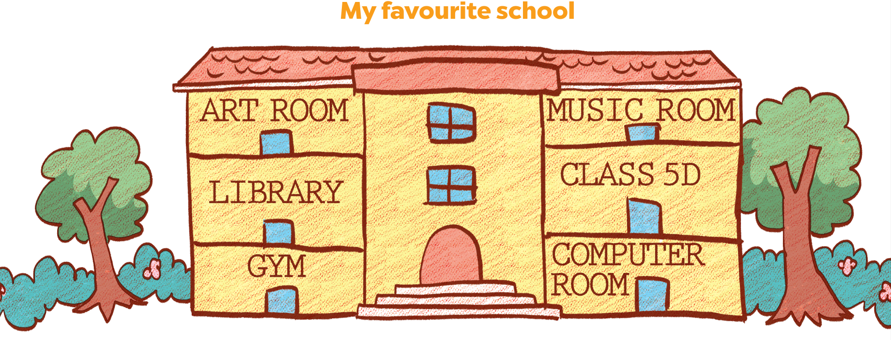

Slide 22

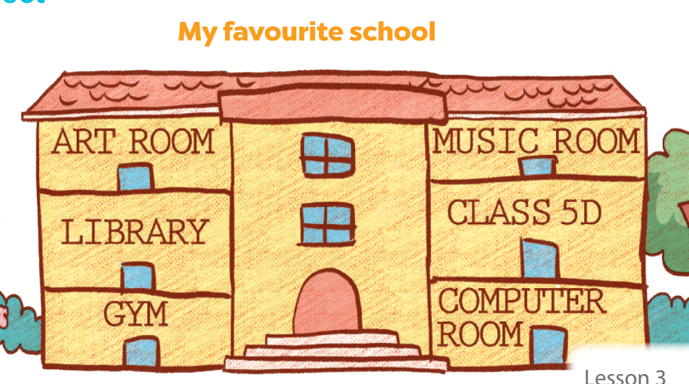
05
Fun corner & Wrap-up

Slide 23
Website: hoclieu.vn
Fanpage: https://www.facebook.com/tienganhglobalsuccess.vn/

