Slide 1





Slide 2


Our school facilities
6
Lesson 2 – Period 4

Slide 3
Table of contents
Warm-up Guessing game
01
02
03
Activity 6 Let’s sing.
04
Activity 4 Listen and tick.
Game
05
Activity 5 Look, complete and read.

Slide 4
01
Warm-up
Guessing game

Slide 5

What is this?

Slide 6
playground

Slide 7
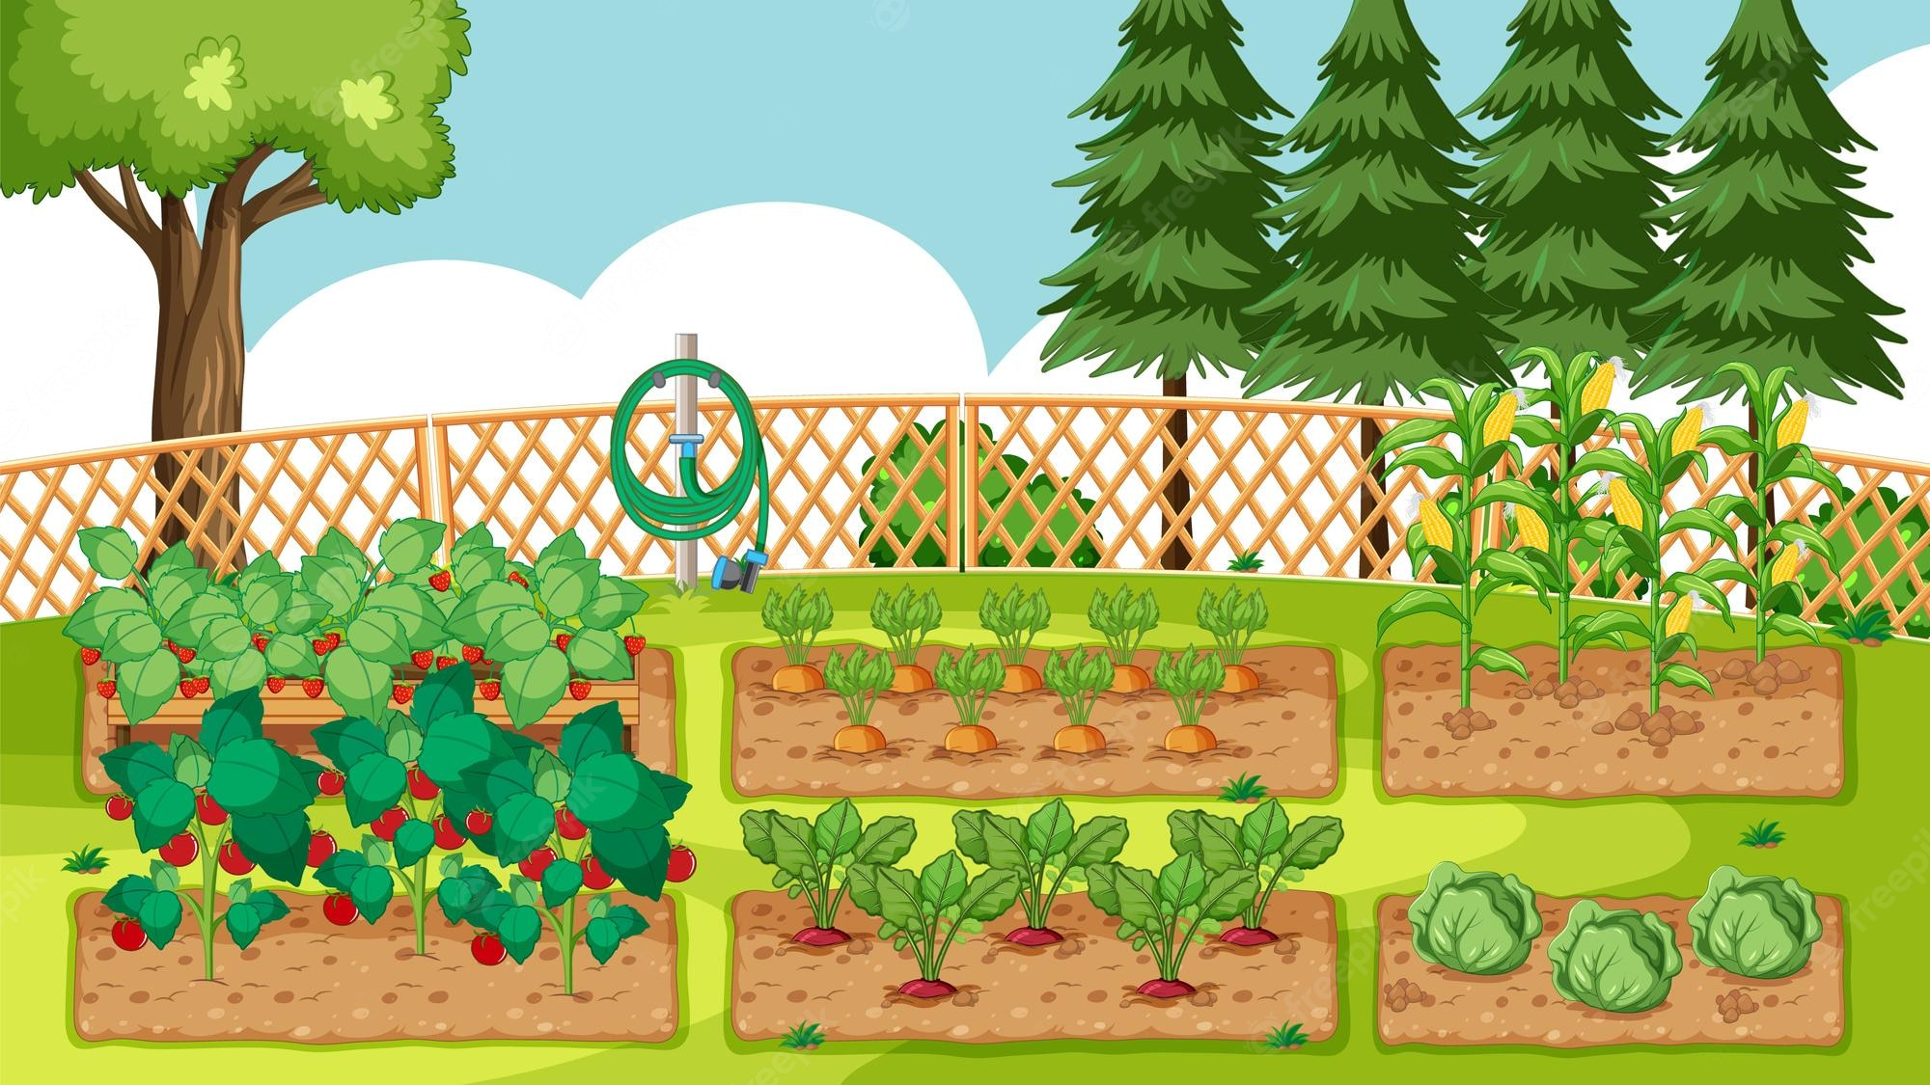
What is this?

Slide 8
garden

Slide 9

What is this?

Slide 10
building

Slide 11
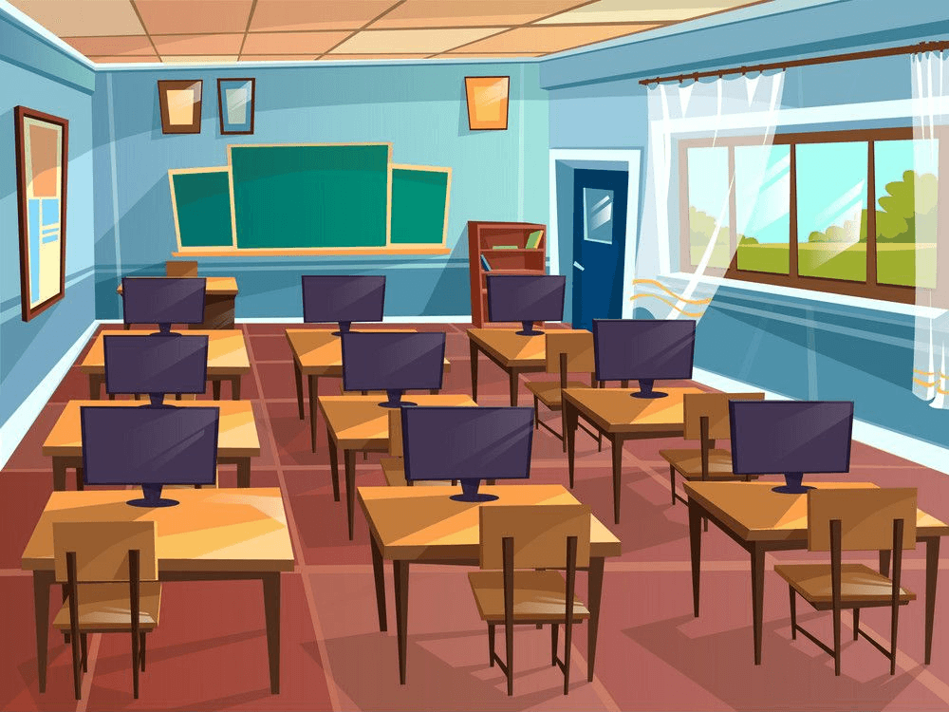
What is this?

Slide 12
computer room

Slide 13
02
Activity 4
Listen and number.

Slide 14


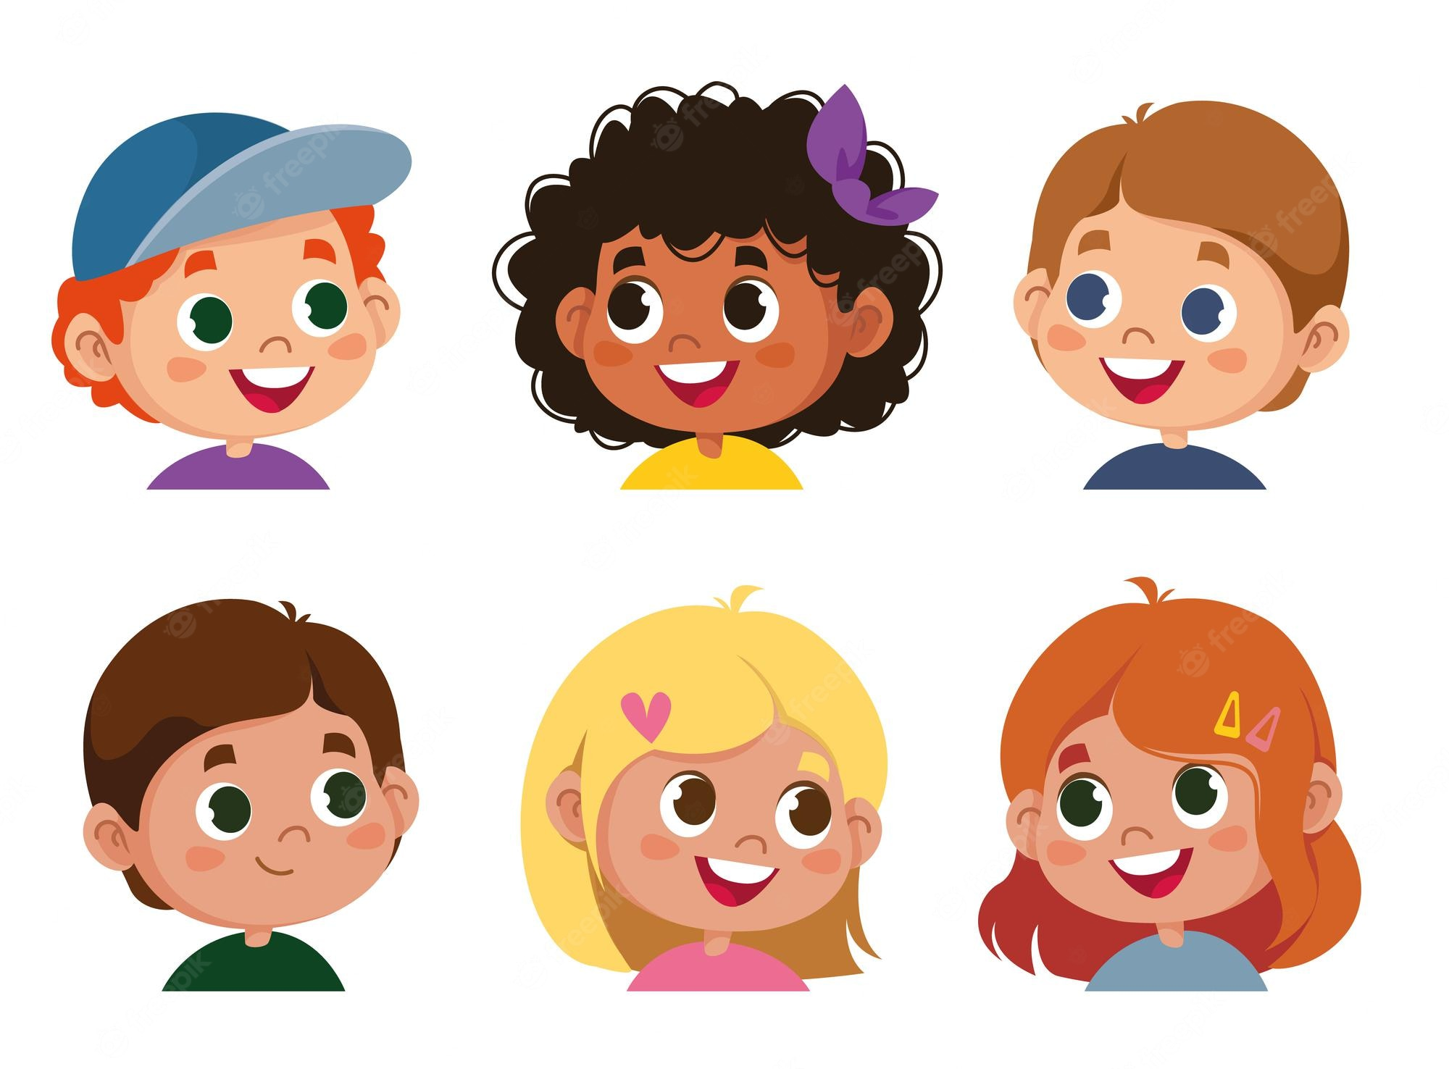
How many buildings are there at your school?
There is one.

Slide 15
How many computer rooms are there at your school?
There are three.

Slide 16
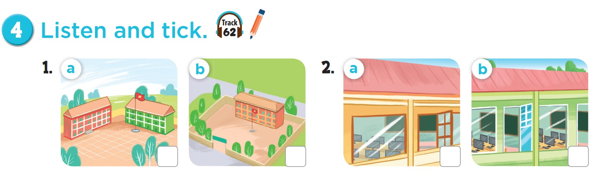

Listen and number
Listen and check.

Slide 17
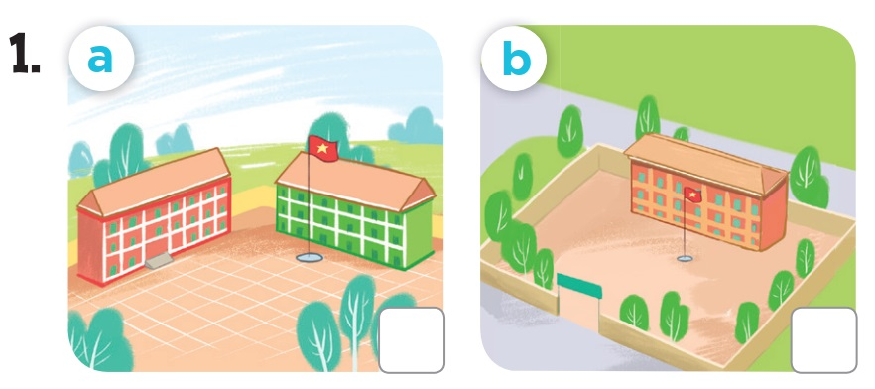

Listen and check.

Slide 18
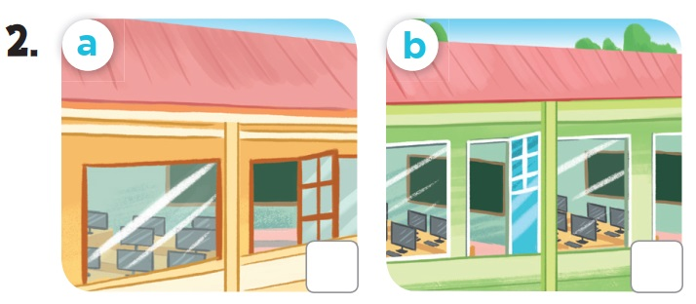
Listen and check.

Slide 19
03
Activity 5
Look, complete and read.

Slide 20
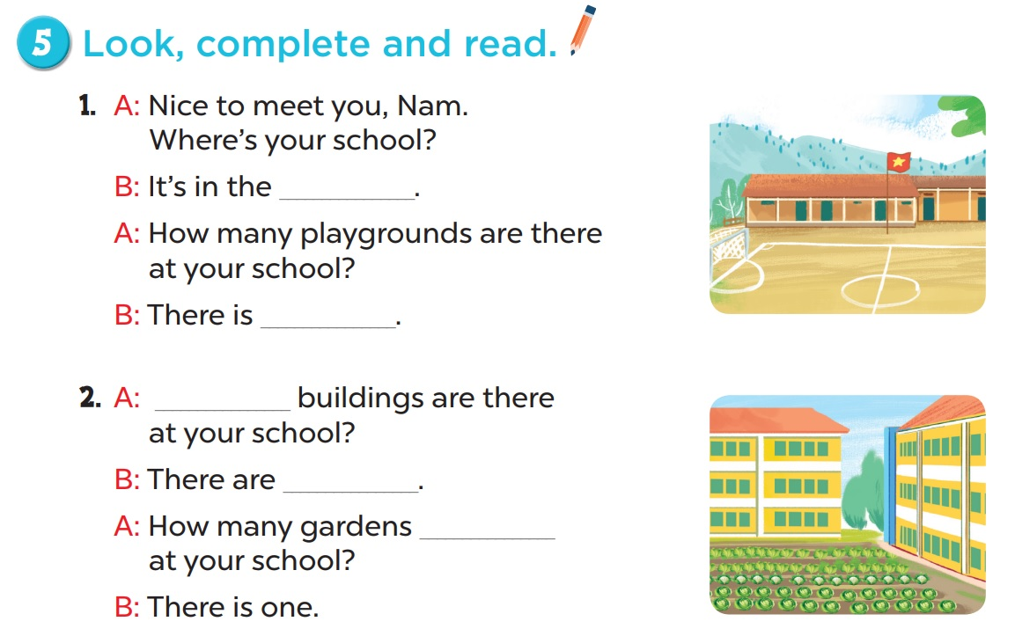

Slide 21
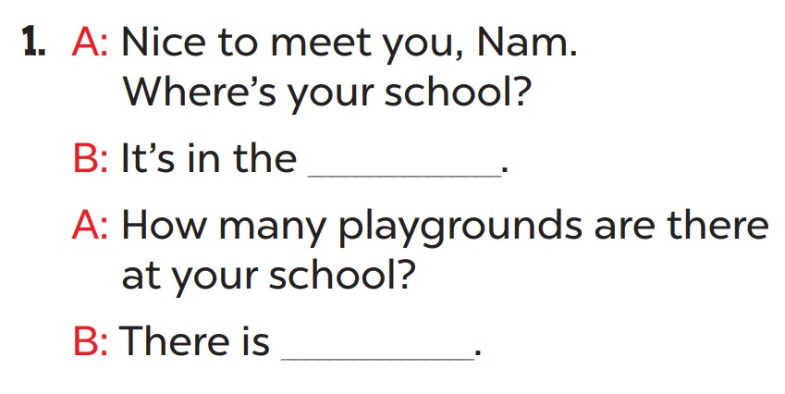
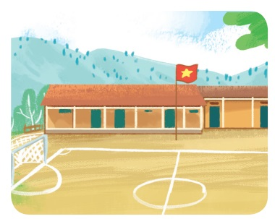
mountains
one

Slide 22
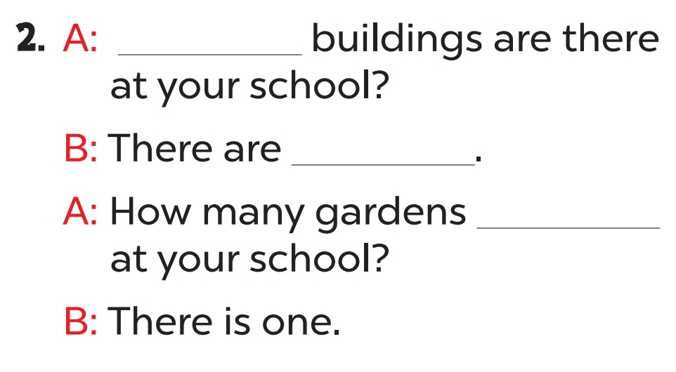
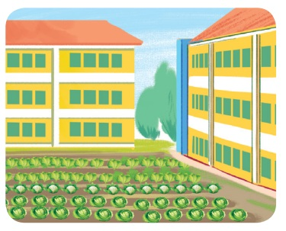
How many
two
are there

Slide 23
04
Activity 6
Let’s sing.

Slide 24
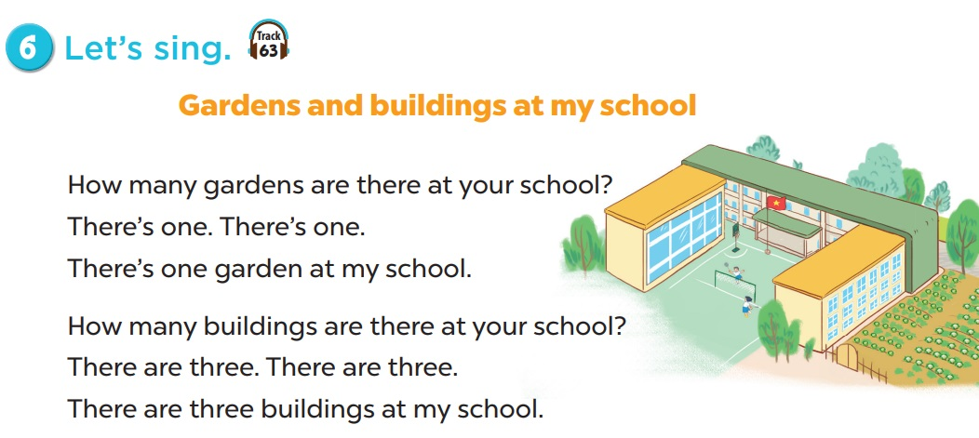

Slide 25
05
Game

Slide 26

presents
Nick’s Wilde Deal
Notes:
This template is for educational, non-commercial purposes only. For more free game templates like this one, visit https://www.taysteachingtoolkit.com

Slide 27

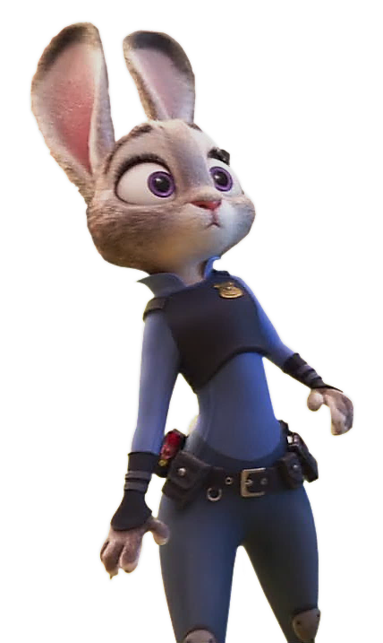
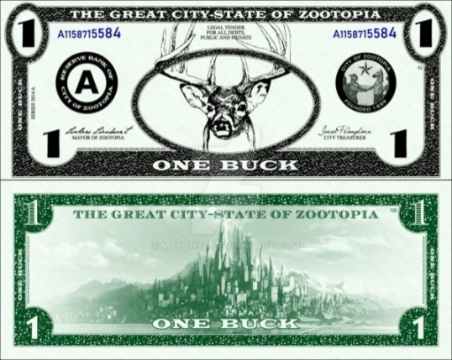
If not, I may give you MORE money or LESS money.
Answer my question right and I’ll give you a few bucks.
You can choose to take my deal or not.
Wanna make a deal?
Hey you.
Psssst…hey.
It’s up to you.
Wanna play?

Slide 28

A
B
C
D
E
F
Choose a question.
End
Notes:
Click a letter to go to a question.

Slide 29
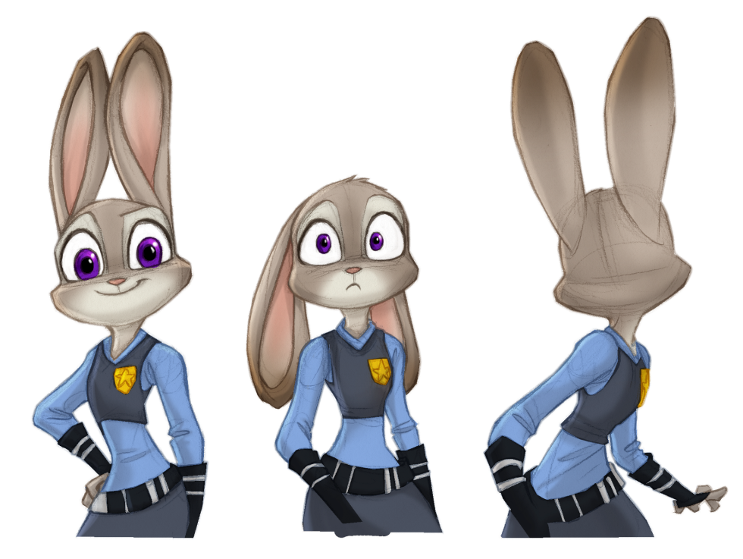
How many buildings are there at your school?
- ______ one.
There is
There are
It is
A. There is
Notes:
Press the spacebar to reveal the answer.
Click happy Judy if the student/team gets the answer right (goes to Nick’s deal).
Click sad Judy if the student/team gets the answer wrong (goes back to the question-choosing slide).

Slide 30

Nick’s deal:
I’ll give you 5 bucks for answering my question right.
Great job. Here’s my deal:
DEAL!
NO DEAL!
Notes:
Press the spacebar to reveal Nick’s deal.
Click “Deal” if the student/team chooses to take Nick’s deal (goes back to the question-choosing slide).
Click “No deal!” if the student/team chooses not to take Nick’s deal (goes to the next slide).

Slide 31

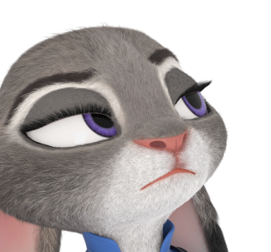

You got conned!
Here’s 1 buck.
Notes:
Click the arrow button in the bottom right-hand corner to go back to the question-choosing slide.

Slide 32
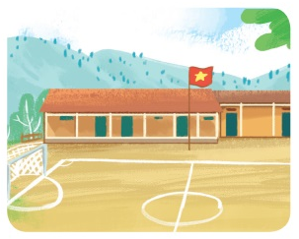
How many playgrounds are there at your school?
There is one.
Notes:
Press the spacebar to reveal the answer.
Click happy Judy if the student/team gets the answer right (goes to Nick’s deal).
Click sad Judy if the student/team gets the answer wrong (goes back to the question-choosing slide).

Slide 33
Nick’s deal:
I’ll give you 6 bucks for answering my question right.
Great job. Here’s my deal:
DEAL!
NO DEAL!
Notes:
Press the spacebar to reveal Nick’s deal.
Click “Deal” if the student/team chooses to take Nick’s deal (goes back to the question-choosing slide).
Click “No deal!” if the student/team chooses not to take Nick’s deal (goes to the next slide).

Slide 34
You got conned!
Here’s 4 bucks.
Notes:
Click the arrow button in the bottom right-hand corner to go back to the question-choosing slide.

Slide 35
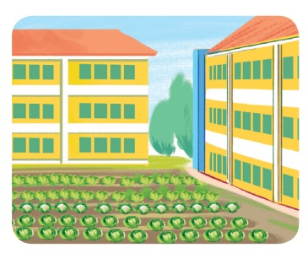
How many ____ are there at your school?
gardens
Notes:
Press the spacebar to reveal the answer.
Click happy Judy if the student/team gets the answer right (goes to Nick’s deal).
Click sad Judy if the student/team gets the answer wrong (goes back to the question-choosing slide).

Slide 36
Nick’s deal:
I’ll give you 3 bucks for answering my question right.
Great job. Here’s my deal:
DEAL!
NO DEAL!
Notes:
Press the spacebar to reveal Nick’s deal.
Click “Deal” if the student/team chooses to take Nick’s deal (goes back to the question-choosing slide).
Click “No deal!” if the student/team chooses not to take Nick’s deal (goes to the next slide).

Slide 37
You got conned!
Here’s 2 bucks.
Notes:
Click the arrow button in the bottom right-hand corner to go back to the question-choosing slide.

Slide 38
- _____ computer rooms are there at your school?
- There are two.
How many
Notes:
Press the spacebar to reveal the answer.
Click happy Judy if the student/team gets the answer right (goes to Nick’s deal).
Click sad Judy if the student/team gets the answer wrong (goes back to the question-choosing slide).

Slide 39
Nick’s deal:
I’ll give you 7 bucks for answering my question right.
Great job. Here’s my deal:
DEAL!
NO DEAL!
Notes:
Press the spacebar to reveal Nick’s deal.
Click “Deal” if the student/team chooses to take Nick’s deal (goes back to the question-choosing slide).
Click “No deal!” if the student/team chooses not to take Nick’s deal (goes to the next slide).

Slide 40
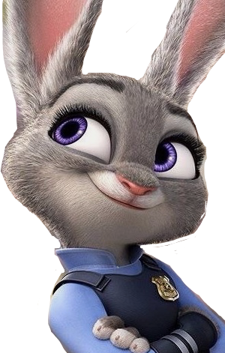

Nice choice!
Here’s 15 bucks!
Notes:
Click the arrow button in the bottom right-hand corner to go back to the question-choosing slide.

Slide 41
How many gardens _____ at your school?
A. is there
B. are there
C. there are
B. are there
Notes:
Press the spacebar to reveal the answer.
Click happy Judy if the student/team gets the answer right (goes to Nick’s deal).
Click sad Judy if the student/team gets the answer wrong (goes back to the question-choosing slide).

Slide 42
Nick’s deal:
I’ll give you 2 bucks for answering my question right.
Great job. Here’s my deal:
DEAL!
NO DEAL!
Notes:
Press the spacebar to reveal Nick’s deal.
Click “Deal” if the student/team chooses to take Nick’s deal (goes back to the question-choosing slide).
Click “No deal!” if the student/team chooses not to take Nick’s deal (goes to the next slide).

Slide 43
Nice choice!
Here’s 8 bucks!
Notes:
Click the arrow button in the bottom right-hand corner to go back to the question-choosing slide.

Slide 44
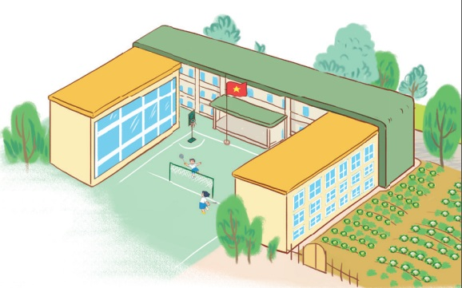
How many buildings are there at your school?
There are three.
Notes:
Press the spacebar to reveal the answer.
Click happy Judy if the student/team gets the answer right (goes to Nick’s deal).
Click sad Judy if the student/team gets the answer wrong (goes back to the question-choosing slide).

Slide 45
Nick’s deal:
I’ll give you 8 bucks for answering my question right.
Great job. Here’s my deal:
DEAL!
NO DEAL!
Notes:
Press the spacebar to reveal Nick’s deal.
Click “Deal” if the student/team chooses to take Nick’s deal (goes back to the question-choosing slide).
Click “No deal!” if the student/team chooses not to take Nick’s deal (goes to the next slide).

Slide 46
You got conned!
Here’s 3 bucks.
Notes:
Click the arrow button in the bottom right-hand corner to go back to the question-choosing slide.

