Slide 1
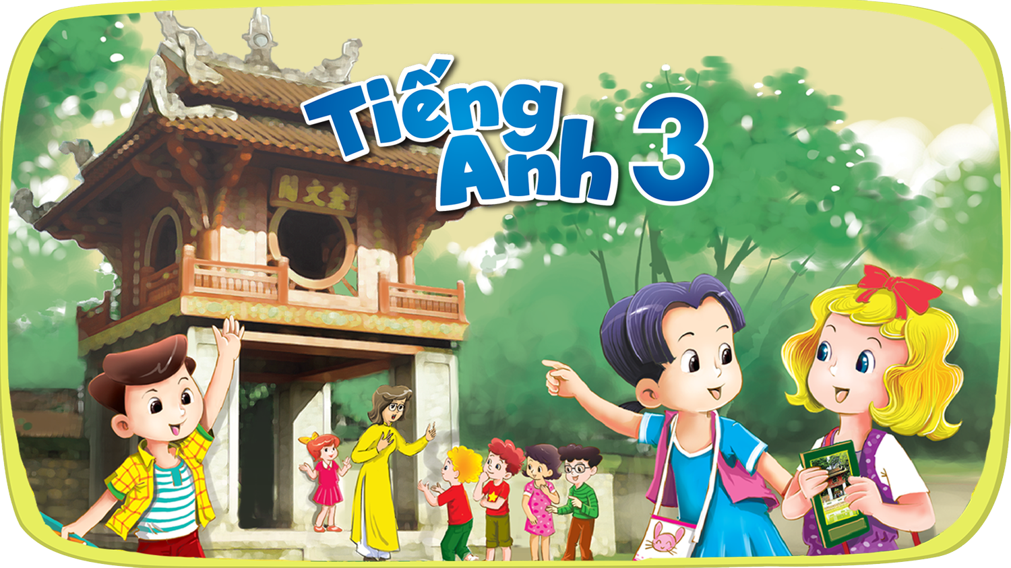
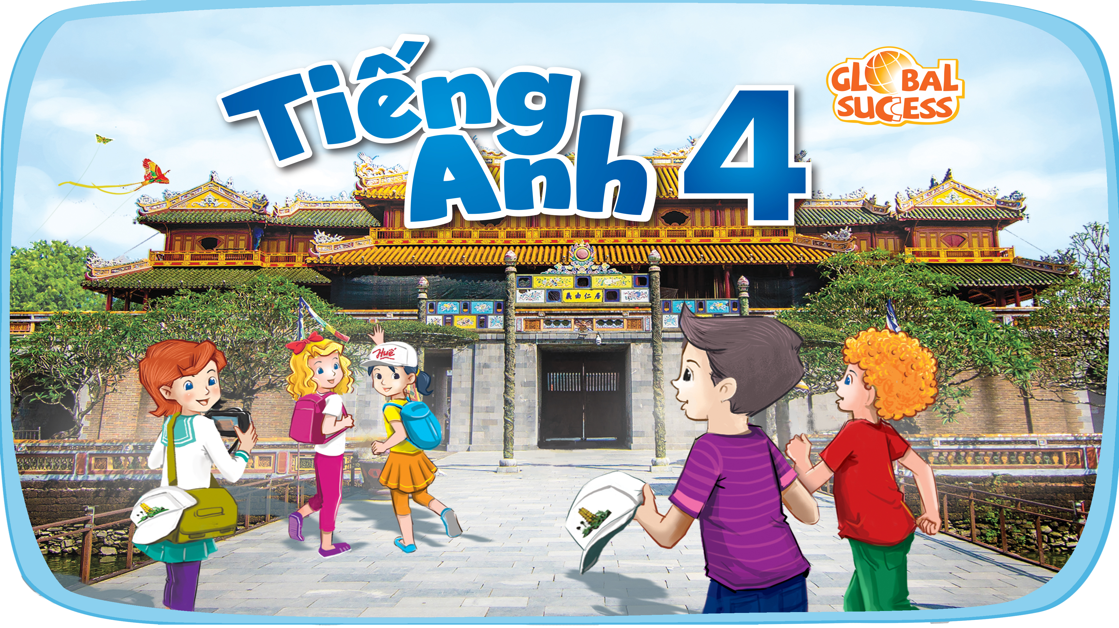



Slide 2


Our school facilities
6
Lesson 3 – Period 5

Slide 3
Table of contents
Warm-up
01
02
03
Activity 6 Let’s chant.
04
Activity 4 Listen and repeat.
Game
05
Activity 5 Listen and circle.

Slide 4
01
Warm-up

Slide 5
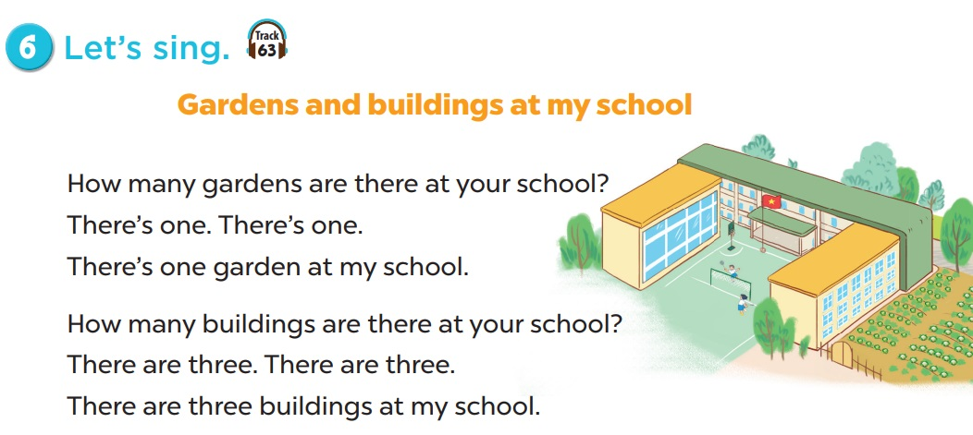


Slide 6
02
Activity 1
Listen and repeat.

Slide 7
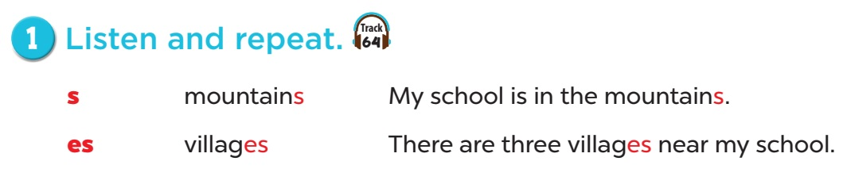

Slide 8
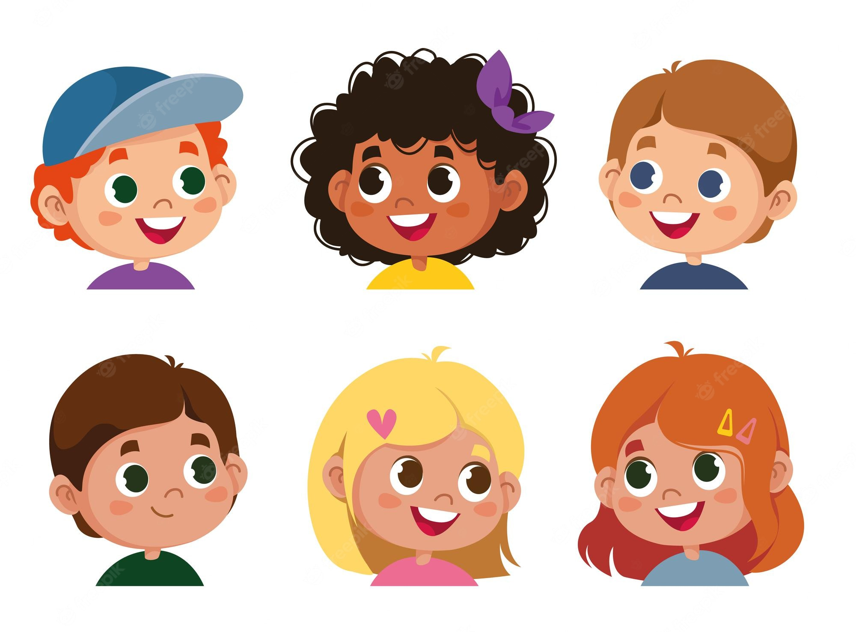
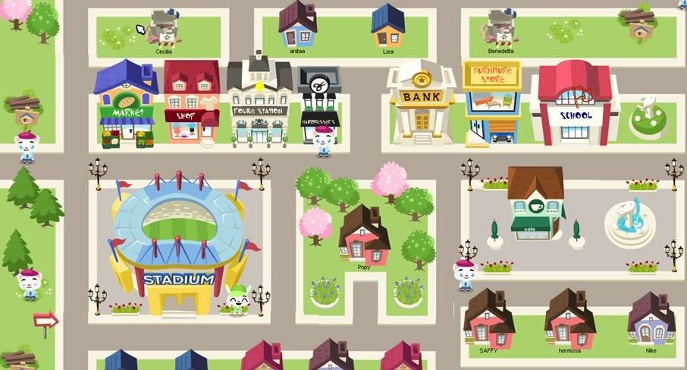
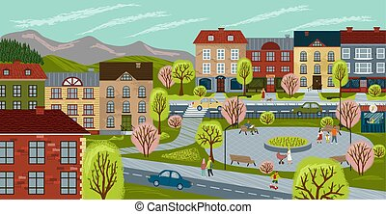
towns

Slide 9

buildings

Slide 10
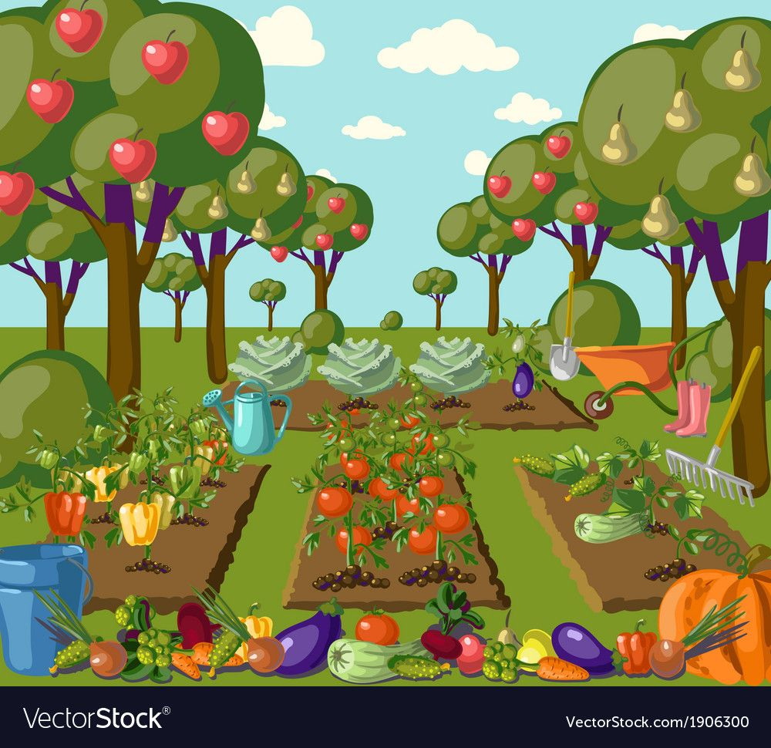
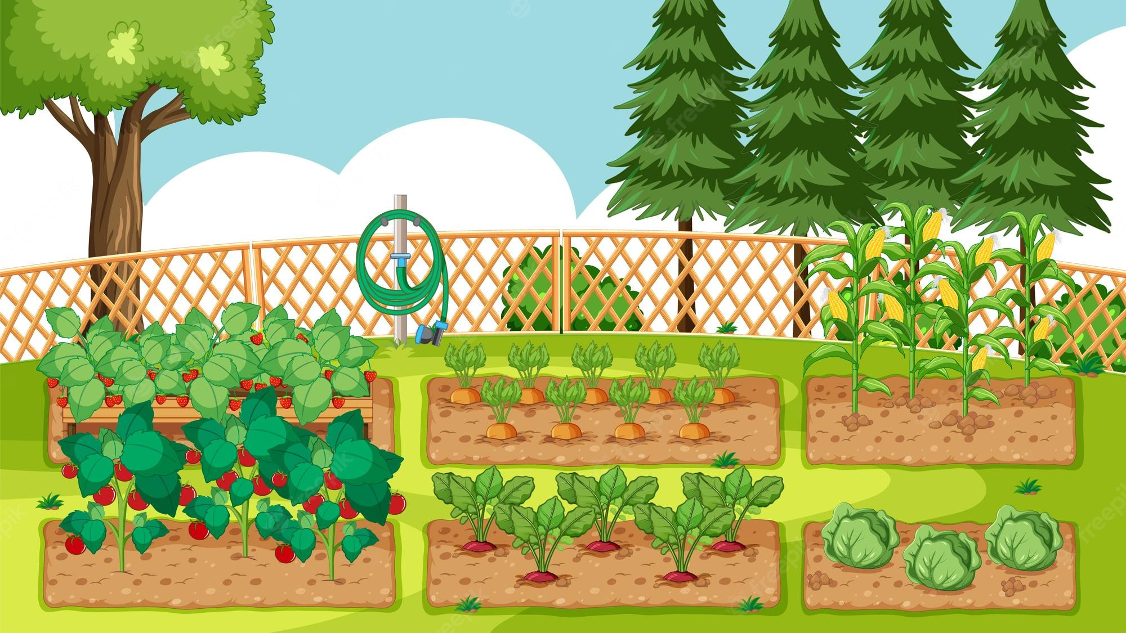
gardens

Slide 11

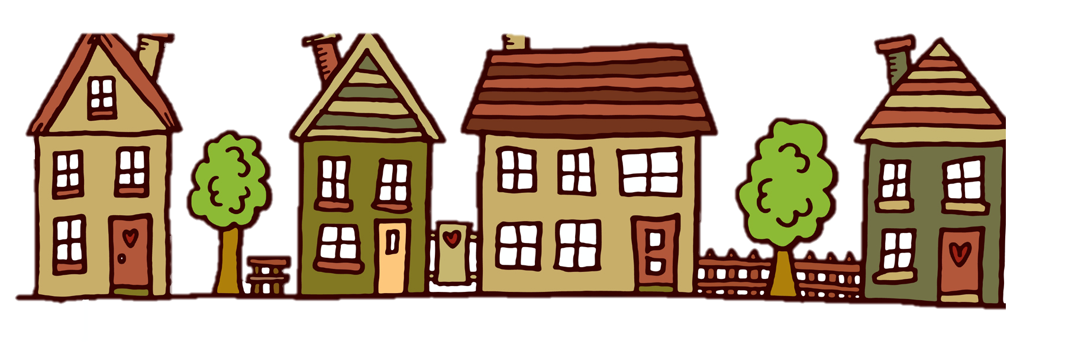
houses

Slide 12
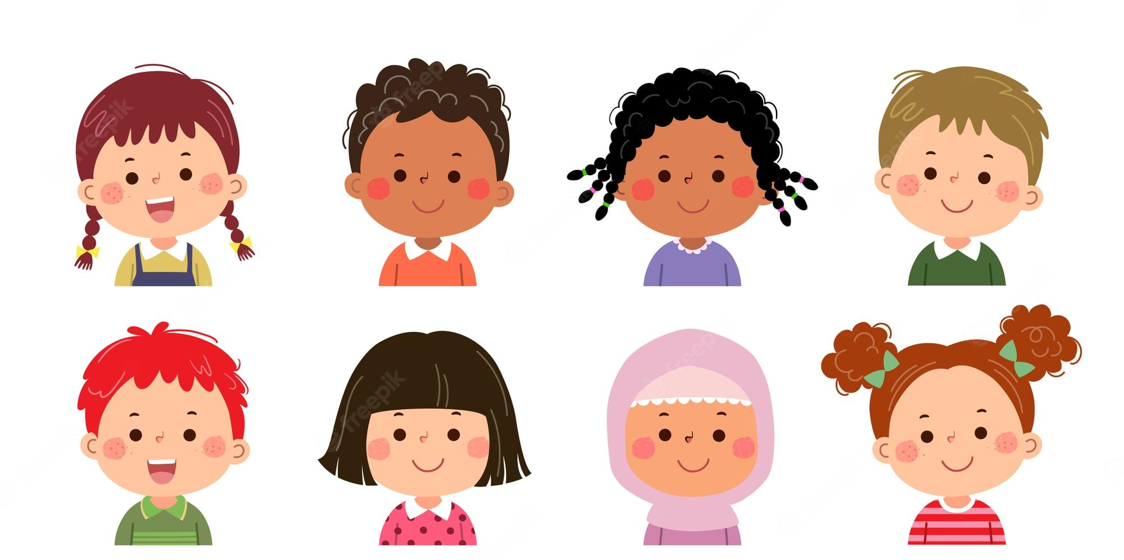
faces

Slide 13
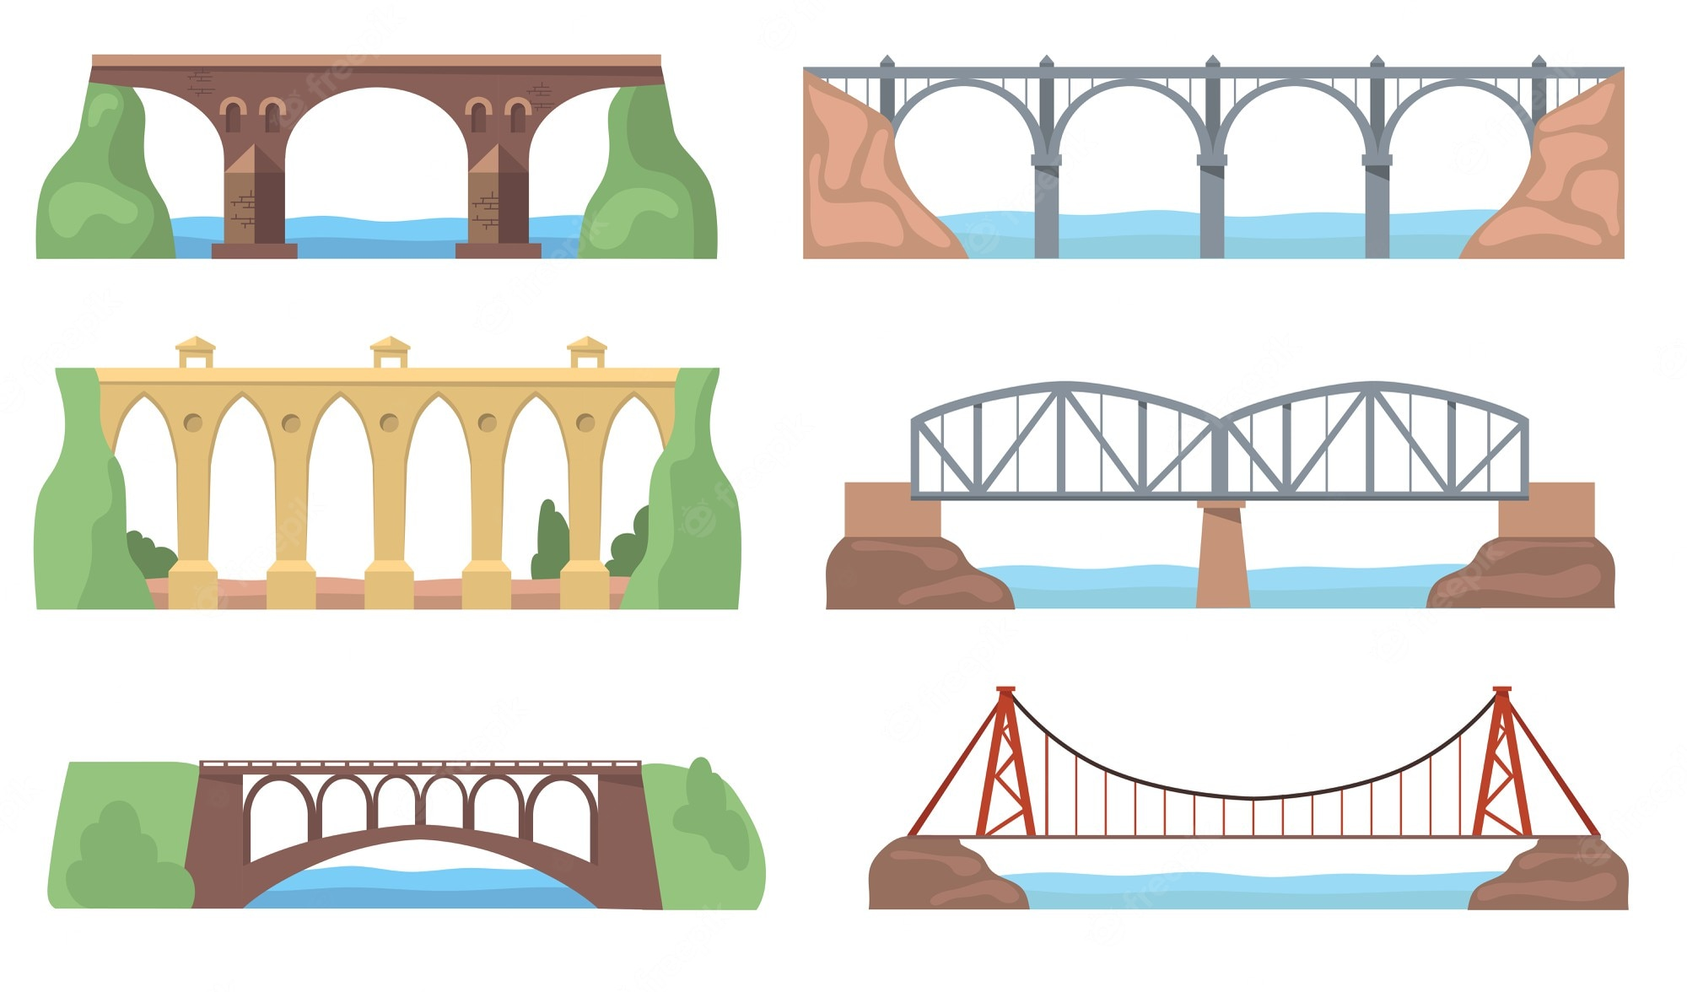
bridges

Slide 14
Let’s practise!
s | es
towns
houses
buildings
faces
gardens
bridges

Slide 15
03
Activity 2
Listen and circle.

Slide 16
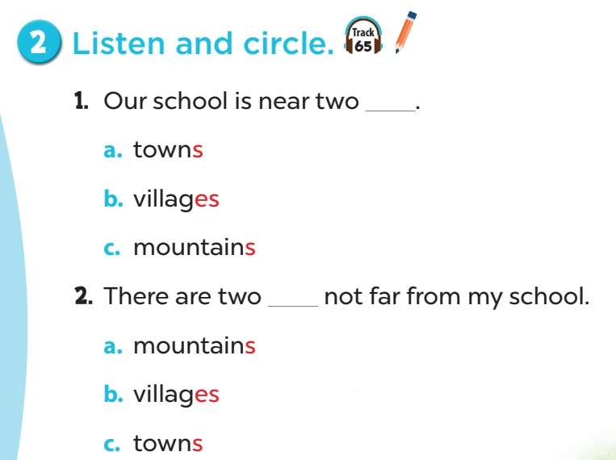

Slide 17
04
Activity 6
Let’s chant.

Slide 18
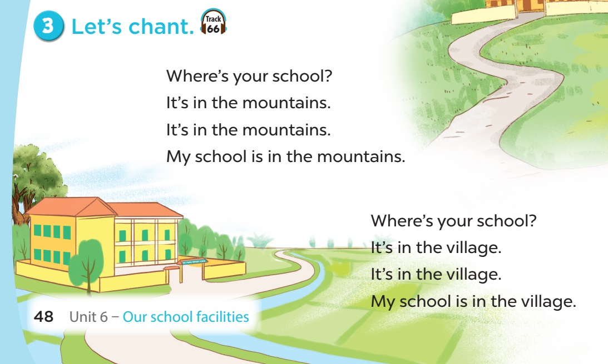

Slide 19
05
Game

Slide 20



Slide 21





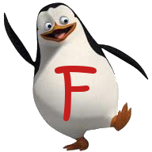




End

Slide 22
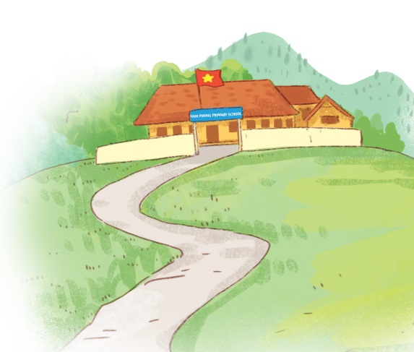
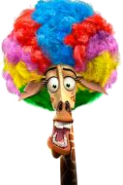
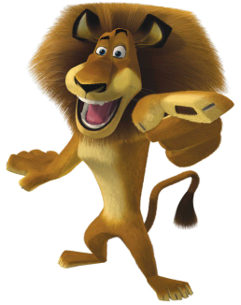
Where’s your school?
It’s in the mountains.

Slide 23
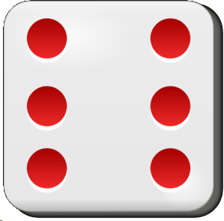


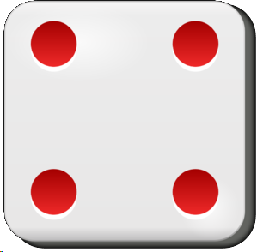

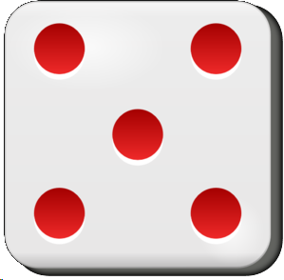
1 point

Slide 24
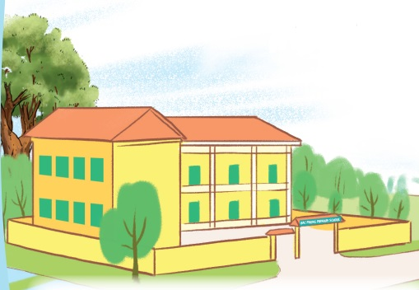
Where’s your school?
It’s in the village.

Slide 25
6 points

Slide 26
How many _____ are there at your school?
building
B. buildings
B. buildings

Slide 27
2 points

Slide 28
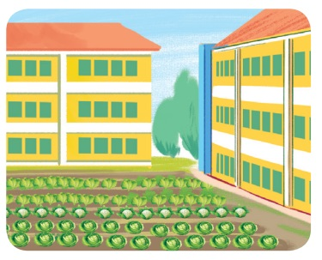
How many gardens are there at your school?
There is one .

Slide 29



Pick a crate!

Slide 30
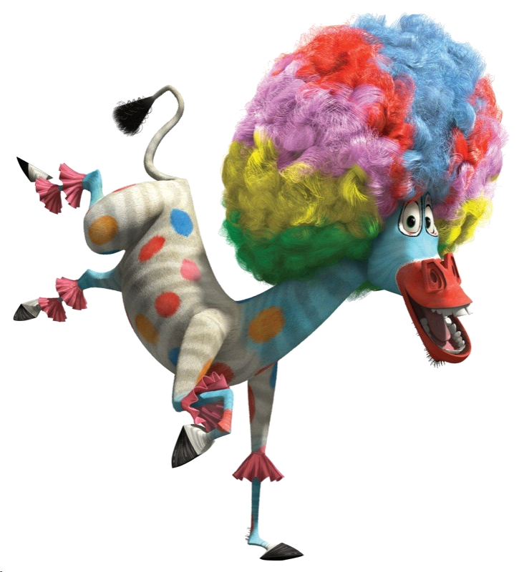
Add 10 points

Slide 31
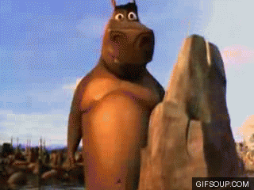

Steal 3 points.

Slide 32
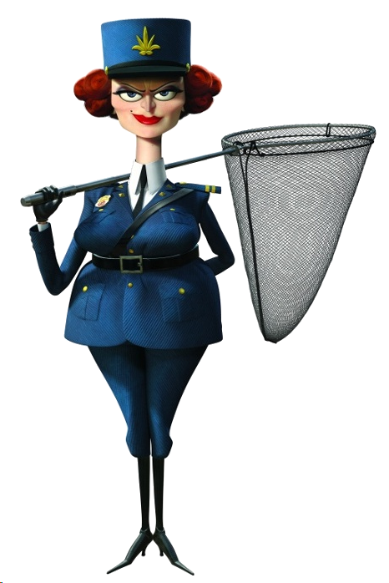
Everyone lose 5 points.

Slide 33

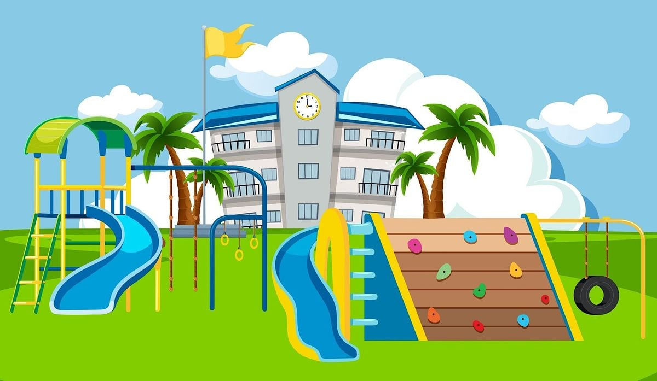
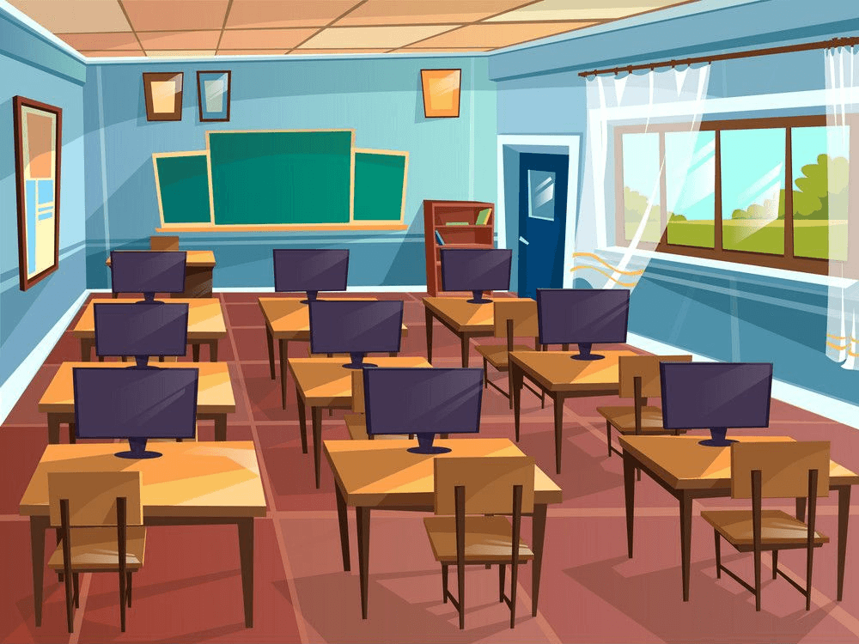
It’s in a playground.
A. B.
A

Slide 34
5 points

Slide 35
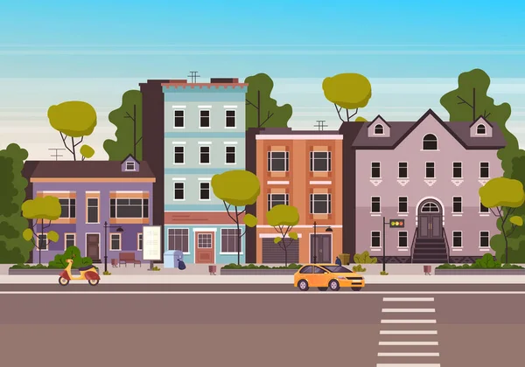
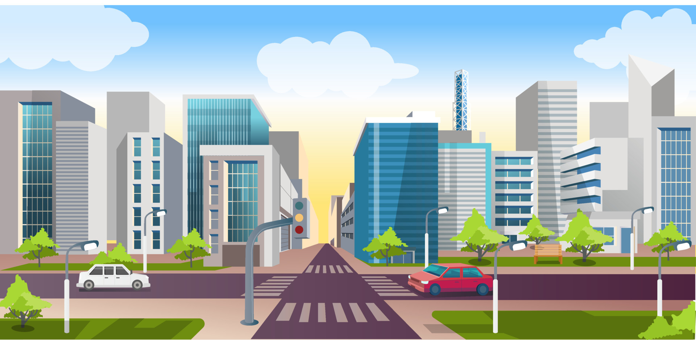
It’s in the city.
A. B.
B

Slide 36
Pick a crate!

Slide 37
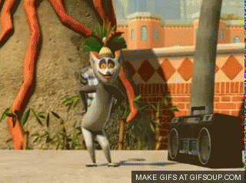
You like to move it!
9 points

Slide 38

Lose 2 points.

Slide 39
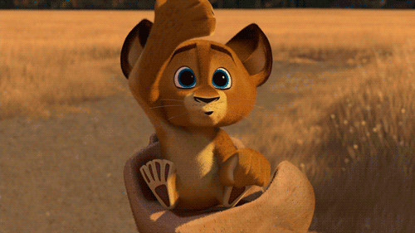
Steal 3 points.

Slide 40
There are two ___ at my school.
computer rooms

Slide 41
4 points

Slide 42
There is one ____ at my school.
garden

Slide 43
6 points

Slide 44
There ____ one computer room at my school.
is

Slide 45
4 points

Slide 46
There __ two buildings
at my school.
are

Slide 47
Pick a crate!

Slide 48
Lose 3 points.

Slide 49
Steal 3 points.

Slide 50
8 points
You like to move it!

