Slide 1
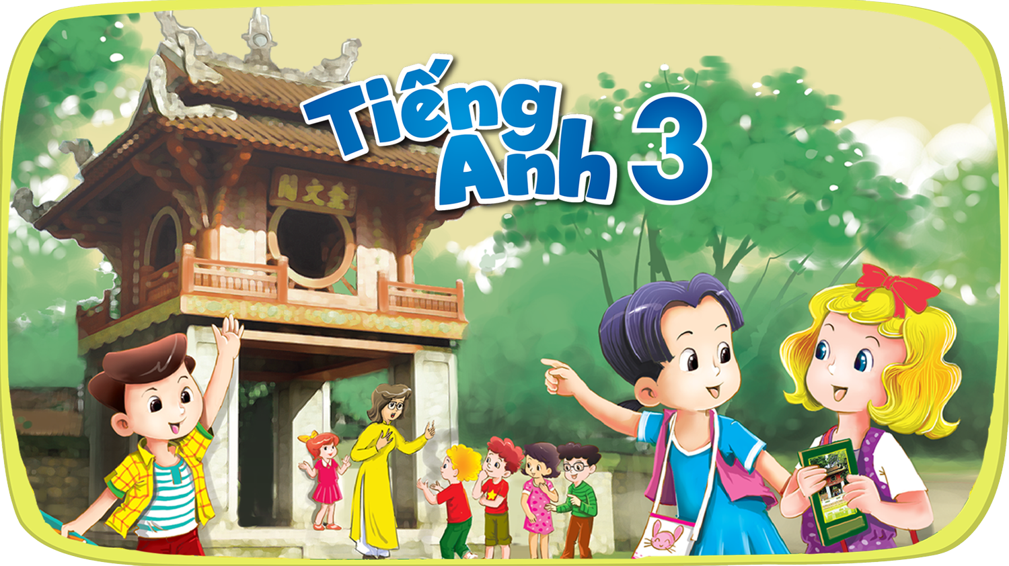




Slide 2


Our school facilities
6
Lesson 3 – Period 6

Slide 3
Table of contents
Warm-up
01
02
03
04
Activity 6 Project
Activity 4
Read and complete.
Game
05
Activity 5
Let’s write.

Slide 4
01
Warm-up

Slide 5
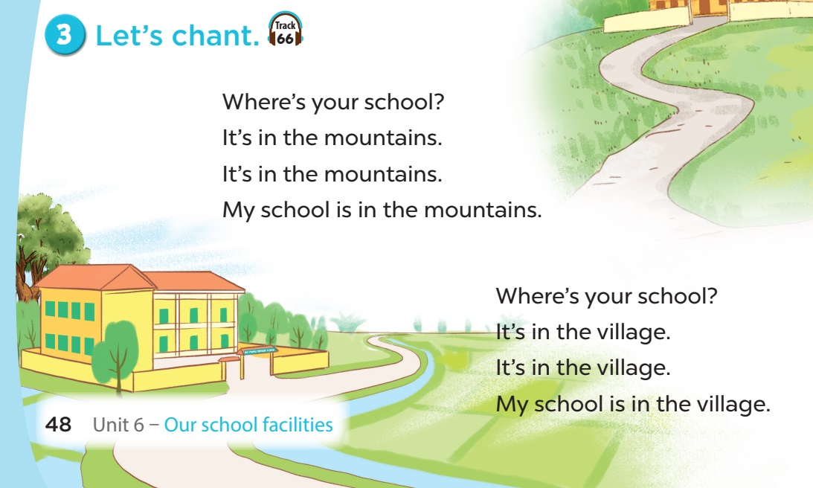


Slide 6
02
Activity 4
Read and complete.

Slide 7
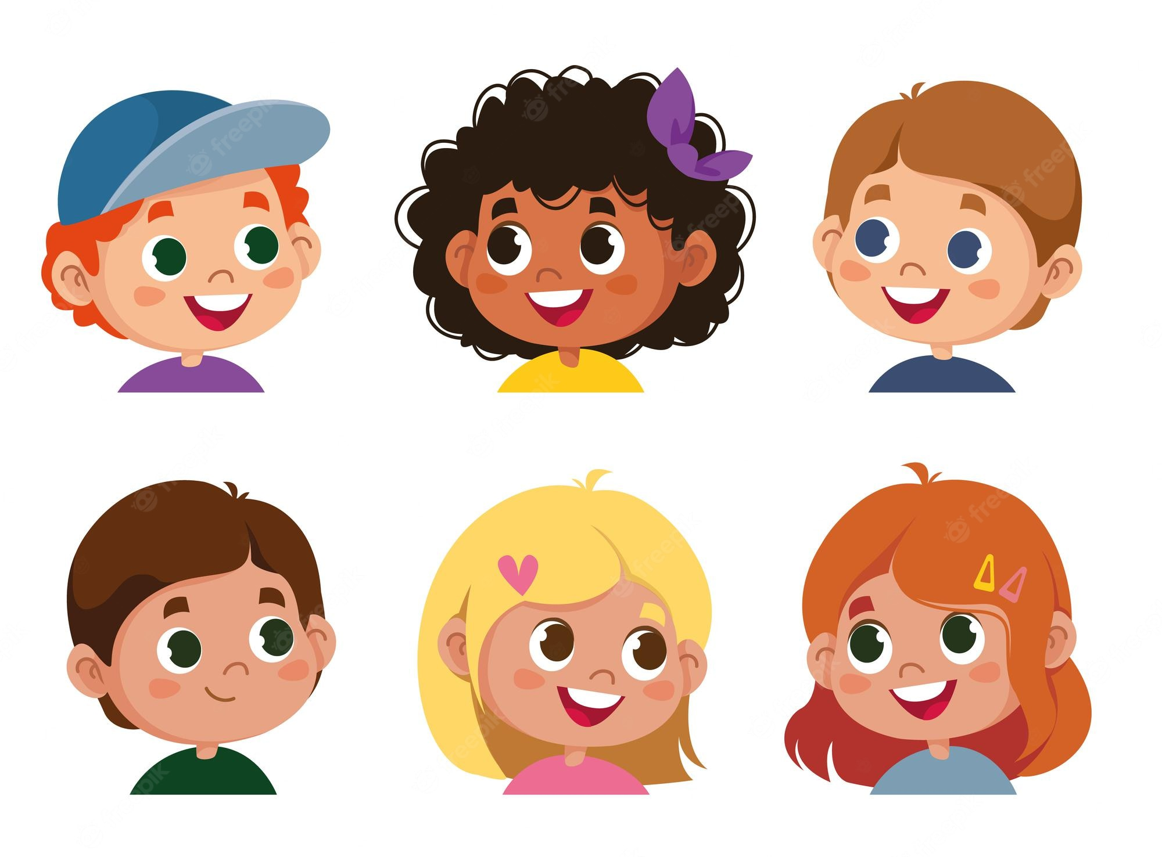
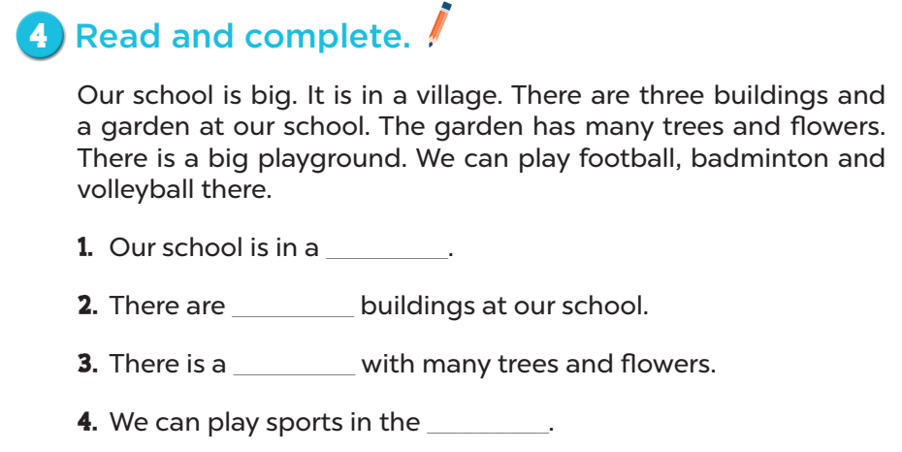
Let’s read.

Slide 8
village
three
garden
playground

Slide 9
03
Activity 5
Let’s write.

Slide 10
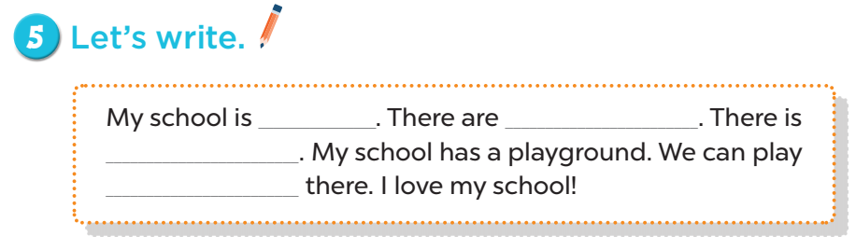

Slide 11
big/ small
My school is ___.
in the city/ village/ town/ mountains

Slide 12
There are (1) ___ (2) ____.
1. two/ three/ four
2. buildings/ computer rooms

Slide 13
There is (1)___ (2) ____.
1. a big/ small
2. garden

Slide 14
We can play _____ there.
football
badminton
volleyball
basketball

Slide 15
04
Activity 6
Project

Slide 16
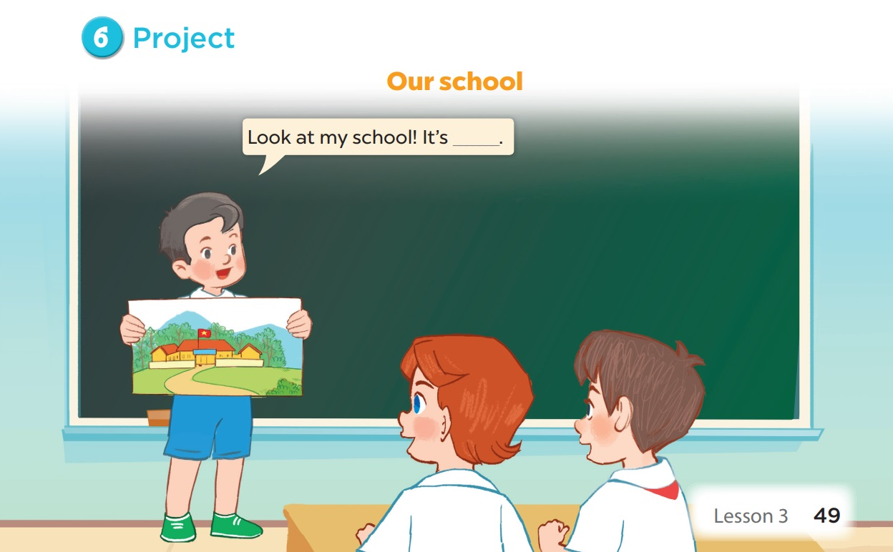

Slide 17
05
Game

Slide 18








LUCKY CHICKEN
Next Activity

Slide 19
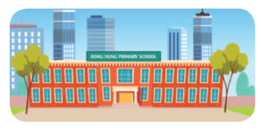
Where’s your school?
5 points
It’s in the city.

Slide 20
There are two ____ at my school.
A. building B. buildings
7 points
B. buildings

Slide 21
_____ one garden at my school.
A. There is B. There are
6 points
A. There is

Slide 22

We can play sports in the ___.
A. garden B. playground
4 points
B. playground

Slide 23
How many computer rooms _____?
A. are there B. there are
8 points
A. are there

Slide 24
Where’s your school?
2 points
It’s in the ___.

Slide 25

Lucky chicken
10 points

Slide 26
Lucky chicken
10 points

Slide 27
Lucky chicken
10 points

