Slide 1





Slide 2



Things we can do
5
LESSON 1 PERIOD 1

Slide 3
Table of contents
Warm-up
Say a chant.
04
01
02
03
Activity 2
Listen, point and say.
New words
05
Activity 3
Let’s talk.
Activity 1
Look, listen and repeat.
06
Games

Slide 4
01
Warm-up

Slide 5

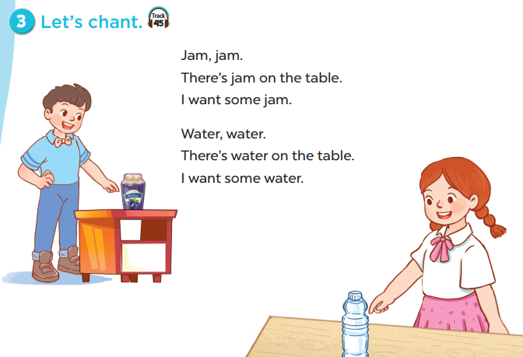

Slide 6

New words

Slide 7
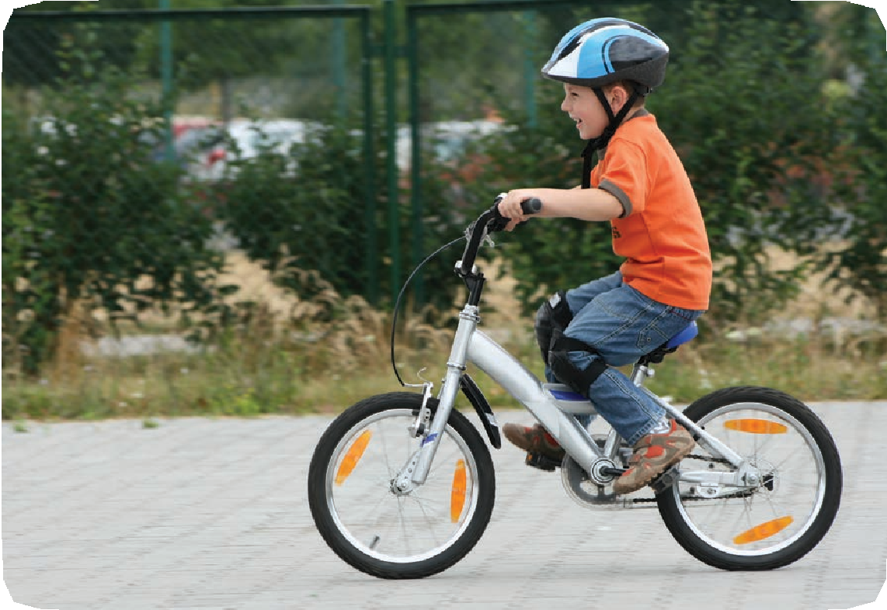
ride a bike

Slide 8
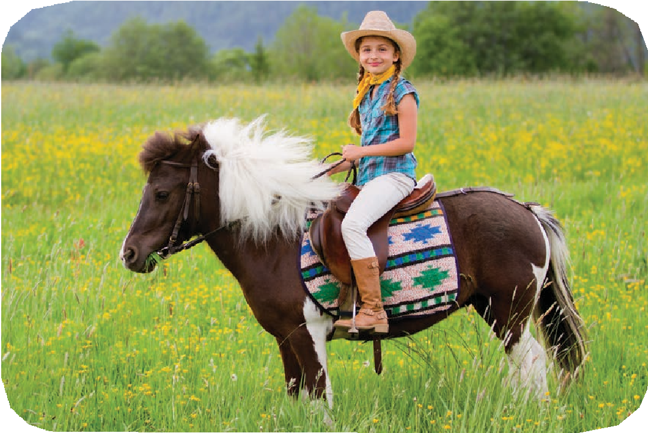
ride a horse

Slide 9
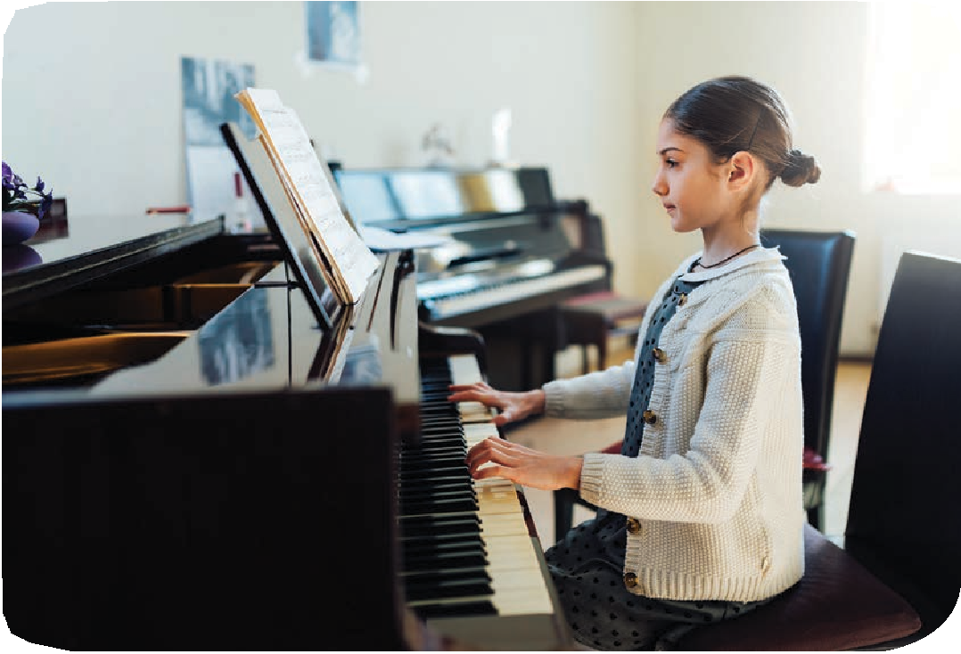
play the piano

Slide 10
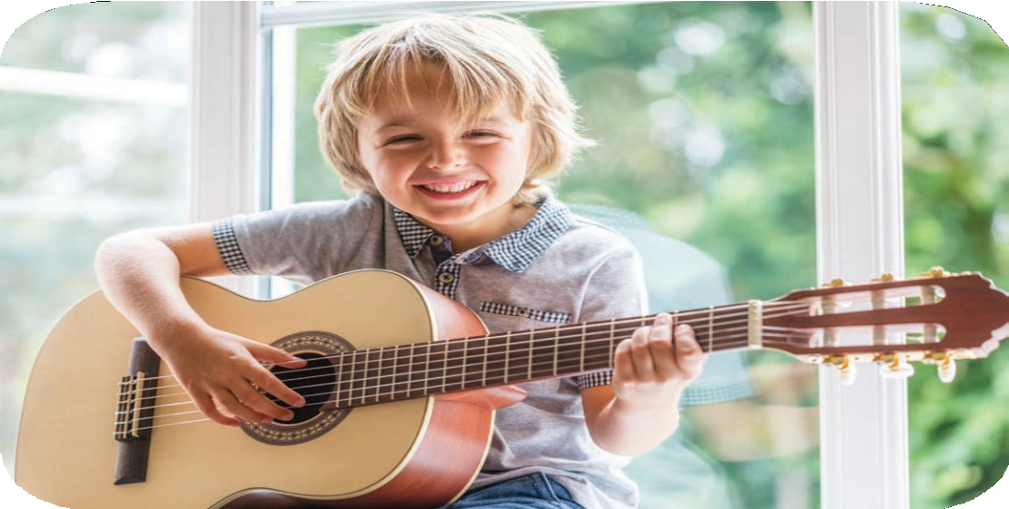
play the guitar

Slide 11
Look and guess.

Slide 12
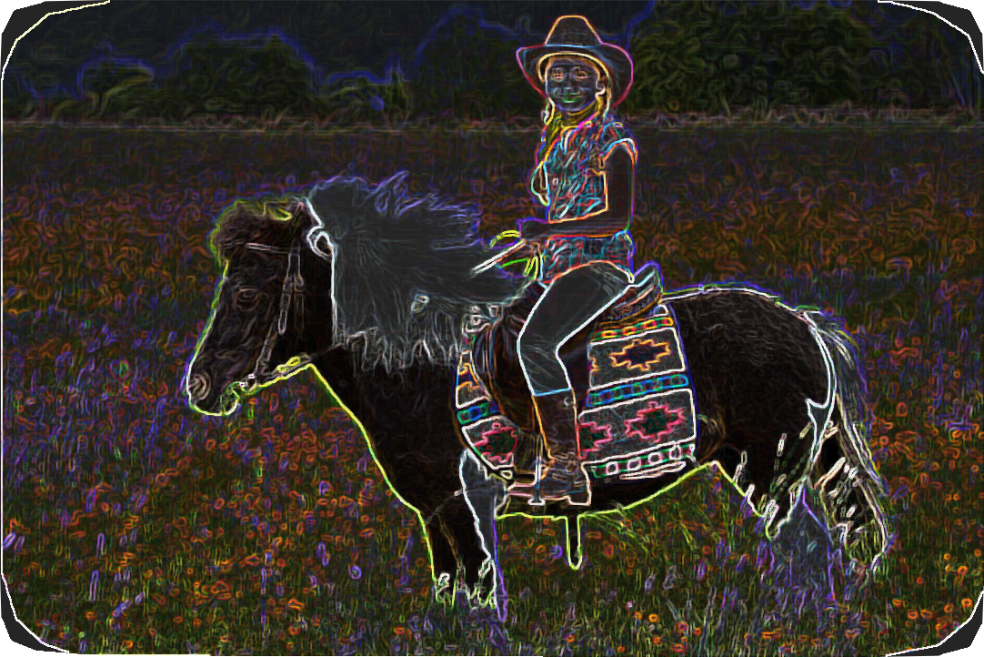
ride a horse

Slide 13
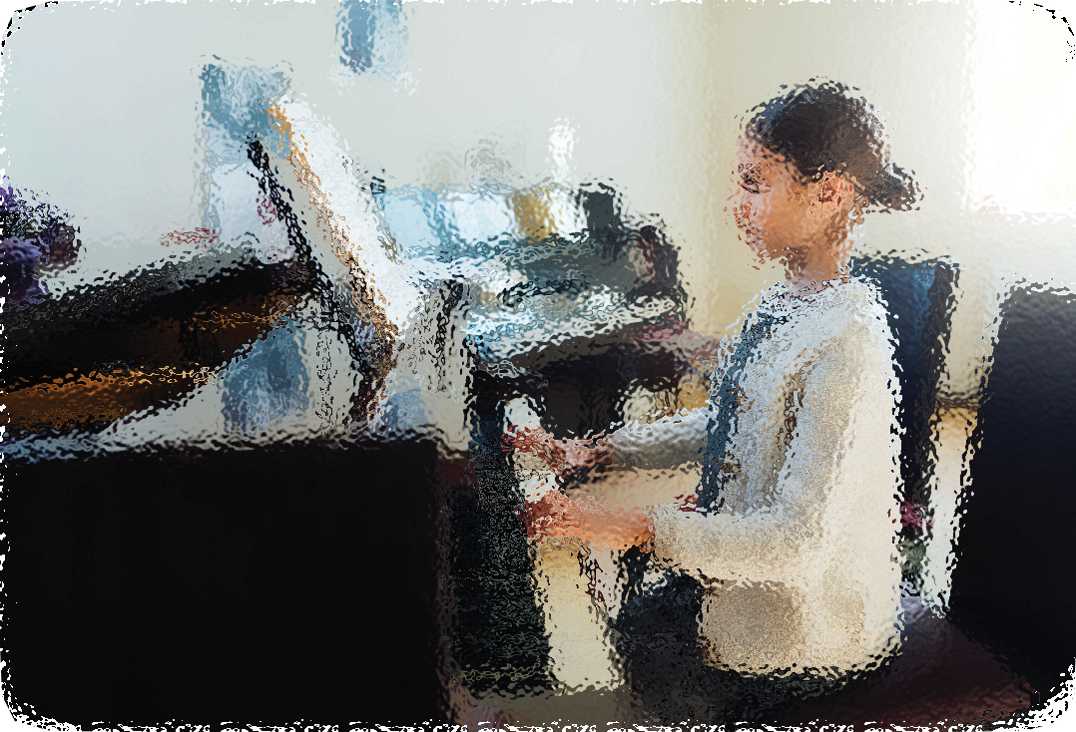
play the piano

Slide 14
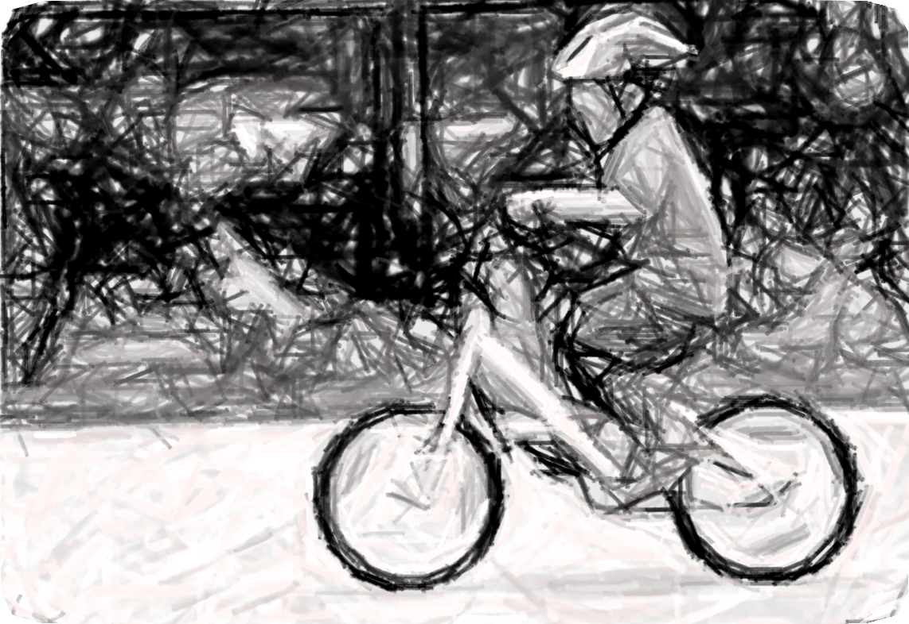
ride a bike

Slide 15
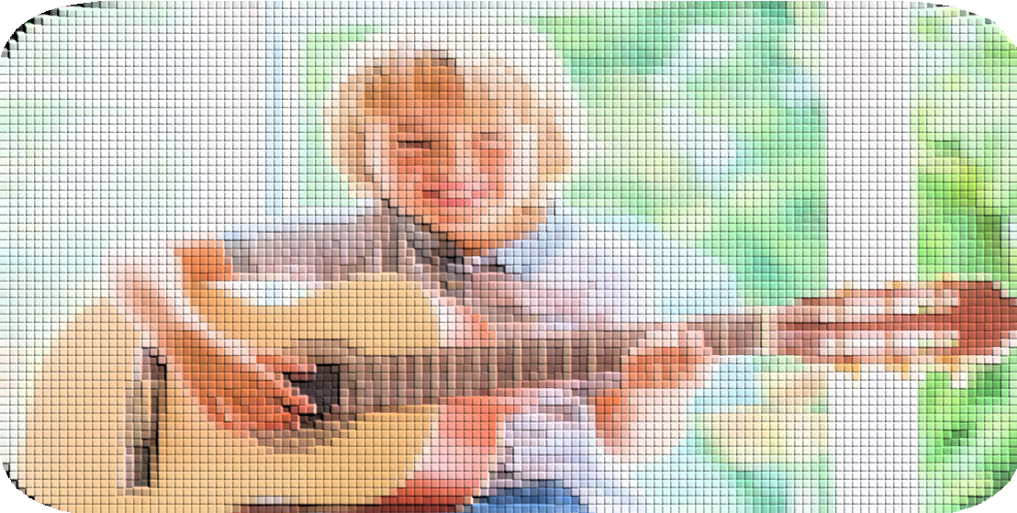
play the guitar

Slide 16
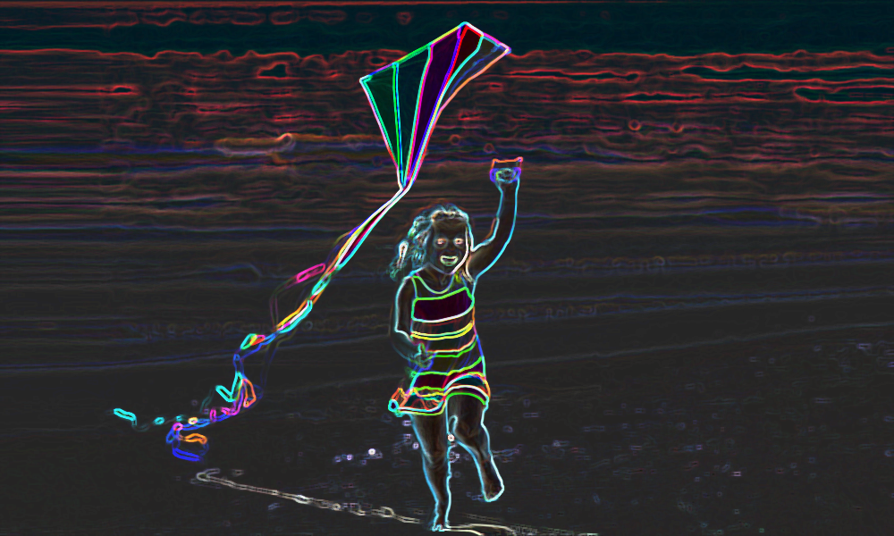
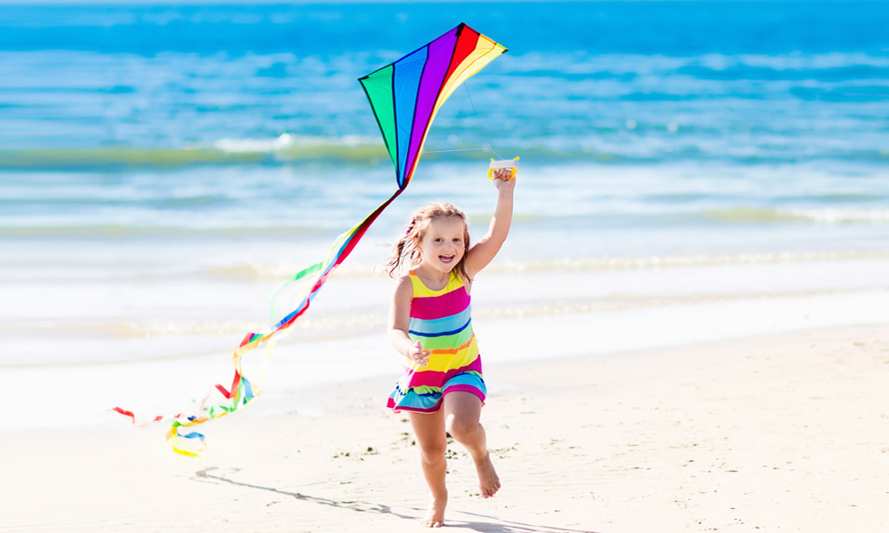
fly a kite

Slide 17

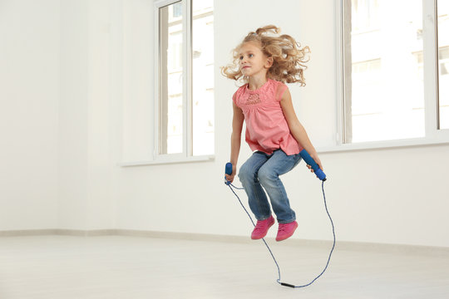
jump rope

Slide 18
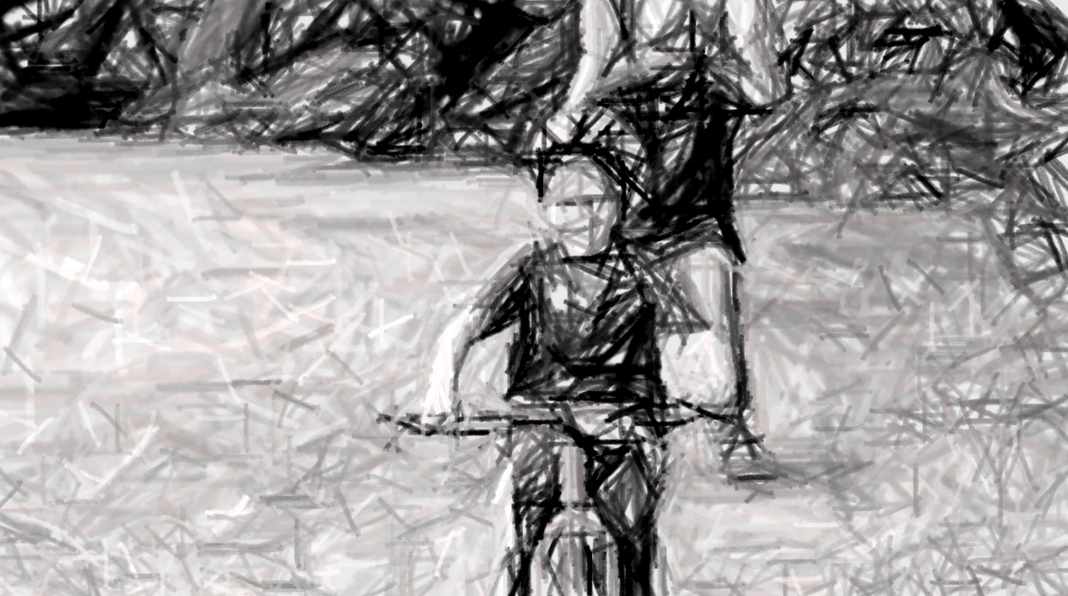
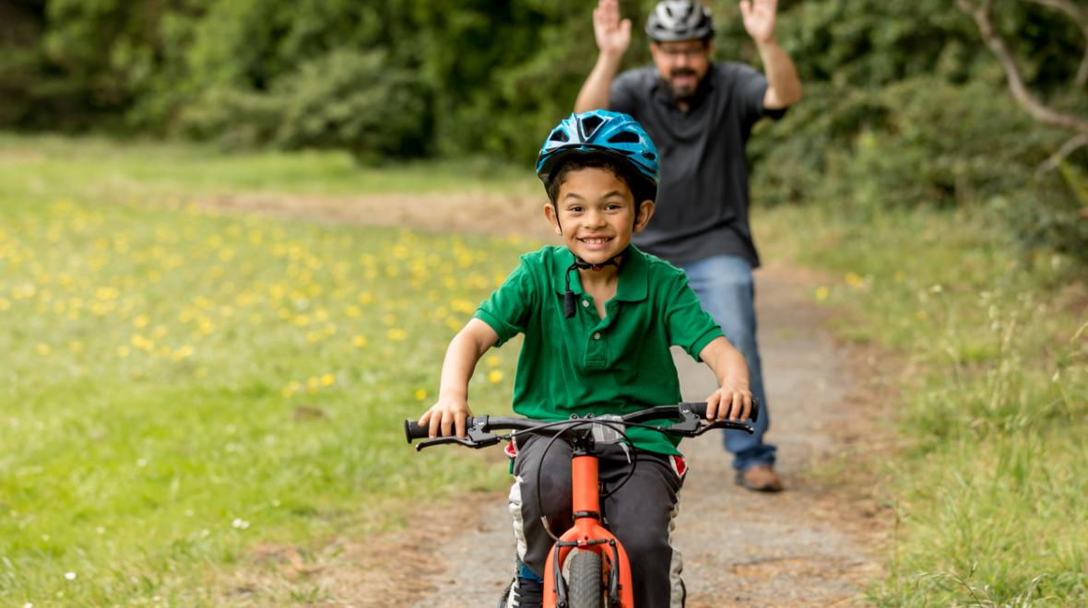
ride a bike

Slide 19
03
Activity 1
Look, listen and repeat.

Slide 20
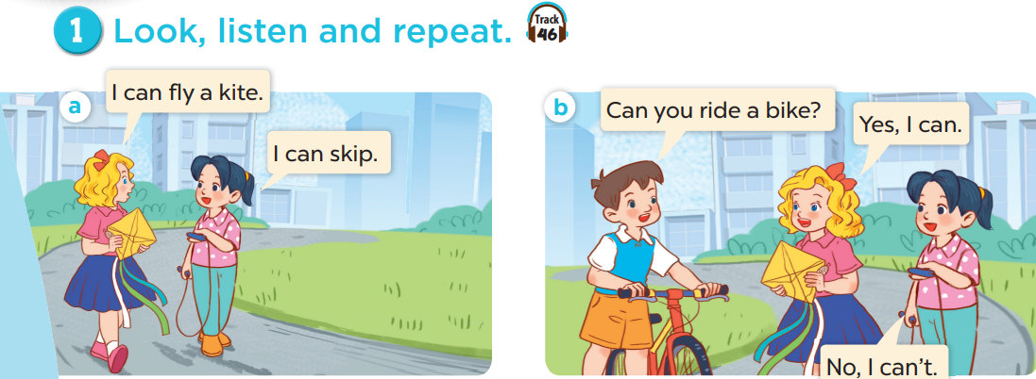
What does Mary have?
What does Mai have?
What does Minh have?
Who are they?

Slide 21
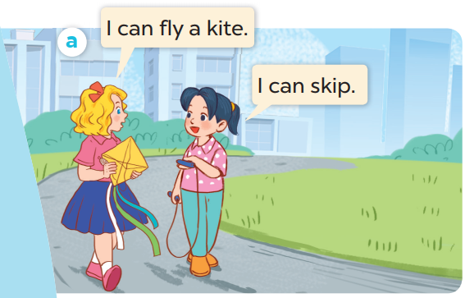
Listen and repeat.

Slide 22
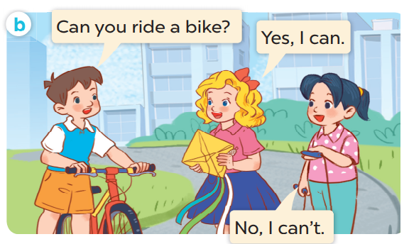
Listen and repeat.

Slide 23
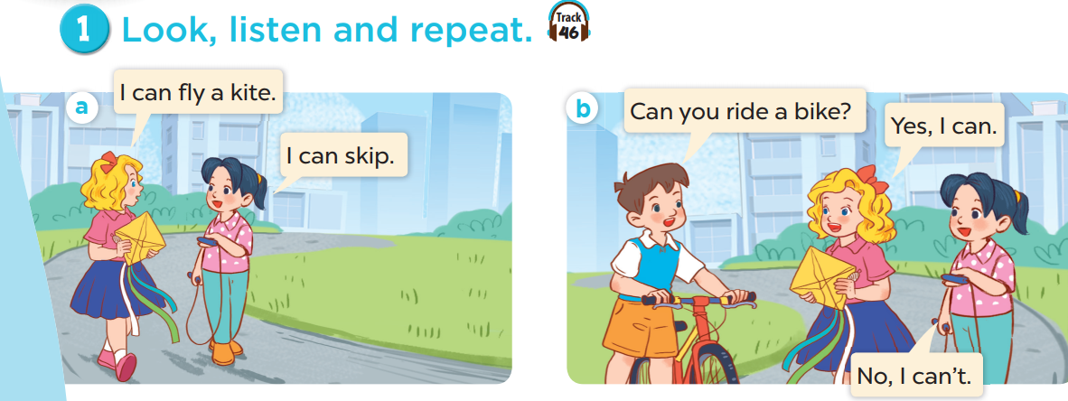
Work in pairs. Practise.
Listen and repeat.

Slide 24
04
Activity 2
Listen, point and say.

Slide 25
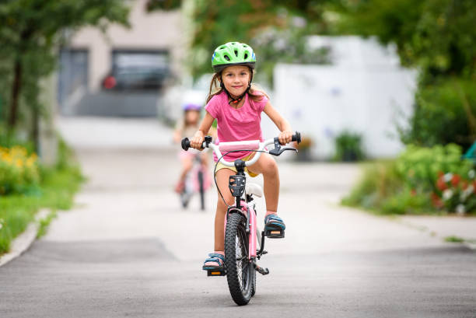

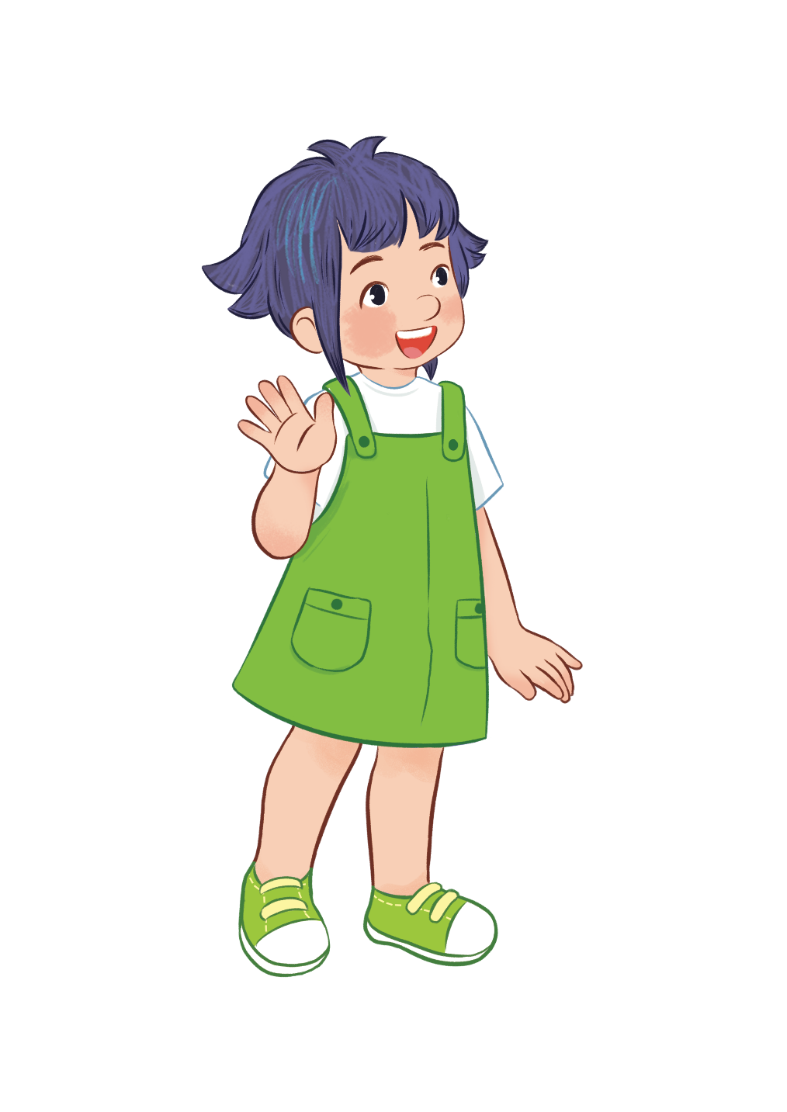
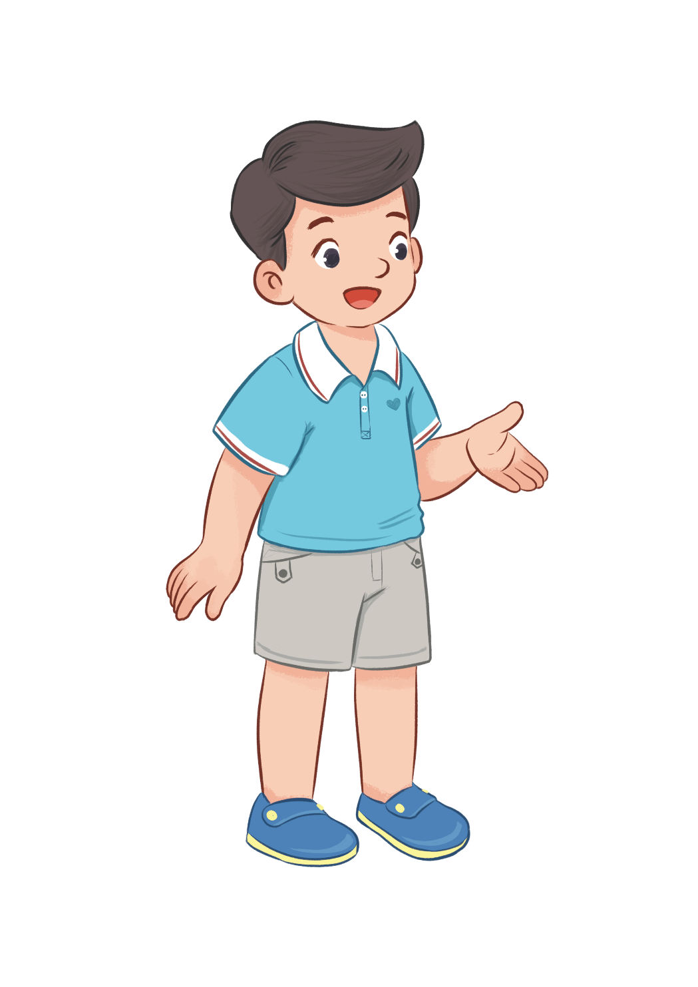
Can you ride a bike?
Yes, I can.

Slide 26
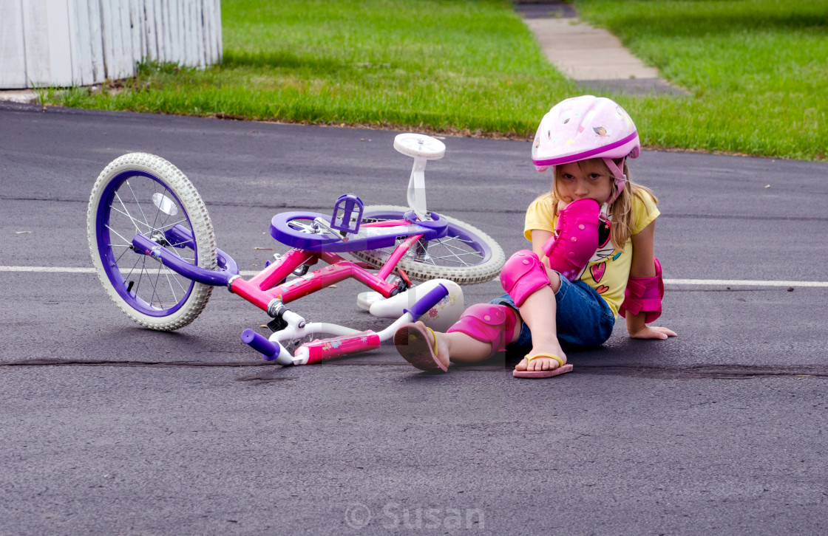

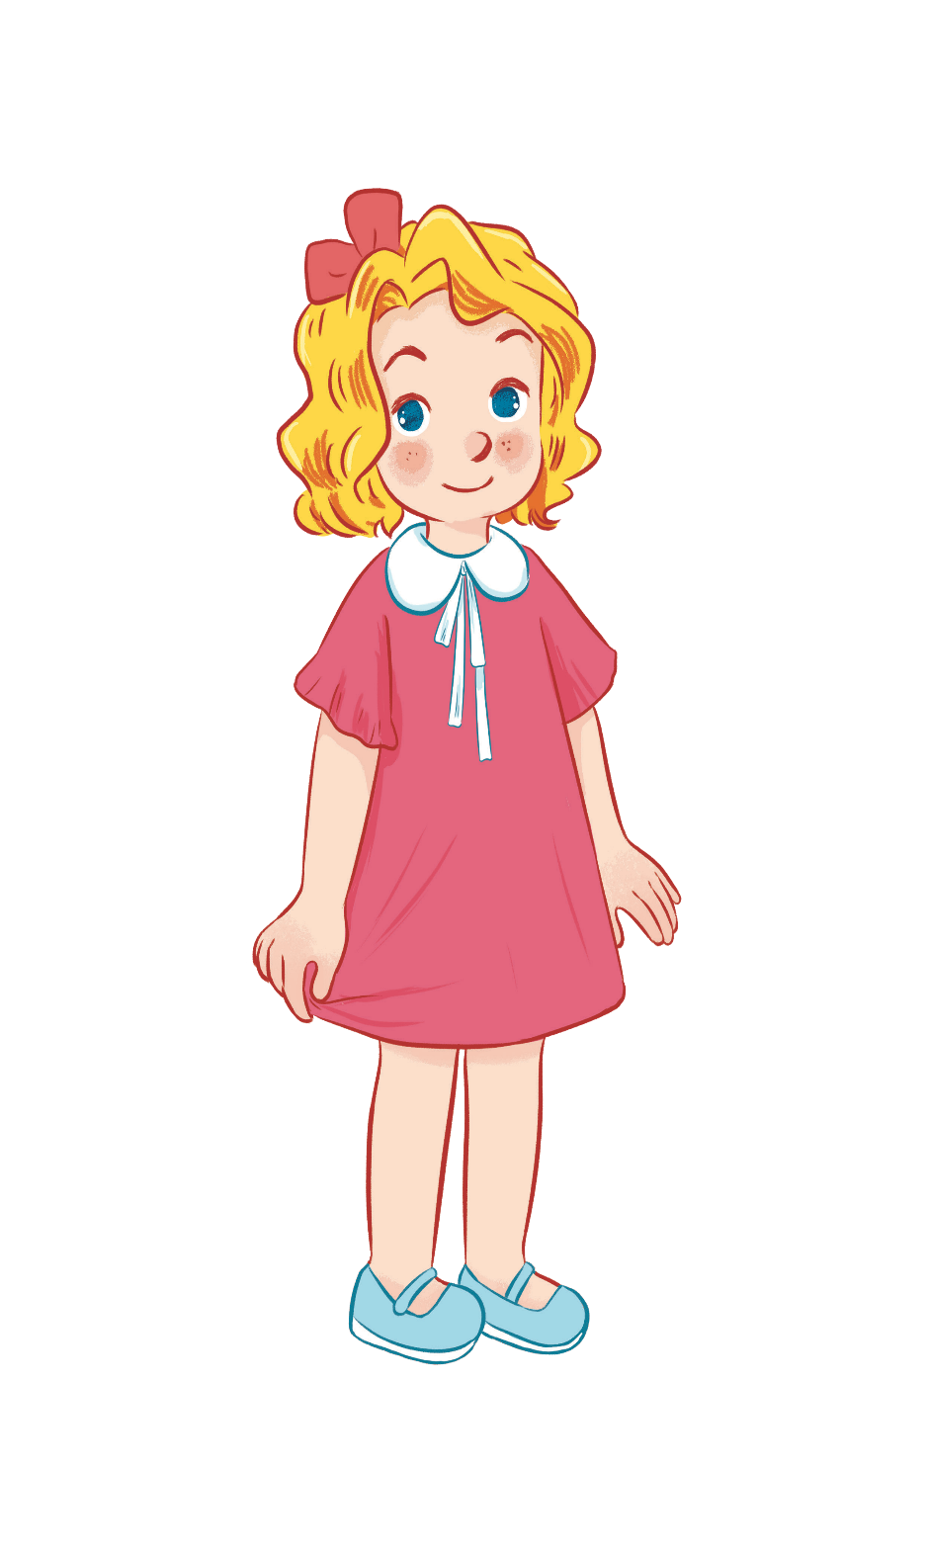
Can you ride a bike?
No, I can’t.

Slide 27

Can you play the guitar?
Yes, I can.

Slide 28
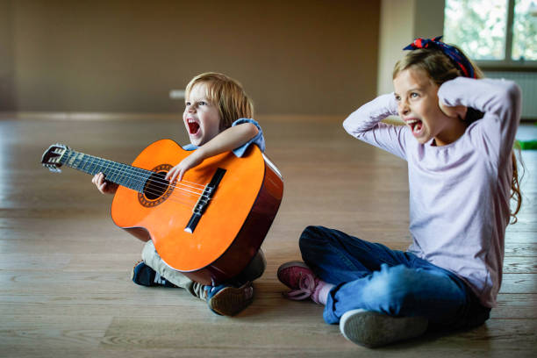
Can you play the guitar?
No, I can’t.

Slide 29
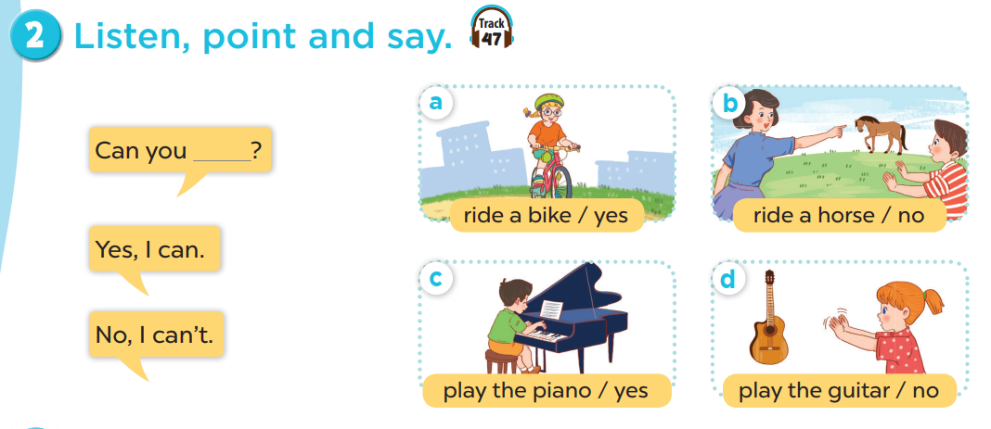
Work in pairs. Practise.
Listen, point and say.

Slide 30
05
Activity 3
Let’s talk.

Slide 31
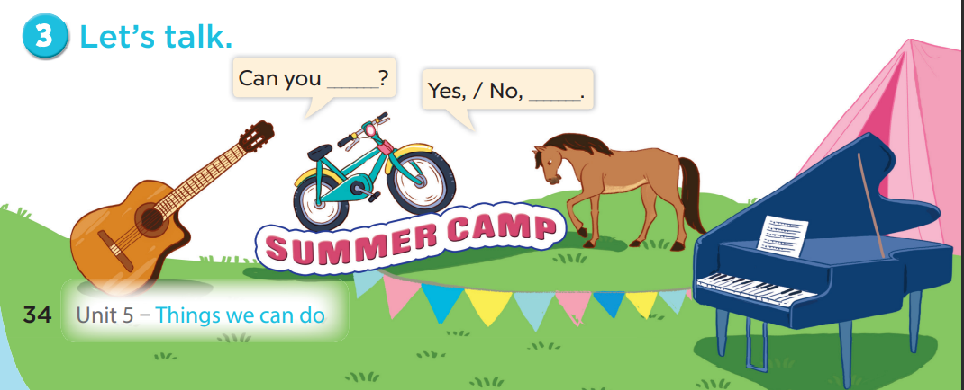

Slide 32
06
Games

Slide 33
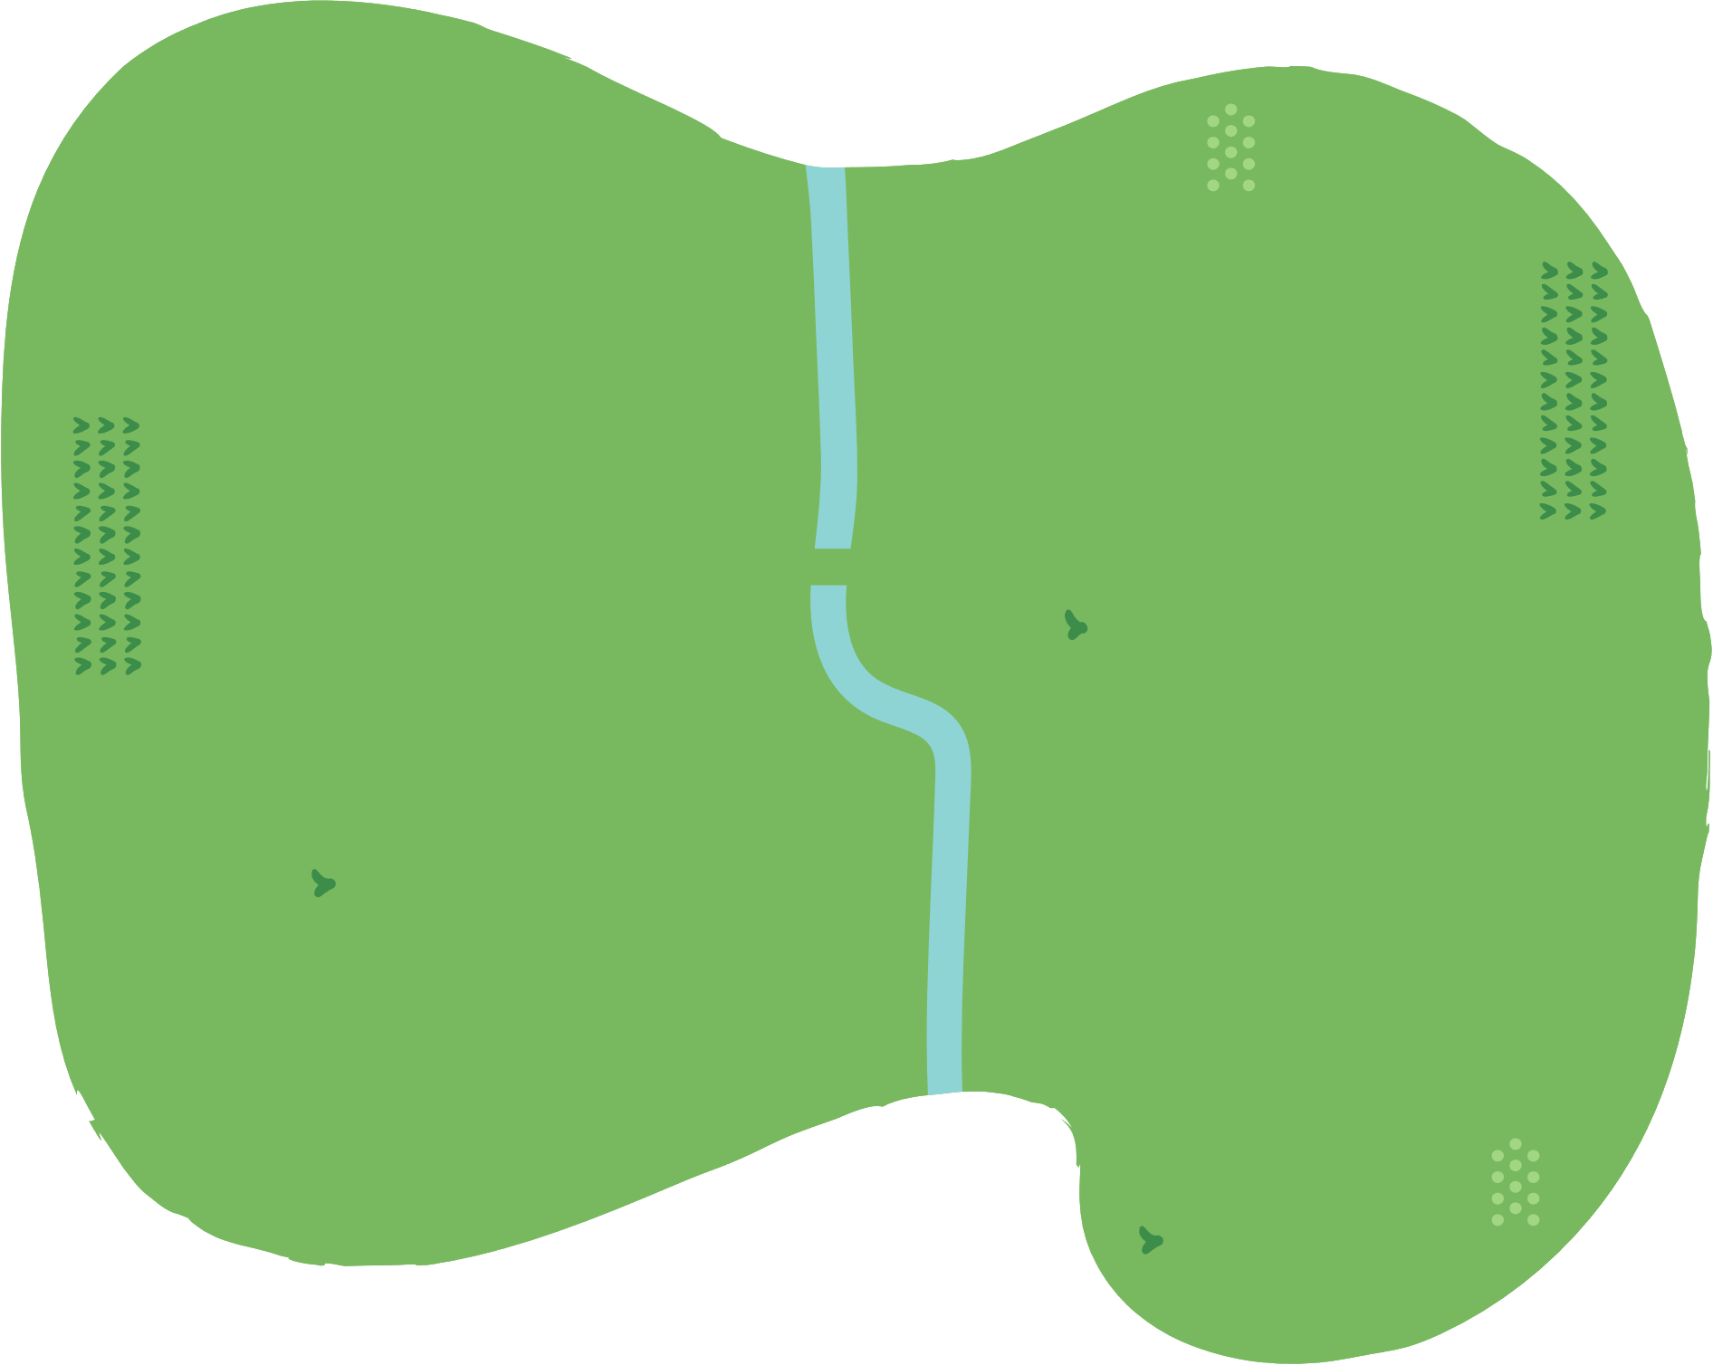





















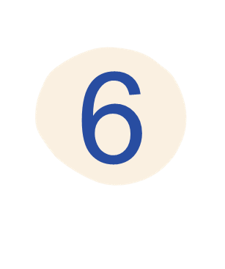



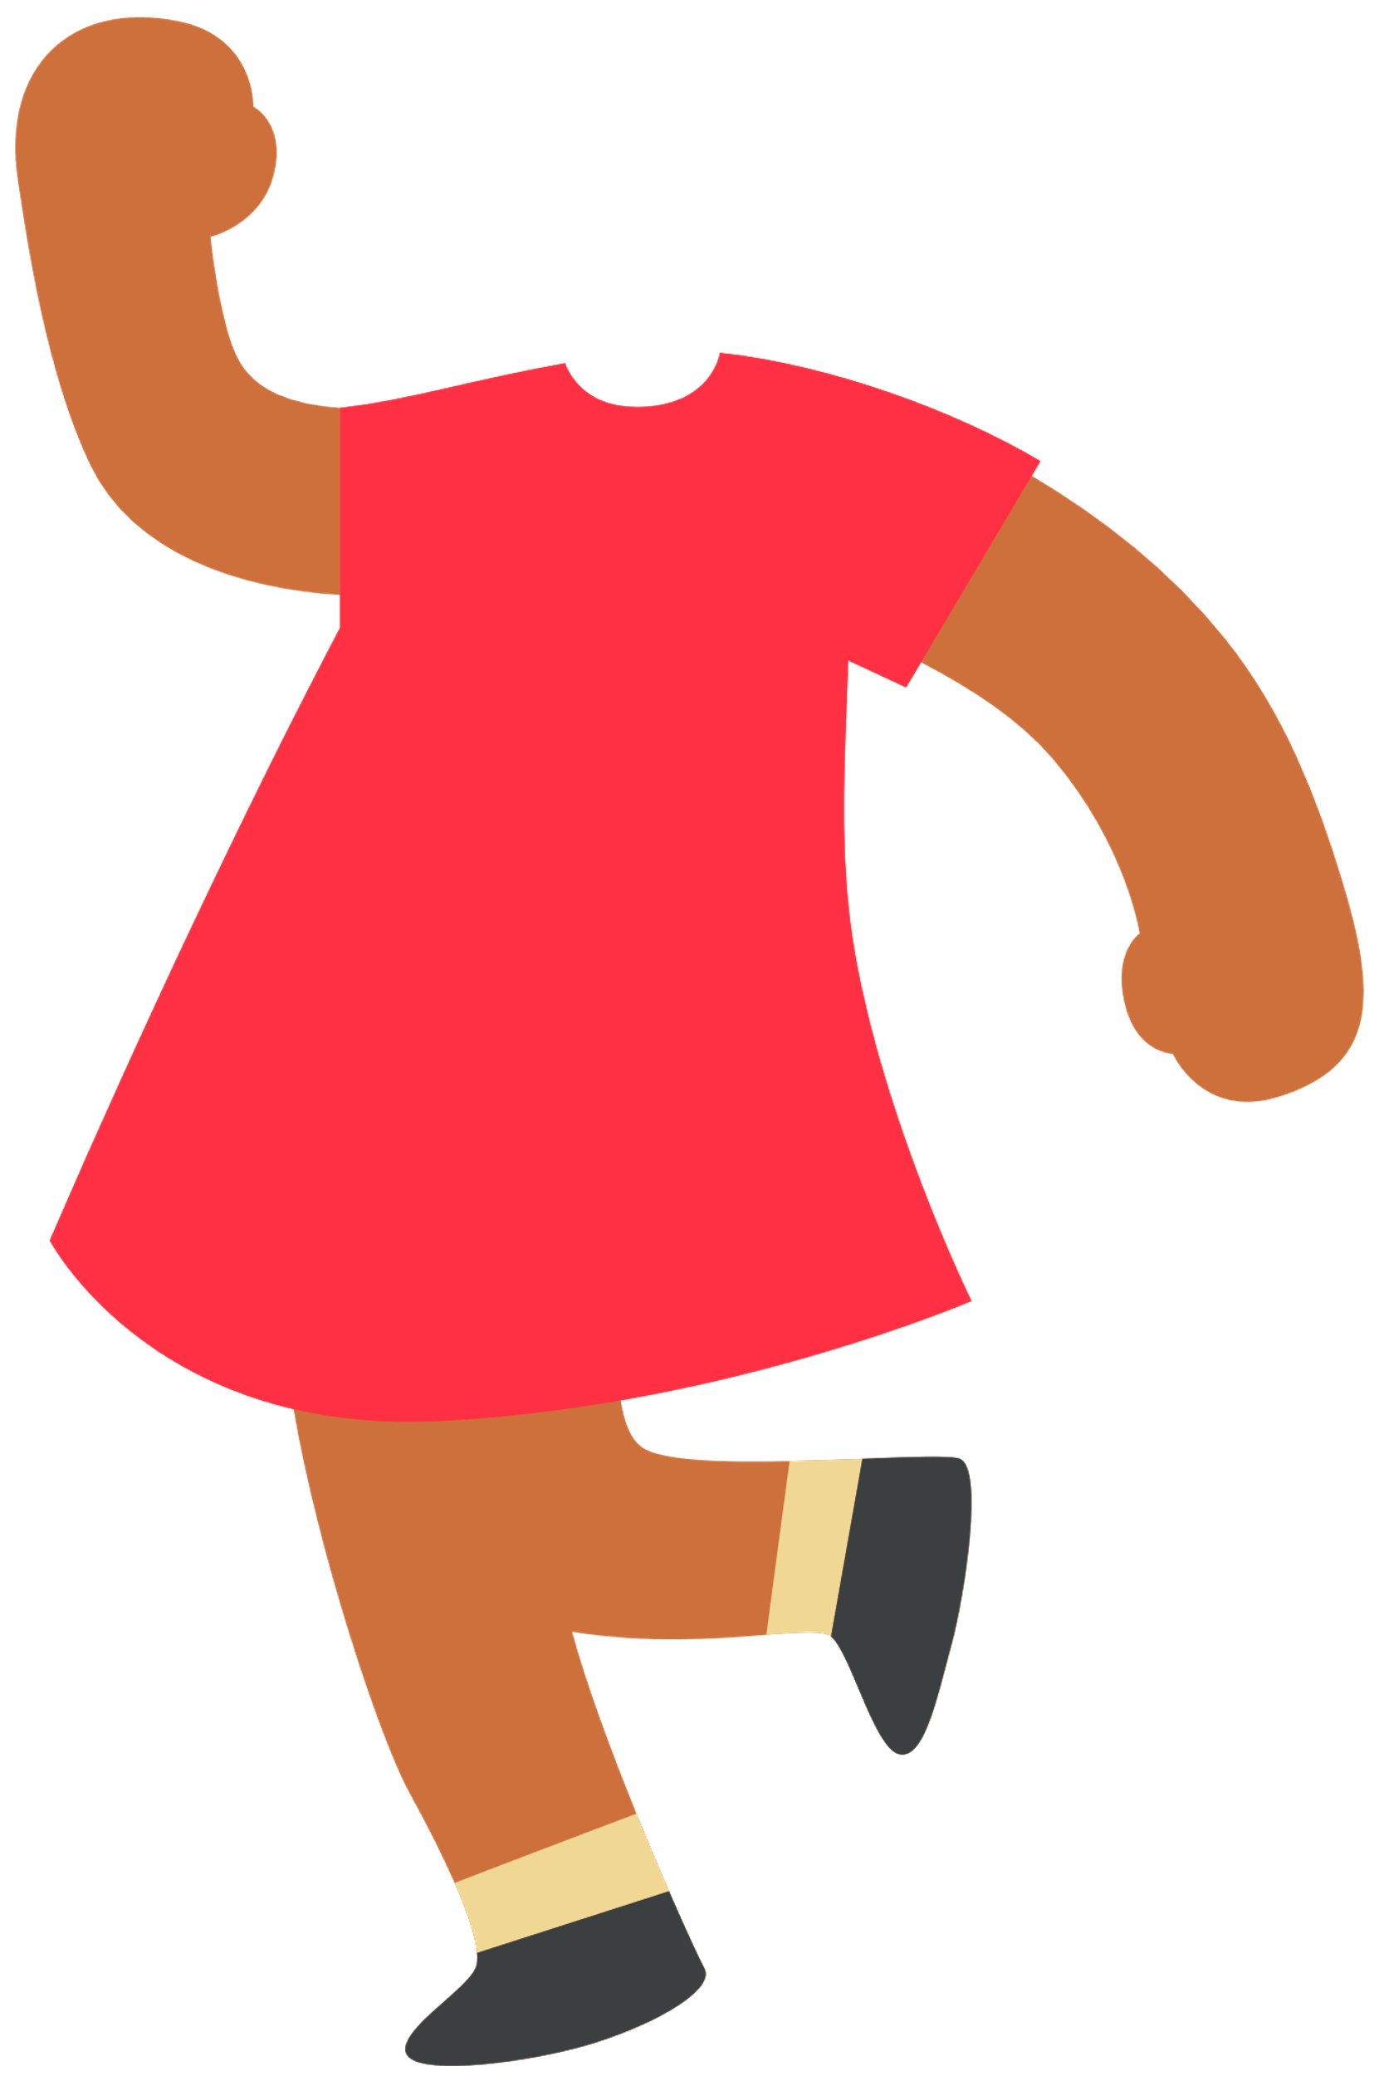
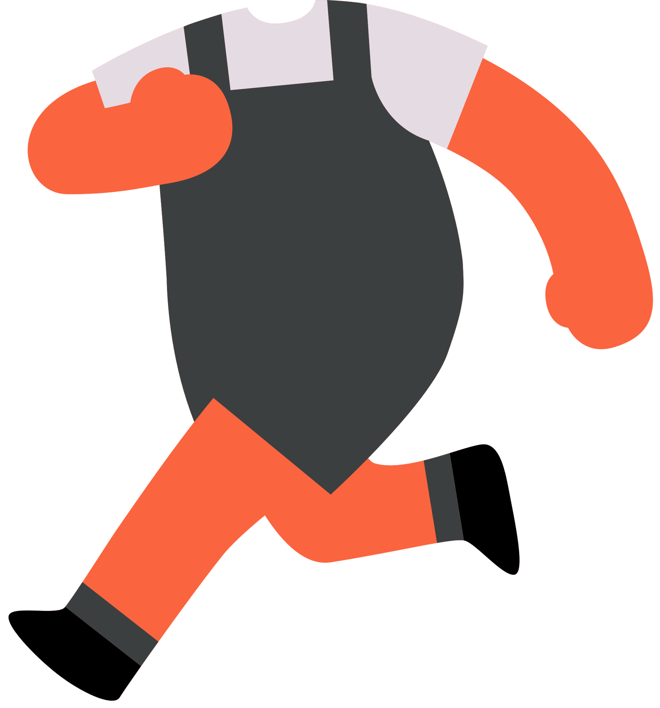




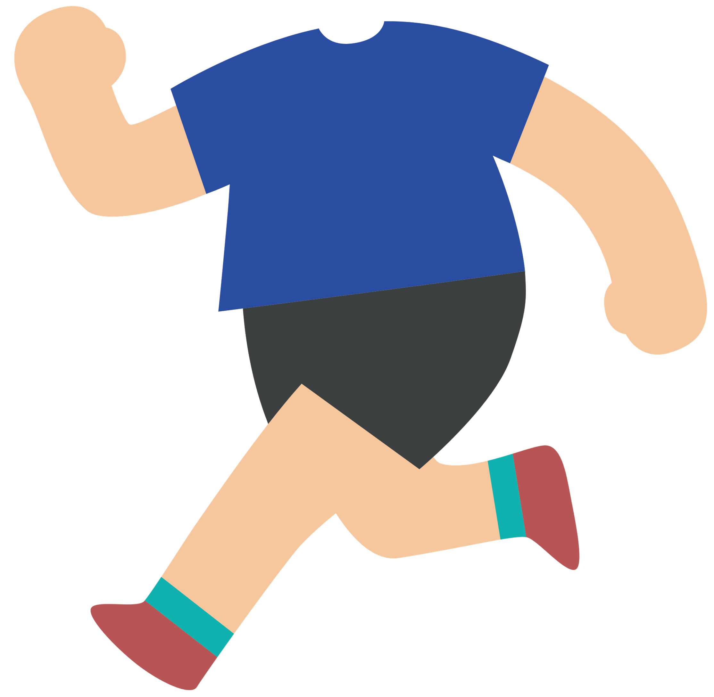



Slide 34
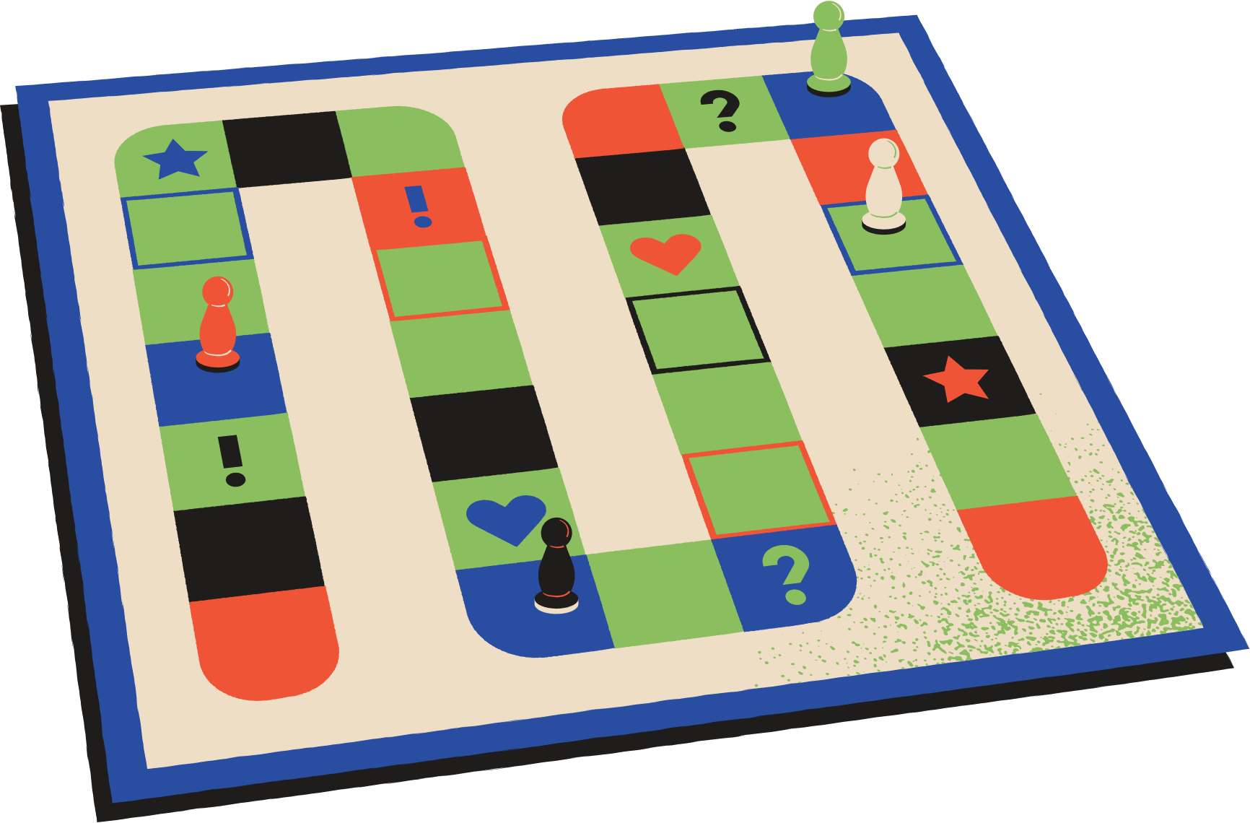




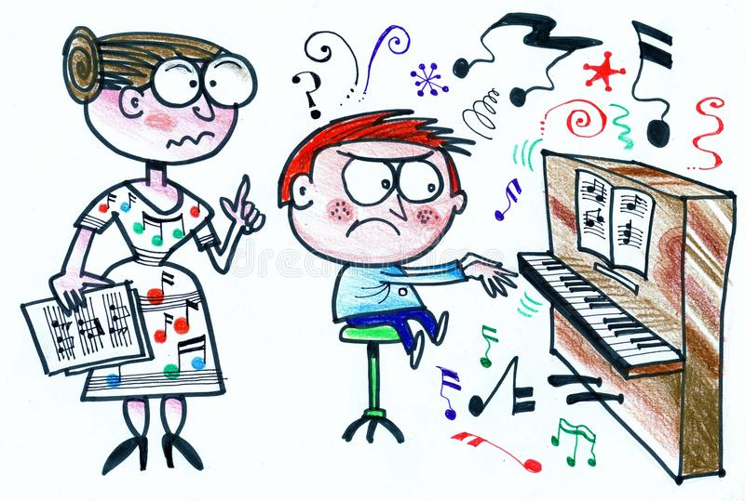

Can you play the piano?
Insert one question here
No, I can’t.

Slide 35
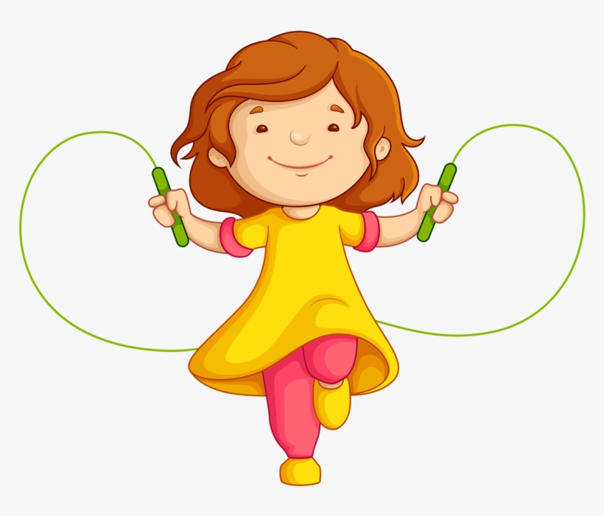
Can you jump rope?
Insert one question here
Insert one question here
Insert one question here
Yes, I can.

Slide 36
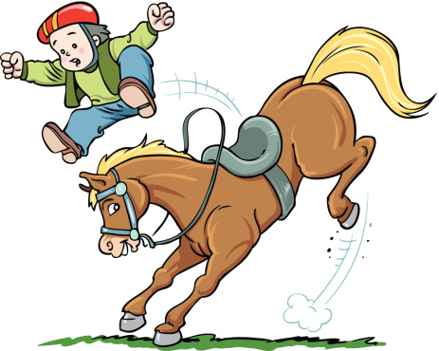
Can you ride a horse?
Insert one question here
Insert one question here
Insert one question here
No, I can’t.

Slide 37
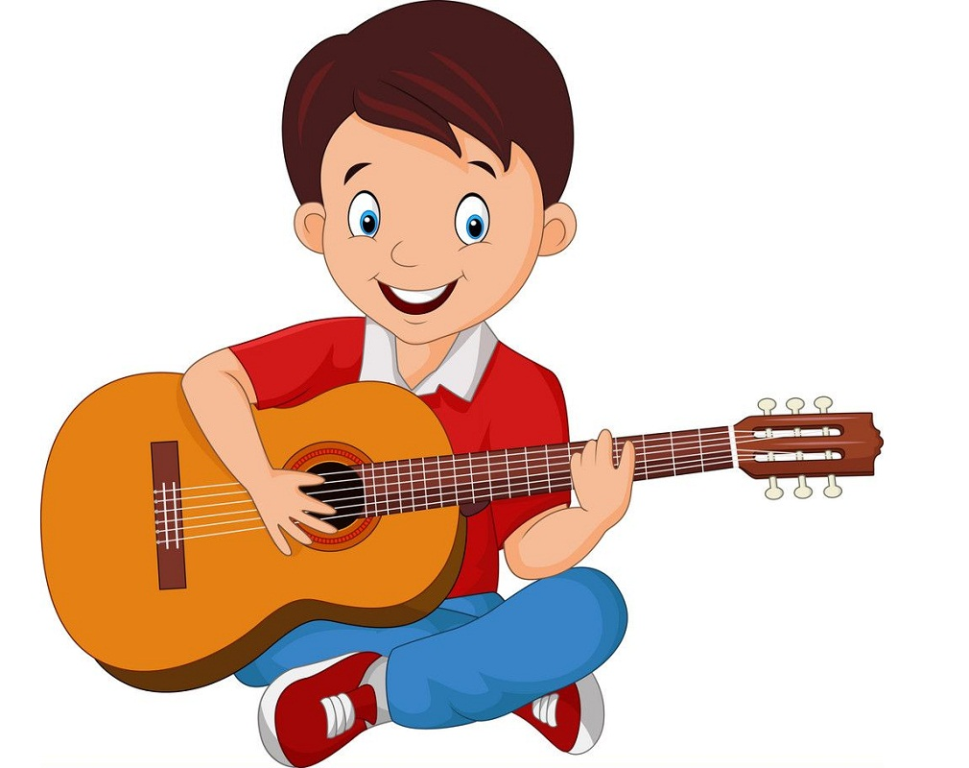
Can you play the guitar?
Insert one question here
Insert one question here
Insert one question here
Yes, I can.

Slide 38
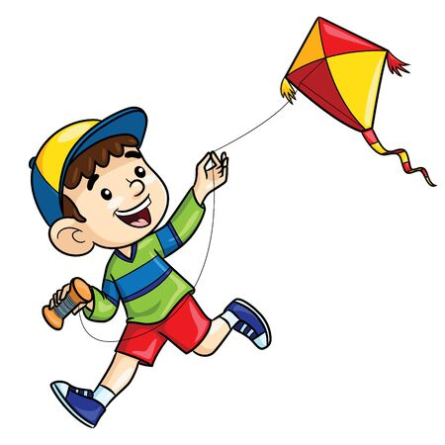
Can you fly a kite?
Insert one question here
Insert one question here
Insert one question here
Yes, I can.

Slide 39
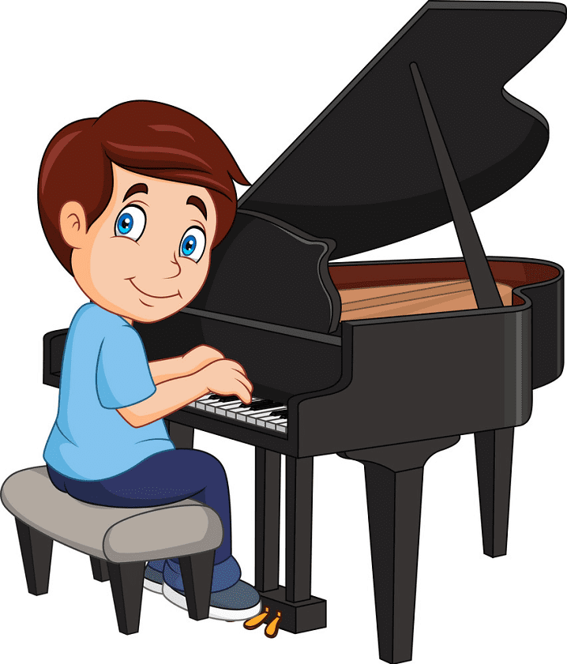
Can you play the piano?
Insert one question here
Insert one question here
Insert one question here
Yes, I can.

Slide 40
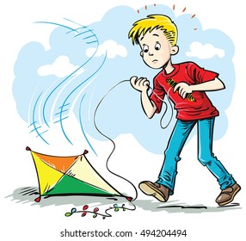
Can you fly a kite?
Insert one question here
Insert one question here
Insert one question here
No, I can’t.

Slide 41
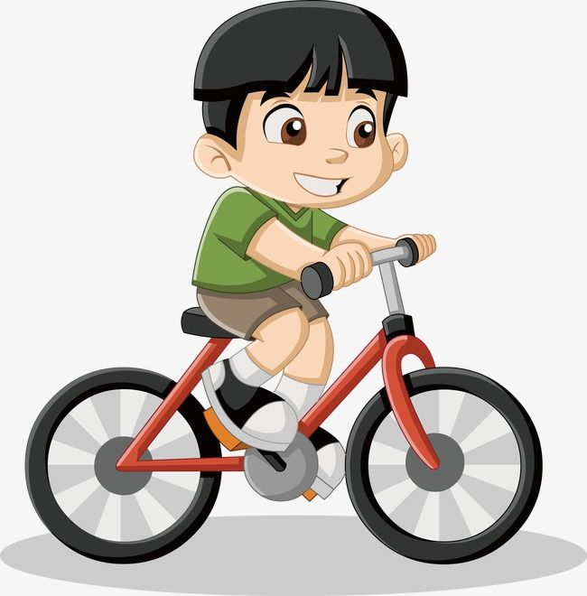
Can you ride a bike?
Insert one question here
Insert one question here
Insert one question here
Yes, I can.

Slide 42
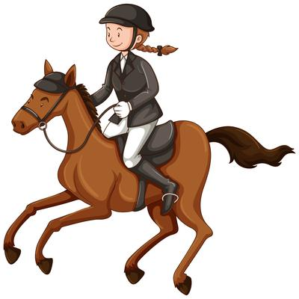
Can you ride a horse?
Insert one question here
Insert one question here
Insert one question here
Yes, I can.

