Slide 1





Slide 2



Things we can do
5
LESSON 2 PERIOD 3

Slide 3
Contents
Warm-up Look and guess.
01
04
02
03
Activity 3 Let’s talk.
Activity 1 Look, listen and repeat.
05
Games
Activity 2 Listen, point and say.

Slide 4
01
Warm-up

Slide 5
Look and guess.

Slide 6
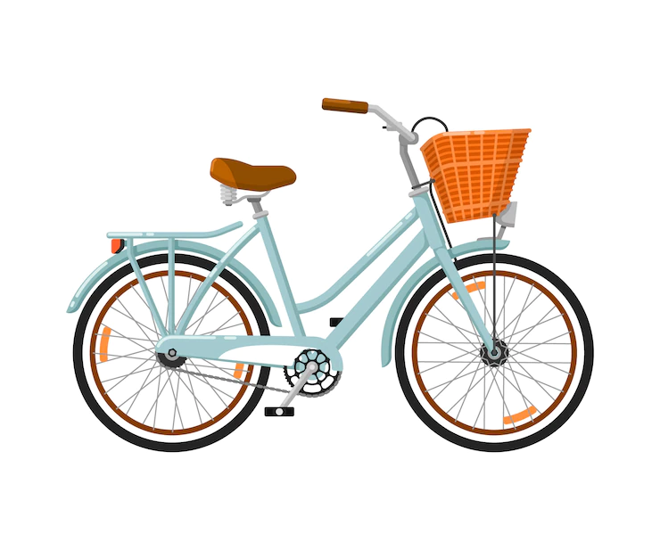

What can you do with this?
I can ride a bike.

Slide 7
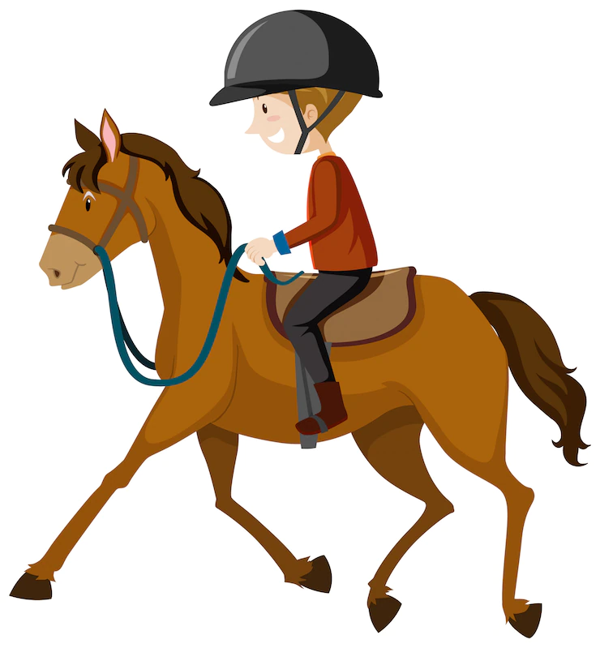

What can you do with this?
I can ride a horse.

Slide 8


What can you do with this?
I can fly a kite.

Slide 9


What can you do with this?
I can play the piano.

Slide 10
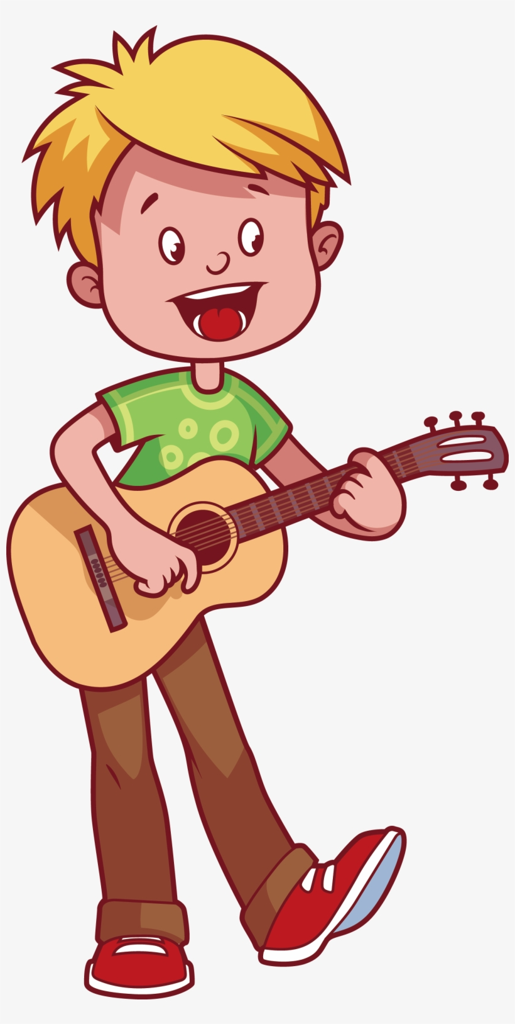

What can you do with this?
I can play the guitar.

Slide 11
02
Activity 1 Look, listen and repeat.

Slide 12
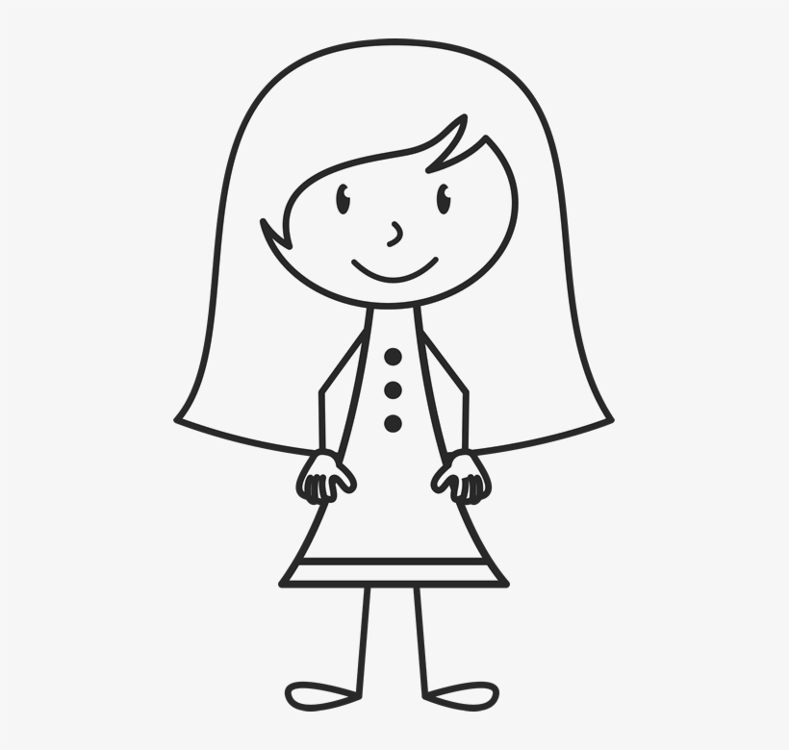
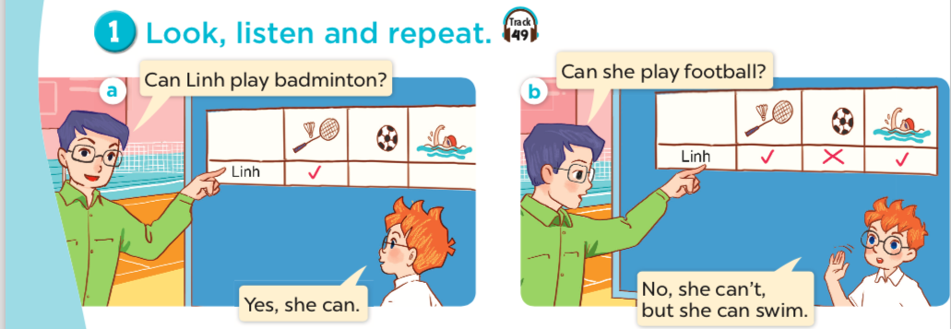
Who is Linh?
What can Linh do?
What can't Linh do?
a girl

Slide 13
Listen and repeat.

Slide 14
Listen and repeat.

Slide 15
Work in pairs. Practise.

Slide 16
03
Activity 2 Listen, point and say.

Slide 17
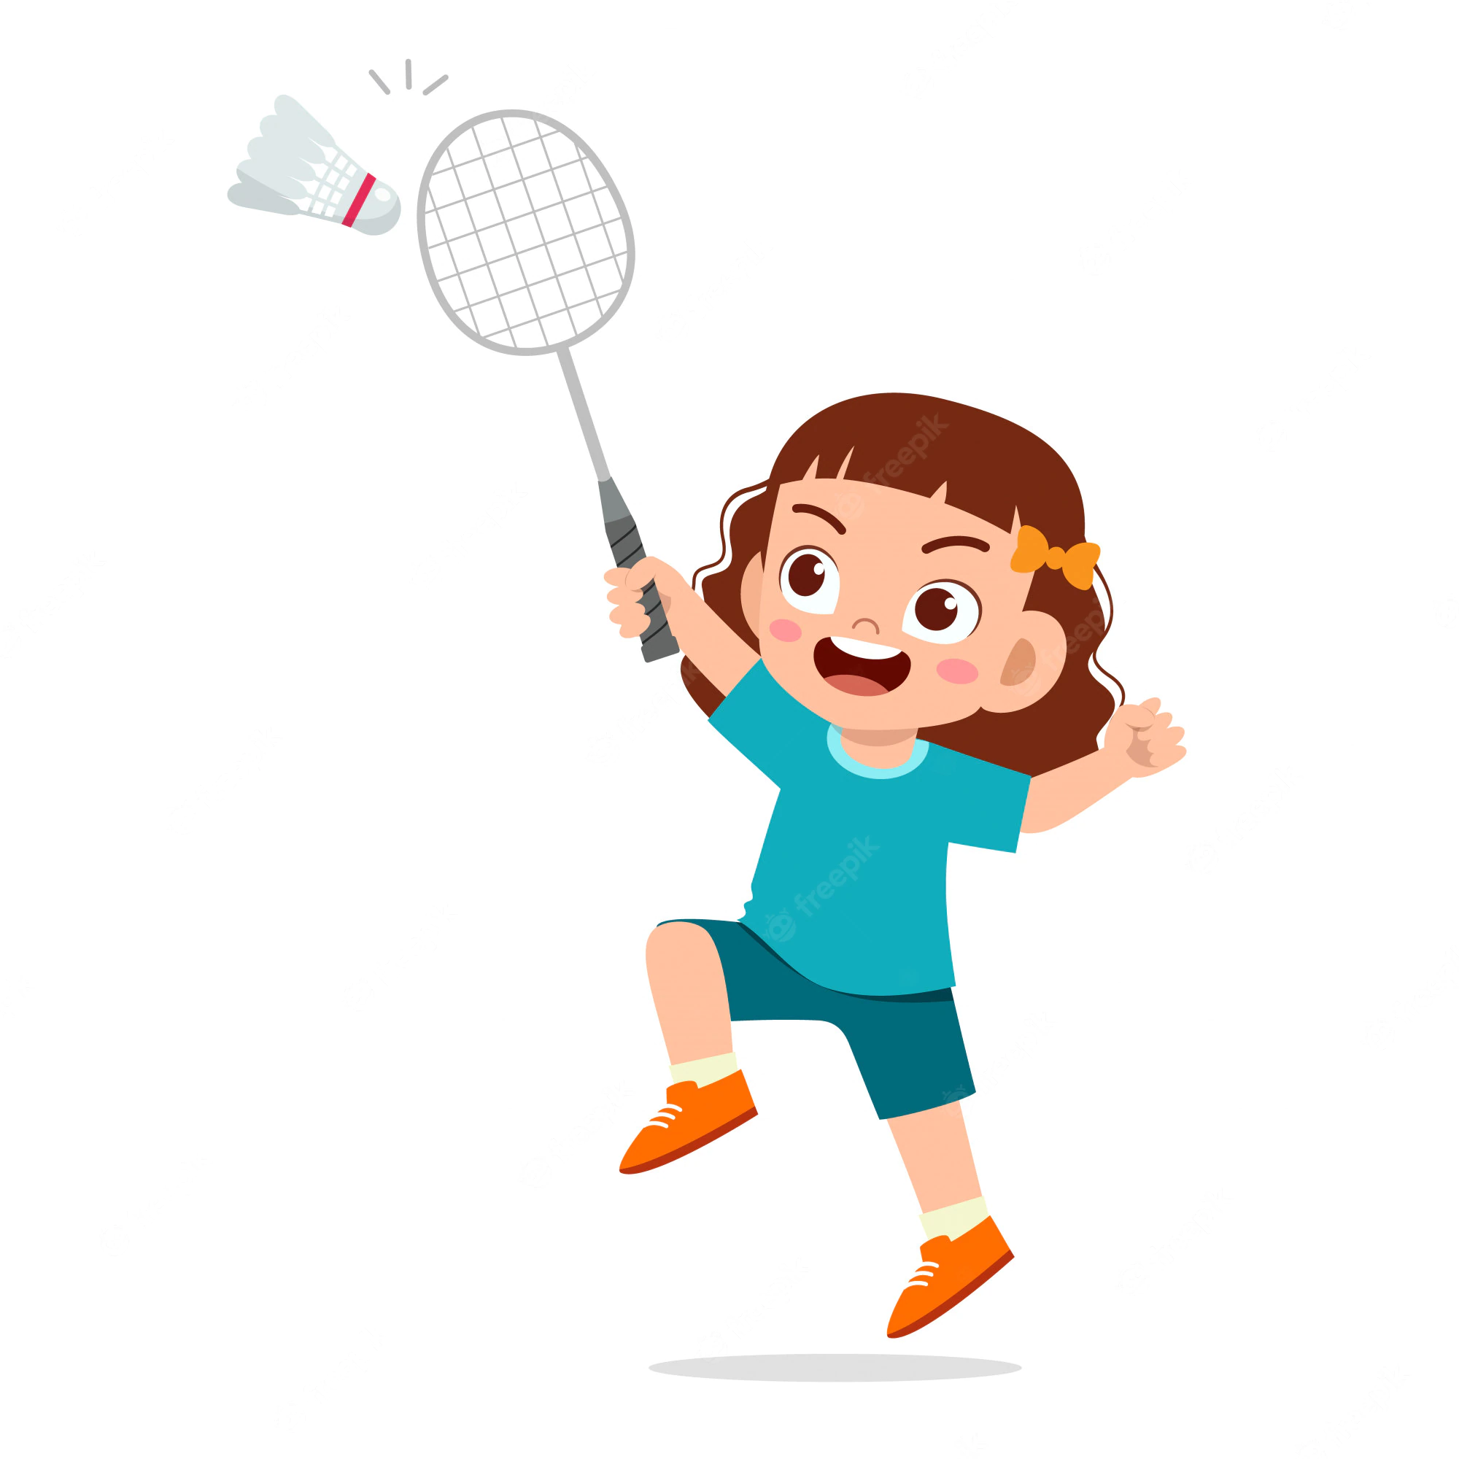
play badminton

Slide 18
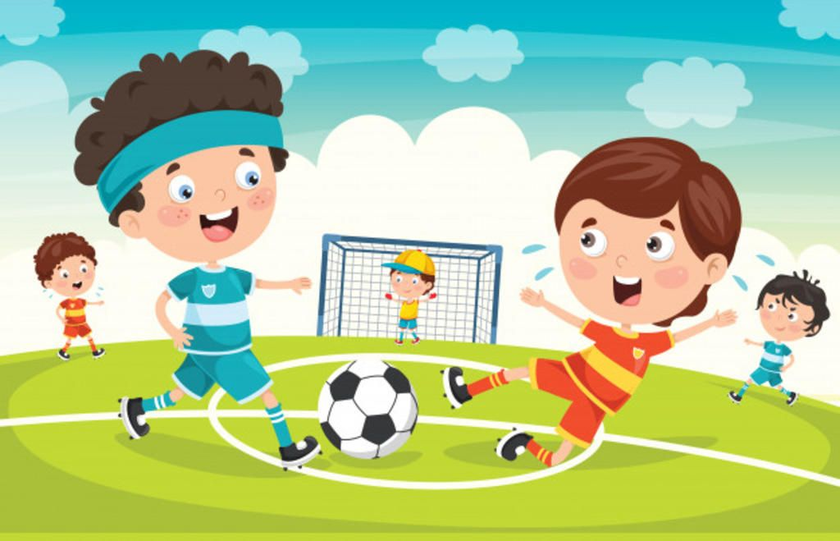
play football

Slide 19

cook

Slide 20

swim

Slide 21
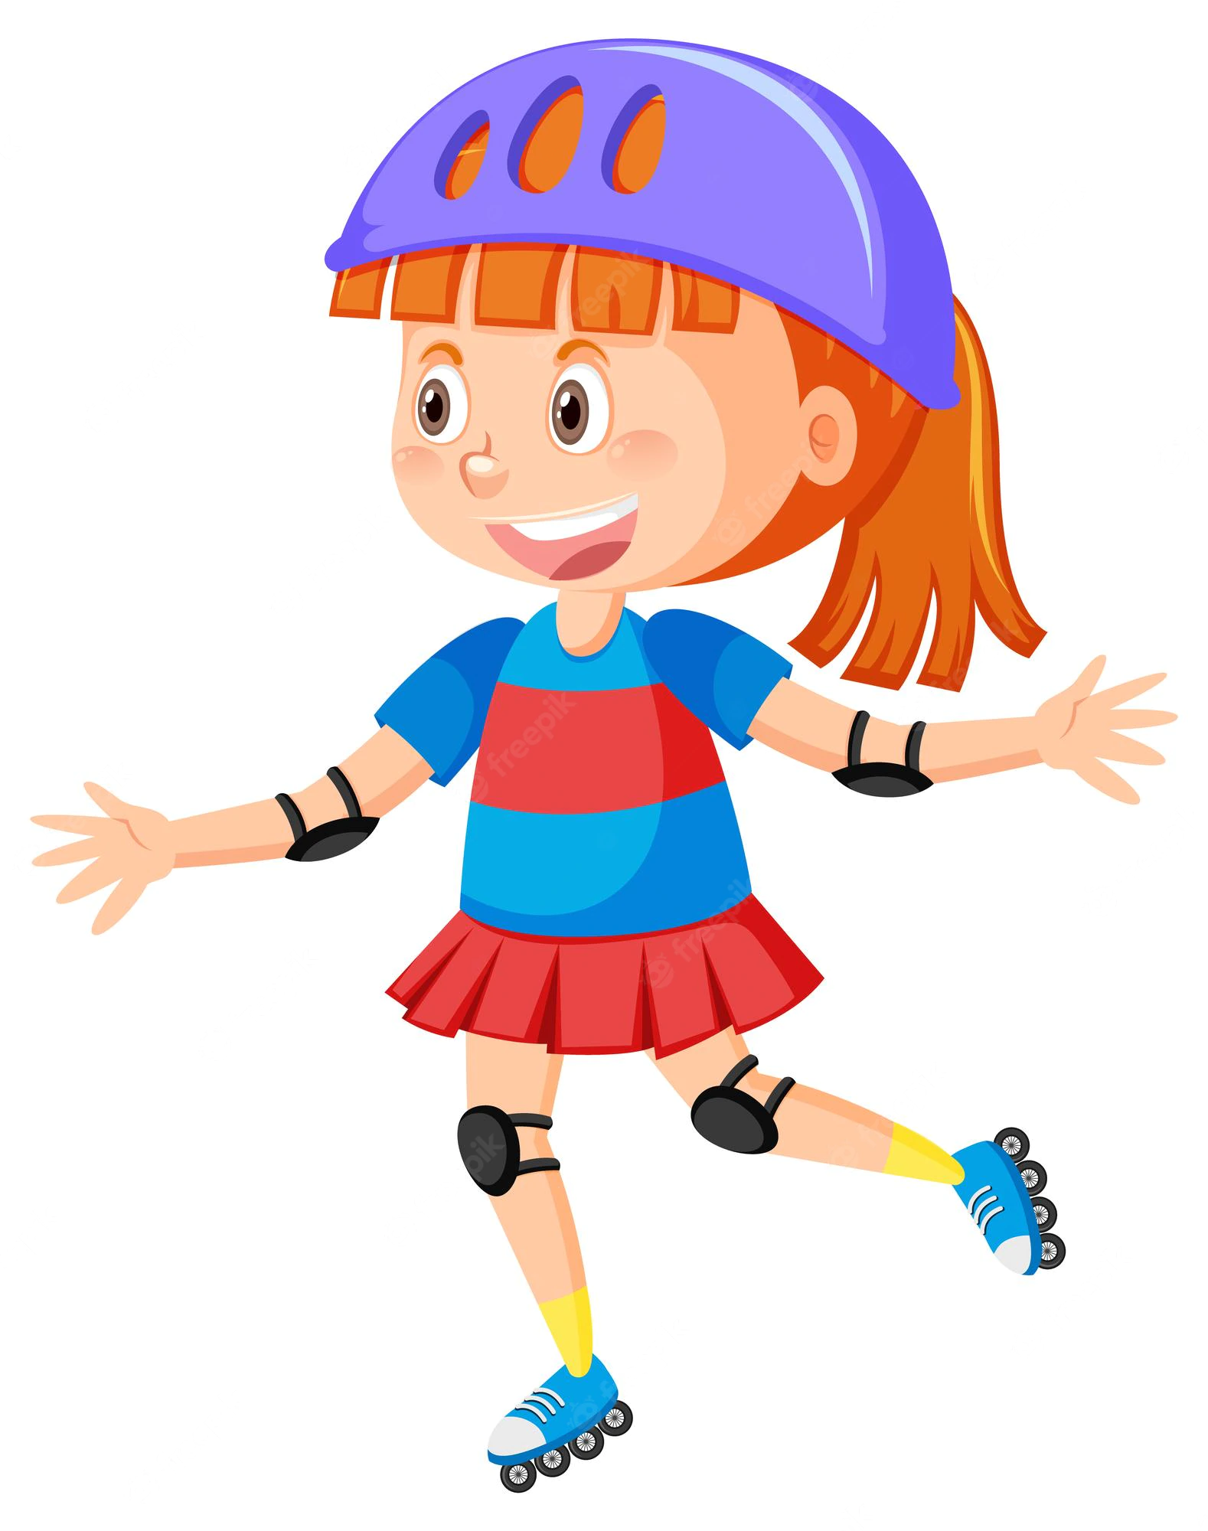
roller skate

Slide 22
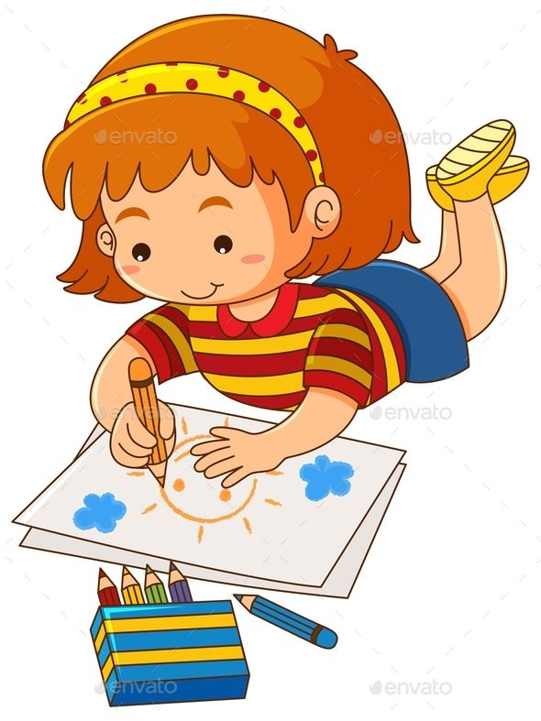
draw

Slide 23
Matching game!

Slide 24


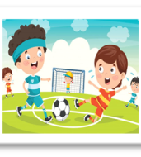

Let’s play
swim
play football
cook
Notes:
Click the card to show the words/picture. Click again to turn it face down.

Slide 25

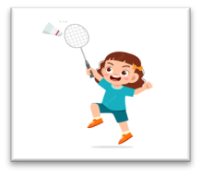
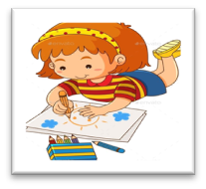
Let’s play.
draw
roller skate
play
badminton
Notes:
Click the card to show the words/ picture. Click again to turn it face down.

Slide 26

Can Mary cook?
she
Yes, she can.

Slide 27


Can she swim?
No, she can't, but she can cook.

Slide 28
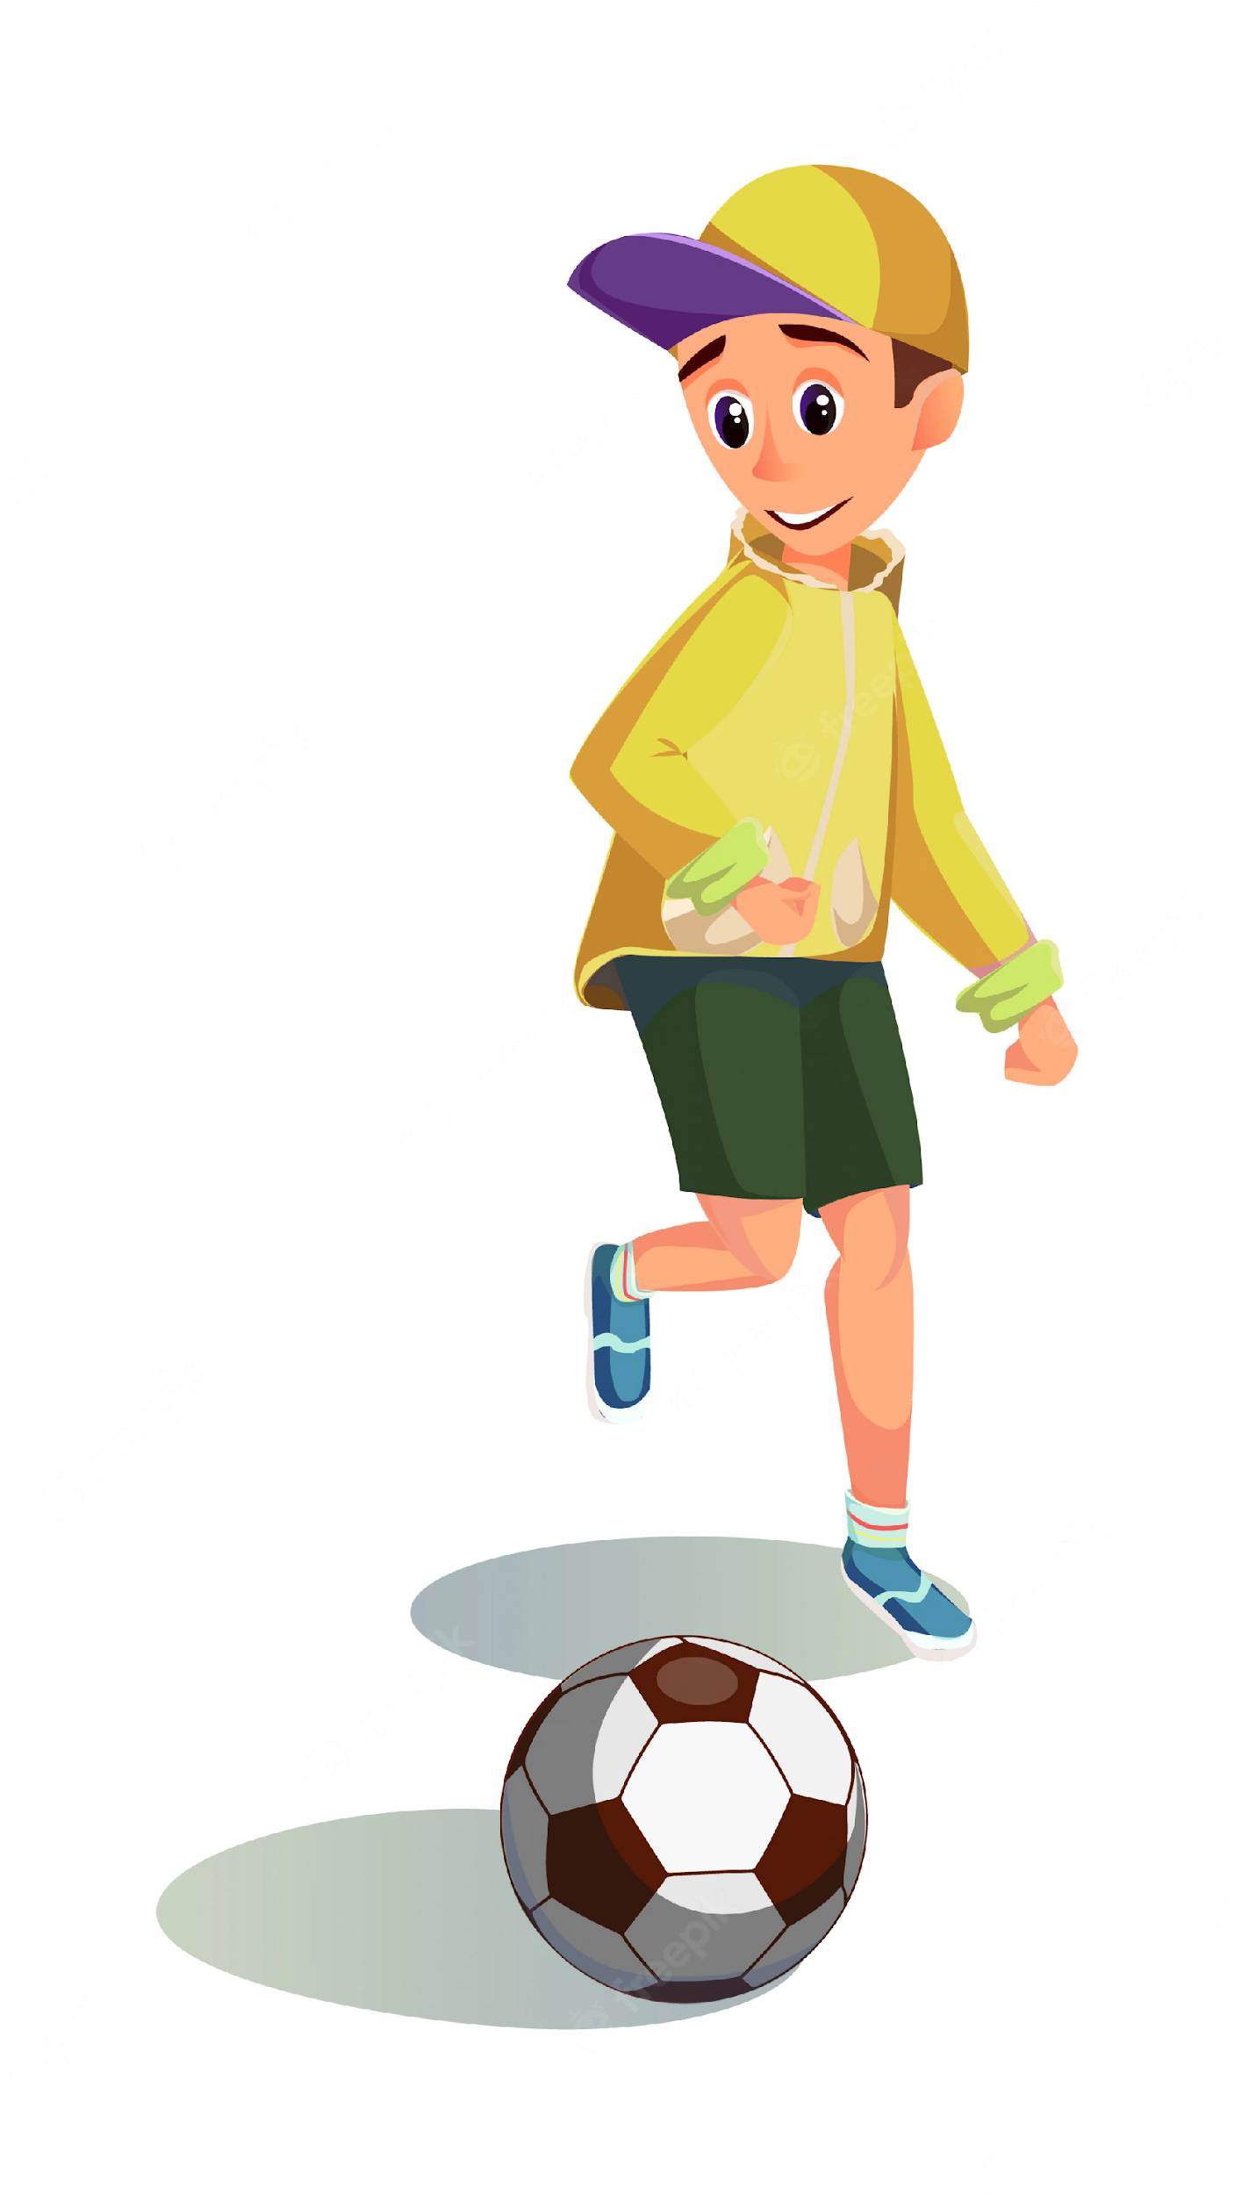
Can Ben play football?
he
Yes, he can.

Slide 29

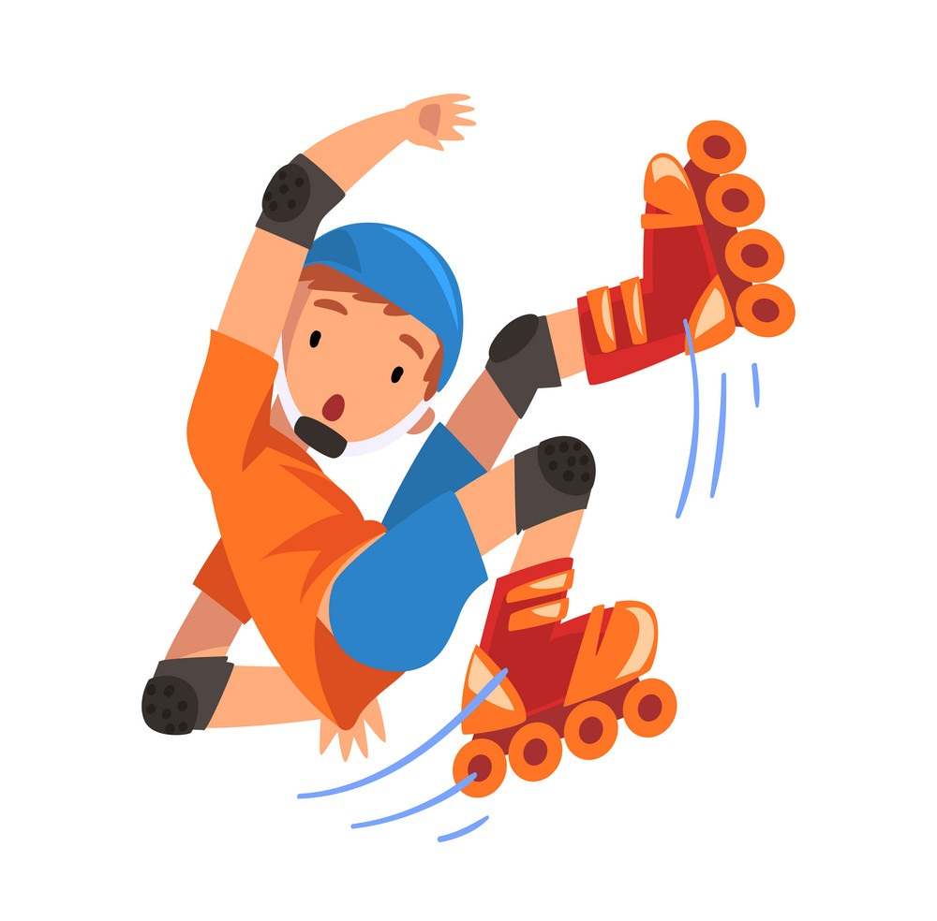
Can he roller skate?
No, he can't,
but he can play football.

Slide 30
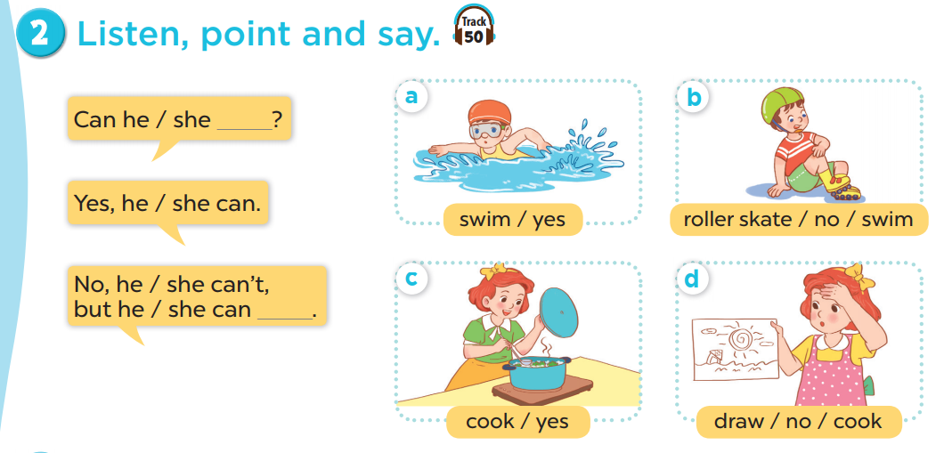
Work in pairs. Practise.
Listen, point and say.

Slide 31
04
Activity 6 Let’s talk.

Slide 32
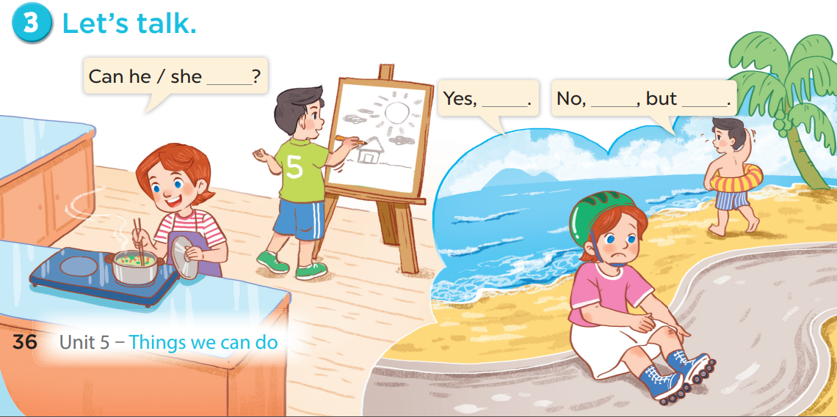

Slide 33
05
Games

Slide 34



Notes:
CLICK THE CLOUD – GO TO PART 4

Slide 35

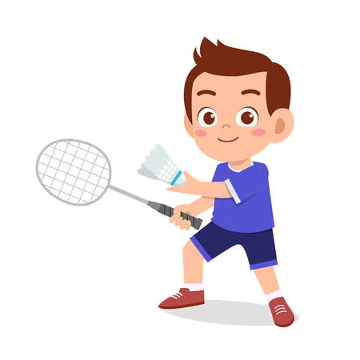

Can he _______________?
play badminton
____, he can.
Yes
Notes:
CLICK PINK AMONG US – GO TO THE POINTS

Slide 36

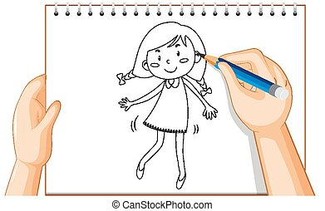
Can she cook?
No
____, she can't,
but she can _____.
draw
Notes:
CLICK PINK AMONG US – GO TO THE POINTS

Slide 37
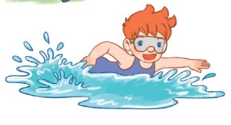
Can he ________?
swim
Yes, he _____.
can
Notes:
CLICK PINK AMONG US – GO TO THE POINTS

Slide 38

Can she ____________?
ride a bike
Yes, ________.
she can
Notes:
CLICK PINK AMONG US – GO TO THE POINTS

Slide 39
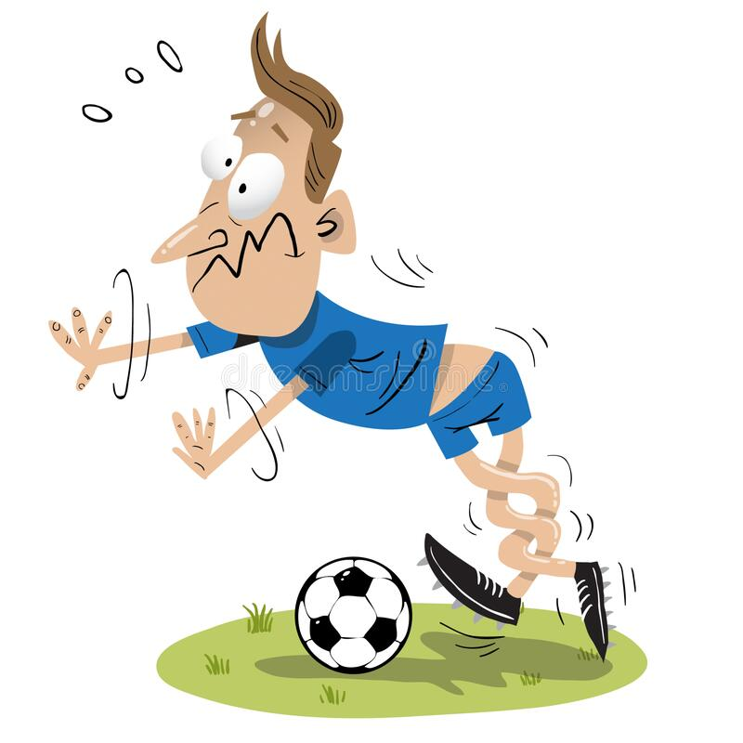
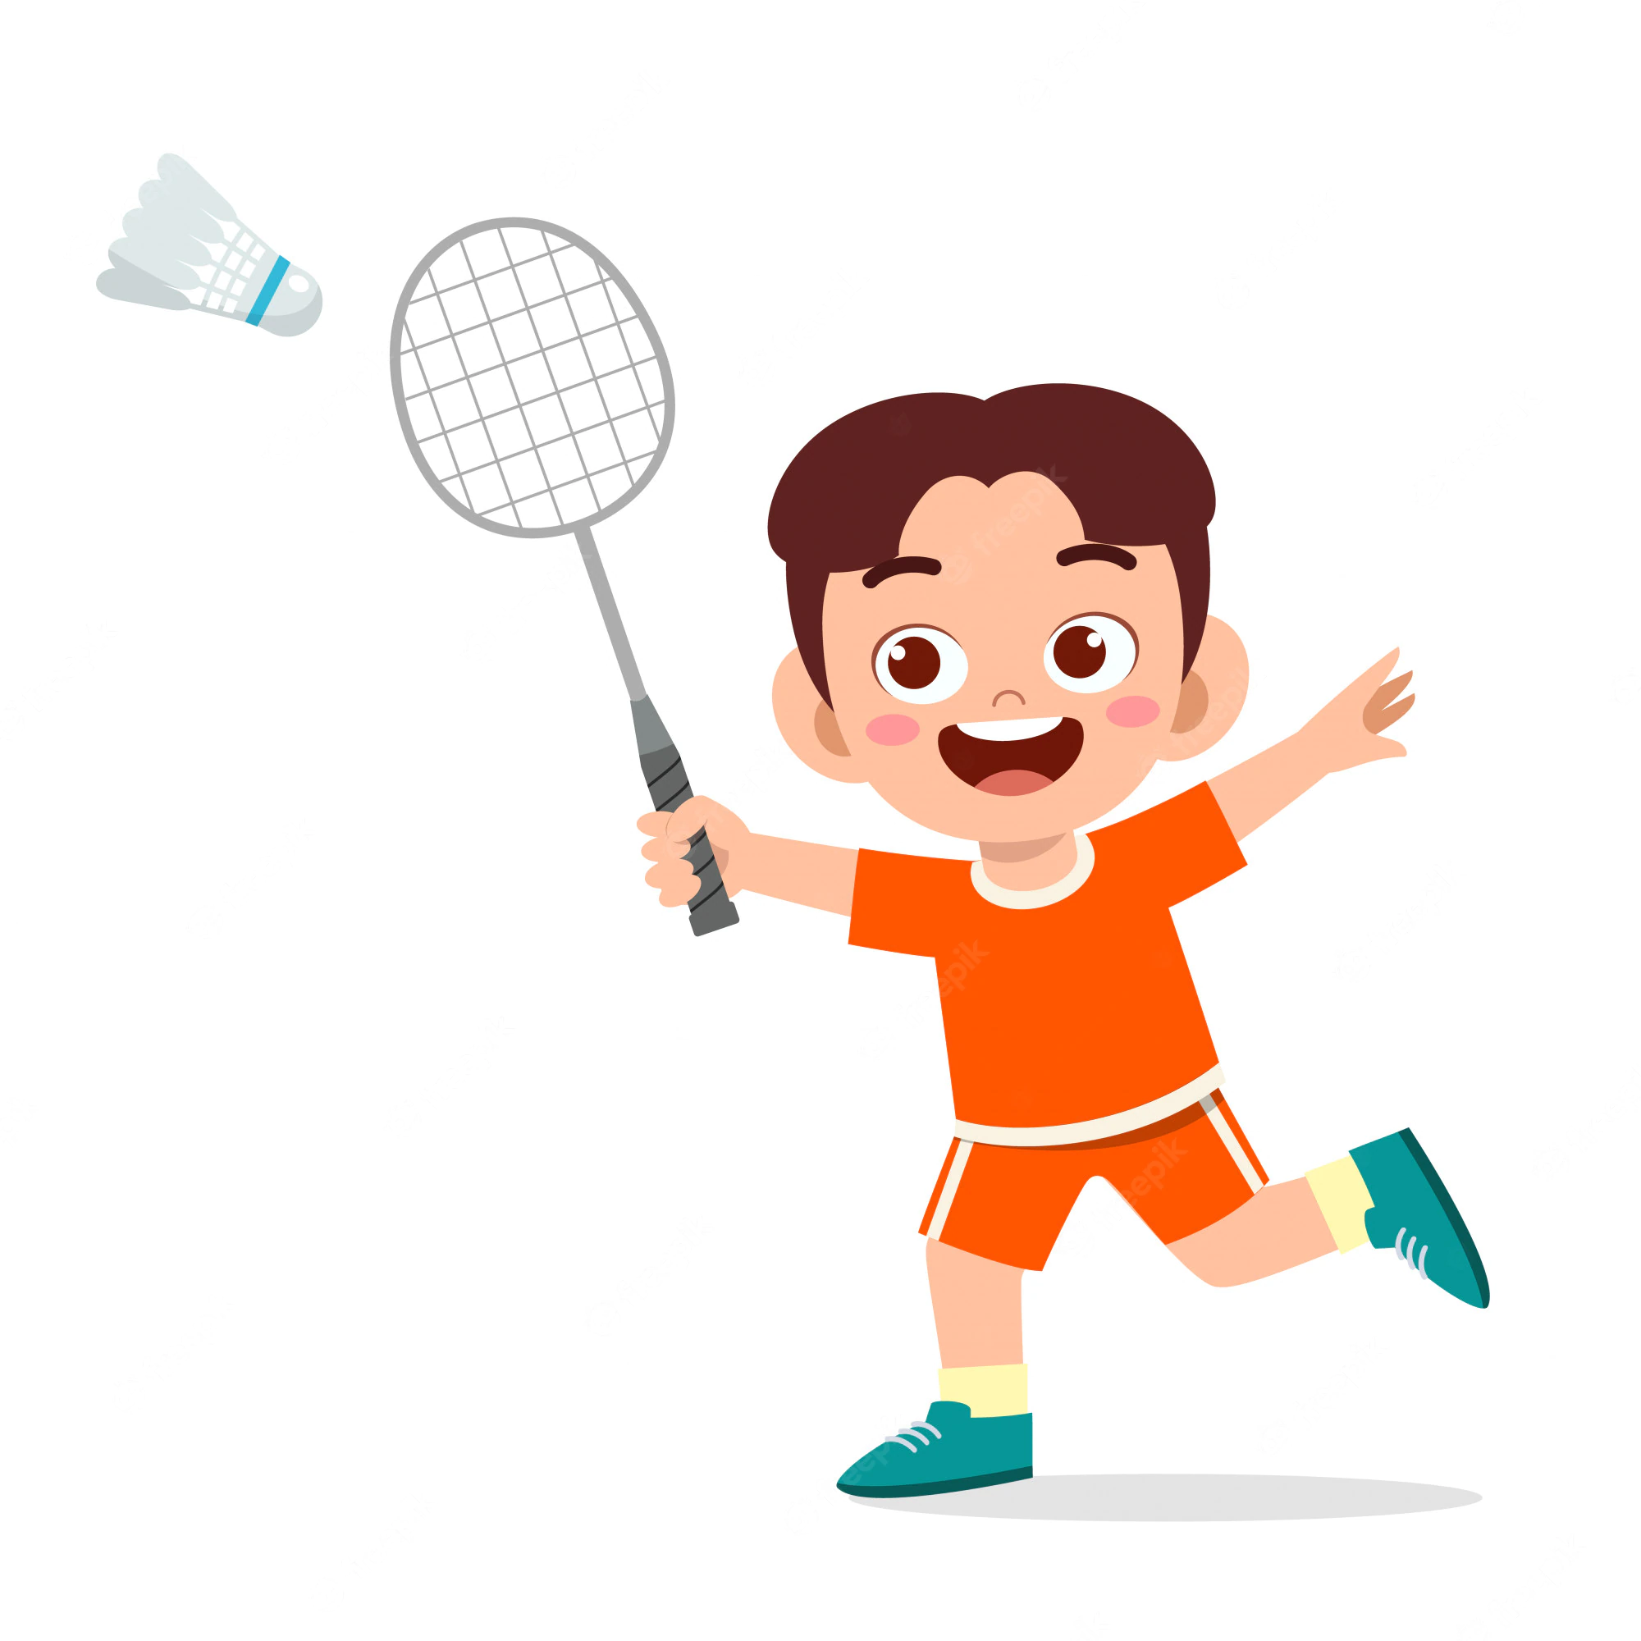
Can he play football ?
No
____, he can't,
but he can ______________.
play badminton
Notes:
CLICK PINK AMONG US – GO TO THE POINTS

Slide 40
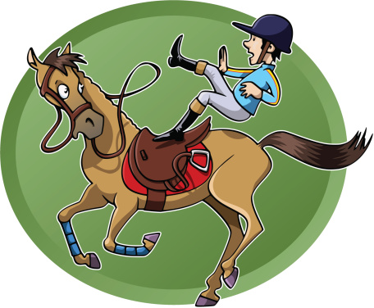
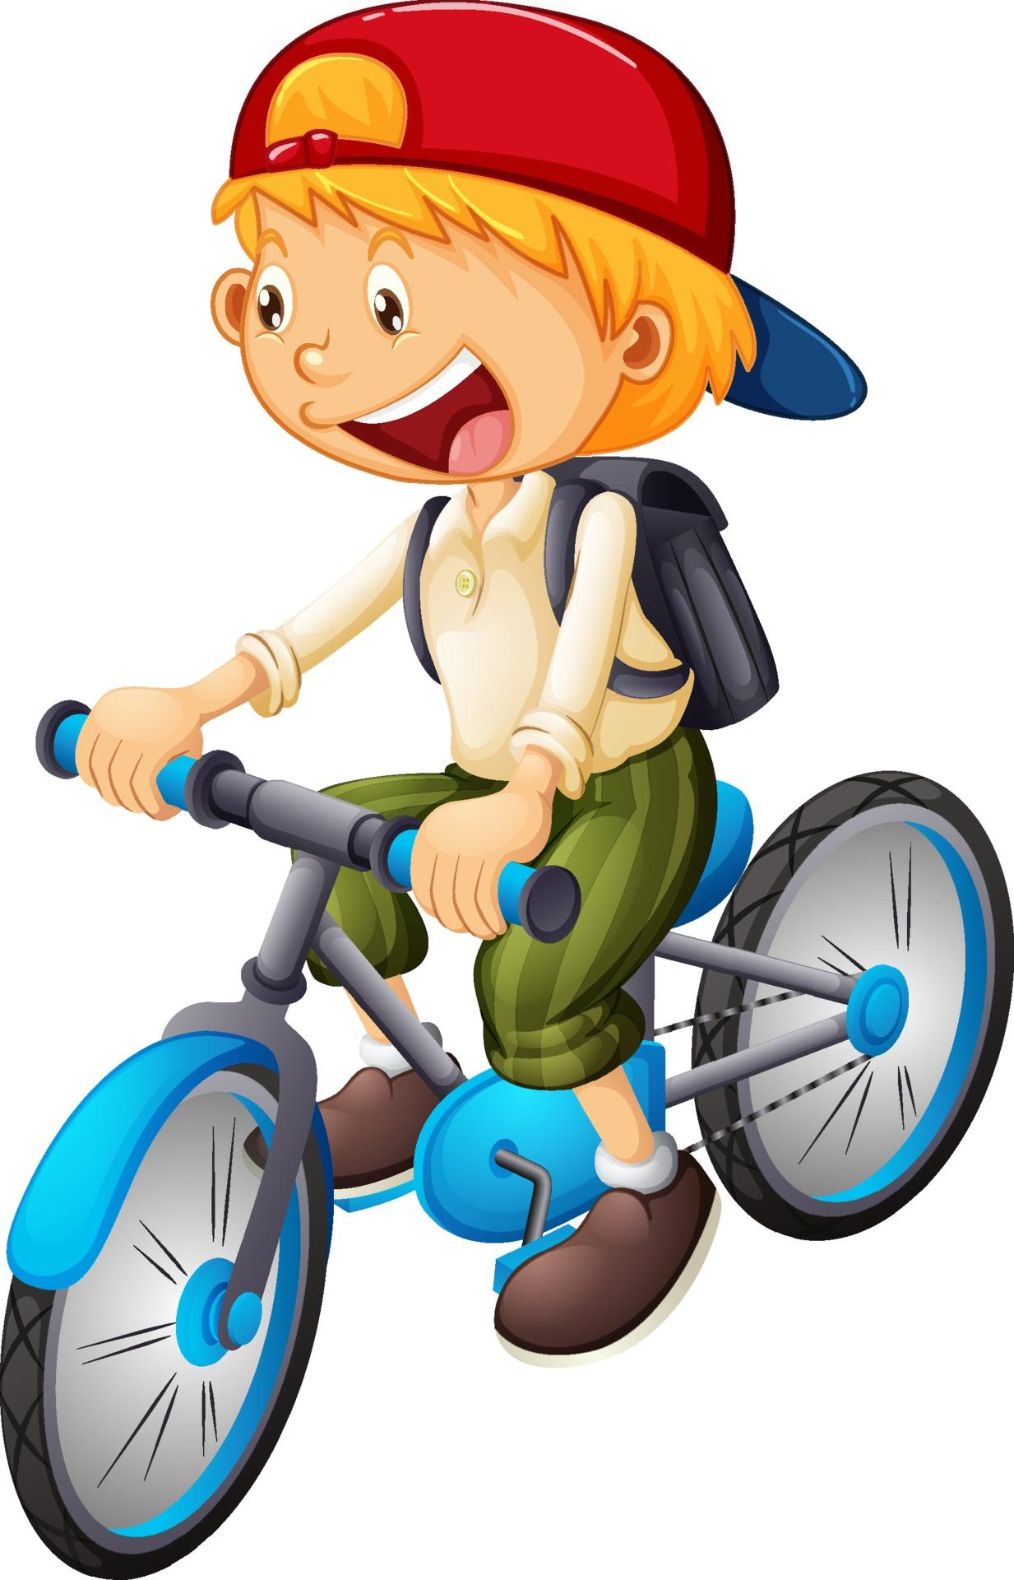
Can he ride a horse ?
can't
No, he ______,
but he _____ ride a bike.
can
Notes:
CLICK PINK AMONG US – GO TO THE POINTS

Slide 41

Can _____ play the piano?
she
Yes, _______.
she can
Notes:
CLICK PINK AMONG US – GO TO THE POINTS

Slide 42
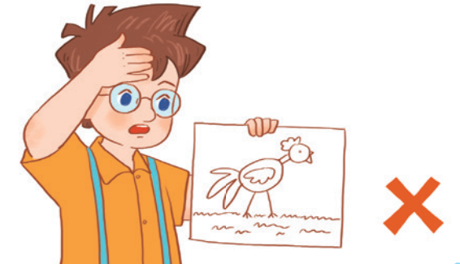
Can he ________?
draw
____, he _____.
No
can't
Notes:
CLICK PINK AMONG US – GO TO THE POINTS

Slide 43





Slide 44



Slide 45


Slide 46


Slide 47


Slide 48


Slide 49


Slide 50


