Slide 1





Slide 2



Things we can do
5
LESSON 2 PERIOD 4

Slide 3
Contents
Warm-up
Guessing game
01
04
02
03
Activity 5
Look, complete and read.
Review
05
Activity 6
Let’s sing.
Activity 4
Listen and tick or cross.
06
Fun corner

Slide 4
01
Warm-up
Guessing game

Slide 5


swim

Slide 6
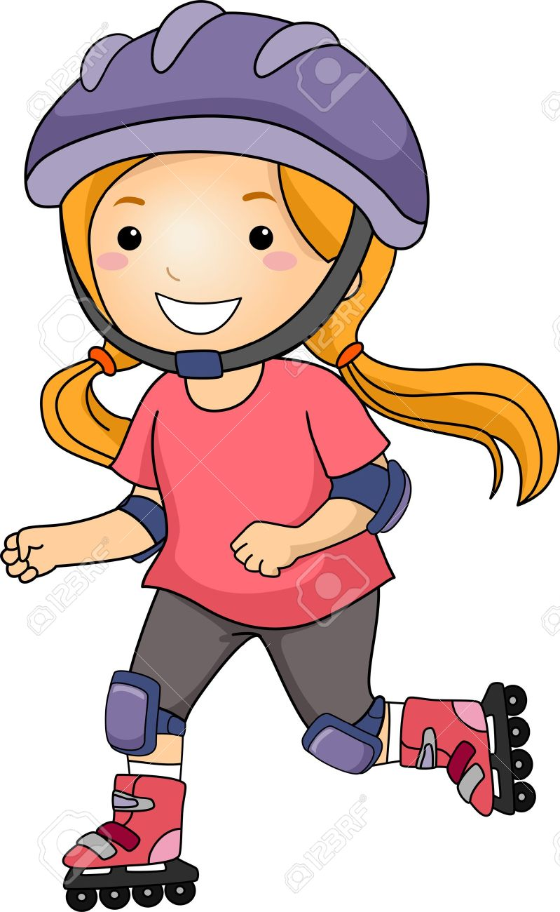
roller skate

Slide 7
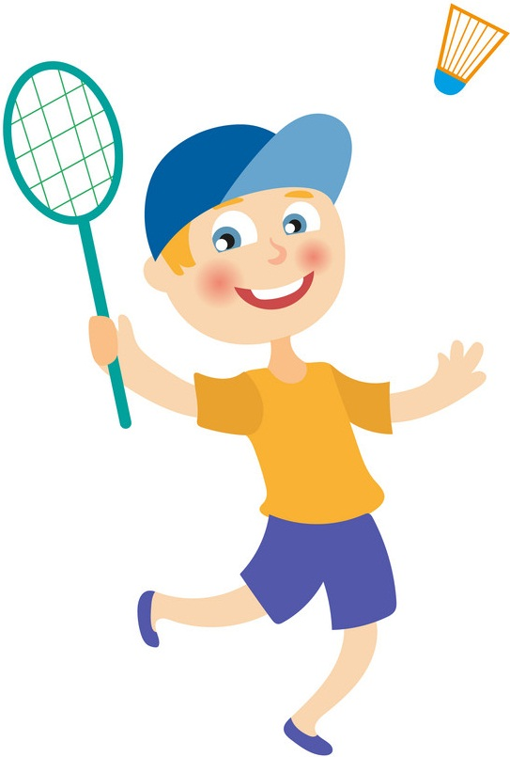
play badminton

Slide 8

cook

Slide 9
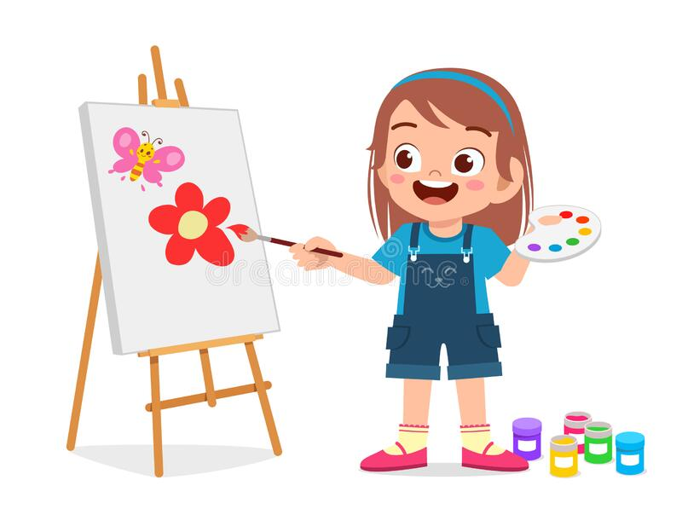
draw

Slide 10
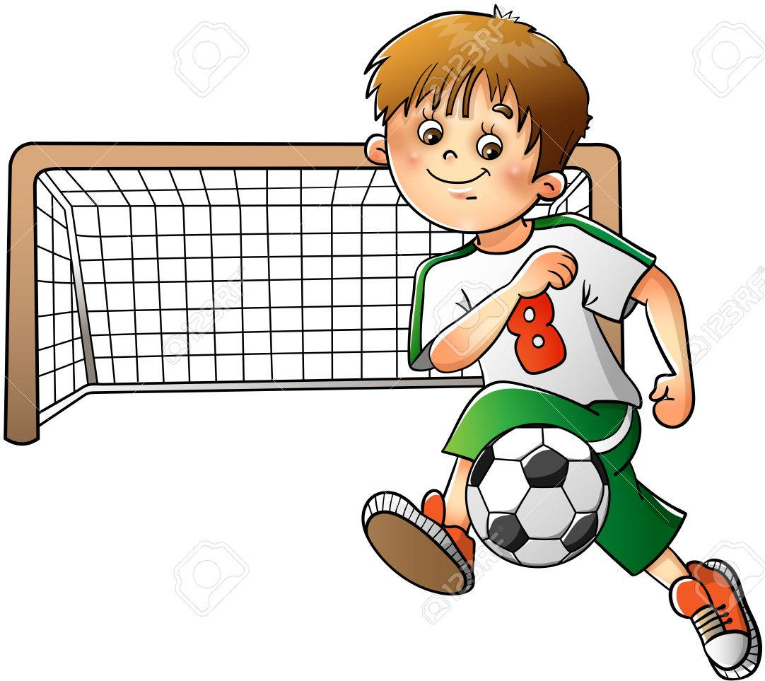
play football

Slide 11

play the piano

Slide 12
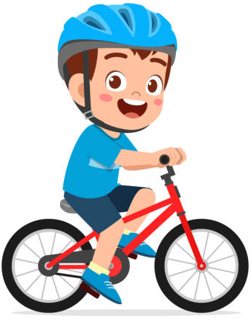
ride
a bike

Slide 14

02
Review

Slide 15
Let’s meet some
friends.
What can / can’t they do?

Slide 16
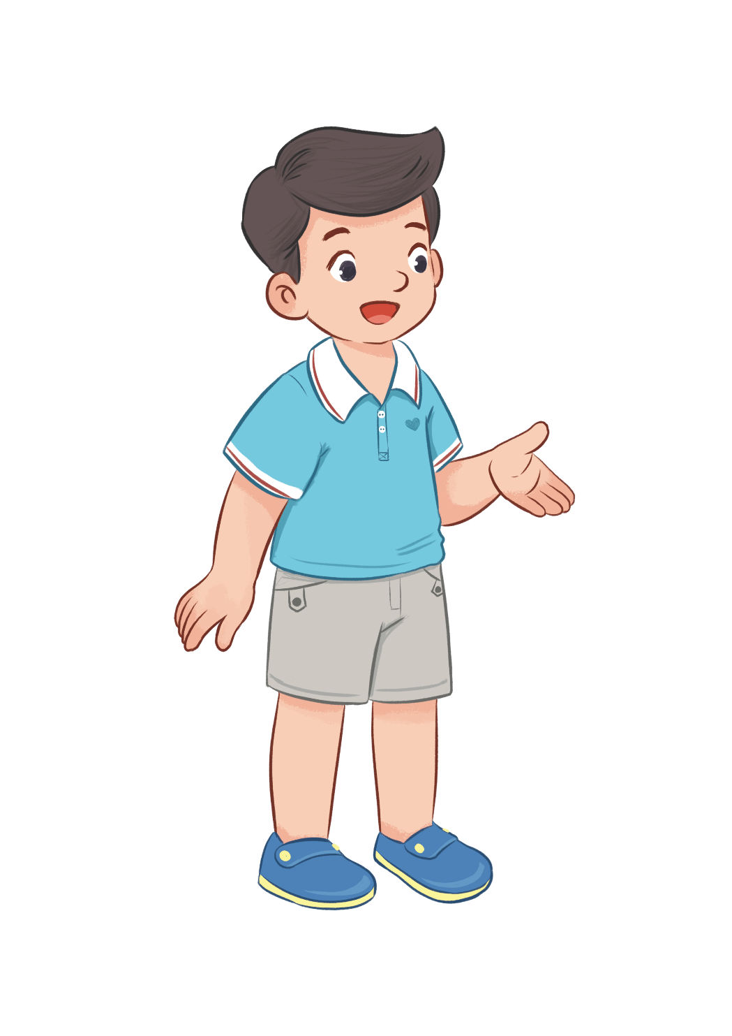
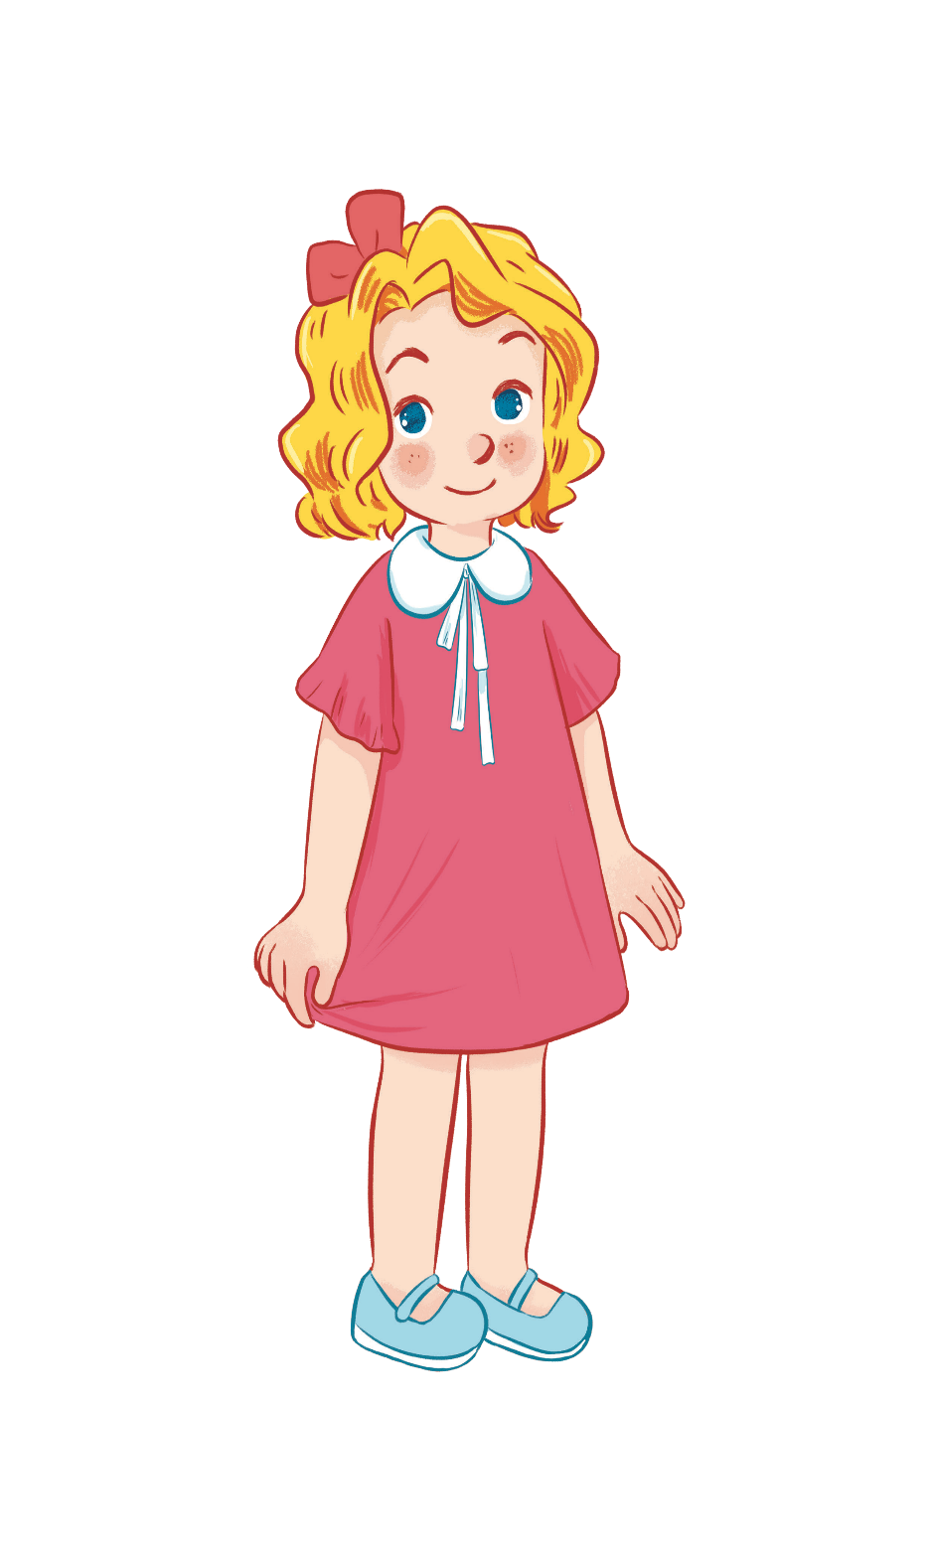



Can he play badminton?
No, he can’t.
Yes, he can.

Slide 17


Can she swim?
Yes, she can.
No, she can’t.

Slide 18
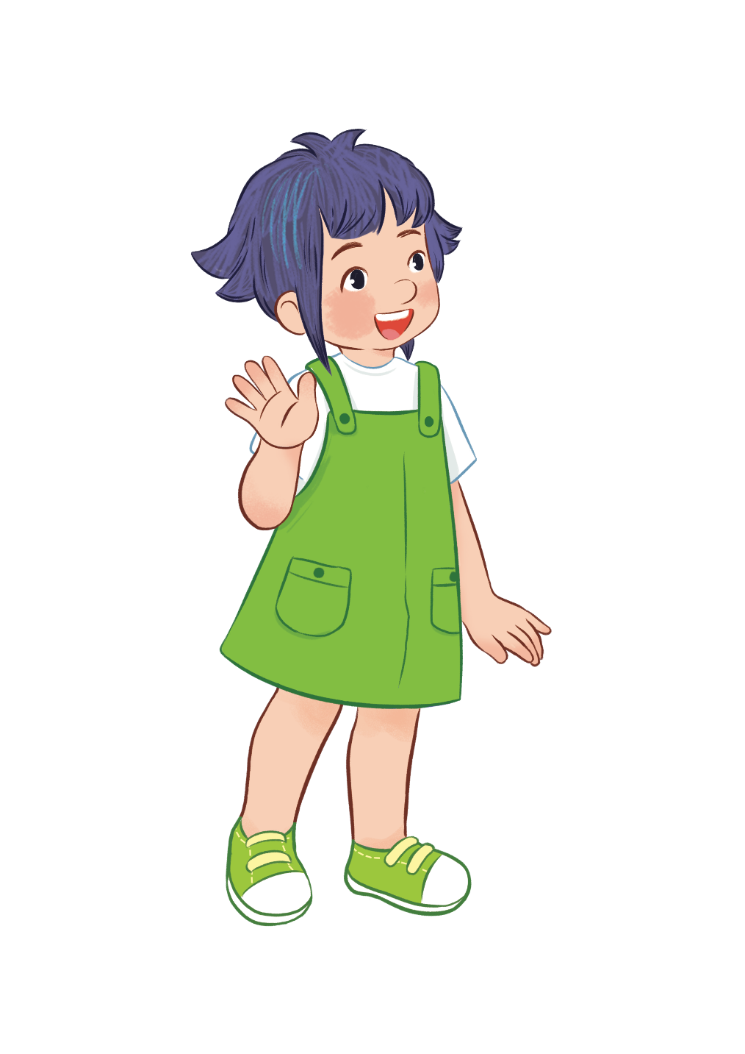
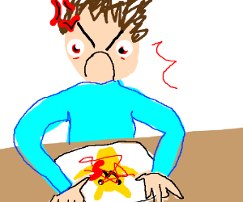

Can she draw?
Yes, she can.
No, she can’t.

Slide 19


Can he cook?
Yes, he can.
No, he can’t.

Slide 20



can ...........
can’t ...........

Slide 21
03
Activity 4
Listen and tick or cross.

Slide 22
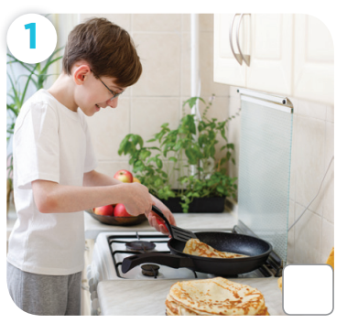
Can he cook?

Slide 23
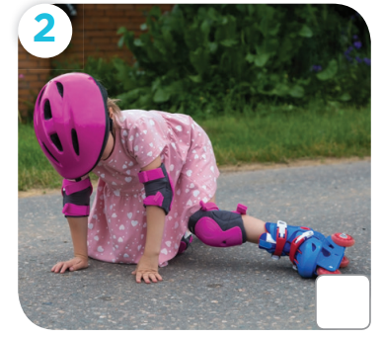
Can she roller skate?

Slide 24
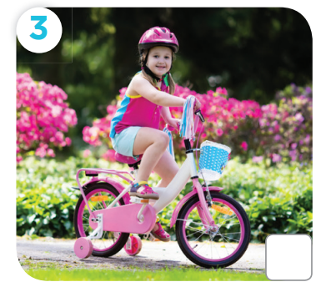
Can she ride a bike?

Slide 25
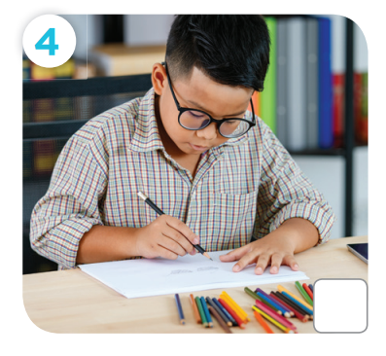
Can he draw a picture?

Slide 26

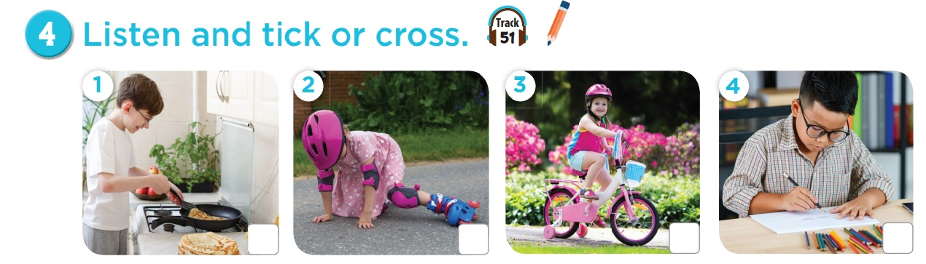



Slide 27
04
Activity 5
Look, complete and read.

Slide 28
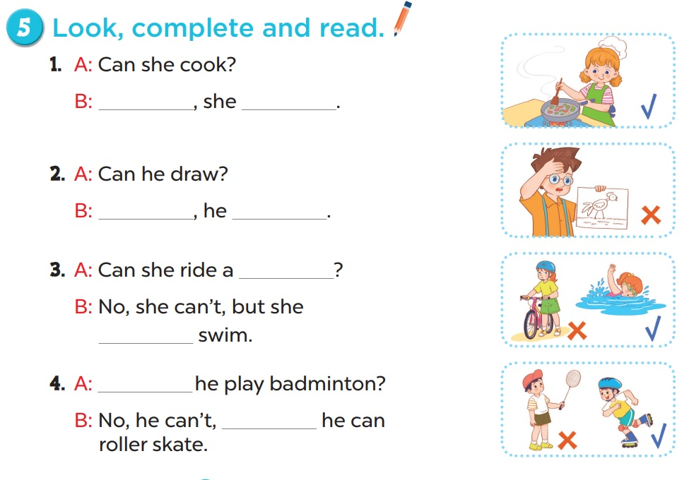
Work in pairs.
Yes
can
No
can’t
bike
can
Can
but

Slide 29
05
Activity 6
Let’s sing.

Slide 30
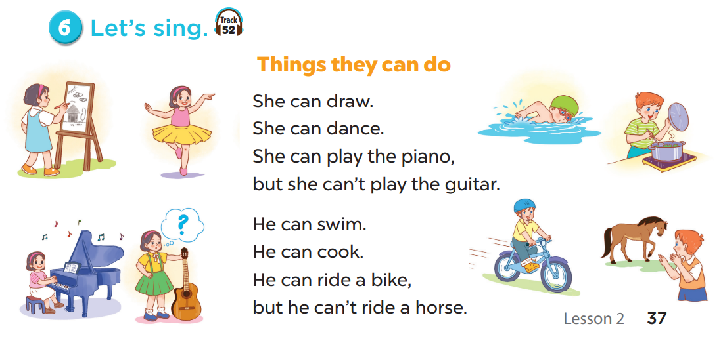

Slide 31
06
Fun corner

Slide 32


Slide 33



Slide 34




Slide 35




Can she play football?
5 points
No, she can’t.
Yes, she can.

Slide 36
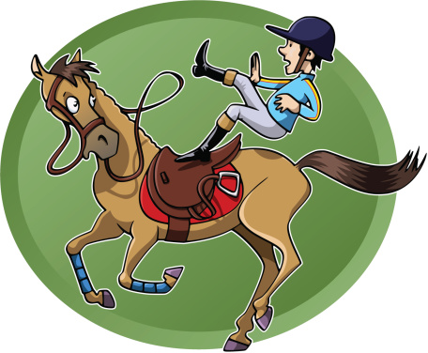



Can he ride a horse?
7 points
No, he can’t.
Yes, he can.

Slide 37



Can he ride a bike?
3 points
No, he can’t.
Yes, he can.

Slide 38
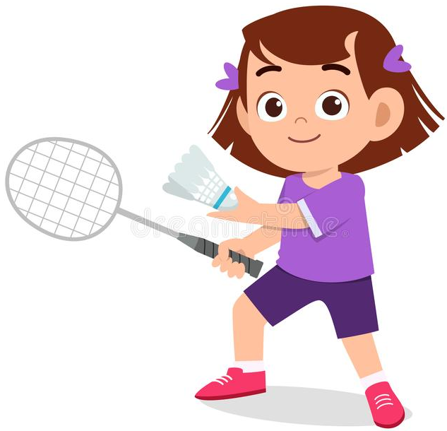
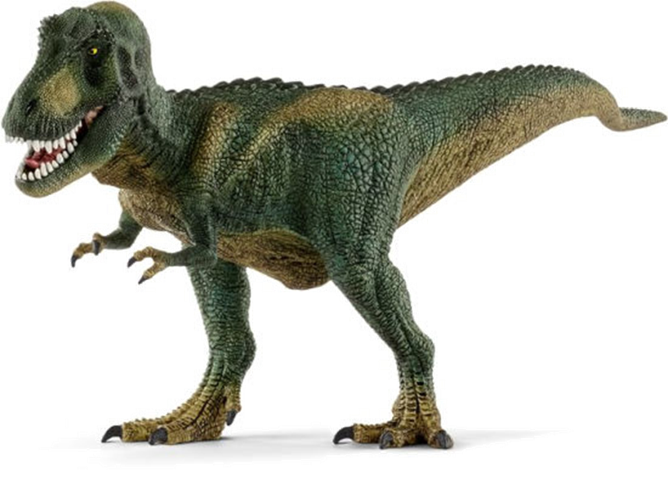

Can she play badminton?
4 points
Yes, she can.
No, she can’t.

Slide 39
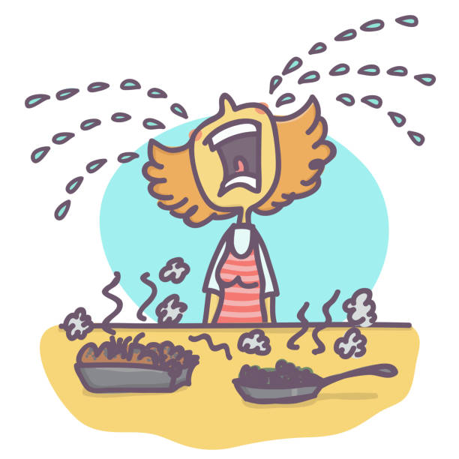
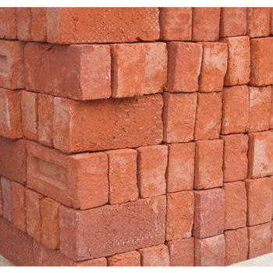


Can she cook?
8 points
Yes, she can.
No, she can’t.

Slide 40

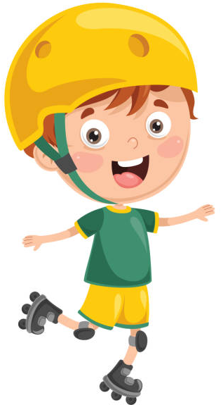
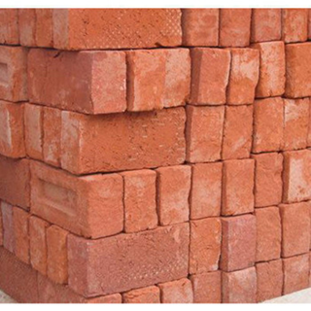

Can he roller skate?
10 points
No, he can’t.
Yes, he can.

