Slide 1




Slide 2




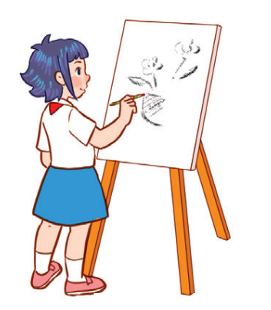

Unit 8
Period 3

Slide 3
Contents
2
1
3
Look, listen and repeat.
Listen, point and say.
Warm-up and review
5
4
Let’s talk.
Fun corner and wrap-up

Slide 4
Warm-up and review
1
1
Game: Who’s faster?

Slide 5

I LIKE…

Slide 6
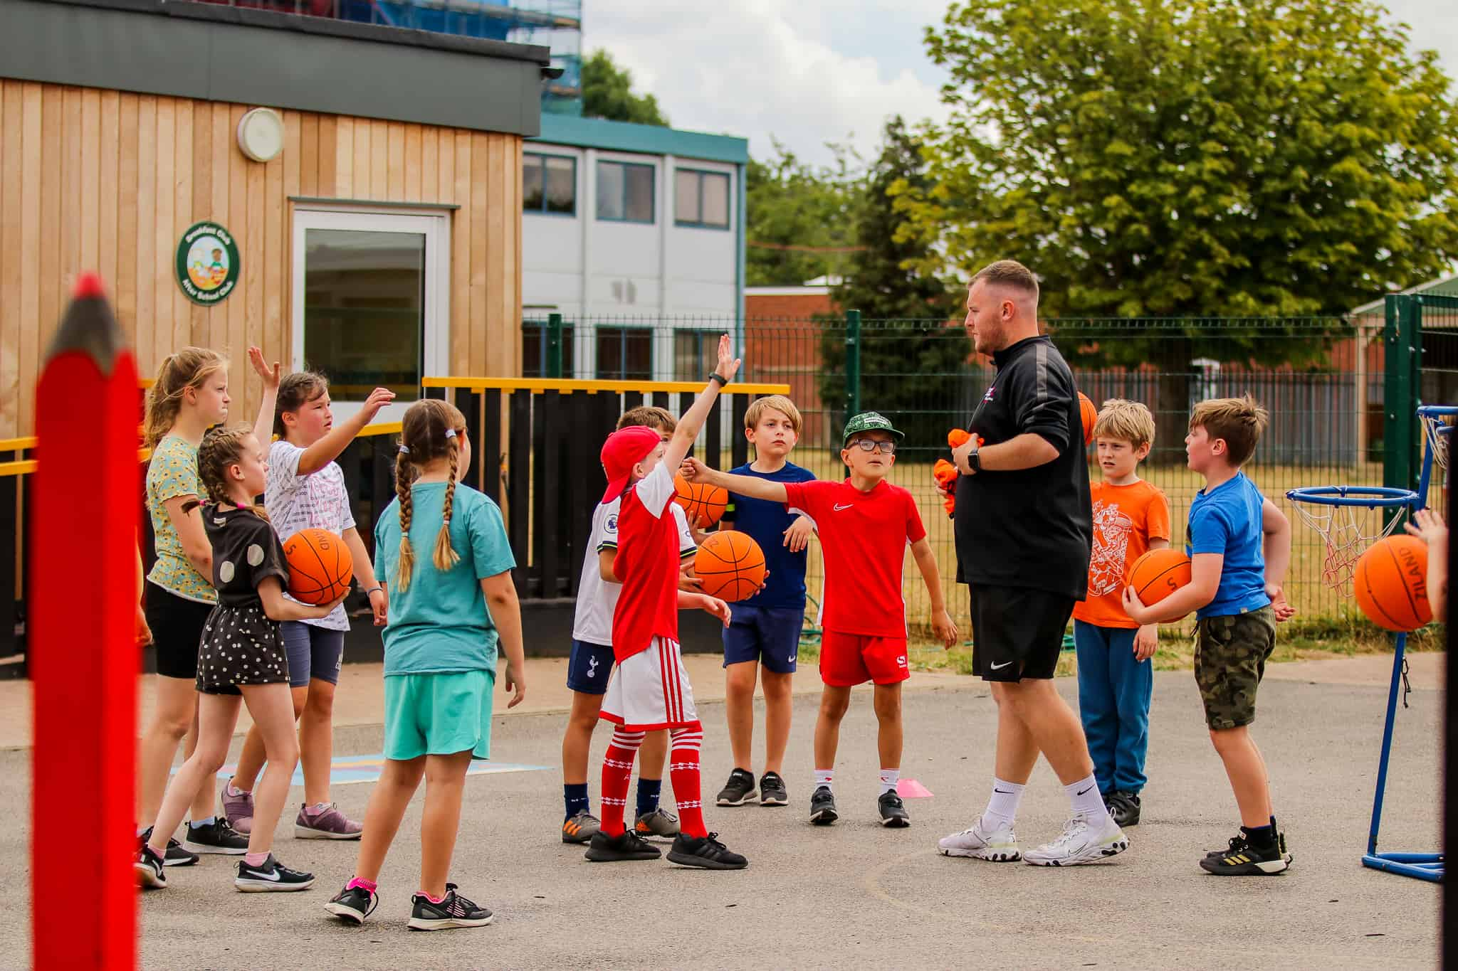
MY FAVOURITE SUBJECT IS...

Slide 7


Slide 8


Slide 9
Look, listen and repeat.
2
2

Slide 10

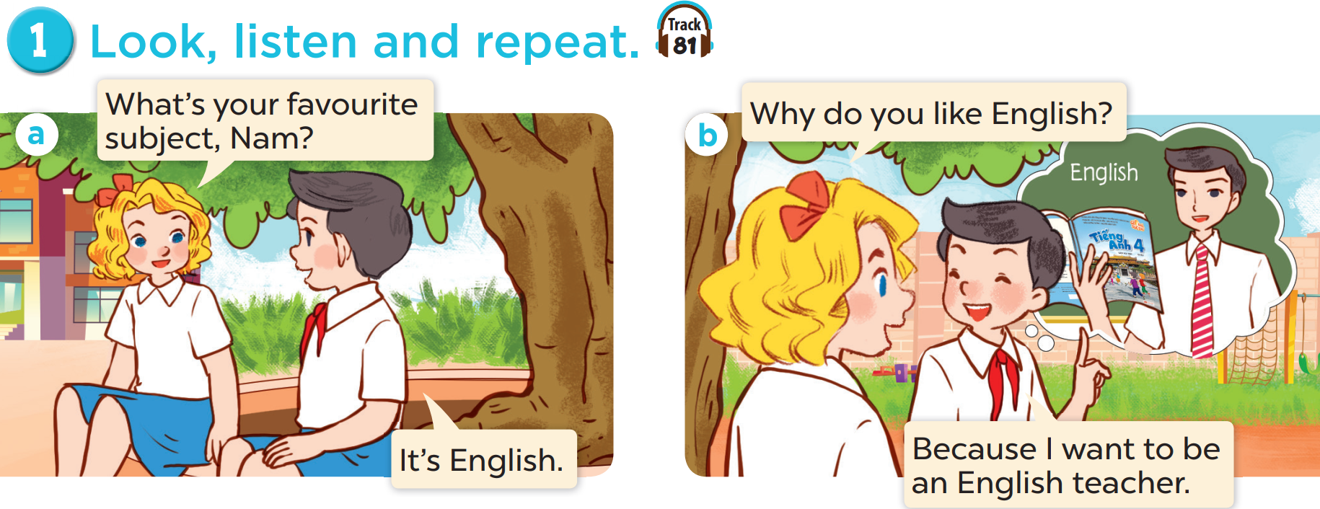

Slide 12
Listen, point and say.
3
3

Slide 13
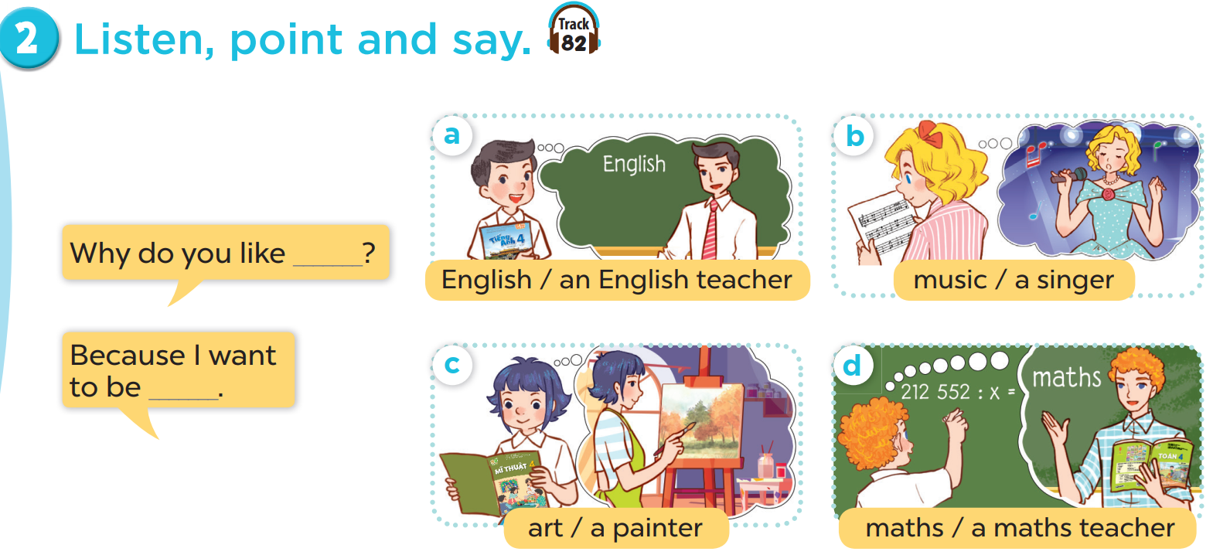

Slide 14


Slide 15

Let’s talk.
4
4

Slide 16
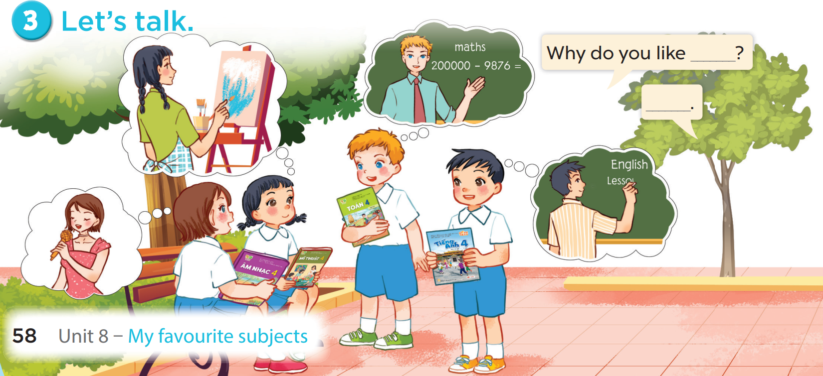

Slide 17
Fun corner and wrap-up
5
5
Game: Guessing game

Slide 18

SHOW

Slide 19

SHOW

Slide 20
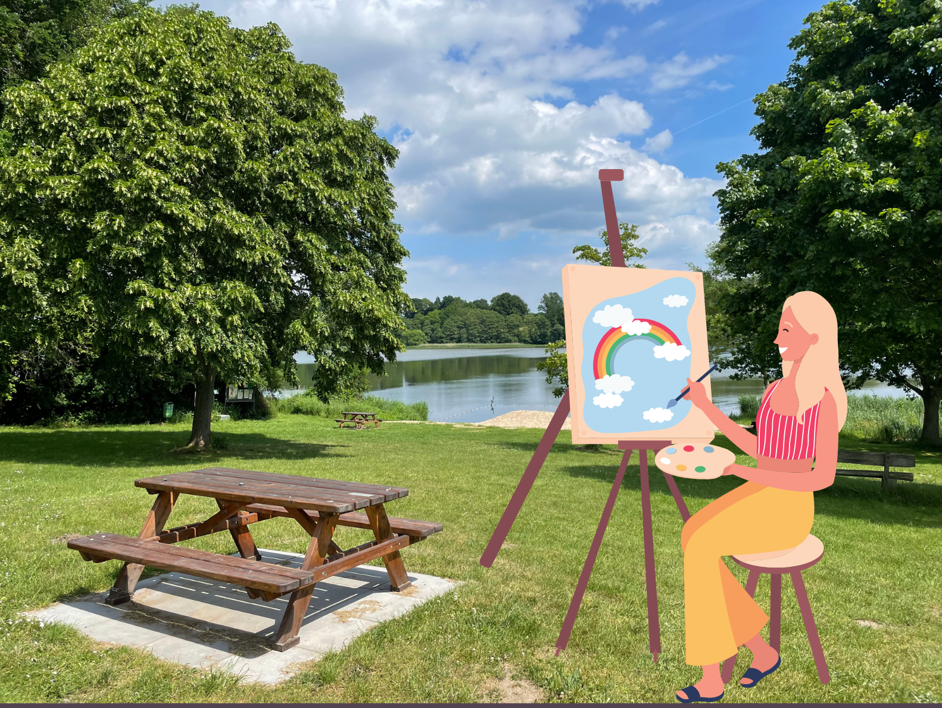
SHOW

