Slide 2

Unit 7 – Lesson 3 In the garden
Notes:
Goal: By the end of the lesson, pupils will be able to:
- listen and repeat the sentence There is a garden.
introduce something, using There is a _______.
sing a song with the structure There is a _______ in the garden.

Slide 3

Warm-up
Notes:
Game: Pass the picture
Goals:
- Help Pupils feel happy at the beginning of the lesson.
- Review vocabulary of previous lesson
Time limit: 5 mins
- Teacher shows flashcards, Pupils read vocabulary.
- Teacher plays a random song, pupils pass a picture around. When the music stops. student who has the picture has to stand up and say the word out loud.

Slide 4
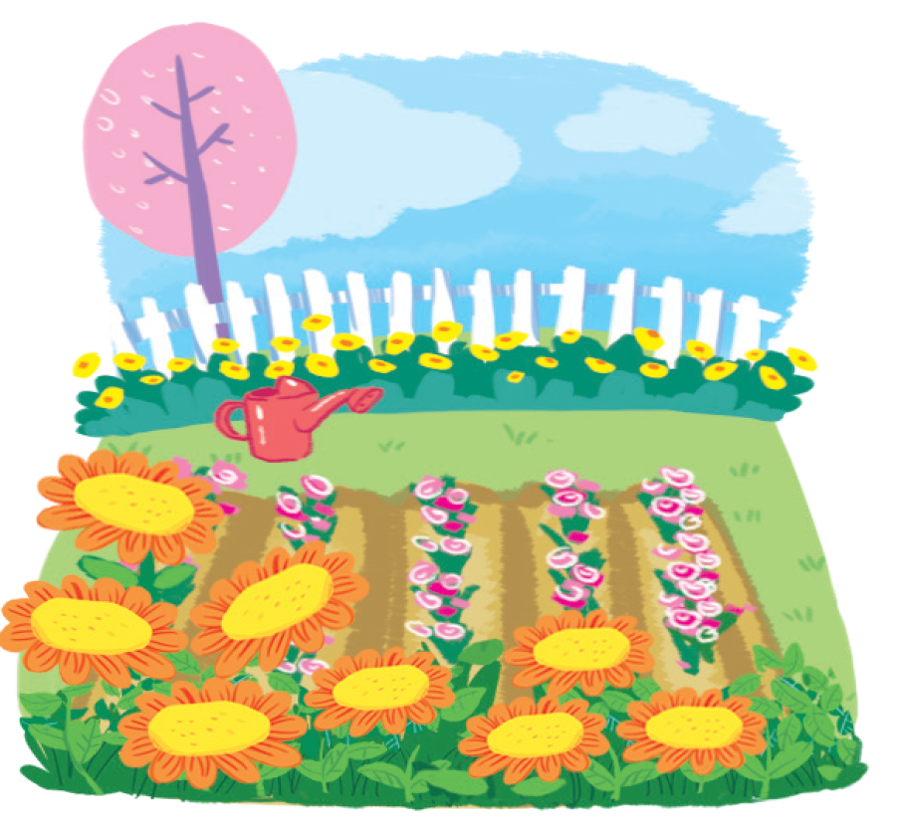
garden

Slide 5
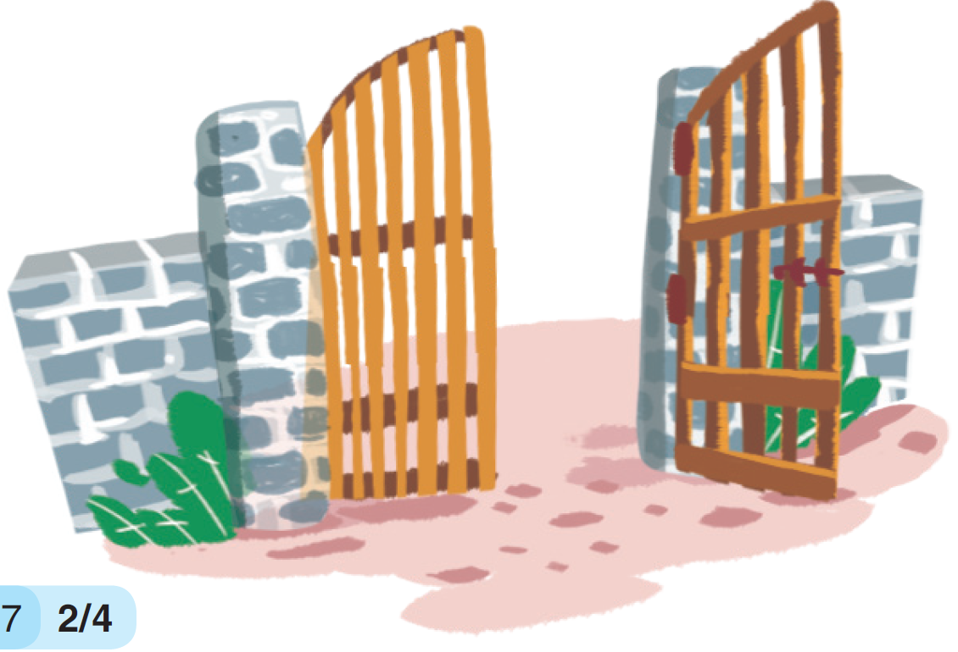
gate

Slide 6
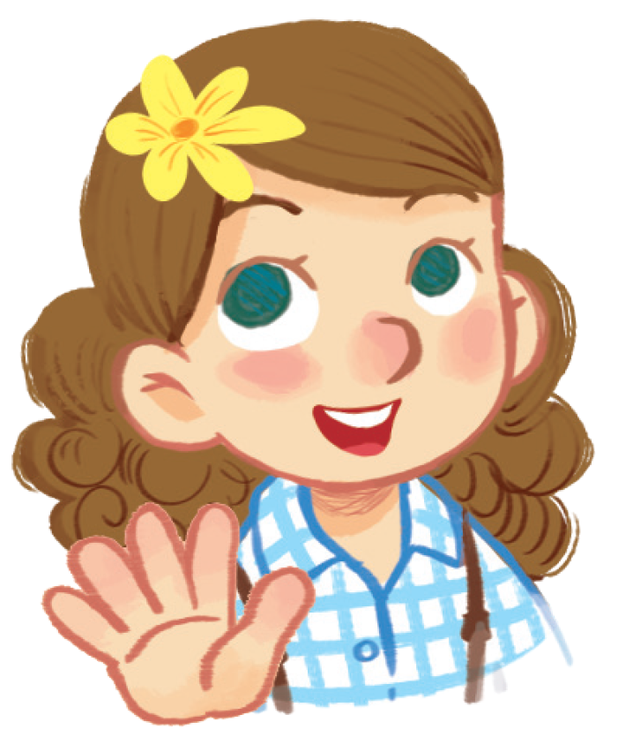
girl

Slide 7
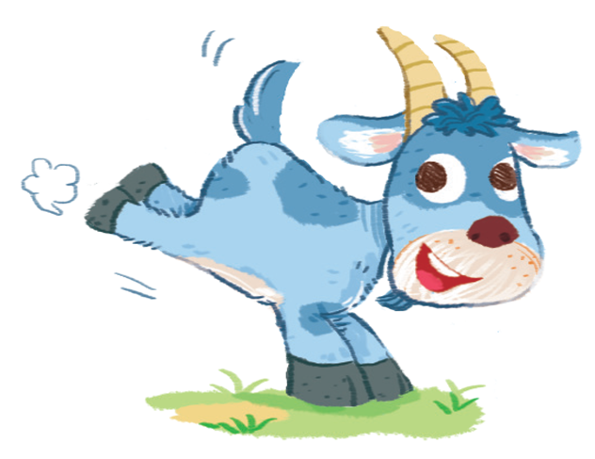
goat

Slide 8


Listen and repeat
Notes:
Goal: Pupils will be able to listen and repeat the sentence There is a garden.
Step 1: Getting to know the structure There’s a _____
- Teacher shows the structure There’s a … on slide. Teacher says, pupils repeat the structure.
- Teacher shows picture of a goat together with the structure. Teacher has whole class say There’s a goat. Teacher does the same with garden, gate, girl.
Step 2: Pupils listen and repeat.
Time limit: 2 mins
Pupils open to the Listen and repeat part in their books.
Teacher plays the audio, pupils listen and repeat.
Step 3: Quick check.
Time limit: 4 mins
- Quick check as teams: Teacher holds up flashcard “girl” and says Team 1. Pupils of team 1 says There’s a girl. Teacher does the same with the other teams.
- Teacher does the same for individual check.

Slide 9
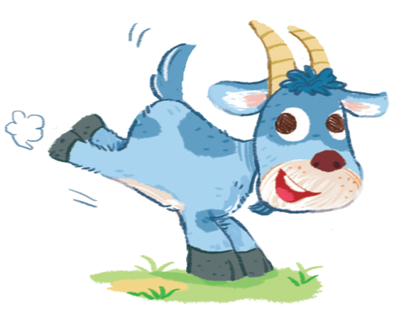
There’s a .
goat

Slide 10

There’s a .
girl

Slide 11
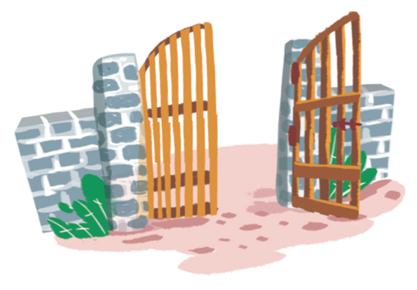
There’s a .
gate

Slide 12
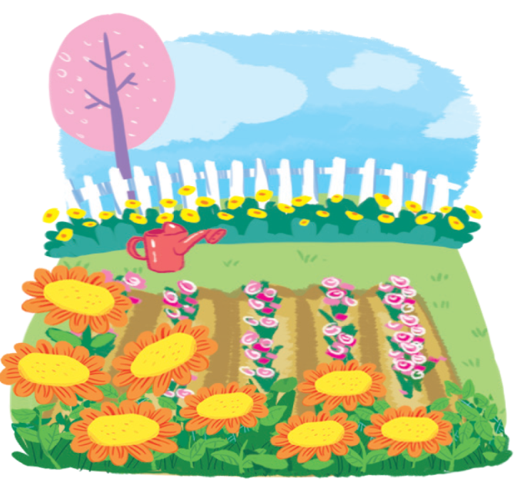
There’s a .
garden

Slide 13

Let’s talk
Notes:
Goal:
- Pupils will be able to introduce something, using There is a _______.
Step 1: Point and say
Time limit: 3 mins
- Pupils open to the Let’s talk! part.
- Pupils point to the pictures and say using the structure There is_____.

Slide 14
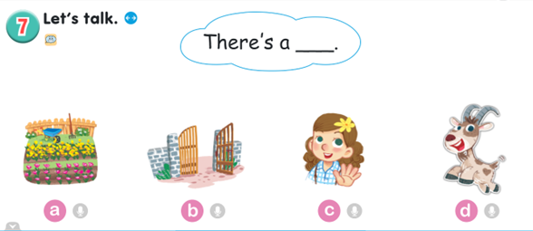

Slide 15
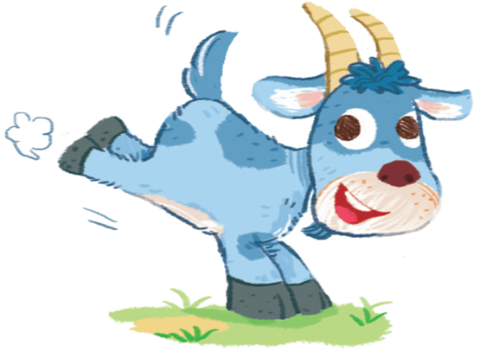
There’s a goat.
1
2
3
Notes:
Step 2: Practice
Game: Lucky star
Time limit: 8 mins
- Teacher shows a picture on slide. Pupils have to say using the structure There’s a _____. If correct, pupils can open a number to get stars.

Slide 16
1
2
3
There’s a girl.

Slide 17
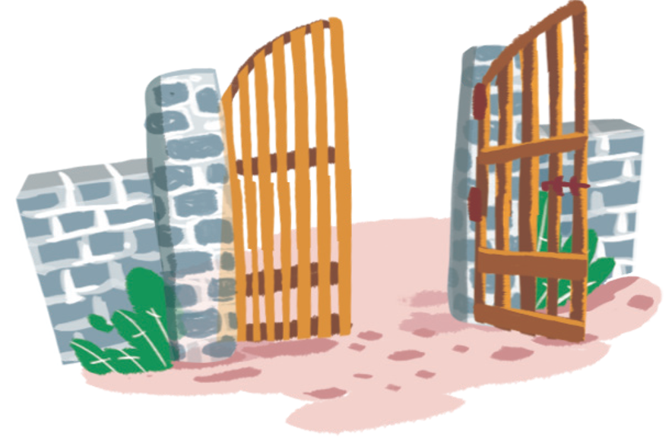
1
2
3
There’s a gate.

Slide 18
1
2
3
There’s a garden.

Slide 19
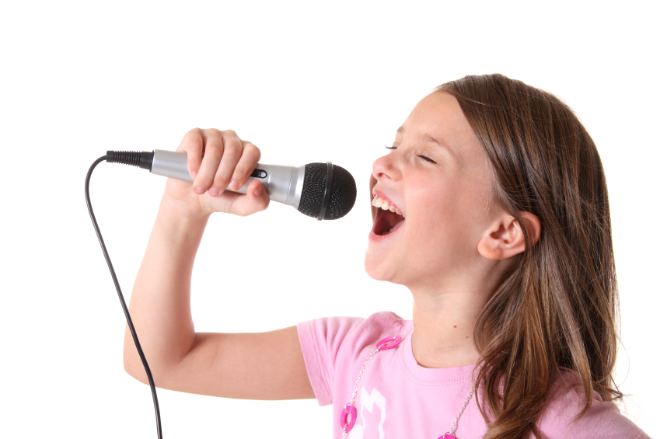


Let’s sing
Notes:
Goal:
- Pupils will be able to sing a song with the structure There is a _______ in the garden.
Step 1: Getting to know the song
Time limit: 4 mins
- Teacher and pupils read the song lyrics together.
- Teacher plays the audio.
1st time: Pupils only listen
2nd time: Pupils listen and sing.
Step 2: Sing and do
Time limit: 5 mins
Teacher plays the audio, shows pupils some actions to do when singing the song.
Step 3: Quick check
Time limit: 4 mins
Pupils sings and do in teams. Better team gets more stars.

Slide 20
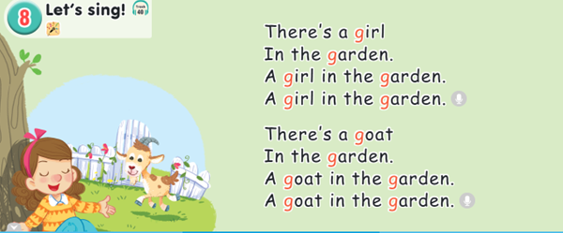

Slide 21
Further activity
Notes:
Goal: Pupils are able to use the structure and vocabulary to write new lyrics for the song.
- Teacher divides pupils into small teams (4-5 pupils/ team).
- Pupils create new lyrics for the song using words and structure There is…
- Teacher may have pupils perform the new song.

Slide 22

Goodbye
Notes:
- Teacher shows the vocabulary of the lesson on slide.
- Pupils say goodbye.

Slide 23
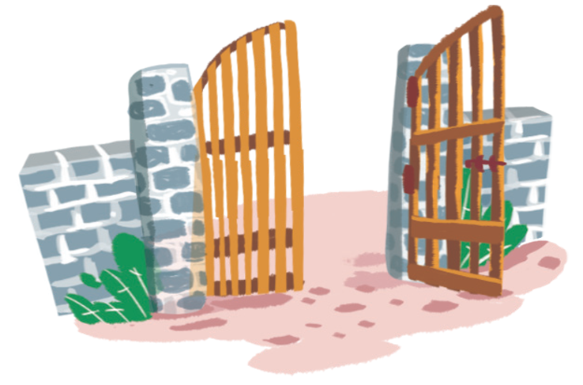
Goodbye

Slide 24
Goodbye

Slide 25
Goodbye

Slide 26
Website: hoclieu.vn
Fanpage: facebook.com/www.tienganhglobalsuccess.vn

