Slide 1


Slide 2

FUN TIME 2
Period 1

Slide 3

Table of contents
01
Warm-up and Review
02
Activity 1. Circle and match. Then say.
03
Activity 2. Let’s play.
04
Fun corner and Wrap-up

Slide 4


01
Warm-up and Review

Slide 5


SORTING BAG
GAME

Slide 6


Team: Green
Team: Pink

Slide 7


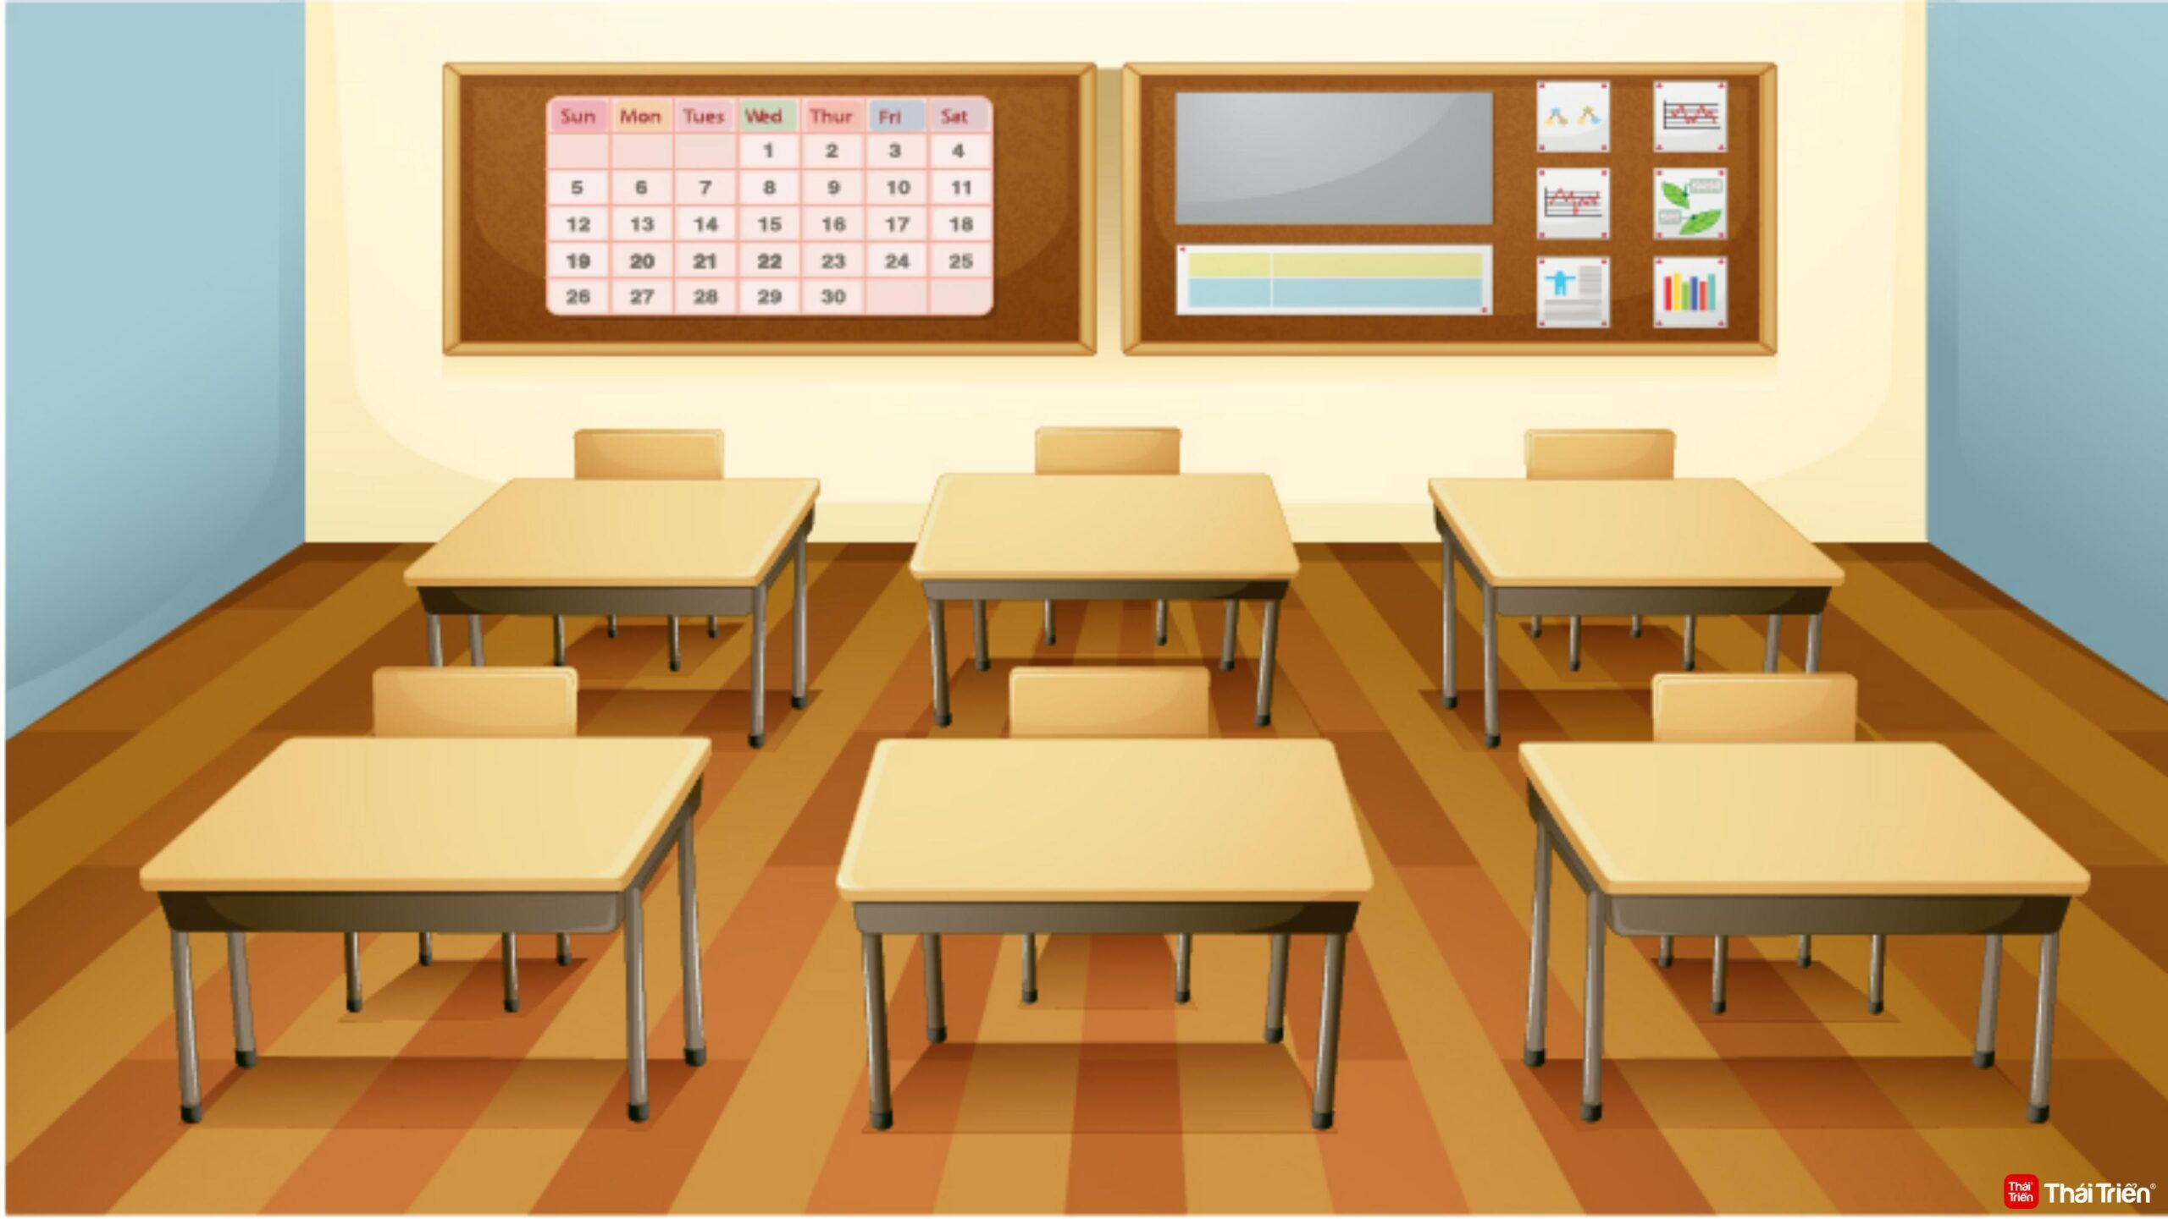

In the dining room:
In the classroom:
pen
Notes:
re

Slide 8
In the dining room:
In the classroom:
pen
fish
Notes:
re

Slide 9
In the dining room:
In the classroom:
fish
pen
book
Notes:
re

Slide 10
In the dining room:
In the classroom:
fish
pen
book
chicken
Notes:
re

Slide 11
In the dining room:
In the classroom:
fish
chicken
pen
book
pencil
Notes:
re

Slide 12
In the dining room:
In the classroom:
fish
chicken
pen
book
pencil
chips
Notes:
re

Slide 13
In the dining room:
In the classroom:
fish
chicken
pen
book
chips
pencil
milk
Notes:
re

Slide 14
In the dining room:
In the classroom:
fish
chicken
pen
book
chips
milk
pencil
bell
Notes:
re

Slide 15

Team: Green
Team: Pink
Summary
Notes:
GV nháy vào tên nhóm để tính điểm cho các đội. Mỗi lần nháy 1 bông hoa xuất hiện.

Slide 16
02
Activity 1. Circle and match. Then say.

Slide 17

Circle and match. Then say.
a
b
c
d
e

Slide 18
a
b
c
d
e

Slide 19
a
b
c
d
e

Slide 20
a
b
c
d
e

Slide 21
03
Activity 2. Let’s play.

Slide 22
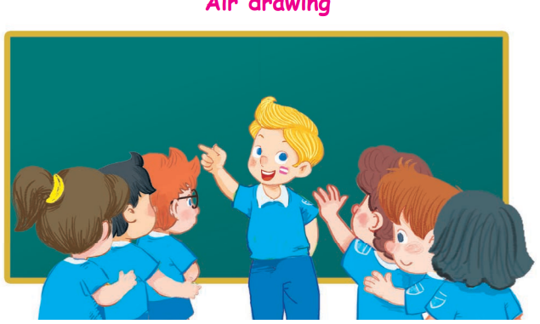
Air drawing

Slide 23



Teamwork

Slide 24
04
Fun corner and Wrap-up

Slide 25

Let’s chant.
3
2
1
E, e, pen.
E, e, pencil.
Pen and pencil.
Pen and pencil.
I, i, fish.
I, i, chips.
Fish and chips.
Fish and chips.

Slide 26
Website: hoclieu.vn
Fanpage: https://www.facebook.com/tienganhglobalsuccess.vn/

