Slide 1





Slide 2
Unit 7 Our timetables
Lesson 1 - period 2

Slide 3
Table of Contents
01
02
03
04
Listen and tick or cross.
Warm-up
Look, complete and read.
Let’s play.
fun corner & wrap-up
05

Slide 4
01
Warm-up

Slide 5

Notes:
https://www.youtube.com/watch?v=AnZxeX_8mVk

Slide 6
02
Listen and tick.

Slide 7


Slide 8


Slide 9
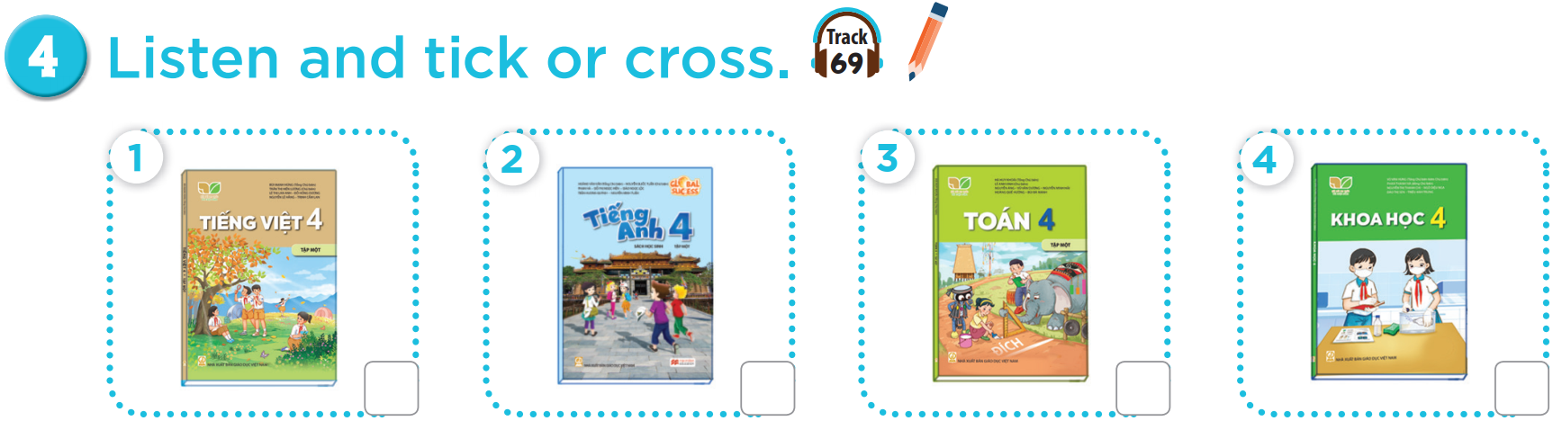


Slide 10



Slide 11
03
Look, complete and read.

Slide 12
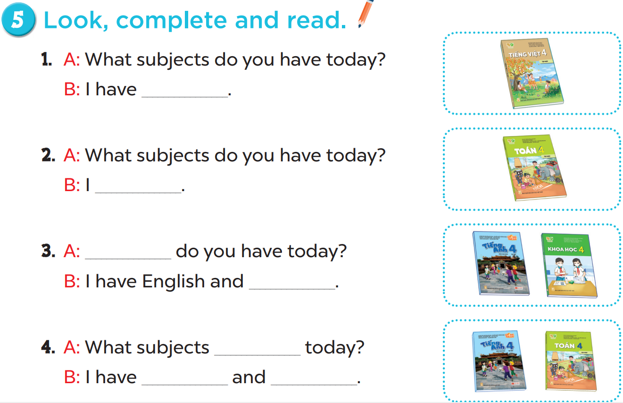

Slide 13
Vietnamese.
have maths
What subjects
science
do you have
English
maths

Slide 14
04
Let’s play.

Slide 15
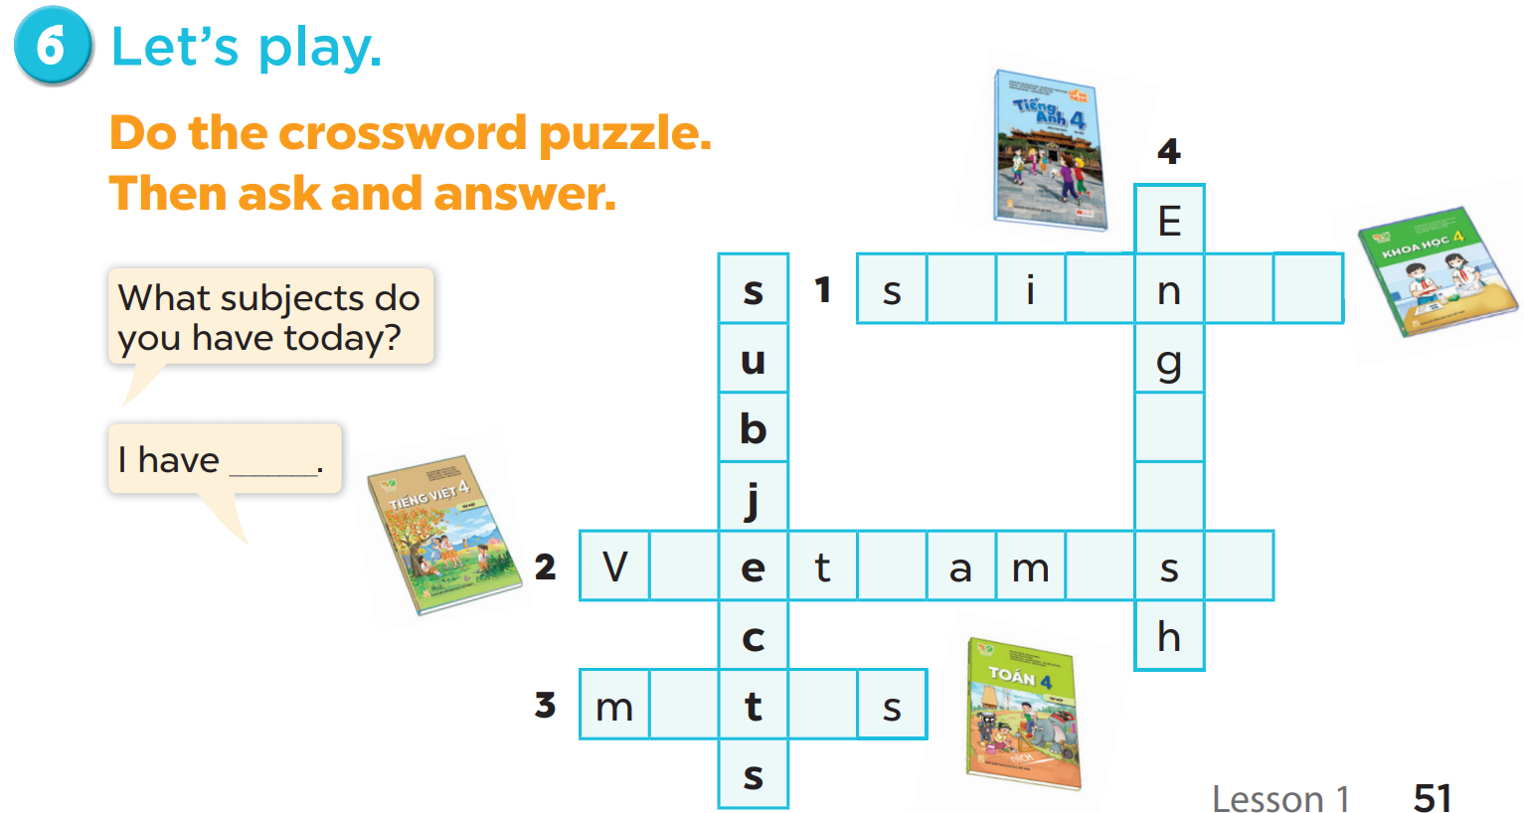
c
e
c
e
l
i
i
n
e
e
a
h

Slide 16
5
fun corner & wrap-up

Slide 17

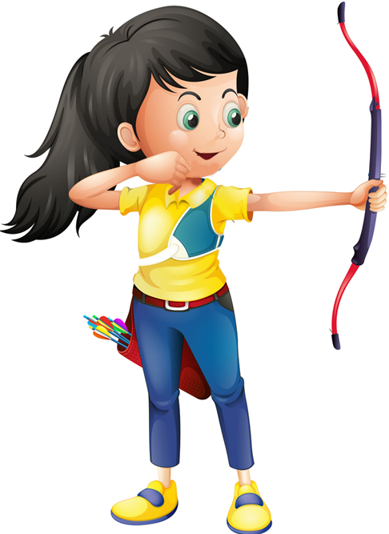





Slide 18


What ______do you have today?
subjects
subject
Ms Huyền Phạm
0936.082.789

Slide 19
_____subjects do you have today?
What
How
Ms Huyền Phạm
0936.082.789

Slide 20
I have________.
Viet Nam
Vietnamese
Ms Huyền Phạm
0936.082.789

Slide 21
I have________.
England
English
Ms Huyền Phạm
0936.082.789

Slide 22
I have Maths and ______.
scienec
science
Ms Huyền Phạm
0936.082.789

Slide 23
I have________.
matht
maths
Ms Huyền Phạm
0936.082.789

Slide 24
What have you learnt today?

