Slide 1





Slide 2
Unit 7 Our timetables
Lesson 3 - period 5

Slide 3
Table of Contents
01
02
03
04
Listen and repeat.
Warm-up
Listen and circle.
Let’s chant.
fun corner & wrap-up
05

Slide 4
01
Warm-up

Slide 5

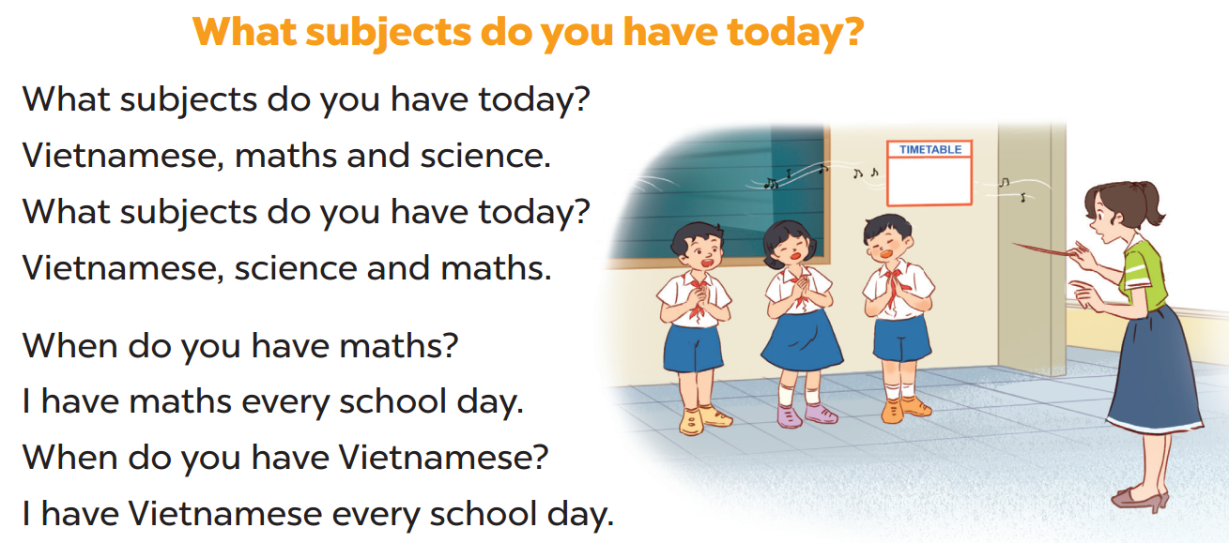

Slide 6
02
Listen and repeat.

Slide 7
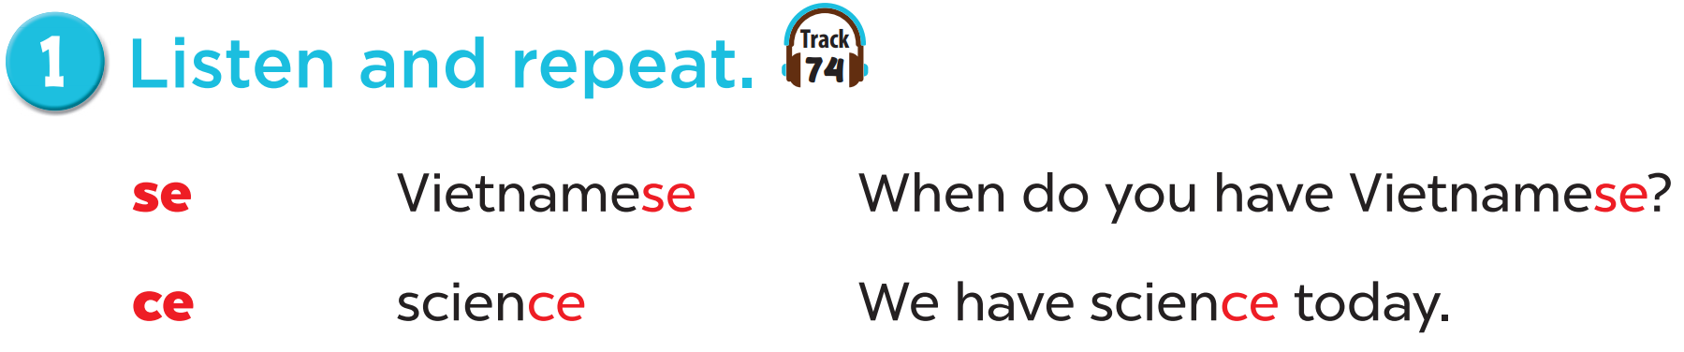

Slide 8
03
Listen and circle.

Slide 9
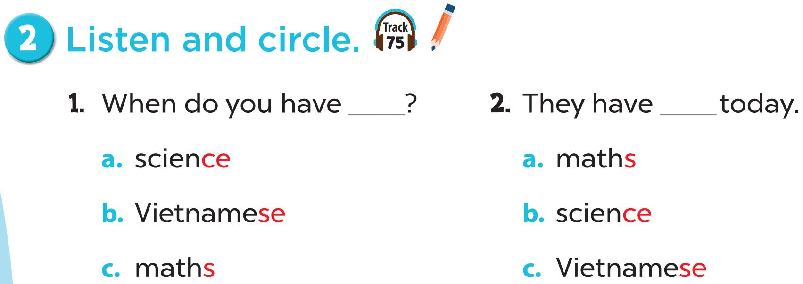

Slide 10


Slide 11
04
Let’s chant.

Slide 12
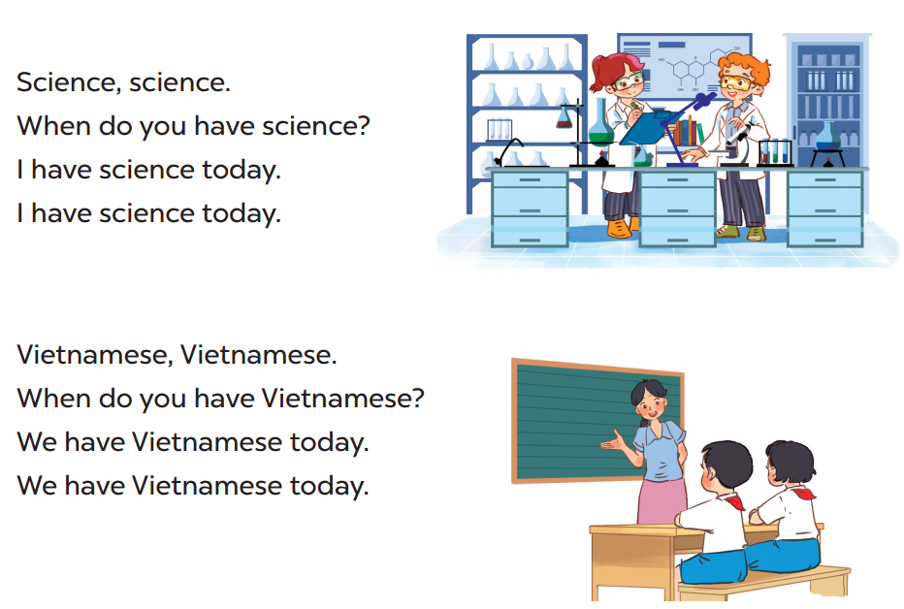

Slide 13
05
fun corner & wrap-up

Slide 14
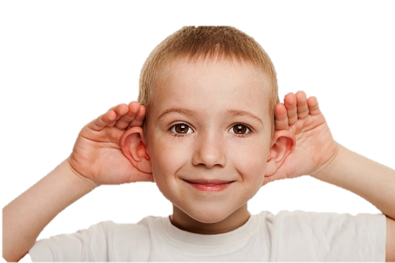

Listen and clap!

