Slide 1











Unit 7
Our timetable
Lesson 2 – Period 1
MsPham
0936082789

Slide 2

Days of a week
Sunday
Monday
Tuesday
Wednesday
Thursday
Friday
Saturday

Slide 3
MsPham
0936082789
Vocabulary
MsPham
0936082789

Slide 4

MsPham
0936082789
art
/ɑːt/
MsPham
0936082789
Môn Mĩ thuật

Slide 5

MsPham
0936082789
music
/ˈmjuːzɪk/
MsPham
0936082789
Môn âm nhạc

Slide 6

MsPham
0936082789
history
/ˈhɪstri/
MsPham
0936082789
Môn lịch sử

Slide 7
geography
/dʒiˈɒɡrəfi/
MsPham
0936082789
Môn địa lí

Slide 8
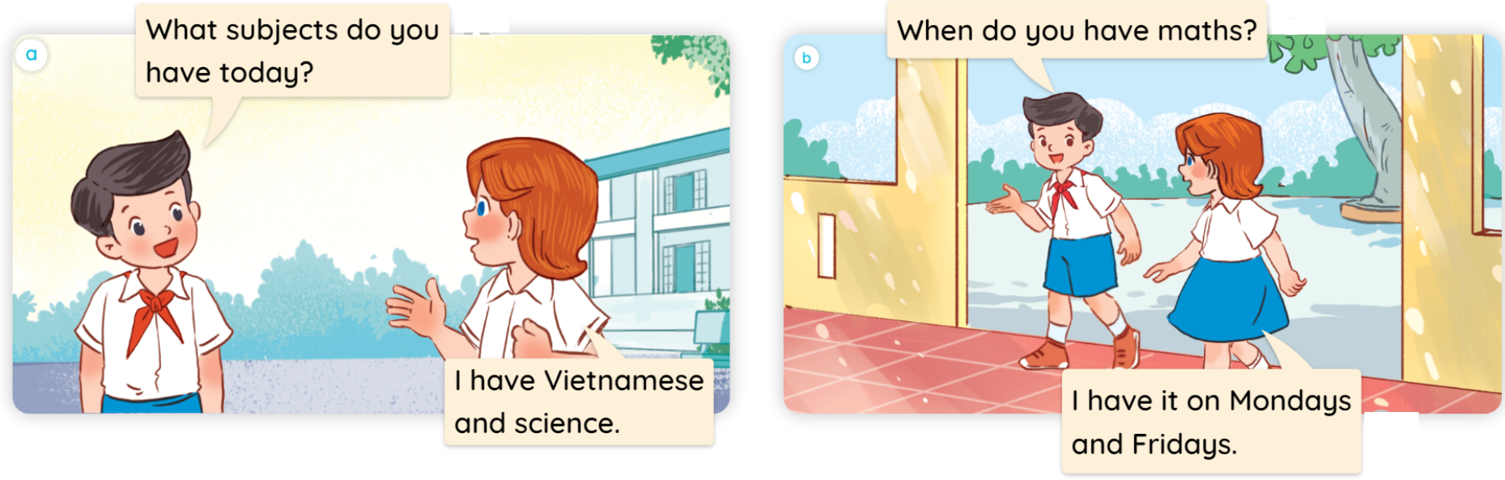

1
Look, listen and read.
MsPham
0936082789

Slide 9
Structure
MsPham
0936082789

Slide 10
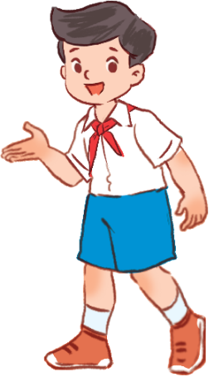
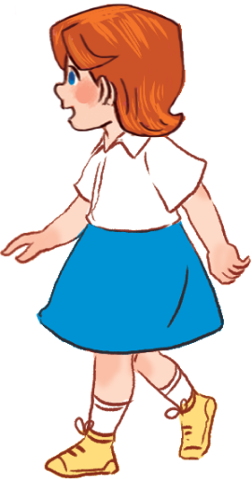
2
Cách hỏi bạn có thể làm gì hay không:
When do you have ________?
I have it on _____________.
(Khi nào bạn có môn ______?)
(Tớ có môn đó vào thứ _______.)
Ex:
When do you have maths?
MsPham
0936082789
I have it on Mondays and Fridays.

Slide 11
Practice
MsPham
0936082789

Slide 12
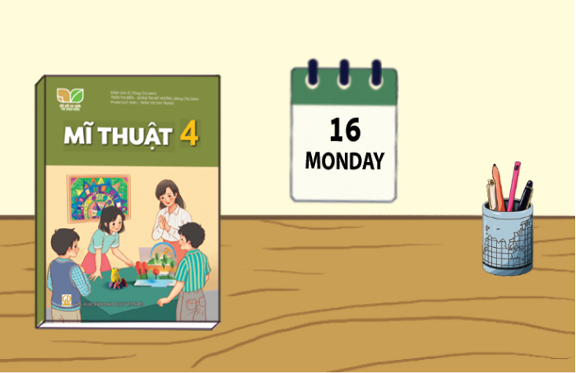


2
Listen, point and say.
a
MsPham
0936082789
art
When do you have art?
I have it on Mondays.

Slide 13
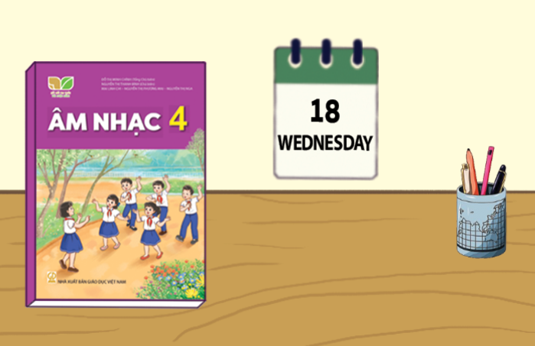
2
Listen, point and say.
MsPham
0936082789
b
MsPham
0936082789
music
When do you have music?
I have it on Wednesdays.

Slide 14
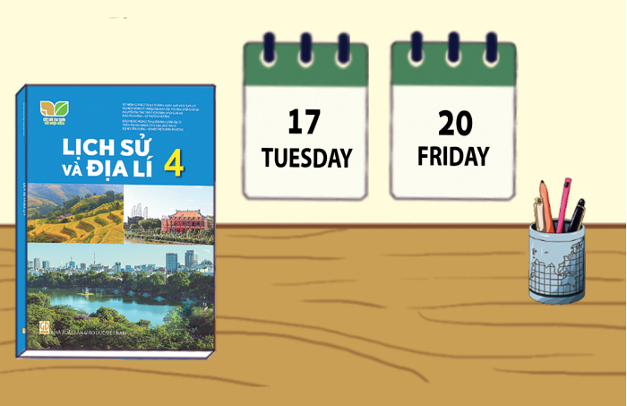


2
Listen, point and say.
c
MsPham
0936082789
history and geography
When do you have history and geography?
I have it on Tuesdays and Fridays.

Slide 15
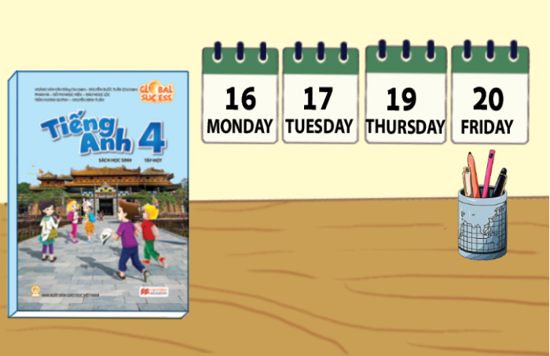
2
Listen, point and say.
d
MsPham
0936082789
English
When do you have English?
I have it on Mondays, Tuesdays, Thursdays and Fridays.

Slide 16
2
Listen, point and say.
When do you have ________?
I have it on _________.
a
b
MsPham
0936082789
Art
music
c
d
history
and geography
English

Slide 17
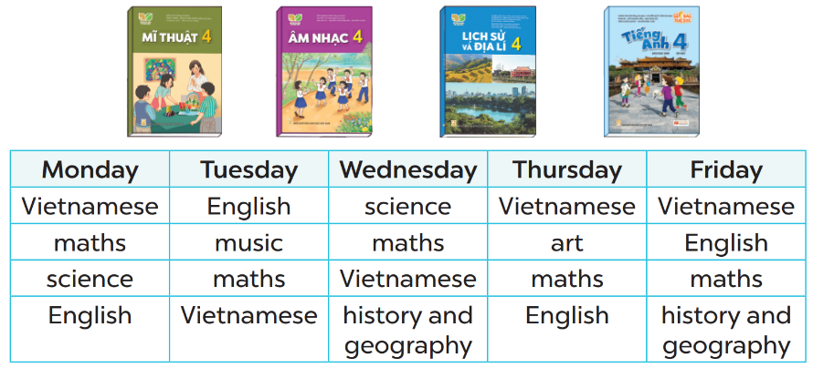


3
Let’s talk.
When do you have English?
MsPham
0936082789
I have it on Mondays, Tuesdays, Thursdays and Fridays.

Slide 18
3
Let’s talk.
When do you have history and geography?
MsPham
0936082789
I have it on Wednesdays and Fridays.

Slide 19
3
Let’s talk.
When do you have music?
MsPham
0936082789
I have it on Tuesdays.

Slide 20
3
Let’s talk.
When do you have art?
MsPham
0936082789
I have it on Thursdays.

Slide 21
MsPham
0936082789
When do you have ______?
I have it on __________.
MsPham
0936082789
art
music
history and geography
English

Slide 22
Thank you!
MsPham
0936082789

