Slide 1







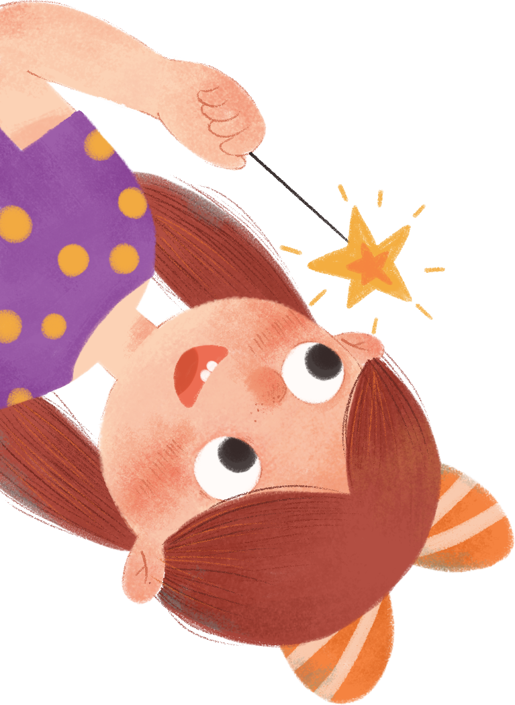



MsPham
0936082789
Unit 7
Our timetable
Lesson 3 – Period 1
MsPham
0936082789

Slide 2
MsPham
0936082789
Review
MsPham
0936082789

Slide 3



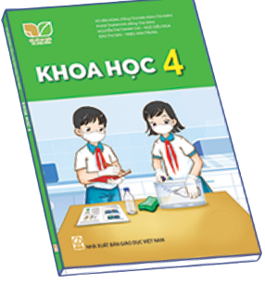
MsPham
0936082789
What subjects do you have today?
MsPham
0936082789
I have __________.
MsPham
0936082789
Vietnamese
English
maths
science

Slide 4
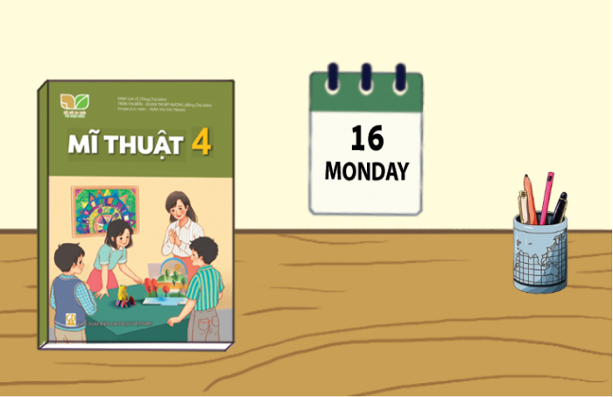
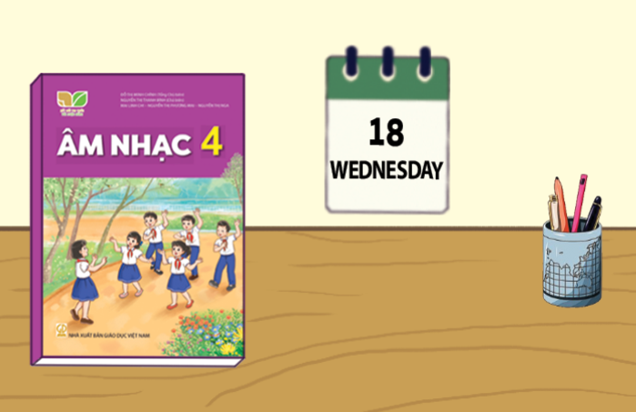
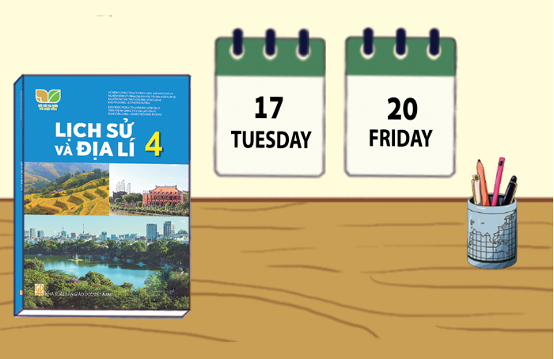
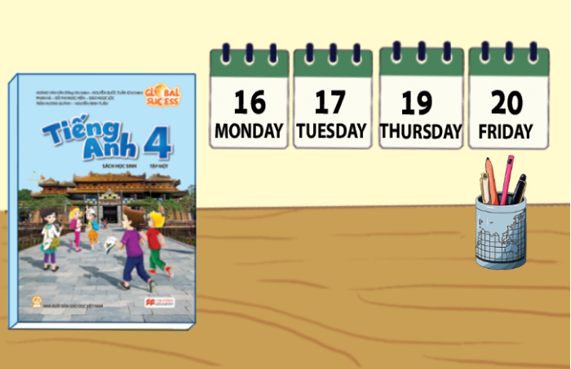
MsPham
0936082789
When do you have ______?
I have it on __________.
MsPham
0936082789
art
music
history and geography
English

Slide 5
MsPham
0936082789
Practice
MsPham
0936082789

Slide 6

1
Listen and repeat.
se
Vietnamese
When do you have Vietnamese?
MsPham
0936082789
ce
science
We have science today.

Slide 7
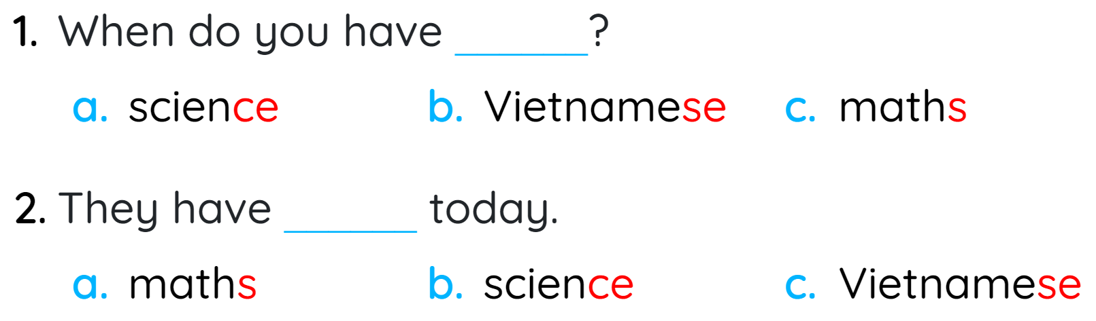
2
Listen and circle.
MsPham
0936082789

Slide 8
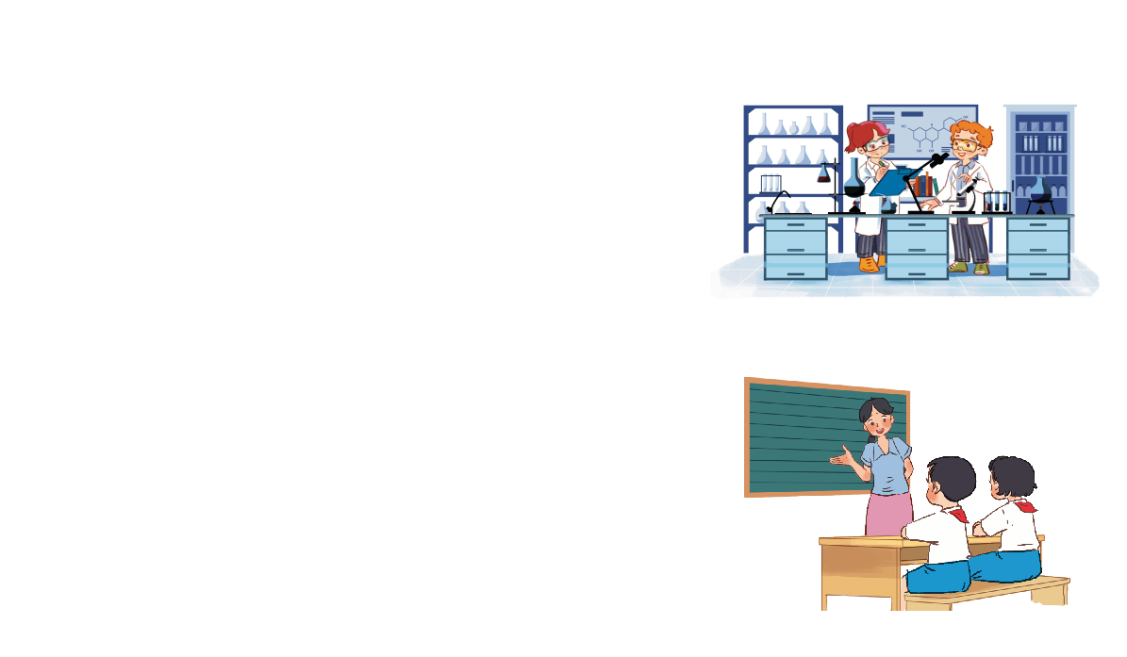
6
Let’s chant.
Science, science.
Science, science.
Science, science.
When do you have science?
When do you have science?
When do you have science?
I have science today.
I have science today.
I have science today.
I have science today.
I have science today.
I have science today.
Vietnamese, Vietnamese.
Vietnamese, Vietnamese.
Vietnamese, Vietnamese.
When do you have Vietnamese
When do you have Vietnamese?
When do you have Vietnamese?
MsPham
0936082789
We have Vietnamese today.
We have Vietnamese today.
We have Vietnamese today.
We have Vietnamese today.
We have Vietnamese today.
We have Vietnamese today.

