Slide 2
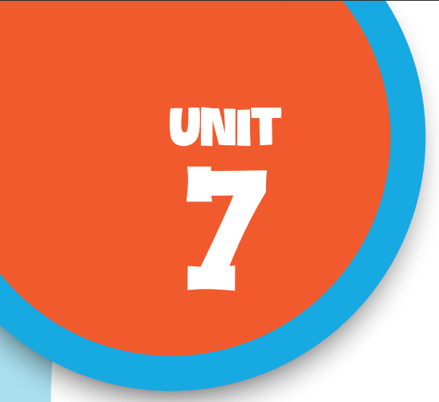

Our favourite school activities
Lesson 1 - Period 1

Slide 3

Table of contents
Warm-up & Review
01
02
Look, listen and repeat.
03
Listen, point and say.
04
Let’s talk.
05
Fun corner & Wrap-up

Slide 4


01
Warm-up
& Review

Slide 5

* Choose a number.
* Answer the question.
* Get the letter.
Unscramble the letters and say the word aloud.

Slide 6


Collect the letters
SCHOOL
S
O
C
1
2
3
L
O
4
H
6
5
What school activity
do you like?
NEXT
Notes:
Click the puzzle to move to the question slide.
Click flower to reveal the unscrambled word.
Click NEXT to move to next activity.

Slide 7
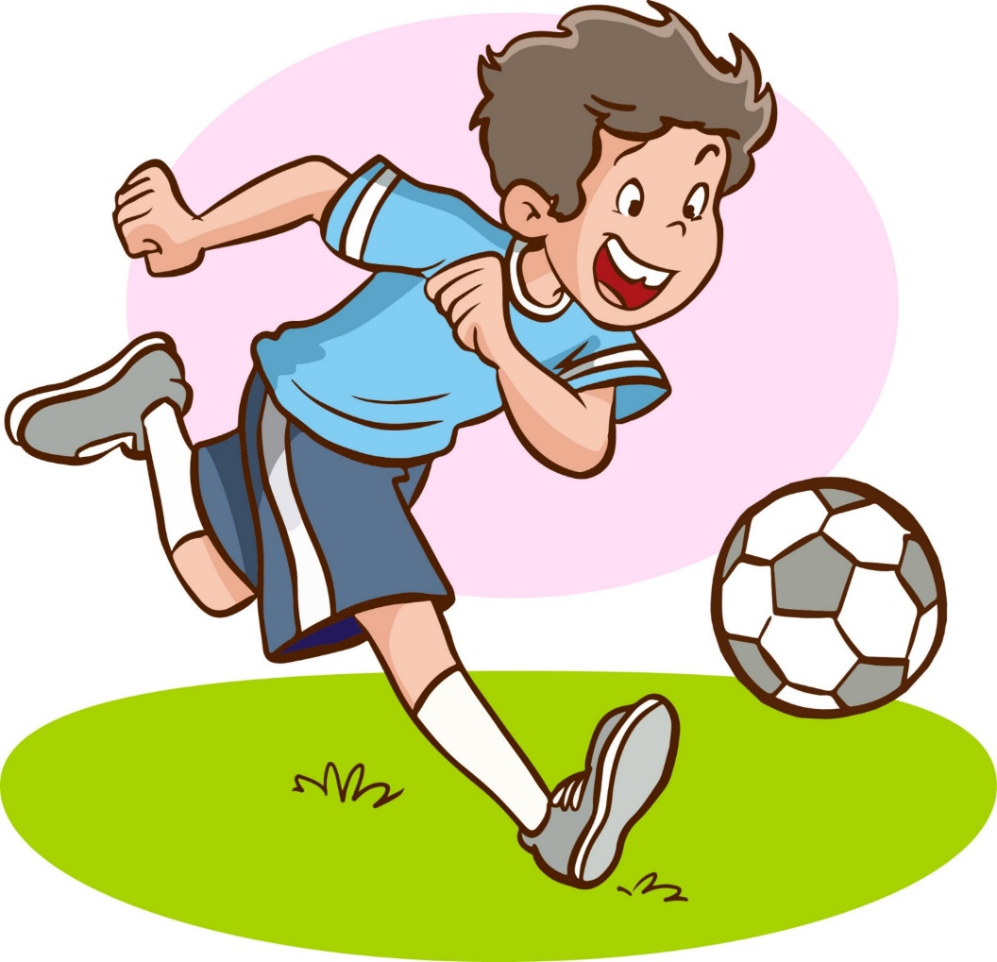
play football
Notes:
- Click flower to move back.

Slide 8

sing

Slide 9
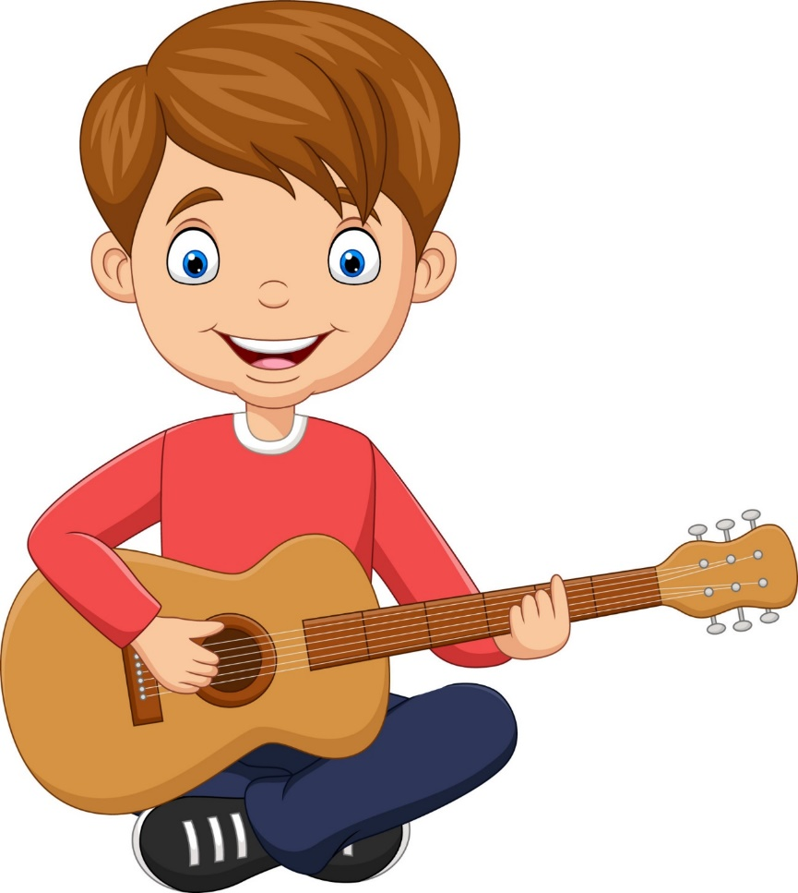
play the guitar

Slide 10
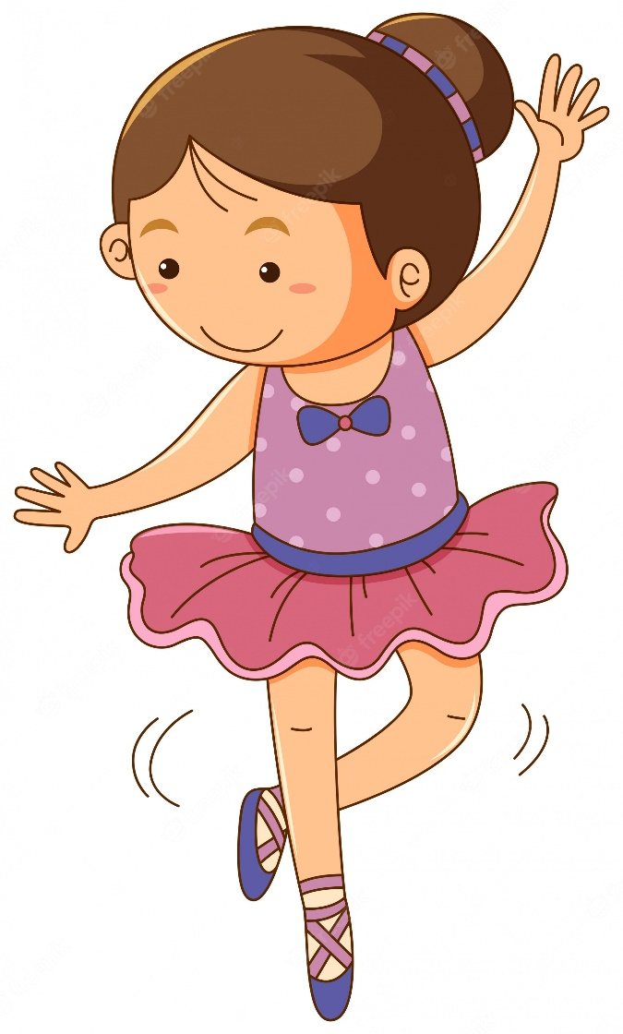
dance

Slide 11
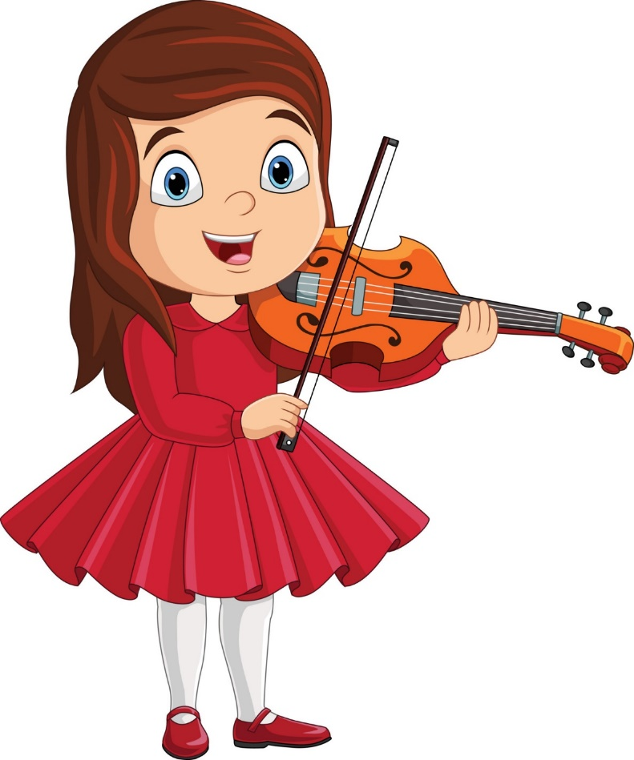
play the violin

Slide 12
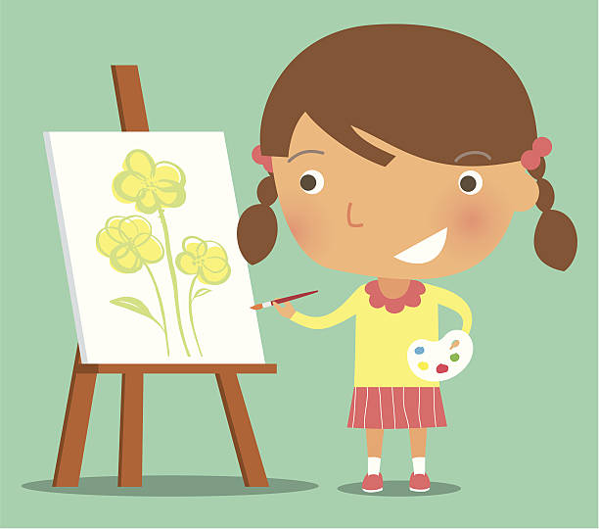
paint

Slide 13
02
Look, listen
and repeat.

Slide 14
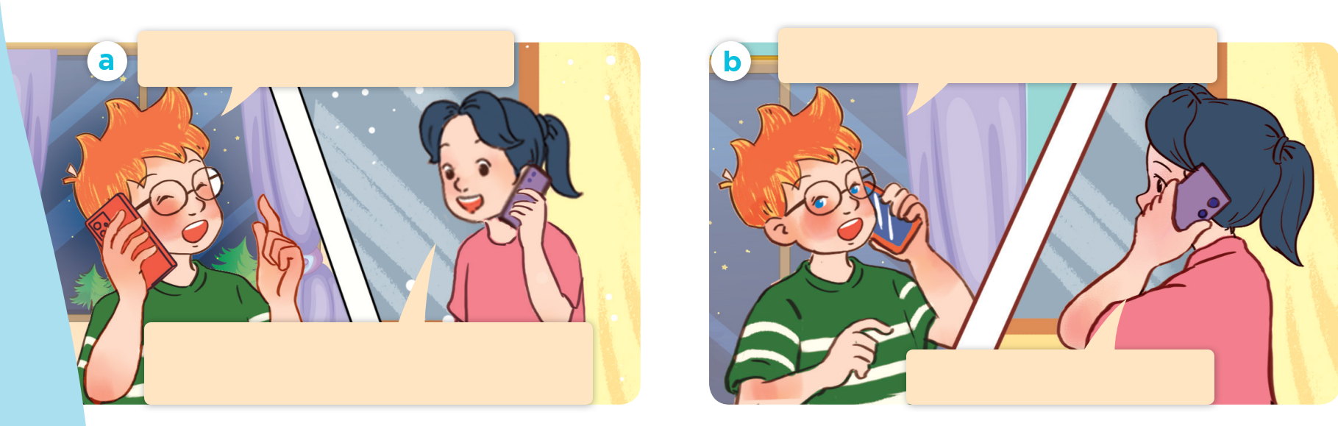
Who are they?
What are they doing?

Slide 15

Look, listen and repeat.
Hi, Mai. What are you doing?
What school activity does he like?
What school activity does he like?
Hello, Ben. I’m helping my brother solve a maths problem.
He likes reading books.

Slide 16
Act it out.
Hi, Mai. What are you doing?
What school activity does he like?
What school activity does he like?
Hello, Ben. I’m helping my brother solve a maths problem.
He likes reading books.

Slide 17
03
Listen, point
and say.

Slide 18
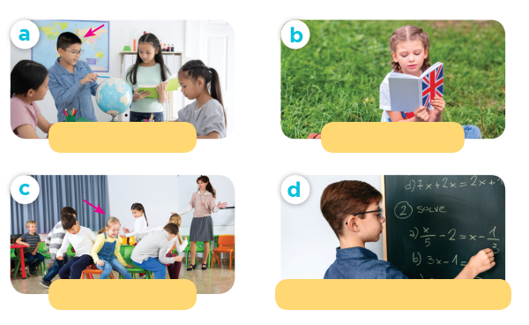
Look and guess.
do projects
read books
play games
solve maths problems

Slide 19
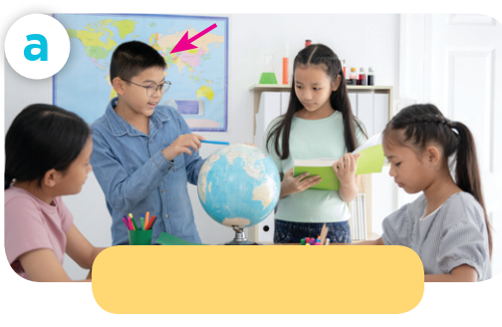
Listen and repeat.
do projects

Slide 20

Listen and repeat.
read books

Slide 21
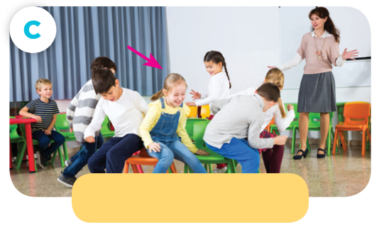
Listen and repeat.
play games

Slide 22
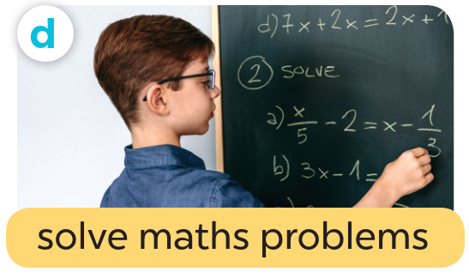
Listen and repeat.
solve maths problems

Slide 23

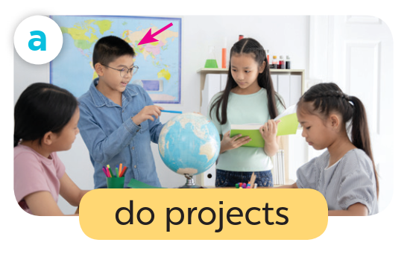

What school activity does he like?
He likes doing projects.

Slide 24

What school activity does she like?
She likes reading books.

Slide 25
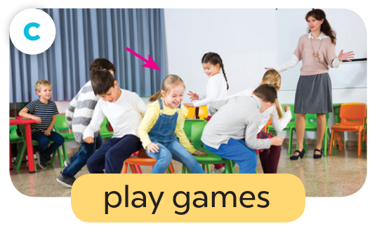
What school activity does she like?
She likes playing games.

Slide 26
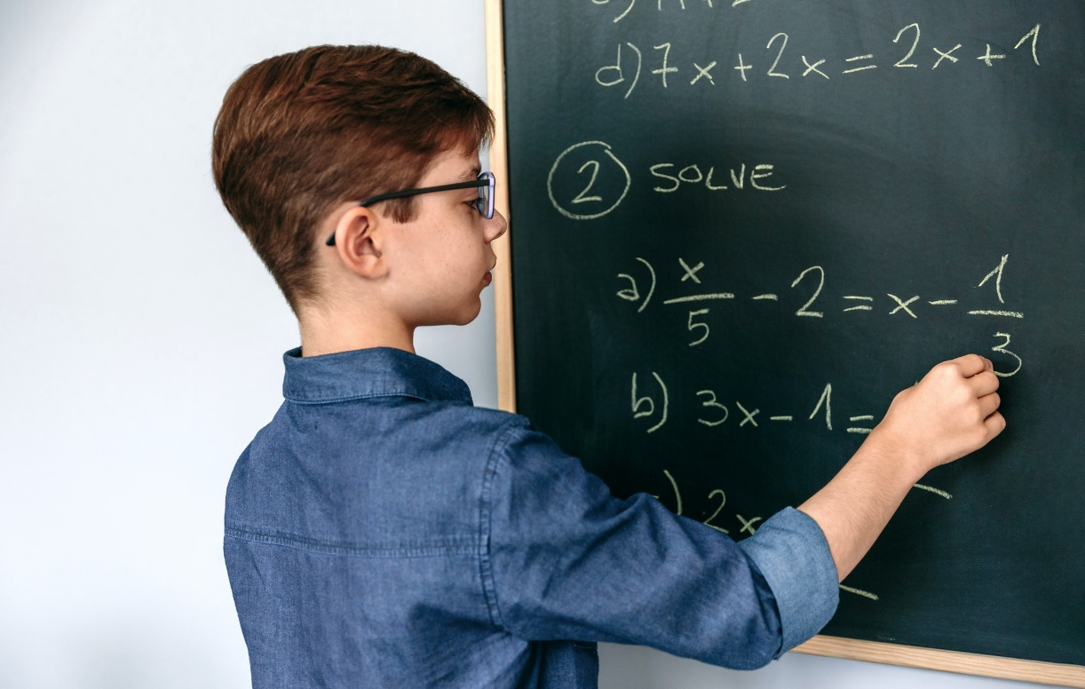
What school activity does he like?
He likes solving maths problems.

Slide 27
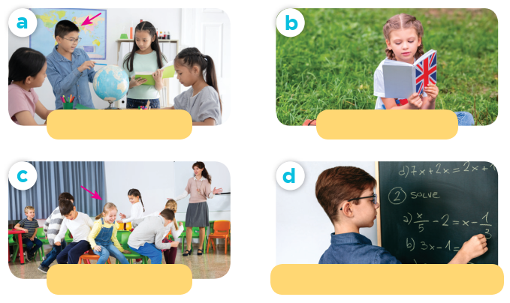
Act it out!
What school activity does he / she like?
do projects
read books
He / She likes ____.
play games
solve maths problems

Slide 28
04
Let’s talk.

Slide 29
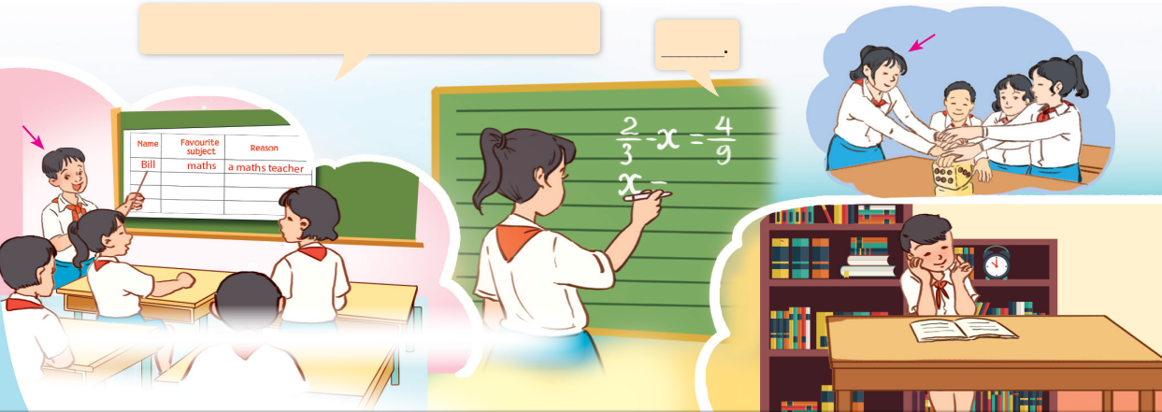
Let’s talk.
What school activity does he / she like?

Slide 30
05
Fun corner & Wrap-up

Slide 31
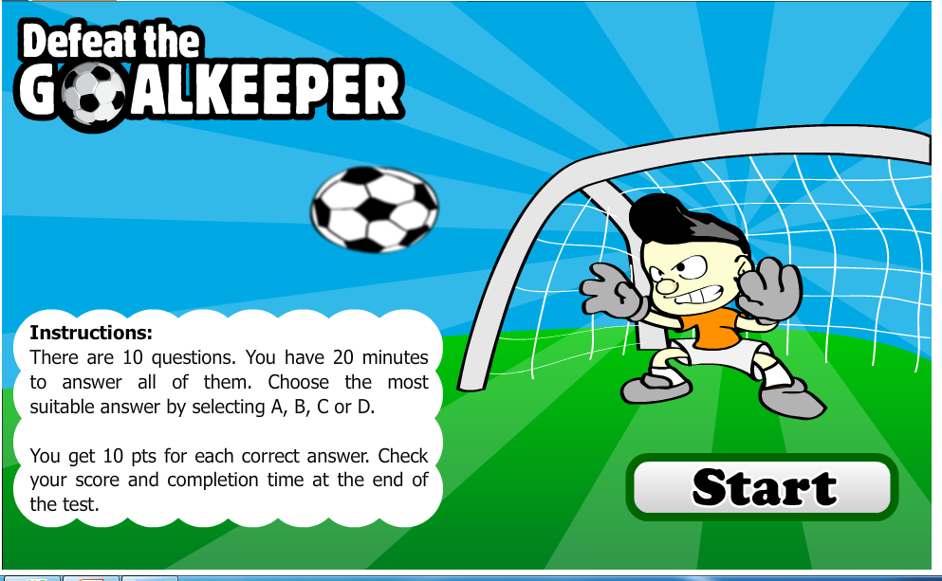
FOOTBALL GAME

Slide 32



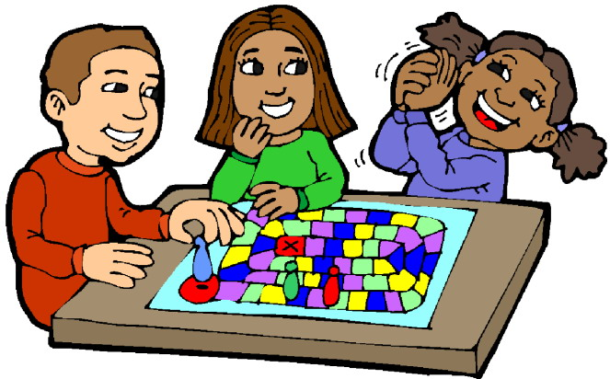


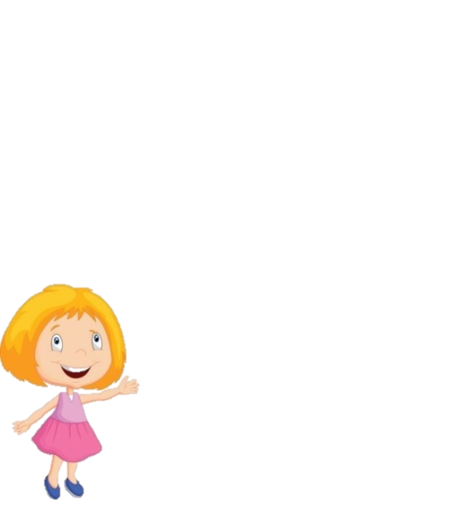
What school activity does she like?
OH NO
She likes playing games.
Notes:
If pupils have the correct answer, click “tick” button and get the goal.
If pupils have the wrong answer, click “cross” button.

Slide 33
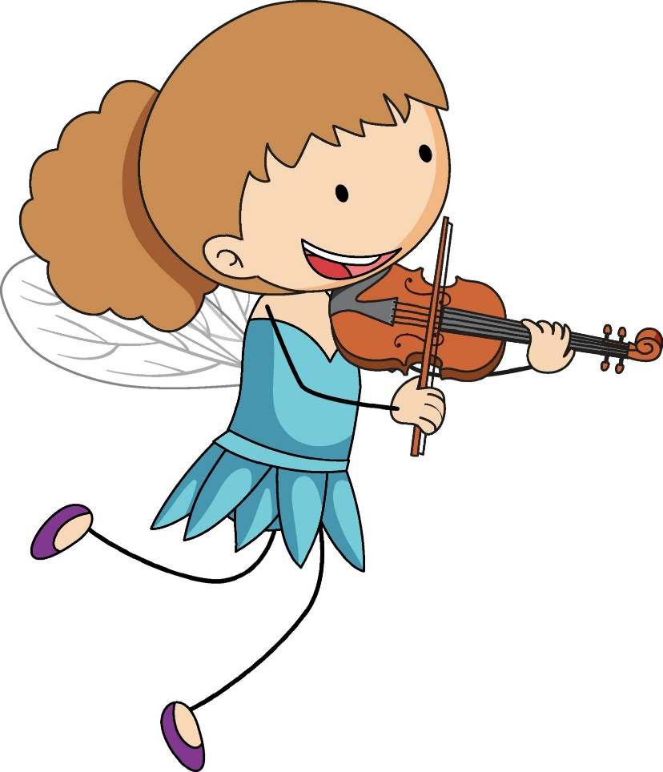
What school activity does she like?
OH NO
She likes playing the violin.

Slide 34
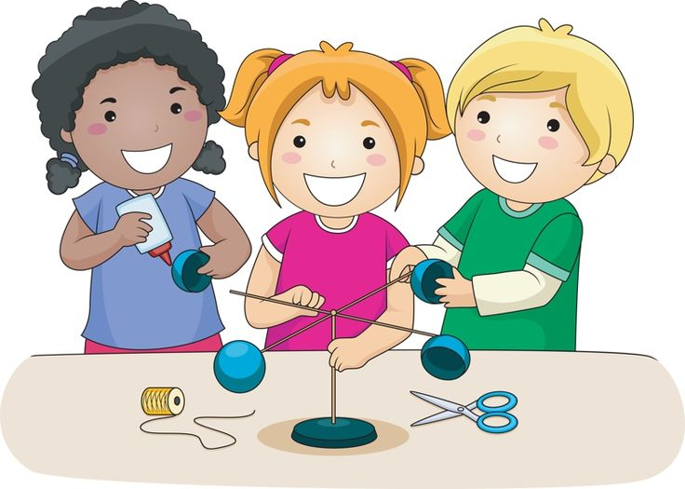
What school activity does she like?
OH NO
She likes doing projects.

Slide 35
What school activity does he like?
OH NO
He likes playing the guitar.

Slide 36
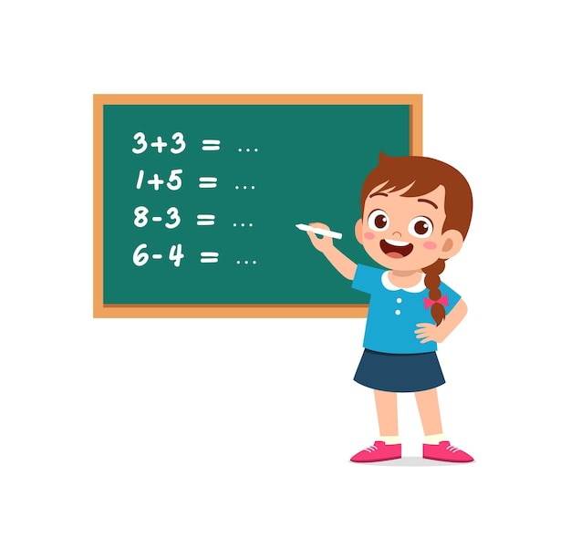
What school activity does she like?
OH NO
She likes solving maths problems.

Slide 37
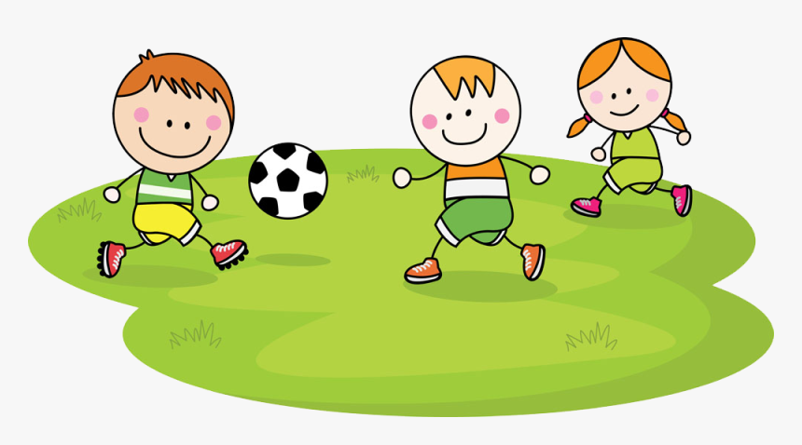
What school activity do they like?
OH NO
They like playing football.

Slide 38

What school activity does he like?
OH NO
He likes reading books.

Slide 39
What school activity does he like?
OH NO
He likes singing.
Notes:
If pupils have the correct answer, click “tick” button and get the goal.
If pupils have the wrong answer, click “cross” button.

Slide 40

What school activity does she like?
OH NO
She likes dancing.

Slide 41
Website: hoclieu.vn
Fanpage: https://www.facebook.com/tienganhglobalsuccess.vn/

