Slide 2
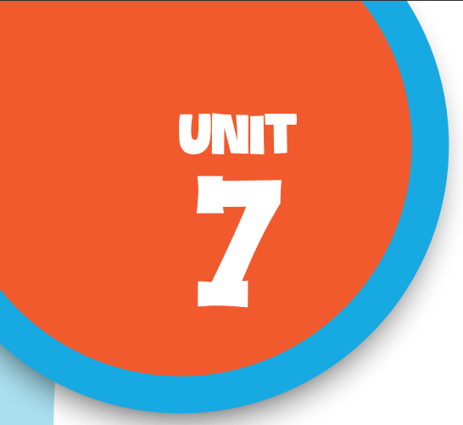

Our favourite school activities
Lesson 2 - Period 4

Slide 3

Table of contents
01
Warm-up and Review
02
Listen and tick.
03
Read and complete.
04
Let’s play.
05
Fun corner & Wrap-up

Slide 4


01
Warm-up and Review

Slide 5
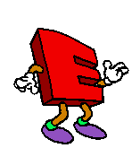
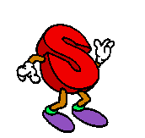
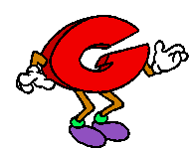
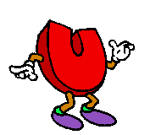
Guessing game
“
Can you
”

Slide 6

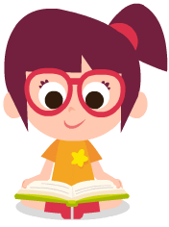

read books

Slide 7
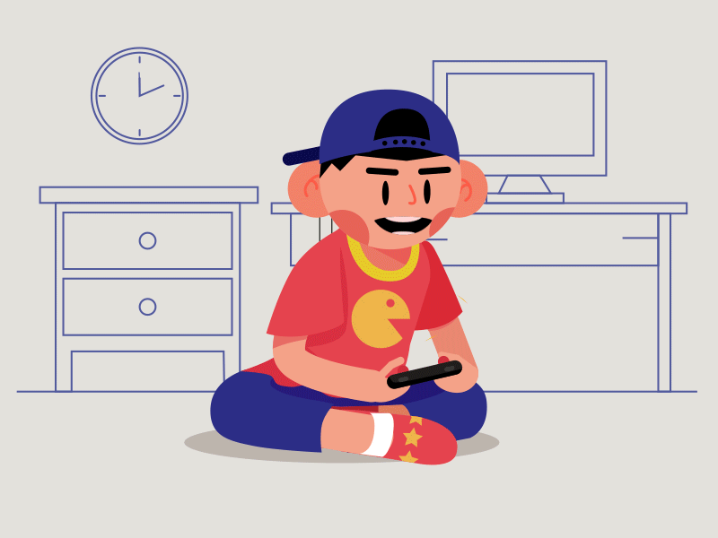
play games

Slide 8
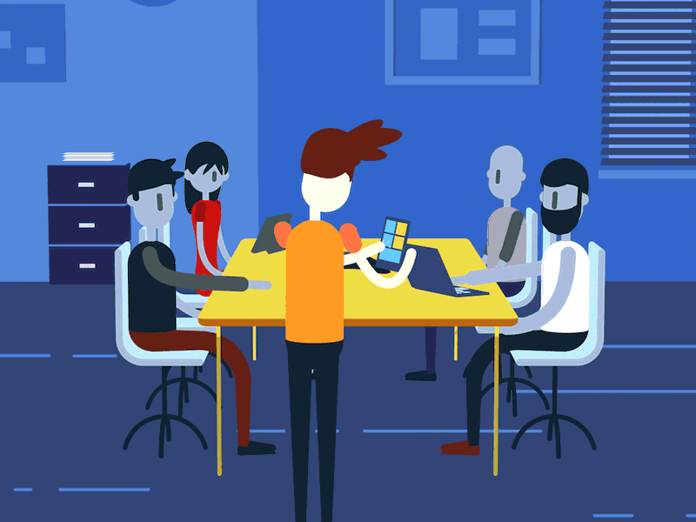
do projects

Slide 9
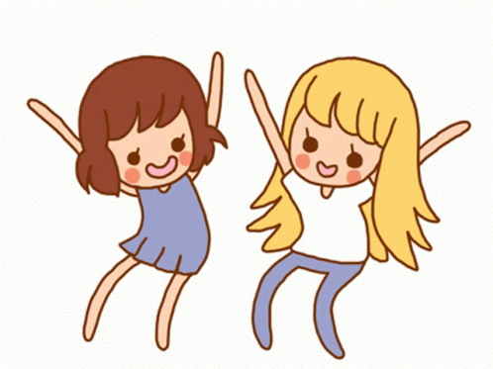
dance

Slide 10
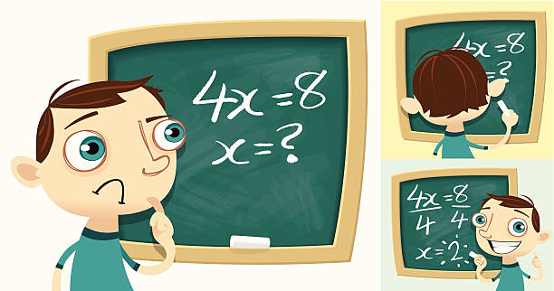
solve maths problems

Slide 11
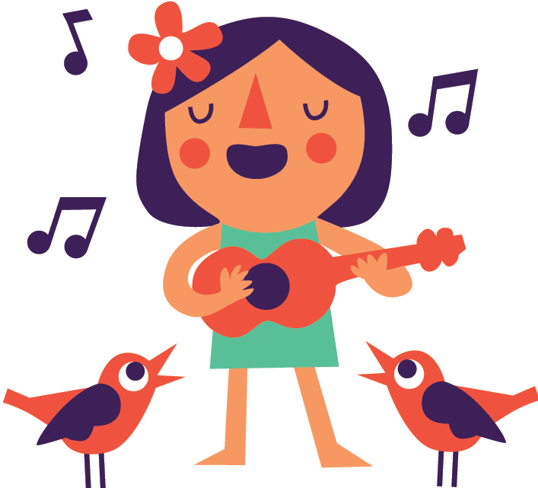
sing

Slide 12
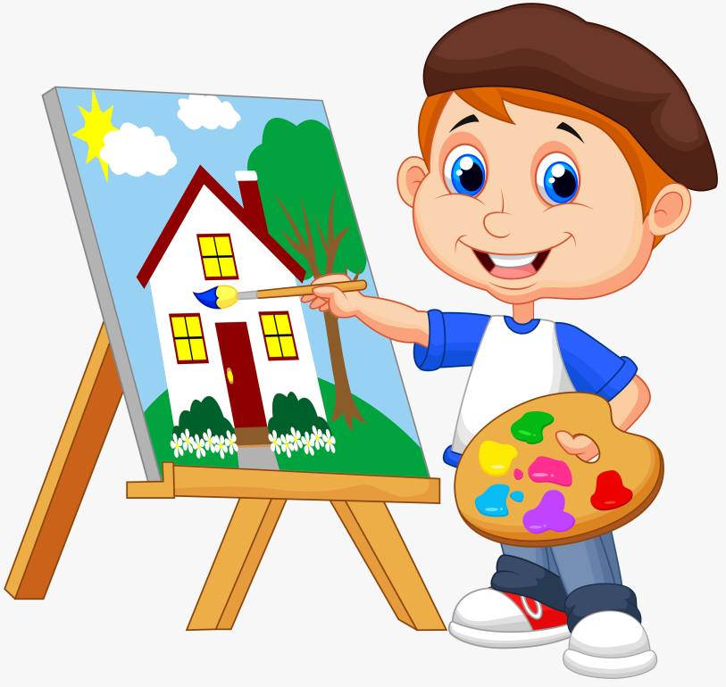
paint

Slide 13
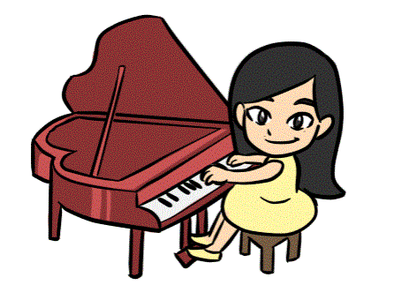
play
the piano

Slide 14
Let’s meet my friends.
Why does he / she like …?
Because he / she thinks …

Slide 15
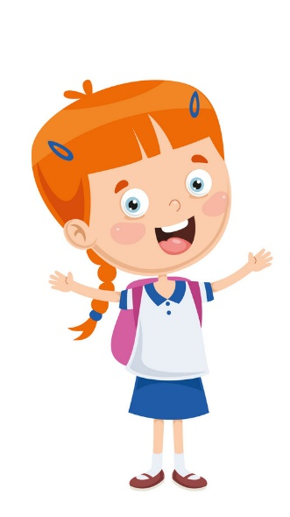

Why does he like doing projects?
Because he thinks …

Slide 16
Why does she like reading books?
Because she thinks …

Slide 17
Why does he like solving maths problems?
Because he thinks …

Slide 18
Why does he like playing games?
Because he thinks …

Slide 19
02
Listen
and tick.

Slide 20
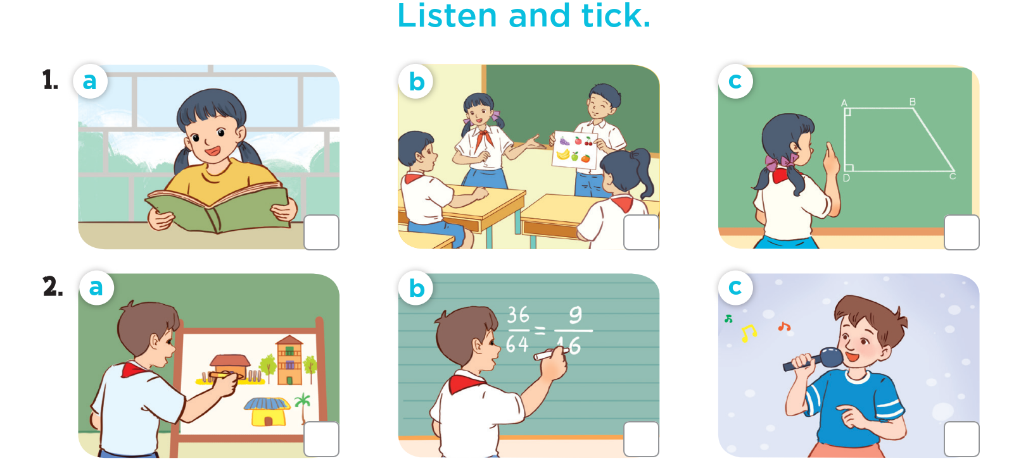




Slide 21
03
Read and
complete.

Slide 22
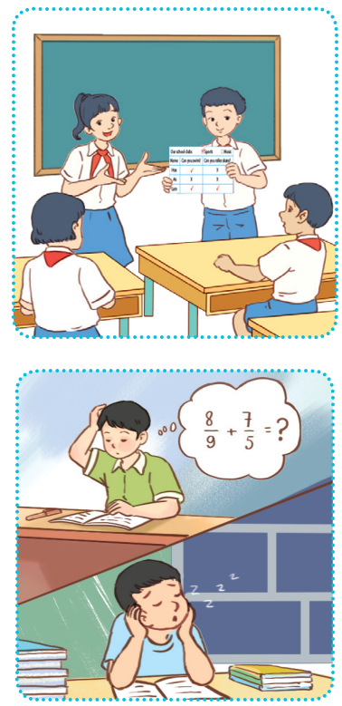
Read and complete.
1. A: What school activity does your sister like?
B: She likes _________________.
A: Why does she like it?
B: Because she thinks it’s interesting.
2. A: What school activities doesn’t your brother like?
B: He doesn’t like __________________________ or reading books.
A: Why doesn’t he like them?
B: Because ___________ they aren’t interesting.
doing projects
solving maths problems
he thinks

Slide 23
04
Let’s play.

Slide 24
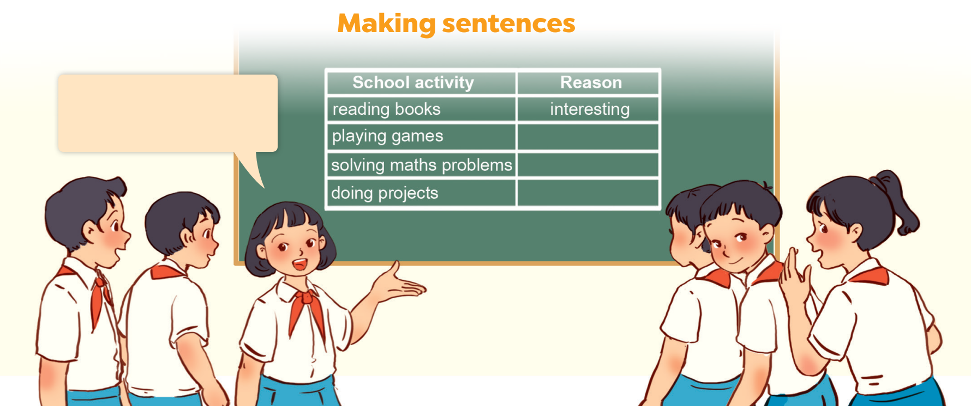
My sister likes reading books because she thinks it’s interesting.

Slide 25
05
Fun corner & Wrap-up
Lucky number

Slide 26
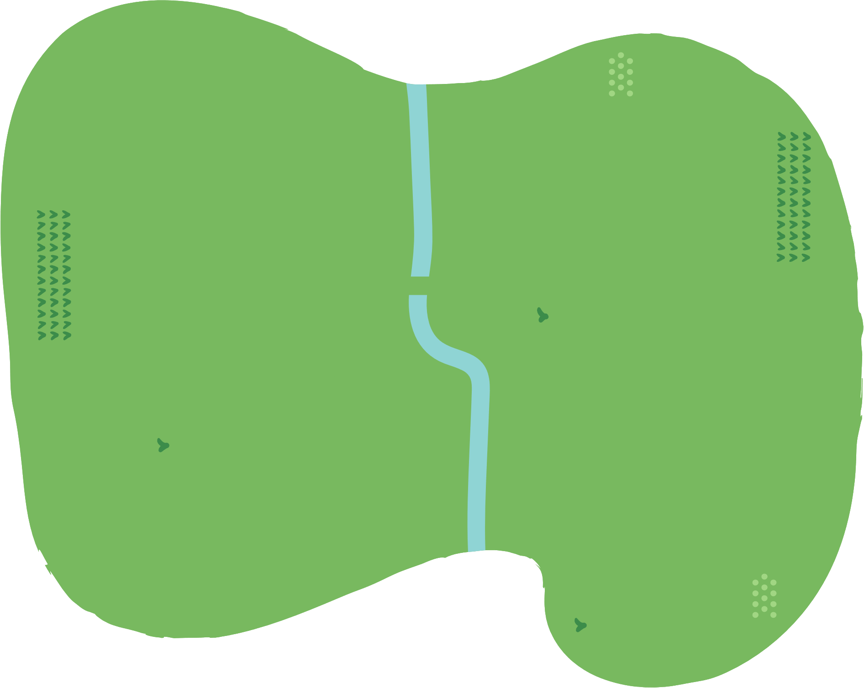





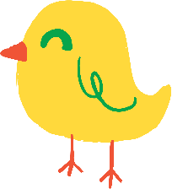





























Slide 27
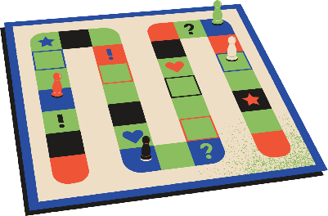

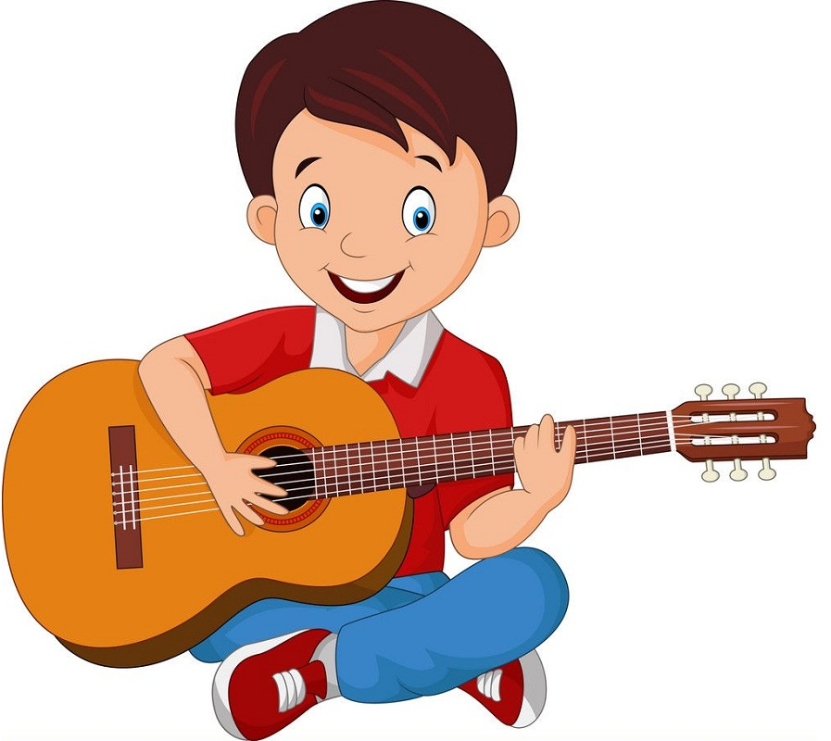


What school activity does he like?
Insert one question here
Insert one question here
Insert one question here
He likes playing
the guitar.

Slide 28
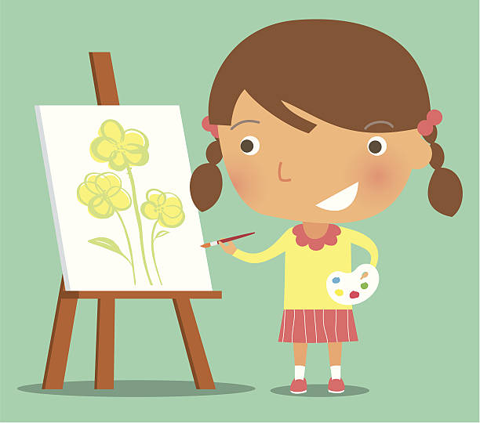
What school activity does she like?
Insert one question here
Insert one question here
Insert one question here
She likes painting.

Slide 29

Why does he like
solving maths problems?
Insert one question here
Insert one question here
Insert one question here
Because he thinks
it’s useful.

Slide 30
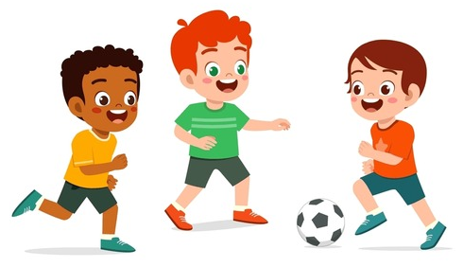
What school activity
do they like?
Insert one question here
They like playing football.

Slide 31

Why does she like
reading books?
Insert one question here
Insert one question here
Insert one question here
Because she thinks
it’s interesting.

Slide 32
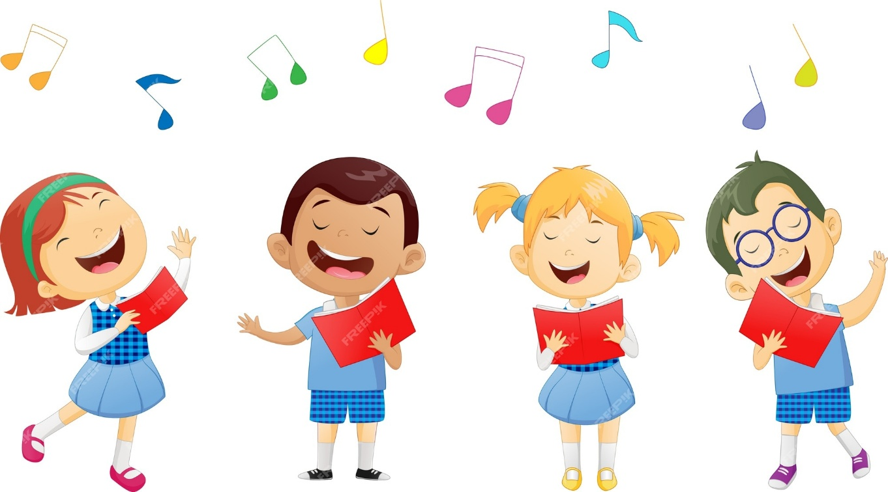
What school activity
do they like?
Insert one question here
Insert one question here
Insert one question here
They like singing.

Slide 33
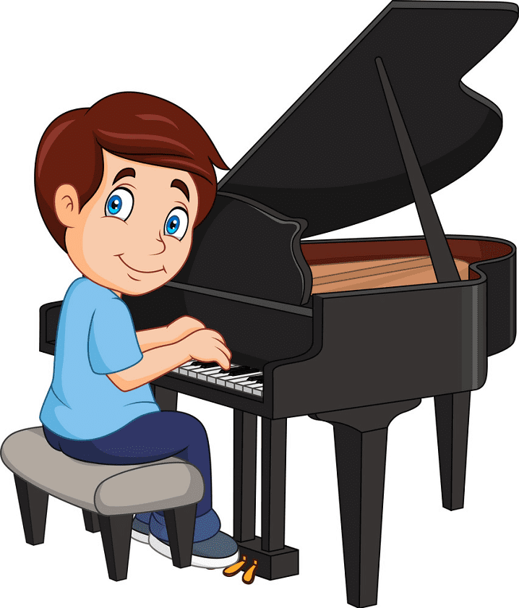
What school activity
does he like?
Insert one question here
Insert one question here
Insert one question here
He likes playing
the piano.

Slide 34
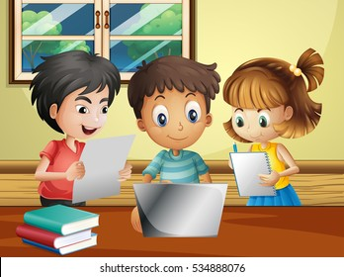
Why do they like
doing projects?
Insert one question here
Insert one question here
Insert one question here
Because they think
it’s good for group work.

Slide 35
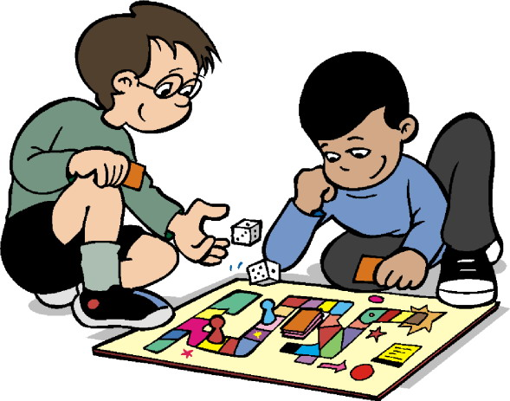
Why does he like
playing games?
Insert one question here
Insert one question here
Insert one question here
Because he thinks
it’s fun.

Slide 36
Website: hoclieu.vn
Fanpage: https://www.facebook.com/tienganhglobalsuccess.vn/

