Slide 1














MsPham
0936082789
Unit 5
Things
we can do
Lesson 2 – Period 1

Slide 2



Warm-up
MsPham
0936082789

Slide 3


Slide 4


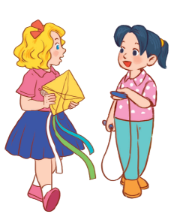

MsPham
0936082789
Review

Slide 5



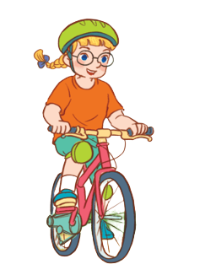

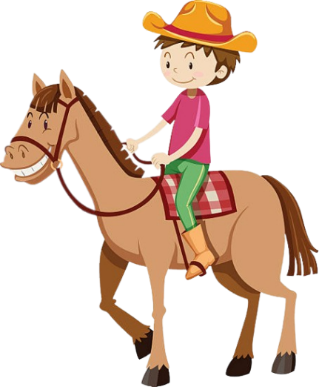
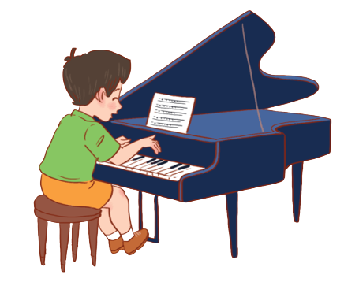

Yes, I can.
Can you + __________?
MsPham
0936082789
No, I can’t.
play the guitar
ride a bike
MsPham
0936082789
play the piano
ride a horse
skip
fly a kite

Slide 6
MsPham
0936082789
Vocabulary

Slide 7

swim
/swɪm/
MsPham
0936082789
Bơi

Slide 8

roller skate
/ˈrəʊlə skeɪt/
MsPham
0936082789
Trượt pa-tanh

Slide 9
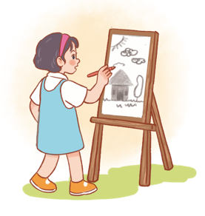
draw
/drɔː/
MsPham
0936082789
Vẽ

Slide 10
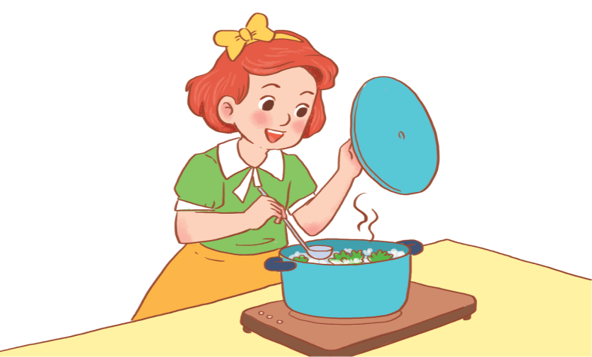
cook
/kʊk/
MsPham
0936082789
Nấu ăn

Slide 11
Vocabulary
swim
: Bơi
roller skate
: Trượt pa-tanh
draw
MsPham
0936082789
: Vẽ
cook
: Nấu ăn

Slide 12
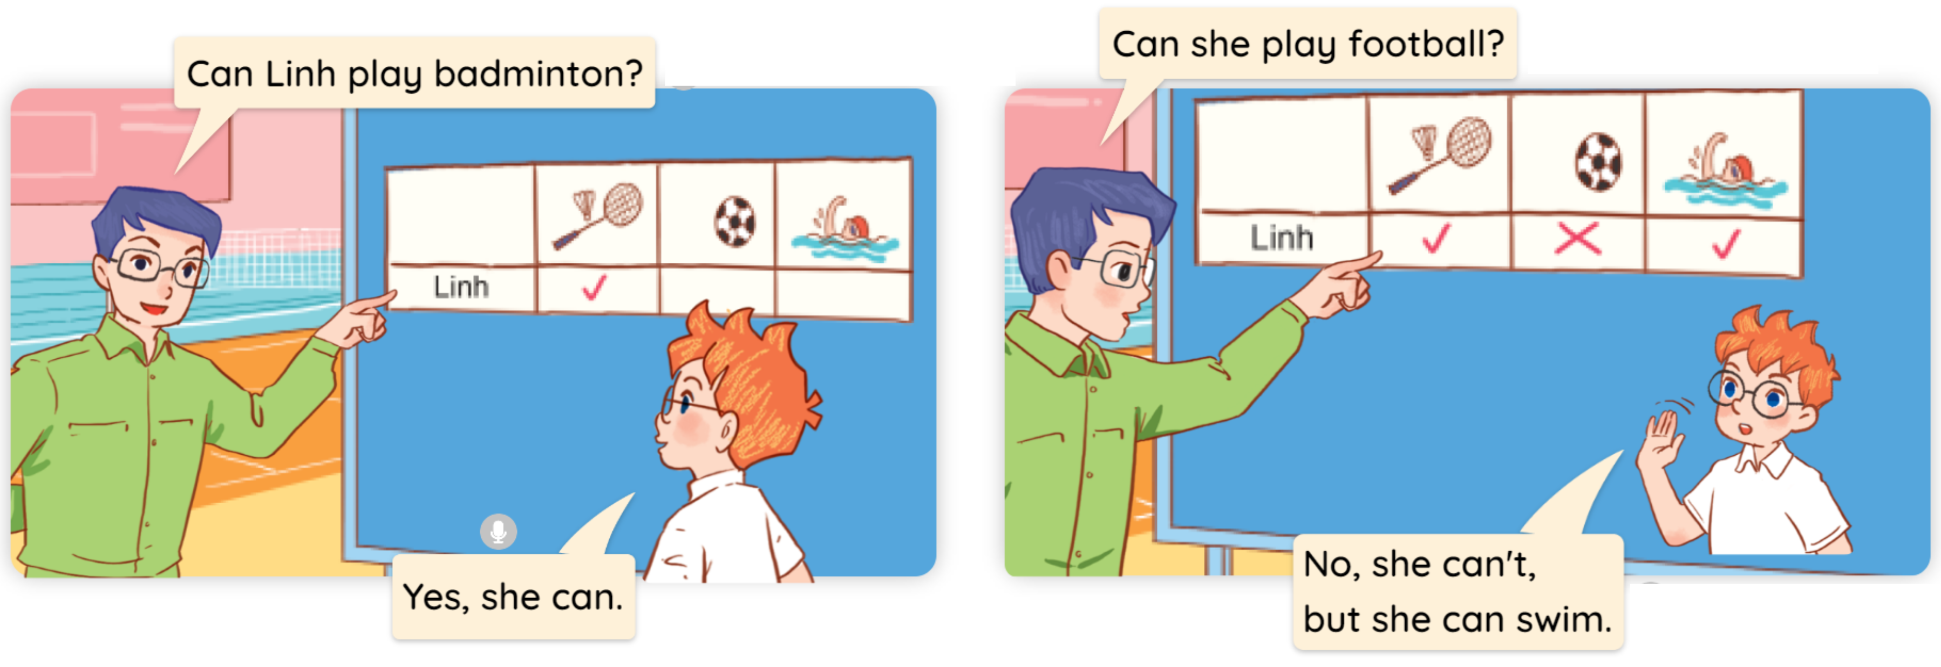

1
Look, listen and read.
MsPham
0936082789

Slide 13
MsPham
0936082789
Structure

Slide 14
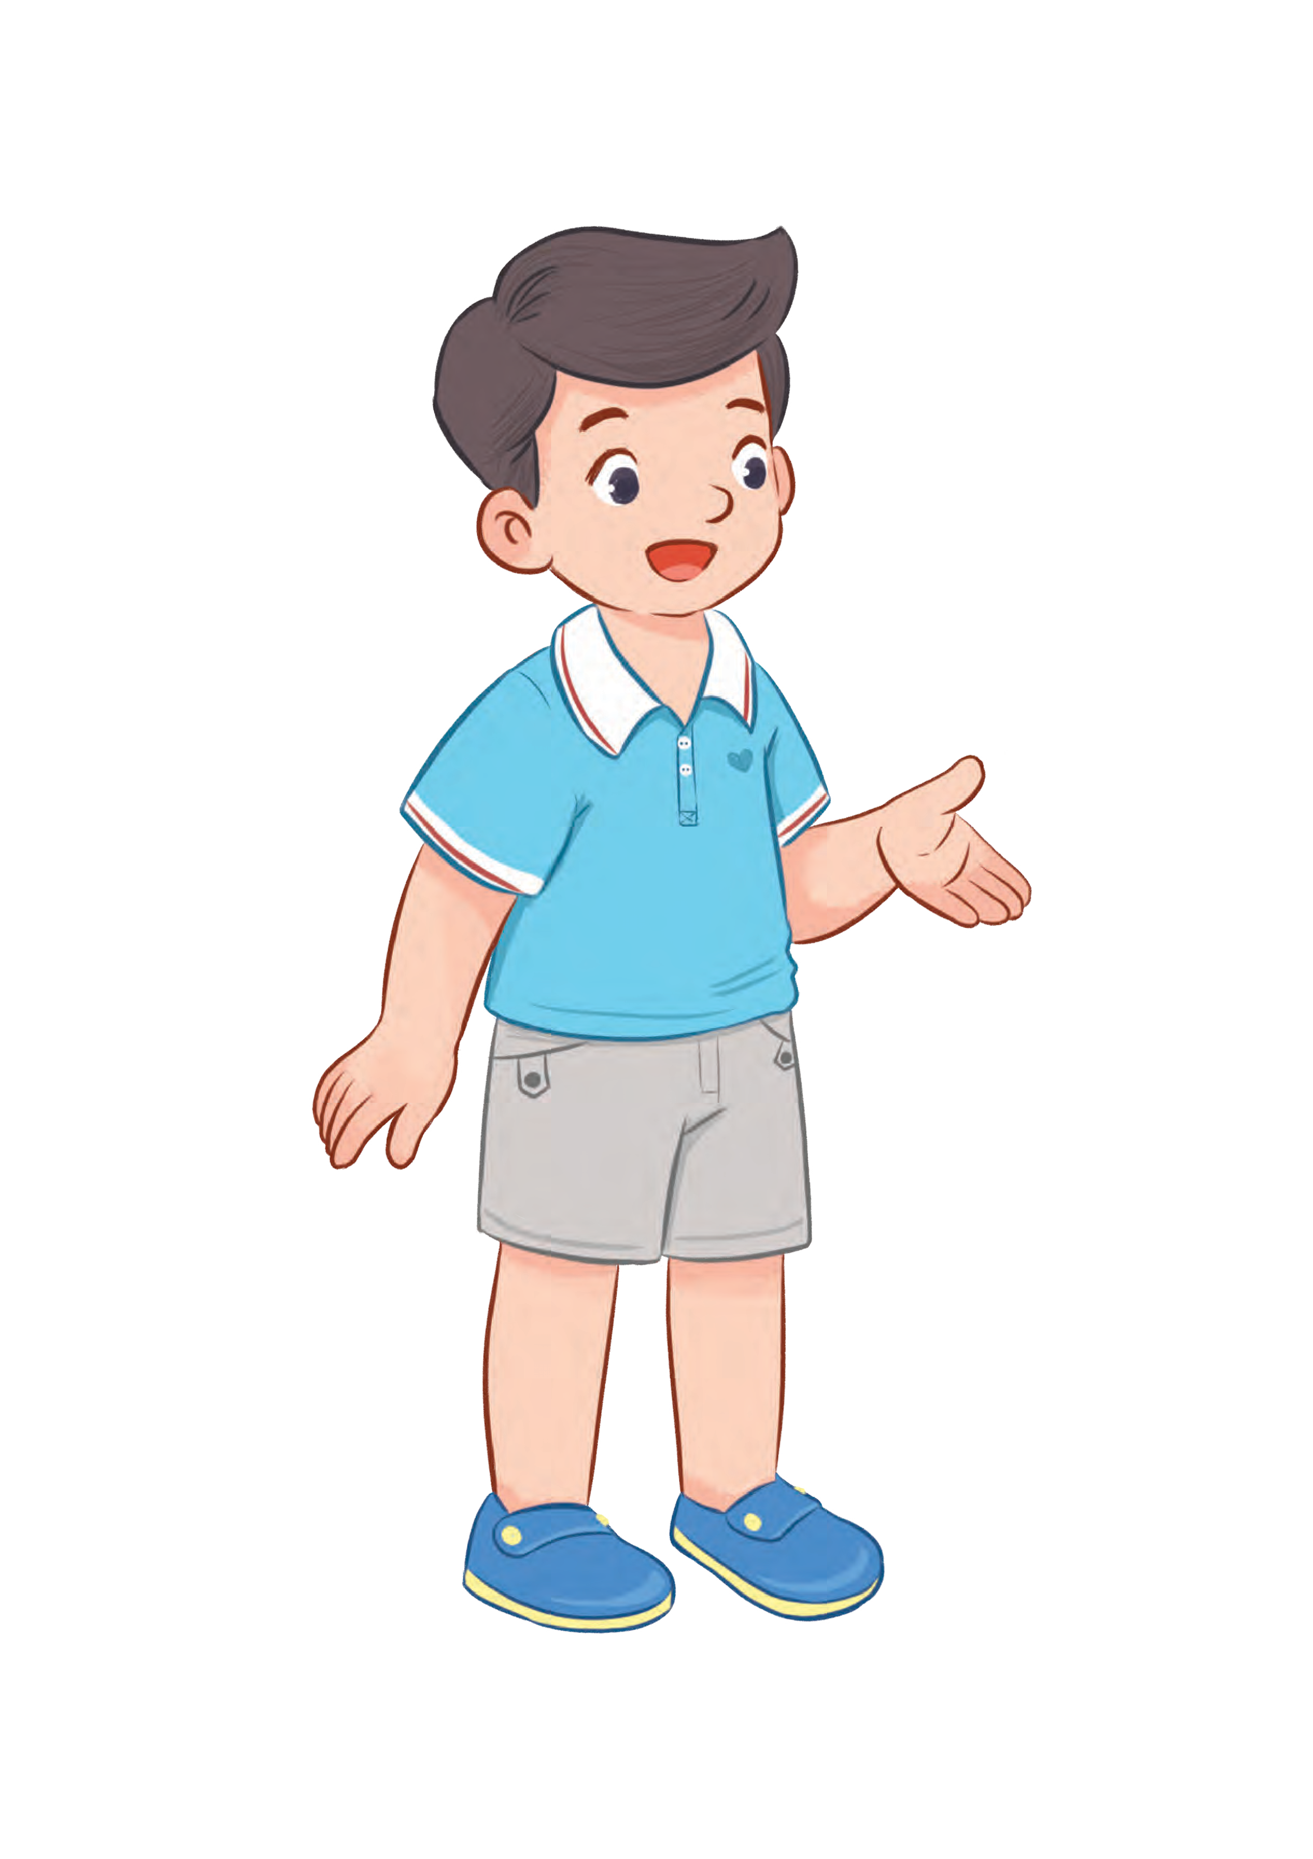


2
Cách hỏi một người nào đó có thể làm gì hay không:
Yes, he/she can.
Can he/she + (hoạt động)?
No, he/she can’t.
(Anh ấy/Cô ấy có thể _________ không?)
Ex:
Can he roller skate?
Yes, he can.
MsPham
0936082789
Can she roller skate?
No, she can’t.

Slide 15

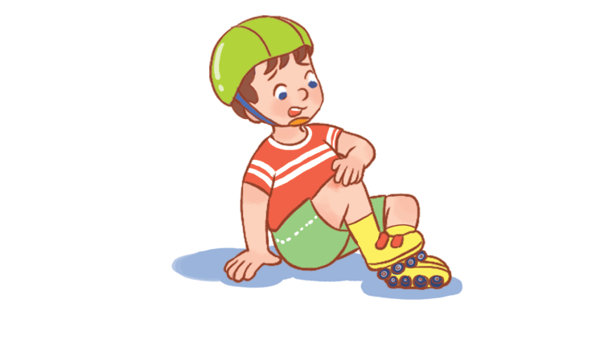

2
Listen, point and say.
Can he/she + _________?
Yes, he/she can.
a
b
No, he/she can’t.
MsPham
0936082789
swim
roller skate
c
d
cook
draw

Slide 16
2
Listen, point and say.
a
MsPham
0936082789
swim
Can he swim?
Yes, he can.

Slide 17
2
Listen, point and say.
a
MsPham
0936082789
roller skate
Can he roller skate?
No, he can’t.

Slide 18
2
Listen, point and say.
c
MsPham
0936082789
cook
Can she cook?
Yes, she can.

Slide 19
2
Listen, point and say.
d
MsPham
0936082789
draw
Can she draw?
No, she can’t.

Slide 20
2
Listen, point and say.
Can he/she + _________?
Yes, he/she can.
a
b
No, he/she can’t.
MsPham
0936082789
swim
roller skate
c
d
cook
draw

Slide 21

MICKEY CHECK
MsPham
0936082789
START

Slide 22




A
roller skate
Can she _______?
No, she can’t.
B
swim
MsPham
0936082789
C
play football
Next

Slide 23

A
roller skate
Can he _______?
Yes, he can.
B
play football
MsPham
0936082789
C
draw
Next

Slide 24
A
cook
Can she _______?
No, she can’t.
B
draw
MsPham
0936082789
C
write
Next

Slide 25

A
swim
Can he _______?
No, he can’t.
B
play badminton
MsPham
0936082789
C
roller skate
Next

Slide 26
A
skate
Can she _______?
Yes, she can.
B
draw
MsPham
0936082789
C
cook
Next

Slide 27
A
skip
Can he _______?
Yes, he can.
B
roller skate
MsPham
0936082789
C
swim
Next

Slide 28
A
Yes, he can.
Can he roller skate?
B
No, he can’t.
MsPham
0936082789
C
Yes, she can.
Next

Slide 29

A
No, she can’t.
Can she swim?
B
Yes, she can.
MsPham
0936082789
C
No, he can’t.
Next

Slide 30

Excellent!
end

Slide 31
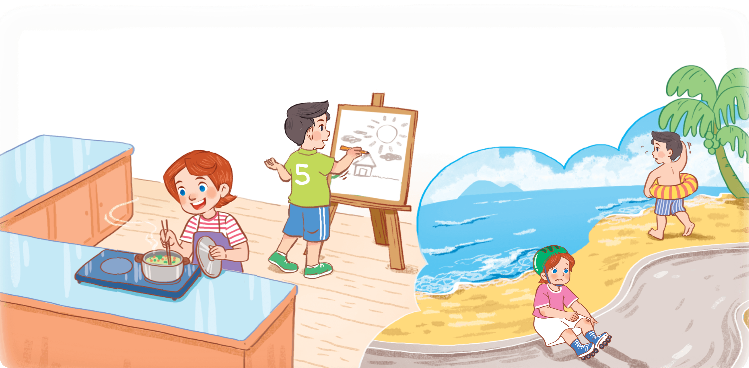
3
Let’s talk
Yes, he/she can.
Can he/she + _________?
No, he/she can’t.

Slide 32


3
Let’s talk
Can she cook?
Yes, she can.
No, he/she can’t.

Slide 33
3
Let’s talk
Can he draw?
Yes, he can.

Slide 34
3
Let’s talk
Can she roller skate?
No, she can’t.

Slide 35
3
Let’s talk
Can he swim?
No, he can’t.

Slide 36
MsPham
0936082789
Review

Slide 37
Yes, he/she can.
Can he/she + _________?
No, he/she can’t.
MsPham
0936082789
draw
cook
roller skate
swim
play
football
play
badminton

Slide 38
MsPham
0936082789
Thank you!

