Slide 1


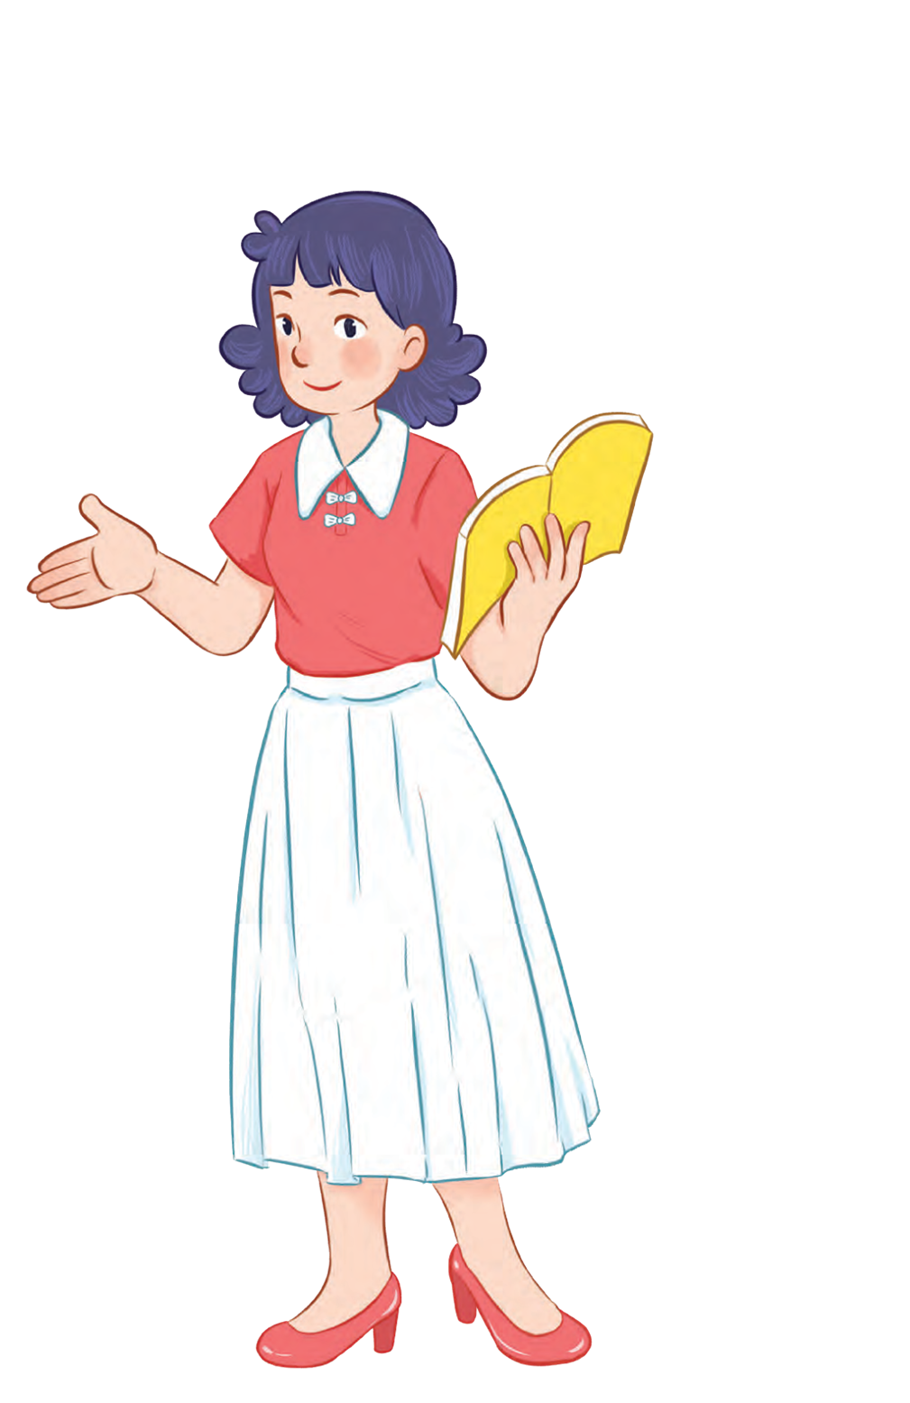



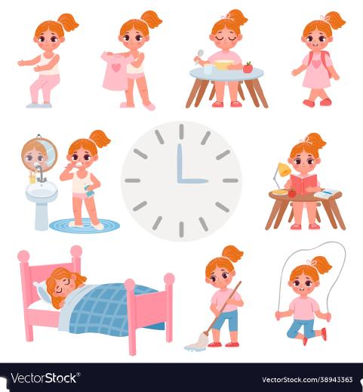


Unit 2
Time and
daily routine
MsPham
0936082789
Lesson 1 – Period 1

Slide 2

Warm up

Slide 3
Can you remember and say numbers:
20
twenty
5
five
30
thirty
10
ten
40
forty
15
fifteen
50
fifty

Slide 4


MsPham
0936082789
MsPham
0936082789
Vocabulary

Slide 5
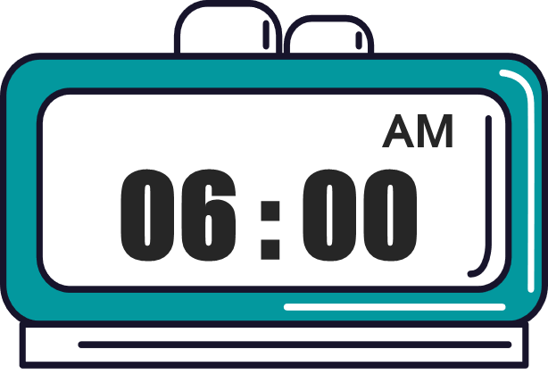
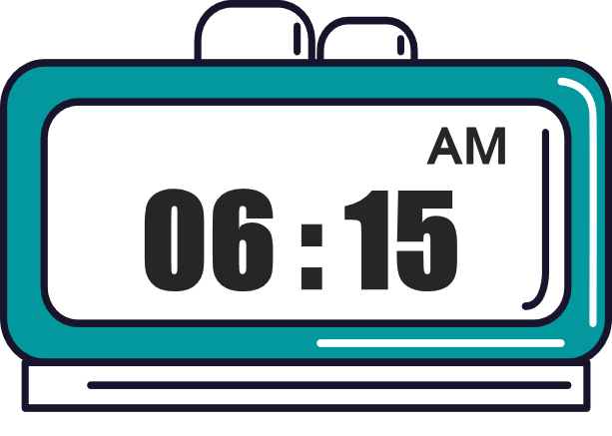


Vocabulary
MsPham
0936082789
o’clock
/əˈklɒk/
: giờ (đúng)
What time
/wɒt taɪm/
: Mấy giờ
fifteen
/ˌfɪfˈtiːn/
: 15
thirty
/ˈθɜːti/
: 30
forty-five
/fɔːti ˈfaɪv/
: 45

Slide 6
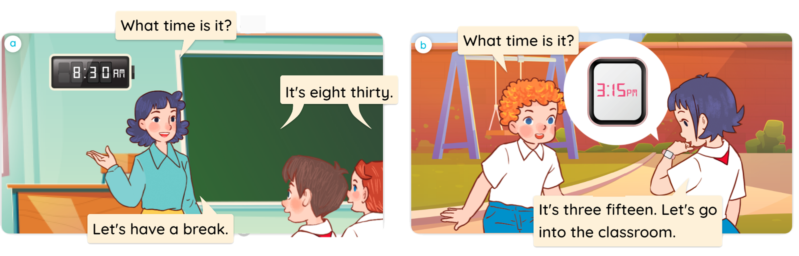


1
Look, listen and read.

Slide 7
MsPham
0936082789
MsPham
0936082789
Structure

Slide 8

1
Cách hỏi giờ:
What time is it?
(Mấy giờ rồi?)
It's + số giờ + o’clock.
It's + số giờ + số phút.
Ex: It’s six o’clock.
Ex: It’s six fifteen.
AM
AM
06 : 00
06 : 15
MsPham
0936082789
MsPham
0936082789
MsPham
0936082789
MsPham
0936082789

Slide 9
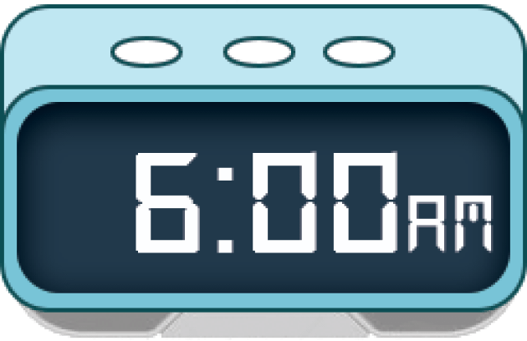
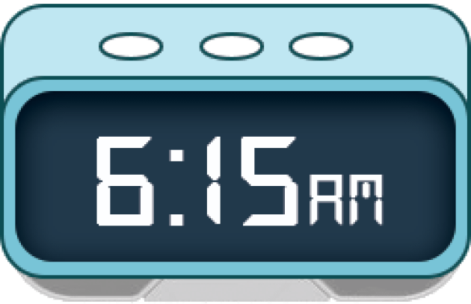
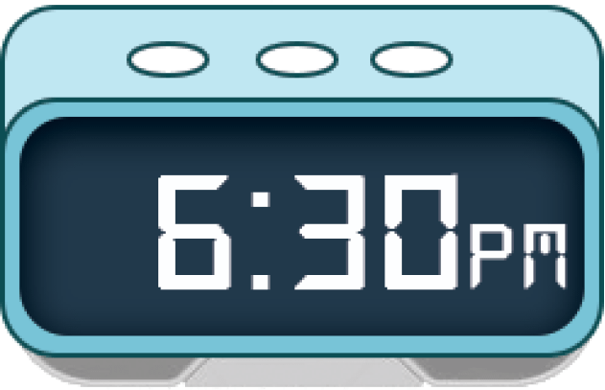
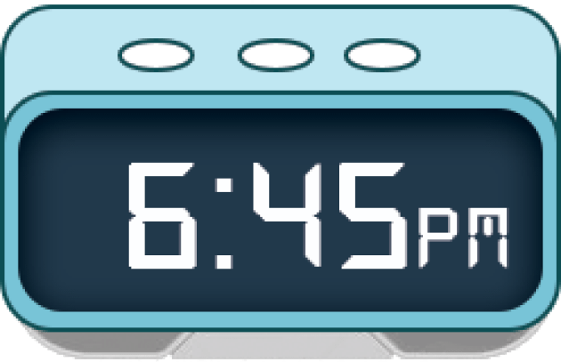
2
Listen, point and say.
a
b
six o’clock
six fifteen
c
d
six thirty
six forty-five

Slide 10
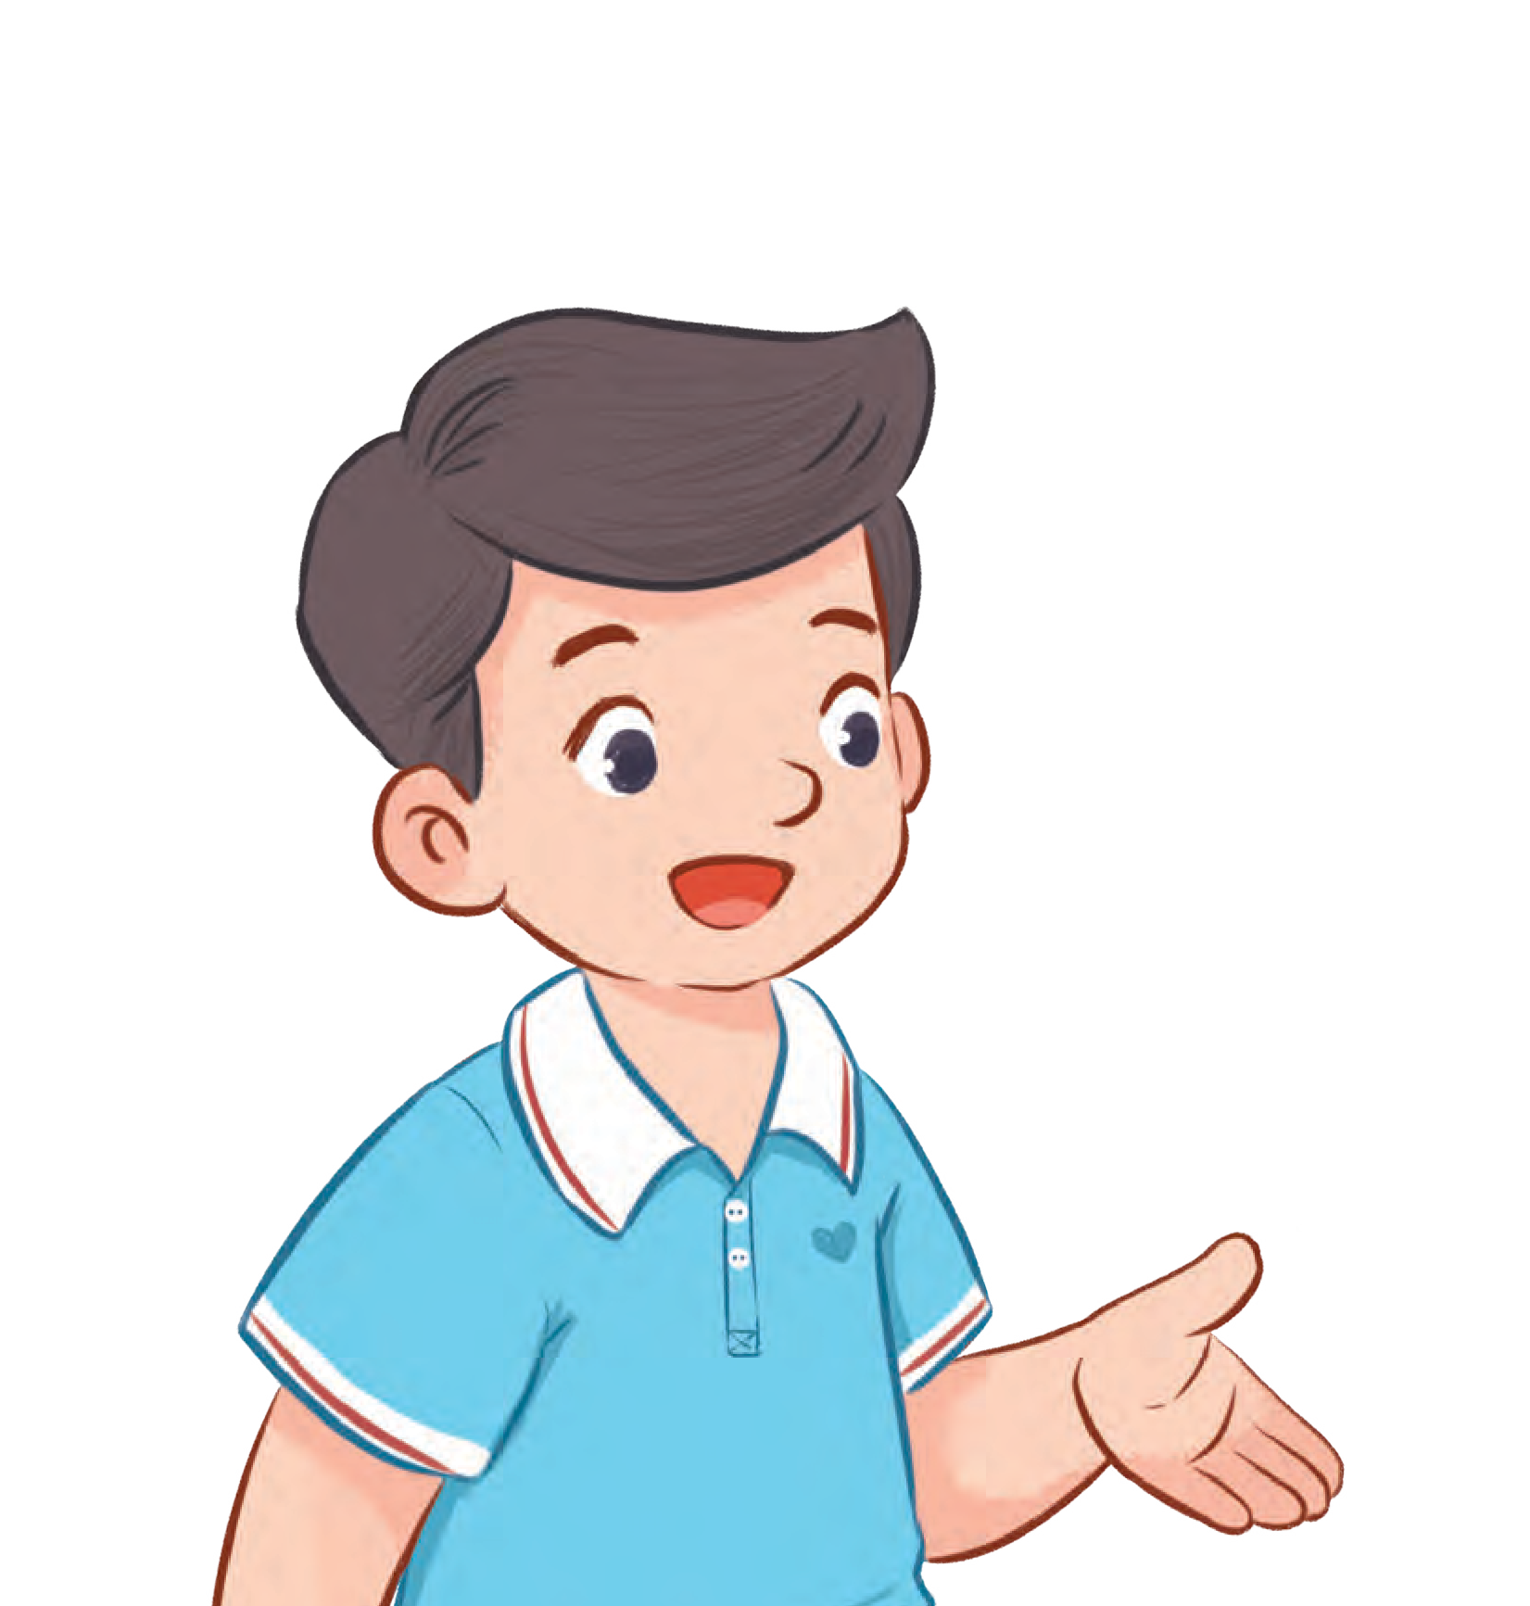

2
Listen, point and say.
a
AM
06 : 00
MsPham
0936082789
MsPham
0936082789
MsPham
0936082789
six o’clock
What time is it?
It’s six o’clock.

Slide 11
2
Listen, point and say.
b
AM
06 : 15
MsPham
0936082789
MsPham
0936082789
MsPham
0936082789
six fifteen
What time is it?
It’s six fifteen.

Slide 12
2
Listen, point and say.
c
AM
06 : 30
MsPham
0936082789
MsPham
0936082789
MsPham
0936082789
six thirty
What time is it?
It’s six thirty.

Slide 13
2
Listen, point and say.
d
AM
06 : 45
MsPham
0936082789
MsPham
0936082789
MsPham
0936082789
six forty-five
What time is it?
It’s six forty-five.

Slide 14
2
Listen, point and say.
a
b
six o’clock
six fifteen
c
d
six thirty
six forty-five

Slide 15
MsPham
0936082789
MsPham
0936082789
Review

Slide 16
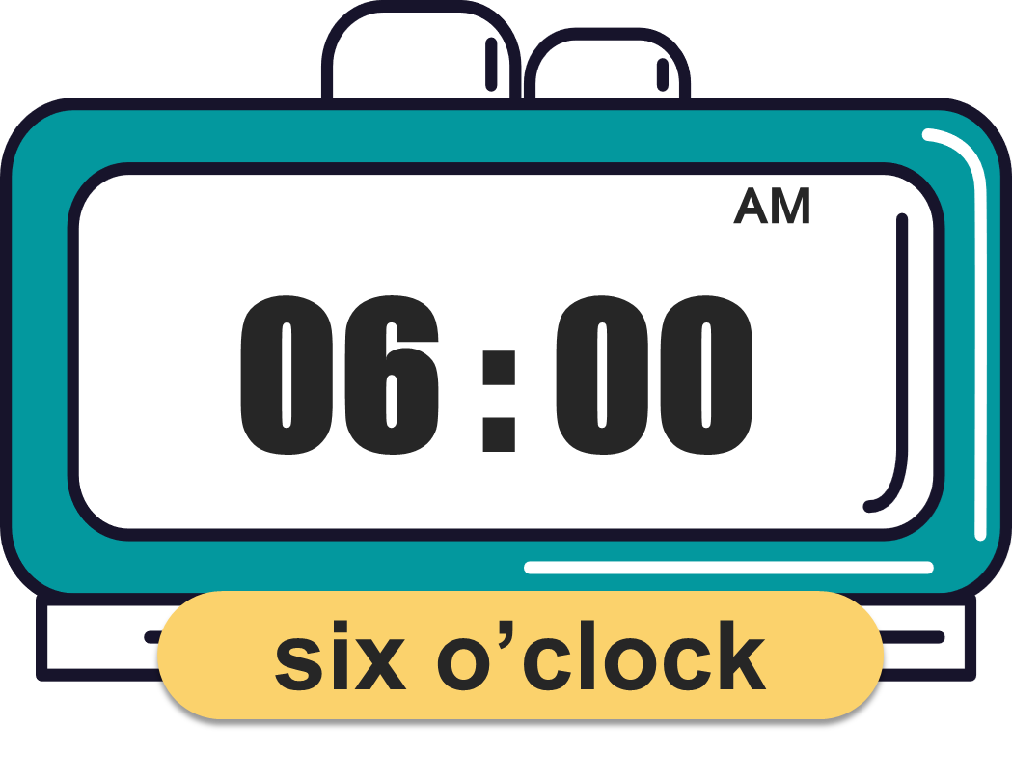
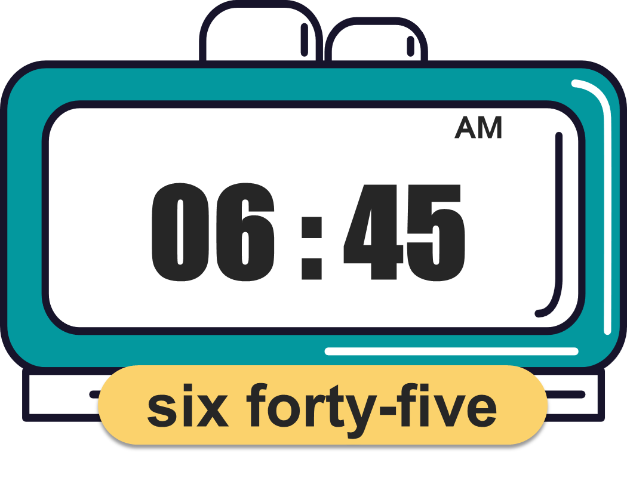
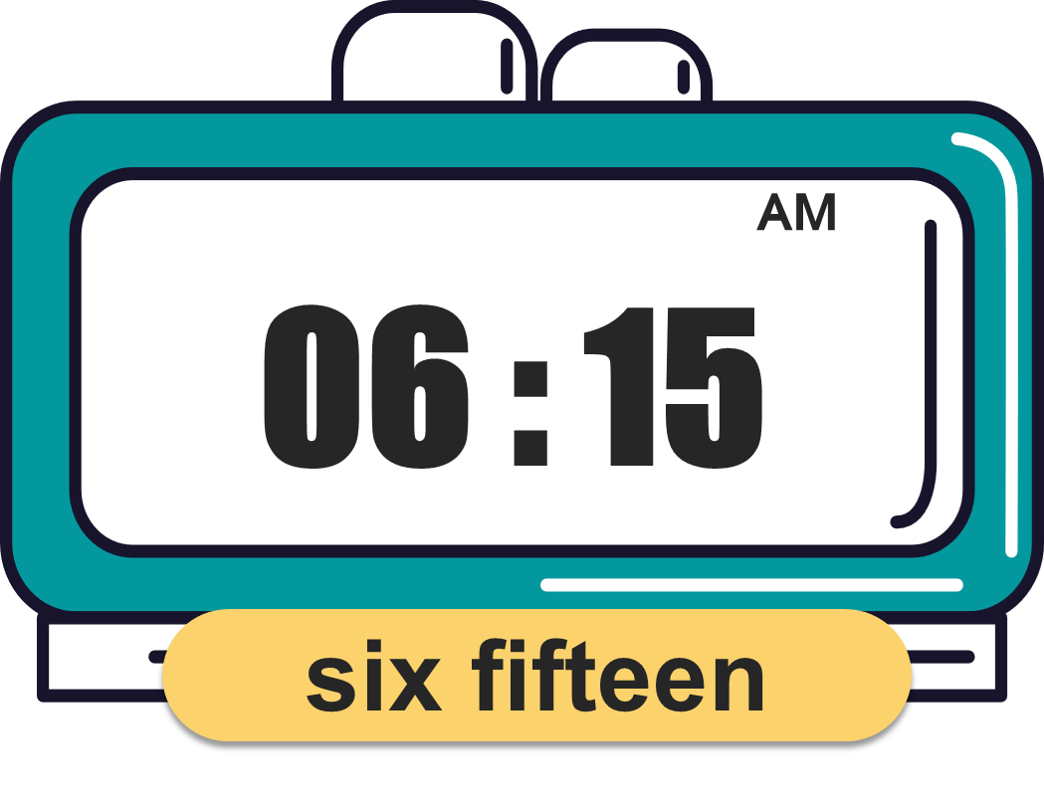
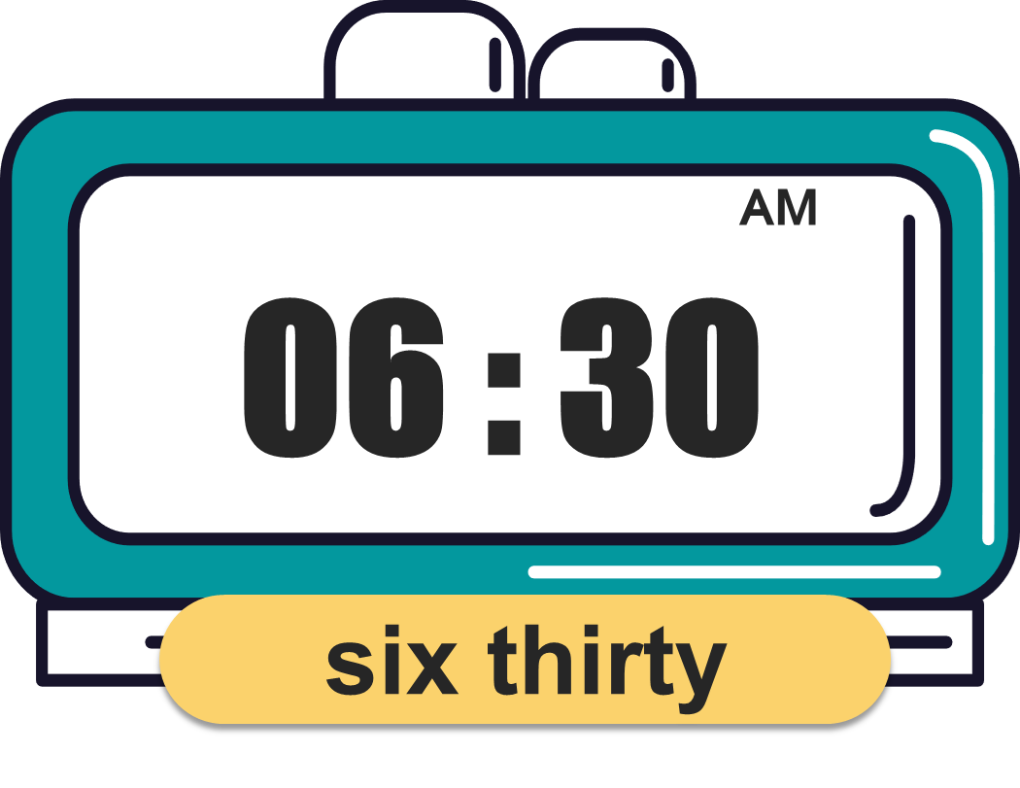
What time is it?
(Mấy giờ rồi?)
MsPham
0936082789
It’s _________.
(____)
MsPham
0936082789

Slide 17
MsPham
0936082789
Thank you!

